Slide 1
Why You Should Join NA-YGN

Slide 2
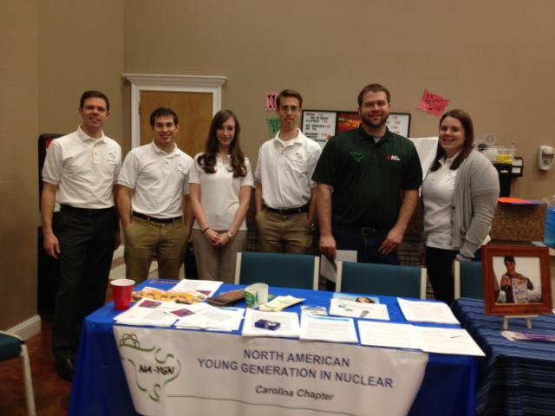
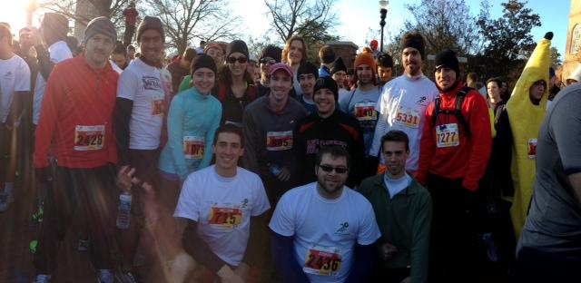
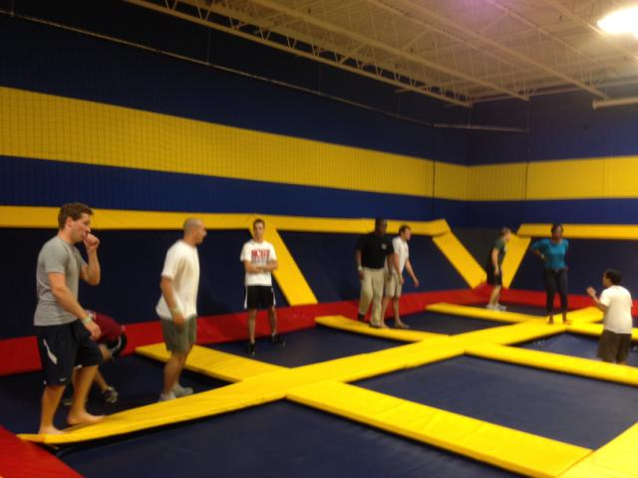
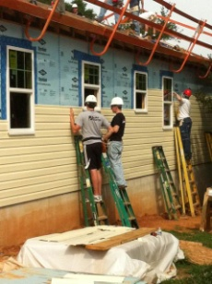
What is NA-YGN?
North American Young Generation in Nuclear (NA-YGN)
Purpose
“NA-YGN provides opportunities for a young generation of nuclear enthusiasts to develop leadership and professional skills, create life-long connections, engage and inform the public, and inspire today’s nuclear technology professionals to meet the challenges of the 21st century”

Slide 3
NA-YGN Vision
Duke-YGN will serve to:
Provide opportunities for a young generation of nuclear enthusiasts to develop leadership
and professional skills,
Create forums to facilitate the exchange of information among the young generation of
nuclear professionals,
Create life-long connections,
Engage and inform the public,
Inform and educate the general population about nuclear science and technology, and
Inspire today’s nuclear technology professional to meet the challenges of the 21st century.

Slide 4
Who Can Join?
Individuals that work in nuclear under the age of 35
OR
Individuals with 10 years or less experience in nuclear

Slide 5
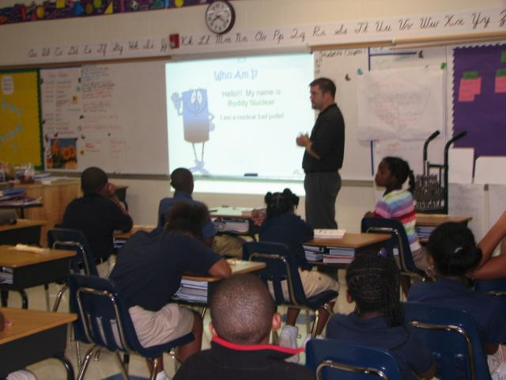
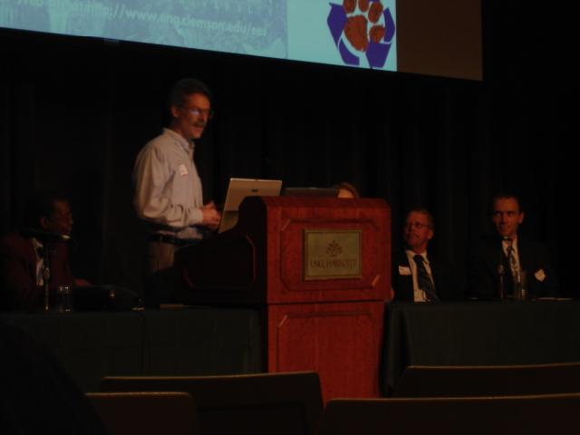
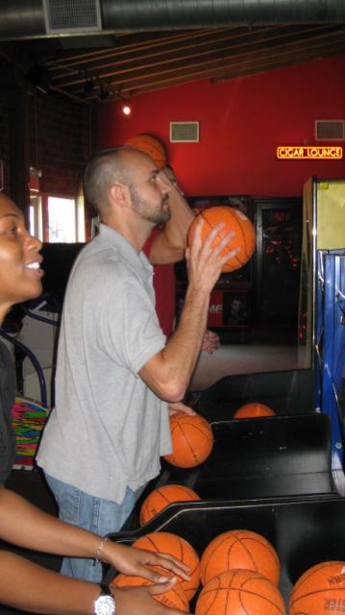
What Do We Do?
Professional Development
Networking
Community Service
Conferences
Social Events

Slide 6
Why Should You Join?

Slide 7
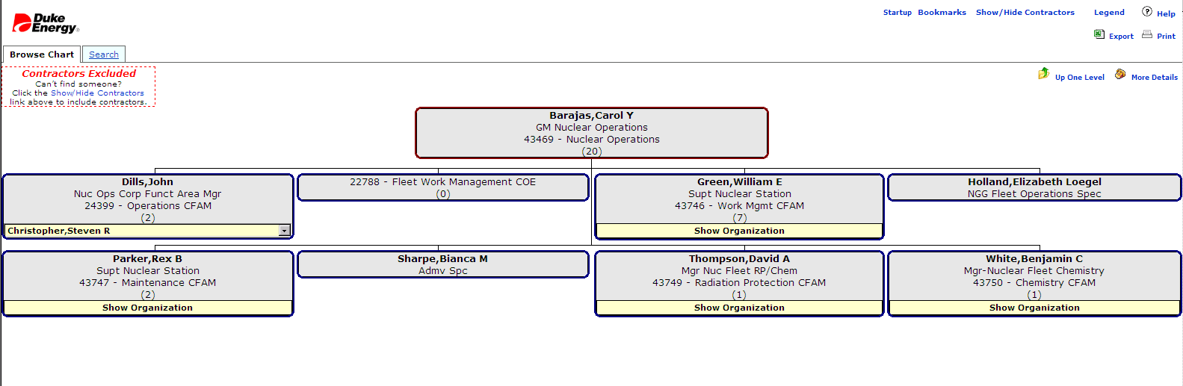
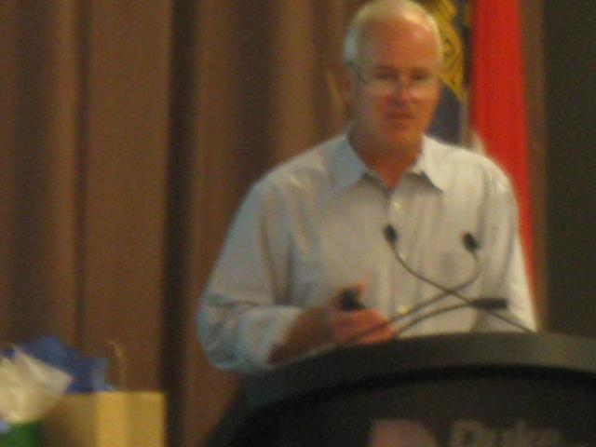
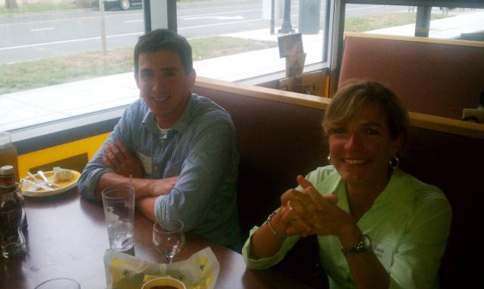
Professional Development
Opportunity to understand how the company is structured
Participate in sessions with upper management, technical leaders and highly experienced co-workers

Slide 8
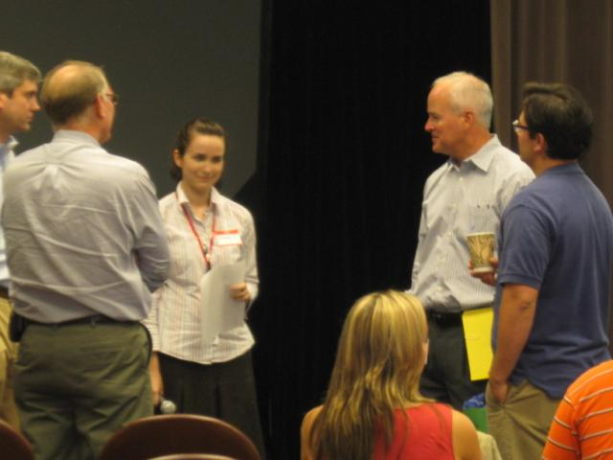
Networking
Opportunity to meet leaders in your organization
Opportunity to meet co-workers from other organizations (Engineering, RP, MNT, OPS)
Opportunity to participate in the Annual Multi-site Event

Slide 9
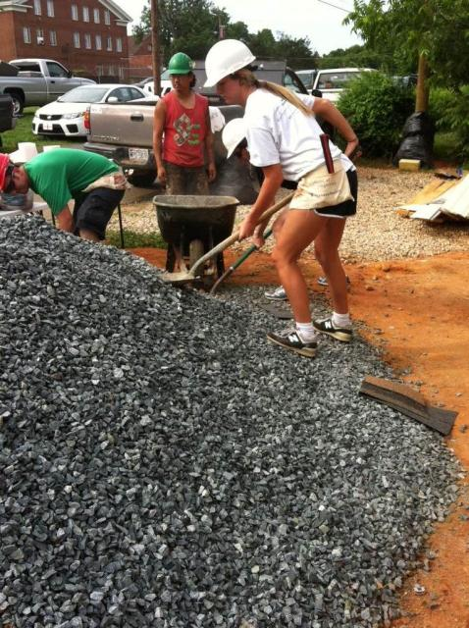
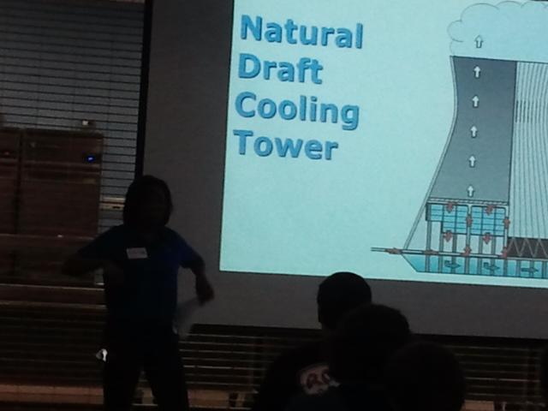
Community Service
E-Week presentations
Annual Service Event
Habitat for Humanity
United Way

Slide 10
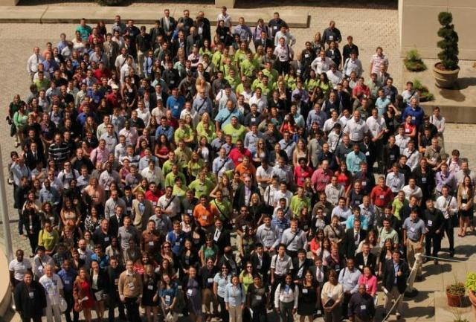
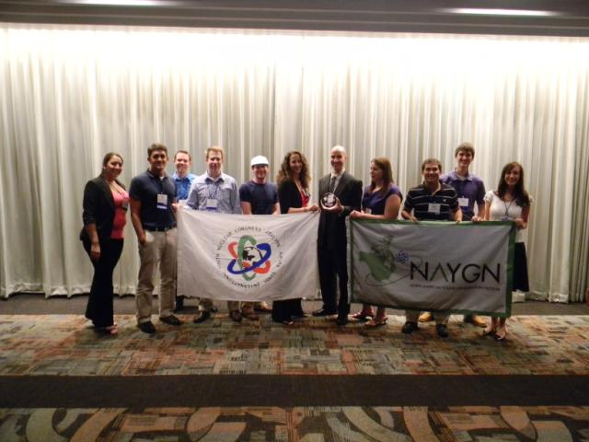
Conferences
Opportunity to travel to national and/or international conferences about the nuclear industry
Learn about industry advancements

Slide 11
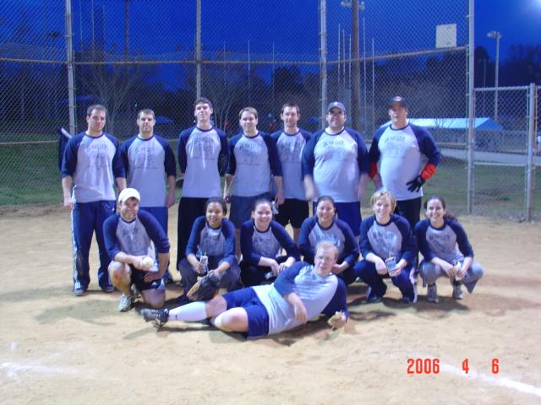
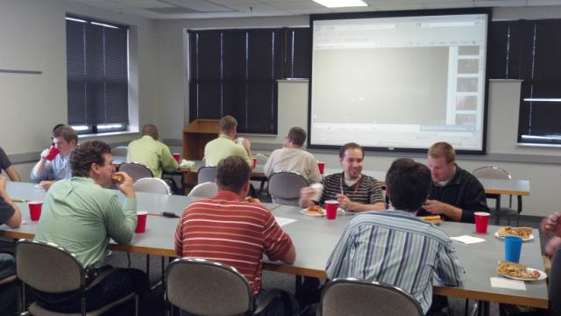
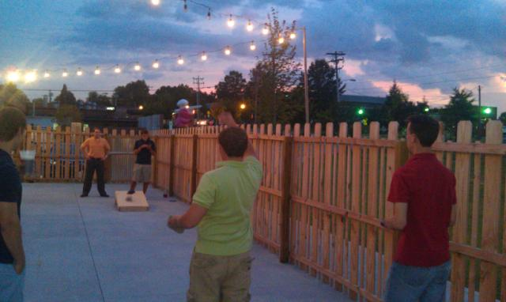
Social Events
Trips to other sites
MNS Volleyball
Krispy Kreme Challenge
Much more to come …

