Slide 1
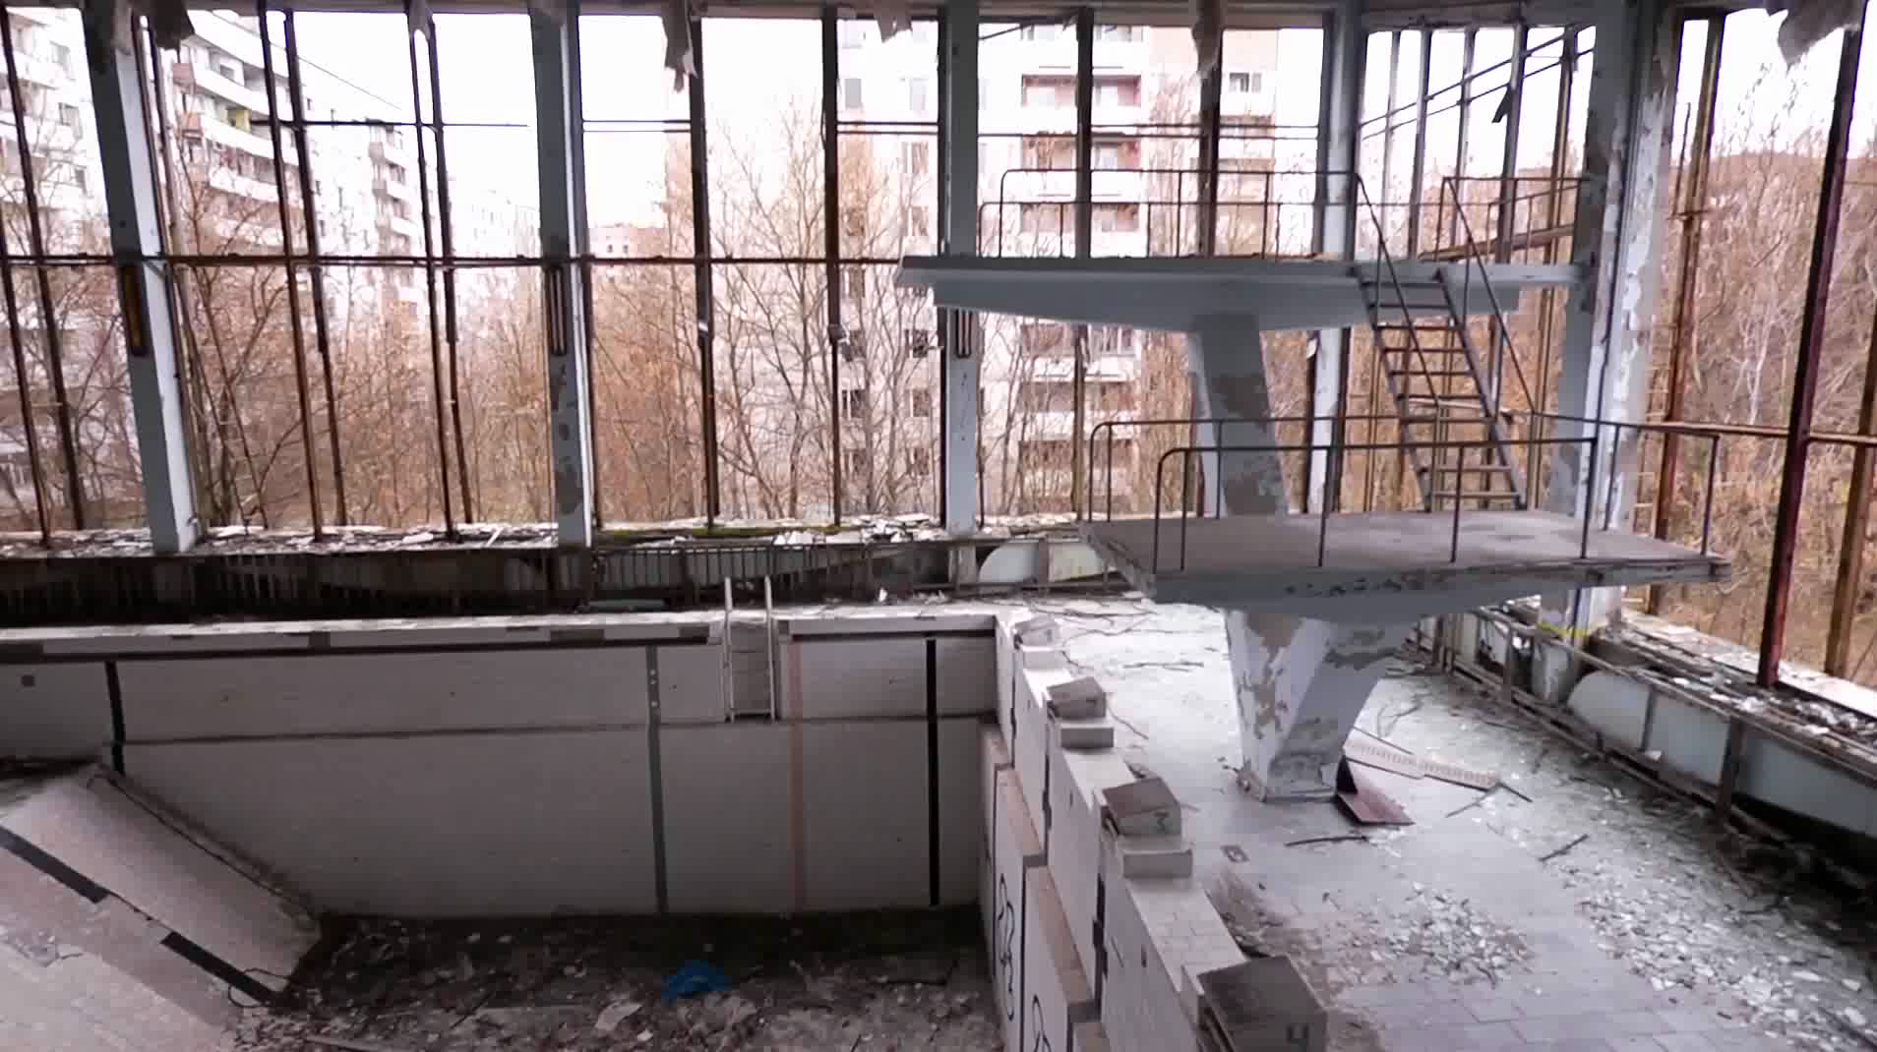
Notes:
Hows it look now:
(doses in microsievets/hr)
*some people never left, others went back:

Slide 2
Notes:
Changes-
WANO
IAEA
**Remember unit 3 ran until Dec 15, 2000.

Slide 3
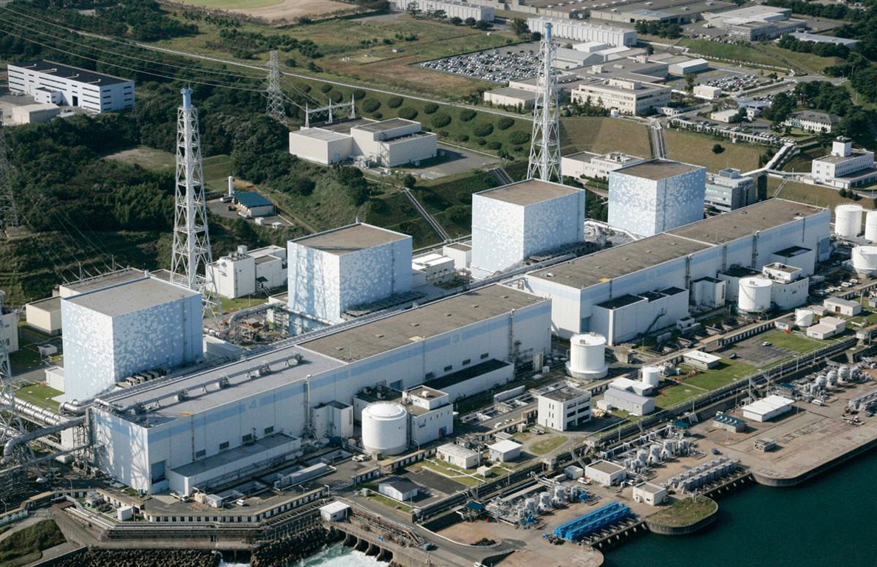
Fukushima

Slide 4
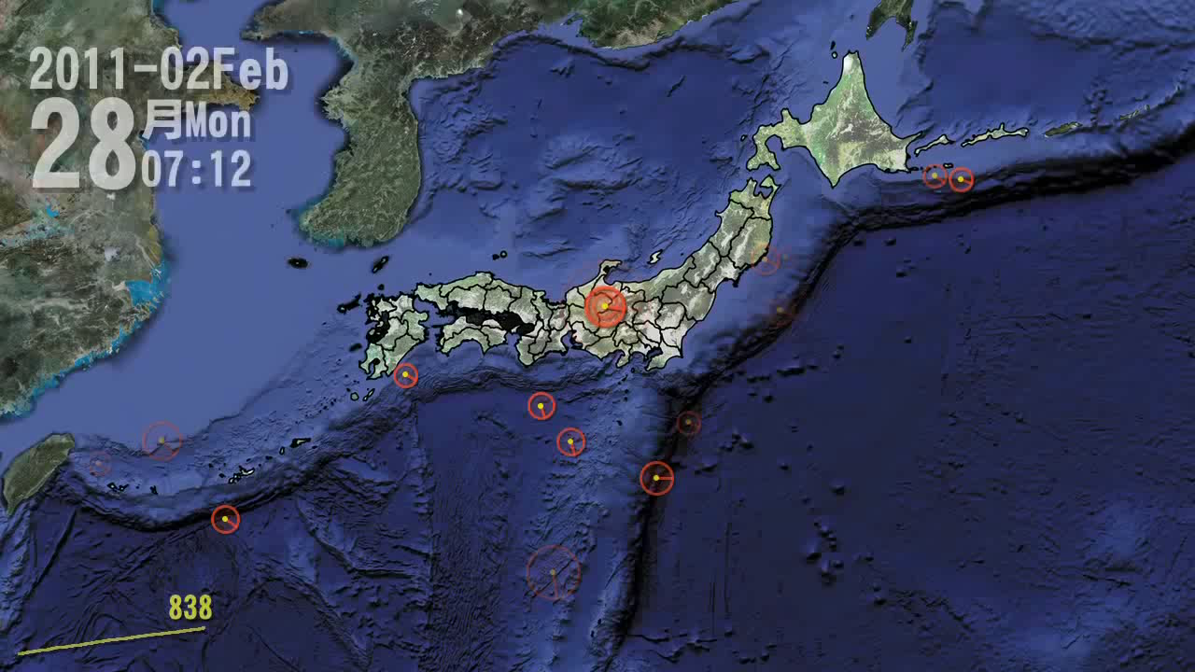
Notes:
Normal Earthquake activity:
Yellow line is trend for the year
March 11th it changes (circles/sound are sized to match magnitude)

Slide 5

Notes:
Perspective
-20,000 people missing suspected dead or washed out to sea-
-Roads destroyed, Ambulances cant move, Refinery and Home Fires, hospitals without power, Food supply destroyed-

Slide 6
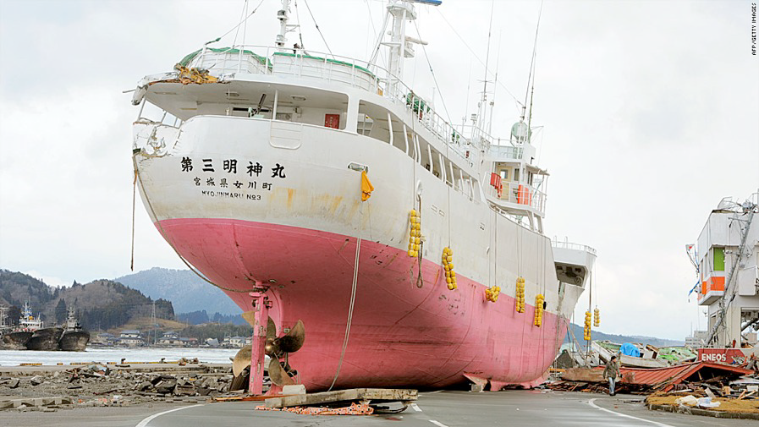
Notes:
Perspective
-20,000 people missing suspected dead or washed out to sea-
-Roads destroyed, Ambulances cant move, Refinery and Home Fires, hospitals without power, Food supply destroyed-

Slide 7
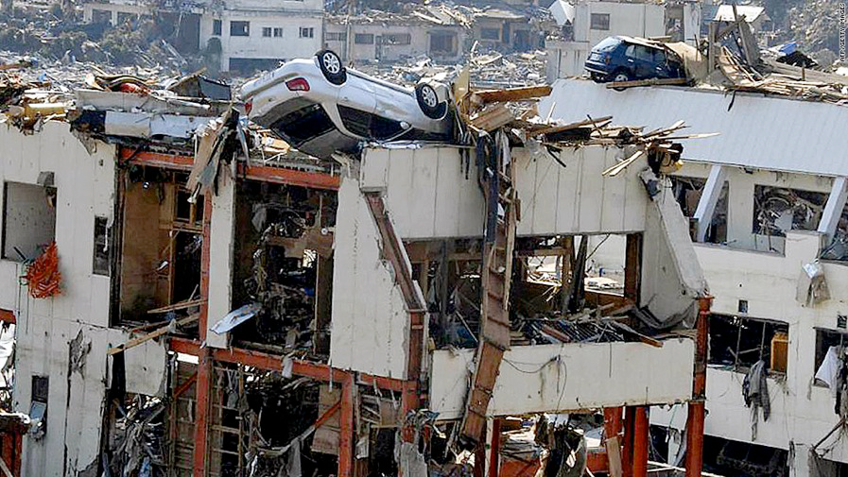
Notes:
Perspective
-20,000 people missing suspected dead or washed out to sea-
-Roads destroyed, Ambulances cant move, Refinery and Home Fires, hospitals without power, Food supply destroyed-

Slide 8
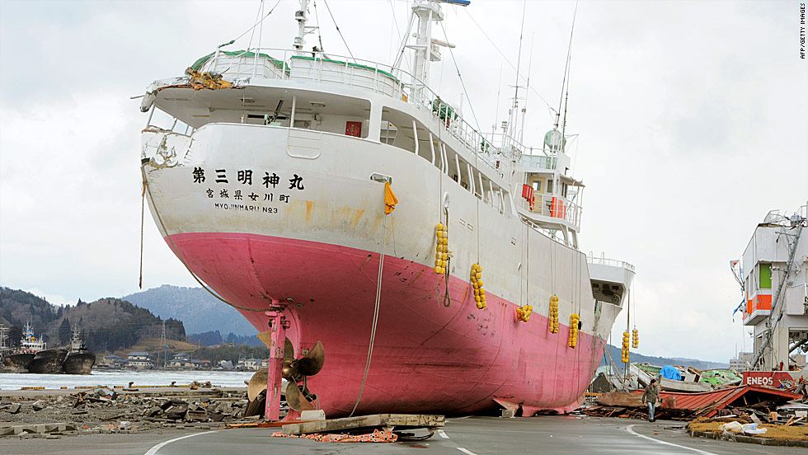
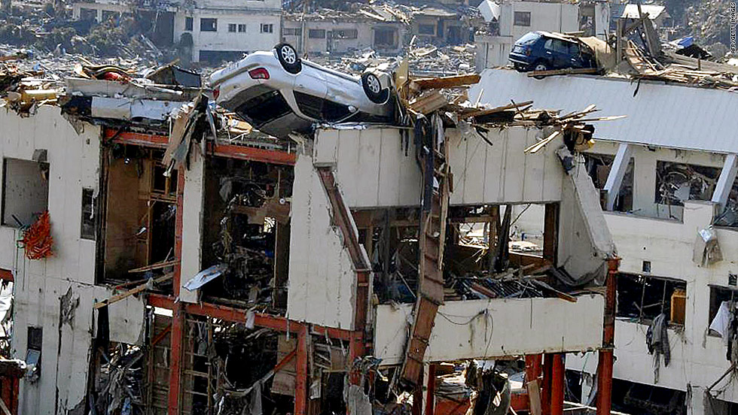
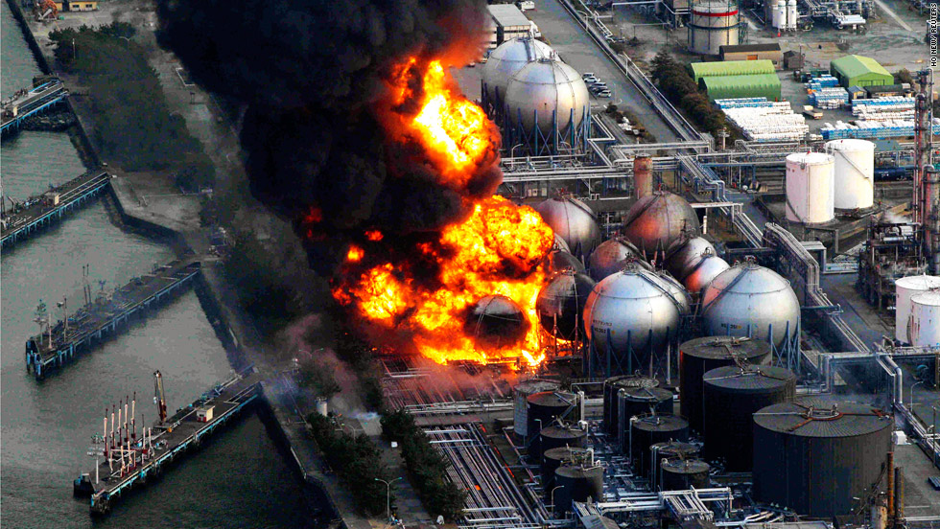
Notes:
Perspective
-20,000 people missing suspected dead or washed out to sea-
-Roads destroyed, Ambulances cant move, Refinery and Home Fires, hospitals without power, Food supply destroyed-

Slide 9
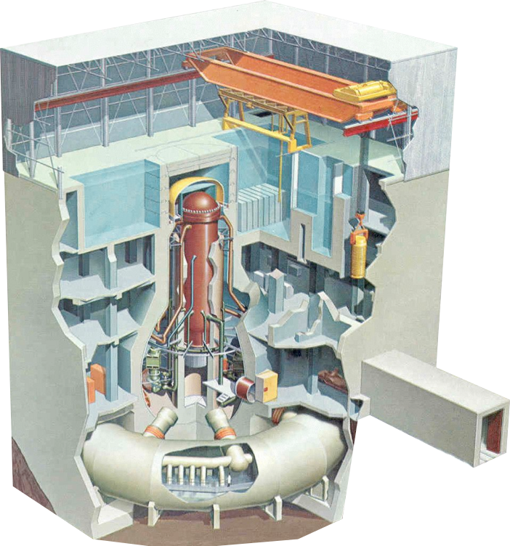
Notes:
Narrative:
1: Loss of Offsite power when earthquake kills power lines to site
2: backup Generators Start- Everything is OK so far
3: ~40 Minutes in Tsunami Hits

