Slide 1
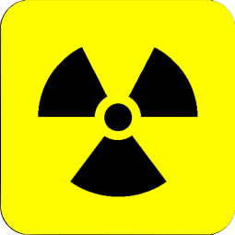
Radiation Effects

Slide 2
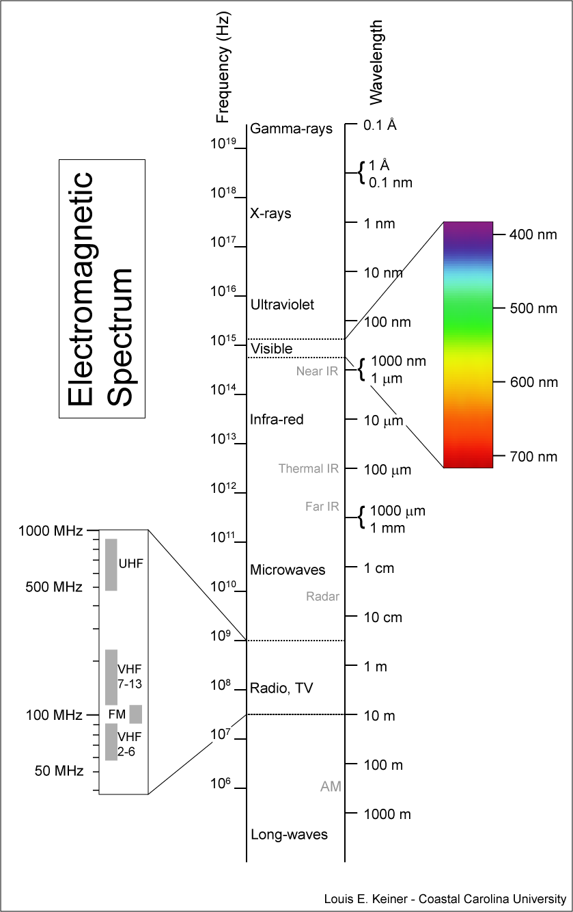
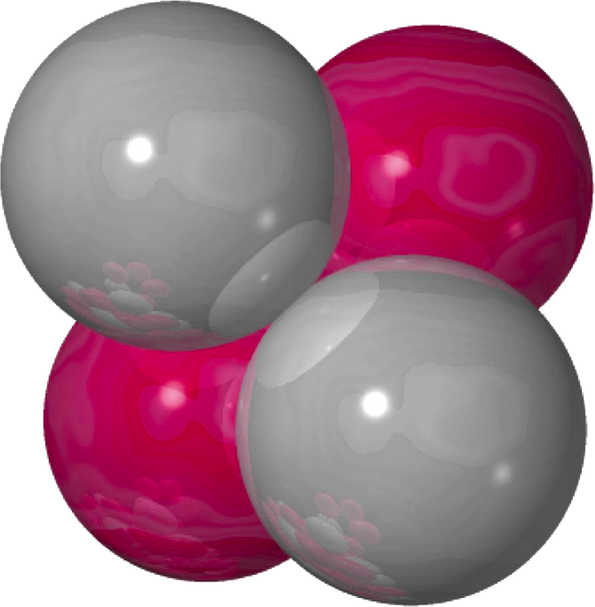
Notes:
Run through Spectrum (bottom to top) and ask- Can this one cause Cancer?
(UV and above cause cancer)-
So whats the difference between a laser pointer and a X Ray?
Ionizing vs Non-Ionizing.
Non-ionizing:
Cell phone and microwave, lasers, and wifi-
vibrate but can’t break bonds- NO CHEMICAL CONSEQUENCE!
(explain how microwave works- EM field that reverses 2.45 Billion times/sec)
**Not “Nuking food- spinning water molecules**

Slide 3
Notes:
Ionizing Radiation-
Xray, UV light, Gamma, Charged particles;
Can knock electron clean off!
SCREWS UP CHEMICAL PROPERTIES!

Slide 4
Notes:
So why do we care about stealing electrons?
Because it breaks chemical bonds…
You care because some of our chemical bonds are really important. (DNA)

Slide 5
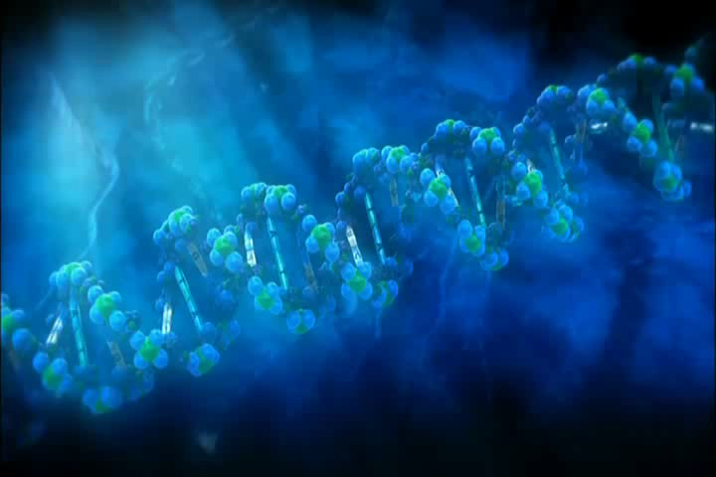
Notes:
We like our DNA just the way it is

Slide 6
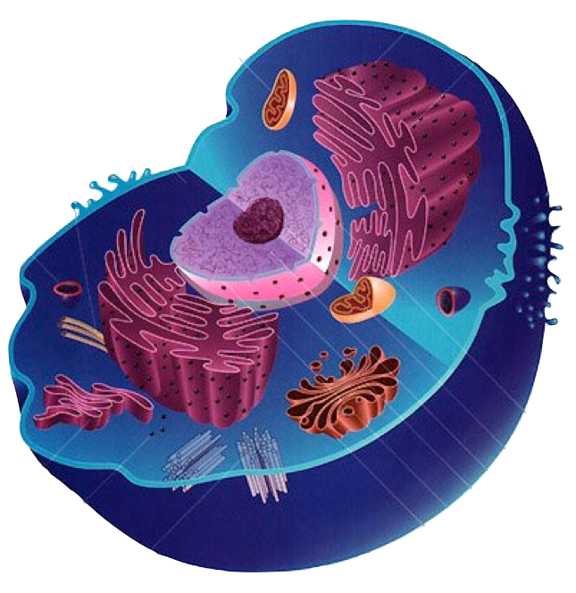
Notes:
Now for the good news:
If I irradiate a cell, what am I most likely to hit?
-water- can make hydrogen peroxide, cell dies, but nothing further consequence
-Organelles- Cell dies, not further consequence
The nucleus is kinda a small target-
To cause cancer I need:
-to hit DNA and
-DNA needs to not repair damage, which it can and does.
(*remember background radiation!)
And it needs to tweak a cancer causing gene-
THEN YOU CAN GET CANCER.
AND HOW DO WE TREAT CANCER?
Radiation- Cancer has rapidly dividing cells,
remember before the cell splits 2 copies of DNA
BIGGER TARGET for radiation!
This is why radiation kills fast growing cells more often!
Who has fast growing cells?
-cancer
-Kids
So how much radiation does it take to hurt us?

Slide 7
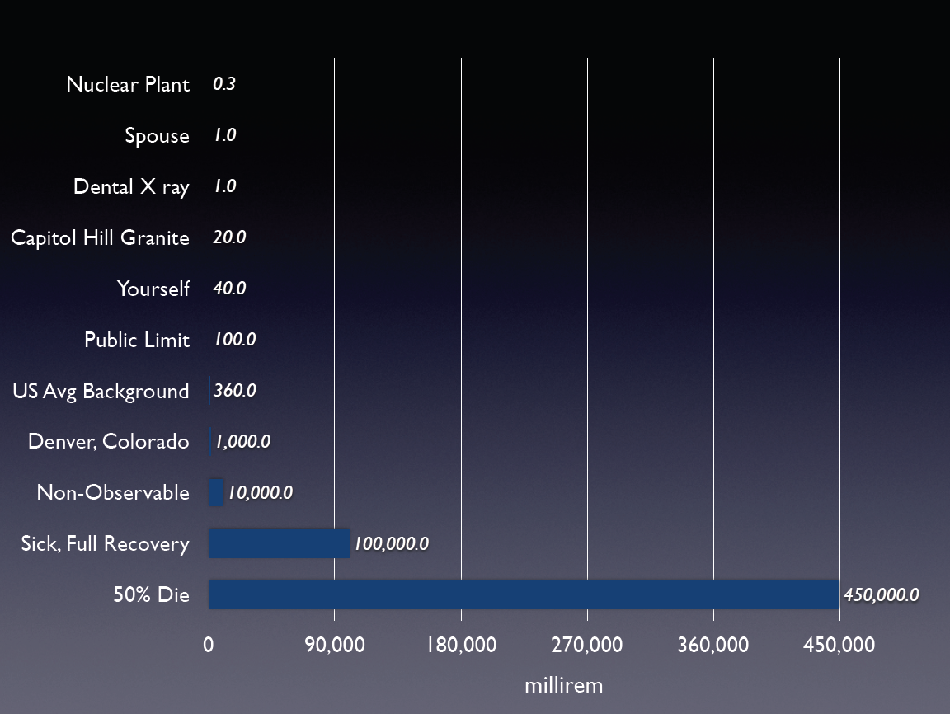
Notes:
10,000 and greater all acute dose-
Below 10,000mR at one time, we can’t detect any changes in body
Denver Gets 1000mR/year from rock they built Denver on... No increase in cancer rates.
Dr. Muller from Berkeley proposes DENVER DOSE as 1000mR/yr.**
When someone tells you something is radioactive
ASK HOW MANY MILLIREM!!
Cell phones =0 (go ahead and try with geiger counter)
Radiation Risk in Perspective*
Health Physics Society* Position Statement March, 1996
Radiogenic Health Effects Have Not Been Observed Below 10 Rem
Radiogenic health effects (primarily cancer) are observed in humans only at doses in excess of 10 rem delivered at high dose rates. Below this dose, estimation of adverse health effects is speculative. Risk estimates that are used to predict health effect in exposed individuals or populations are based on epidemiological studies of well-defined populations (e. g. the Japanese survivors of the atomic bombings in 1945 and medical patients) exposed to relatively high doses delivered at high dose rates. Epidemiological studies have not demonstrated adverse health effects in individuals exposed to small doses (less the 10 rem) delivered in a period of many years.

Slide 8
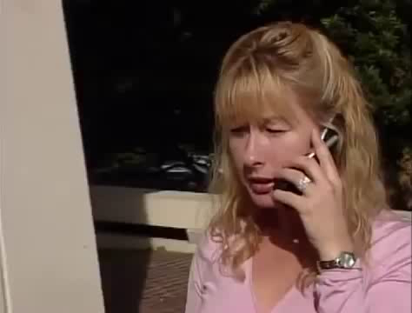
Notes:
So lets try a practical:
Cell phones give off radiation...
What should you ask? (how many millirem?)
Cell phones =0mR, because they are NON IONIZING
But don’t take my word for it... (video clip)
Radiation Risk in Perspective*
Health Physics Society* Position Statement March, 1996
Radiogenic Health Effects Have Not Been Observed Below 10 Rem
Radiogenic health effects (primarily cancer) are observed in humans only at doses in excess of 10 rem delivered at high dose rates. Below this dose, estimation of adverse health effects is speculative. Risk estimates that are used to predict health effect in exposed individuals or populations are based on epidemiological studies of well-defined populations (e. g. the Japanese survivors of the atomic bombings in 1945 and medical patients) exposed to relatively high doses delivered at high dose rates. Epidemiological studies have not demonstrated adverse health effects in individuals exposed to small doses (less the 10 rem) delivered in a period of many years.

Slide 9
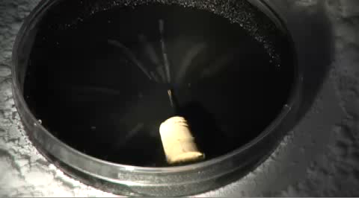
Notes:
We can see radiation
(Particles leave trails, EM waves are just light)
Alpha and beta particles leaving tracks
(cloud chamber is alcohol vapor at saturation conditions,
ions leave trail through the vapor)

Slide 10
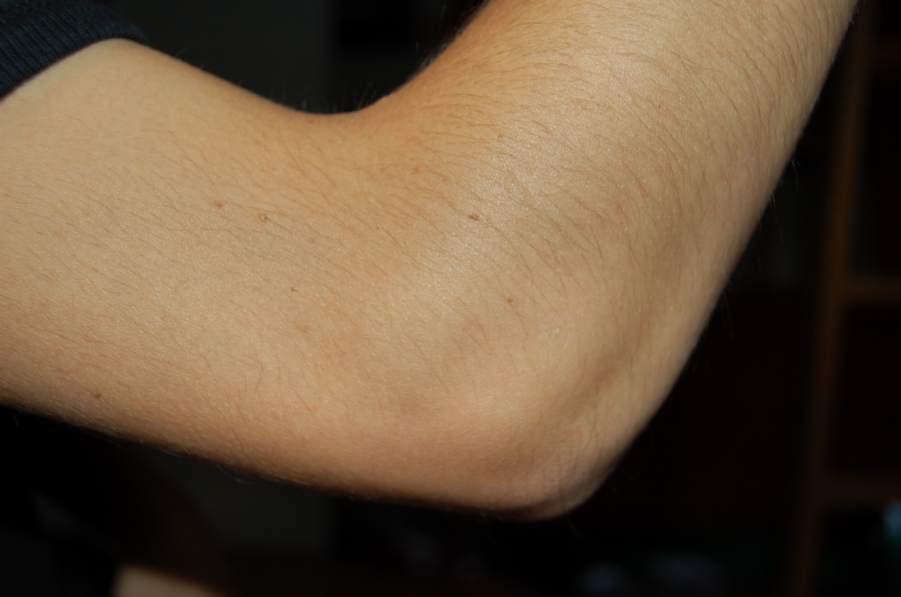
Contamination
Notes:
Contamination vs Radiation:
Fiesta Ware demo: Ask Student to rub fiesta ware- will their hand alarm the Geiger counter?
NO!- The radioactive material can’t get off the plate- its stuck under the glaze-
So what If I ground the plate into powder and sprinkled it over their desks?
Their elbows would have radioactive atoms on them (just like dirt or germs)
(UNLESS THEY WORE A JACKET.... Then the jacket is crapped up)
These atoms are giving off lots of Alphas, betas, or gammas- stealing our electrons
How do we get them off?
Wash (but thats a cold water shower)
Tape- or Lint Roller!
Show ANTI-C’s
don’t stop radiation (X ray would work fine), just keep you from getting contaminated.

Slide 11
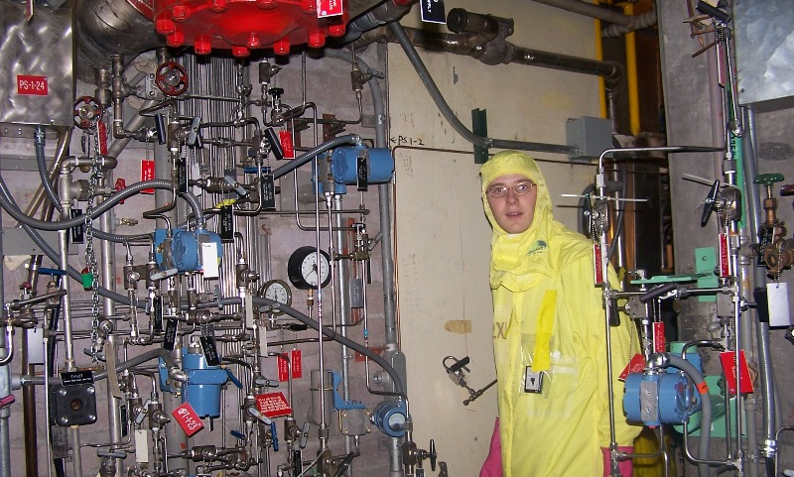
Contamination
Notes:
Show ANTI-C’s
don’t stop radiation (X ray would work fine), just keep you from getting contaminated.

Slide 12
Notes:
Time
Distance
Shielding
OPTIONAL:
(ALARA- Linear No Threshold)
Alcohol or aspirin deaths
-say 100 aspirin would kill a person
-then every 100 aspirin consumed should result in a death
(wrong, but its how we model radiation)

Slide 13
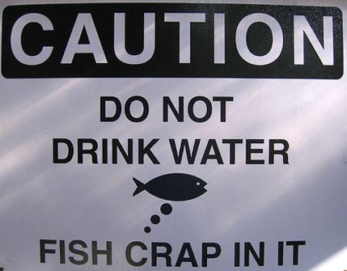
What IS Safe?
Notes:
Uses of radiation- some unexpected...

Slide 14
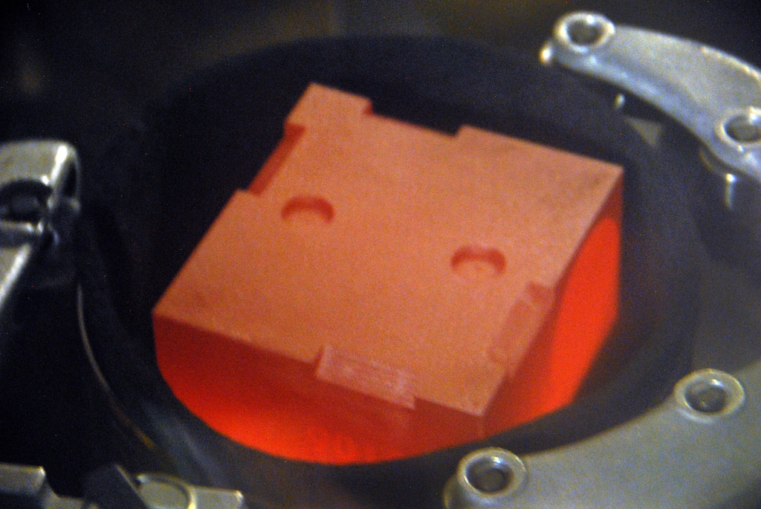
Notes:
Uses of Radiation
Space battery powering Mars Rover and will last for decades!
Pu-238 (87 yr half life)
decay heat->Thermocouples-> Voltage!

Slide 15
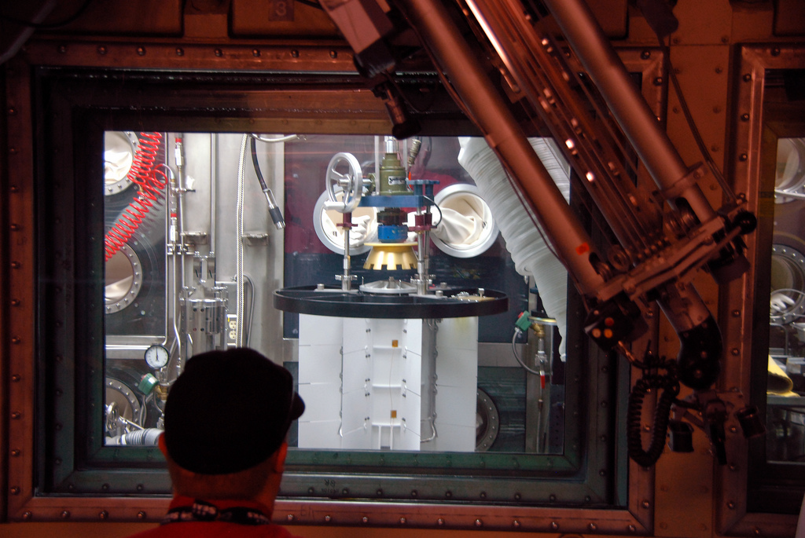
Notes:
Loading the plutonium bricks into the battery (in a hot cell)

Slide 16
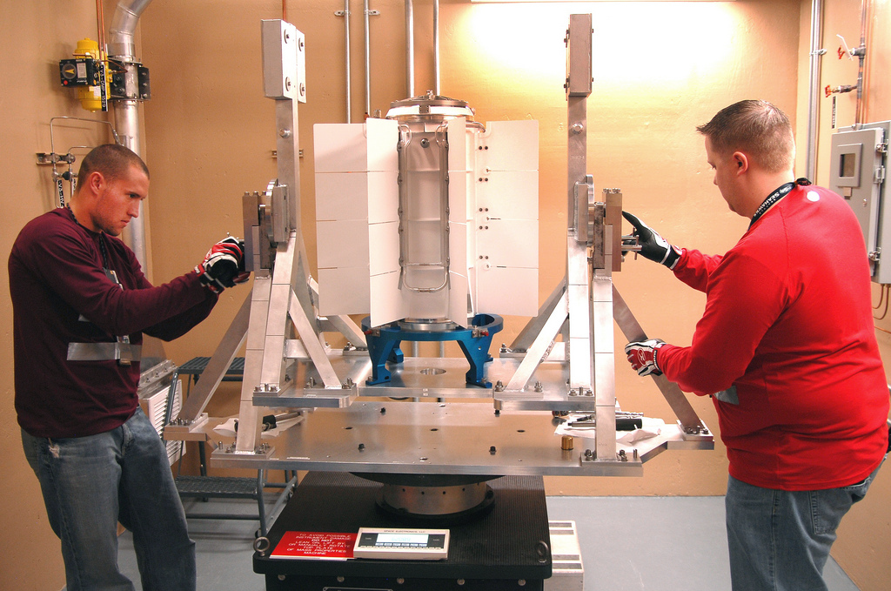
Notes:
Once sealed battery is safe to handle

Slide 17

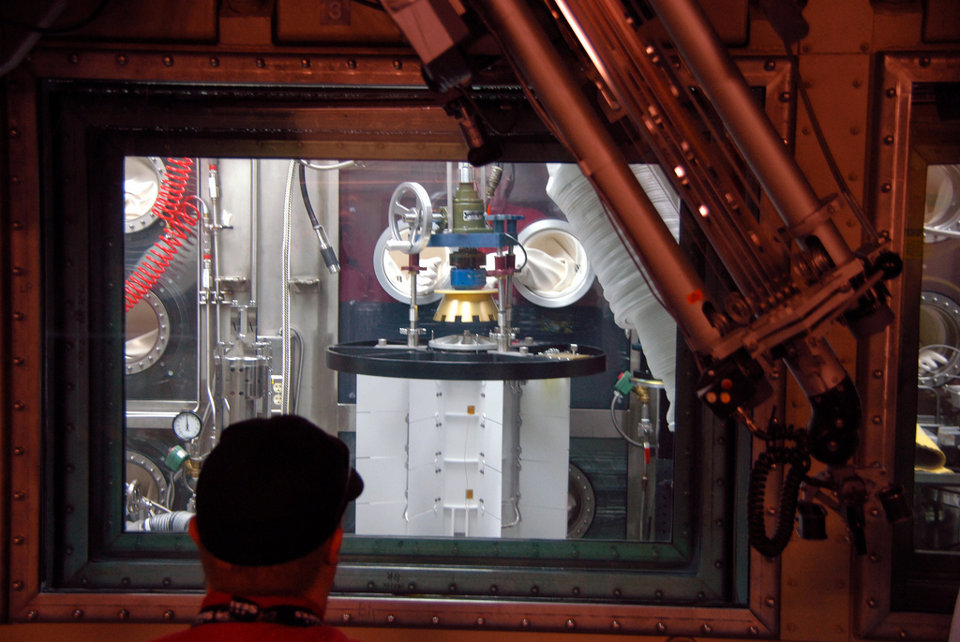

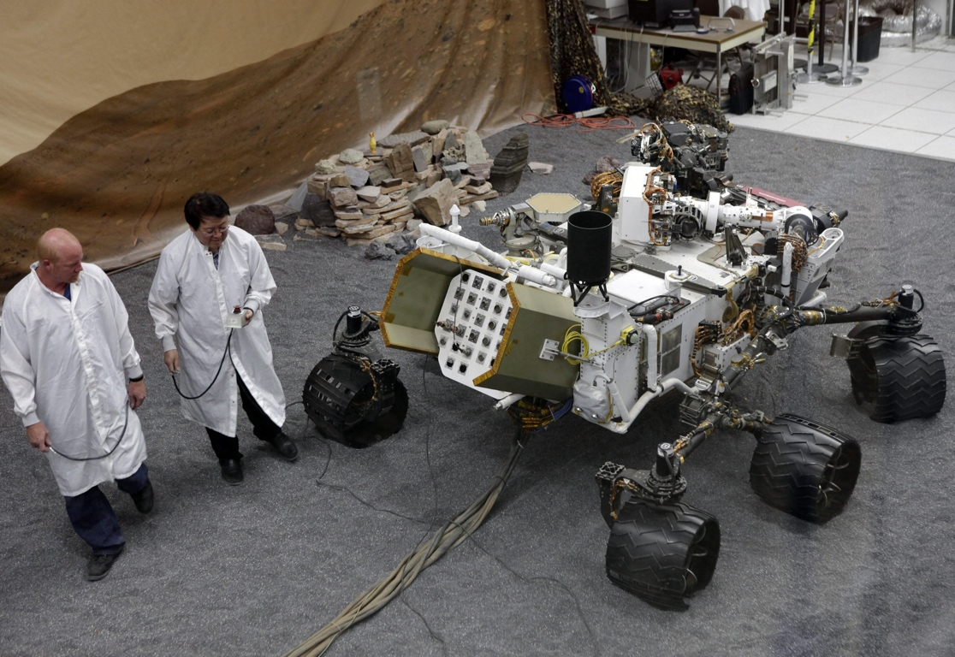
Notes:
Battery pack mounts on back of river (white tilted platform)
Space battery powering Mars Rover and will last for decades!
Pu-238 (87 yr half life)
decay heat->Thermocouples-> Voltage!

Slide 18
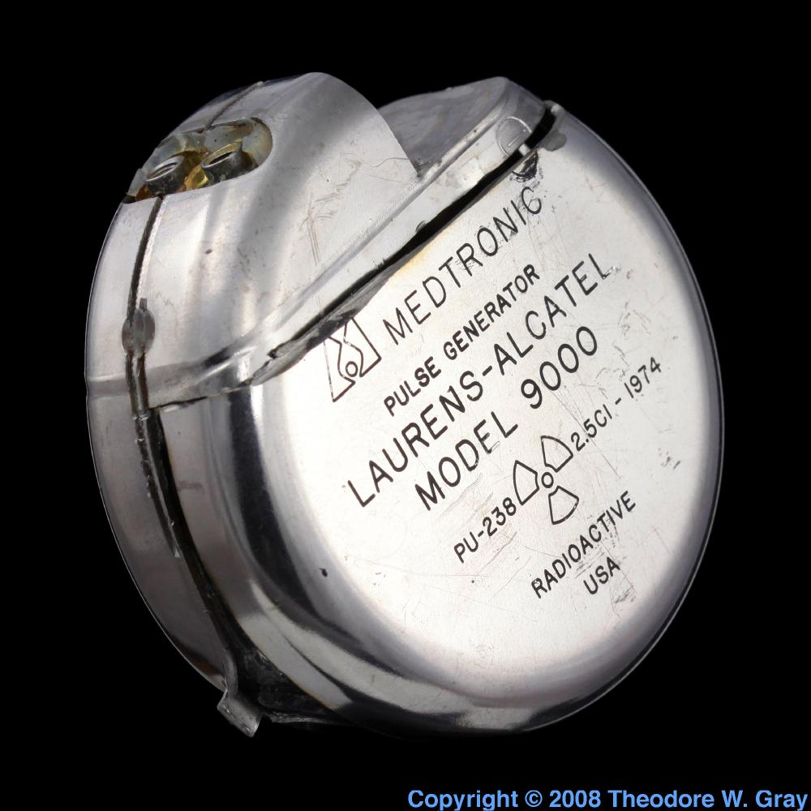
Notes:
Hey theses same batteries can be used for pacemakers- (surgically implanted)
osrp.lanl.gov/pacemakers.shtml‎

Slide 19
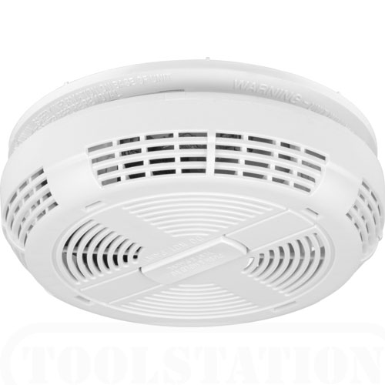

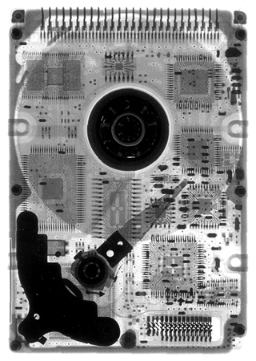
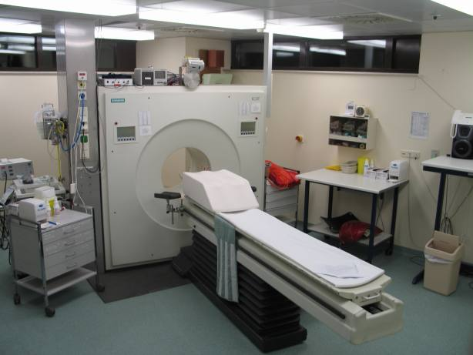
Notes:
Beneficial Uses: We keep it around for a reason!
Smoke Detectors!
Makeup/ Surgical Sterilization
Radiographing- Welds/ Security
Medical-(PET- Actually you are given a radioactive tracer!-)
Ice cream air fraction measurement
Tire Quality inspections
Hardening Plastics for use with hot foods. (crosslinking polymers)
and of course the X-ray

Slide 20
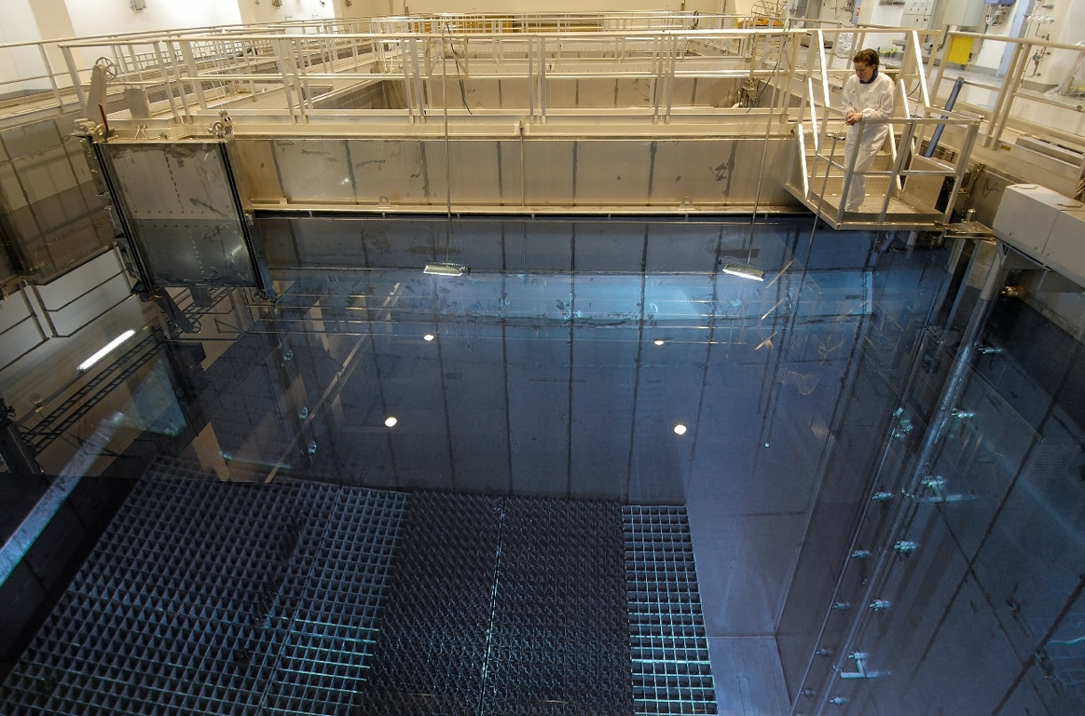
Questions ?

Slide 21
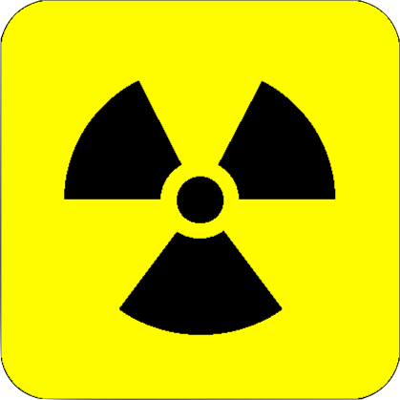
Radiation
Notes:
OPTIONAL SLIDES-
Radiation Theory...- Types, Half Lives, and shielding

Slide 22
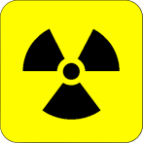
Notes:
Go down the electromagnetic spectrum and ask if each can cause cancer-
(students usually split on microwaves)
Difference between ionizing and non-ionizing radiation
Non ionizing radiation (like the microwave) just makes the atoms move faster- no electrons get pulled off
Ionizing radiation- (like x-rays) can pull the electron away from the nucleus
Made by applying energy to the atom- like pulling the electron away
Get energy back when the fall back into place
Fluorescent lights, fall a little bit
(what If it falls further-
X-rays)

Slide 23
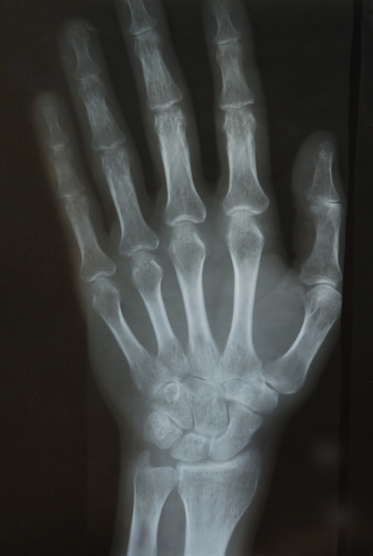
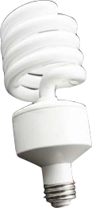
Notes:
Go down the electromagnetic spectrum and ask if each can cause cancer-
(students usually split on microwaves)
Difference between ionizing and non-ionizing radiation
Non ionizing radiation (like the microwave) just makes the atoms move faster- no electrons get pulled off
Ionizing radiation- (like x-rays) can pull the electron away from the nucleus
Made by applying energy to the atom- like pulling the electron away
Get energy back when the fall back into place
Fluorescent lights, fall a little bit
(what If it falls further-
X-rays)

Slide 24
γ
Notes:
Particles-
Alpha Decay-
Its easy to stop the alpha particles- Think helium balloon.
What if the big atom thats decaying gets on your skin-

Slide 25
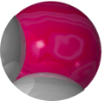

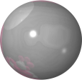





γ
α
β
Notes:
Beta Decay,
Same thing-

Slide 26
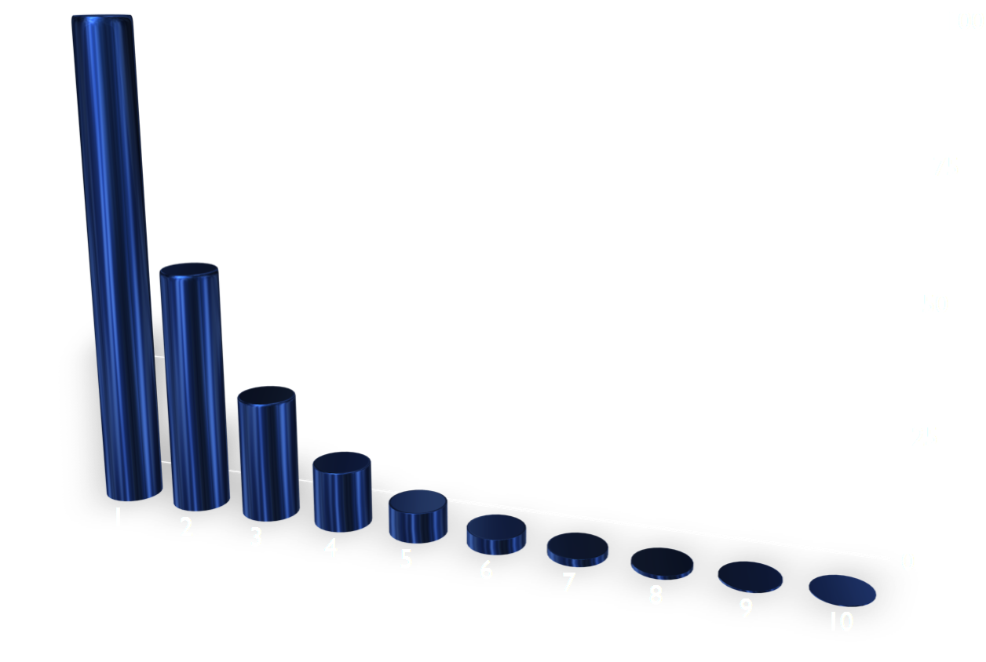
# of Radioactive Atoms Left
# of Half Lives
Notes:
Half Life-
Duration vs intensity.... Don’t get both.

Slide 27
Notes:
Each of these are ionizing:
How to stop them
(or make them take something else’s electrons)

