Slide 1
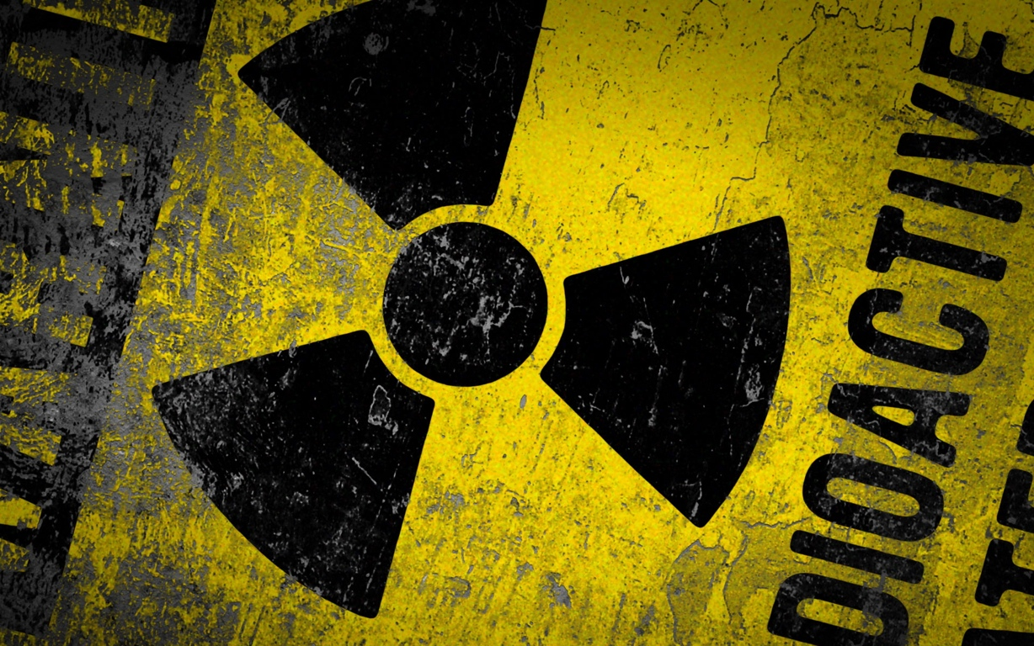
Nuclear Waste
Notes:
What do you think Nuclear Waste Look Like?”
Expected response- Liquid form, Green, Poorly stored...
(We should give CNN a picture of some spent fuel....)

Slide 2
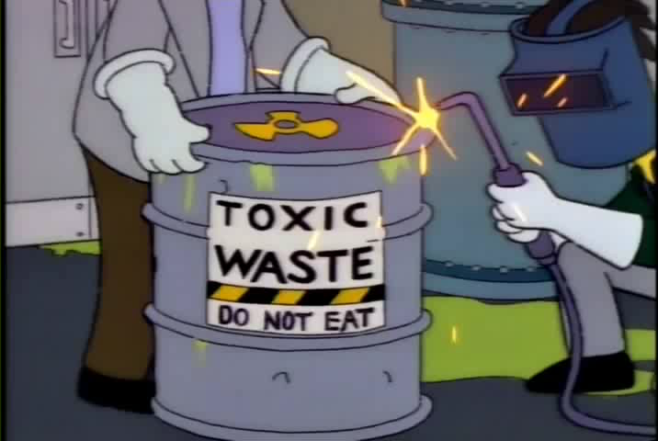
Notes:
So there are some misconceptions to correct.

Slide 3
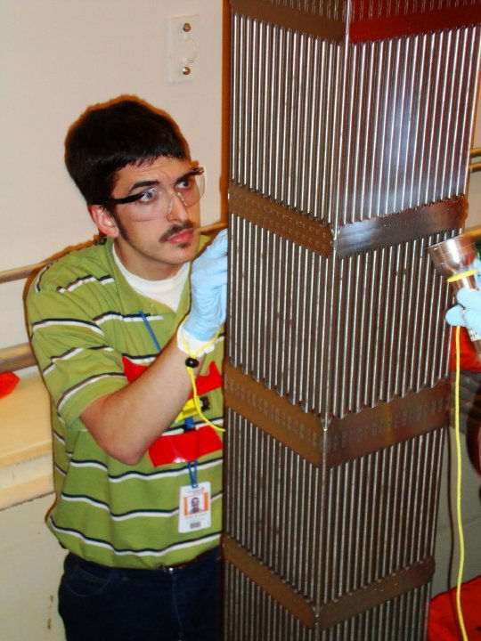
Notes:
This is what nuclear waste looks like!
Its actually a Fresh Fuel assembly-
Notice the TLD-
Chad could stand here all day- He’d be fine
And he knows that because of the TLD he’s wearing
The fuel is radioactive-
Just like Fiestaware.... go ahead and make geiger counter go off.

Slide 4
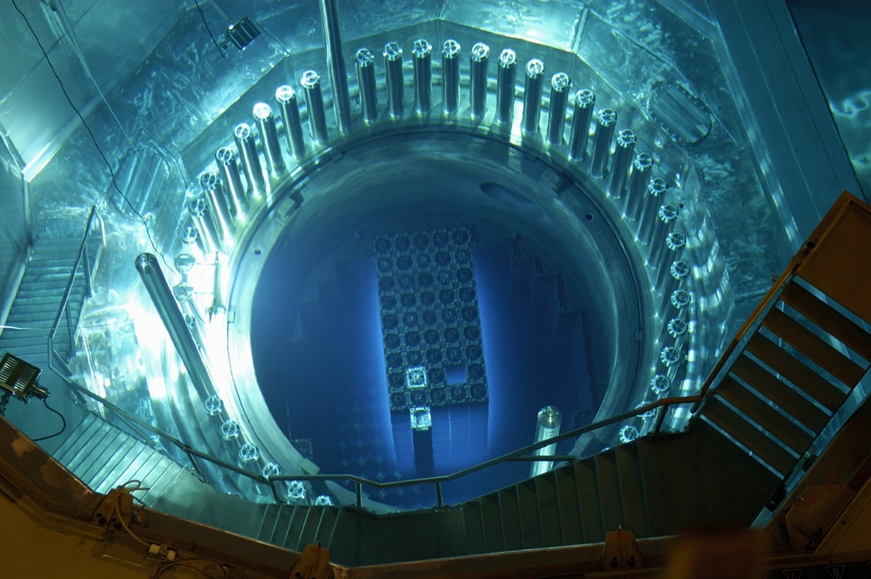
Notes:
Ask “what happens to Uranium inside the reactor”
(it breaks)
The stuff it breaks into is about 1,000,000 time more radioactive than the uranium that went in! (t1/2 for u235=70E6a t1/2 for fission product avg~30a)
Thats why the old fuel glows, its ~1,000,000X more radioactive than the new fuel!

Slide 5
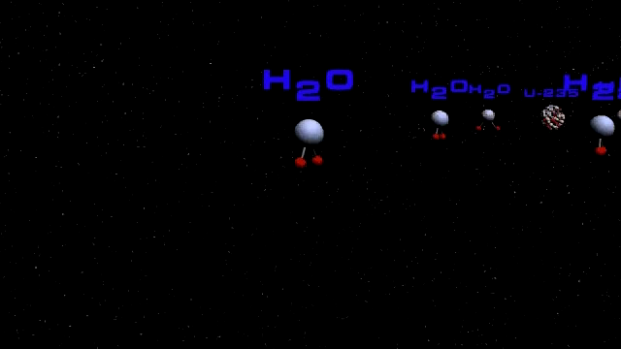
Notes:
(Fission Products)
We’re not scared of the uranium.... we’re scared of what it breaks into.
Pause the video when it becomes nasty... the moment we create fission products
Don’t get the same fission fragments every time.... get the whole periodic table (can show fission product dist.)
So “nuclear waste” is everything.... no clean t1/2, toxicity etc,

Slide 6
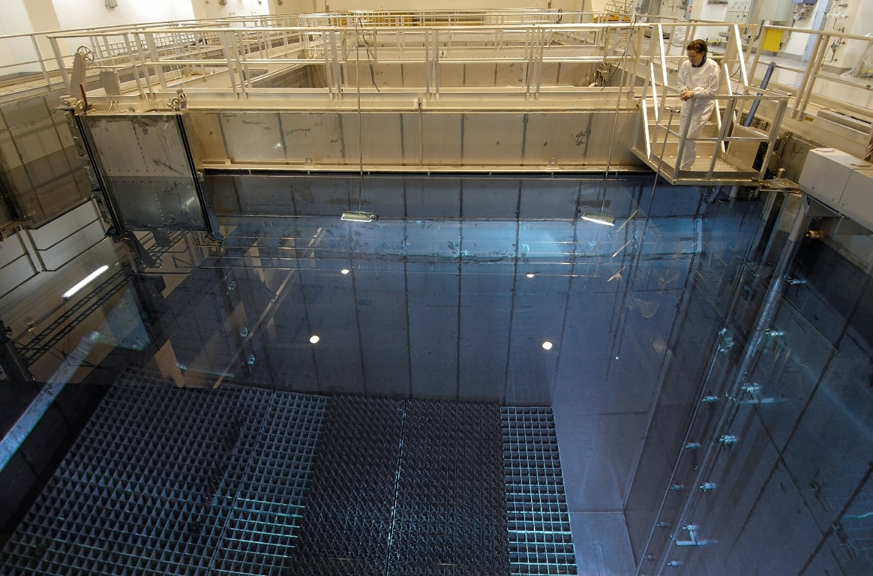
Notes:
SO used rods are have lots of stuff the uranium broke into-
and are 1,000,000X more radioactive than the starting uranium
Thats WHY we have to keep them underwater.
The fuel rods come out, go underwater, and decay off.
(a pool holds ~50 years worth of reactor fuel)
(you need ~10 feet of water for shielding- Per NRC req)
Each fuel assembly gives off about the same heat as a space heater, and decreasing
So what should we do with it?
(Fuel looks different because this is BWR fuel)
So we have these pools, and eventually the fuel needs to go SOMEWHERE!
But where?
Ask them for ideas....

Slide 7
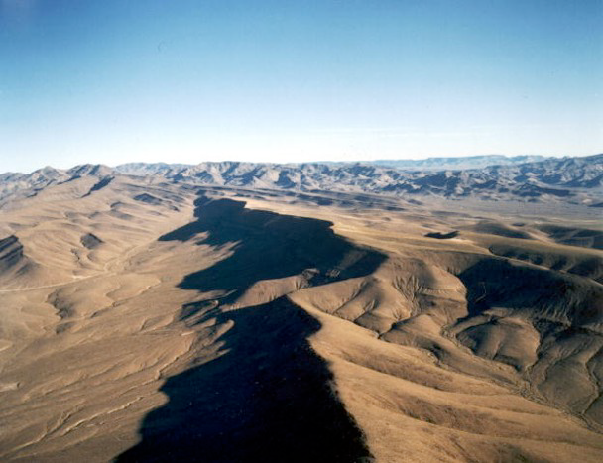
Notes:
Yucca mtn...
Take the fuel out, Store it in the pools for a few years-
Bury them forever.
(simple plan, but VERY long lived nuclides in that fuel- U238=4.46 BILLION Years)
Lots of energy left in the fuel too... (all that u238 could be changed to fuel!)
Of course, nevada might have something to say about it...
No Reactors
Weapons Testing...
They kinda feel they’ve done their part. Yucca mtn...
Take the fuel out, Store it in the pools for a few years-
Bury them forever.
(simple plan, but VERY long lived nuclides in that fuel- U238=4.46 BILLION Years)
Lots of energy left in the fuel too... (all that u238 could be changed to fuel!)
Of course, nevada might have something to say about it...
No Reactors
Weapons Testing...
They kinda feel they’ve done their part.

Slide 8
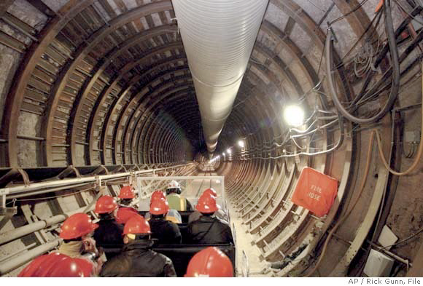
Notes:
Yucca mountain tunnel

Slide 9
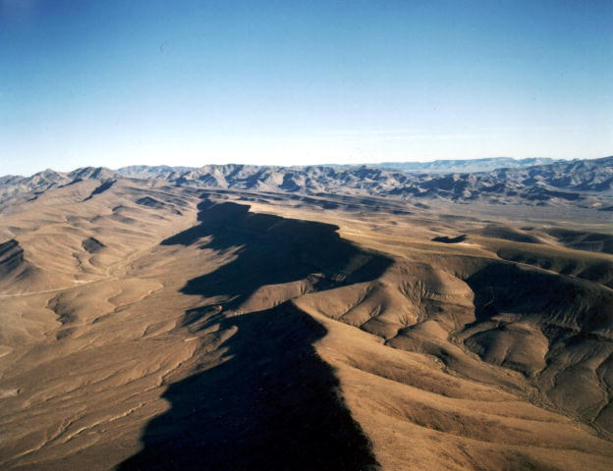
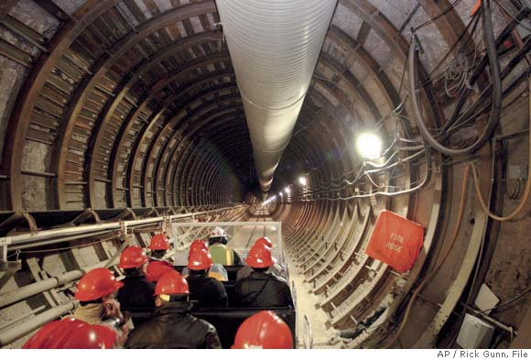
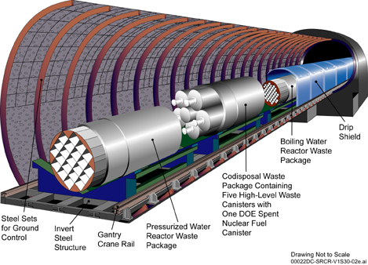
Notes:
So this is what we’re legally required to do with the waste- per Nuclear Waste Policy Act of 1982
But…
Feds still haven’t opened yucca mountain (despite taking the money to make it)
So what to we do…

Slide 10
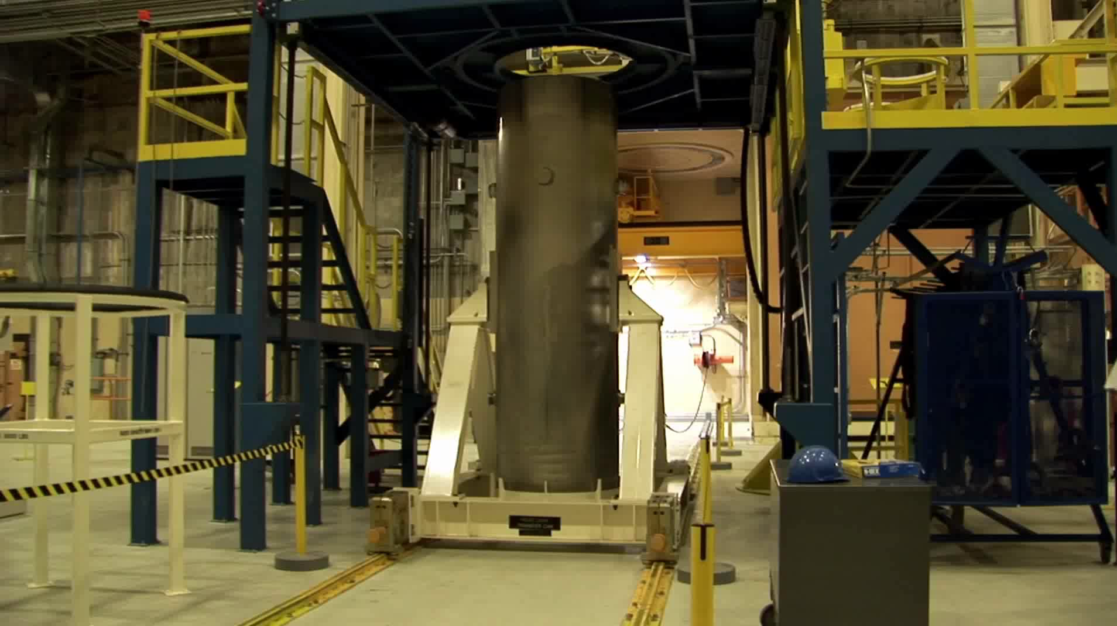
Notes:
Dry Cask Storage
Current (lack of) plan
The pools filled up because yucca never opened...
This is the patch...
(of course we could still recycle if we chose to!)

Slide 11
Notes:
This is what nuclear waste looks like-
What about gasoline waste?
coal waste?
natural gas waste?
So how much is there?

Slide 12
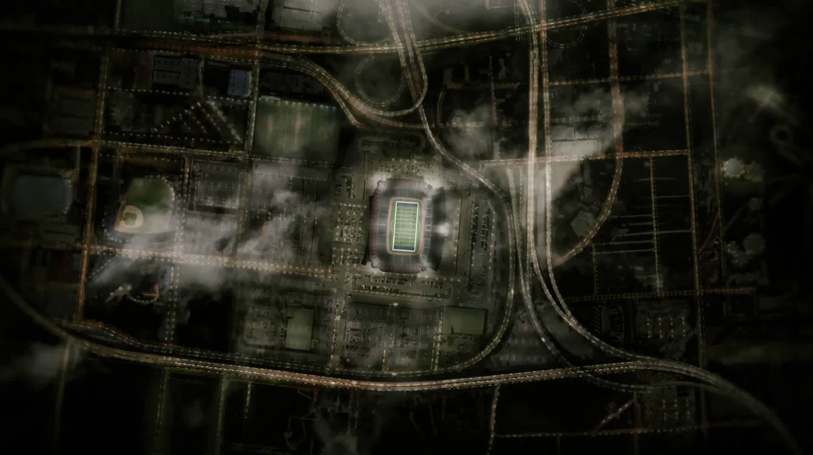
Notes:
How much is there?

Slide 13
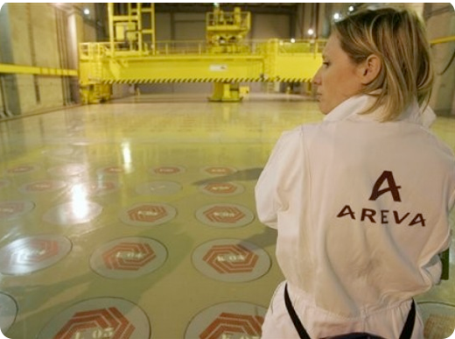
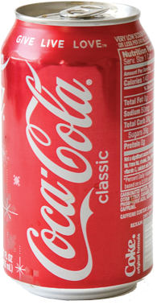
Notes:
Recycling!
Advantages-
Less fuel goes to waste
1 Coke can could provide all your energy for your entire life
How much gas will your car use?
How much garbage will you throw away this WEEK?
*Remember this is why we have nuclear powered subs- all the fuel fits inside and lets you go around the world!

Slide 14
Notes:
Shorter waste lifetime (300 yr vs 100,000‘s because we get rid of the Transuranics)
*MIT Future of the nuclear fuel cycle

Slide 15
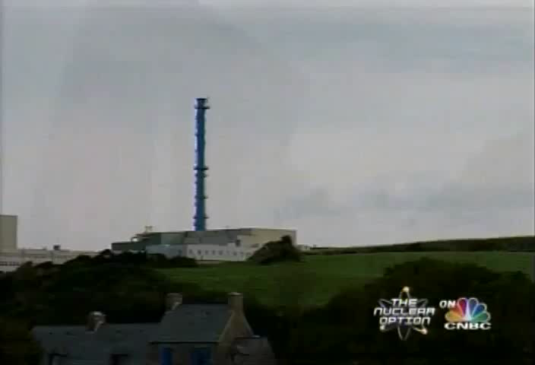
Notes:
Fuel Recycling-
Just like normal recyling
Instead of seperating glass, plastic metal
we seperate uranium, plutionium, fission products
The uranium and plutonium go back to the reactor
the fission products get mixed with concrete/ glass and buried
Not new- we had a plant in New York State that recycled in the 60’s.
It was shut down along with 2 others.
France recycles using the same process as those US plants. (PUREX)

Slide 16




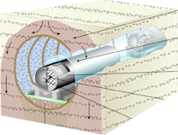

Materials Accountability
Notes:
So why don’t we-
Materials accountability-
We know what goes into the reactor and waste,
We don’t know the input so well, (tough nut to crack)
How can you prove the bad guys aren't taking any.
France put up cameras.... We want the math to balance.
***India’s bomb, from a CANDU....

Slide 17
Questions ?
Notes:
Questions?

