Slide 1
Reactor Safety
Notes:
Key Points:
Reactor Design
-barriers
-reactivity feedbacks (for normal people!)
Emergency Systems
Human imperfection
Events- TMI, Chernobyl, Fukushima
Progress- first reactors built since the 70’s are better!
** but even today nuclear has the best safety record of ANY power source

Slide 2
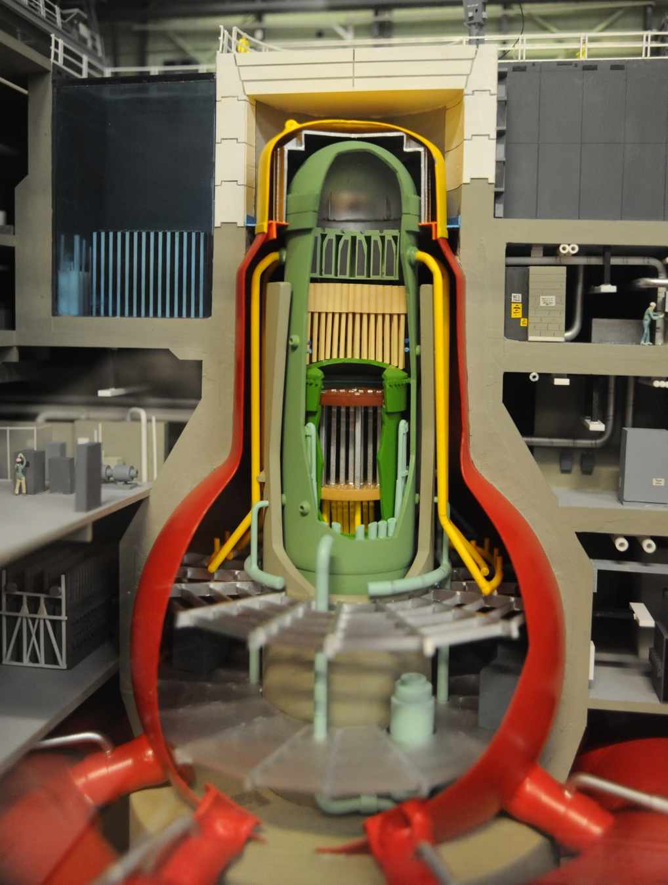
Multiple Barriers
Notes:
What if ...?
Answer has to be credible-
Multiple barriers block fuel from “you”

Slide 3
Notes:
As animated:
Fuel, cladding
Reactor Vessel (~4-8 inches thick)
Bioshield wall (4 ft thick)
Weir wall (24 ft tall, 1.5 ft thick)
Drywell (5ft thick)
Containment Vessel (1.5 in thick)
Sheild Building (3 ft thick)
*BWR mark 3 containment shown, others are different but must meet same design requirements. (like cars have crash test requirements)
One of these design requirements is an aircraft crash: (next slide)

Slide 4
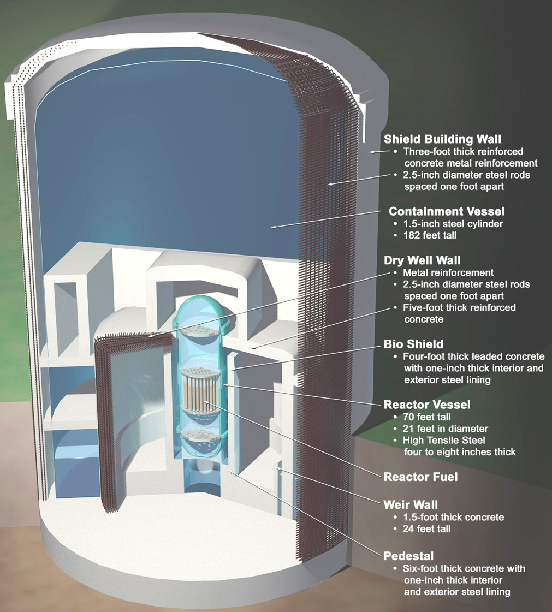
Notes:
Thickness of layers

Slide 5
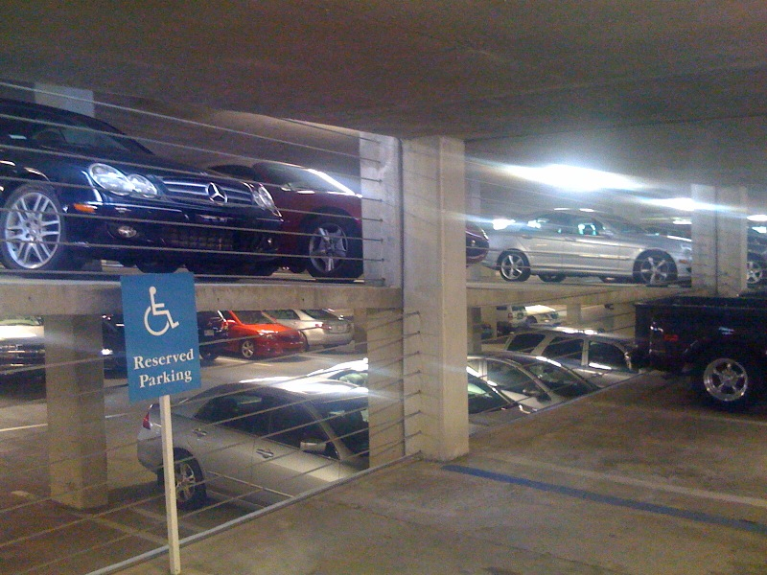
Notes:
For perspective- our parking garage
How much concrete does it take to hold a car?

Slide 6
Notes:
Aircraft Impact assessment- Design Requirement (767)
Impact is modeled with computer program, but how do you know its right?
Go try it and see if your program was right
Model Verified with F-14
1/2in deep hole in concrete slab.

Slide 7
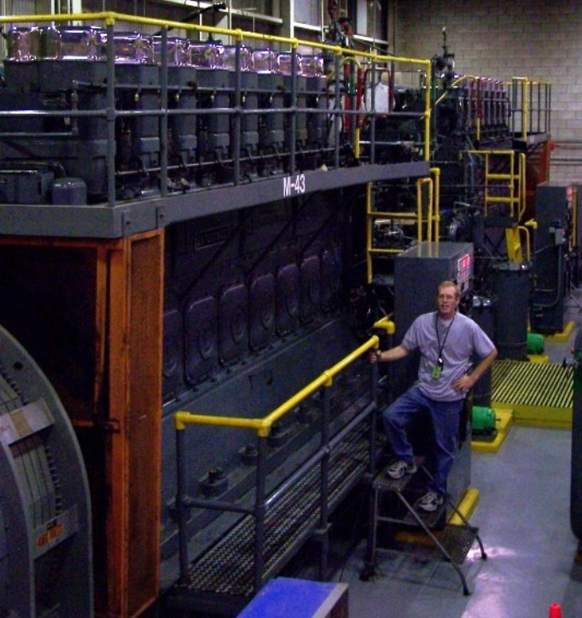
(Emergency Systems)
Notes:
Decay heat-
Reactors still heat up as the atoms we broke stabilize (falls of quickly)
MUST HAVE COOLING AFTER SHUTTING DOWN
What if airplane crash takes out power!!
Need failsafe cooling systems (ECCS)

Slide 8
Notes:
Example:
Core spray on a BWR
Push button gets you 10,000 gpm spray on the fuel
ECCS
(BWR- ADS, HPCI(CS), RCIC, LPCI(CS),
(PWR- SRV, HPSI, RHR, Aux FW)

Slide 9
Notes:
But what if they break?
Single Failure Design- in multiple trains
How many are enough??
EPR has 4,
Passive reactors attempt the opposite- no moving parts required (IFR)
Again- designs are different, but have to meet same design requirements.

Slide 10
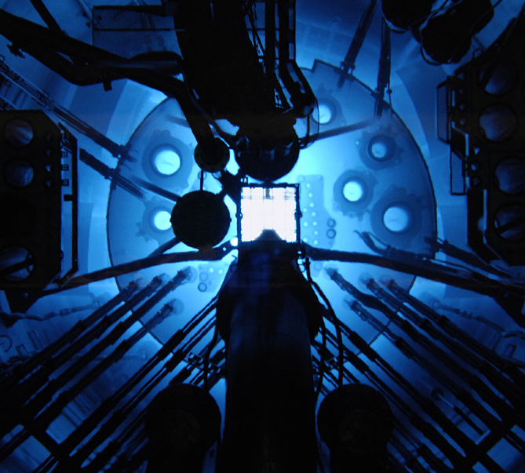
Inherent Safety
(this is reactor physics)
Notes:
A reactor cannot blow up like a bomb, for several reasons
-fuel is not restrained- will just bend and stop reaction
-Reactivity feedback mechanisms (moderator, doppler)
-Enrichment too low
Don’t take my word for it- we’ll show you-

Slide 11
Notes:
Thermalization-
Neutron has to be SLOWED DOWN,
Or it will (most likely**) bounce off the uranium-235.

Slide 12
A Control Rod Is Rapidly Pulled From The Reactor-
What Will Happen?
Notes:
talk them through as follows:
1: rod pulled, chain reaction starts...
2: so what happens to water temp
3: what happens when water heats up (boils)
4: what happens to neutrons if water boils? (speed up)
5: And if neutrons go too fast what happens to reactor (shuts off)
So your telling me I can pull the control rod out
(try to make the thing blow up like a bomb)
and it will SHUT ITSELF DOWN!

Slide 13
Notes:
LETS TRY IT! (BORAX) (Long video- but can skip forward)
Did this reactor blow up? (nuclear explosion vs steam explosions)

Slide 14
Notes:
Another reactor (Special Power Excursion Reactor Test)
But now a twist....
what If we kept the water and steam inside a container when this happened?
(go to water heater slide)

Slide 15
Notes:
Same as you get overheating a water heater- we’d get a steam explosion
**Steam explosions aren’t little things!!

Slide 16
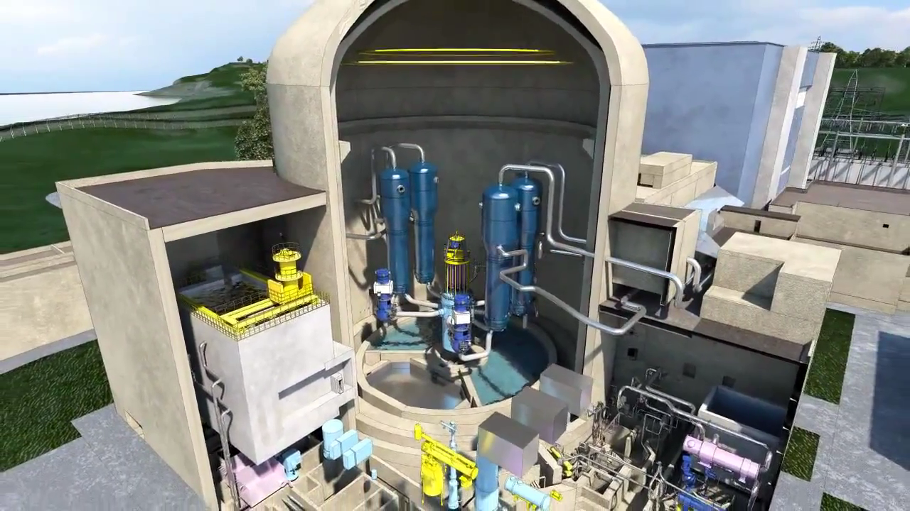
Notes:
LOCA- Steam pressure-Containment Integrity
~580*F coolant, what happens if you break RCS pipe-
Containment fills with steam (~50psi)
This is why we have a containment building
Allow us to cool and reuse the water (ECCS)
Keep the coolant from “getting out”
ALL US REACTORS ARE DESIGNED TO WITHSTAND A COMPLETE BREAK IN THE RCS.

Slide 17
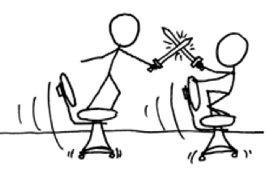
Humans
Notes:
No matter how well the systems are designed,
A person still runs them...

Slide 18
Notes:
So lets get Homer out of the way.
Notice how complicated the control panel is...

Slide 19
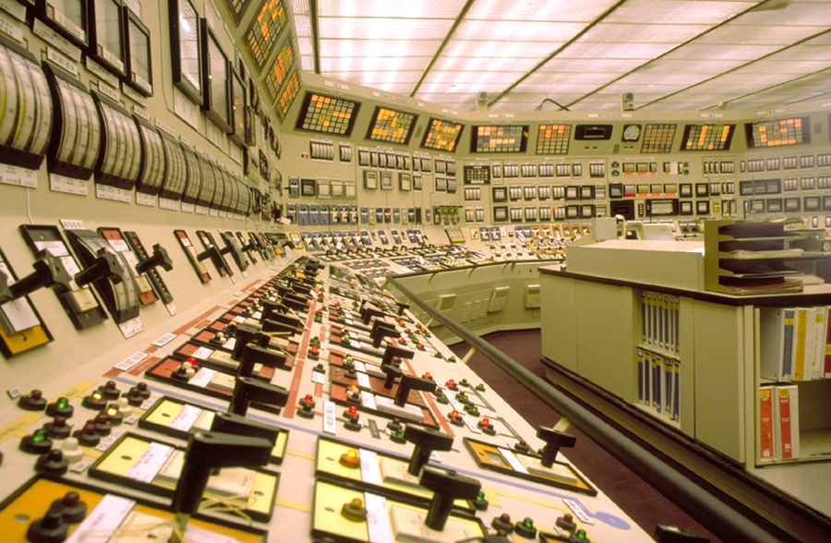
Notes:
THIS IS A REAL ONE (Oconee)
-SRO training, initial testing, Simulator refresh
Knowing the buttons only skims the surface....
Red carpet-
Need operator approval because you’d be in arms reach of buttons
Three way communication (try it with a student)
Have to get things right in nuclear...(even though it can’t blow up)

Slide 20
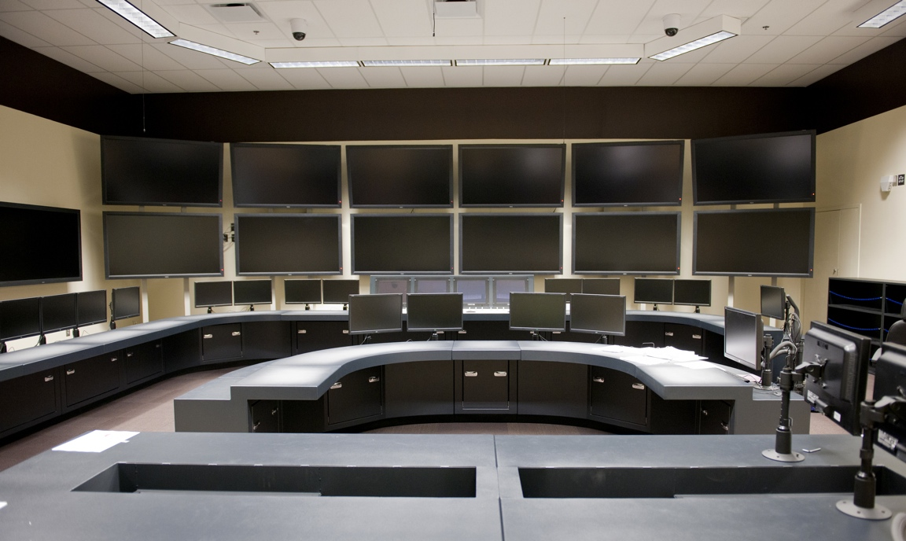
Notes:
AP1000 Simulator

