Slide 1
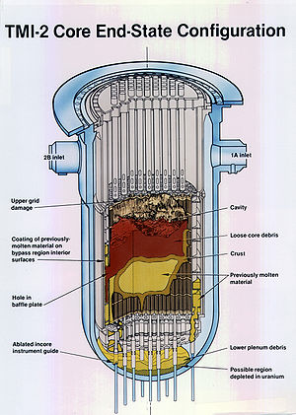
TMI
Notes:
Three Mile Island

Slide 2
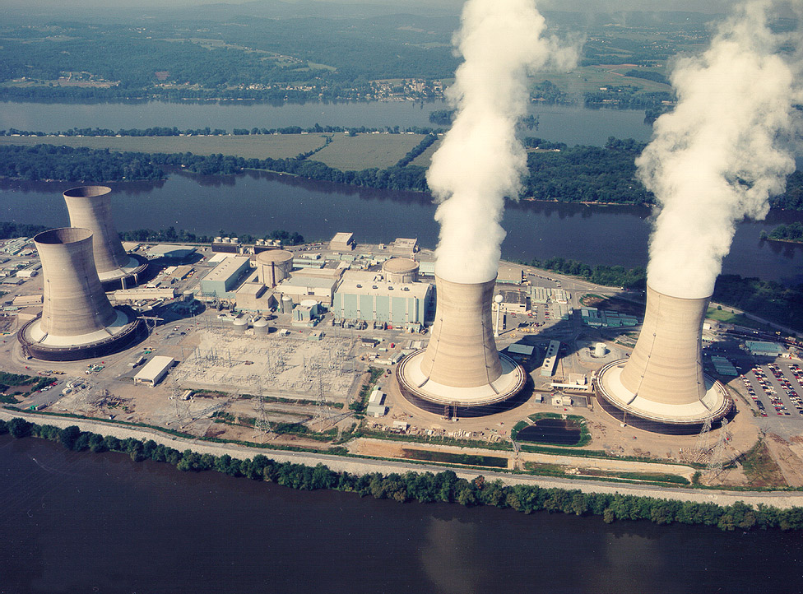
Notes:
This is what TMI looks like today..

Slide 3
Notes:
Narrative of TMI Events
Demins trip->FW
AFW (but it was left isolated by maint.)
SG boiling dry - No heat removal mechanism
RX temp & Press rise
Pressurizer level rises (due to pressure rise)
PORV lifts- discharges to tank
Valve sticks OPEN-
Pressurizer level NOT A PRESSURE INDICATOR (unknown to ops)
Steam forms in reactor (raises pzr level-
ops thinks overpressure danger because of rising pzr level
ops cuts high pressure injection
Core uncovers and melts 1/3 of the fuel
Hydrogen explosion

Slide 4
Notes:
This is what TMI looks like today (and the day after the accident)
No Deaths (NRC)
But it scared the crap out of people-
People really thought they were leaving and never coming back...
But containment worked.

Slide 5
Notes:
Fuel removed and transported to Idaho- now lives at CPP-1774 (Chemical Proccessing Plant-1774)

Slide 6
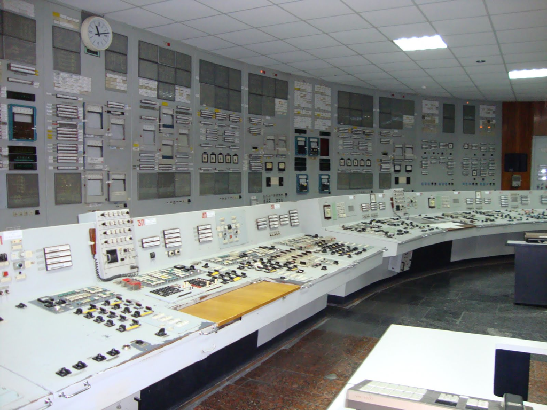
Chernobyl
Notes:
Unit 1 Control Room

Slide 7
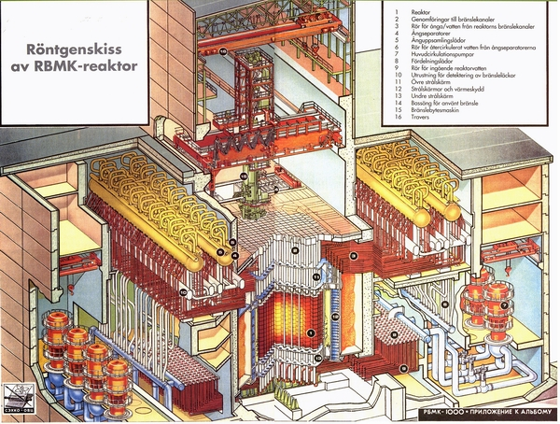
Notes:
This power plant design could not be built in the US
didn’t meet our design requirements
No containment
Graphite slows down the neutrons
(Overmoderated/ +MTC, losing water increases reactivity since graphite slows down neutrons, water is a poison that just absorbs/ steals neutrons.)
Control rods has graphite tips
On insertion they actually raise power at first until the absorber gets into the fuel
leningrad `75 Power Oscillations caused fuel melt
Ignalina `83 +reactivity on rod insertion discovered- no fix made
Reactor operators told design was perfect, accident proof.
Event:
1:Turbine trip-> Slowdown of 4 RCP’s fed by generator (other 4 offsite power)
2: + reactivity as water flow decreases
(Overmoderated/ +MTC, losing water increases reactivity since graphite slows down neutrons, water is a poison that just absorbs/ steals neutrons.)
3: Less flow-> Increased RCS temps, lower subcooling, pumps cavitate, Flow drops sharply
4: MORE + reactivity as water flow decreases (+mod Temp Coeff)
5: MANUAL SCRAM on power increase- Graphite followers=reactivity addition
6: + reactivity as water is displaced by graphite at base of core
BOOM- 2100 ton containment lid blown off reactor through ceiling.
7: Core melts, (graphite was glowing orange)
8: Sand added to core by liquidators to extinguish the fire- core heats up
9: Suppression pool had to be drained to prevent steam explosion from core melting through it.
CHINA SYDROME
Issues:
1: Graphite Water Displacers on control rods; Water->Graphite is reactivity addition (graphite has lower absorption cross section)
2: Void Coeff could become so severely + that it could make power reactivity coeff + when sufficient rods were removed (as done @ chernobyl)
3: OE not used- Ignalina in 1983 discovered this problem- no fixes were made.
4: Push to get the test done- Break one barrier after another.

Slide 8
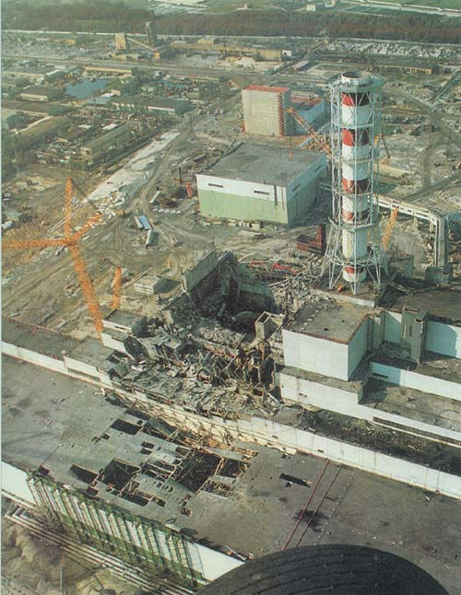
Notes:
Whats different between this and TMI?
CONTAMINATION Killed:
28 liquidator deaths within 1 month
19 more by end of 2004
UN 2005 Study Sites 56 deaths from chernobyl
(4000 Fatal Cancers ESTIMATED;
vs 100,000 “Natural Cancer Fatalities in the same region pg 16 IAEA Chernobyl Report)

Slide 9
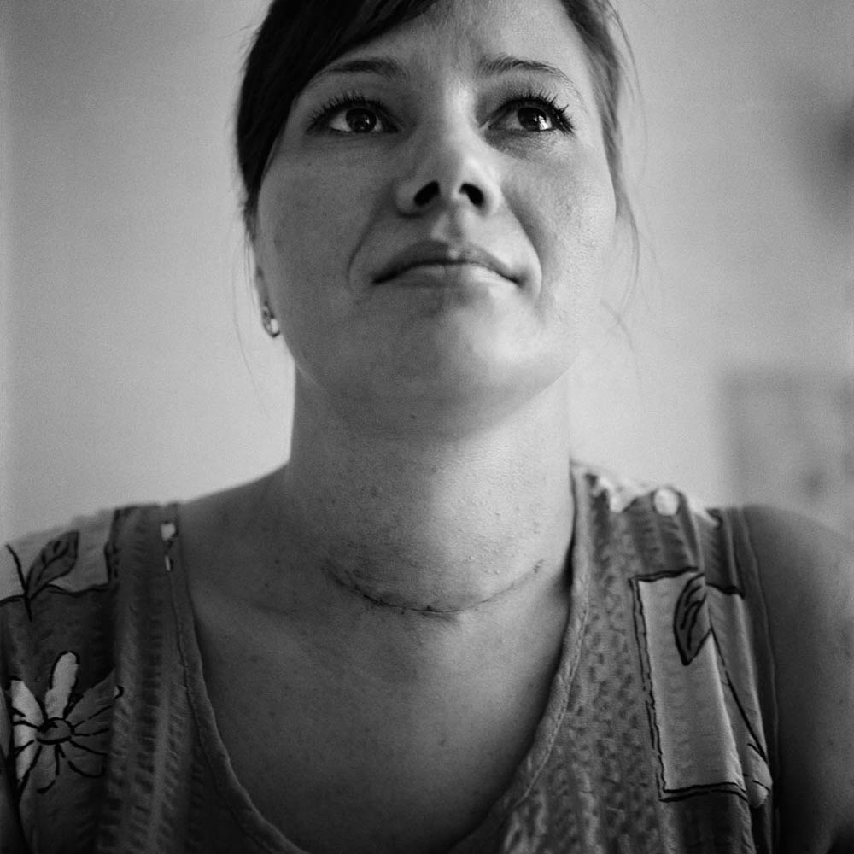
Notes:
Non-death effects:
Thyroid Cancer- I-131 that landed over the countryside.
>4000 Thyroid cancers, 15 deaths- from non-treatment. (IAEA report)

Slide 10
Notes:
Hows it look now:
(doses in microsievets/hr)
*some people never left, others went back:

Slide 11
Notes:
Hows it look now:
(doses in microsievets/hr)
*some people never left, others went back:

Slide 12
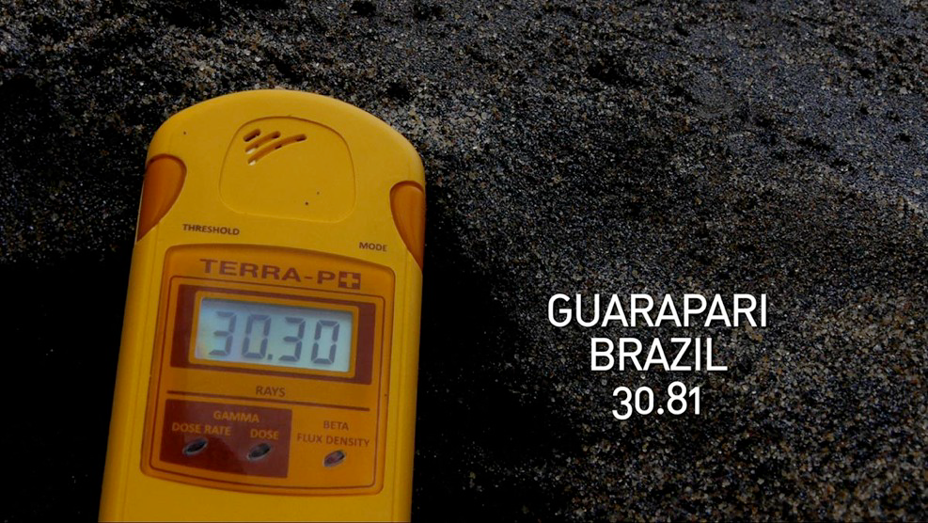
Notes:
Hows it look now:
(doses in microsievets/hr)
*some people never left, others went back:

Slide 13
Notes:
Hows it look now:
(doses in microsievets/hr)
*some people never left, others went back:

