Slide 1
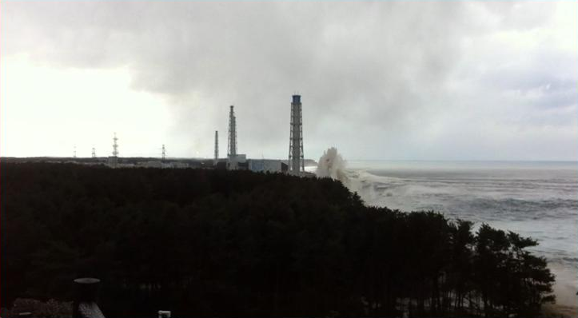
Notes:
That wave is >150’ (reactor bldg is 150’)
So news says... “they should have build the reactor higher!”
wow- why didn’t we think of that?!
Design basis-
have to ask experts what maximum threat is-
answer was- (Credible 18’)
So what do you think they designed to (let them guess)
Designed for 21’
48’ Actual (notice height of wave well above roof of turbine bldg)
Even doubling what the experts thought wouldn’t have been enough!
(all heights relative to Normal High Tide)

Slide 2
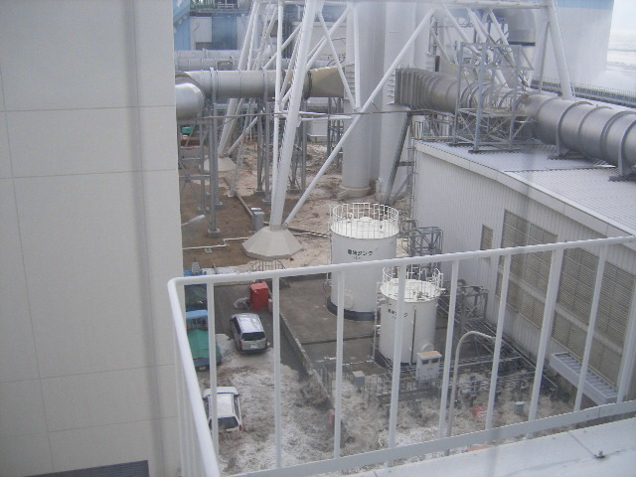
Notes:
Floodwater Before and during
Floods power distribution network, MCC’s- Motors all shorted, coolant flow to reactor stops.

Slide 3
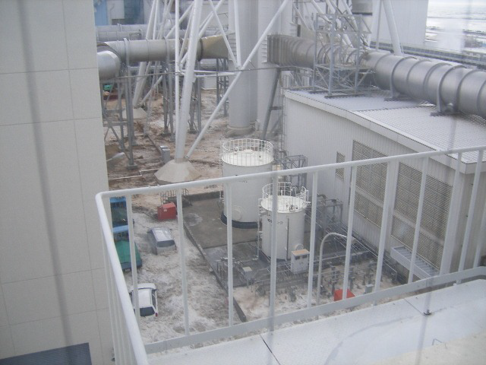
Notes:
Floodwater Before and during
Floods power distribution network, MCC’s- Motors all shorted, coolant flow to reactor stops.

Slide 4
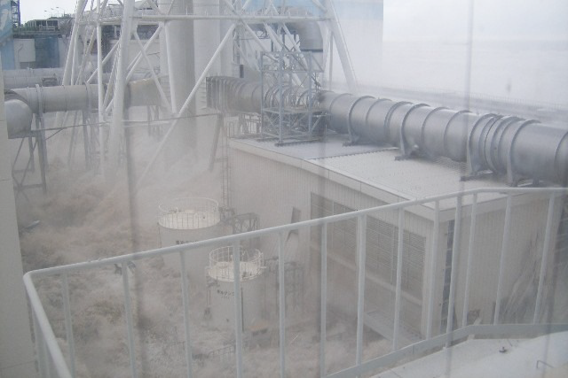
Notes:
Floodwater Before and during
Floods power distribution network, MCC’s- Motors all shorted, coolant flow to reactor stops.

Slide 5
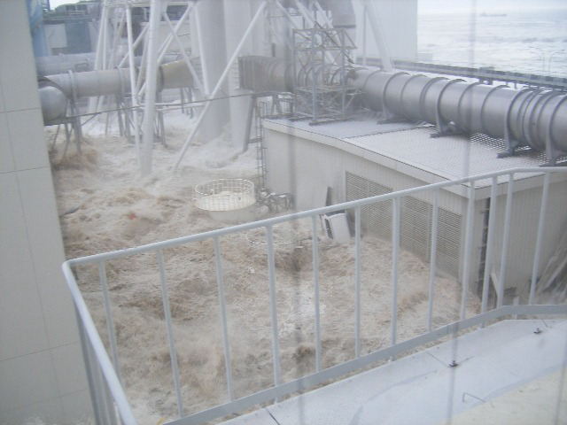
Notes:
Floodwater Before and during
Floods power distribution network, MCC’s- Motors all shorted, coolant flow to reactor stops.

Slide 6
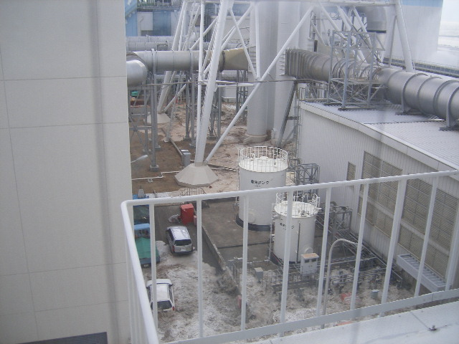
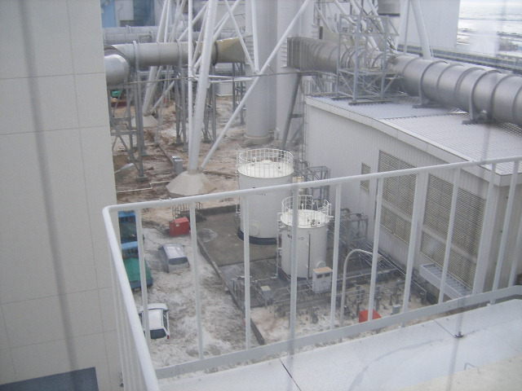
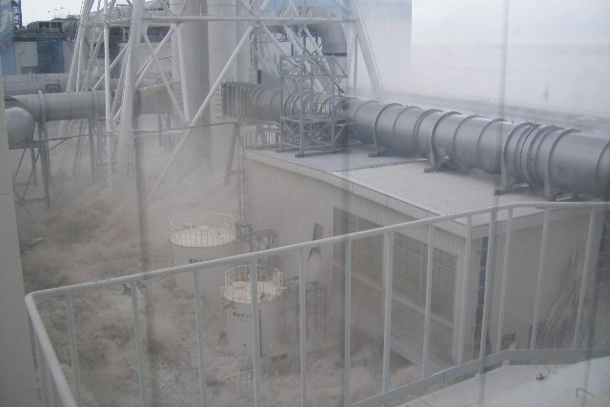
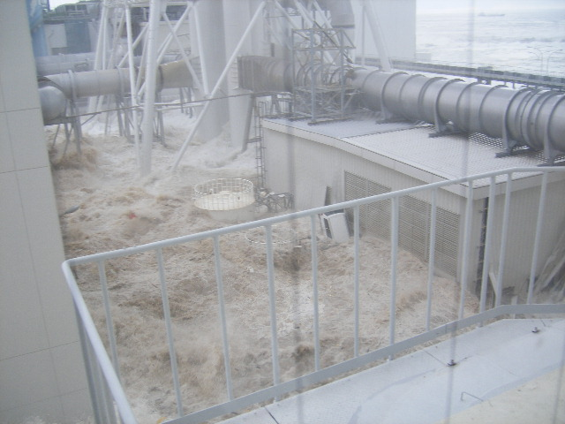
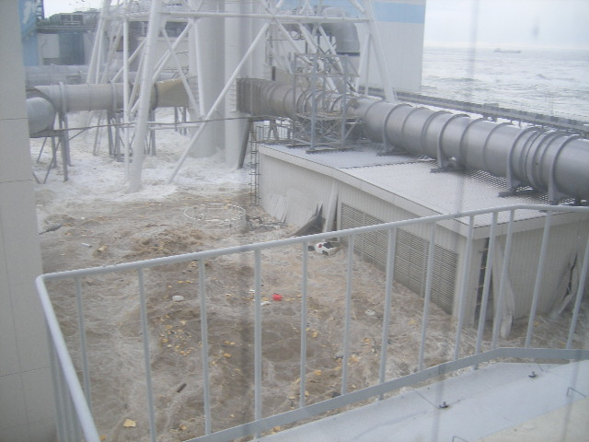
Notes:
Floodwater Before and during
Floods power distribution network, MCC’s- Motors all shorted, coolant flow to reactor stops.

Slide 7
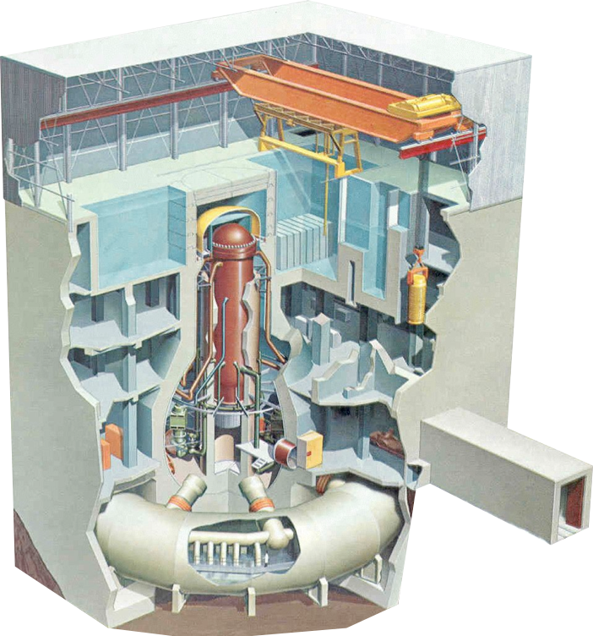
Notes:
Narrative:
4: Flooding shorts all electrical distribution (AD/DC)
5: Reactor begins to heat up (Decay heat)
6: Hot steam discharged to Suppression Pool
7: Power trucks and fire engines attempt to restore power/ injection
Power no go because of extensive water damage
Pumper Trucks cant overcome vessel pressure and/or deliberate decision not to flood for fear of hydrogen deflagration (high steam content lowers deflagration risk)
8: Containment Over pressurizes (~120 psi- design=60) BUT HOLDS!
Meanwhile- H2 leaking out penetrations into the rest of the building
9: H2 Ignites- Workers have to pull back

Slide 8
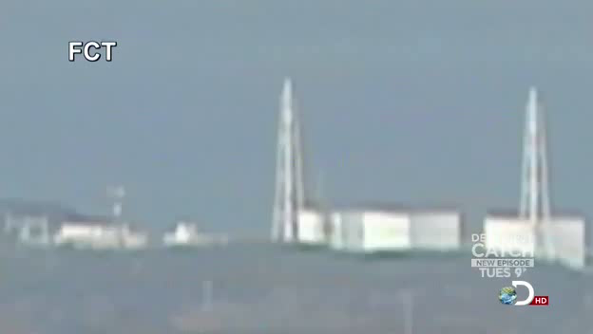
Notes:
U1 H2 Explosion
After a few days the containment pressure went down (leaked)
Water injection was connected
(Tanks-SARRY, Kurion long cycle recirc)
Recap- 0 workers dead from radiation including “Fukushima 50”-
20,000 dead from TSUNAMI
But land was contaminated- containment leaked...

Slide 9
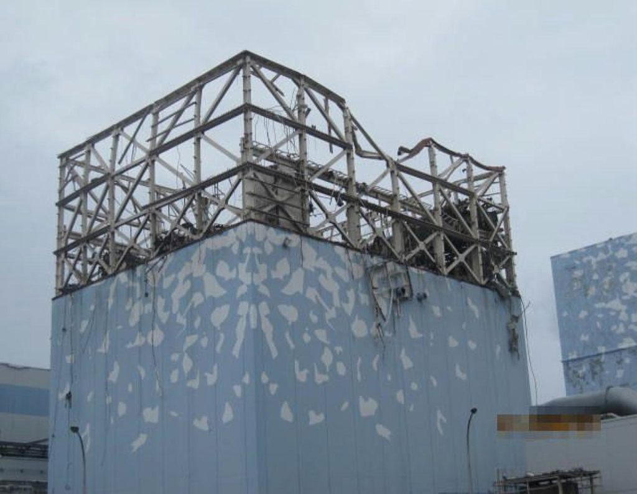
Notes:
U1 H2 Explosion
After a few days the containment pressure went down (leaked)
Water injection was connected
(Tanks-SARRY, Kurion long cycle recirc)
Recap- 0 workers dead from radiation including “Fukushima 50”-
20,000 dead from TSUNAMI
But land was contaminated- containment leaked...

Slide 10
Notes:
Hows it look now:
0 Deaths
0.370 microsieverts on site (WIDE VARIATION onsite, cores melted in reactor building)
0.18 Microsieverts and parents are afraid to let children play outside.

Slide 11
Notes:
Hows it look now:
0 Deaths
0.370 microsieverts on site (WIDE VARIATION onsite, cores melted in reactor building)
0.18 Microsieverts and parents are afraid to let children play outside.

Slide 12
Notes:
Hows it look now:
0 Deaths
0.370 microsieverts on site (WIDE VARIATION onsite, cores melted in reactor building)
0.18 Microsieverts and parents are afraid to let children play outside.

Slide 13
Notes:
Hows it look now:
0 Deaths
0.370 microsieverts on site (WIDE VARIATION onsite, cores melted in reactor building)
0.18 Microsieverts and parents are afraid to let children play outside.

Slide 14
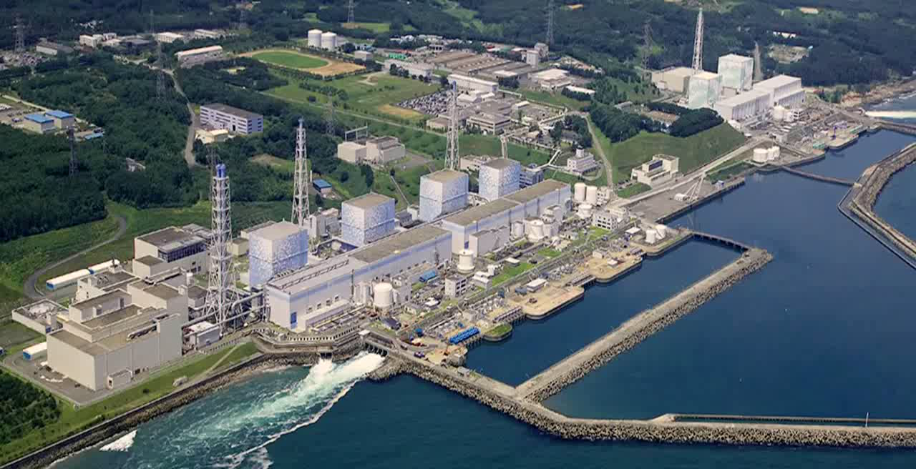
Notes:
What did we change:
Portable core cooling-
Portable pumps to inject cooling water
Portable Generators to run equipment
Either multiple storage facilities, or hardened to survive threats
2 national centers with same equipment (5 sets each)
equipment will be flown out whenever needed

Slide 15
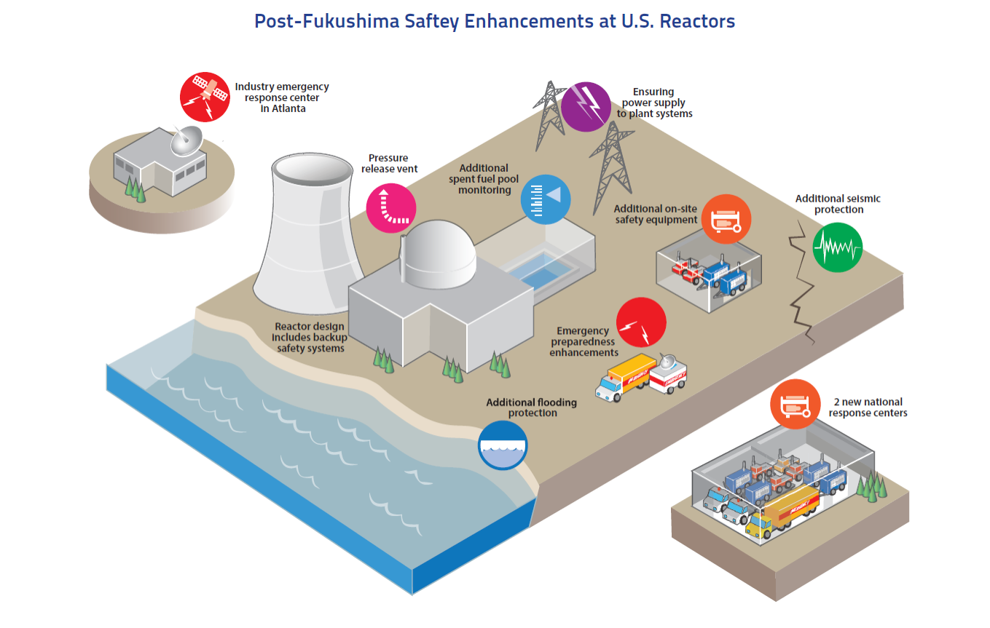
Notes:
What did we change:
Portable core cooling-
Portable pumps to inject cooling water
Portable Generators to run equipment
Either multiple storage facilities, or hardened to survive threats
2 national centers with same equipment (5 sets each)
equipment will be flown out whenever needed

Slide 16
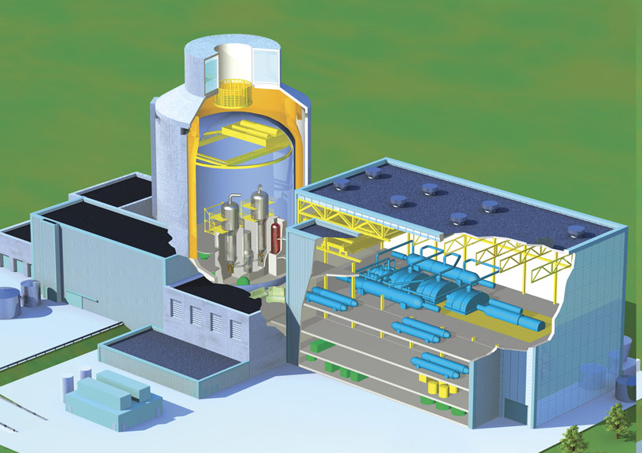
Progress
Notes:
Can’t we build a better reactor?

Slide 17

Notes:
30 years ago a COMPLETELY passive reactor was already designed and running.

Slide 18
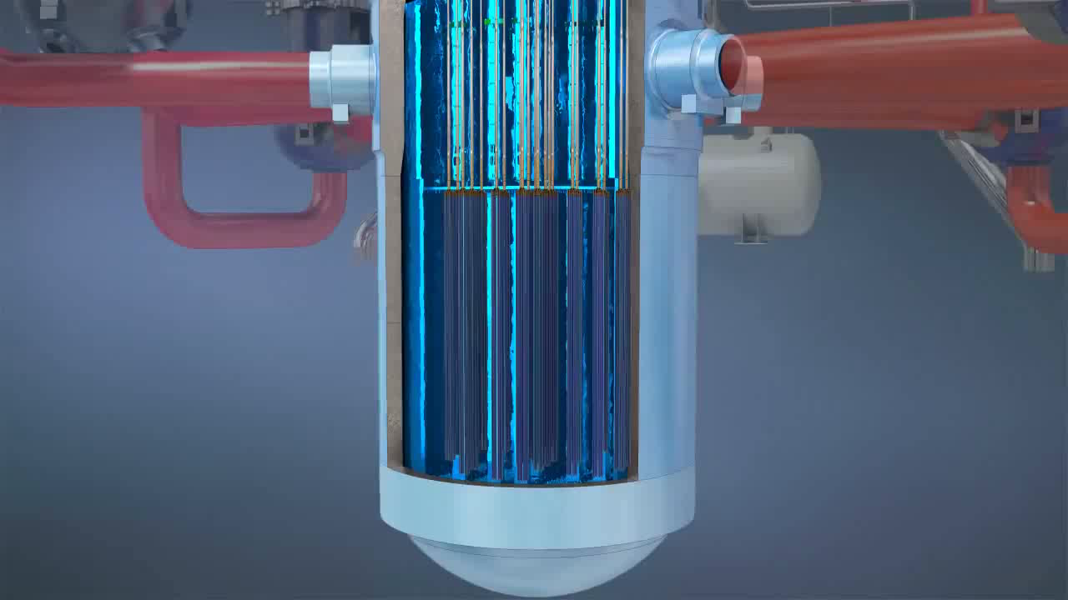
Notes:
EPR design
4 copies of each ECCS,
core catcher

