Slide 1
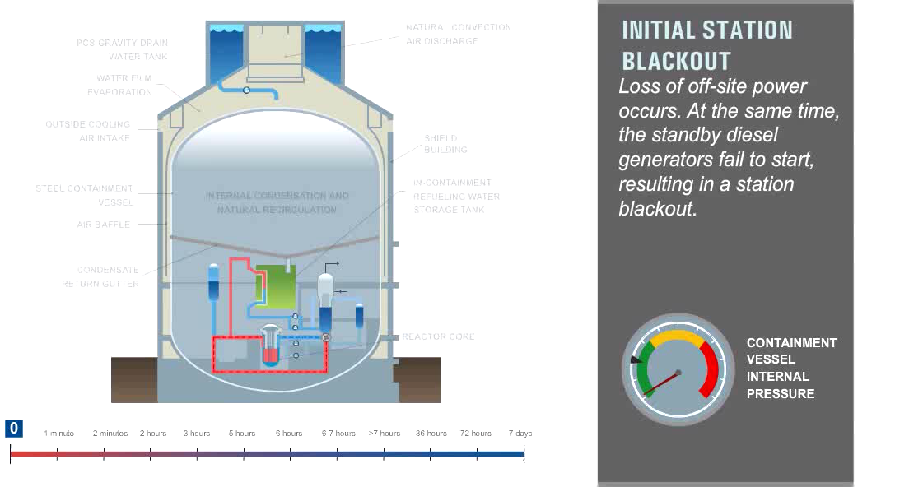
Notes:
INCREDIBLE CONCEPT
This is what the US is building
2 being built in Georgia
2 being built in South Carolina

Slide 2
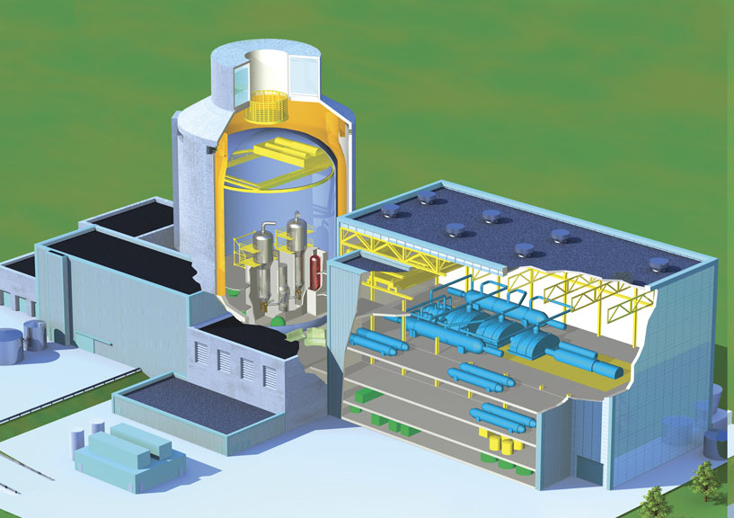
Questions
Notes:
Questions-

