Slide 1

Energy Realities

Slide 2

?
Notes:
Where does our power actually come from?
IF we got it all from gas =~2500 gal/yr (2487 gal/yr)
(309E6 BTU/yr consumed per person (EIA- August 2015 MER table 1.7)
(5.218E6 BTU/barrel (42gal) gasoline (EIA August 2015 MER Table A.2)

Slide 3
Notes:
But we don’t burn gas... what do we do?

Slide 4
Notes:
Extreme growth in wind/ solar!!
(but not so impressive when others are added!- scales matter)
Decline of coal!
Whats replacing it (before you advance to show gas)
Which is growing faster, gas or wind/solar?

Slide 5
Notes:
Extreme growth in wind/ solar!!
(but not so impressive when others are added!- scales matter)
Decline of coal!
Whats replacing it (before you advance to show gas)
Which is growing faster, gas or wind/solar?

Slide 6
Notes:
Extreme growth in wind/ solar!!
(but not so impressive when others are added!- scales matter)
Decline of coal!
Whats replacing it (before you advance to show gas)
Which is growing faster, gas or wind/solar?

Slide 7
Notes:
Extreme growth in wind/ solar!!
(but not so impressive when others are added!- scales matter)
Decline of coal!
Whats replacing it (before you advance to show gas)
Which is growing faster, gas or wind/solar?

Slide 8
Notes:
Extreme growth in wind/ solar!!
(but not so impressive when others are added!- scales matter)
Decline of coal!
Whats replacing it (before you advance to show gas)
Which is growing faster, gas or wind/solar?

Slide 9
Notes:
Extreme growth in wind/ solar!!
(but not so impressive when others are added!- scales matter)
Decline of coal!
Whats replacing it (before you advance to show gas)
Which is growing faster, gas or wind/solar?

Slide 10
Notes:
Extreme growth in wind/ solar!!
(but not so impressive when others are added!- scales matter)
Decline of coal!
Whats replacing it (before you advance to show gas)
Which is growing faster, gas or wind/solar?

Slide 11
Notes:
Extreme growth in wind/ solar!!
(but not so impressive when others are added!- scales matter)
Decline of coal!
Whats replacing it (before you advance to show gas)
Which is growing faster, gas or wind/solar?

Slide 12
Notes:
Extreme growth in wind/ solar!!
(but not so impressive when others are added!- scales matter)
Decline of coal!
Whats replacing it (before you advance to show gas)
Which is growing faster, gas or wind/solar?

Slide 13
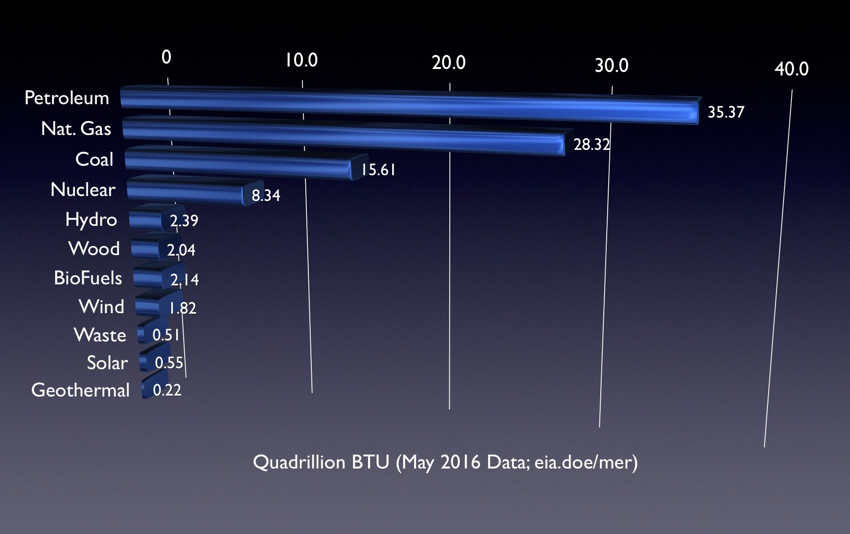
Current Energy Sources
Notes:
“Energy Independence”... whats the replacement for gasoline....?
CARS/TRUCKS are biggest energy use-
So if we want to stop burning gasoline/ coal/ natural gas-
Then what fills the void?

Slide 14
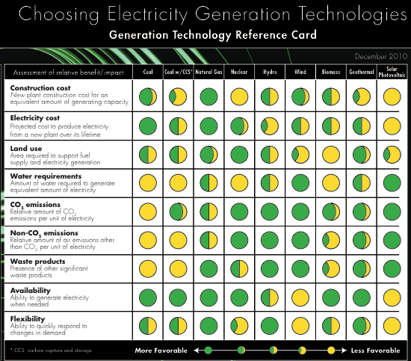
Notes:
There is no perfect solution- (each power supply has yellow in the chart)
each has a drawback- (EPRI 2010)
Look at availability-
Notice that most of the stuff we use (coal, Nat Gas, Nuclear, Biomass) are all green here-
Why would that matter?

Slide 15

Notes:
So, this Brittish show tried to power a house with bicyclists.
HOW many do you think would take (~80)
(1 Cyclist= 100W (500W for Pro Athlete) So 1500W hair dryer is 15 people!)

