Slide 1
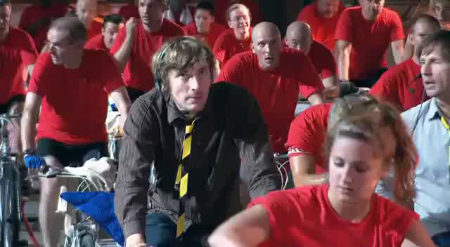
Notes:
What happens if we need more than is there?
Blackout (occurred in evening)
So we need enough cyclists ready to go when we turn on/off stuff.
called grid balancing- and its being done 24x7

Slide 2
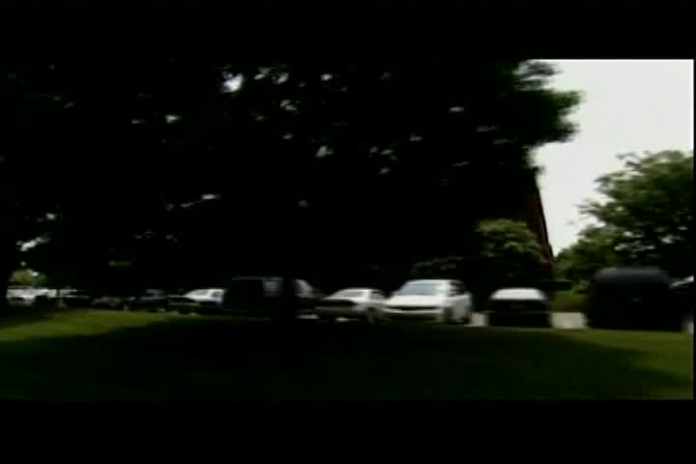
Notes:
On the Big Scale-
Grid Controllers balance supply and demand

Slide 3
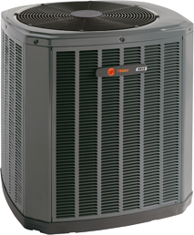
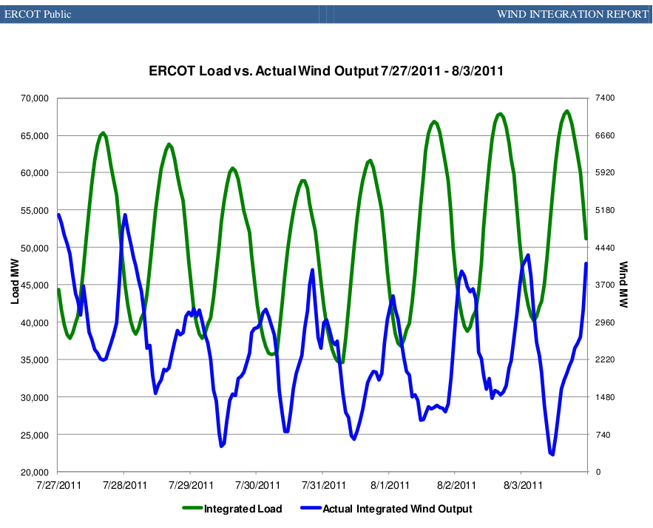
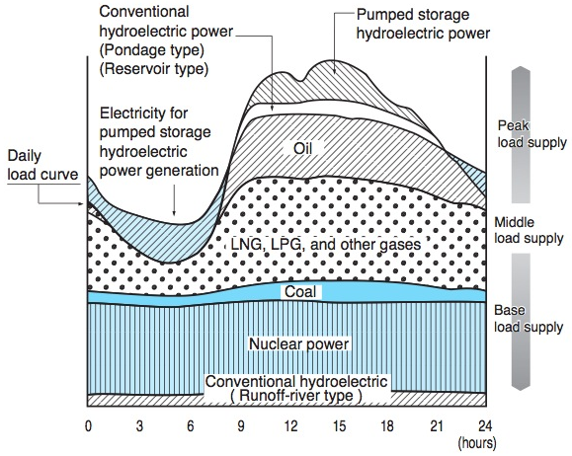
Notes:
Base Load Vs Peak Load
AC- Your AC turns on as day heats up
so does you everyone else's
So the city needs more power
More and the grid controllers have to spin up another power generator

Slide 4
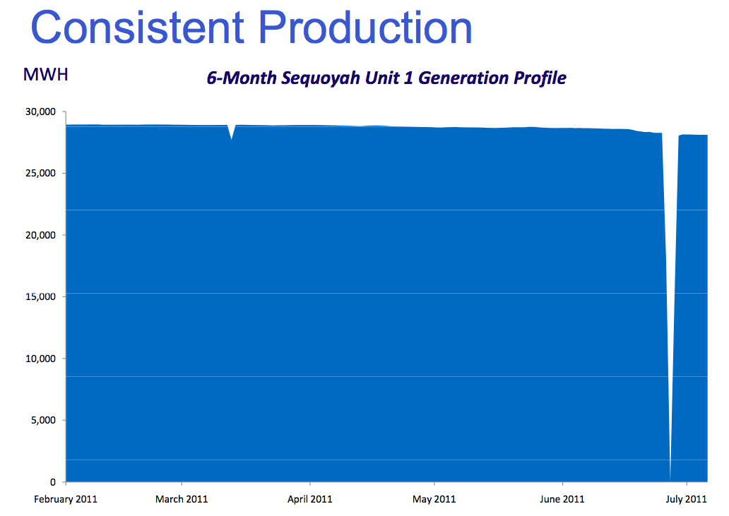
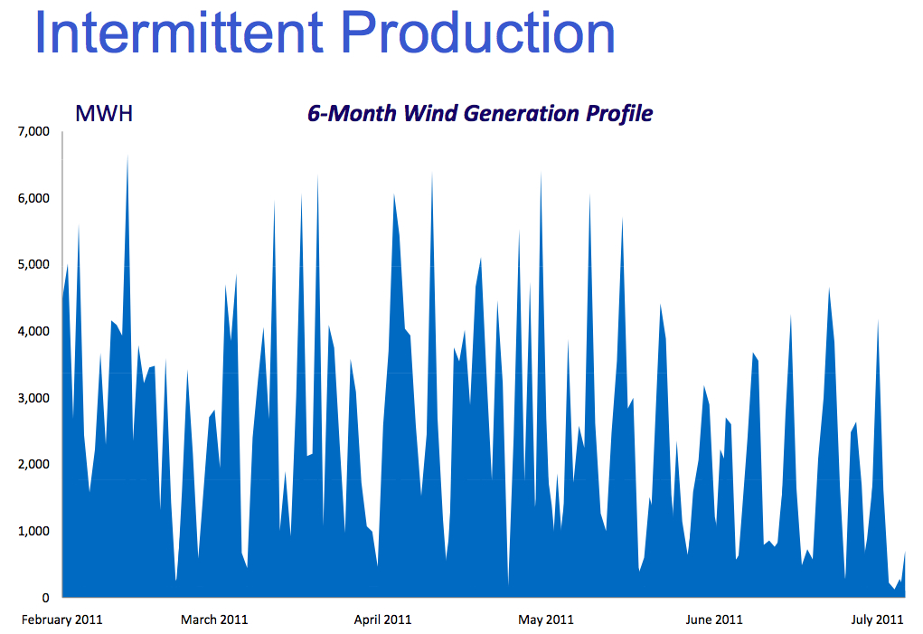
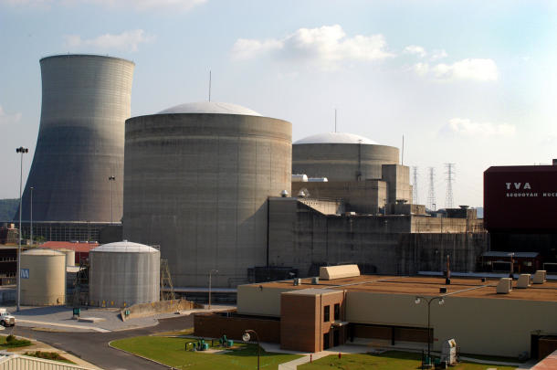
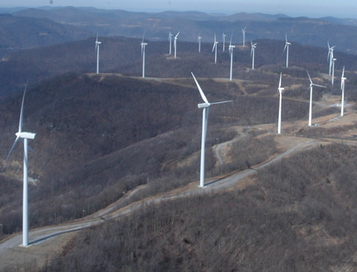
Equivalency
Notes:
But its kinda hard to tell certain power sources to start up.
That means everything else has to compensate for the wind/solar being infrequent
Makes the grid controllers life a lot harder,
DEMAND changes with Air Conditioners etc
SUPPLY is going to be moving with the wind/ clouds
Not a big deal yet because most wind/solar are small contributors.
Use gas/ pumped storage to supplement
(TVA Load profile for wind and Sequoyah Unit 1)

Slide 5
Notes:
Kinda slows up the goal of 0 CO2 when natural gas is the backup power supply.
(from https://cna.ca/wp-content/uploads/2015/03/CNA-Factbook-2015-English1.pdf
The original source is the Intergovernmental Panel on Climate Change (IPCC). Renewable Energy Sources and Climate Change Mitigation. Geneva; 2011. )

Slide 6
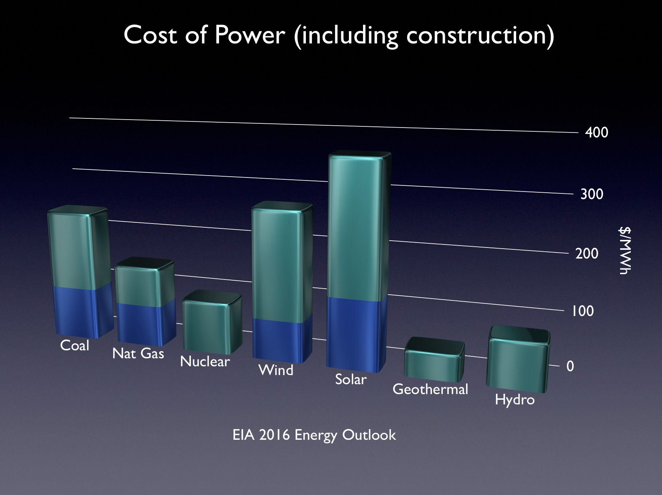
Notes:
Power Cost
EIA Annual energy Outlook 2016
Blue is basic,
Green is advanced
(wind green=offshore blue=land based)
(solar green=solar thermal blue= photovoltaic)

Slide 7
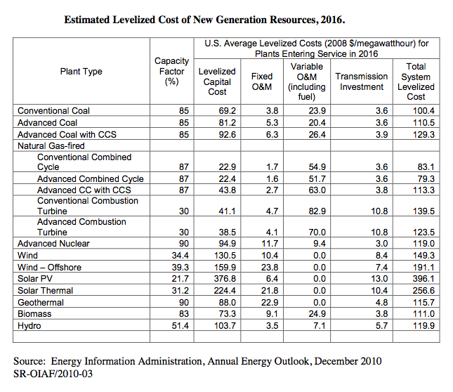

Future Energy Use
Notes:
OPTIONAL:
What about the future energy needs-

Slide 8
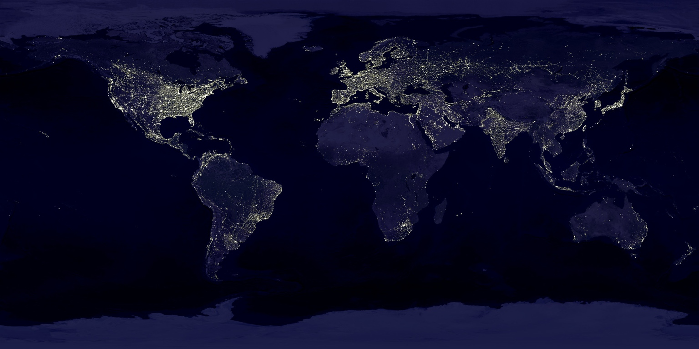
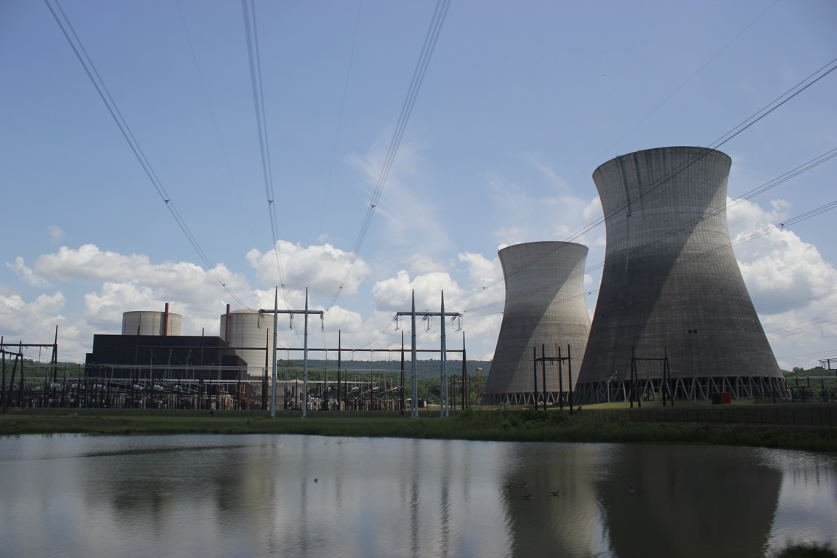
Questions
Notes:
Energy Perspectives

