Slide 1
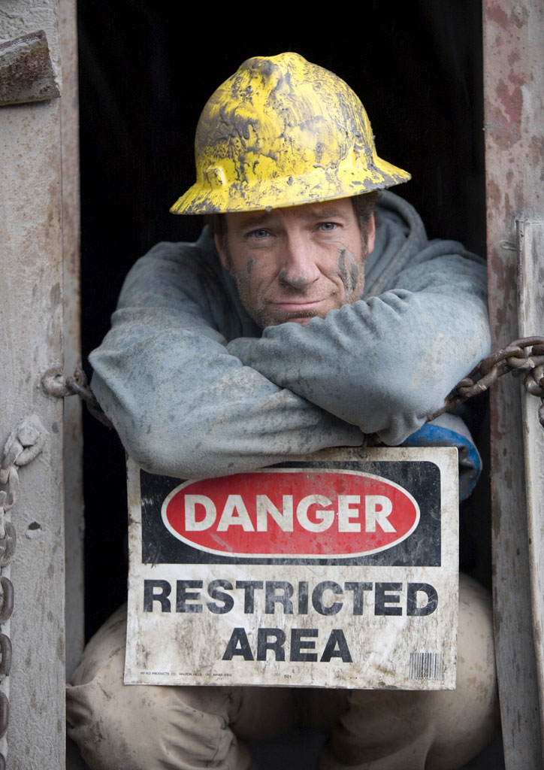
Jobs...
Notes:
You all are getting close to graduating high school - what are you going to do with yourselves?
I am sure you want to do a lot of fun stuff - but you will have to pay for it somehow

Slide 2
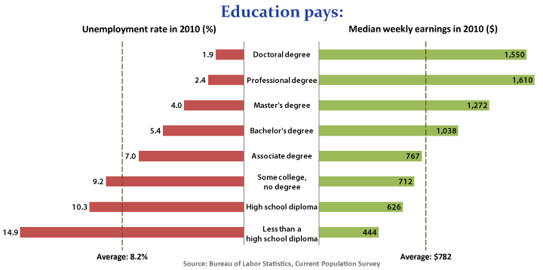
Notes:
Should I stay in School? - YES!!! This is 2010 data - “Recession Numbers”

Slide 3
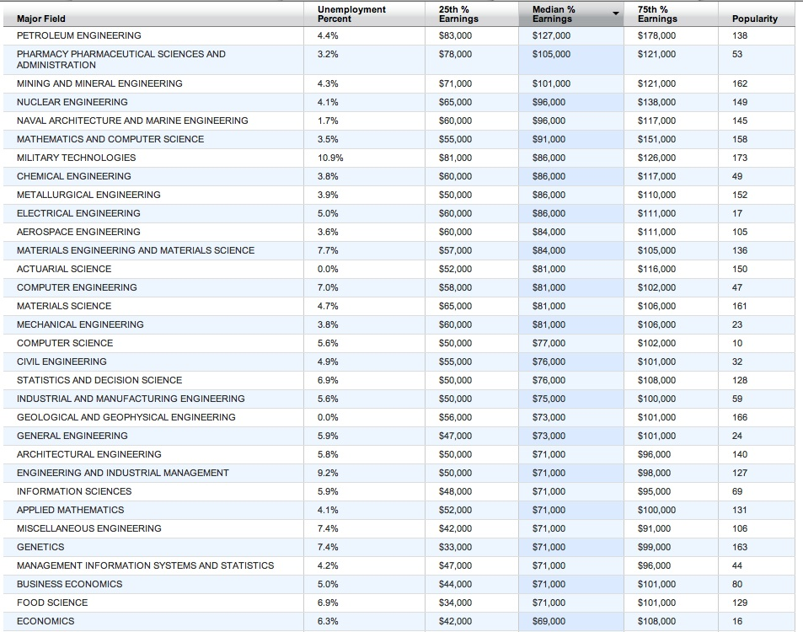
Notes:
4 year degree (only) salaries highest to lowest - From Wall Street Journal

Slide 4
Notes:
Our Industry is about to retire, need new people that are interested

Slide 5
TVA Salaries 2011 from Chattanooga Times Free Press
School | Title | Start | Mid | Senior
2-Year w/training | Maintenance Tech | $60,000 | $67,000 | $71,000
 | Aux Operator | $72,000 | $72,000 | $72,000
4-Year | Reactor Operator | $80,000 | $90,000 | $110,000
 | Engineer | $70,000 | $90,000 | $110,000
Usually 4-Year | Supervisor | $110,000
 | Manager |  | $140,000
 | Senior Manager |  |  | $190,000
 | Vice President |  |  | $700,000
Notes:
In Jan 2012, the Chattanooga times free press released all of the salaries of TVA employees - name, title, and salary. They were able to do this because of the Freedom of Information Act due to TVA being a government entity.

Slide 6
Notes:
Showing this again - because it is very important. Get a college degree!

