Slide 1
Introduce Yourself Here
Name, Company
Nuclear Energy Packs a Punch

Slide 2
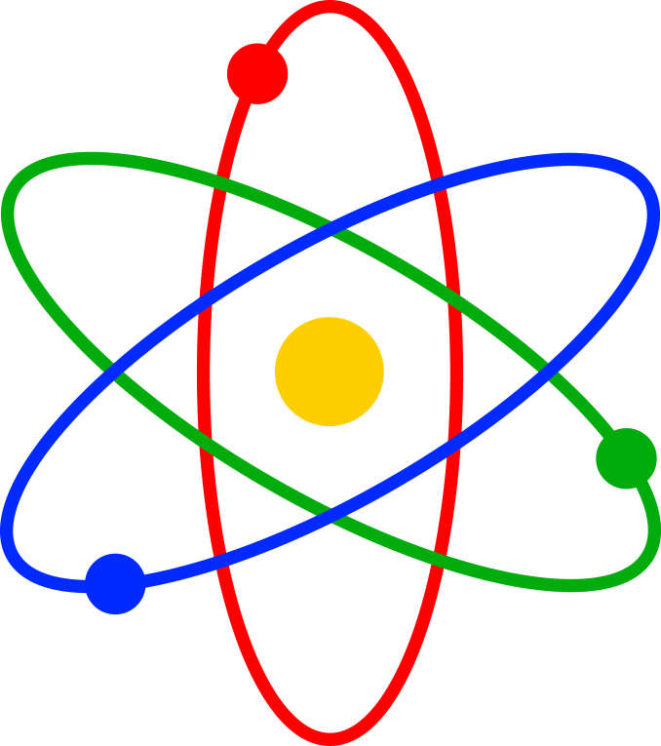
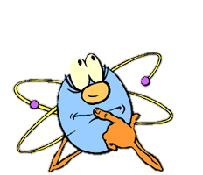
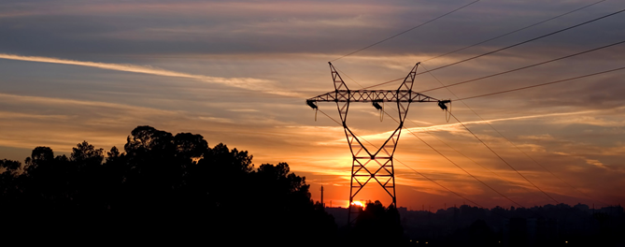
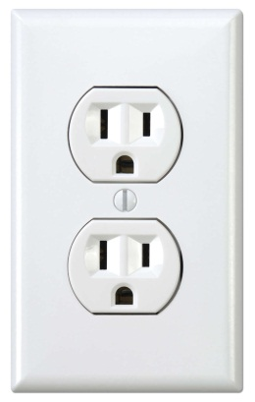

What is nuclear energy?
What is nuclear energy?
Using atoms to make electricity
Notes:
Nuclear energy means using atoms to make electricity.
Why is electricity important? What do you use electricity for?
What is an atom?

Slide 3
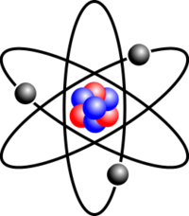
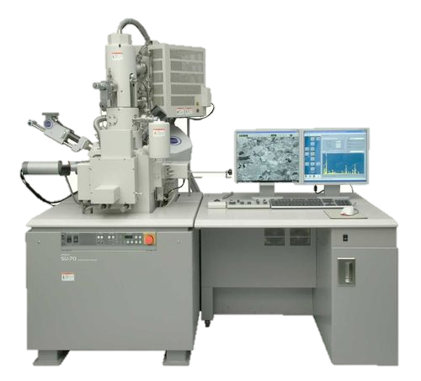
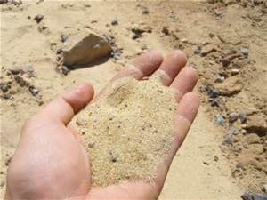
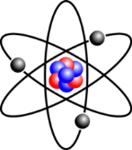



What is an atom?
An atom is extremely small and it is the building block of everything around you!
Special Microscope
Notes:
Atoms are the building blocks of matter. They are mostly empty space and they are so small that we need a special microscope to see them.

Slide 4
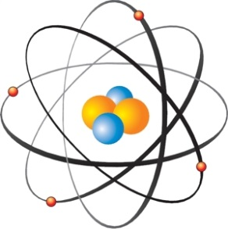

Atoms have a lot of energy!
=

Slide 5

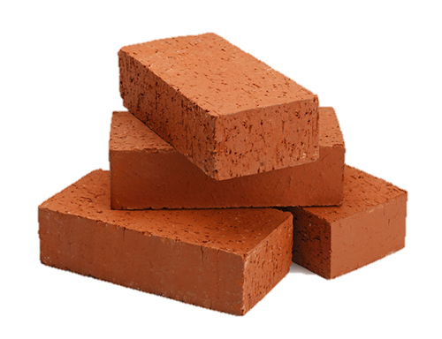
What is energy density?
The amount of energy in a certain space
Notes:
If you had a box of feathers and a box of bricks, which would weigh more?
A box of bricks.
This is because the bricks have a higher density.
Like bricks, atoms have a high (energy) density.

Slide 6
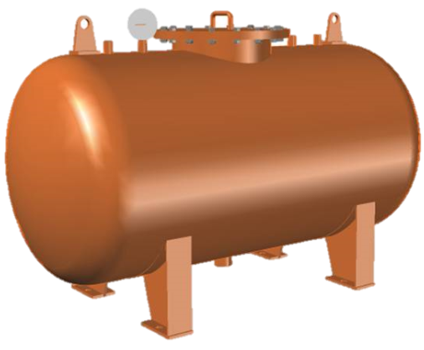
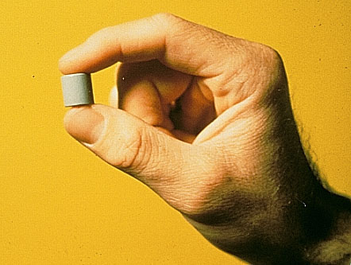
Nuclear energy density
1 Uranium
Pellet
3 Barrels
of Oil
1 Ton of Coal
17,000 Cubic Feet
of Natural Gas
Nuclear fuel stores a lot of energy in a very small package!
Notes:
A nuclear fuel pellet is about the same size as your pinkie finger and it has a lot of energy.
A nuclear fuel pellet has the same amount of energy as 1 ton of coal!
These are some other types of fuel we use to make electricity.

Slide 7
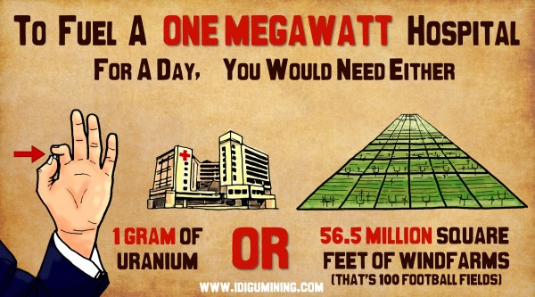
Why does energy density matter?

Slide 8



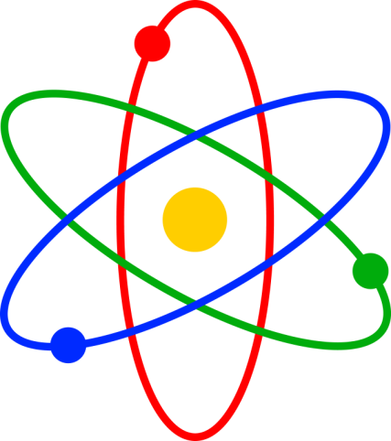
Atoms have a high energy density!
Nuclear energy really packs a punch compared to other forms of energy.

Slide 9
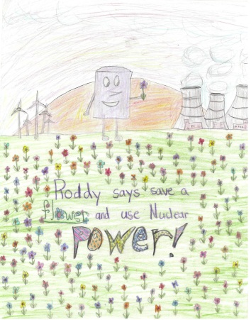
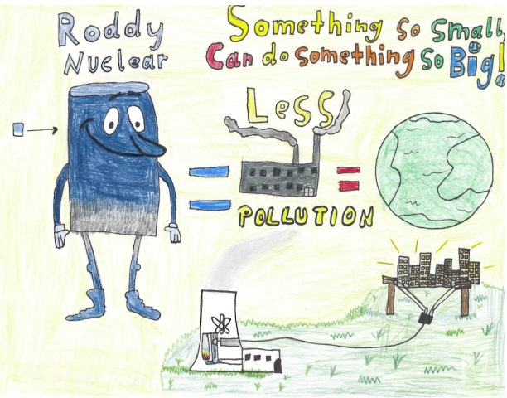
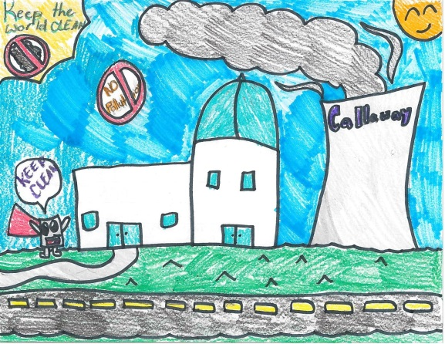
2015 Drawing Contest
Theme: Nuclear Energy Packs a Punch
8 ½ x 11” sheet of paper
On the BACK of the drawing, write:
  Your name
  Your age & grade
  T shirt size
  Your school & teacher’s name
Drawings due 11/6/15

Slide 10


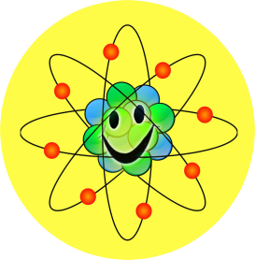

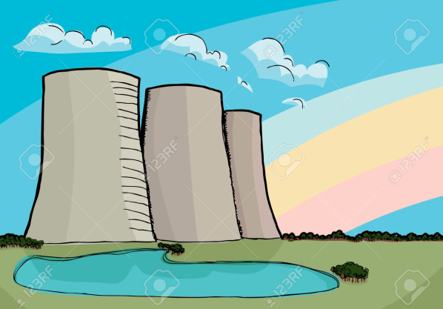
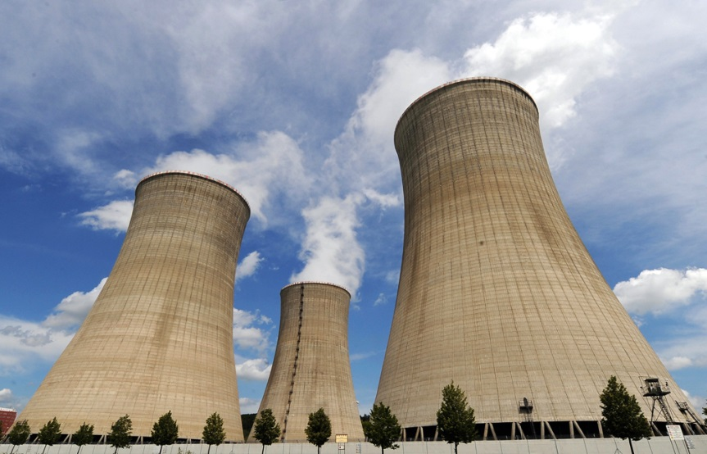
Nuclear Energy Packs a Punch
  On back:
  Name
  Age & Grade
  T-shirt size
  School & Teacher

Slide 11
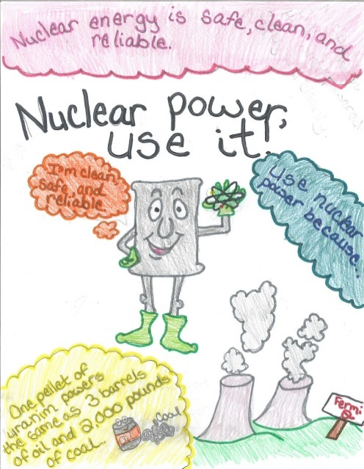
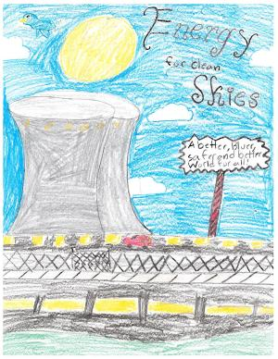
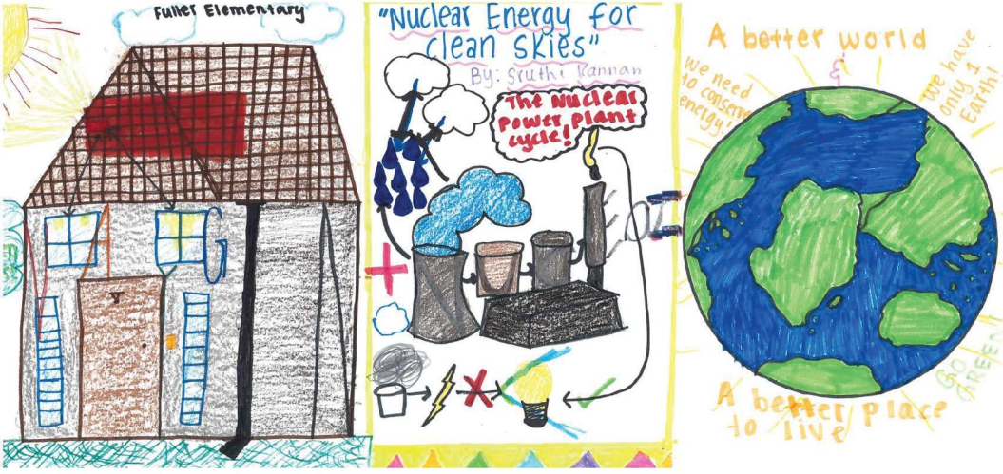
Questions?

Slide 12
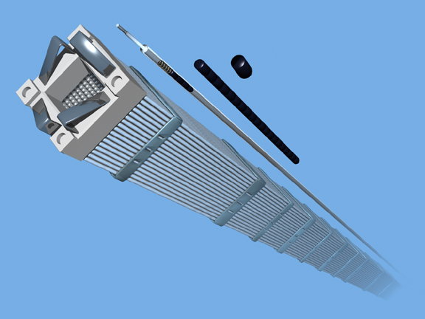
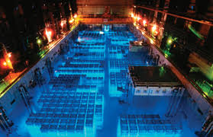
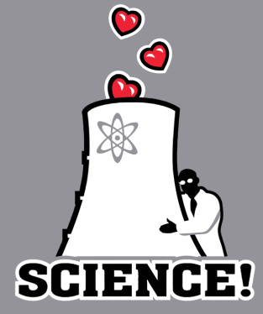
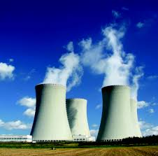
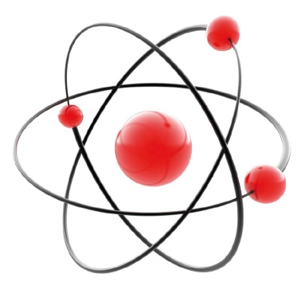

Ideas for Drawings

Slide 13
Optional Slides

Slide 14
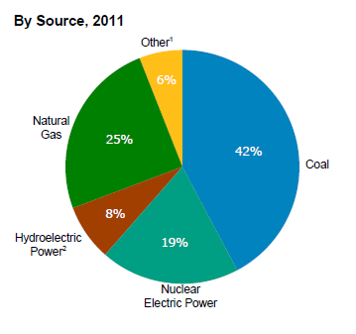
How else can electricity be made?
[1] Wind, petroleum, wood, geothermal, solar, etc.
[2] Conventional hydroelectric power and pumped storage
US Energy Information Administration Annual Energy Review 2011

Slide 15
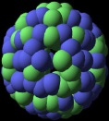


How does a nuclear power plant work?
Steam
Generator
Steam produced
Turbine
Heat
Electricity

