Slide 1
Introduce Yourself Here Name, Company RADiation is RAD!

Slide 2
What do you use electricity for?
Notes:
Let students give examples. (xbox, tv, cooking, driving a car, etc.)
Do we all agree that electricity is an important part of our everyday lives?

Slide 3
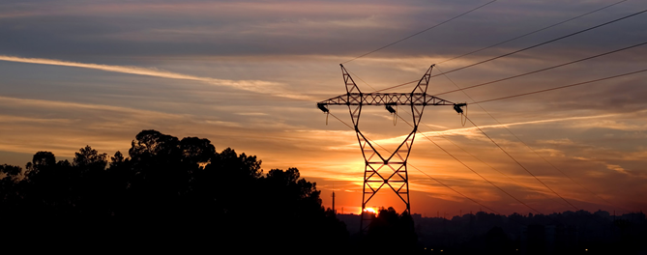
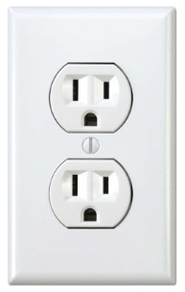
What is nuclear energy production?
Using atoms to make electricity
Notes:
Since electricity is such an important part of our everyday lives the companies that make electricity are pretty important.
What do you think nuclear energy is? Let a few students answer, you will likely hear “atomic bomb”. If you do, be sure to dispel the correlation between nuclear bombs and nuclear energy production. We are not the same thing.
(enter) Nuclear energy production harnesses the energy of atoms to make carbon free electricity 24 hours a day, 7 days a week, 365 days a year regardless of the weather. So, what is an atom?

Slide 4
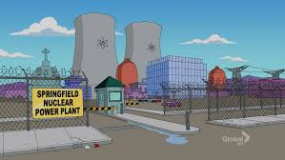
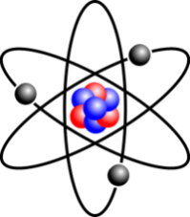
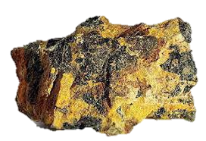
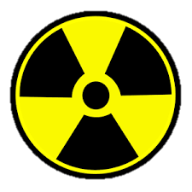
What is an atom?
Atoms are extremely small and are the building block of everything around you!
Nuclear power plants use the radioactive atom Uranium
Notes:
(enter) Atoms are extremely small and are at the center of everything around you. The sun, the stars, the air, the grass and birds. Even you are made of atoms. (enter)
Nuclear Power Plants use a radioactive atom called Uranium in a process called Fission to make electricity. Uranium is a rock that is mined and processed into fuel pellets that are used to fuel nuclear reactors.

Slide 5
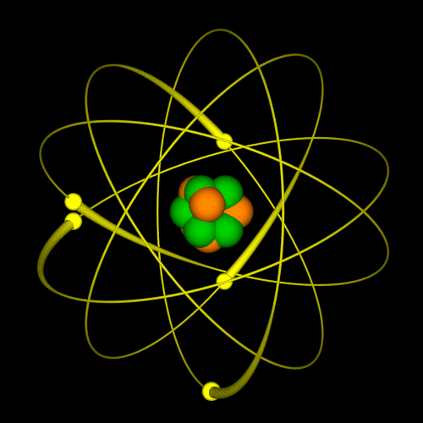
Atoms have a lot of energy
=
Notes:
We use the energy from atoms to create heat in a process called Fission.

Slide 6
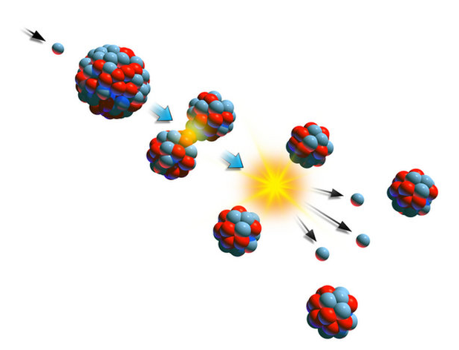
What is Fission?
Neutron
Uranium 235 Atom
Heat
Neutrons
Notes:
Fission is when a neutron (enter) smashes into an atom (enter) making it unstable causing it to split. When it splits it releases enormous amounts of energy in the form of heat (enter) and it releases more neutrons (enter).
Lets look at this a little closer.

Slide 7
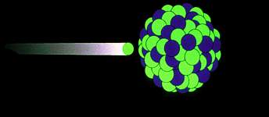
Neutron
Uranium 235 Atom
Before
Notes:
Here you see a neutron smashing into a Uranium 235 atom.

Slide 8
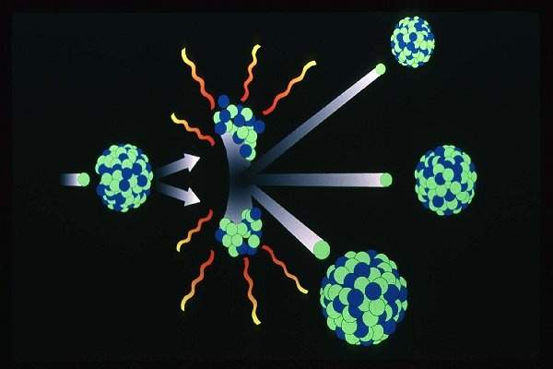
Uranium 235 Atom
Heat
Heat
Neutron
Neutron
Neutron
Uranium 235 Atom
Uranium 235 Atom
Neutron
Heat
Heat
Uranium 235 Atom
After
Notes:
When the Uranium atom is hit by the neutron it splits releasing energy in the form of heat(enter) it also releases more neutrons (enter). Those crazy neutrons are then free to smash into other atoms (enter) causing a nuclear chain reaction.
Nuclear power plants capture the heat released every time an atom splits and use it to turn water into steam. Lets take a look at what a chain reaction looks like.

Slide 9
Nuclear Chain Reaction Demonstration
Notes:
Every time a mousetrap goes off it signifies an atom being split which releases what two things? Energy in the form of heat and more neutrons.
We harness the heat being released to make hot water which makes to steam and turns our turbine.

Slide 10
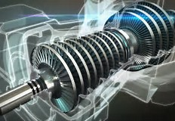
Turbines
Transforms rotational energy into usable energy.
Blades attached to a shaft capture rotational energy and use it to turn to an electric generator.
Turned by Steam
Nuclear Power Plants
Coal Power Plants
Natural Gas Plants
Turned by Water
Hydro Electric Dams (Hoover Dam)
Turned by Wind
Windmill
Pinwheels
Notes:
The nuclear chain reaction (like the one you just saw) heats water which we use to make steam. The steam is used to turn a turbine.
(enter).Turbines transform rotational energy into usable energy. Blades attached to a shaft capture rotational energy which is used to turn an electric generator.
Turbines can be turned by steam (enter), by water (enter), or by wind. Nuclear power plants turn their turbine with steam.

Slide 11
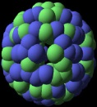
Basic Nuclear Power Plant
Steam
Generator
Steam produced
Turbine
Electricity
Heat
Fission
Notes:
So far we’ve talked about fission, a nuclear chain reaction, and turbines. So I bet you’re wondering how this all works together to make electricity?
Nuclear power plants use fission (enter) to create heat which is used to make hot water which turns to steam (enter). The steam produced is used to turn a turbine (enter), like the one you just saw, which is attached to a generator (enter) that spins to make electricity!
The fission process, at nuclear power plant, uses radioactive atoms that can emit radiation. So what is radiation?

Slide 12
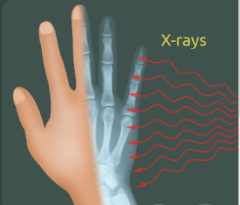
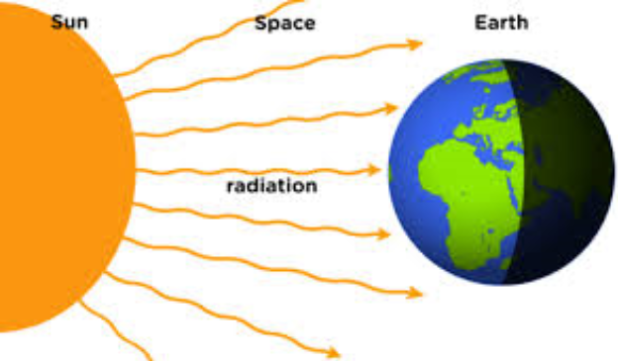
What is Radiation?
Energy traveling in waves
Notes:
(enter) Radiation is energy that moves from one place to another.
(enter) Light, sound, heat, and X-rays are examples of radiation.
Sometimes you can feel radiation like when you feel heat from the sun. Other times, you can’t sense radiation but it can be measured with detectors.
Not to worry, radiation isn’t something caused by nuclear power. In fact it’s been around since the beginning of time and it’s everywhere!

Slide 13
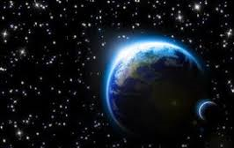
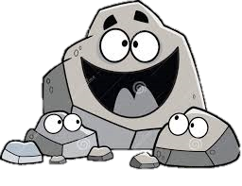
We live in a radioactive world!
Radiation is all around us!
Background Radiation is the radiation in our environment from both natural and man-made sources.
Natural radiation sources include:
Cosmic: Sun & Stars
Terrestrial: Soil, Rocks, Radon, Water
Internal: Exists in all living things.
You have radiation in you!
Notes:
We live in a radioactive world – humans always have! (enter)
Radiation is all around us. It’s part of the earth, the atmosphere, and all living things. The radiation we get exposed to everyday comes from natural and man-made sources. (enter)
This radiation is called Background Radiation. (enter)
Natural sources of radiation come from:
(enter) outer space (Cosmic),
(enter) from materials in the earth itself (Terrestrial) like naturally occurring radon in the air,
and (enter) from inside our own bodies (Internal).
(enter) You even have radiation inside you!
Lets look at some common items that contain Natural radiation!

Slide 14
Some radiation occurs in food!
Notes:
How many people ate a banana today? (enter) Bananas contain potassium which is radioactive! You would have to eat 10 Million bananas all at once to get radiation poisoning.
(enter) Red meat
(enter) Carrots
(enter) Drinking water contains trace amounts of Radon and other radioactive particles.
(enter) Who here loves potatoes? I know I do. Potatoes are also radioactive. If you eat one medium size potato every day for a year you will receive about 4 millirem of radiation.
These are just a few examples of natural radiation. Lets take a look at examples of man-made radiation.

Slide 15
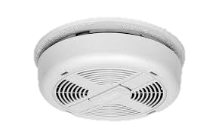
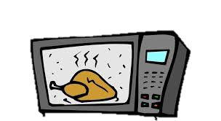
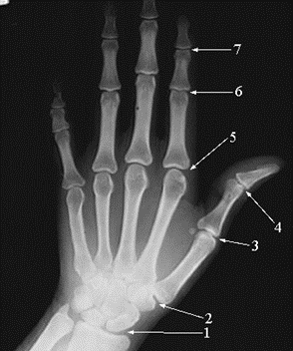
Some radiation is man-made
Notes:
(enter) Smoke detectors have Americium which is a radioactive element.
(enter) Cell phones and (enter) Microwaves give off radiation too.
(enter) How many people have had an x-ray before? X-rays are radioactive as well.
Remember radiation is energy moving from one place to another traveling in waves or fast particles. You can’t see it but it’s all around us!

Slide 16
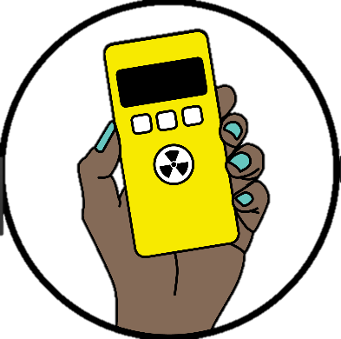
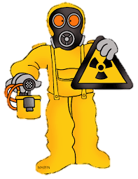
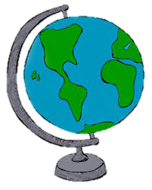
Radiation Exposure Q&A
Q. How is radiation measured?
Q. What can impact a persons exposure to radiation?
A. Radiation is measured in millirems (mrems) with special equipment
Where they live,
Medical procedures (xrays),
The food they eat
Travel
Q. How much radiation does the average American receive yearly?
A. 620 millirem
Notes:
Read Question. (enter) Read Answer (enter)- Dosimeters are one example of the special equipment used to detect radiation.
(enter) Read Question. (enter) Read Answer – Where you live can impact your exposure. People who live in higher elevations (closer to the sun) typically receive more radiation than people who live in lower elevations. Also impacting your radiation exposure are the number of medical procedures you receive, your travel habits, and the food you eat among other things.
(enter) Read Question (enter) Read Answer - The average American receives 360 millirem of background radiation and about 260 millirem from man-made sources like x-rays and medical treatments.
Lets calculate your estimated annual radiation dose!

Slide 17
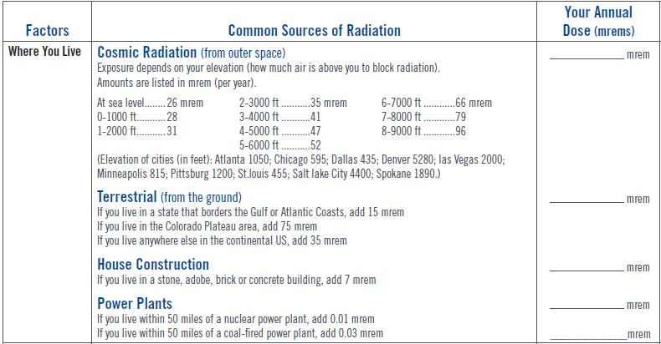
Personal Annual Radiation Dose
Notes:
Presenter – Distribute the Radiation is Rad – Dose Calculation Worksheet and explain that we will be walking through the worksheet as a group but each student should fill in the numbers that apply to them.
Pre-determine which elevation you’re at and have this ready for the students. Go through each section as a group and answer any questions the students might have.

Slide 18
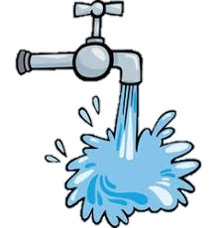
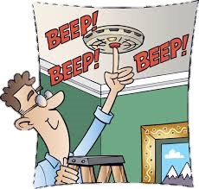
Personal Annual Radiation Dose
Notes:
Radioactive Foods: You can give some examples if you want. Bananas (10Million Bananas eaten at once to get radiation poisoning), Potatoes (4 mrem/year), Meat & Fish (4.9 mrem/year), Brazil Nuts, Drinking Water (.244 mrem/year)
Jet Plane Travel - Have students determine how many airplane trips they take in a year. Assume 3 hours for each trip.

Slide 19
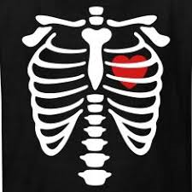
Personal Annual Radiation Dose
Notes:
Once finished with the calculations have the students share their annual radiation dose. Highlight how they’re all different.
Even though we all receive radiation in our everyday lives, nuclear workers can be exposed to more than that. Lets talk about how nuclear workers protect themselves.

Slide 20
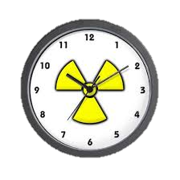
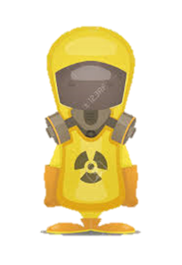
Radiation Protection
TIME
DISTANCE
SHIELDING
Less time spent near source = less radiation received
Greater distance from the source = less radiation received
Use protective shielding = less radiation received
Time Examples:
Limit the time you’re near the radiation source to only the time required to perform job.
Distance Examples:
Low dose waiting areas not near the radiation source.
Shield Examples:
Lead, concrete, water
Notes:
How do we protect nuclear workers from radiation exposure? Time (enter)
(Enter) The less time you spend near an item giving off radiation the less radiation you receive. (enter). Workers limit the amount of time in radiation areas to lessen the amount of radiation they are exposed to. Think of it like a fire, the more time you spend next to the fire the hotter you get. The heat is radiation. (enter)
Another method is (enter) Distance – (enter) The farther you are from the source of radiation the less radiation you receive.
(enter) Workers will wait in low dose waiting areas instead of right next to the source of radiation when they aren’t performing work to limit their radiation exposure. Think of it like a fire, the closer you are the fire the hotter you feel. Move away and the heat lessens.
The last method is (enter) Shielding – (enter) Workers use protective shielding to receive less radiation. (enter) Lead (like the apron they put on you when getting an xray), concrete, and water are common sources of shielding. Think of it like a fire, if you put a wall between you and the fire it protects you from the heat.
You can use these methods to protect yourself at home as well. We will now do an activity to demonstrate these concepts. (enter)

Slide 21
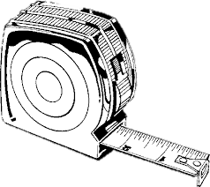
RP Activity
If you were going to the beach, how would you keep yourself from getting radiation from the sun (aka sunburn)?
DISTANCE
TIME
SHIELDING
Notes:
Have students give examples and then cover specific examples below.
(enter) Time – Less time at the beach. Go for two hours instead of three.
(enter) Distance – Go to a beach in a lower elevation.
(enter) Shielding – Use Sunscreen, put on a hat, wear a t-shirt, use an umbrella
Nice work everyone! Now that we all have a better understanding of nuclear energy production and radiation. Lets see what we learned!

Slide 22
What did we learn?
Nuclear Power Plants make electricity using F______.
Fission is when a neutron smashes into an a___ causing it to split releasing h___ and more neutrons. This creates a c____ r_______.
Nuclear Power Plants use the radioactive atom U______
Electricity is made when the steam created by fission turns a t______ which is attached to an electric g________.
Effects from the fission process r________.
Radiation is e_____ traveling in waves. (like heat waves or xrays)
Radiation that occurs naturally and is all around us is called b________ r________.
Radiation sources include: C_____ (sun & stars), T_________ (earth/ground), and I_______ (in all living things).
Radiation is measured in m_______ (mrems) using a d________.
The average America receives 6__ mrems of radiation exposure per year. (300 mrems from background radiation)
Nuclear Workers use t___, d_______, and s________ to protect themselves from radiation.
ission
tom
eat
hain
eaction
ranium
urbine
enerator
adiation
nergy
ackground
adiation
osmic
erresterial
nternal
illirems
osimeter
20
ime
istance
hielding
Notes:
Fission
Atom, heat, chain reaction
Uranium
Turbine, generator
Radiation
Energy
Background radiation
Cosmic, terrestrial, internal
Millirem, dosimeter
620
Medium, high
Time, shielding

Slide 23
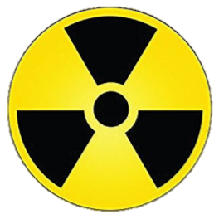
RADiation is
totally RAD
It’s all around you and me!

Slide 24
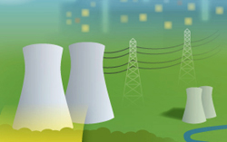
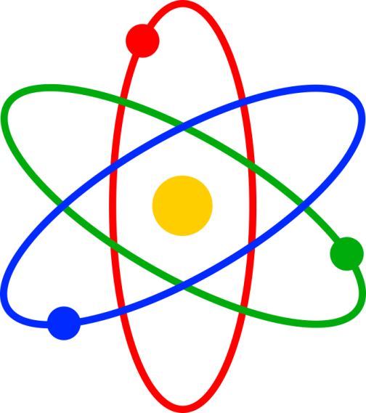
Nuclear Energy is RAD!

Slide 25
2017 Drawing Contest
Theme: RADiation is RAD!
8 ½ x 11” sheet of paper
Draw what you think makes RADiation RAD!
On the BACK of the drawing, write:
Your name
Your age & grade
T shirt size
Your school & teacher’s name
Drawings due 3/8/18

Slide 26
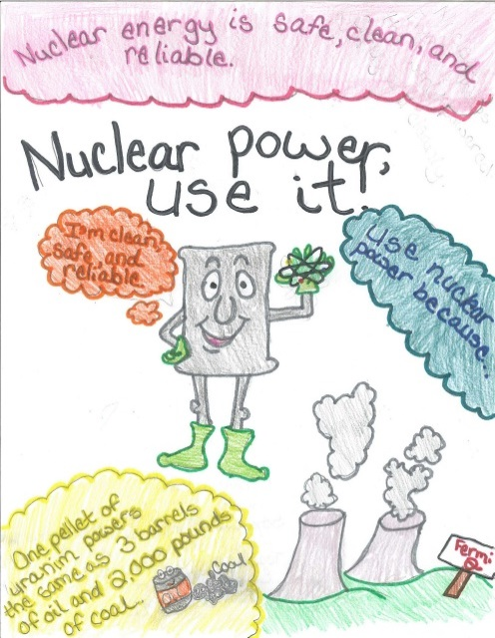
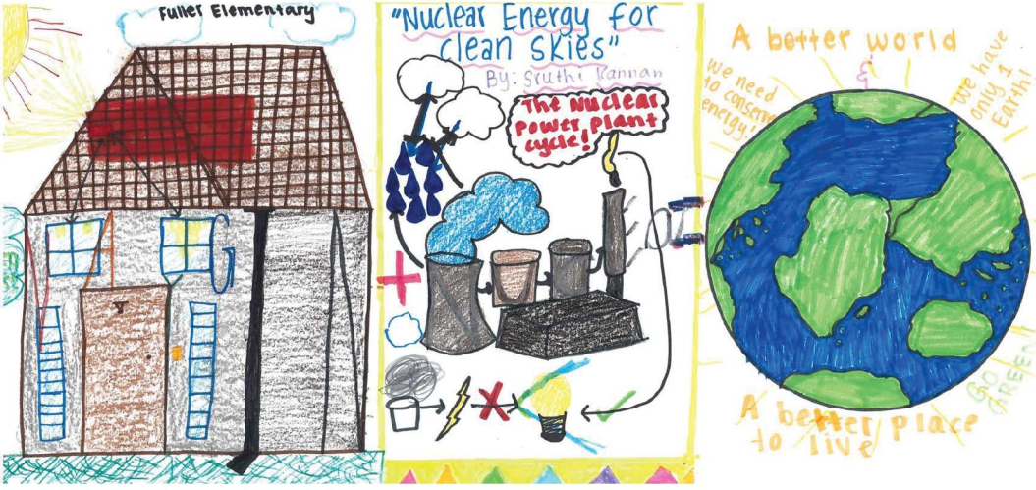
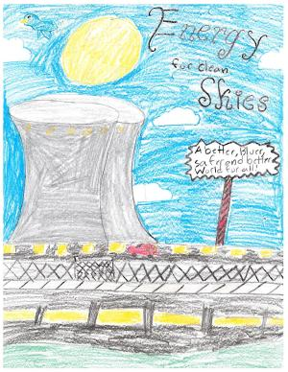
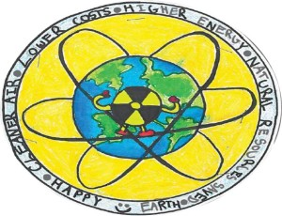
Questions?

Slide 27
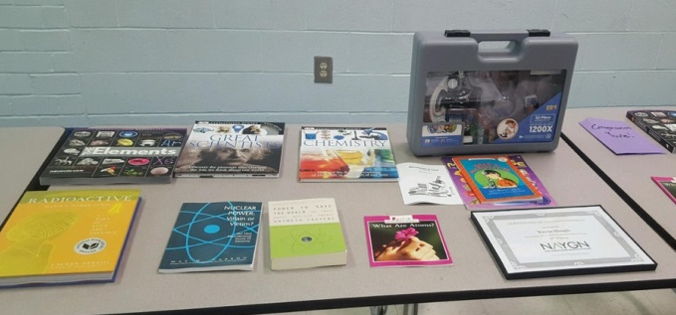
Prizes!

