Slide 1
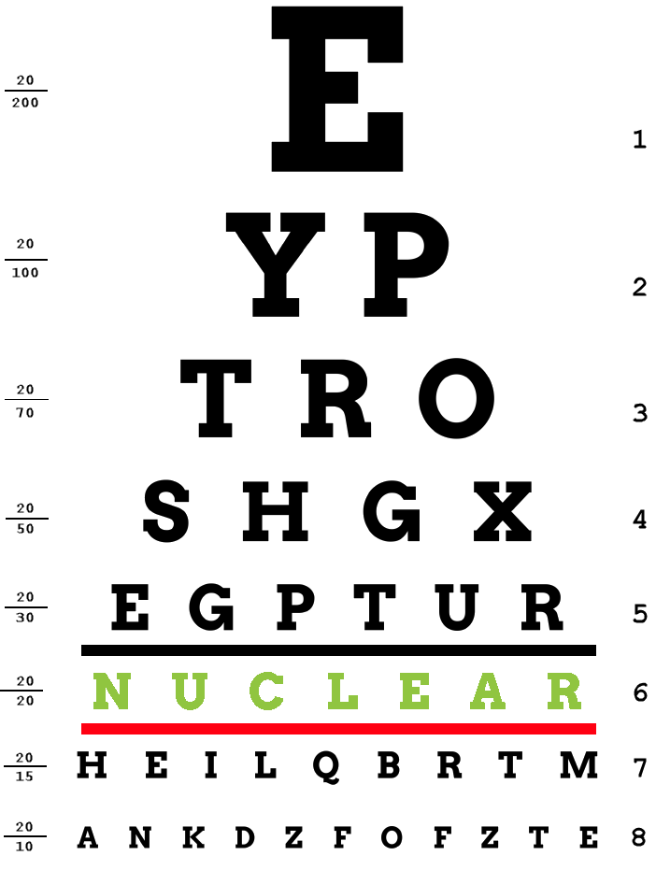

2020 Fission: Bringing Nuclear Energy Into Focus
Your Name
Your Company
Notes:
NOTE: The speaker notes are for guidance and are not intended as a script. Additional information is included so the speaker can elaborate as they desire.
NOTE: [CLICK] in the speaker notes means that clicking the mouse will cause material to appear on the screen that goes with the note.
Good afternoon. Thank you so much for having me. My name is ___.
I’m here on behalf of the North American Young Generation in Nuclear. We are an organization of people interested in nuclear technology.
A little bit of your personal background is encouraged. Be warned that kids at this age tend to jump into questions about salary. Be prepared.
Today, we are going to talk about how nuclear energy can help with environmental and societal needs of the future.

Slide 2





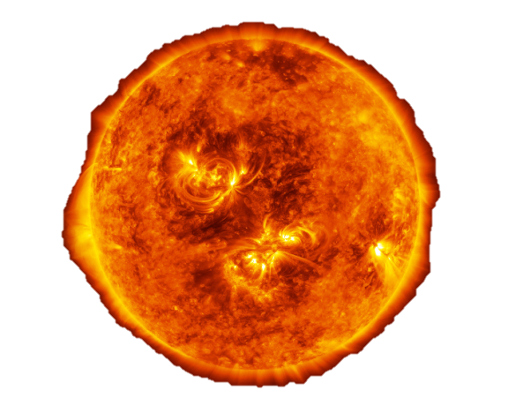
What is Energy?
Energy is the ability to do work. It is the capacity or ability to cause a physical change.
Notes:
Before we get into the real topic, we need to discuss some basics. First, what is energy?
Ask open-ended questions if time permits. The focus is on electrical and thermal energy later in the presentation.
[CLICK] Chemical: When you eat an apple, it converts the chemical energy stored in the apple to allow you to run and jump.
[CLICK] Mechanical: Motion (Could discuss potential/kinetic energy of a roller coaster)
[CLICK] Light: Nature’s way of transferring energy through space. Energy is moved at an extremely rapid rate. This includes parts of the electromagnetic spectrum that we can’t see…such as radio waves, x-rays, microwaves, and UV. Energy from the sun travels 93 million miles to Earth as light and UV waves.
[CLICK] Thermal: explain this with rubbing hands together and the heat from friction that occurs.
[CLICK] Sound: can explain this with clapping your hands
[CLICK] Electrical: The motion of electrons causes motors to spin, lights to turn on, etc.

Slide 3
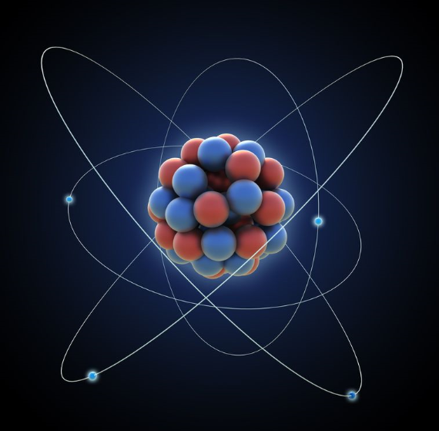
What is an Atom?
Neutron
Proton
An atom is the smallest unit of matter.
Electron
Notes:
Atoms are the basic building blocks of everything we see around us. The chair you sit in is made up of atoms, the air you breath is made up of atoms, and even YOU are made up of atoms.
Atoms are extremely small! If you had a powerful microscope you would see on the atomic level, that atoms are made up of a nucleus of protons and neutrons, surrounded by electrons.
How many atoms are in a small grain of salt? Approximately 1.2x10^18! That’s one billion-billion atoms! Or a million-trillion!
This is the basis for ALL matter!
The secret to an atom is that it contains a tremendous amount of energy!
BONUS DISCUSSION: What are protons, neutrons, and electrons? Elementary particles! Compare electrical attraction to poles on a magnet. Strong forces are needed to keep all of those positive charges together in the nucleus.
What happens if we try to break an atom down? What if we divide a proton or neutron? Quarks! (This level of detail isn’t necessary to present, but be ready to answer the question)

Slide 4
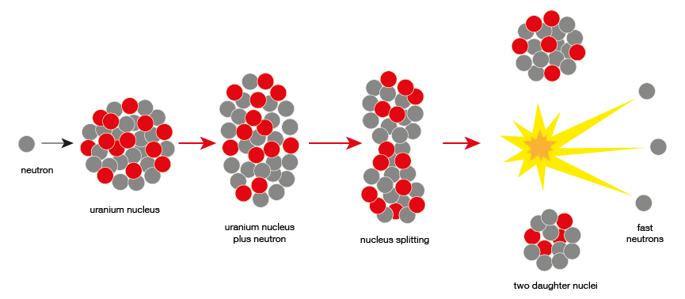
What is Nuclear Energy?
When you split an atom in half (Fission), or force two atoms together (Fusion), you can release an enormous amount of energy!
ENERGY!
Notes:
Talk through the diagram explaining how nuclear fission works.
Make mention that we call these events “nuclear reactions” because that is a term that will see again later in the presentation.
Emphasize that there is energy created in this process.

Slide 5
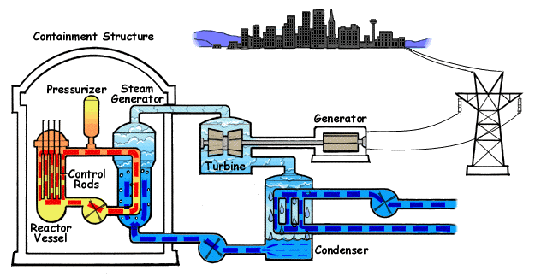
What can we do with Nuclear Energy?
If we can capture the energy created from multiple nuclear reactions, we can use it to create electricity!
Notes:
In a nuclear power plant, we harness the energy created from fission in a nuclear reactor.
Inside a nuclear reactor, there are BILLIONS of nuclear reactions occurring every second! All that energy is harnessed inside the nuclear power plant and is converted to electricity.
That electricity then travels through the power lines to your school, your house, your parent’s work, the grocery store, and everywhere else you go to provide electricity!
So a nuclear power plant essentially just converts Nuclear Energy into Electrical Energy or ELECTRICITY!

Slide 6



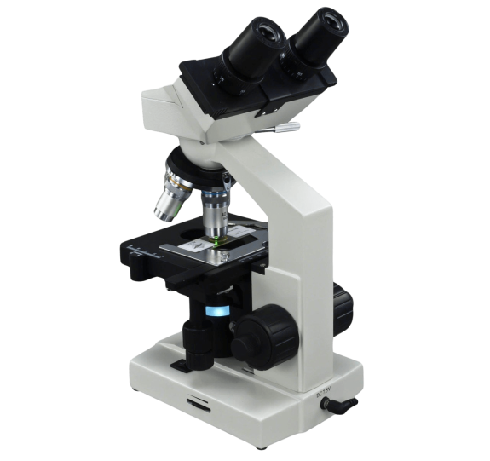



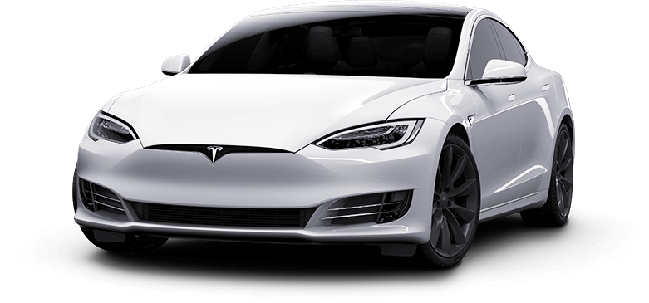
What do you use electricity for?
Notes:
Lead in: Almost every man-made instrument or machine uses electricity as the power source. Let students give examples.
You might use electricity to…
[CLICK] Learn biology.
[CLICK] Drive a car.
[CLICK] Control the air conditioner.
[CLICK] Watch TV.
[CLICK] Keep your food cold.
[CLICK] Talk to your mom.
[CLICK] Use a computer.
[CLICK] Light your room at night.
QUESTION: Why might you not be able to “plug into” a power source?

Slide 7

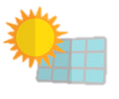



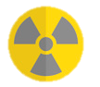

Where Are Other Places Electricity Comes From?
Coal Power Plants
Natural Gas Power Plants
Hydroelectric Power Plants
Wind Farms
Solar Farms
Biomass Power Plants
NUCLEAR POWER PLANTS!
Notes:
So we already talked about how nuclear power plants produce electricity. Where else might electricity come from? Let the students give examples.
Electricity is also made at…
[CLICK] Coal plants by burning coal.
[CLICK] Natural gas plants by burning gas.
[CLICK] Hydroelectric plants by using water to turn large motors.
[CLICK] Wind farms by using wind to turn large motors.
[CLICK] Solar farms by converting sunlight into electricity.
[CLICK] Biomass plants by burning organic matter such as wood or manure.
[CLICK] AND NUCLEAR POWER PLANTS!

Slide 8
Let’s talk about energy for 2020 and beyond!
What do you think some of the challenges we will face are?

Slide 9

Challenge :
1
Meeting the Energy Needs of the Future
Our world is becoming more and more reliant on electricity.
As we become more dependent on electricity, it creates bigger problems when electricity isn’t available.
Notes:
CHALLENGE NUMBER 1
Our society is becoming more and more reliant on electricity. Think of all the things we named just a second ago that use electricity. We use electricity for everything!
Ask the students what the worst things they could think of losing power would be?
Imagine if we didn’t have reliable electricity and the hospital lost electricity? Or the airport?
We could lose power to cell phone towers and not be able to call anyone. Banks could lose power and prevent anyone from having access to their money.

Slide 10
Challenge :
1
Meeting the Energy Needs of the Future
NUCLEAR power plants are more reliable than ANY OTHER form of electricity generation!
Notes:
Nuclear Power Plants are the most reliable form of electricity generation we have.
All power plants have a maximum amount of energy that they can produce. Nuclear power plants on average produce 92% of their maximum amount of energy a year. That is significantly more than any other form of electricity generation:
Natural Gas: ~55%
Coal: ~53%
Hydropower: ~38%
Wind: ~34%
Solar: ~25%
NOTE: The chart is showing capacity factor, but we’ll present it as reliability as this might be easier for the 4th and 5th grade level
Data from energy.org: https://www.energy.gov/ne/articles/what-generation-capacity

Slide 11



Challenge :
1
Meeting the Energy Needs of the Future
Coal and natural gas plants need more maintenance than nuclear power plants (which means less time they can produce electricity)
Solar farms need the sun to make electricity
Wind farms need the wind to make electricity
Hydro plants need water to make electricity
Notes:
QUESTION to the students: Why do you think other forms of electricity generation aren’t as reliable?
[CLICK] Coal and natural gas plants are more prone to needing to stop making power in order to have things that break be fixed.
[CLICK] Solar farms need the sun to make electricity and the sun doesn’t shine at night.
[CLICK] Wind farms need the wind to make electricity and the wind doesn’t always blow.
[CLICK] Hydro plants need water to move through the plant, so if it hasn’t rained in a while and lake and river levels are low, then they can’t produce electricity.

Slide 12

Challenge :
1
Meeting the Energy Needs of the Future
NUCLEAR power plants are reliable and can produce power whether its sunny or dark, whether the wind is blowing or not, and whether it’s been rainy or dry!
Notes:
Nuclear power plants are so reliable because they don’t require the amount of maintenance that coal and natural gas plants do. They don’t require the sun to shine, the wind to blow, or rain to fall.

Slide 13

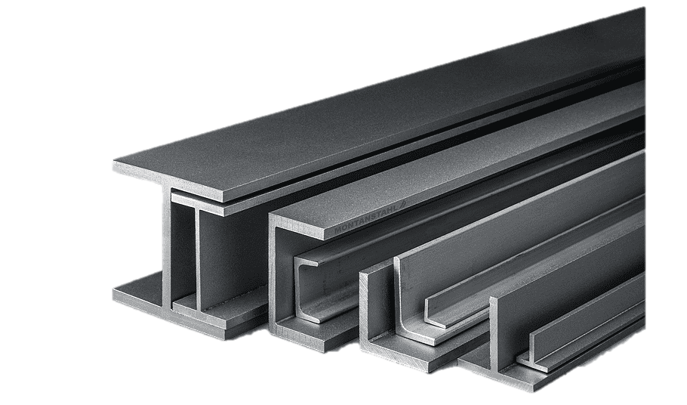

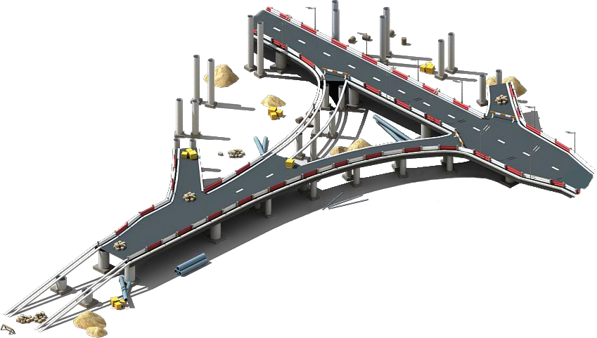

Challenge :
1
Meeting the Energy Needs of the Future
The world is expected to use nearly 50% more energy by 2040!
Notes:
As time goes on, our world is requiring more and more electricity. Population increases result in more people in the world, therefore more electricity needed. As other countries and rural areas become more modernized, they begin using more electricity. As technology advances, we begin using more things that require more electricity.
These things result in…
[CLICK] More houses being built
[CLICK] More steel being made for construction and infrastructure developments
[CLICK] More people driving electric cars
[CLICK] More people using cell phones
[CLICK] Higher demand for air conditioning
[CLICK] More roads being developed
With more people in the world, and more technology being used, we need more electricity. We call this “demand.”
We must be able to produce enough electricity to meet this demand.
Data from EIA: https://www.eia.gov/todayinenergy/detail.php?id=26212

Slide 14
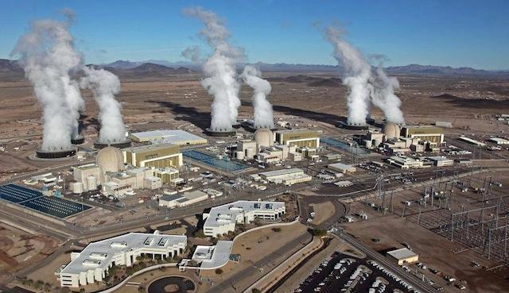
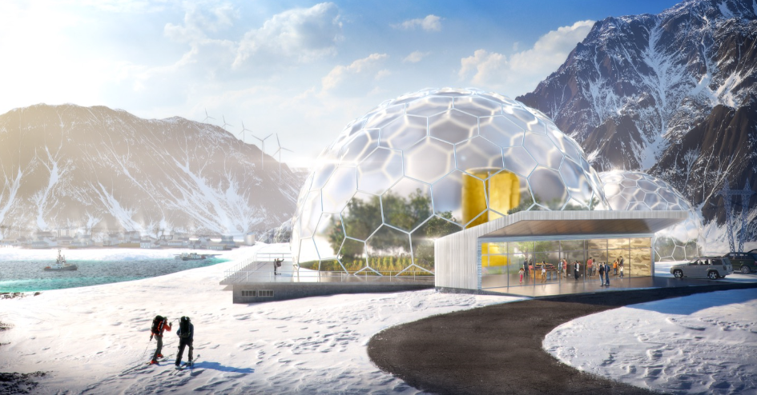
Challenge :
1
Meeting the Energy Needs of the Future
Large NUCLEAR plants can provide very reliable electricity for power hungry cities.
Small Module Reactors (SMRs) are mini NUCLEAR power plants that can provide electricity for areas more difficult to deliver power to.
Notes:
Nuclear power plants have the capability to meet society’s power demands, no mater where they are!
Large scale nuclear power plants produce enough electricity to power MILLIONS of homes. The largest nuclear power plant in the United States (Palo Verde) can provide power for about 4 million people.
Make a comparison to your local area of about how many people this is.
One type of modern nuclear technology are called Small Modular Reactors. SMRs are basically mini nuclear power plants that can be quickly built and installed just about anywhere. They produce a much smaller amount of electricity compared to the large power plants. This is a strength of the SMR because it means they can be used to provide power to remote locations that it has traditionally been difficult to provide power for from the grid. Make a comparison to a remote location that students in your area might understand.
SMRs can be used to meet the electricity demand of remote locations and smaller villages that it has traditionally been very hard to provide electricity for.
But SMRs are extremely scalable, meaning if you wanted to produce a lot of power for a city using SMRs, you can still do that too by just installing multiple SMRs at the same site.
By using nuclear power plants, we can meet the electricity demand of the future in a reliable way!

Slide 15
As we make more electricity, we want to do it with as little impact on the environment as possible.

Slide 16
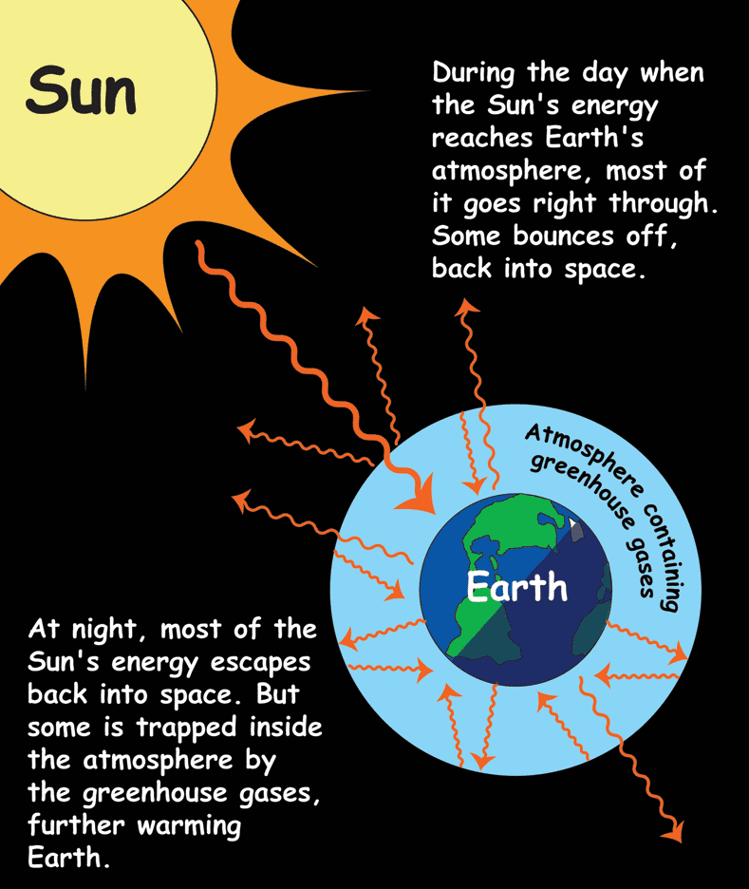
Challenge :
2
Protect the Environment: Reduce GHG Emissions
Greenhouse gases (GHG) can build up in our atmosphere, trapping heat and making the planet warmer.
Notes:
CHALLENGE NUMBER 2
Ask the students if they know what the greenhouse gas effect is and ask them to explain it.
Greenhouse gases can build up in the Earth’s atmosphere. When they build up too much, they can result in the Earth getting warmer.
Buzzwords to consider using to help make this relatable to what they might have heard before:
Carbon Dioxide or CO2
Global Warming
Greenhouse Effect
Climate Change
Carbon Free

Slide 17
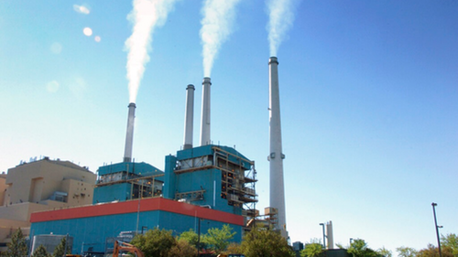
Challenge :
2
Protect the Environment: Reduce GHG Emissions
What creates GHG emissions?
Notes:
There are all sorts of things that produce greenhouse gases. The most common greenhouse gas is carbon dioxide. Other types of greenhouse gases include methane, nitrous oxide, and water vapor.
The following are the top industries creating greenhouse gases in the United States:
Transportation – from the exhaust of cars, planes, buses, trains, etc.
Electricity Production – mostly from the burning of fossil fuels such as coal and natural gas
You might want to dwell on this one for a minute and go into a little more detail about what fossil fuels are and why burning them creates GHGs since we’ll focus on the electricity production sector on the next slide
Industry – mostly from the burning of fossil fuels the manufacturing of parts and materials
Commercial and Residential – mostly from the burning of fossil fuels for heating
Agriculture – from the burning of organic matter and from off-gassing of decomposing matter (manure, etc.)
Data from EPA Inventory of U.S. Greenhouse Gas Emissions and Sinks annual report, 2017 values: https://www.epa.gov/ghgemissions/sources-greenhouse-gas-emissions

Slide 18
Challenge :
2
Protect the Environment: Reduce GHG Emissions
Nearly all the GHG emissions from Electricity Production can be stopped by using technology that doesn’t produce GHGs.
NUCLEAR is a technology that doesn’t produce GHGs!
Notes:
Electricity Production is a large contributor (28%) to greenhouse gas emissions. Nearly 100% of the GHG emissions produced from Electricity Production can be stopped by using technology that doesn’t produce greenhouse gases such as wind, solar, hydro, and NUCLEAR!

Slide 19

Challenge :
2
Protect the Environment: Reduce GHG Emissions
Just like wind, solar, and hydro power production, NUCLEAR power plants produce ZERO greenhouse gases when generating electricity!

Slide 20








Challenge :
3
Protect the Environment: Natural Resources
Why is it good to recycle?
Notes:
CHALLENGE NUMBER 3
Ask the students why it is good to recycle?
[CLICK] It is good to recycle because it reduces the amount of natural resources that we must consume. For example, by recycling paper, it reduces the amount of trees that must be cut down to make new paper.
It is good to recycle because it saves the environment. By reducing the amount of natural resources we consume, we save the
[CLICK] Plants
[CLICK] Animals
[CLICK] Recycling preserves the environment so that future generations can appreciate it as well.
[CLICK] Recycling is good for the whole world. In general, we want to recycle in order to reduce the amount of natural resources we are consuming.

Slide 21

Challenge :
3
Protect the Environment: Natural Resources
Coal has 50% more energy than wood
Gasoline has 187% more energy than wood
Natural Gas has 244% more energy than wood
NUCLEAR fuel has 24,374,900% more energy than wood!
NUCLEAR fuel has WAY more energy than any other type of fuel!
Notes:
A way we can reduce the amount of natural resources we’re consuming in the energy industry is by using more fuels that contain more energy.
[CLICK] Think about a campfire. Remember when we talked about different forms of energy earlier? A fire is just a form of releasing stored energy. When the wood burns, it gives off that stored energy in the form of heat.
Has everyone been around a campfire before? You know how hot it can get right? It can get pretty hot, and sometimes, burning wood is even used to make electricity. But let's compare the amount of energy that is contained in wood with some other more common fuels used to produce electricity.
[CLICK] An equivalent weight of coal can produce 50% more energy than wood
[CLICK] An equivalent weight of gasoline in equal weight to wood can produce 187% more energy than wood
[CLICK] An equivalent weight of natural gas can produce 244% more energy than wood
At this point, ask the students to guess how much more energy they think is in nuclear fuel than wood.
[CLICK] An equivalent weight of nuclear fuel can produce more than 24 million percent more energy than wood
[CLICK] Nuclear fuel has WAY more energy than any other fuel type.
Data from University of Calgary: https://energyeducation.ca/encyclopedia/Energy_density

Slide 22
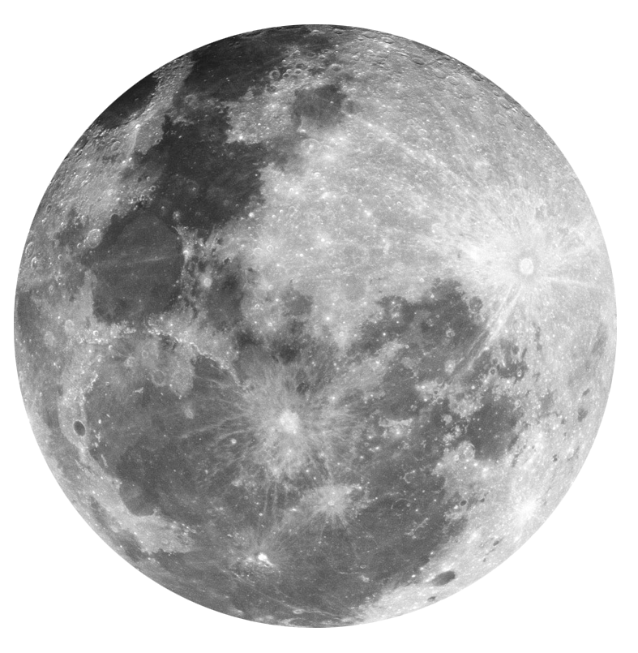

Challenge :
3
Protect the Environment: Natural Resources
Another way to look at it:
With 1 gallon (3.8L) of gasoline, the average car can drive 25 miles (40km).
With the same weight of gas in NUCLEAR fuel, the same car could drive 2,212,500 miles (3.56M km)!
That’s like driving to the moon and back…
9 times!
Notes:
Here’s another way to think about the amount of energy in nuclear fuel.
Ask the students if anyone knows how far the average car can drive on 1 gallon of gasoline.
[CLICK] The average car can drive about 25 miles on 1 gallon of gasoline.
Now ask the students if they can guess how far the average car could drive if it could run on the same amount, in weight, of nuclear fuel.
[CLICK] With the same weight of 1 gallon of gas in nuclear fuel, the same card could drive 2.2 million miles!
[CLICK] That’s like driving to the moon and back…9 TIMES!
Data from University of Calgary: https://energyeducation.ca/encyclopedia/Energy_density

Slide 23
Challenge :
3
Protect the Environment: Natural Resources
There is a LOT of energy in NUCLEAR fuel. Which means we can use a LOT less natural resources to produce energy than other forms of fuel.
BUT WAIT!!!
THERE’S MORE!
Notes:
There is a LOT of energy in NUCLEAR fuel. Which means we can use a LOT less natural resources to produce energy than other forms of fuel.
[CLICK] But wait. There’s More!

Slide 24
Challenge :
3
Protect the Environment: Natural Resources
Nuclear fuel can be recycled!

Slide 25

Challenge :
3
Protect the Environment: Natural Resources
When nuclear fuel is “used up” in most nuclear reactors, there is about 90% of it’s energy left!
Notes:
When you burn wood, or coal, or natural gas, there is no energy left once it’s burnt.
But when we use nuclear fuel in most nuclear reactors, we don’t use up all the energy that it has available. There is about 90% of the energy remaining in the fuel!
With the right technology, we can recycle the used nuclear fuel in order to reuse it again and get even more energy out of it!
This is just like recycling paper or plastics: we are reusing what we’ve already made in order to avoid having to consume more natural resources.

Slide 26
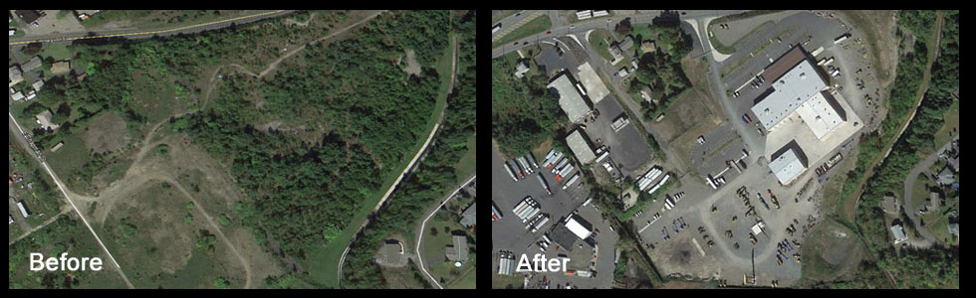
Challenge :
4
Protect the Environment: Land Development
Building roads, houses, buildings, power plants, and other things requires land to be changed by removing trees, plants, and dirt.
Notes:
CHALLENGE NUMBER 4
The last challenge that we’ll talk about is with land development.
Any time we build a road, a house, a building, or a power plant, the construction process requires the natural land to be changed in order to build something on it. This involves the removal of trees, plants, and dirt and replacing it with concrete, steel, gravel, etc.
In the photos here, you can see where before we had an area with lots of grass and trees and it was developed into parking lots and buildings.

Slide 27
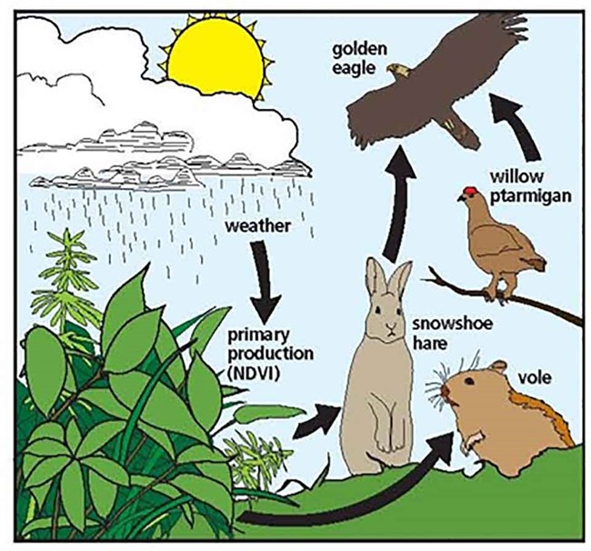
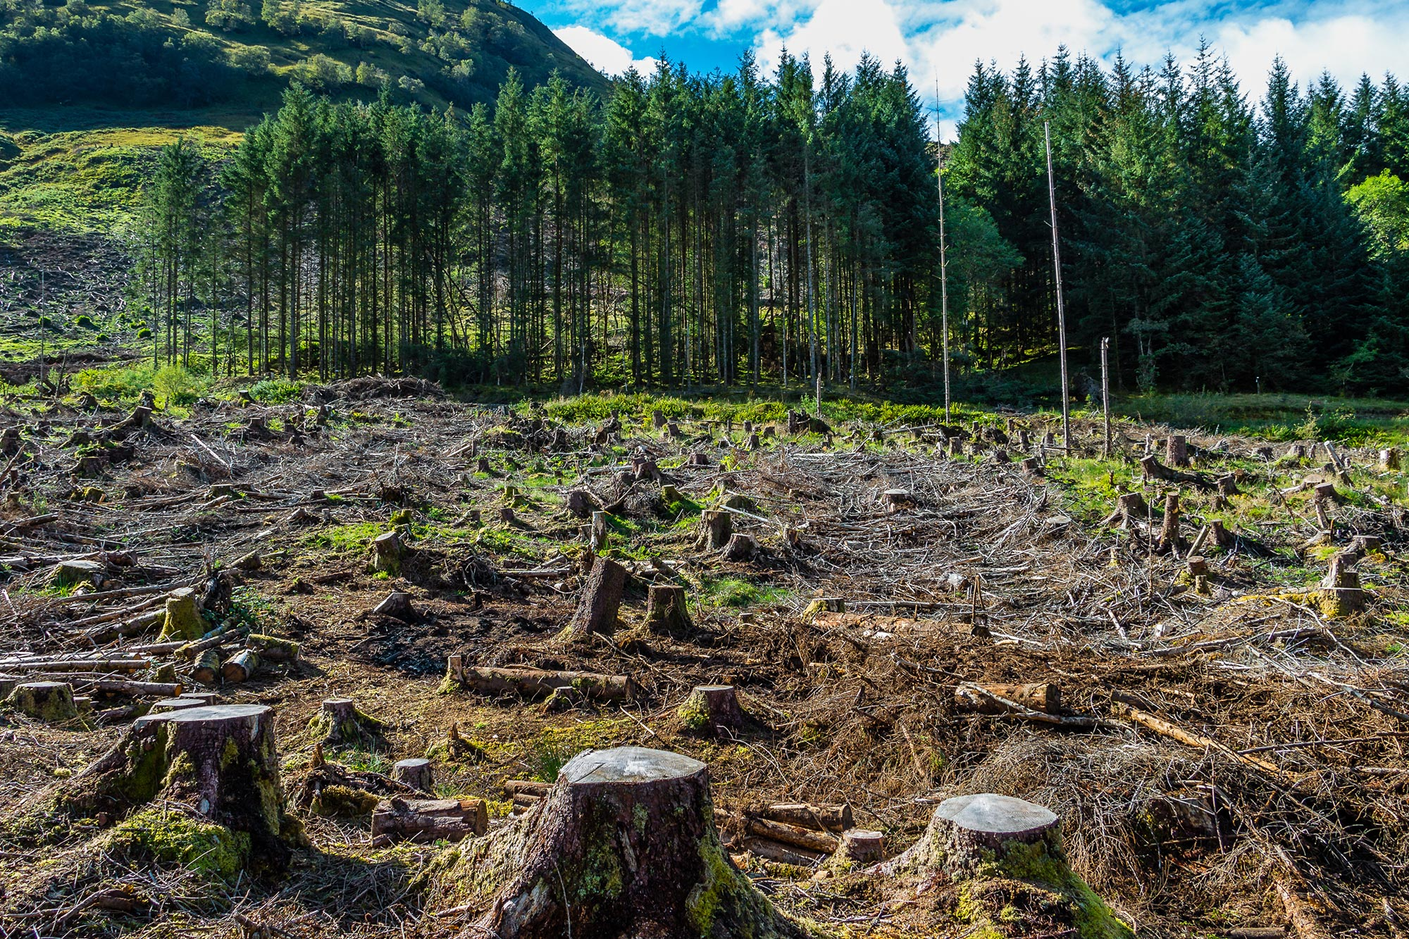
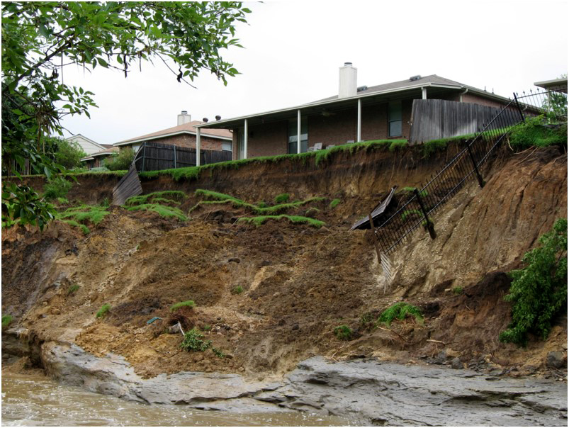
Challenge :
4
Protect the Environment: Land Development
Land development can create problems for the environment:
Animals must find new homes
Plants are removed
Increases soil erosion
Notes:
Ask the students, “Do you think there is any problems that can be created by developing the land from it’s natural state?”
[CLICK] Land development can lead to the following problems for the environment:
[CLICK] Animals must find new homes - this can lead to instability in ecosystems by throwing off the balance between predator and prey
[CLICK] Plants must be removed
The removal of plants leads to less vegetation being available to remove greenhouse gases from the atmosphere
The removal of plants means there are less roots in the soil. When you remove the roots from the soil, this can lead to…
[CLICK] Increased soil erosion
Increased erosion can lead to
Land slides and sinkholes can form
Rainwater not being absorbed into the ground as easily and thus washing away quicker than desired
Because ground water is moving faster, this can lead to pollutants and debris getting into our rivers, lakes, and streams more
There are some ways to help prevent these things from happening, but the best way is to not develop our natural landscape as much as possible.

Slide 28
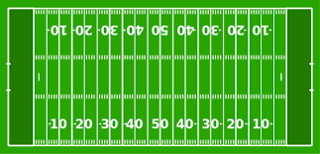
Challenge :
4
Protect the Environment: Land Development
46 football fields covered in solar panels
Electricity for 2,000 homes
NUCLEAR power needs less land area than solar or wind to produce the same amount of electricity!
Notes:
Nuclear power plants have a large advantage over other carbon free electricity sources when it comes to the amount of land area they require.
[CLICK] A nuclear power plant about the size of a football field could power approximately 2,000 homes.
[CLICK] It would take solar panels covering approximately 46 football fields to power the same amount of homes.
[CLICK] IT would take wind turbines installed across approximately 200 football fields to power the same amount of homes.
Because nuclear power needs way less land area to provide electricity, that means there would be fewer animal habitats being disrupted, less plants having to be removed, and less erosion and groundwater problems.
Data from NEI: https://www.nei.org/news/2015/land-needs-for-wind-solar-dwarf-nuclear-plants

Slide 29
Summary
We have learned that nuclear energy can help us produce electricity for 2020 and beyond
  Nuclear energy is very reliable
  Nuclear energy can make electricity for everyone, everywhere
We learned that nuclear energy can help us protect the environment
  Nuclear energy can help reduce greenhouse gas emissions
  Nuclear energy can help protect natural resources
  Nuclear energy can help prevent land development
Notes:
So we’ve focused on nuclear energy today and we’ve learned nuclear energy can help supply electricity for the future and protect the environment while doing it.
[CLICK] We talked about how nuclear energy can help us produce electricity for the future.
[CLICK] We talked about how reliable nuclear energy is
[CLICK] And we learned that nuclear energy can meet the demand for electricity for everyone, everywhere
[CLICK] We learned about 3 ways nuclear energy can help us protect the environment. Can anyone name some of the environmental challenges we talked about?
Wait for the students to say a them.
[CLICK] Nuclear energy can help reduce greenhouse gas emissions
[CLICK] Nuclear energy can help protect natural resources
[CLICK] Nuclear energy can help prevent land development

Slide 30
2020 Drawing Contest
2020 Fission: Bringing Nuclear Energy Into Focus
How can nuclear energy help meet the energy and environmental needs of the future?
How will nuclear energy be a part of our future?
Draw your picture showing how nuclear can help us now and in the future.
Notes:
So for the 2020 NAYGN Drawing Contest, the topic is 2020 Fission: Bringing Nuclear Energy Into Focus.
We want to focus on how nuclear energy can help meet the energy and environmental needs of the future. We want to show people that nuclear must be a part of our future in order to meet our energy and environmental needs.
Think about the challenges that we talked about today where nuclear energy can help us going into the future, and draw your pictures showing how nuclear can help us now and in the future with our energy and environmental needs.

Slide 31
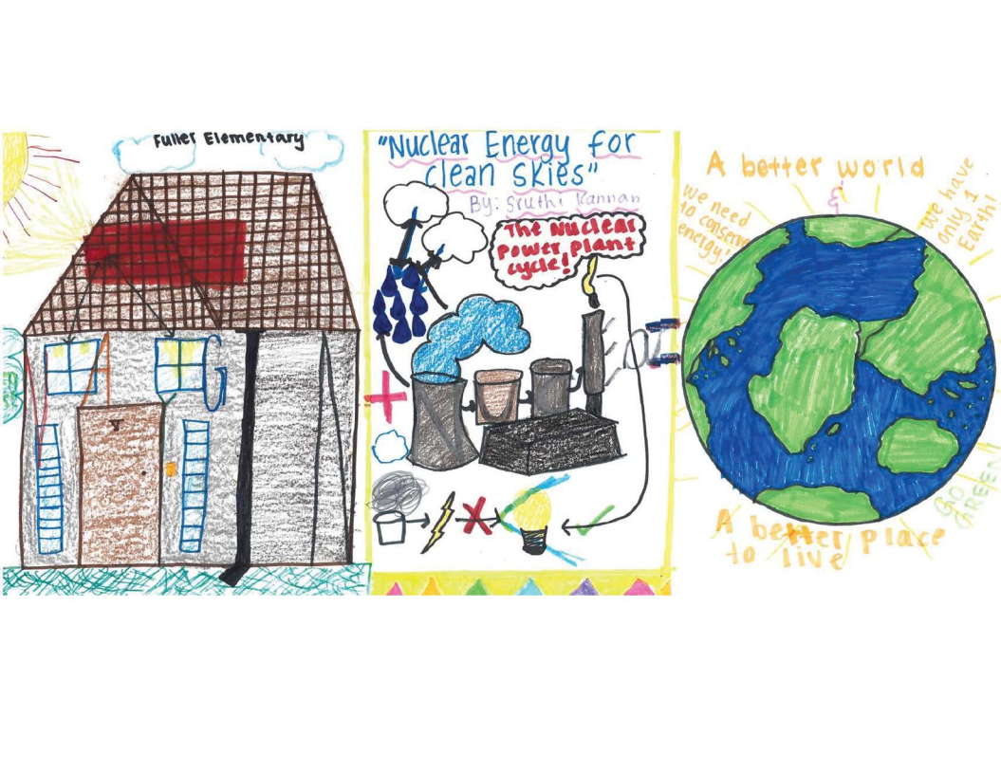
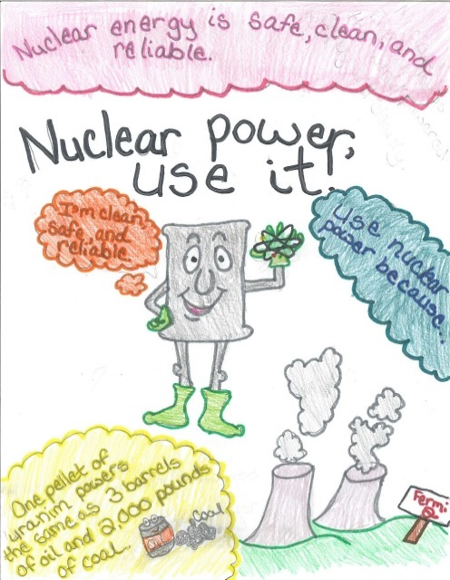
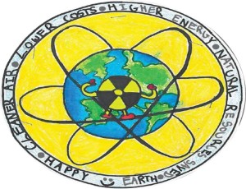
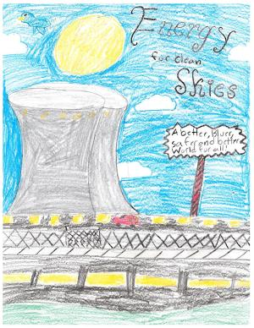
QUESTIONS?

