Slide 1
RADiculture
Radioactive Agriculture

Slide 2
DID YOU KNOW!?
Nuclear technology and radiation are used in agriculture every day!
In fact, you probably ate something today that was made possible by radiation!

Slide 3
Today you’re going to learn ways radiation is used in agriculture!
4
Fertilizer Tracing
Food Irradiation
Plant Breeding
Insect Control

Slide 4
FERTILIZER TRACING
1

Slide 5
What are fertilizers?
Fertilizers help plants grow
Fertilizers are expensive
Too much fertilizer can result in water pollution
It is important to use fertilizers EFFICIENTLY!
Notes:
https://www.world-nuclear.org/information-library/non-power-nuclear-applications/radioisotopes-research/radioisotopes-in-food-agriculture.aspx
More detail: Research has shown that less than 40% of the fertilizer applied globally is taken up by crops, while the remaining 60% is either lost to the atmosphere or to groundwater, or is left in the soil in a form that cannot be taken up by the crop.
https://www.iaea.org/newscenter/news/stable-nitrogen-isotope-helps-scientists-optimize-water-fertilizer-use

Slide 6
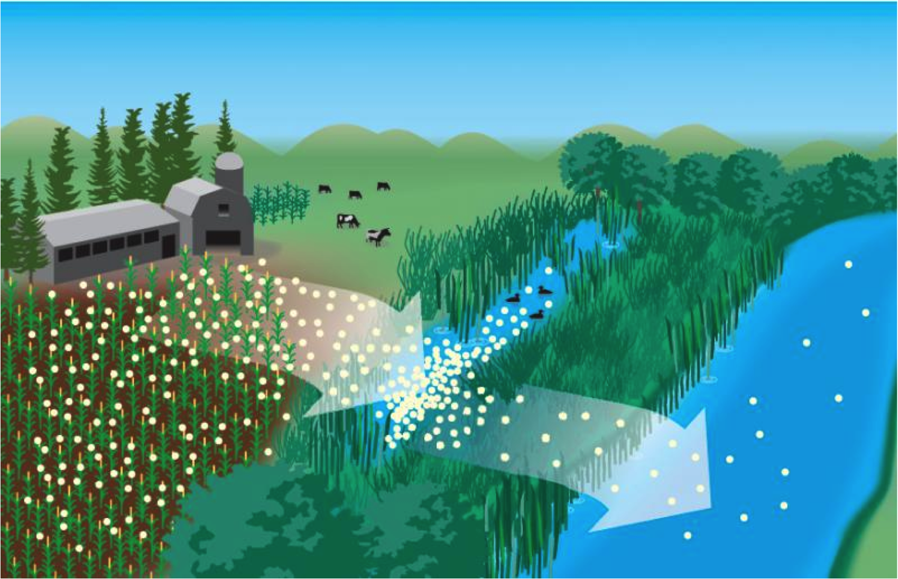
How do we know if fertilizers are getting to plants or if they are polluting water?
Radiation “tags” can be added to important nutrients in fertilizers.
Since radiation can be detected (even in tiny amounts!) the amount of fertilizer absorbed by the plant can be tracked.
If we don’t see all the radiation we added to the fertilizer in the plant, we know we are applying too much fertilizer and can reduce the amount of fertilizer we use!
Notes:
https://www.world-nuclear.org/information-library/non-power-nuclear-applications/radioisotopes-research/radioisotopes-in-food-agriculture.aspx
Radioactive tracers, radiation labels, isotope labels, isotopic techniques ➔ These are all essentially referring to the same thing
Radiolabeling or radiotracing: A radioactive isotope can be added to the fertilizer.
Isotopic labelling: A more rare isotope can be added to the fertilizer. The abundance of this rare isotope is not usually seen in nature therefore wherever it is present in large amounts, it is from the fertilizer.
Image from Wikipedia

Slide 7
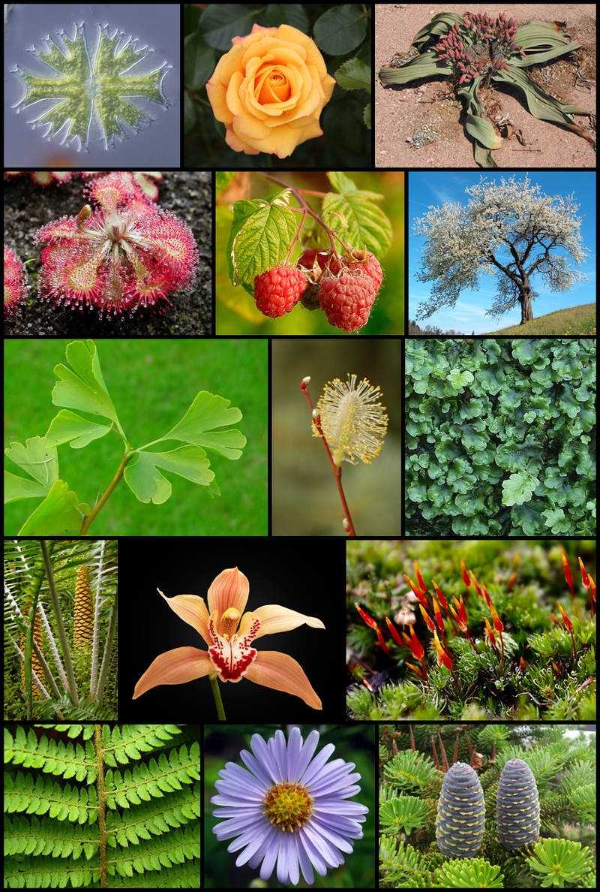
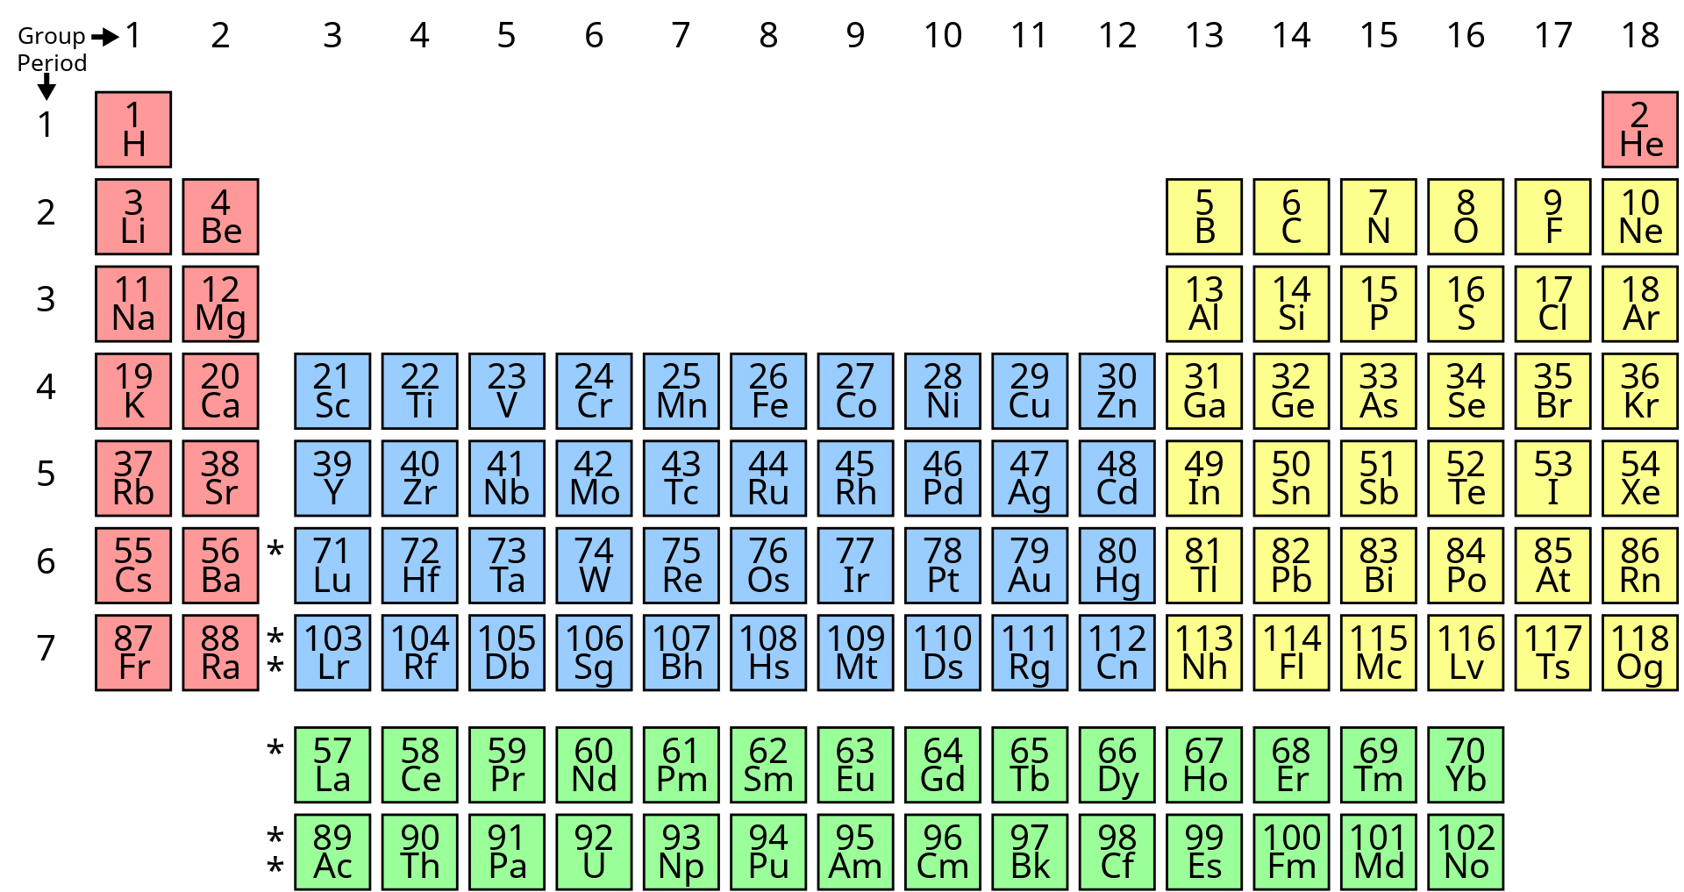
3 Main Nutrients Needed for Plant Growth
Nitrogen (N)
Phosphorus (P)
Potassium (K)
These are ELEMENTS from the Periodic Table
ISOTOPES are types of elements. ISOTOPES have the same number of protons (same element) but a different number of neutrons.
Notes:
https://www.gardeningknowhow.com/special/children/how-plants-grow.htm
Images from Wikipedia

Slide 8
So what exactly is Fertilizer Tracing?
Isotopes of Nitrogen (N)
Isotopes of Phosphorus (P)
N-14
P-31
Very common! Most of Nitrogen in nature is N-14
Phosphorus found in nature will be P-31 – it’s everywhere!
N-15
P-32
P-32 is radioactive! This radioactive isotope can be added to the phosphorus in fertilizers. Radiation means that energy is emitted. This energy can be detected by scientists!
Pretty rare. N-15 labeling or tracing means the amount of N-15 is increased by scientists. Then plants, soil, and water can be tested for the amount of N-15. If there is a lot of it, we know that the nitrogen is from the fertilizer!
Notes:
N15 tracing: https://en.wikipedia.org/wiki/Nitrogen-15_tracing#:~:text=Nitrogen%2D15%20(15N),one%20nitrogen%20compound%20to%20another.
https://en.wikipedia.org/wiki/Radioactive_tracer

Slide 9
Movie Time!
Notes:
2.5 minute video

Slide 10
FLASH QUIZ!
What nutrients do plants need to grow?
Why is too much fertilizer a bad thing?
What technique can be used to monitor fertilizer?
Name a radioactive isotope of Phosphorus.
Notes:
Phosphorus, nitrogen, potassium
Wastes money, wastes resources, pollutes water/the environment
Fertilizer tracing (which tracks isotopes – some radioactive; some stable)
Phosphorus 32 is radioactive.

Slide 11
FOOD IRRADIATION
2

Slide 12
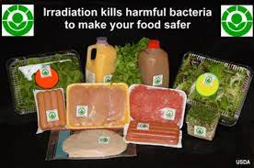
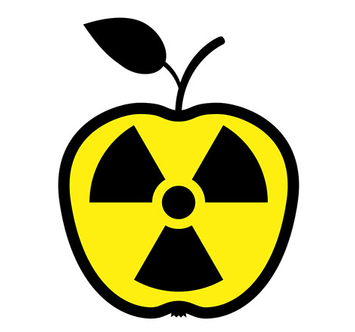
What is Food Irradiation?
ionizing radiation improves the safety and extends shelf life of foods
It can make food safer by killing microorganisms and insects that can cause food to spoil
gross!
Irradiation does NOT make foods radioactive, compromise nutritional quality or change the taste, texture or appearance of food
Notes:
Resource: Food Irradiation: What You Need to Know | FDA

Slide 13
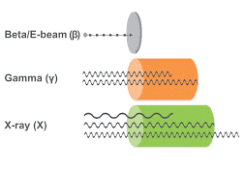
How is Food Irradiated?
There are 3 approved sources of radiation
High energy beta electron beams from an electron accelerator are beamed into food
Gamma rays from Cobalt-60 and Cesium-137 are commonly used
X-rays produced by reflecting a high-energy stream of electrons from a heavy metal target into food
Notes:
Electron accelerator is used to create an electron beam.
A radioactive source such as Cobalt-60 or Cesium-137 is placed near the food and the gamma rays emitted from natural decay of the source are focused onto the food.
An electron beam from an accelerator is used, just like for item 1, but rather than focusing the electron beam on the food, the electron beam is aimed at a heavy metal like lead. When the electrons strike the lead, the lead emits x-rays, which are then focused onto the food.

Slide 14
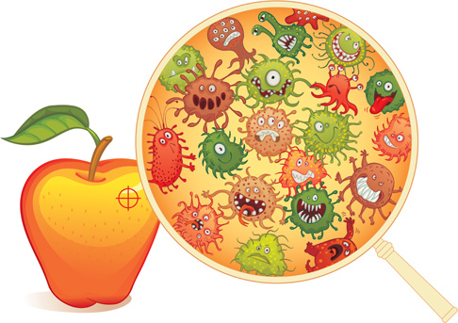
Why Irradiate Food?
Prevention of Foodborne Illness – to effectively eliminate organisms that cause foodborne illness, such as Salmonella and Escherichia coli (E. coli).
Notes:
Food Irradiation: What You Need to Know | FDA

Slide 15
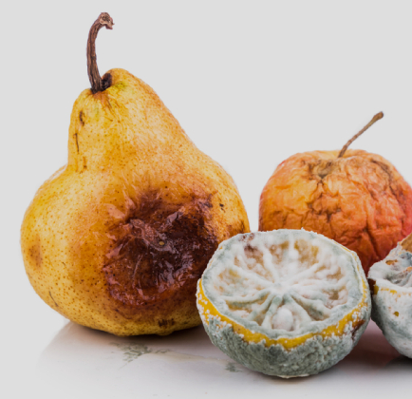
Why Irradiate Food?
Preservation – to destroy or inactivate organisms that cause spoilage and decomposition and extend the shelf life of foods
Notes:
Food Irradiation: What You Need to Know | FDA
Using Nuclear Science in Food Irradiation - YouTube

Slide 16
Why Irradiate Food?
Control of Insects
To destroy insects in/on imported tropical fruits.
If non-native insects are allowed into the country, they could kill native plants, insects, or animals
Irradiation also decreases the need for other pest-control practices that may harm the fruit.
Notes:
Food Irradiation: What You Need to Know | FDA
Using Nuclear Science in Food Irradiation - YouTube

Slide 17
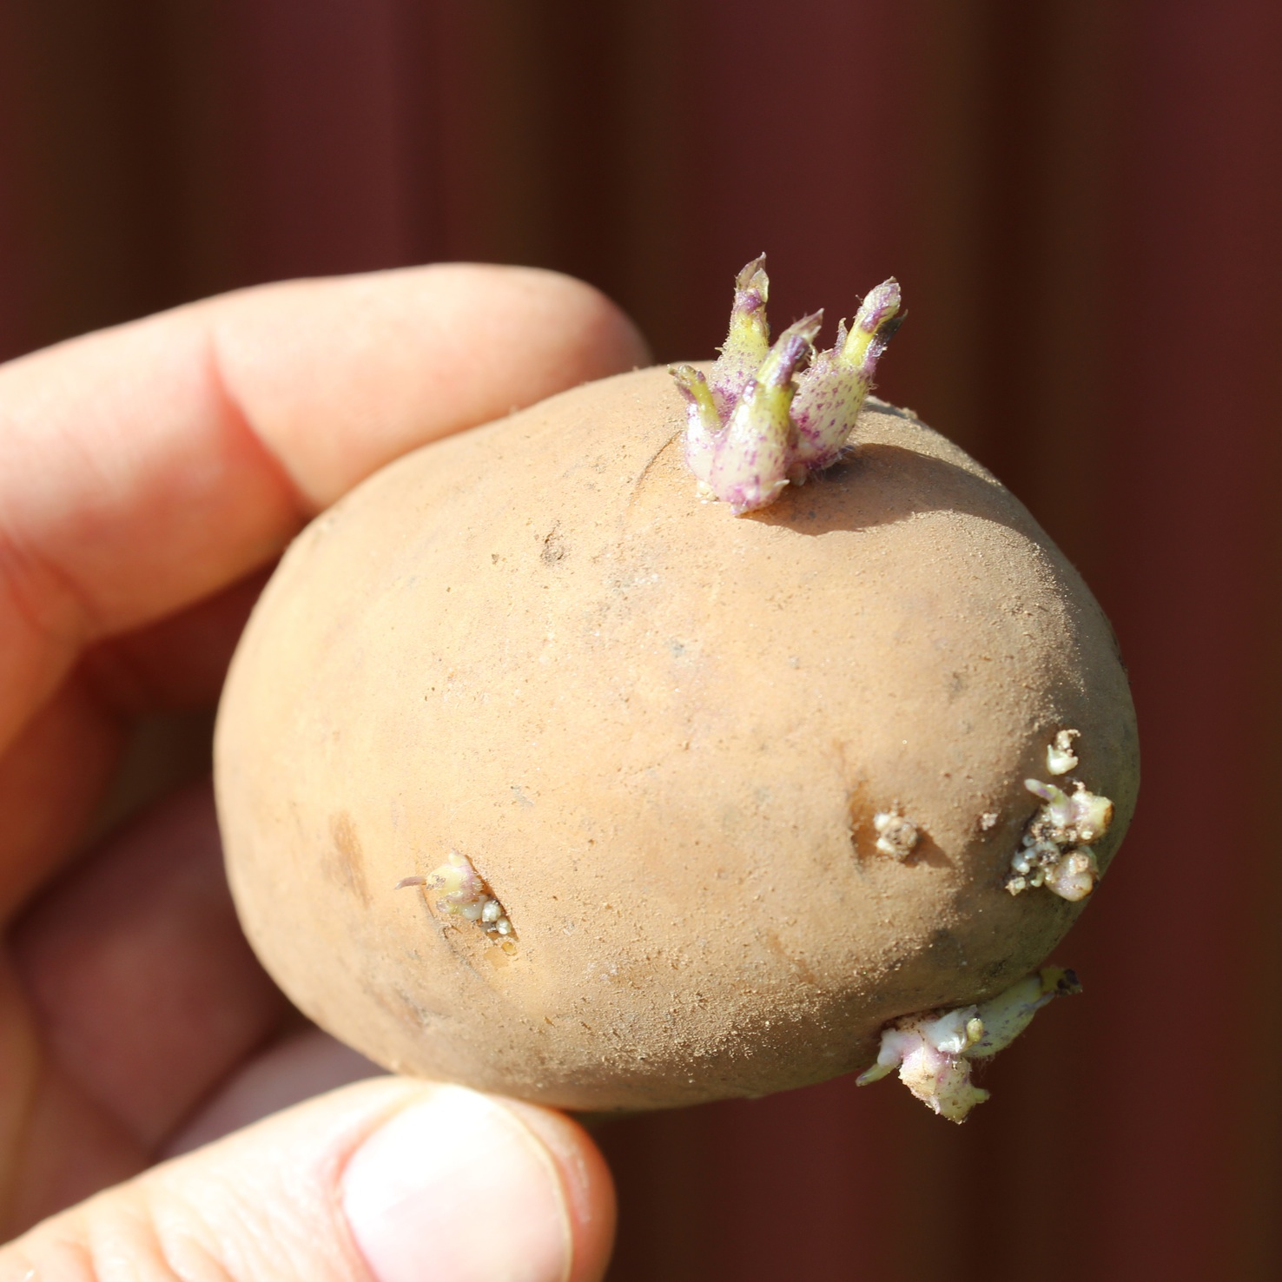
Why Irradiate Food?
Delay of Sprouting and Ripening – to inhibit sprouting (e.g., potatoes) and delay ripening of fruit to increase longevity.
Notes:
Food Irradiation: What You Need to Know | FDA
Using Nuclear Science in Food Irradiation - YouTube

Slide 18
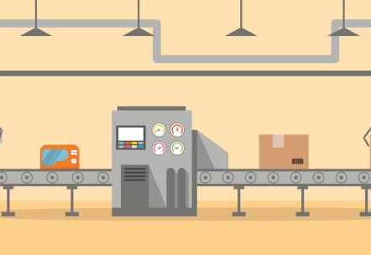
Why Irradiate Food?
Sterilization
Irradiation can be used to sterilize foods, which can then be stored for years without refrigeration.
Sterilized foods are very useful in hospitals for patients with severely impaired immune systems, such as patients with AIDS or undergoing chemotherapy.

Slide 19
Movie Time!

Slide 20
FLASH QUIZ!
What are three benefits of food irradiation?
Why don’t we want non-native insects to enter the country?
Does food irradiation make food radioactive?
Does food irradiation change the way our food looks or tastes?
Notes:
Any of the following are acceptable: prevent food born illness, preservation, control insects, prevent sprouting, sterilization
They could threaten or kill off our native plants, insects, and animals.
NO! Food irradiation does not make our food radioactive.
NO! Food irradiation does not change the appearance or taste of our food?

Slide 21
3
Mutation
Plant
Breeding

Slide 22
Plant Breeding
The science of making plants with specific, desirable traits
Make new fruits, new vegetables, or new varieties of plants
Scientists can intervene in the plant life cycle to help speed up what would happen in nature

Slide 23
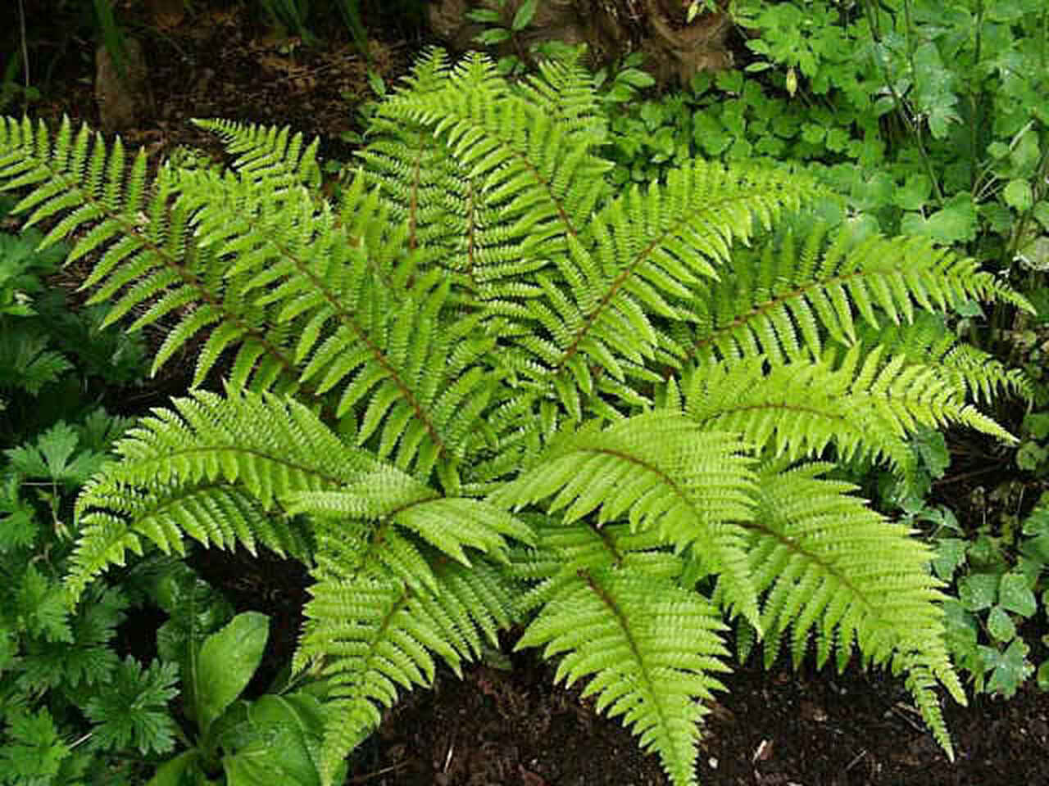
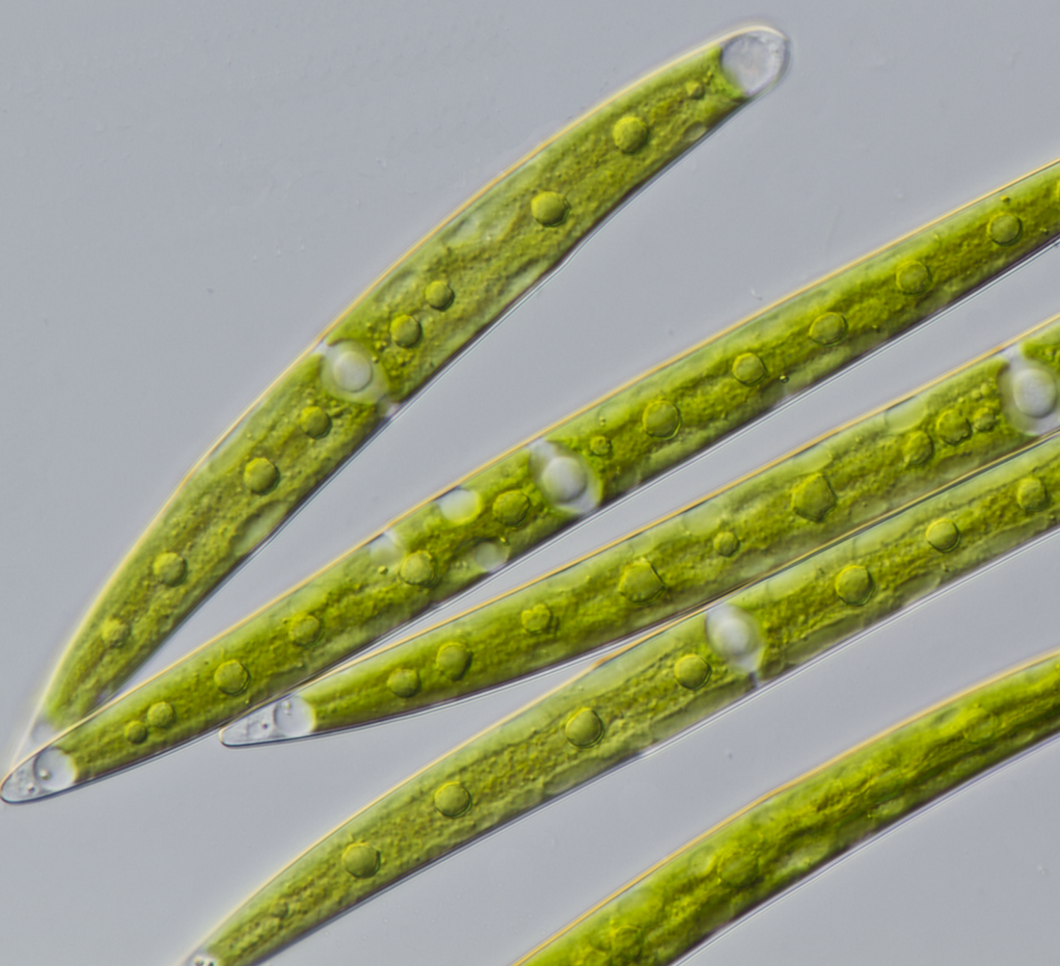
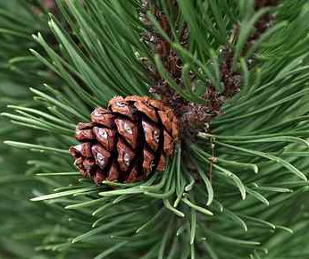
The Evolution of Plants
Algal Ancestors
Mosses
Ferns
Conifers
Flowering Plants
Paleozoic
Mesozoic
Cenozoic
500
350
200
100
TODAY!
Notes:
[Click] Shortly after single celled organisms, the ancestors of modern-day algae started to appear on Earth around 500 MILLION YEARS AGO!
[Click] Then around 400M years ago, the original algae organisms had started to evolve into mosses, which are more complex organisms! That’s EVOLUTION!
[Click] Then, those mosses eventually evolved into even more complex organisms such as ferns! That all happened over 350M years ago!
[Click] Then, ferns started to evolved into plants like pine trees, or what are also called conifers.
[Click] THEN!! Finally! Dinosaurs started to appear on Earth only 200 million years ago. The first plants, plants you still see today such as algae, moss, and ferns, and pine trees were all already on the earth!
So, as you can see, we’re getting all these plants are evolving into more and more complex plants.
[Click] And finally, around 100 million years ago flowering plants finally started to show up.
[Click] Then, only 300 thousand years ago, the first humans started to appear on Earth!
Plants, like all living creatures, evolve naturally overtime into more complex organisms. This is generally to make survivability more likely so they can continue to live and thrive by obtaining new traits and characteristics that make it easier for them to reproduce, endure different environments, be stronger, etc. But natural evolution takes a long time. It took almost 400 MILLION YEARS for the first plant life to evolve into the flowers that we see today! That’s a really REALLY long time!

Slide 24
Radiation can help speed up this process!

Slide 25
Step 1
Plant breeders expose plants or seeds to radiation.
Step 2
The radiation causes the plants or seeds to randomly change (these changes would have happened in nature over a long period of time).
Step 3
Some of the changes are desirable, and some are not. Plant breeders will keep the plants that show desirable traits and dispose of the others.
Step 4
Plant breeders will use these new plants to breed additional plants just like it!
Notes:
Additional info other than what’s on the slide:
Step 1. Most of the time it’s the seeds or pollen that are exposed to radiation and not the plant itself. The seeds and pollen contain all the DNA and genetic structure of the plant in a small volume, which makes them much easier to expose to radiation than the whole plant or flowers, etc.
Step 2. Additional fact: because these changes are random, unpredictable, and could happen in nature, this process is NOT considered making GMOs. GMOs are created when scientists or breeders target very specific genes of a plant and alter the genetic structure directly. Mutation plant breeding is NOT that.

Slide 26
What benefits can we get from mutation plant breeding?
More nutritious food
Larger harvests
Hardier (more tolerant of extreme conditions)
More colorful flowers
Notes:
A large majority of all the species of agricultural crops across the world are the result of mutation plant breeding (either directly or the offspring of varieties that came from mutagenesis). Without mutation plant breeding, it would likely be impossible to keep up with the demand for produce by the increase in human population, and thus, consumption.
Some prime examples of mutation plant breeding are:
A lot of different varieties of rice – using mutagenesis, rice varieties have been made that can be harvested multiple times a year, provide larger rice grains, produce more grains per stalk, provide more nutritional value, and can withstand severe droughts.
Cotton – Cotton is typically grown in dry environments and areas that are prone to drought. However, sever droughts can result in cotton plants not producing harvestable cotton. Varieties of cotton have been made that can withstand severe drought and still produce harvestable cotton, or produce higher yields of cotton.
Barley – Barley typically grows at low altitudes and moderate climates. But mutation plant breeding led to the development of a verieties of barley that can be grown in high elevation environments over 3000m and can continue to grow during the winter.
Wheat – wheat is one of the most globally grown crops in the world. Wheat is also prone to developing diseases that can wipe out large crops of wheat. Using mutation plant breeding, varieties of wheat that are more resistant to common diseases such as leaf rust have been created)

Slide 27
Movie Time!

Slide 28
FLASH QUIZ!
How many years did it take for the first plant life to evolve into the flowers we have today?
How do you use radiation to help plants evolve?
What are 4 benefits of mutation plant breeding?
What desirable trait did radiation make in the plant that Dr. Laura Masor showed you in the video?
Notes:
Almost 400M years.
Explanation should include exposing the plant/seeds to radiation and then selecting desirable plants that grow with new traits to continue to breed further.
Better nutrition, larger harvests, hardier plants, new flowers.
Caused it to be a smaller, more contained plant?

Slide 29
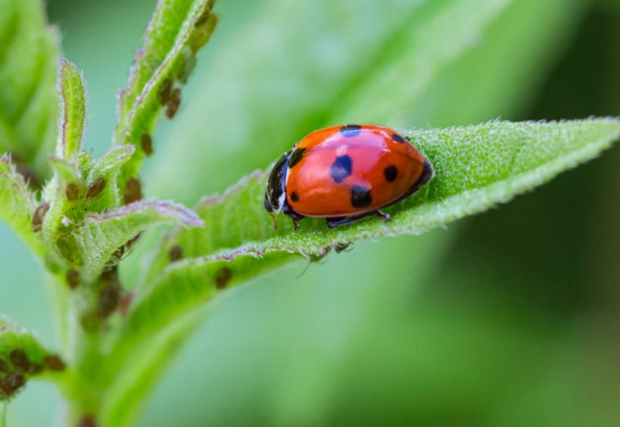
4
Insect Control
Notes:
Food Irradiation: What You Need to Know | FDA

Slide 30
Across the world, insects are a major contributor to significant loses of crops
Wheat
Soybean
Corn
Rice
10-28%
11% - 32%
20% - 41%
25% - 41%
Notes:
These percentages are the percentage of crops that die, worldwide, due to pathogens or pests (insects of which are a major contributor).
Source: https://californiaagtoday.com/pests-diseases-cause-worldwide-damage-crops/

Slide 31
Insects can also cause the malnutrition and even death of livestock like cattle, horses, and goats.
Flies
Ticks
Mosquitos
Notes:
It’s common for flies to result in stress of animals which can result in lower nutritional value or weight loss.
Ticks and mosquitos are known for spreading diseases that can be fatal to animals

Slide 32
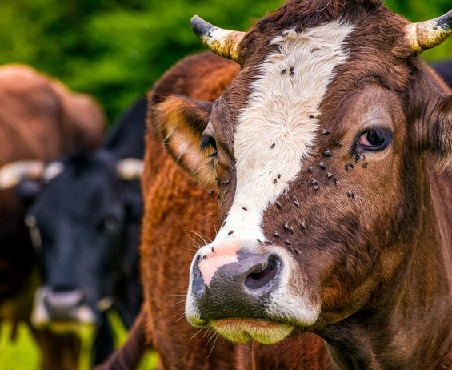
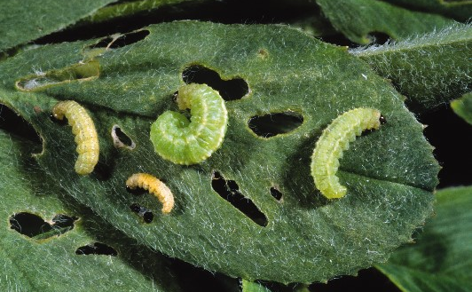
Radiation Can Help!
By using radiation, we can control harmful insect populations!

Slide 33
How Radiation Can Help
Notes:
Briefly explain that radiation is used to sterilize a bunch of male insects. Then those sterilized male insects can be released back into the wild. Then, when they mate with females, the eggs the females lay won’t hatch! This helps prevent the insect population from growing, and can even be used to reduce the insect population.

Slide 34
Benefits of SIT Using Radiation
Farmers and ranchers can target a single insect
Reduce the amount pesticides and chemicals needed
More precise control of the ecosystem
Improve health of livestock and reduce veterinary visits
Notes:
[Click] Farmers can target a single insect. This is important because there are a lot of helpful insects that we don’t want to harm like bees and other pollinators. When chemicals like pesticides are used, this can often result in killing helpful insects as well.
[Click] By reducing the among of pesticides needed, you’re protecting the environment by preventing harmful chemicals from getting into plants, soil, and water.
[Click] By using SIT instead of pesticides, biologists and farmers can more precisely control the ecosystem. Sometimes, when using pesticides, you might kill off too many insects which could cause problems in the local ecosystem.
[Click] By controlling insect populations, the health of livestock can be improved. This will reduce the number of veterinary visits for livestock which can improve the quality of life for the animals and increase the profits for ranchers.

Slide 35
Movie Time!

Slide 36
FLASH QUIZ!
What percentage of corn crops across the globe are destroyed by insects?
Name 3 insects that can be harmful to livestock.
How can radiation be used to control insects?
Name 2 benefits of the Sterile Insect Technique.
Notes:
20% - 41%
Flies, ticks, mosquitos.
Male insects are sterilized using radiation, then they are released back into the wild where they can’t create offspring.
Any of the following are acceptable:
single insect species can be targeted
less pesticides are needed
the impact on the ecosystem can be reduced
better health for livestock

Slide 37
RADiculture Recap!
4
We covered
ways radiation and nuclear technology help the agriculture industry every day!

Slide 38
Can you name the 4 ways?
Fertilizer
Tracing
Food Irradiation
Mutation Plant Breeding
Insect Control
Notes:
[First Click] Fertilizer Tracing – Top left picture
[Second Click] Food Irradiation – top right picture
[Third Click] Mutation Plant Breeding – bottom right picture
[Fourth Click] Insect Control – bottom left picture

Slide 39
RADIATION!
Making agriculture
better every day.
That’s RADiculture!

