Slide 1
Introduce Yourself Here Name, Company “What would you [nuclear] power?
Notes:
My name is…
North American Young Generation in Nuclear is an organization of young professionals in the nuclear industry.
Today we are here to discuss our 2023 drawing contest theme: “What would you [nuclear] power?”

Slide 2
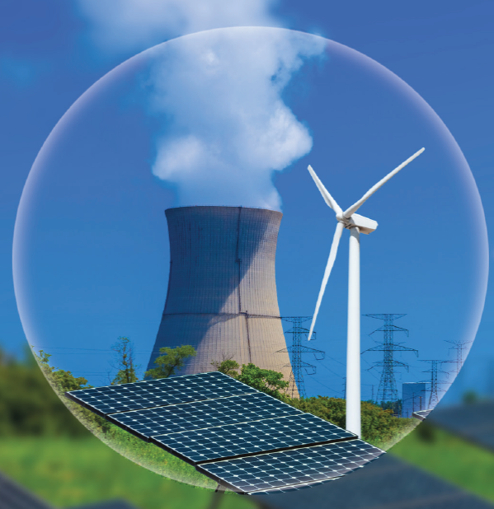
Did you know?
There are CLEAN ways to make electricity
nuclear
solar
wind
Notes:
Solar, nuclear, and wind are all carbon free ways to make electricity!

Slide 3
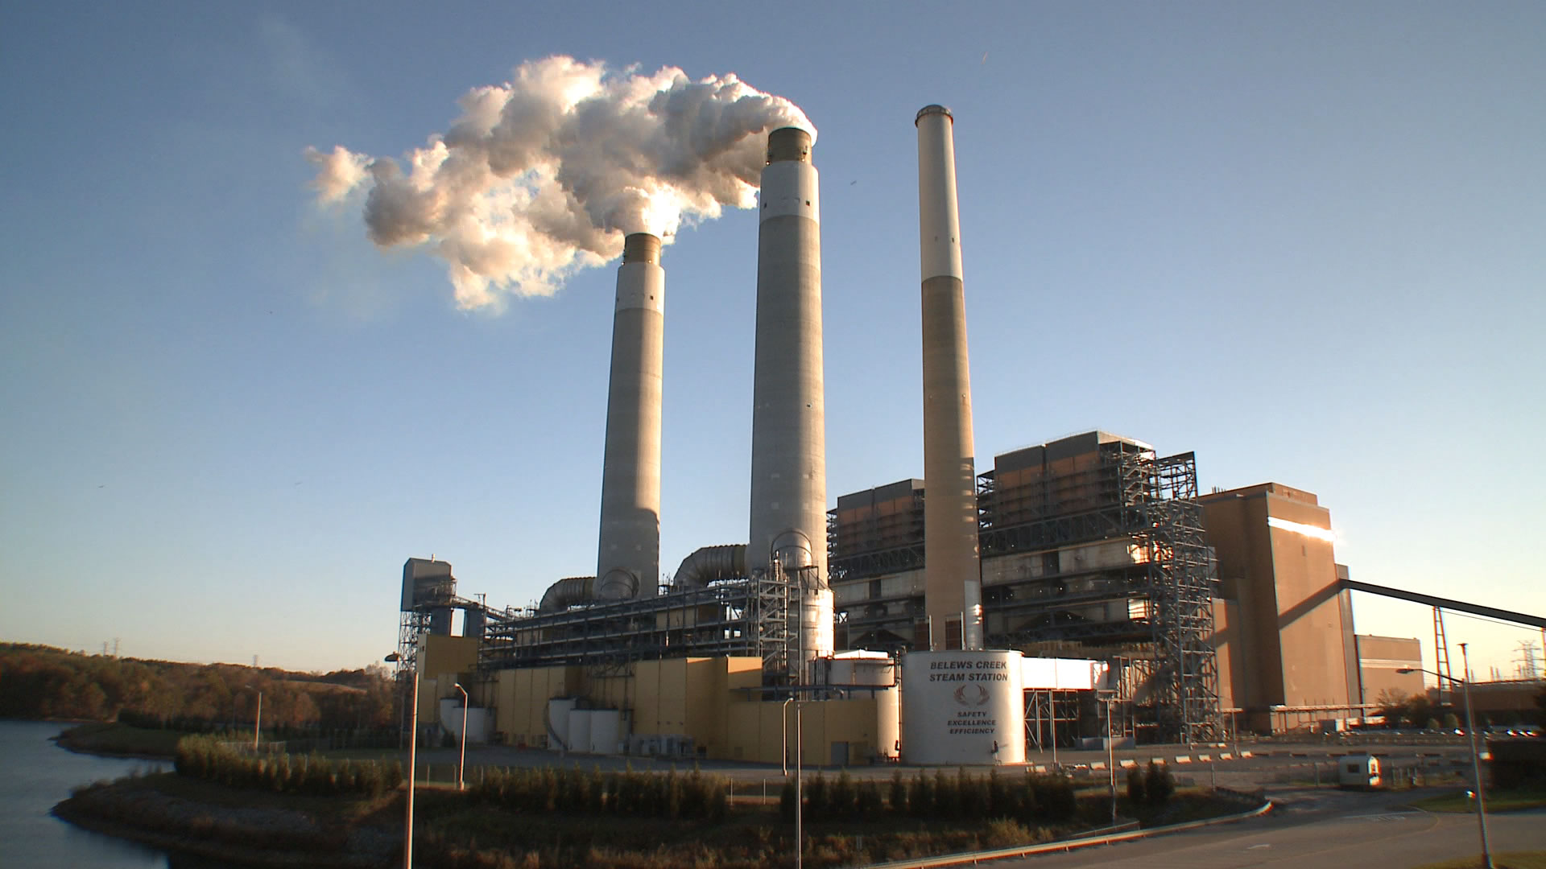
Coal Plant
Carbon dioxide
Notes:
This is carbon dioxide coming out of a coal plant, it can heat up our planet.

Slide 4
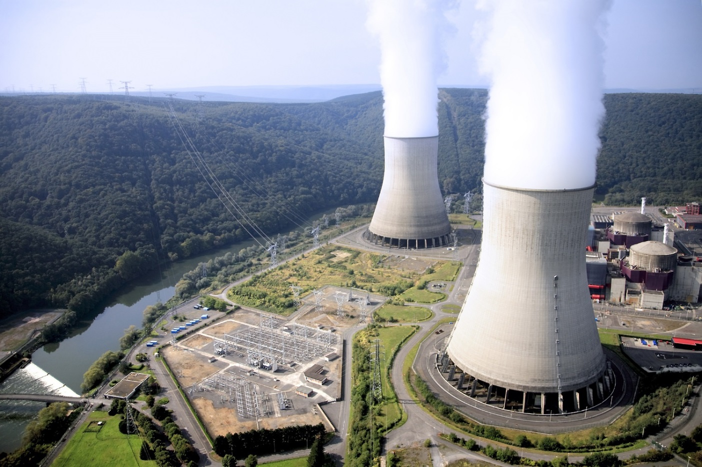
Nuclear
YES!
carbon
STEAM
Notes:
Really? Nuclear?
Yes!
The cloud coming out of a nuclear plant is not like the cloud coming out of a coal plant.
The cloud out of a nuclear plant is just steam – it’s just water! Nuclear is a carbon free source of electricity.

Slide 5
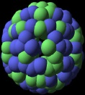
How does a nuclear power plant work?
Steam
Generator (Motor)
Water is boiled
Turbine (Fan)
Heat
Electricity

Slide 6
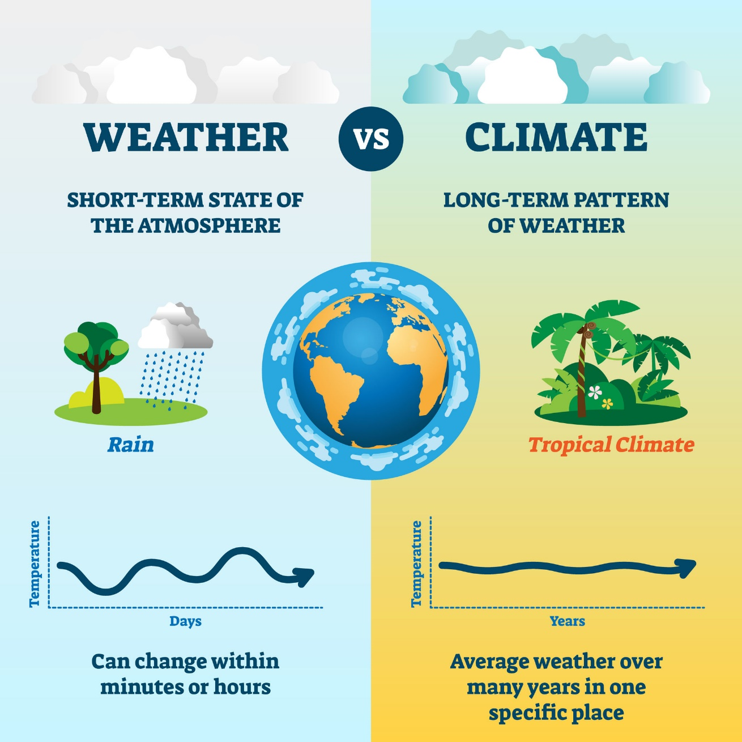
What is climate change?
Notes:
Weather = day to day
Climate = long term

Slide 7
Why is climate change bad?
Notes:
What if the world changed drastically? Many animals might become extinct!
Sad polar bear.
Sad penguin.

Slide 8
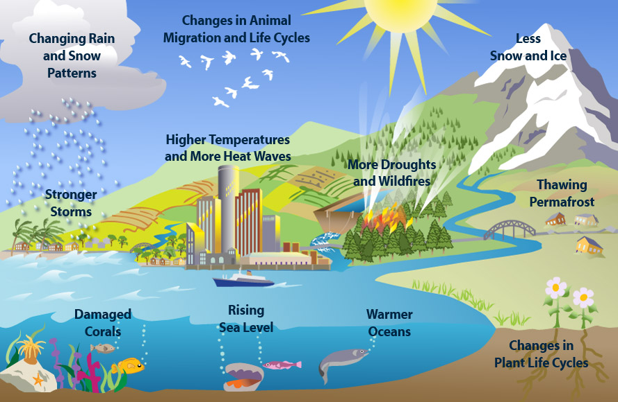
Environmental Protection Agency
Notes:
Here are some other reasons climate change would be very bad.

Slide 9
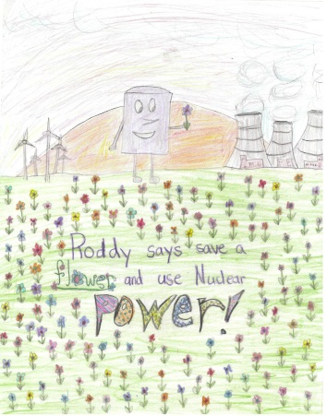
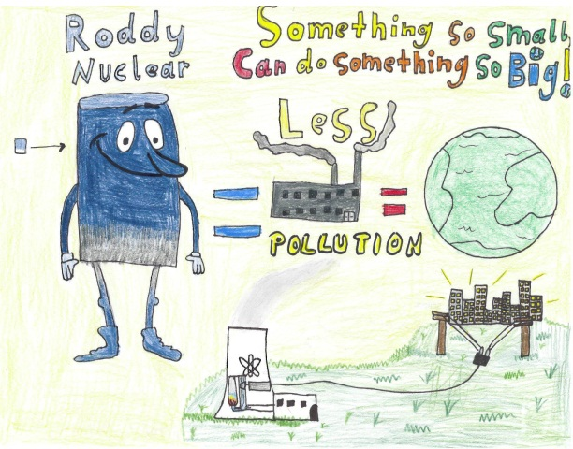
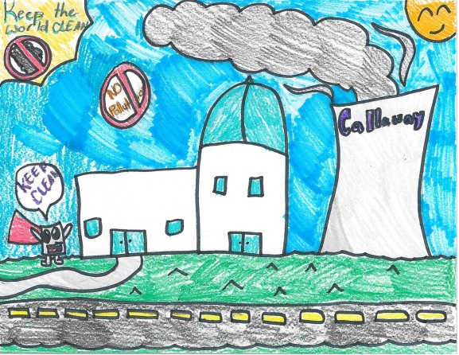
2023 Drawing Contest
Theme: “What would you [nuclear] power?”
8 ½ x 11” sheet of paper
On the BACK of the drawing, write:
Name
Age and Grade
T-shirt size
School and Teacher’s Name
Drawings due 3/31/2023

Slide 10
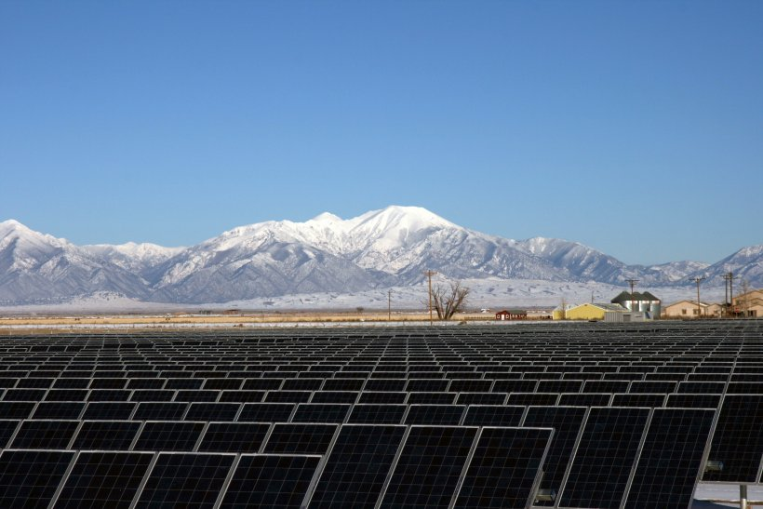
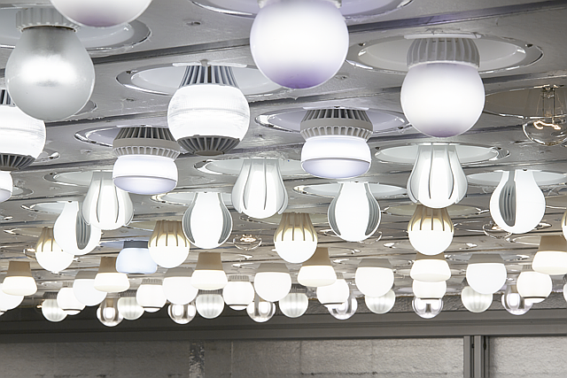
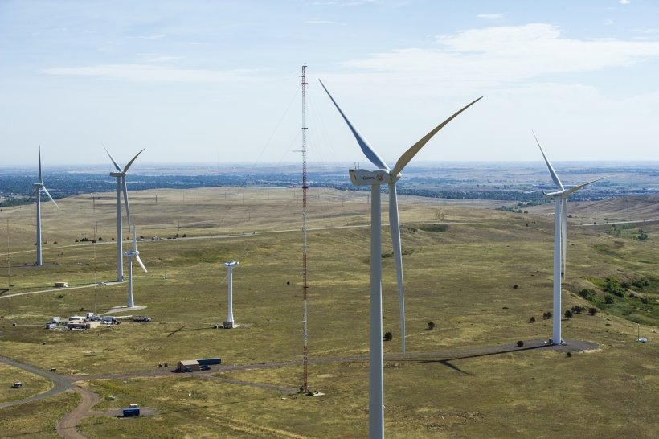
How much power is a nuclear power plant?
A single nuclear power plant produces as much energy as:
3 Million Solar Panels!
100 Million Lightbulbs!
333 Wind Turbines!
Notes:
Nuclear power plants are powering-up something great. What could you do with 1GW of clean nuclear energy?

Slide 11
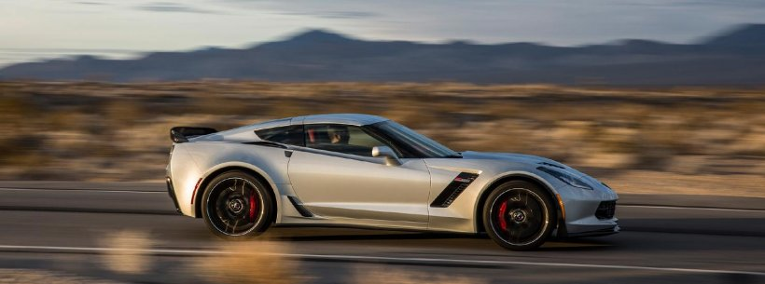
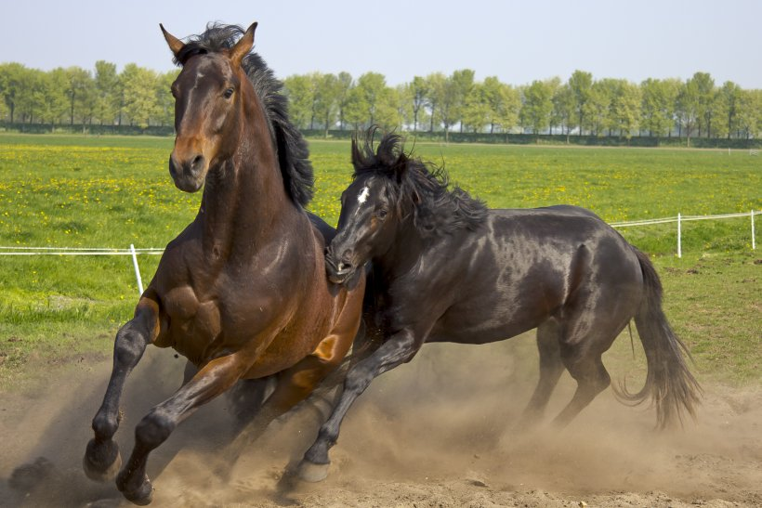
How much power is a nuclear power plant?
A single nuclear power plant produces as much energy as:
2,000 Corvettes!
1 Million Horses!
100,000 Elephants!

Slide 12
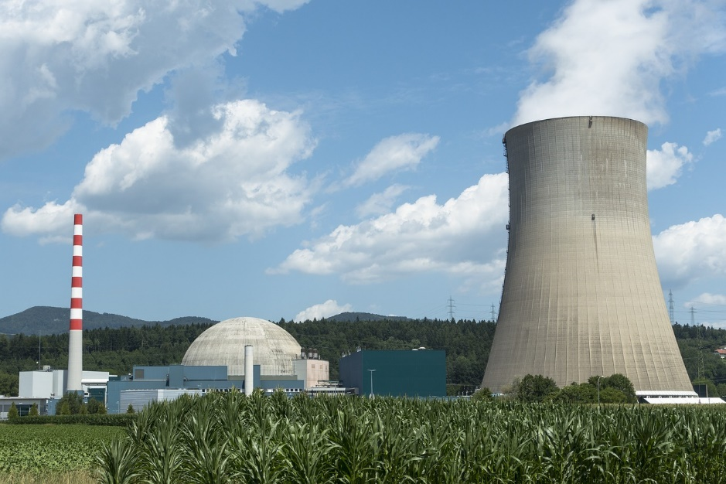
That is a lot of electricity! What would you power with it?
You could draw a nuclear power plant…
Powering up a big boat!

Slide 13
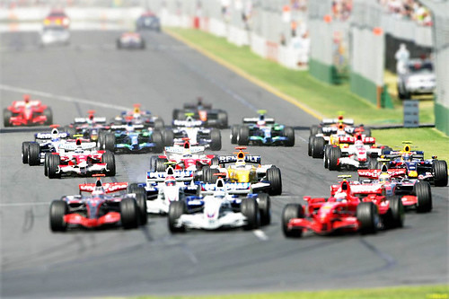
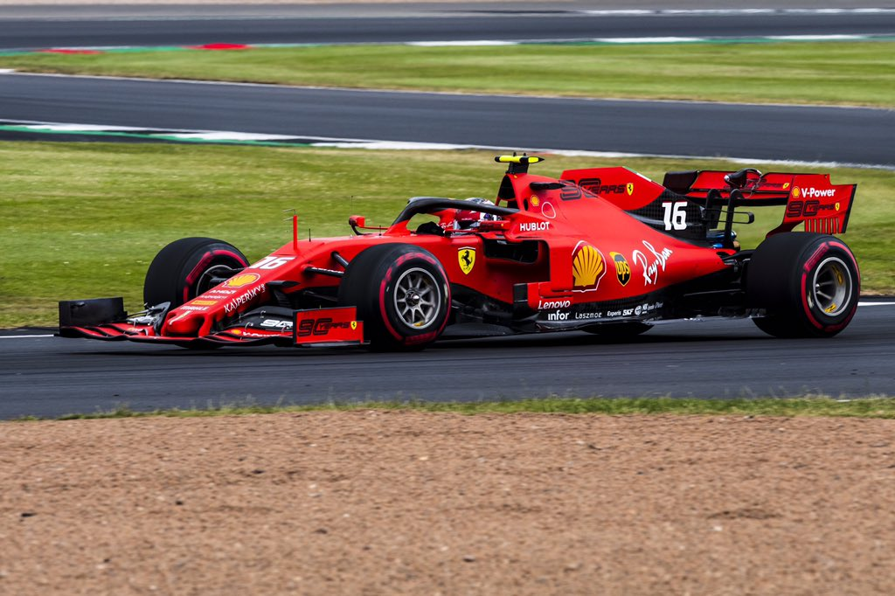
Or maybe your nuclear power plant is…
Powering a racecar!
Or a lot of racecars!

Slide 14
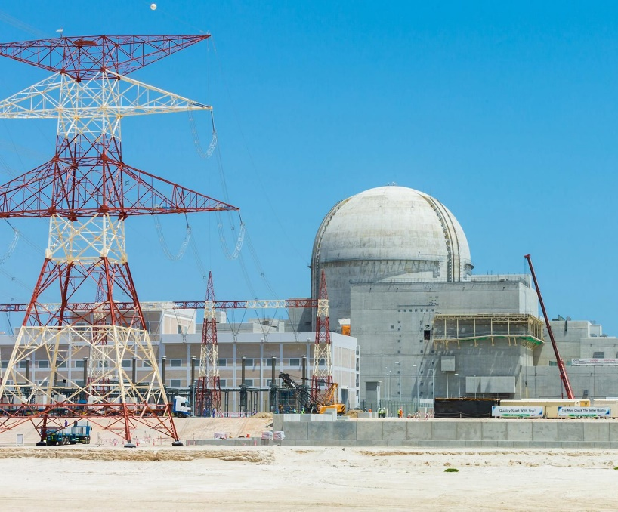
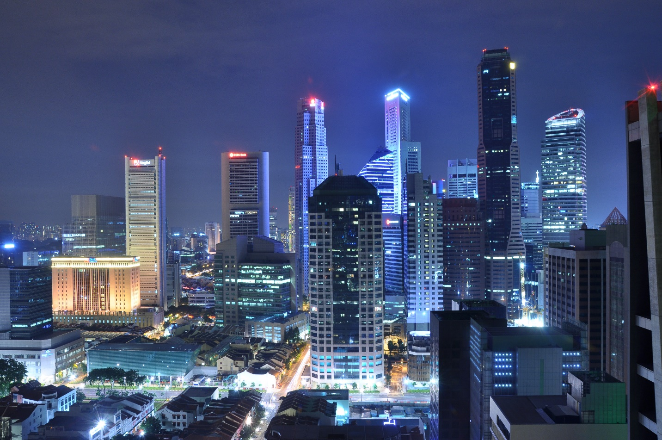
Your nuclear power plant could…
Light up a whole city!

Slide 15
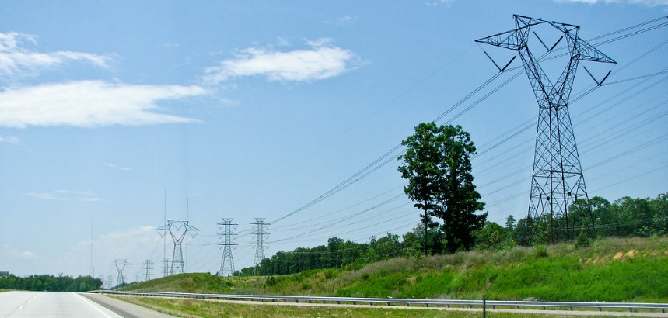
What will YOU nuclear power?
?
Draw your nuclear power plant powering up something big!

Slide 16
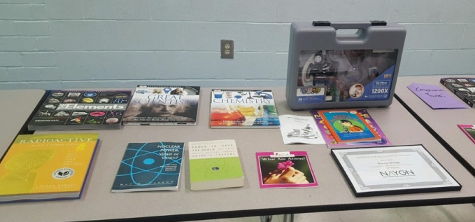
Prizes!

Slide 17
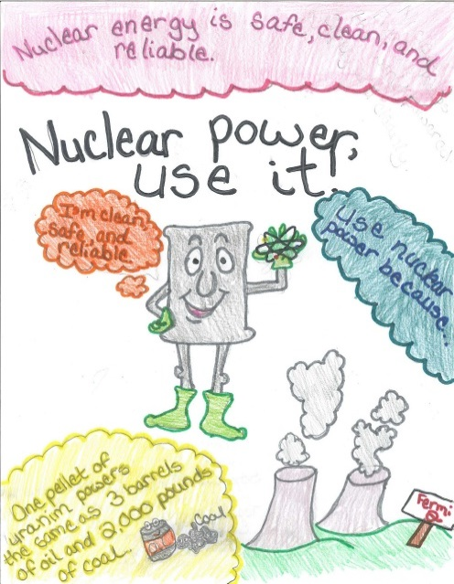
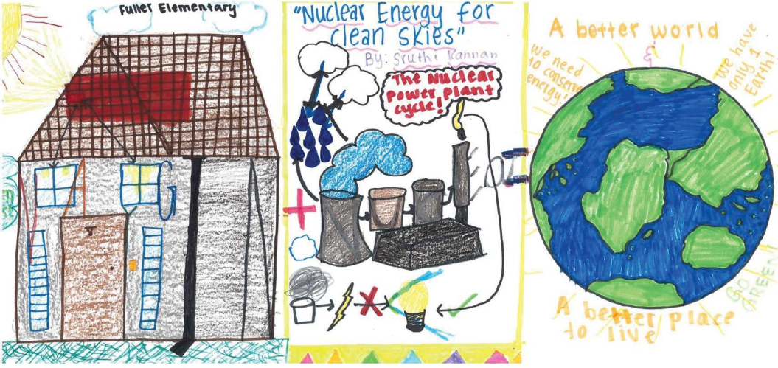
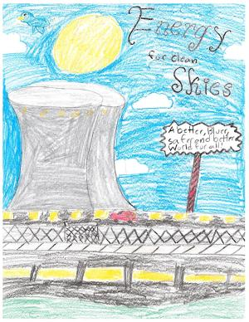
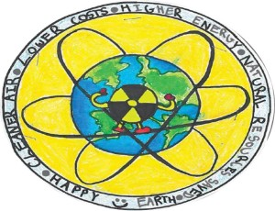
Questions?

