Slide 1
Nuclear Science Teacher Workshop
A Diverse Energy Portfolio
Electricity is everywhere! It's in our houses, on our streets, in our pockets and for some of us... in our hearts. We depend on it for our daily lives, but did you know that it's the only commodity that must be used as soon as it's made? How do you deliver a product that you can't ship? In this session we'll discover how a diverse portfolio of sources for generating electricity makes it possible to power our extraordinary lives with several activities.
May 19, 2018 Atlanta, Georgia

Slide 2
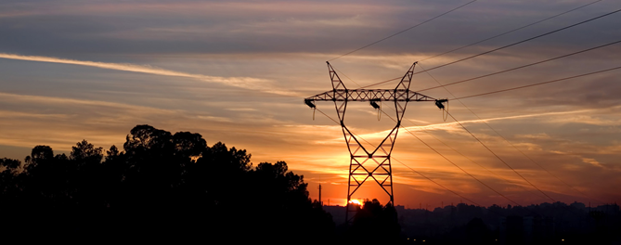
Where does electricity come from?
Notes:
Power plants. What do you use electricity for? How often do you need electricity?
What is electricity? Moving electrons
Our lives would not be the same without electricity. Electricity generation sources or power plants make electricity for our immediate consumption. Electricity is not stored on the grid, in the wires, or in the walls in your house. Electricity is generated at power plants and consumed by you (the user) instantaneously (or almost instantaneously: electrons travel through transmission lines at ~2200 km/s or 1300 miles per second which is ~1% the speed of light). Electricity can be stored by conversion to another form of energy such as batteries (chemical energy) or heat (thermal storage often used with solar energy) or pumped storage (often associated with hydroelectric generating stations, potential energy)

Slide 3
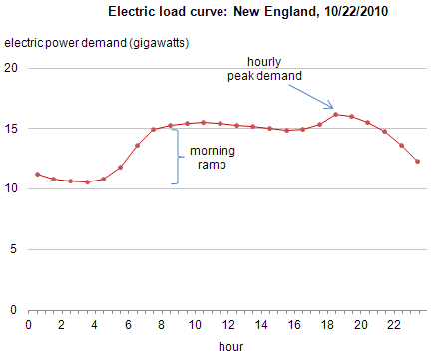
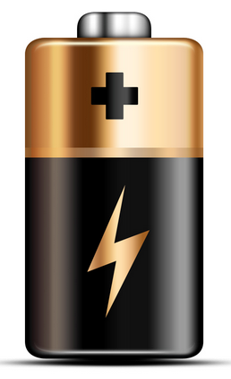
What are some challenges to electricity generation?
Electricity cannot be stored
Electricity is generated and consumed almost instantaneously
It is possible to store energy, but there are losses during the conversion
Demand is not consistent
Electricity use varies throughout the day
A set amount (“baseload”) of electricity is required at all times
Activity: Life Feed
Do you have electricity when you need it?
Notes:
Reiterate battery storage, summarize what we learned about electricity as a commodity that is produced and consumed instantaneously.
Also, demand is not consistent. What happens at 6am? People turn on their heat, open their refrigerators. At 6pm? People turn on their stoves, make dinner. At 10pm? People go to sleep and turn off the lights.
What happens when you don’t have electricity?

Slide 4
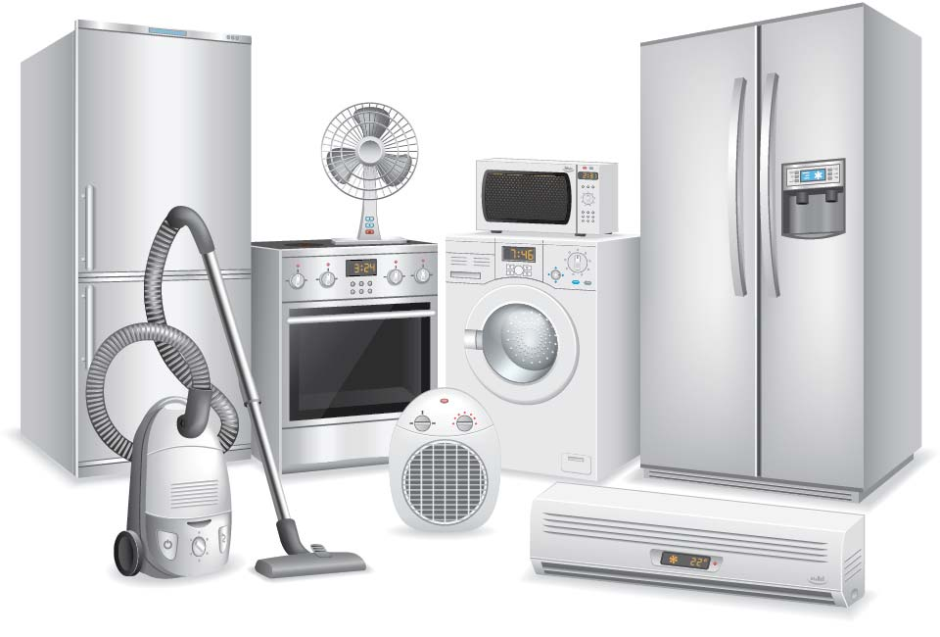
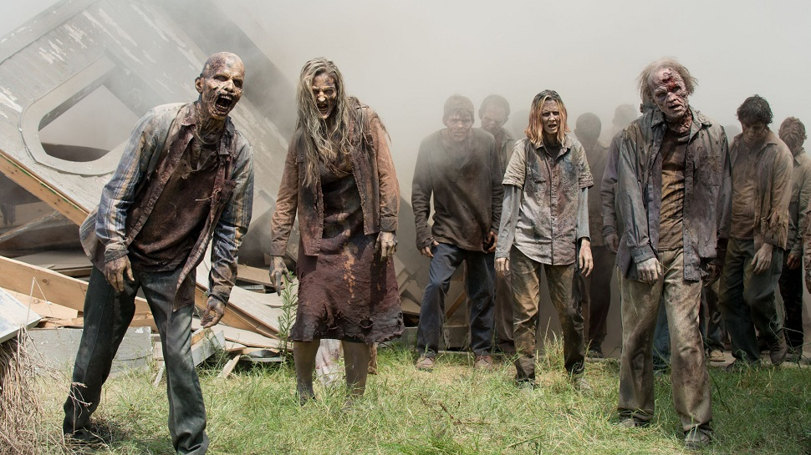
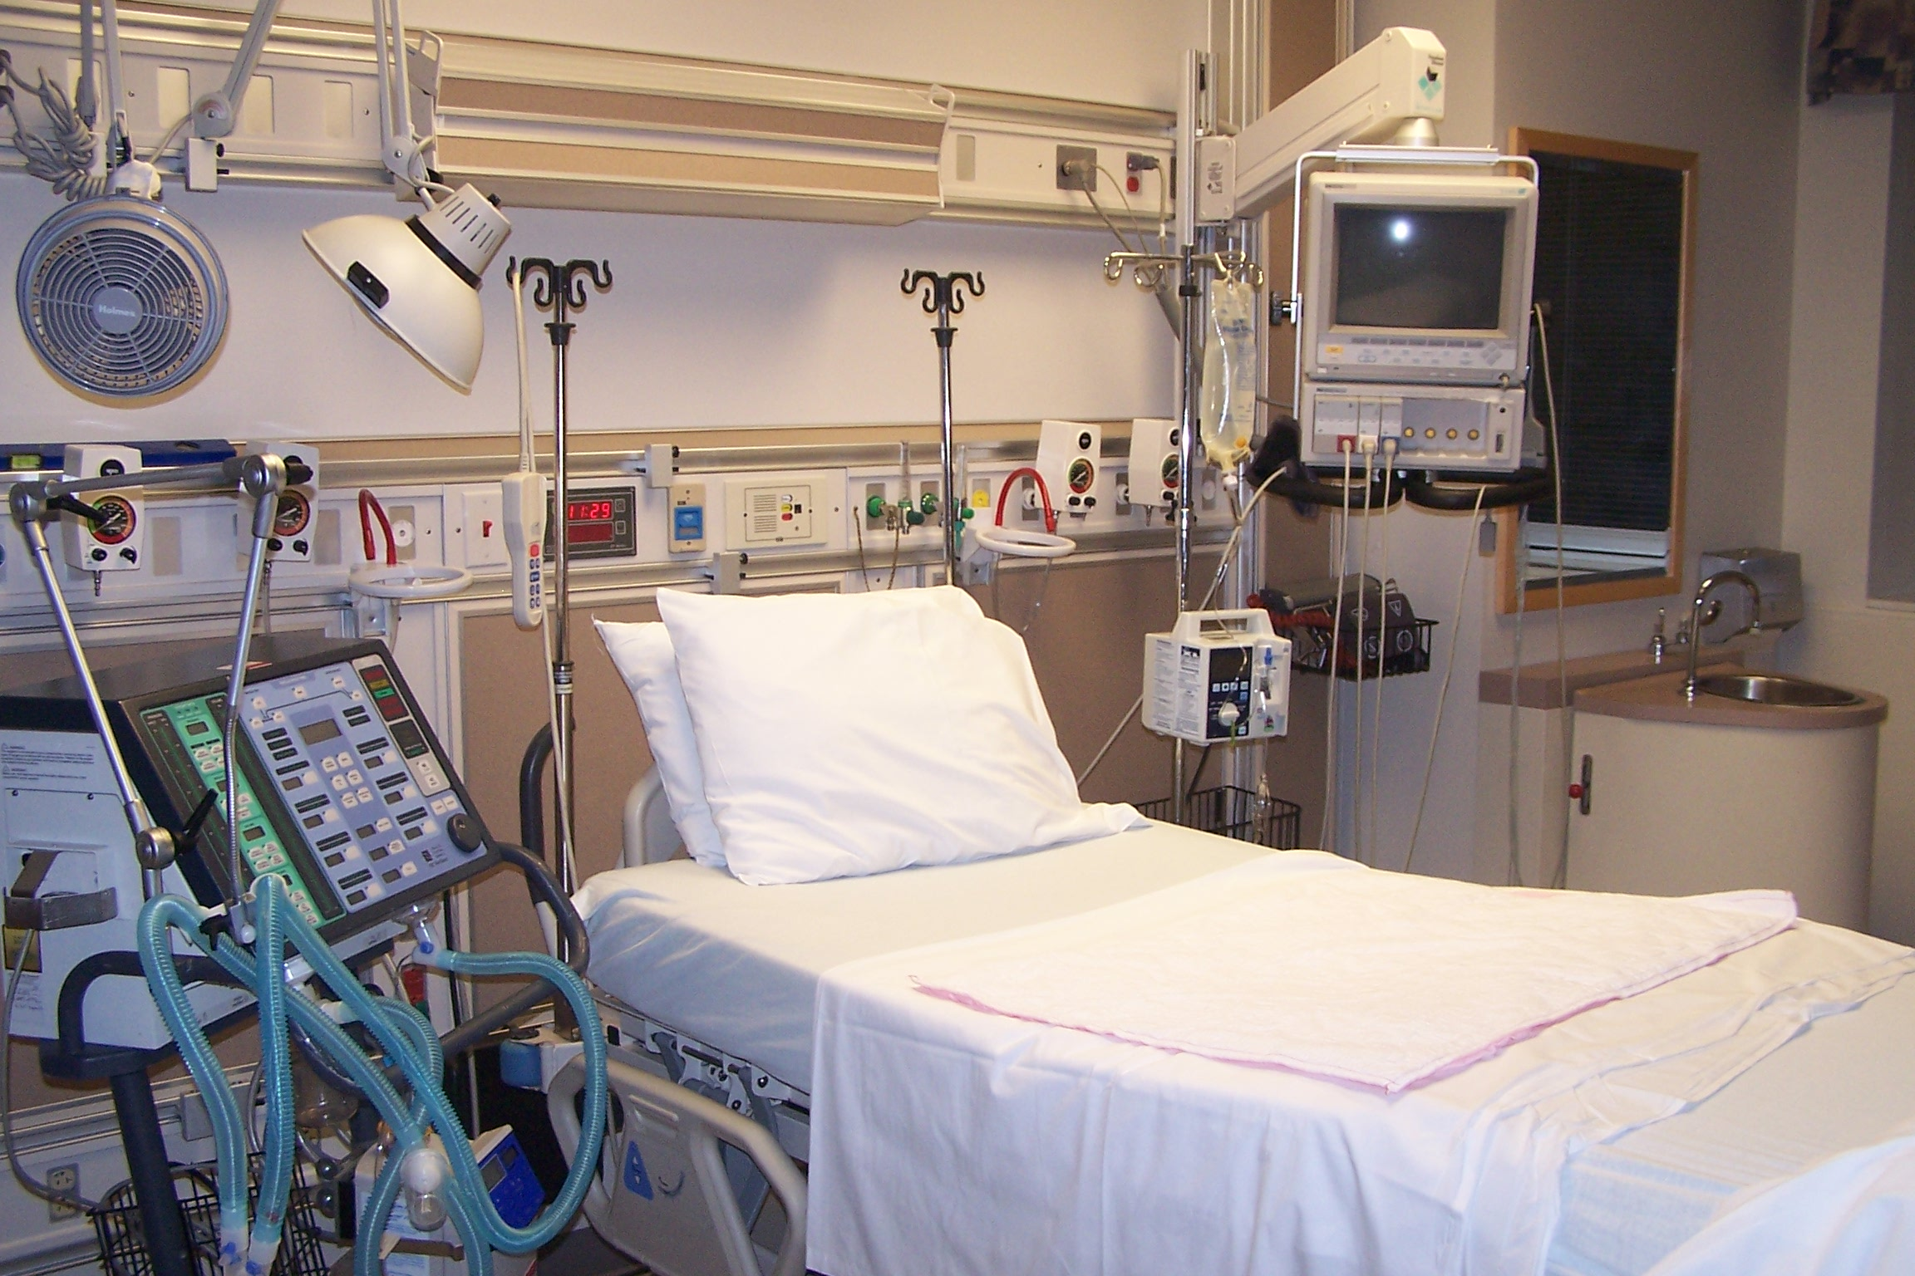
Notes:
The zombie apocalypse! ie no cell phones, tv, lights, etc
Imagine if you were in a hospital and your life depended on electricity. Imagine life without the appliances we all love for their time savings and convenience?
Key concept: it is VERY IMPORTANT to have reliable electricity sources

Slide 5
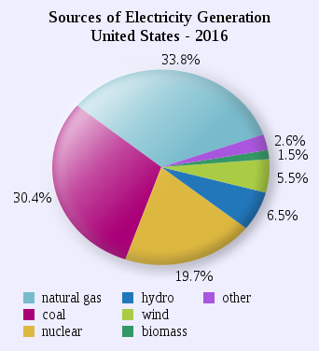
Name a type of electricity generation
Notes:
The major sources are: fossil fuels (coal, natural gas), nuclear, hydro, wind, biomass, other (solar, petroleum)
Fossil fuels = dinosaur bones = are organic material that formed over geological time scales into a fuel
Cross concept: energy and the environment
Natural gas gives off about half the carbon that coal does (per MW)
Carbon free generation is nuclear, hydro, solar, and wind

Slide 6
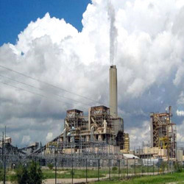
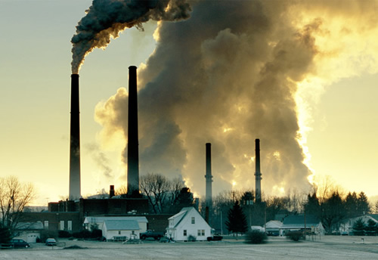
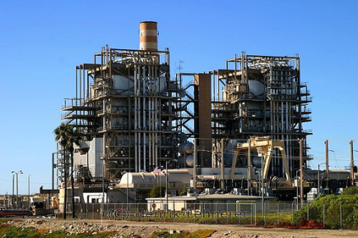
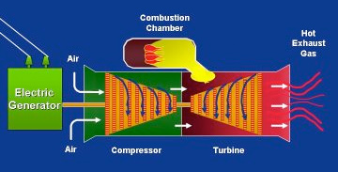
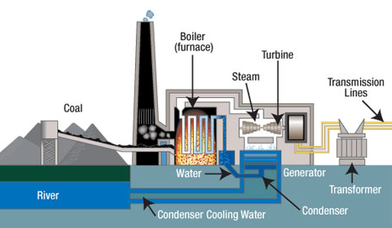
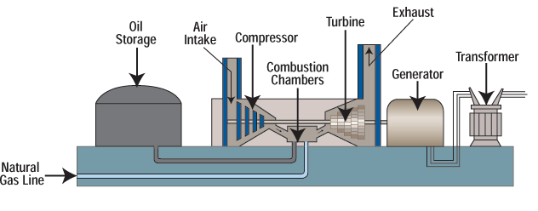
Fossil Fuels: Coal, Natural Gas, Petroleum
A gas turbine operates like a steam turbine, but air is used as the working fluid.
Notes:
Coal: coal is burned as a heat source. Heat is used to boil water to steam which turns a turbine (Rankine cycle). Turbine spins generator which makes power.
Natural Gas: Compressor draws air in. Combustion system mixes fuel and air and burns mixture. This combustion produces a high pressure stream that expands and turns the turbine (connected to a generator).
Petroleum - can use either method

Slide 7
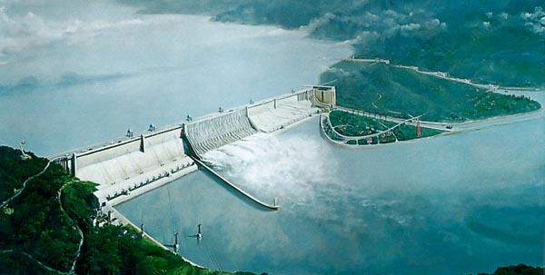
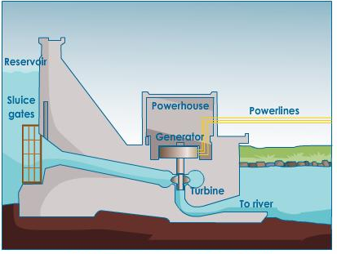
Hydroelectric

Slide 8
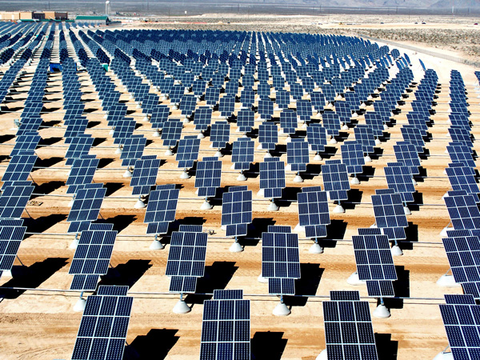
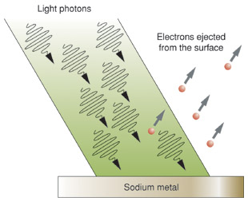
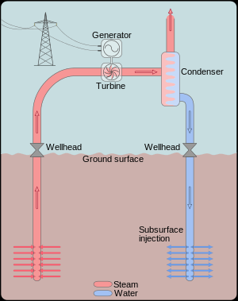
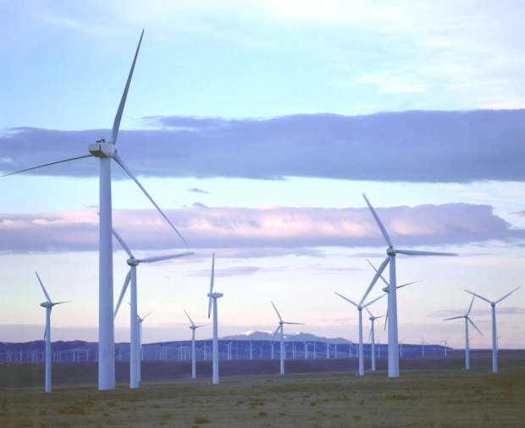
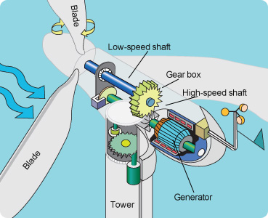
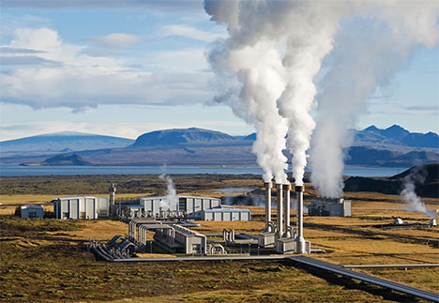
Other Renewables: Wind, Solar, Geothermal
Notes:
Solar: photoelectric effect - light photons hit a metal and eject electrons
Wind: The blades act as a huge turbine which spins a generator
Geothermal: Hot steam underground (typically in volcanic areas) is used to turn a turbine which spins a generator.
Biomass: biomass burned to produce hot gas which via a heat exchanger boils water to make steam, turn a turbine which turns a generator.

Slide 9
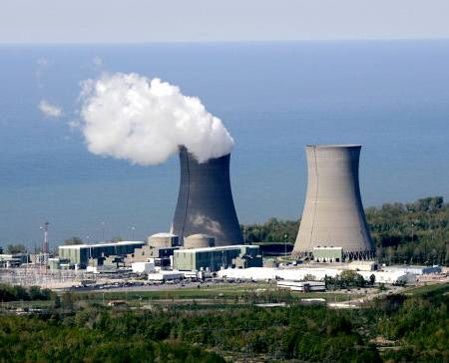
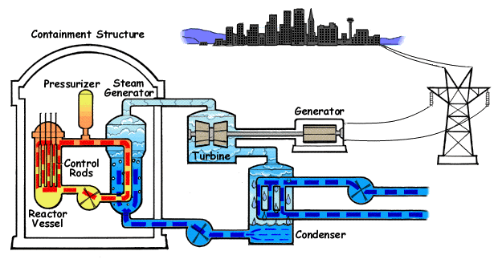
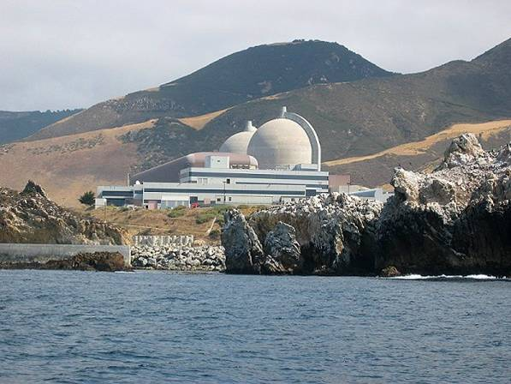
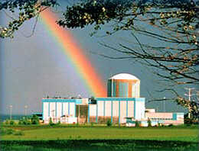
Nuclear
Notes:
Like other sources, nuclear energy is used to heat water, make steam, turn a turbine, and generate electricity.
The heat is produced via fission or splitting atoms. The change in mass between the products and reactants is converted to energy (E=mc^2)

Slide 10

Conclusions
We need a mix! Impossible to achieve 100% solar or wind generation.
What are the pros/cons of various types?
What would you choose as your energy portfolio?
Notes:
https://www.thirdway.org/e-binder/we-need-a-mix
Be fast through this part so you have time to play Megawatt Fever

Slide 11
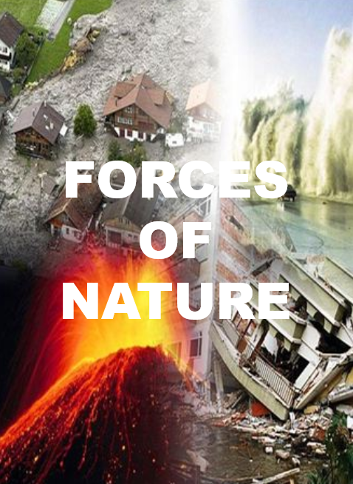

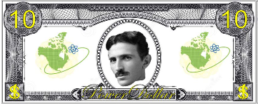
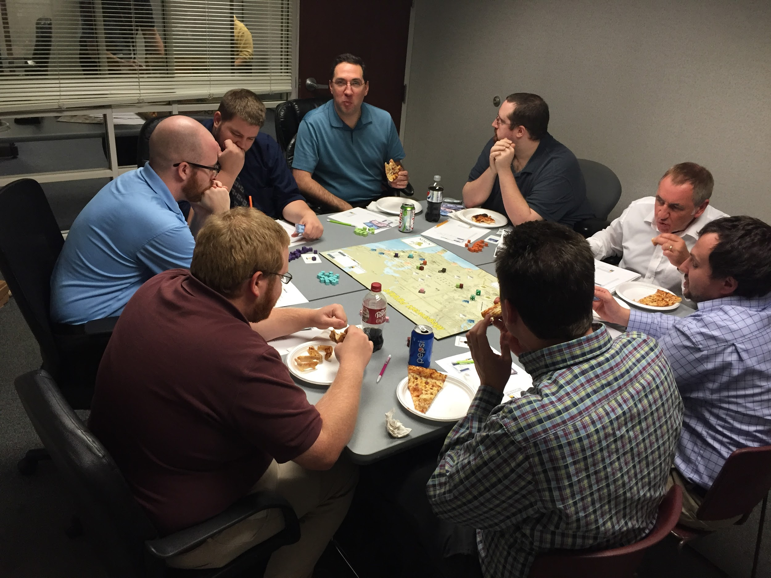


In Class Activity: Megawatt Fever
Notes:
Premise: you are a utility CEO and you must grow your company by investing in various generation types.
“Days” will be represented by dice rolls. A day could be cloudy in which case a solar plant will pay out 0. A day could be stormy in which case a wind plant might pay out more. This represents the variability of intermittent sources.
Power Up Effects: explained on the card. Include effects such as a carbon tax (coal taxed at a rate twice that of natural gas indicative of actual carbon contributions)

Slide 12
Play for ~15 minutes to understand mechanics
FORCE OF NATURE CARD

Slide 13
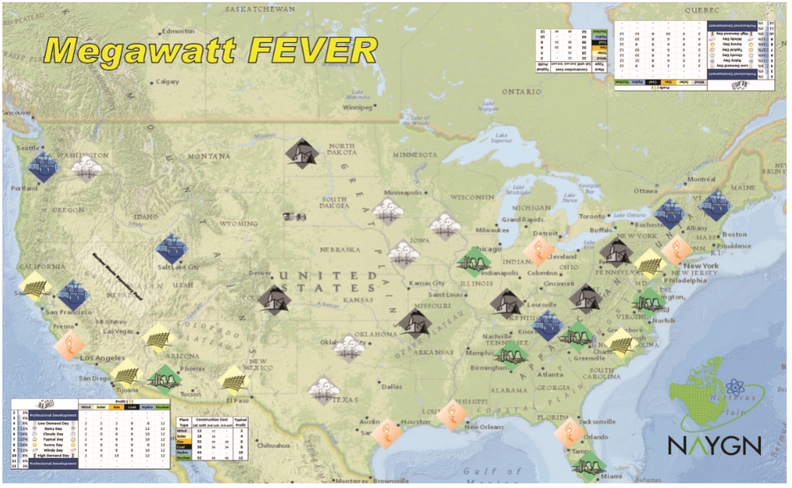
Play for another 15 minutes
Notes:
Count up your total company worth (money+assets)
Winner can keep the board game!

Slide 14
Education Standards
Physical Science
Georgia State Standards
SPS4 Obtain, evaluate, and communicate information to explain the changes in nuclear structure as a result of fission, fusion, and radioactive decay.
c. Construct arguments based on evidence about the applications, benefits, and problems of nuclear energy as an alternative energy source.
Activity: Megawatt Fever - This game explores the concept of alternative energy sources and the balance necessary to have a functioning grid.

Slide 15
Education Standards
ETS
Next Generation Science Standards
HS-ETS1-1 Analyze a major global challenge to specify qualitative and quantitative criteria and constraints for solutions that account for societal needs and wants.
Activity: Megawatt Fever - This board game allows students to consider how electricity is generated to suit the needs of society.
Notes:
Engineering Technology and Applications of Science

Slide 16
Education Standards
ETS
Next Generation Science Standards
HS-ETS1-2 Design a solution to a complex real-world problem by breaking it down into smaller, more manageable problems that can be solved through engineering.
Activity: The problem is turning a generator. The solutions are various! Break down a chosen electricity generation type into it’s small steps and consider how engineering is used to design components for each step.
Notes:
High School Engineering Technology and Applications of Science

Slide 17
Education Standards
ETS
Next Generation Science Standards
HS-ETS1-3 Evaluate a solution to a complex real-world problem based on prioritized criteria and trade-offs that account for a range of constraints, including cost, safety, reliability, and aesthetics as well as possible social, cultural, and environmental impacts.
Activity: NAYGN Essay Contest - Research energy sources and climate change. Propose an informed energy solution that limits climate change, allows developed countries to maintain their standard of living, and can provide reliable electricity to the 1.2 billion people currently without access to power. Proposed energy solution should consider the environmental and practical benefits and consequences of baseload (e.g. nuclear, fossil, hydro) versus intermittent (e.g. wind or solar) sources.

Slide 18
More Information
http://naygn.org/committees/public-information/student-education/
Requirements:
• In this essay, define baseload and intermittent electricity sources.
• Use at least 3 different reliable sources for your research and cite these sources.
• Essay must be between 700 and 1000 words.
Optional Topics (questions to get you thinking!):
What is the cause of global warming?
Where do carbon emissions come from?
How is electricity made?
Can electricity be stored?
How much electricity do we need? How much do we use?
Could electric cars factor into the solution?
All electricity generation sources generate waste. How do we deal with this waste? (chemical, materials, carbon, radioactive materials)
What is the average electricity price in the United States?
Why is a diverse energy portfolio important?
What are the limitations of each electricity generation source?

Slide 19
Education Standards
Middle School: Sixth Grade
Georgia State Standards
S6E6 Obtain, evaluate, and communicate information about the uses and conservation of various natural resources and how they impact the Earth.
a. Ask questions to determine the differences between renewable/sustainable energy resources (examples: hydro, solar, wind, geothermal, tidal, biomass) and nonrenewable energy resources (examples: nuclear: uranium, fossil fuels: oil, coal, and natural gas), and how they are used in our everyday lives.
Activity: Megawatt Fever - Use the board game to familiarize students with various generation types.

Slide 20
Education Standards
Elementary: Second Grade
Georgia State Standards
S2P1 Obtain, evaluate, and communicate information about the properties of matter and changes that occur in objects.
a. Ask questions to describe and classify different objects according to their physical properties.
Activity: Boil water (steam rises, now a gas)
Pour into insulated cup and normal mug - which one would you want to hold if your hands were cold and you wanted to warm up? Rudimentary concept of a heat exchanger.

