Slide 1

2020 August Local Chapter Lead Meeting
Ashley Lawrence, US Operating Officer (USA@naygn.org)
August 27, 2020
Notes:
We’ll start off with Safety.
Please stop and look around your areas for any potential hazards that would affect you leaving your area safely in case of an emergency. If there are any hazards, please take a moment to eliminate them. Make sure we are also following our COVID-19 protocols.
If you have to get off the call, I’ll be glad to catch you up at a later time.

Slide 2
Agenda
Metrics
Diversity and Inclusion
2020 Q3 Excellence Awards
2020 Regional Conferences
NAYGN Committee Updates
Professional Development Opportunities
Public Information Opportunities
Open discussion
Notes:
Metrics update
Update on our diversity and inclusion initiative
Information on our 2020 regional conferences
Committee updates
Professional development opportunities
Public information opportunities

Slide 3
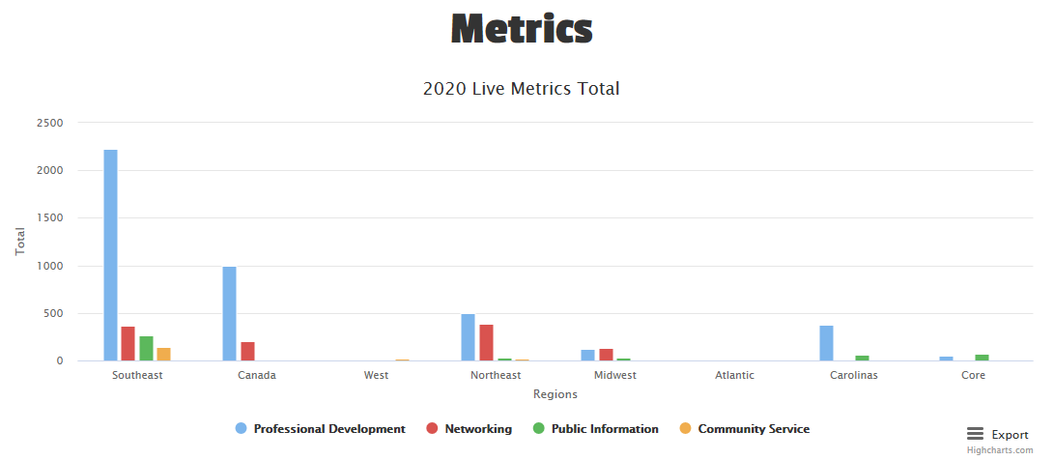
2020 Metrics
https://naygn.org/local-chapters/metrics/
Please submit 2020 metrics as they happen
Any questions/concerns (i.e. if you need to edit a submission, if your chapter doesn’t appear, etc.) email Canada@naygn.org or USA@naygn.org and we will fix it!
Notes:
Here are the current metrics for this year.
Please continue to add your metrics as you complete events throughout the year.
Any questions/concerns, please reach out!

Slide 4
Diversity and Inclusion
Our organization is continuing to take action on how we can do better. We first started by establishing the Diversity and Inclusion Committee. This committee was chartered to review the current state of diversity and inclusion in the NAYGN organization and form actions and initiatives to make NAYGN a more diverse and inclusive environment. Additionally, these initiatives should ultimately help NAYGN to be better in addressing systemic racism in our organization, in the nuclear industry, and in the communities we live.
  Please contact diversity@naygn.org to engage with the D&I Council – we’d be happy to work with you.
External review of D&I performed by MMCS limited on 7/28/20.
As NAYGN leaders, we are asking that you self reflect on D&I in your chapter
  Created a document of chapter activity ideas for your use
Notes:
Our organization is continuing to take action on how we can do better. We first started by establishing the Diversity and Inclusion Committee.
We also had an external review of D&I performed by MMCS limited at the end of July.
We received great feedback from them on are actively creating a plan based on this feedback
Our next step is we need your help. As NAYGN leaders, we are asking that you self reflect on Diversity and Inclusion in your chapter. How is your chapter doing with D&I initiatives?
We’ve created a few documents of chapter activities and questions to help your chapter with D&I ideas

Slide 5
2020 Q3 Excellence Awards
Nominations for the Q3 Excellence awards are now open
These nominations will be for the time period from July 1, 2020 through September 30, 2020
Deadline to submit is October 31, 2020.
Nomination link: 3Q 2020 NAYGN Excellence Awards
Past award winners now appear on the website here: https://naygn.org/past-award-winners/
Recognize your fellow members for their activities supporting NAYGN!
Notes:
Nominations for Q3 excellence awards are now open.

Slide 6
Regional Conference Dates
Region | Date(s)
Atlantic | November 10-11
Carolinas | October 19-22
Canada | November 27th
Midwest | December 10th
Northeast | November 10-12
Southeast | November 30th - December 3rd
West | December 7-10
Notes:
Regional conference season is approaching and We’re going virtual!
Be on the lookout for more information from your regional and conference leads on session details and how to register.

Slide 7
2021 Sponsorship Drive
Sponsorship Committee looking for help – contact Treasurer@NAYGN.org to get involved!
2021 Sponsorship Brief - will be used to assist discussions for sponsorships
2021 Sponsorship strategy
  Retain current sponsors and thank them!
  Gain commitment back from previous sponsors recently lost
  Find new sponsors
    Active NAYGN chapters can help!
    Core providing one-on-one discussions and mentoring
    Utilize our extensive network and great reputation!
  Two-way approach – Core requests support from company CNOs and LCLs request support via company sponsors
  LCLs will receive information packets for their company sponsors
Benefit to NAYGN – continue to fund our amazing initiatives and events!
Notes:
Dan Deckman, NAYGN treasurer

Slide 8

Awards Committee Update
Notes:
Paul Rodi – awards chair

Slide 9
Virtual PD Committee Inaugural Event
Maximizing Your Virtual Presence - Collaborating & Leading Remotely with Nadia Bilchik
  Nadia Bilchik is the President of Greater Impact Communication, is an internationally renowned television personality, communication and professional development training expert, author and keynote speaker.
Tuesday, September 22, 2020 from 1100-1230 EST
Training held via ZOOM
Register HERE
Notes:
Nadia Bilchik is the President of Greater Impact
Communication, is an internationally renowned television personality,
communication and professional development training expert, author and keynote
speaker. She was one of our fantastic speakers at the 2019 National NAYGN
Professional Development Conference!

Slide 10
Medical Isotopes Webinar
Save the date – James Scongack, Executive Vice President
Corporate Affairs and Operational Services at Bruce Power will speak to us on Bruce Power’s Medical Isotope program!
  Wednesday, September 23, 2020 from 1200-1300 EST.
  Contact Emma Paul – Emma.Paul@brucepower.com – for webinar details!

Slide 11
Professional Development Book Club
August PD Book Club – September 1st at 11:00 EDT
Book for discussion - “Mistakes Were Made (But Not by Me)”
  Chapters 4 & 5
Register for the event HERE
Call Information:
  Event Number: 127 300 5256
  Event Password: x8fVsZk8GJ6
Audio Conference:
  Call-in toll number (US/Canada)
    1-650-479-3208
    Access code: 127 300 5256
Notes:
Our next Professional Development book club discussion will be July 21st
The book for the discussion is “Mistakes were made (But Not By Me)” and we’ll discuss chapters 4 & 5 on the call.

Slide 12
Professional Development Book Club
September PD Book Club – September 29th at 11:00 EDT
Book for discussion - “Mistakes Were Made (But Not by Me)”
  Chapters 6-8
Register for the event HERE
Call Information:
  Event Number: 127 098 8817
  Event Password: ryUMYC3Wj42
Audio Conference:
  Call-in toll number (US/Canada)
    1-650-479-3208
    Access code: 127 098 8817

Slide 13
Professional Development Book Club
Call for 4Q2020 Book Club ideas!!
What topics, articles, or videos are you interested in? Email pd@naygn.org with your input!

Slide 14
2021 NAYGN PD Conference Committee
Call for Committee Members for 2021 National NAYGN PD Conference!
  Are you interested in being on the planning committee for the 2021 National NAYGN Professional Development Conference? Are you interested in leading or co-leading the planning committee?
  If interested, please email pd@naygn.org to get engaged!

Slide 15
2020 Fission
Bringing Nuclear Energy Into Focus (oh the puns!)
DRAWING CONTEST
Deadline is noon on Sunday September 20th
More information: https://naygn.org/committees/public-information/student-education/
Send this pre-recorded presentation to a 4th or 5th grade teacher today! https://www.youtube.com/watch?v=eE3jp-ppk7M
Due to COVID, we are accepting submissions from current 4th, 5th, or 6th grade students (since some started this last spring before school was disrupted).

Slide 16
Nuclear Science Week
Starts Monday October 19!
This year, the “Big Event” will be virtual so plan to join!
Add your #NuclearSciWeek event here for a bigger reach & more advertising!
Please follow #NuclearSciWeek on all social media platforms for key information.
Learn more at the Nuclear Science Week webinar cohosted by ANS & NAYGN on September 3 at 1pm ET. Registration details available soon.

Slide 17
NSW: Virtual Postcard Push Day
Rather than mail hard copies to our congressmen, chapters are encouraged to make Facebook posts tagging them. How it’ll work:
  NAYGN will supply the graphic and three factoids to choose from.
  Members will make the posts through their official NAYGN chapter Facebook page or personal account during Nuclear Science Week.
  Chapter members will like/share the posts, which should help them catch the eye of a political aide.
  Between the graphic, factoid, and number of likes/shares, the aide is more likely to remember that constituents support nuclear power.
  Government Outreach is still working through the details, but directions will be provided.
  Contact governmentoutreach@naygn.org to receive an email with the directions and graphic.

Slide 18

NAYGN Enercon Services, Inc.
Congressman David Scott
Please support nuclear power! Nuclear energy accounted for 55% of America’s clean energy in 2019.
Nuclear Energy
Powering Us through a Pandemic
Graphic above is a placeholder and will not be used.

Slide 19
NSW: School Outreach
The high school essay contest will be launched for #NuclearSciWeek
Set up virtual classroom visits! Watch this video for some cool ideas: https://youtu.be/1_PFLcNXMqg
For younger students, try reading George’s Energy Adventure & Marie’s Electric Adventure. The e-books are free!

Slide 20
Questions?
What would you like to see discussed on future LCL calls?

Slide 21
Open discussion with NAYGN President
Notes:
Before we turn it over to our president, Amber, I want to open it up for any questions or comments that you may have.
Ok, over to you Amber.

