Slide 1
Chernobyl
The HBO Miniseries

Slide 2
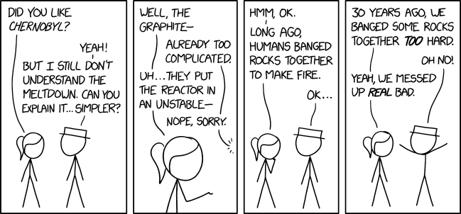
Introduction: kristie soliman
Image: Randall Munroe / https://xkcd.com/2163/

Slide 3
Ask the Panel:
pollev.com/kristiesolim569

Slide 4
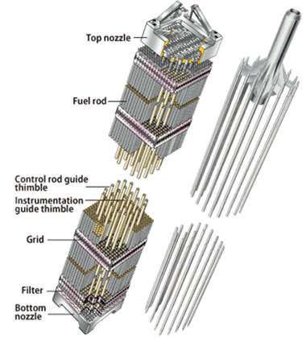
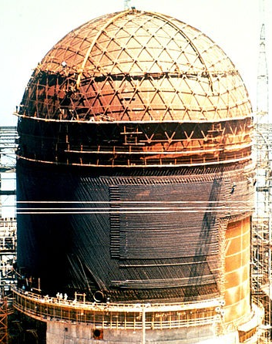
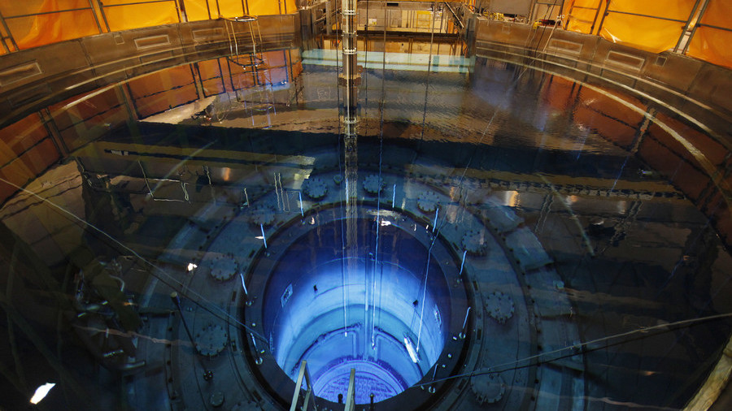
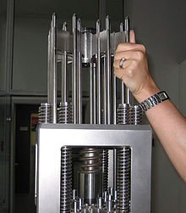
Engineered Differences
Containment
Control Rods
Light Water Reactors

Slide 5
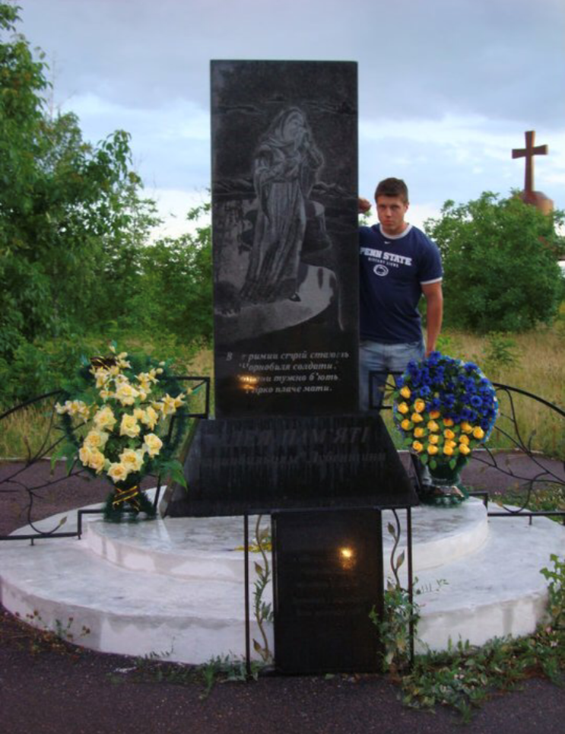
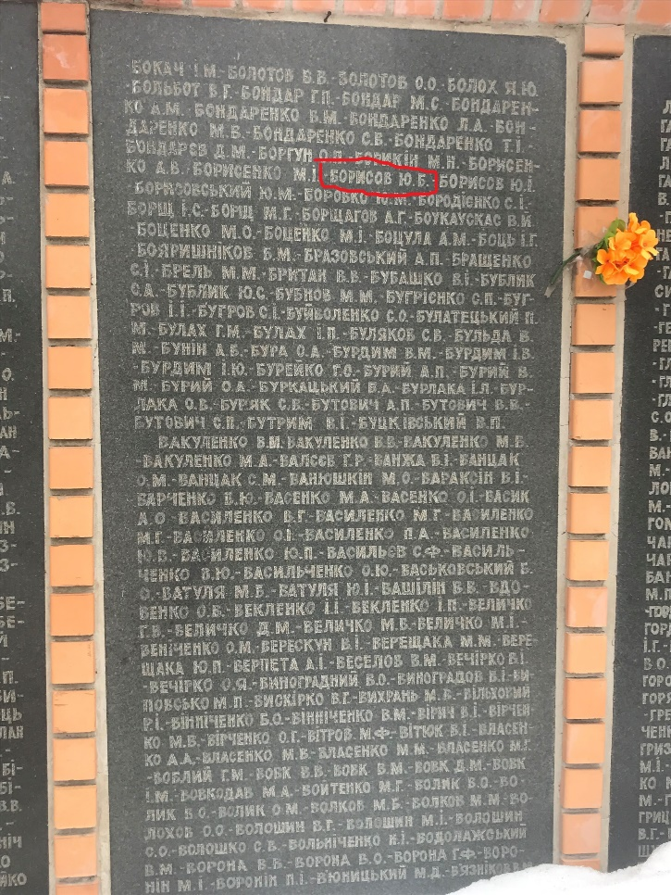
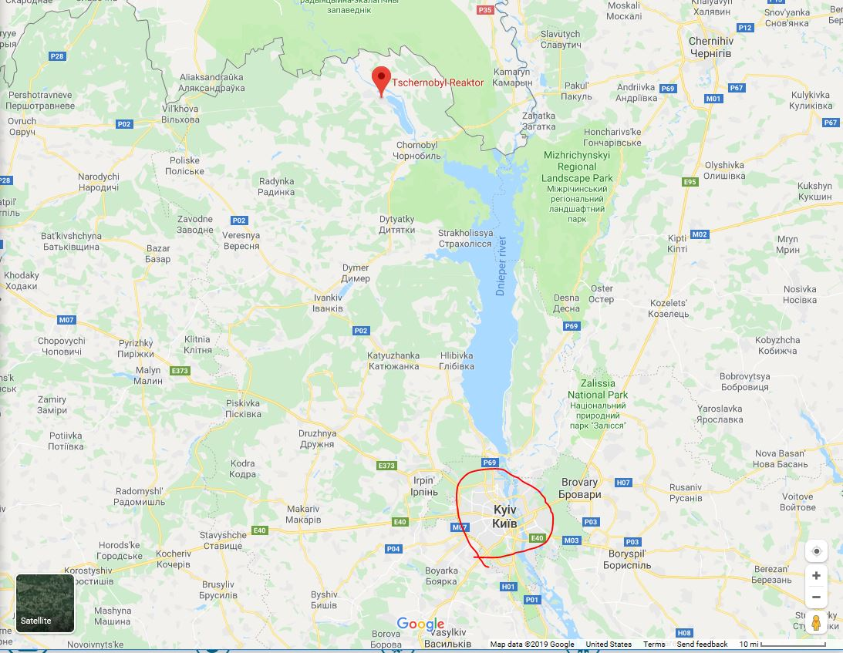
Back in the ussr
Chernobyl monument in Lubny, Ukraine
Chernobyl Lubny workers honorary plaque in Lubny, Ukraine (Uncle’s name outlined)
Google Maps: Chernobyl distance to Kyiv

Slide 6
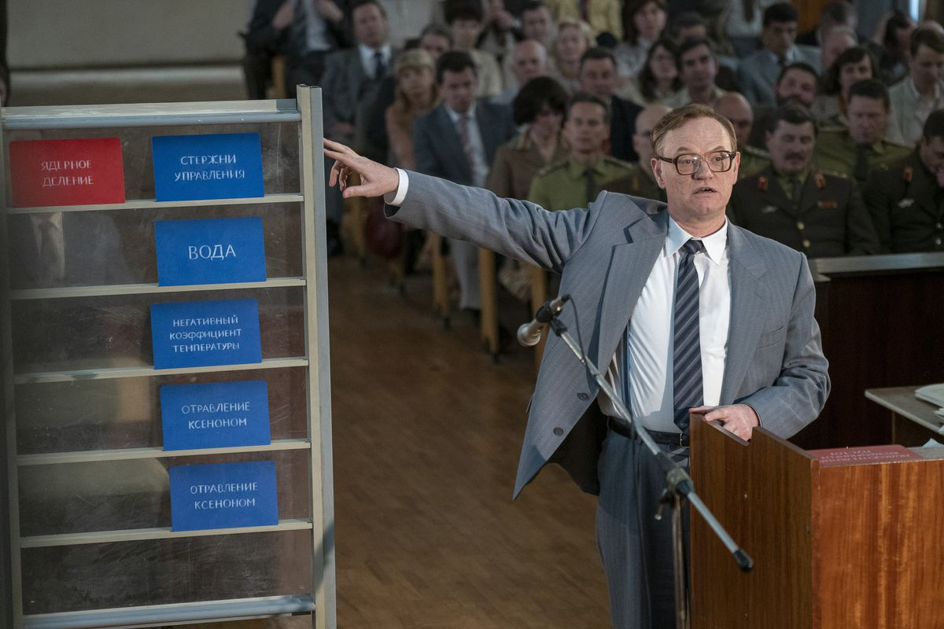
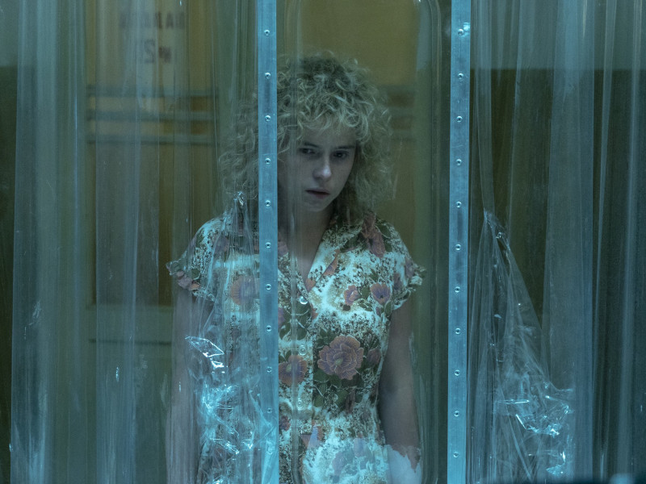
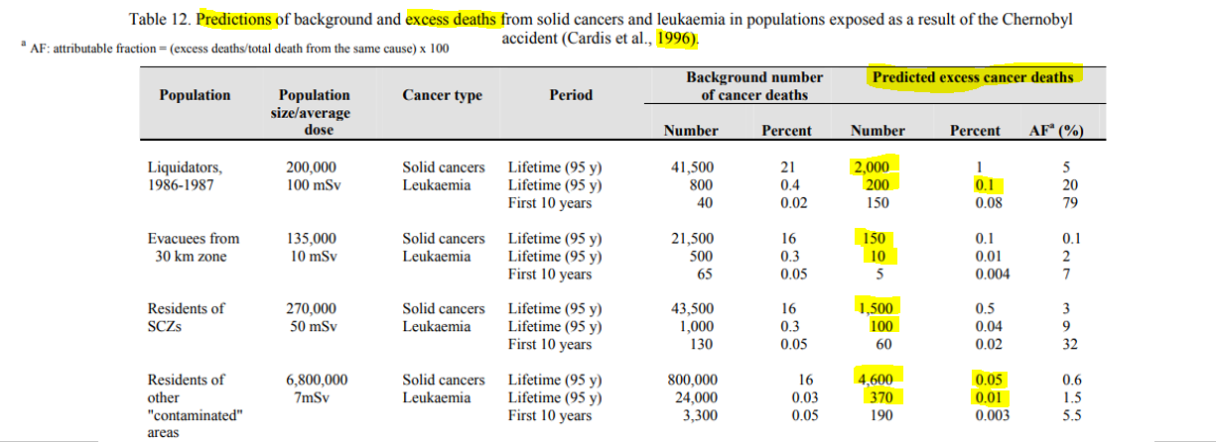
Images: Liam Daniel/HBO

Slide 7
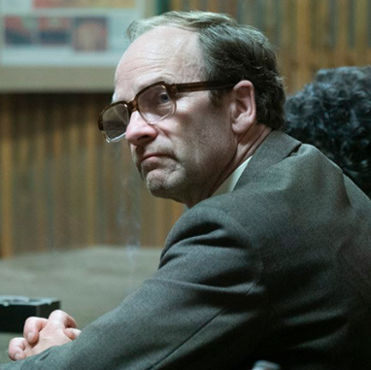
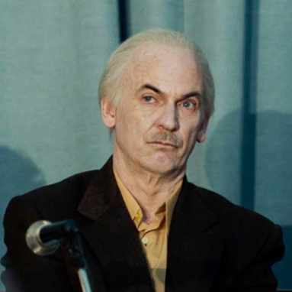
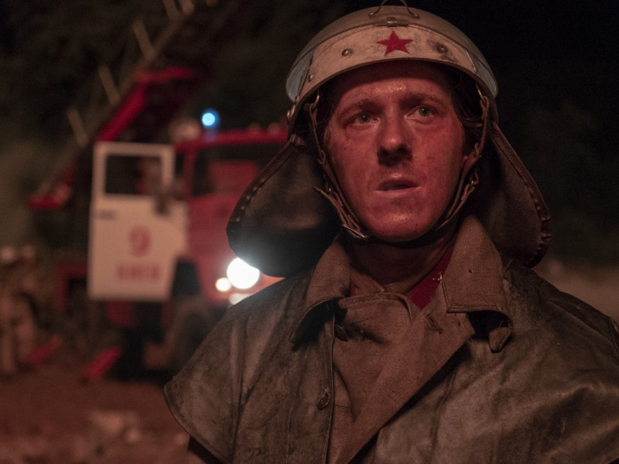
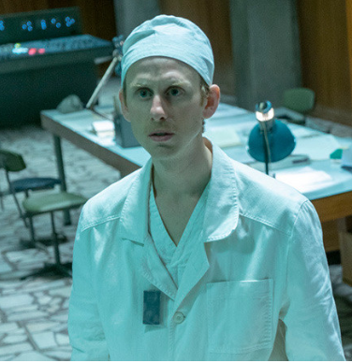
Cast of Characters
Anatoly Dyatlov
Deputy Chief
Engineer
Viktor Bryukhanov
Plant Director
Nikolai Fomin
Chief Engineer
Boris Shcherbina
Aleksandr Akimov
Shift Supervisor
Vasily Ignatenko
Lyudmilla Ignatenko
Leonid Toptunov
Senior Reactor Operator
Ulana Khomyuk
Valery Legasov
Images: Liam Daniel/HBO

Slide 8
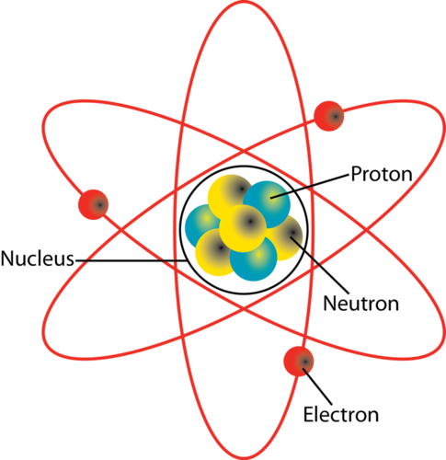
Nuclear Engineer – English Dictionary
Containment – concrete structure designed to hold nuclear material in the event of an accident
Coolant – removes heat from fuel (to make electricity), RBMK coolant was water
Fission – use a neutron to split an atom and release energy
Graphite – form of Carbon, moderates (slows down) neutrons which increases reaction rate
Moderator – slows down neutrons which increases power
Poison – (1) substance that causes illness OR (2) neutron absorber that decreases reaction rate
Radiation – energetic particles (gamma, beta, alpha, neutron, etc)
Reactivity – rate of fission within a nuclear reactor
Uranium – element on Periodic Table, can be split by a neutron, nuclear fuel
Xenon – element on Periodic Table, absorbs neutrons, fission product
Ask a Question: pollev.com/kristiesolim569

Slide 9
Backup Slides

Slide 10
Pressurized Water Reactor

Slide 11
RBMK – Chernobyl Design (Light Water Graphite-Moderated Reactor)

Slide 12
Rbmk control rod design
Boron
(strongly absorbs neutrons)
1.25 m
Water
(slightly absorbs neutrons)
4.5 m
Graphite
(moderates neutrons)
1.25 m
Steve Skutnik University of Tennessee Knoxville Nuclear Engineering Professor

Slide 13
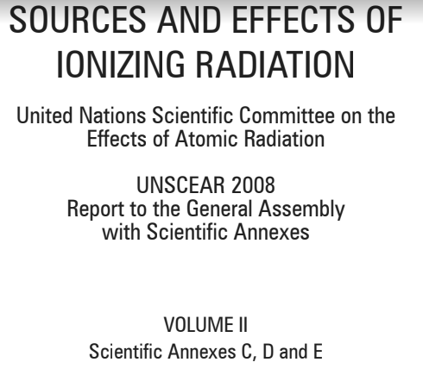
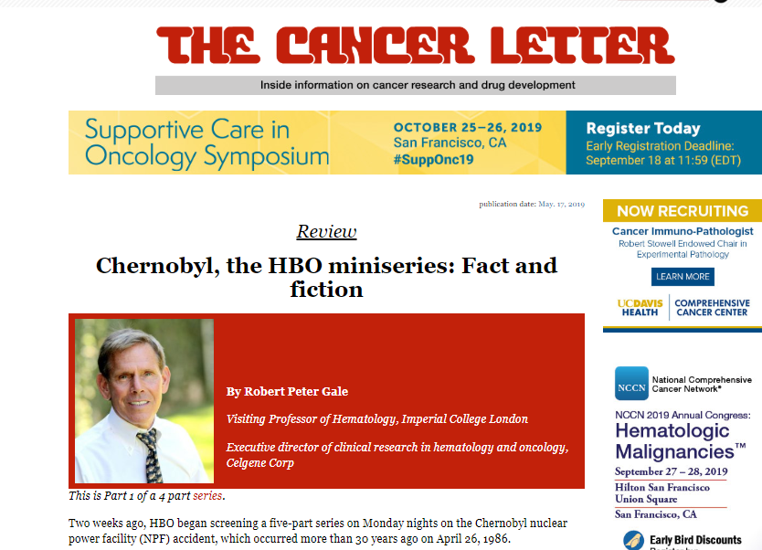
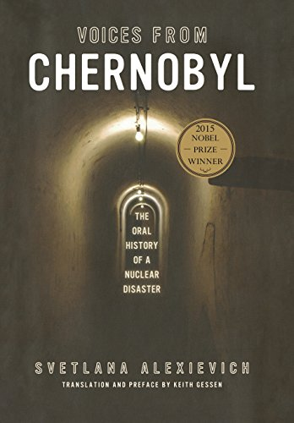
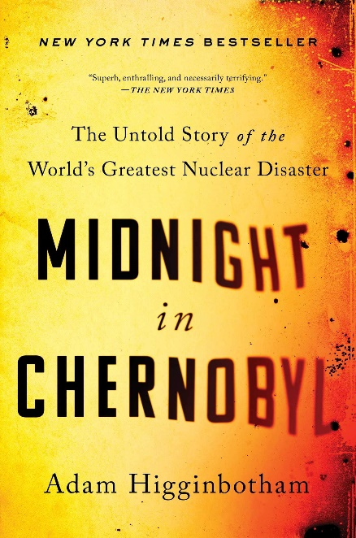
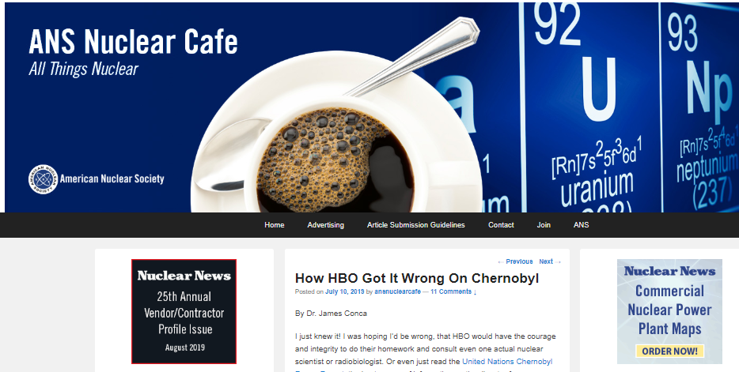
Want to learn more?
X
☑

Slide 14
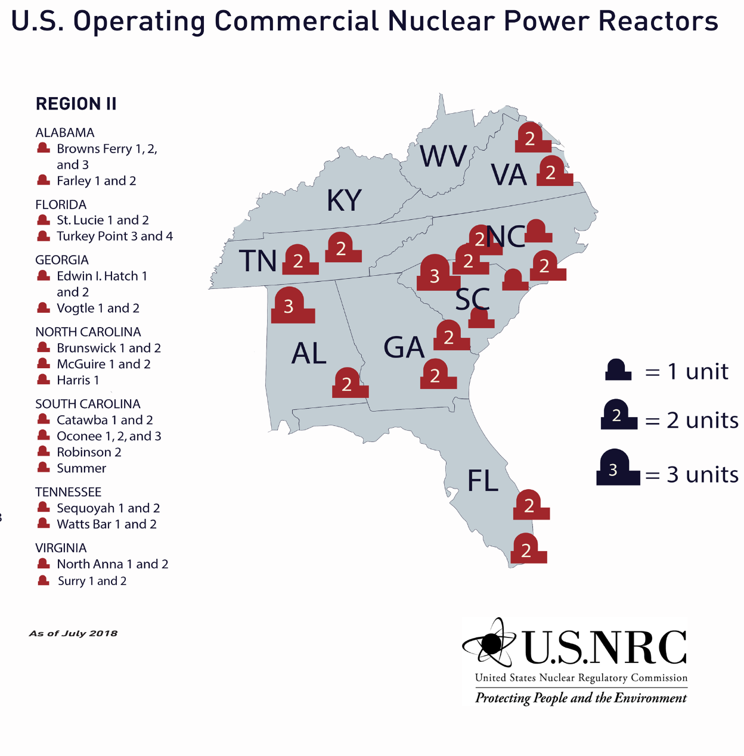
Where is the nearest nuclear plant?

Slide 15
Radiation in Everyday life
Bananas
The Sun (it’s a fusion reactor!) – source of cosmic radiation
Brazil nuts
Air
Rocks
Medical procedures
Flying (closer to the sun)

Slide 16
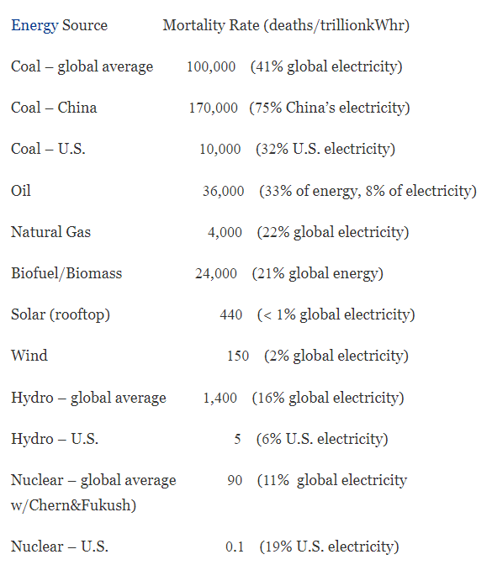
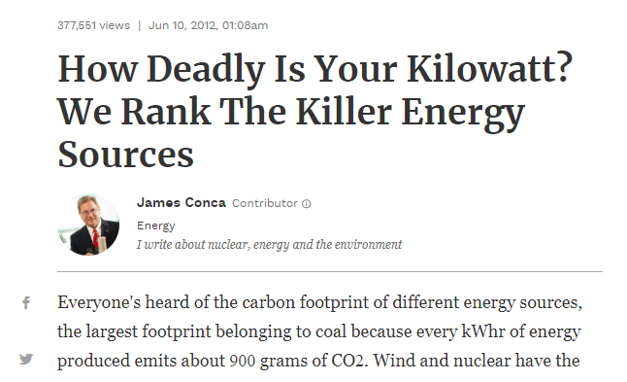
Energy comparison

Slide 17
“It has been reported”
Images: Liam Daniel/HBO

Slide 18
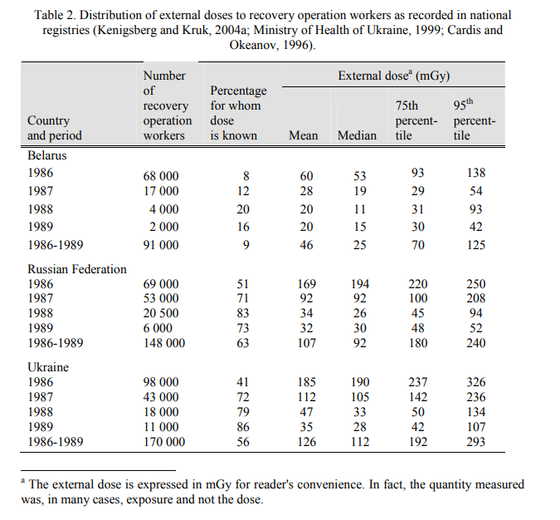
How much dose did “liquidators” get?

Slide 19
Acute effects
Stochastic effects
Direct, immediate result of exposure to radiation
Occur within hours to days
Strongly predictable relative to dose
Driven by destruction of cells within the body
Examples: Hair loss, burns, organ failure
Indirect, long-term result of exposure to radiation
Occur over years to decades
Probability of occurrence proportional to dose (random)
Driven by damage to DNA
Examples: Cancer, leukemia
Steve Skutnik University of Tennessee Knoxville Nuclear Engineering Professor

Slide 20
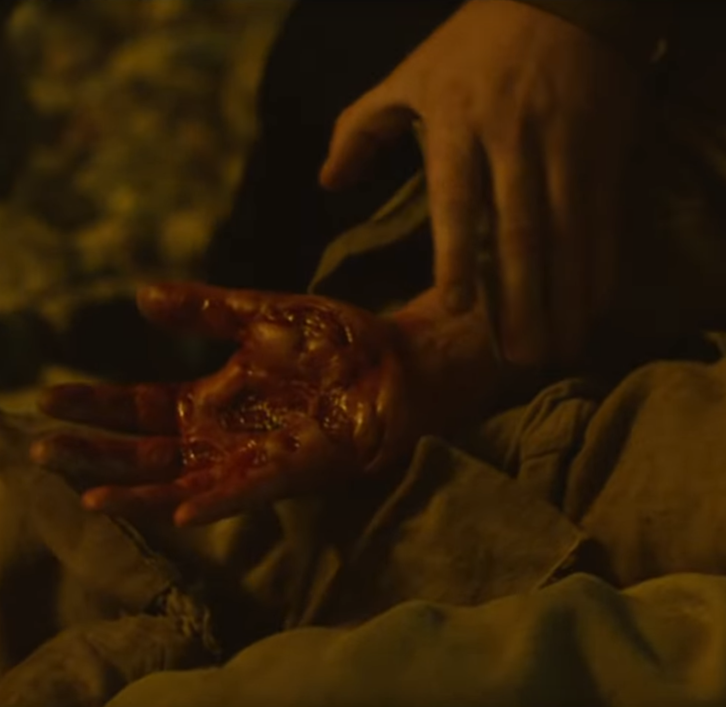
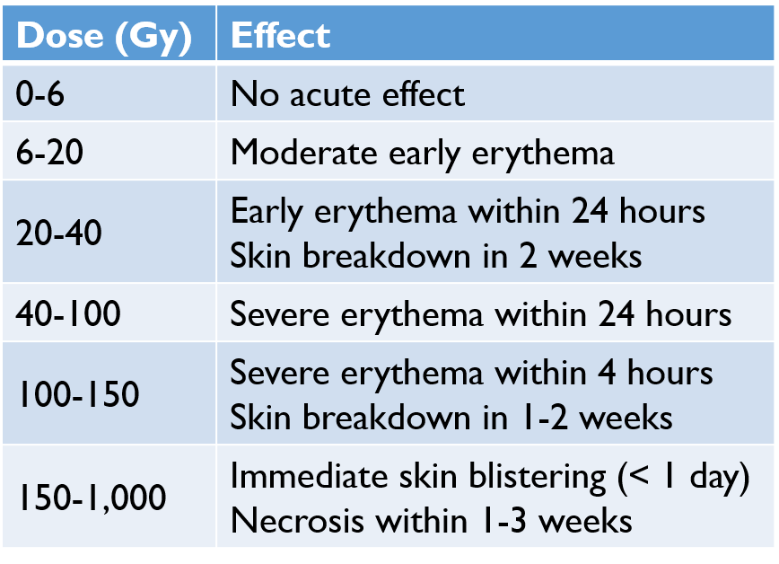
Acute radiation exposure: effects on skin
1 Gy = 100 rad
=100 rem
(gamma/beta ➔ quality factor of 1)
Adapted from “Nuclear Handbook for Medical Service Personnel,” US Department of the Army, 1969
Steve Skutnik University of Tennessee Knoxville Nuclear Engineering Professor
Images: Liam Daniel/HBO

Slide 21
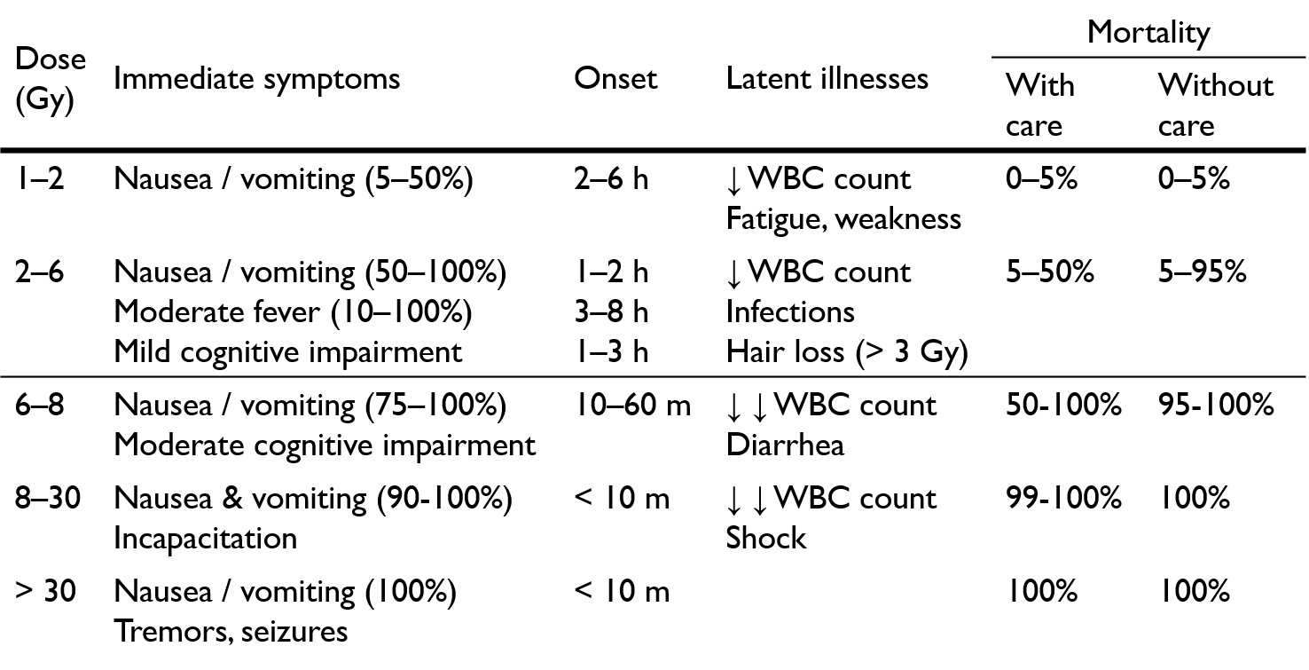
Whole body radiation effects
Adapted from Merck Manual
Steve Skutnik University of Tennessee Knoxville Nuclear Engineering Professor

Slide 22
“Chernobyl”
Reality
Firefighters showing immediate signs of skin blistering, ulceration, & erythema
Real but exaggerated: Many of these symptoms will occur but gradually
Days later, first responders vomiting, losing hair, & other symptoms
Real: Consistent with acute radiation syndrome, which killed 31 people
Ludmilla receives a radiation dose while visiting her husband, Vasily
Bogus: Individuals do not “become radioactive” in contact with radiation
Ludmilla’s unborn child absorbs a fatal dose of radiation in lieu of Ludmilla
Bogus: Developing fetuses are radiation-sensitive but do not “absorb” radiation in place of the mother
Steve Skutnik University of Tennessee Knoxville Nuclear Engineering Professor

Slide 23
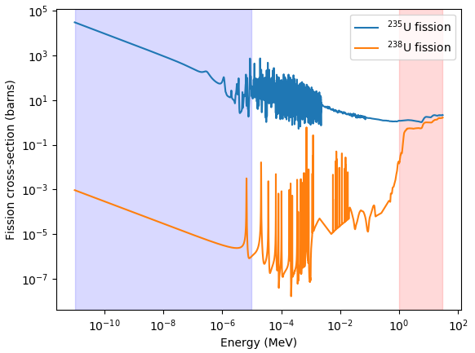
Fast and slow neutrons
“Fast” region:
Neutrons created in this energy range
“Thermal” (“slow”) region:
Fission much more likely in this range
Steve Skutnik University of Tennessee Knoxville Nuclear Engineering Professor

