Slide 1
GAMIFY Session
2017 Duke Energy NAYGN Chapter Conference – 6/08/17

Slide 2
Overview
Review
  Periodic table of elements
  Isotopes
  Decay
  Half-life
  Chart of Nuclides
Learn how to play CRITICAL PATH
Game on!

Slide 3
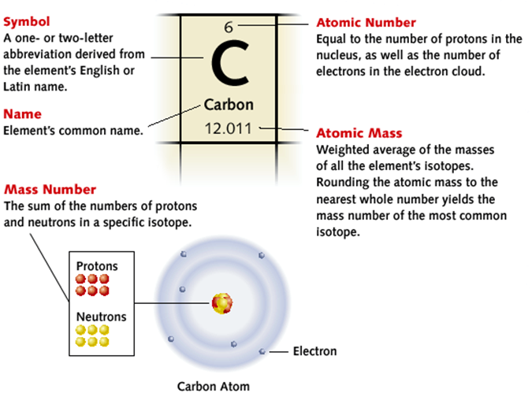
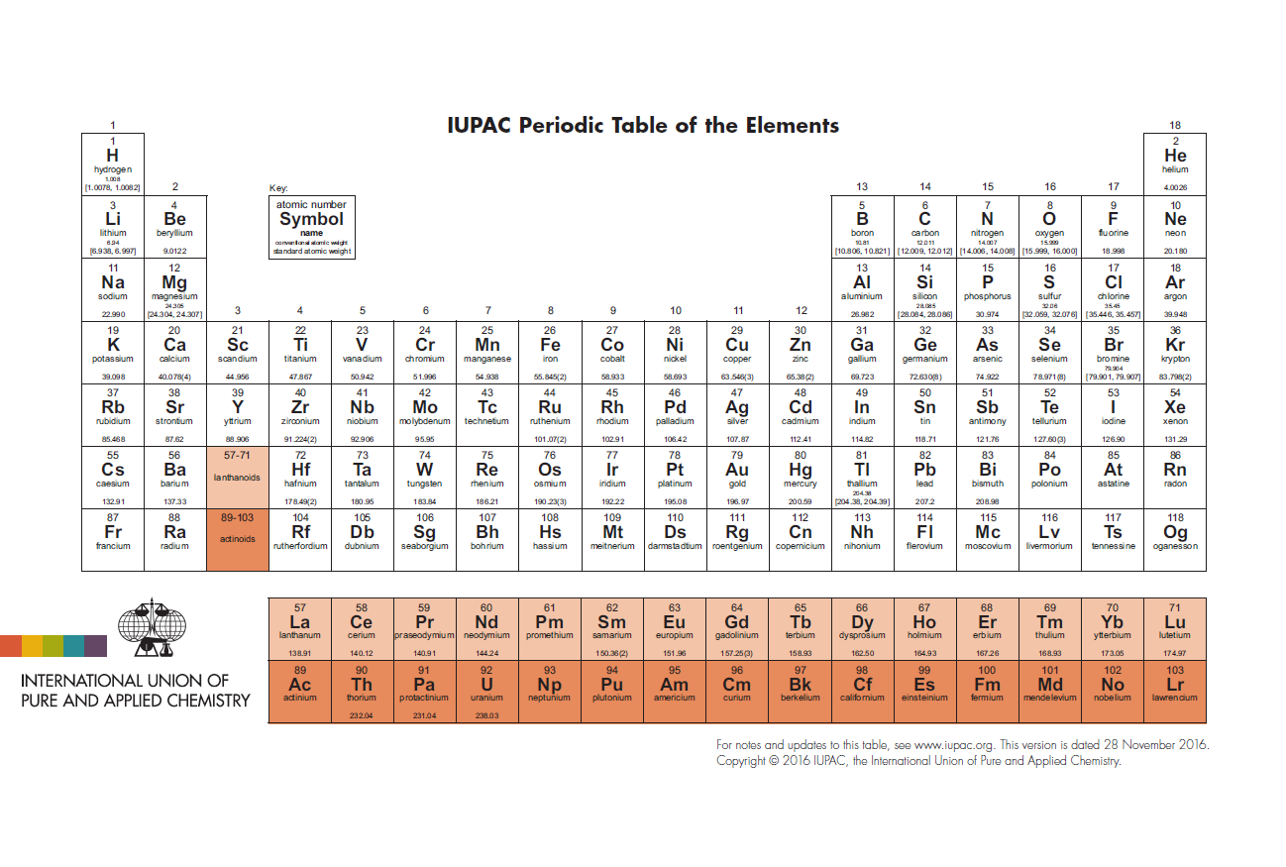
Periodic Table of Elements
https://www.classzone.com/books/earth_science/terc/content/investigations/es0501/es0501page06.cfm

Slide 4
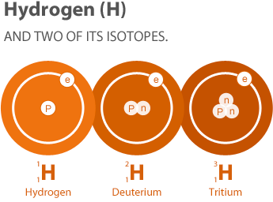
Isotopes
The atomic number (or number of protons) defines the element
Elements have various isotopes which differ in their number of neutrons
Nuclide is another term used to define isotopes when speaking specifically about the nucleus
Radioactive isotopes have an unstable nucleus and decay until stability is reached
http://nuclearconnect.org/know-nuclear/science/isotopes

Slide 5
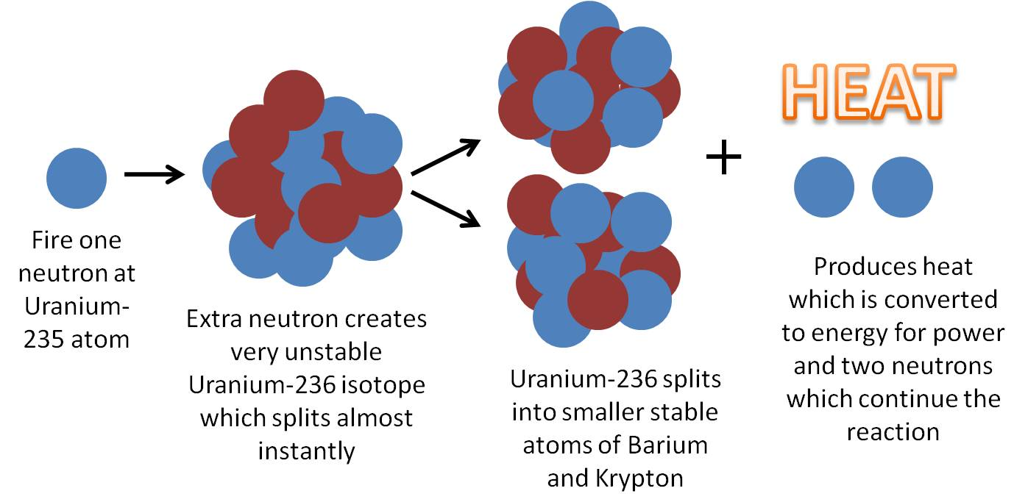

Fission
$${}_{0}^{1}n+ {}_{92}^{235}U→ {}_{92}^{236}U$$

Slide 6
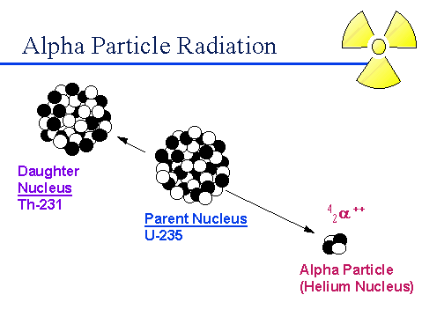
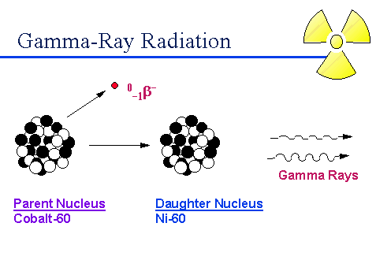


Alpha and Gamma Decay
Alpha Decay – Nucleus emits an alpha particle (helium nucleus)
Gamma decay
$${}_{27}^{60}{Co} → {}_{28}^{60}{Ni}+ {}_{−1}^{0}β+2{}_{0}^{0}γ$$
$${}_{92}^{235}U → {}_{2}^{4}α+ {}_{90}^{231}{Th}$$
http://www.physics.isu.edu/radinf/rads&rads.htm
Notes:
Define parent/daughter

Slide 7
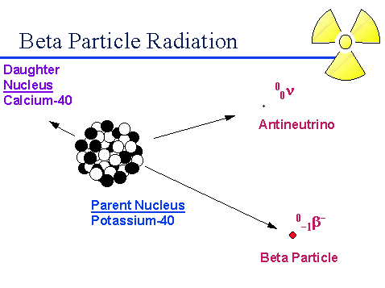


Beta Decay
Beta Decay
Positron Emission
$${}_{19}^{40}K → {}_{20}^{97}{Ca}+ {}_{−1}^{0}β$$
$${}_{8}^{15}O → {}_{7}^{15}N+ {}_{+1}^{0}β$$
http://www.physics.isu.edu/radinf/rads&rads.htm

Slide 8
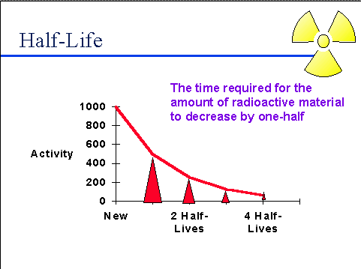
Half-life
All nuclides have a particular half life ranging from very long to very short
http://www.physics.isu.edu/radinf/rads&rads.htm
Notes:
Half-life – time required for the quantity of radioactive material to be reduced to one-half of its original value

Slide 9
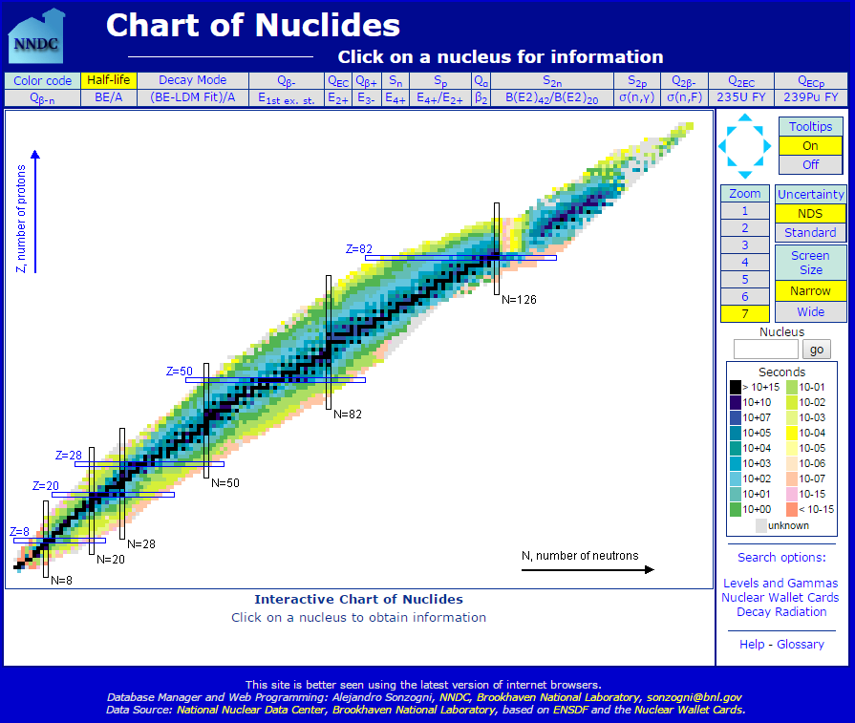

Slide 10
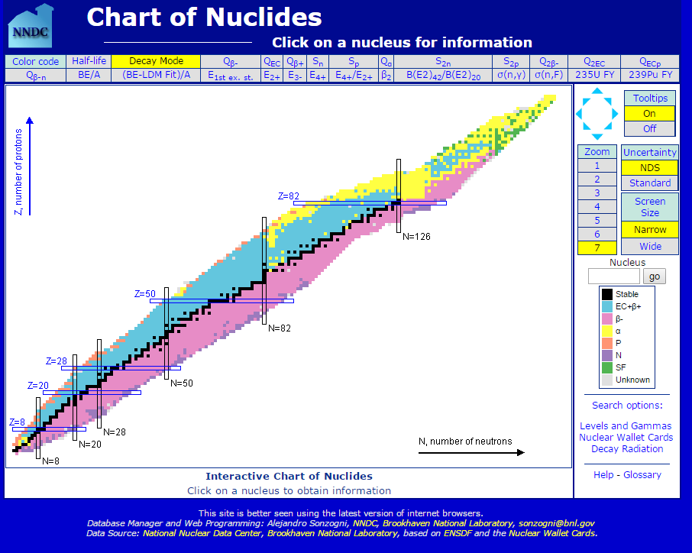

Slide 11


Slide 12
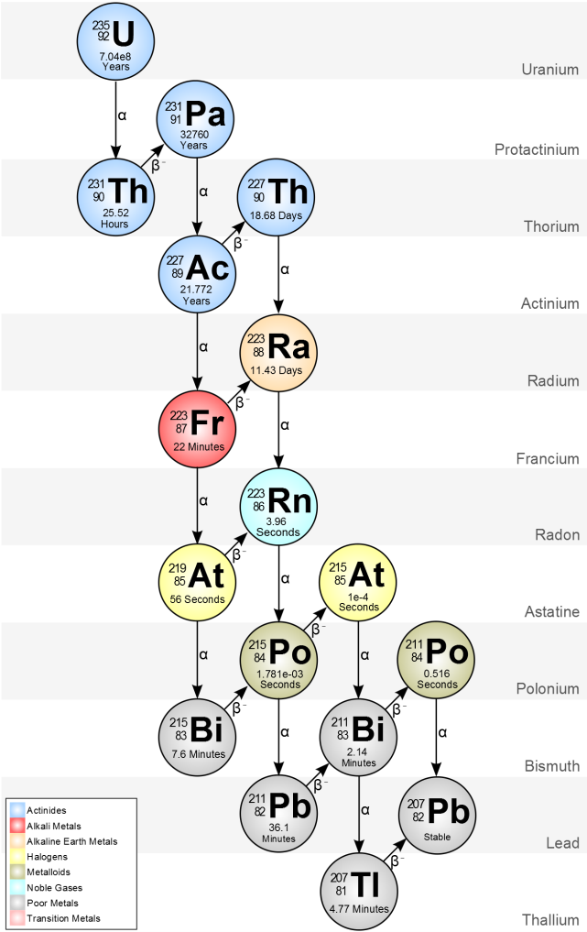
Critical Path
Objective:
  All players start as an atom of Uranium-235 on the chart of nuclides
  The player who reaches Lead-207 first wins!
http://metadata.berkeley.edu/nuclear-forensics/Decay%20Chains.html

Slide 13
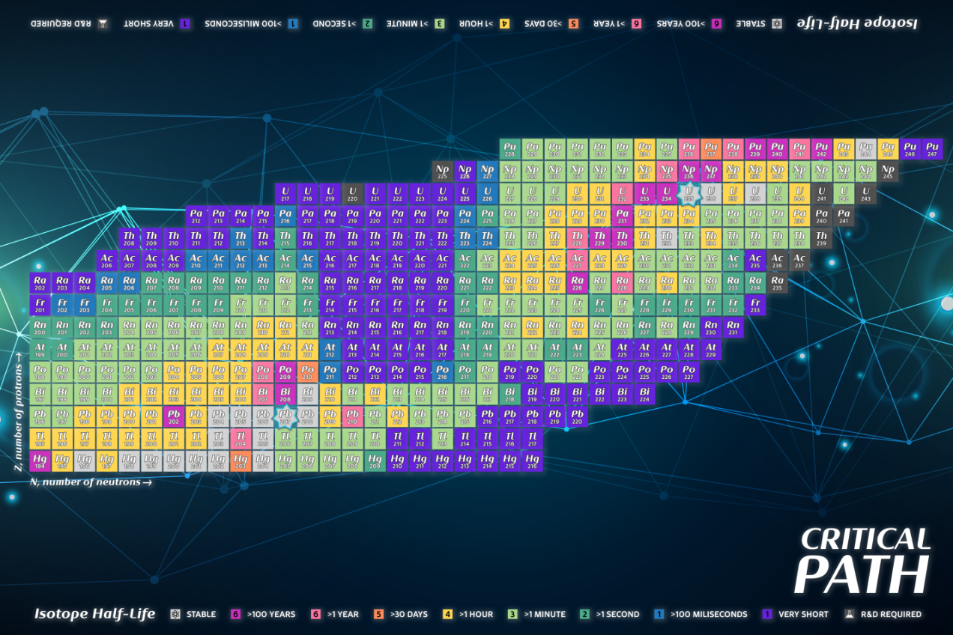
Critical Path
Components - Board
  Game board is a segment of the chart of nuclides colored based on each isotope’s half-life
Notes:
Go through a few examples
Isotope space description
U = Isotope element symbol. This isotope is an atom of Uranium
235 = Mass number for this isotope of Uranium. The mass number is the total number of protons and neutrons in this isotope’s nucleus
Background color = Grey. This indicates the isotope is stable
The star border indicates this is the starting isotope for all players.
Uranium 234 is an isotope with a half-life greater than 100 years
Neptunium 235 is an isotope with a half-life greater than 1 year
Polonium 210 is an isotope with a half-life greater than 30 days
Thorium 227 is an isotope with a half-life greater than 1 hour
Bismuth 217 is an isotope with a half-life greater than 1 minute
Francium 209 is an isotope with a half-life greater than 1 second
Protactinium 216 is an isotope with a half-life greater than 100 milliseconds
Radon 217 is an isotope with a very short half-life
Uranium 220 is an isotope that has not yet been discovered and research and development (R&D) is required

Slide 14
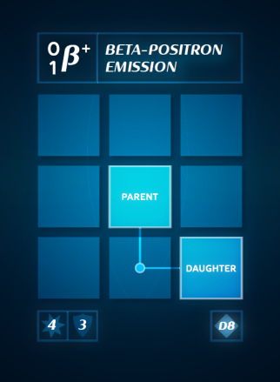
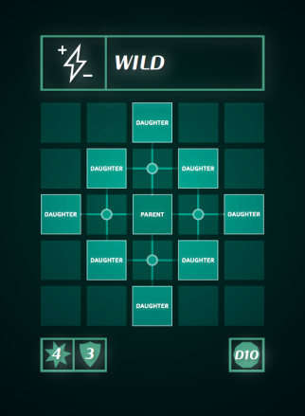
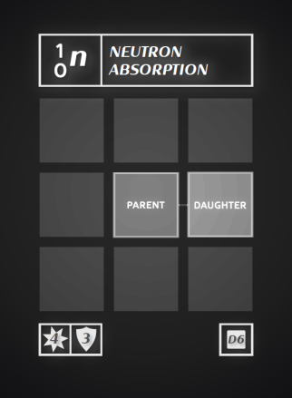
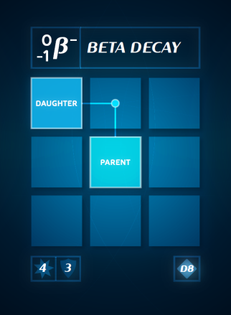
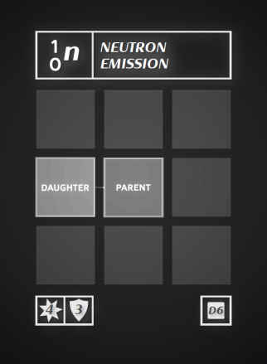
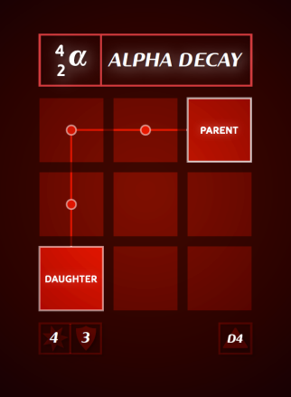
Critical Path
Components - Cards
  5 types – each player starts with 4 cards
  Used to move yourself OR your opponents on the game board
Notes:
Parent indicates starting point/Daughter indicates ending point
Attack Symbol/Defense (self play) symbol
Dice symbol

Slide 15
Critical Path
Components - Dice
  Each player gets one white D6 dice
  The remaining dice are colored for the type listed below
  Note the color of the dice corresponds to the color of the cards
Type | Number included | Color | To be used during
Four-sided (D4) | 5 | Red | Alpha Decay
Six-sided (D6) | 15 | White | Neutron Absorption, Neutron Emission, or spontaneous decay
Eight-sided (D8) | 5 | Blue | Beta or Beta-Positron Emission
Ten-sided (D10) | 5 | Green | “Wild” card
Notes:
Components – Remaining pieces
Each player chooses a disc to represent their player
Research and Development Cone – set aside

Slide 16
Critical Path
Round Summary – during each player’s turn, they may choose one of these two actions:
  Draw two cards
    Draw top two cards from the decay card draw pile
    Maximum of 10 cards in hand at a time – if you go over 10 cards, discard down to 10
  Play cards
    Play as many cards as you please
    Collect corresponding dice to the cards being played – one dice per card
    Declare if you are using the decay cards on yourself (defend) or another player (attack):
      Defend:
        The player gets one guaranteed card to move of their choice
        For the remaining cards played, the decay is successful if the dice result is greater than or equal to 3.
      Attack:
        The decay is successful if the dice result is greater than or equal to 4

Slide 17
Critical Path
Round Summary (continued)
  Half-life resolution:
    After each player has played their turn, every player spontaneously decays
    Look at isotope occupied by your piece and determine the successful spontaneous decay roll from the isotope half-life legend
    Roll your white six sided dice.
      If the result is greater than or equal to the number in the legend, the spontaneous decay occurs – move player disc equal to the half-life legend number in any direction

Slide 18

Critical Path
Special Rules:
  R&D Required – if a player lands on an undiscovered isotope then they lose a turn to research the element!
  Once landing on the space, place the R&D cone on the player piece to signify you are losing your next turn

Slide 19
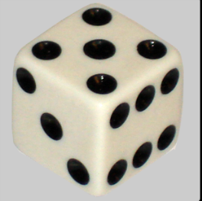
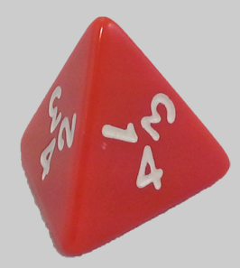
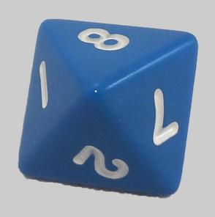
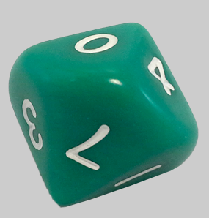
Critical Path
Example 1:
  Emily is on the starting point of U-235 and decides it’s a little crowded so she is going to move. She declares: “I am outta here, so I am playing for myself” and lays the following cards:

Slide 20
Critical Path
Example 1 (continued)
  Emily decides, since she likes the wild card so much, that she will choose that as her guaranteed move, and will not need to roll for it
  She then rolls the remaining four dice, trying to get a 3 or above

Slide 21
Critical Path
Example 1 (continued)
  Emily rolls the following, and gets to move her player corresponding to the successes
1
5
4
2

Slide 22


Critical Path
Example 1 (continued)
  Now that everyone in the group has played their turn, it is the spontaneous decay phase
  At the end of her last turn, Emily landed on Ac-228 which has a half life of > 1 hr
  Emily must roll a 4 or higher in order to spontaneously decay!
  She rolls her white D6 dice shouting “Big Money Big Money!!!” and rolls…..
  A 5! Therefore lucky Emily gets to move 4 additional spaces in any chosen direction
Notes:
Actinium

Slide 23

Critical Path
Example 2 (continued)
  Emily realizes that Jason is about to win the game since he is only two spaces away from Pb-207, on Pb-209!
  She decides to ‘attack’ by saying: “I’m going to play this turn for Jason!” and lays the following cards:

Slide 24
Critical Path
Example 2 (continued)
  Since this is an ‘attack’ play, Emily must roll all dice, and get a 4 or higher for a successful decay
3
1
8
6
5

Slide 25
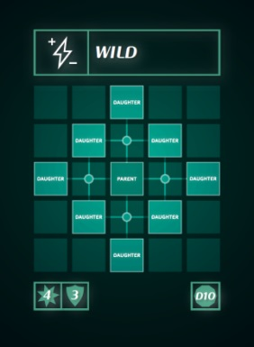
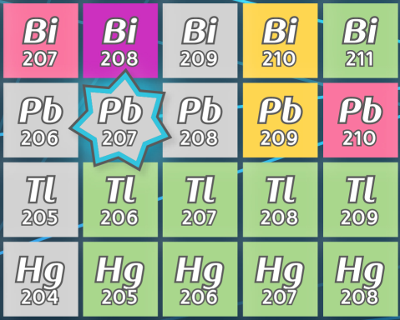



Critical Path
Example 2 (continued)
  Emily realizes that her beta decay and positron emission cards cancel each other out!
  But she can still use her wild to move him 2 spaces to Bi-209
  Since Bi-209 is STABLE, Jason will not be able to spontaneously decay!
Notes:
Thallium

Slide 26

Critical Path
Questions
  Can I play a card even though it would make me go off the table?
    NO – you can only use cards that move you to a position that is on the board
  What if 2 people reach Pb-207 after decaying?
    There will be a roll-off to determine the winner
  Can I attack two people at once? Or play some cards for myself and others for them?
    No, all cards being played are for only one person at a time

Slide 27
Critical Path
Special thanks to everyone who came up with the game concept and helped us with our beta testing run through (listed) and the many volunteers helping facilitate!
Emily Young
Kyle Hemker
Ben Horstman
Jason Young
Alyse Scurlock
Ryan Trogstad
Nathan Huffman
Enjoy the game!!!

