Slide 1

December 2019 Local Chapter Lead Meeting
Matthew Mairinger, Canadian Affairs Chair
Canada@naygn.org
December 18th, 2019

Slide 2
Agenda
Metrics
Q4 Excellence Awards
PD Update - NAYGN Book Club
PI Update(s)
Benchmarking Survey
Regional Update
Open discussion with NAYGN President

Slide 3

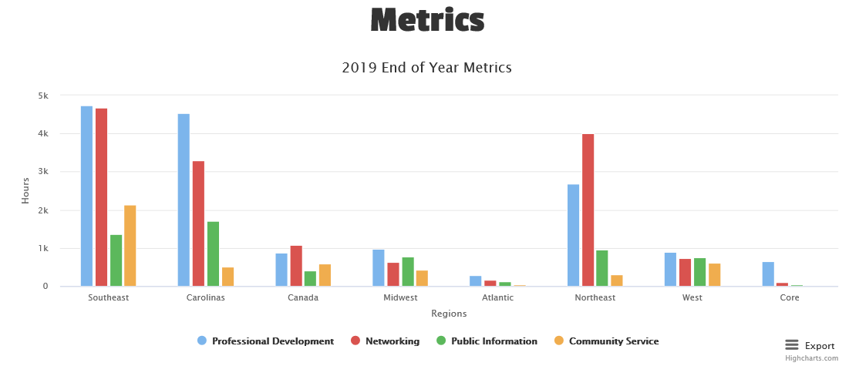
2019 Metrics
https://naygn.org/local-chapters/metrics/
~40,000 hours so far where we should be ~90,000 hours
Deadline to submit is December 20th!!
  Crucial to have all metrics in for the 1-page year end summary

Slide 4
Q4 Excellence Awards Open
Nominations for the Q4 Excellence awards are now open
  These nominations will be for the time period from October 1 through December 31,
  Deadline to submit is January 15, 2020
  Nomination link is https://www.surveymonkey.com/r/NAYGN_4QExcellenceAwards
  Past award winners now appear on the website here: https://naygn.org/past-award-winners/
  Recognize your fellow members for their activities supporting NAYGN

Slide 5

PD - NAYGN Book Club
Q1 2020 reading “How to Fail at Almost Everything and Still Win Big”
  Webinar once a month starting January 2020
  WebEx invite coming soon
    On January 23rd, the club will be discussing chapters 1 – 13.
  Email pd@naygn.org for more information

Slide 6
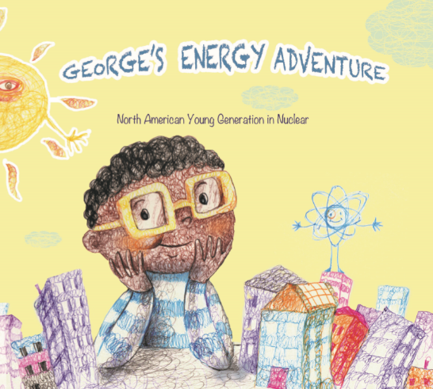
PI - George’s Energy Adventure
-George’s Energy Adventure is now digitally available for free!
-The book is also available in hard copy on Amazon for a limited time.
-Fantastic stocking stuffer!

Slide 7
PI - Social Media Contest
In partnership with Generation Atomic and ANS YMG
Theme of the contest is, “Nuclear on the Human Scale” (think football fields, coke cans, etc.)
Full details in membership email sent Dec 17th
Deadline to submit is Feb 14th and there are $1000 in prizes
You can submit a meme, video, or infographic to #FallInLoveWithU on any social platform

Slide 8
PI Award
Awarded to NAYGN during Nuclear Science Week!
We sincerely thank you all for you engagement during this week. Whether it was visiting a classroom, sending a post card, or talking to anyone you knew about nuclear energy, your impact was huge!
Amanda Lang
NAYGN PI Chair
The prize

Slide 9
Benchmarking Survey
Survey deadline is December 20th
Update: We are at 840 responses as of Dec-17, help us get to 1,000!!
Survey participants entered in a raffle (Amazon Dot Echo, Fire TV stick, Ring Video doorbell) https://www.surveymonkey.com/r/NAYGN2019CareerSurvey
Curious what the report will look like? See previous reports here:
https://naygn.org/resources/naygn-org-documents/

Slide 10
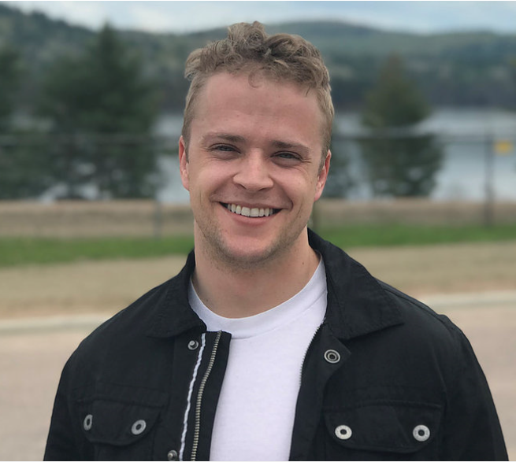
New Canadian Regional Lead
Welcome Owen Marshall-Glew as the new Canadian Regional Lead!
  Email Canada-region@naygn.org
Owen got his start in the nuclear industry after working for B.C. Hydro's research division on electric vehicles, renewable power, and grid modernization.
In 2016 he transitioned to the NRU reactor at Chalk River, where he worked as a components and maintenance specialist for two years. There he learned from industry pioneers and veterans and developed a deep appreciation for the lesser known facets of nuclear energy (nuclear medicine, isotope production, and material research to name a few). He also moonlighted on a small team of scientists and engineers dedicated to vetting siting one or more SMRs at Chalk River–work which continues there to this day.
Following the shutdown of NRU, Owen transitioned once again: this time to his current role on the Darlington refurbishment project as a series lead.

Slide 11
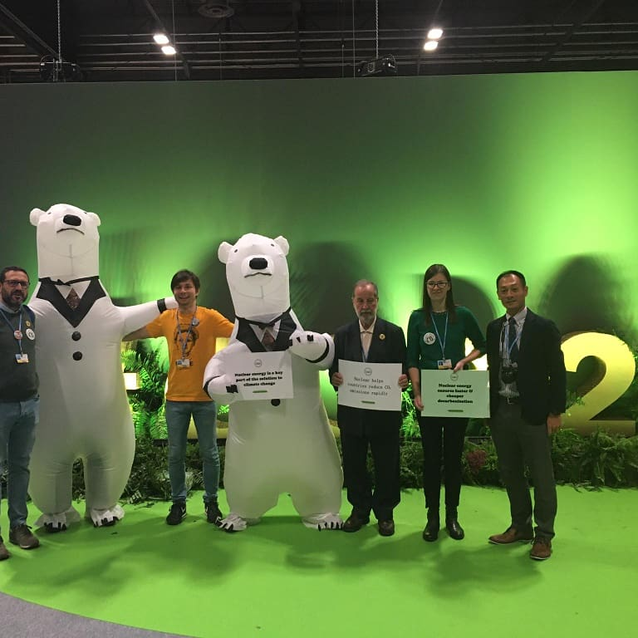
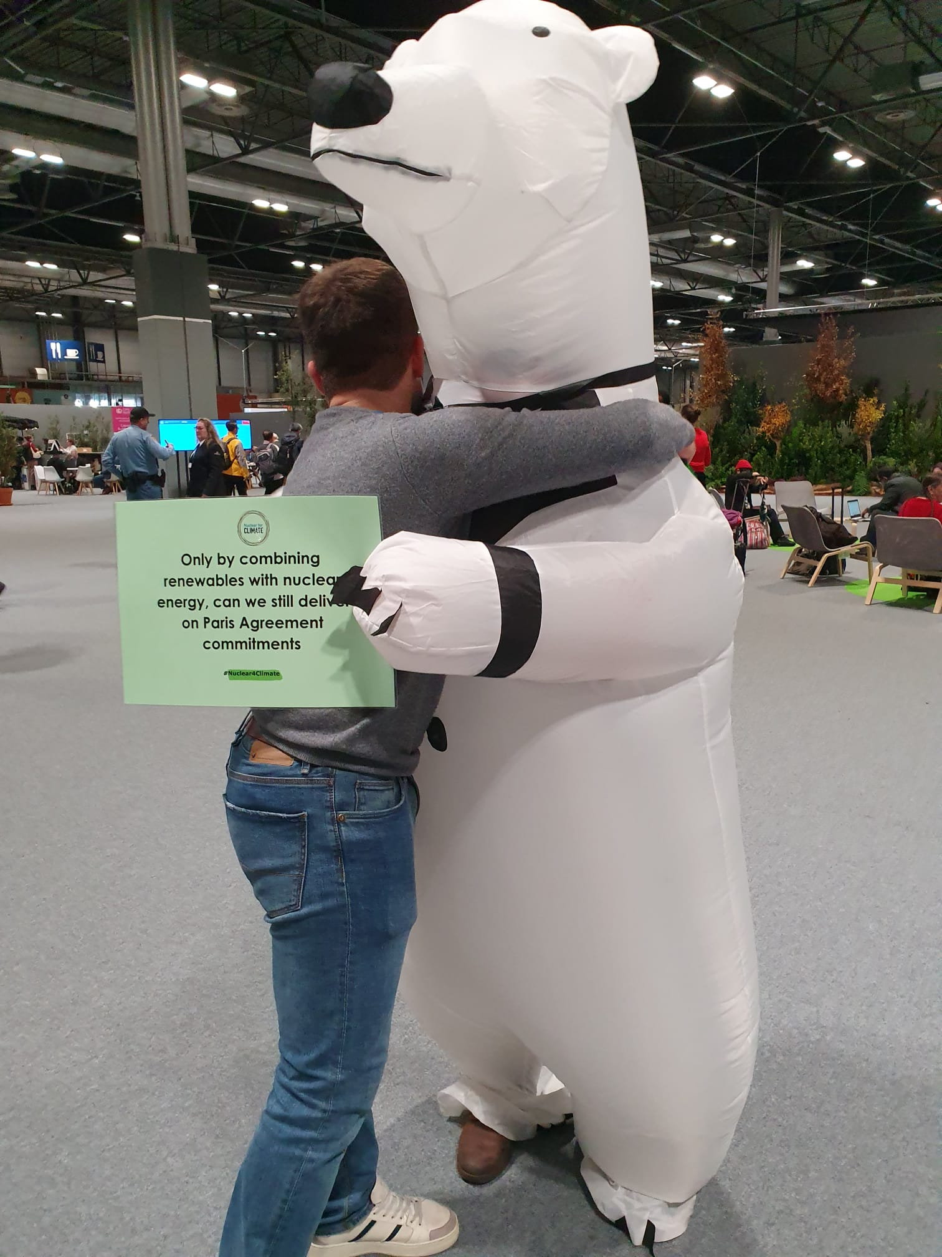
NAYGN @ UN COP25
Matthew Mairinger had the privilege to attend the United Nations Climate Conference COP25 in December 2019
Full story on Go Nuke
Nuclear team
Nuclear getting some love

Slide 12
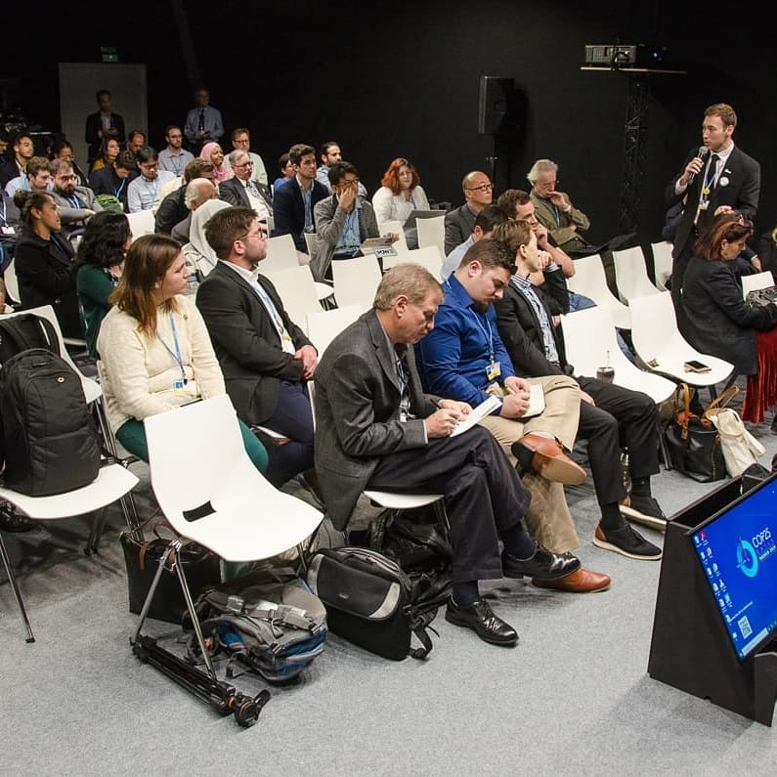
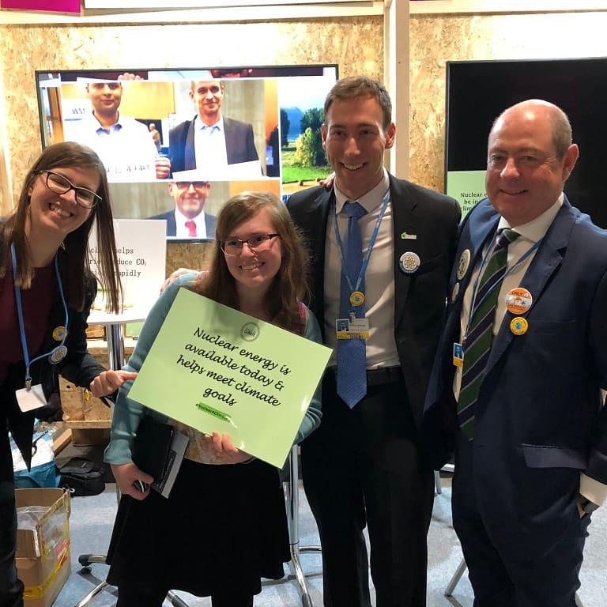
NAYGN @ UN COP25
Nuclear side event
Nuclear booth

Slide 13
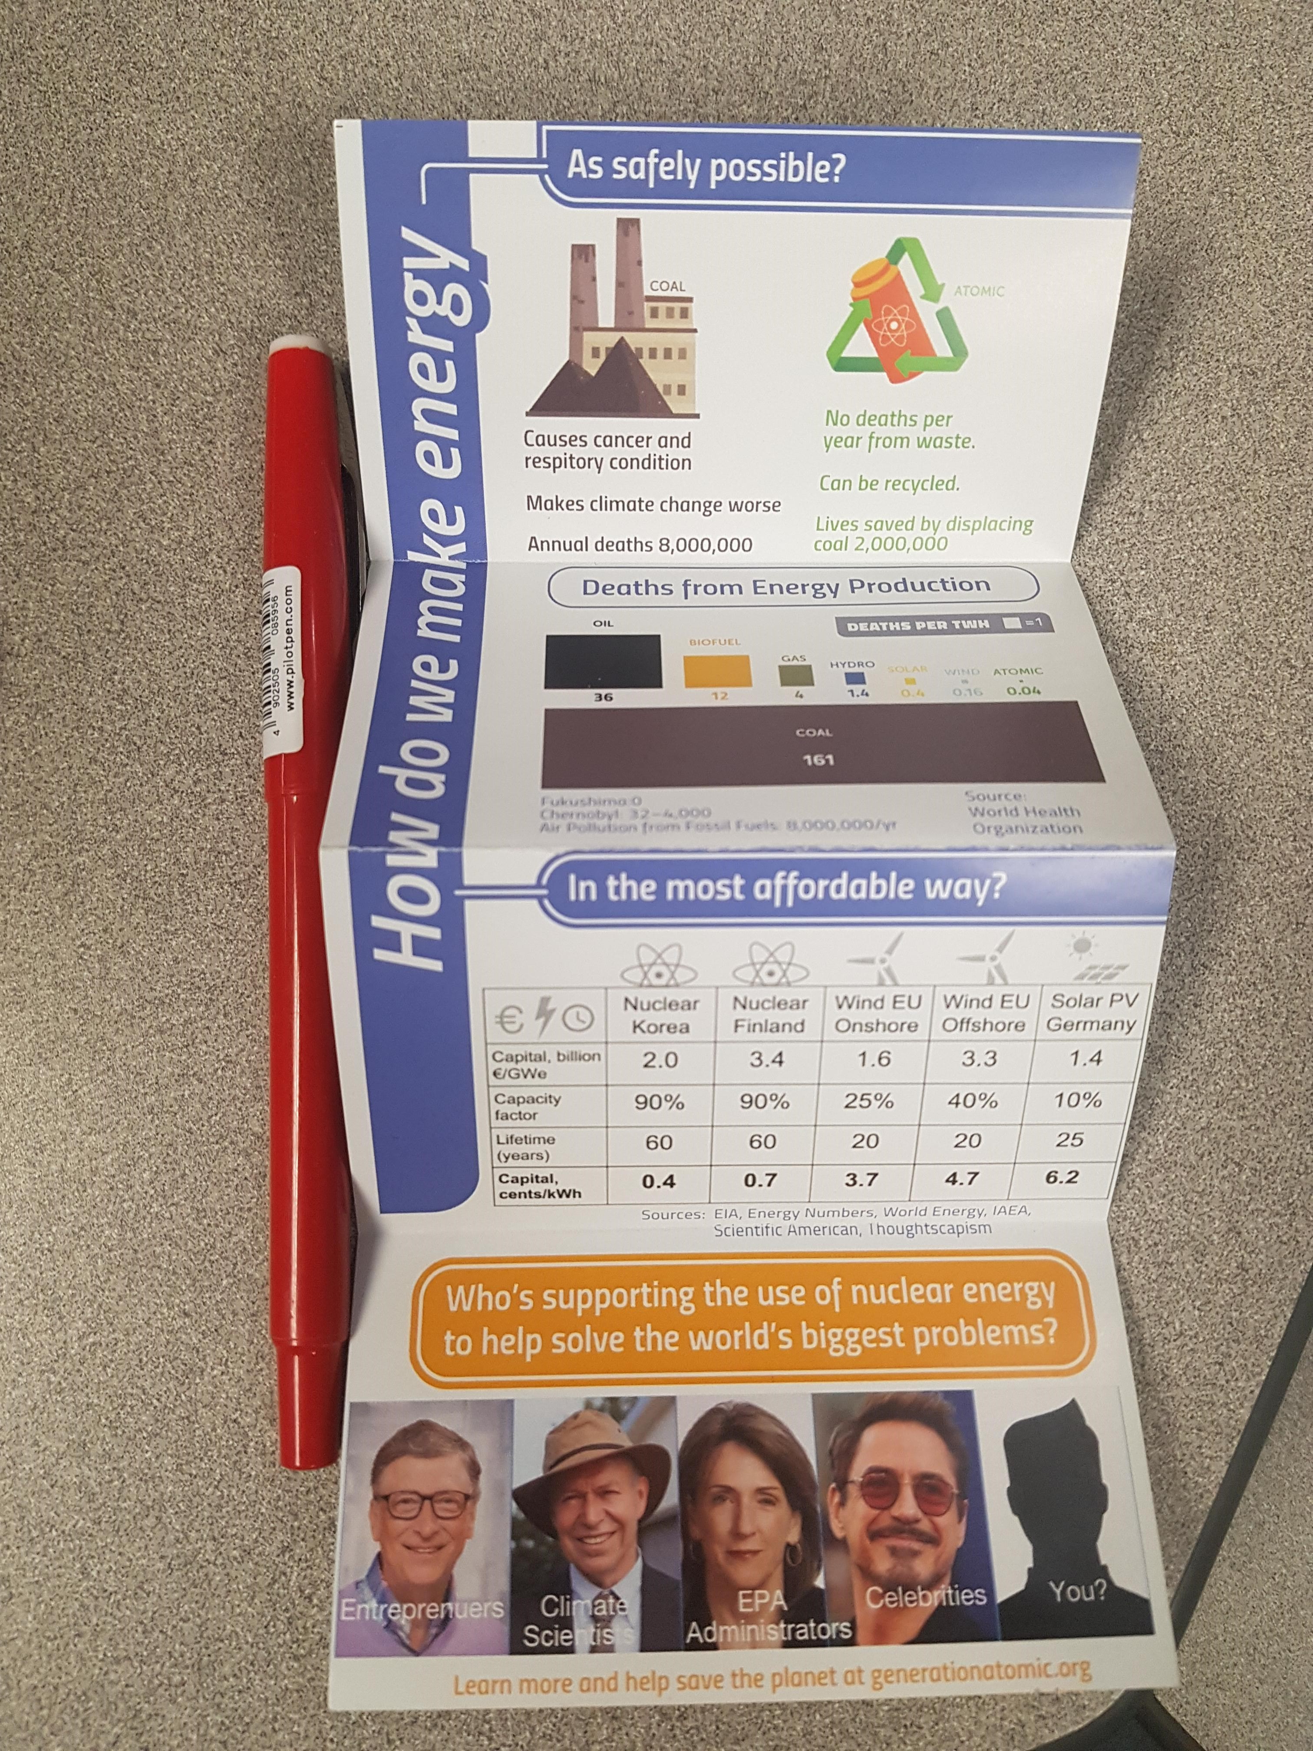
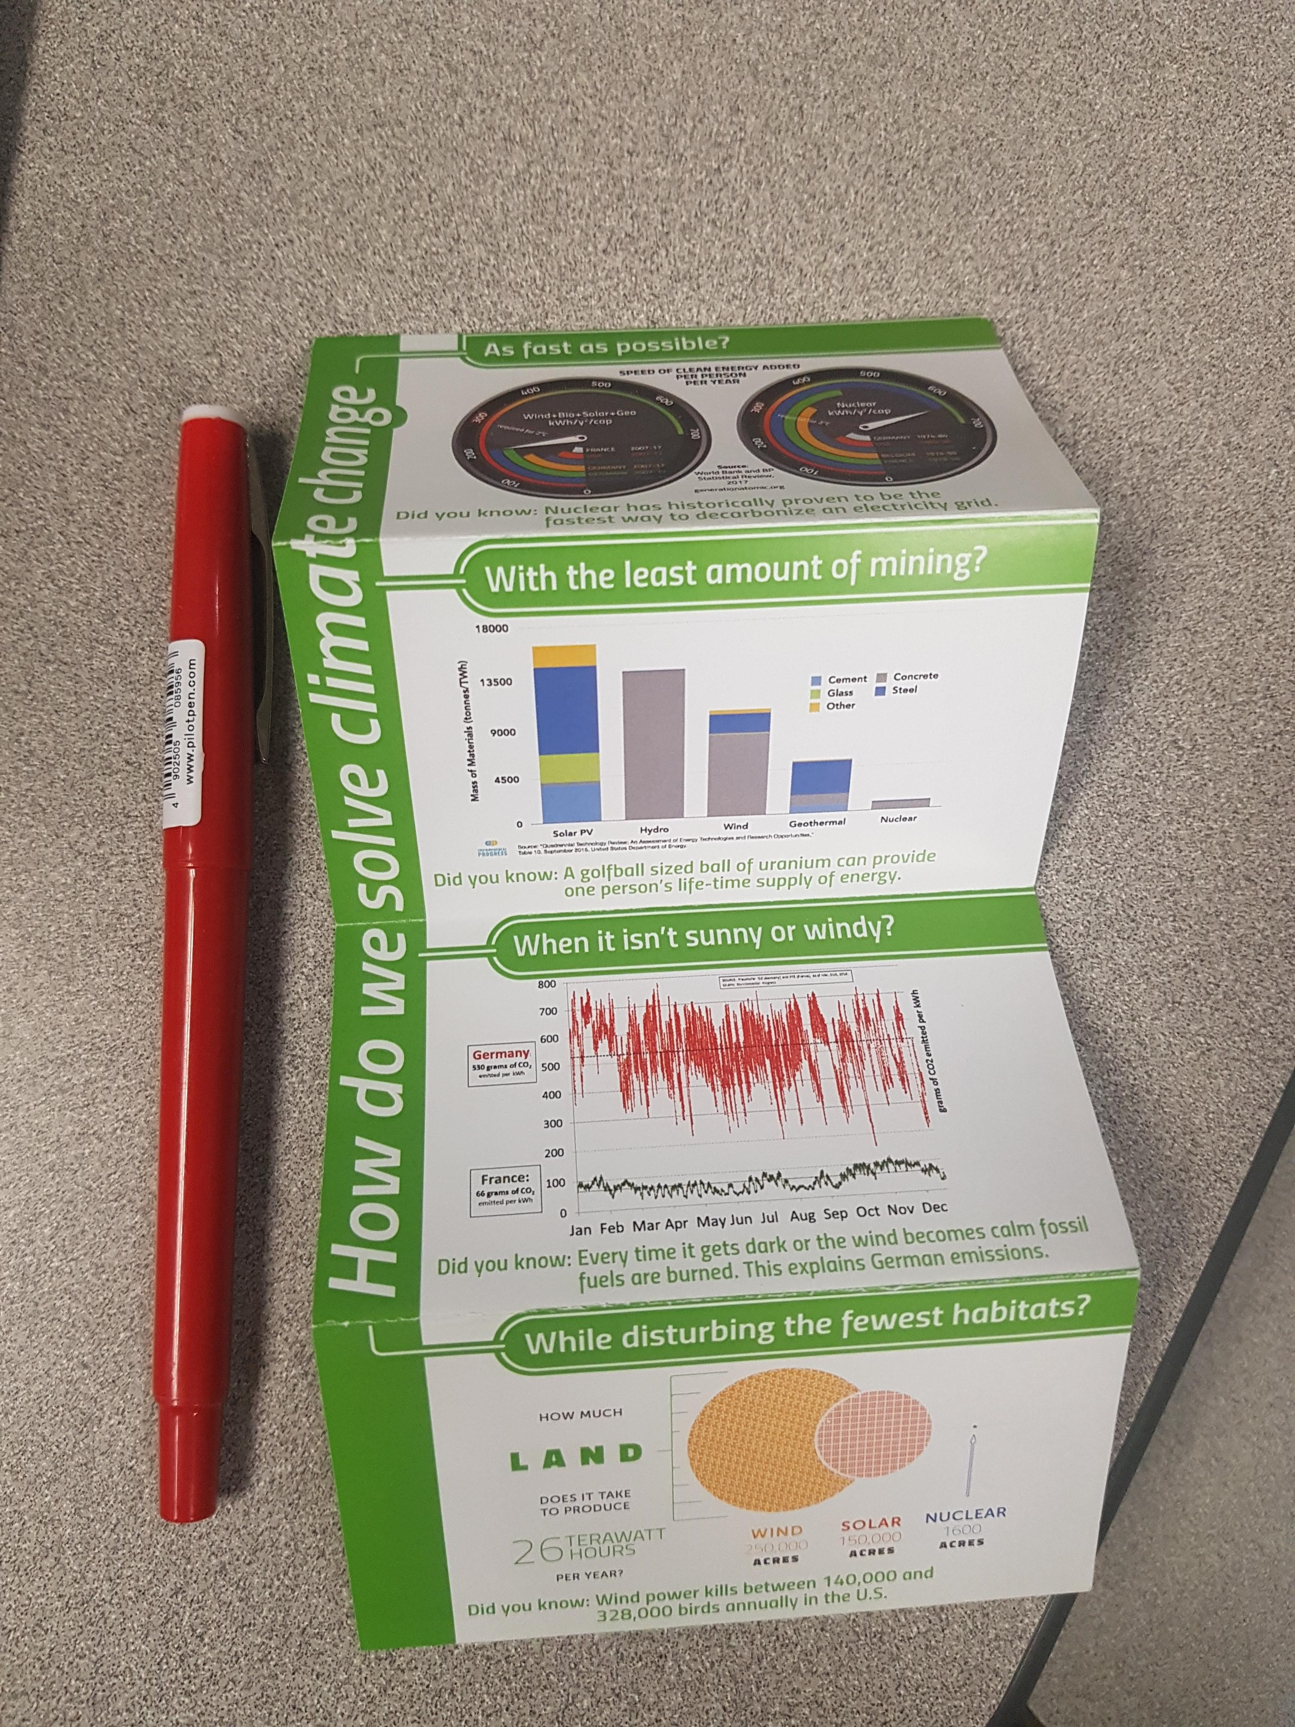
NAYGN @ UN COP25
Many are still using the word “renewable energy”
Many still viewed nuclear as “dangerous” or “risky” – some were against nuclear and some viewed it as “okay for now until renewables are 100%” – strong lack of education/awareness from attendees
World Bank/Asia Bank have nuclear against the funding policy (along with terrorism and weapons)
Collaborated with European Nuclear Society/Atoms for Japan/ENS Young Generation/Spanish Nuclear Society/World Nuclear News
Nuclear pins were super popular and the Generation Atomic pamphlet was very effective
  I’ll work on building this for NAYGN

Slide 14
Communications & Best Practices
Had a great event? Is your chapter up to something cool?
Submit an event summary and pictures to communications@naygn.org to be featured in the Go Nuke article.
And/or engagement@naygn.org to have
And/or to USA@naygn.org and Canada@naygn.org to be shared on the next LCL call.

Slide 15
Open Discussion with NAYGN President
What is one of your chapter's goals for 2020?

