Slide 1
Introduce Yourself Here
Name, Company
NuClear: the NEW Clear Air Energy

Slide 2

What is climate change?
Weather
Climate
Notes:
Weather = day to day
Climate = long term

Slide 3


Movie Time!
https://youtu.be/TDcpvybA-M0

Slide 4


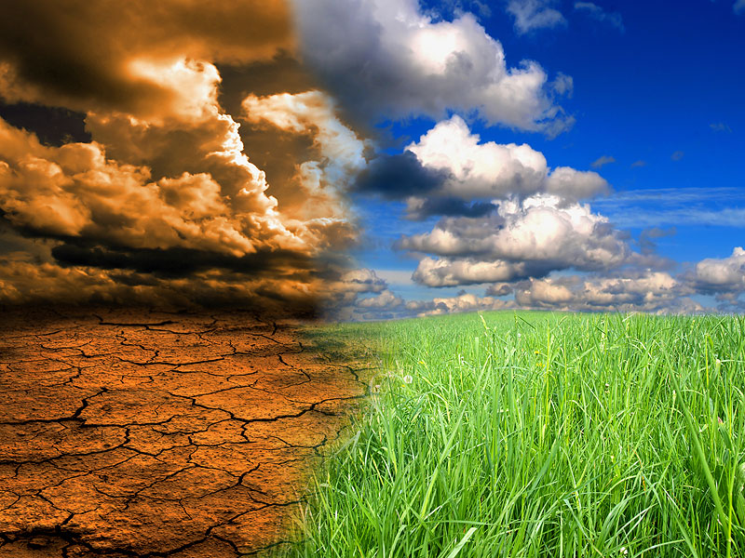
Why is climate change bad?
Notes:
What if the world changed drastically? Many animals might become extinct!
Sad polar bear.
Sad penguin.

Slide 5
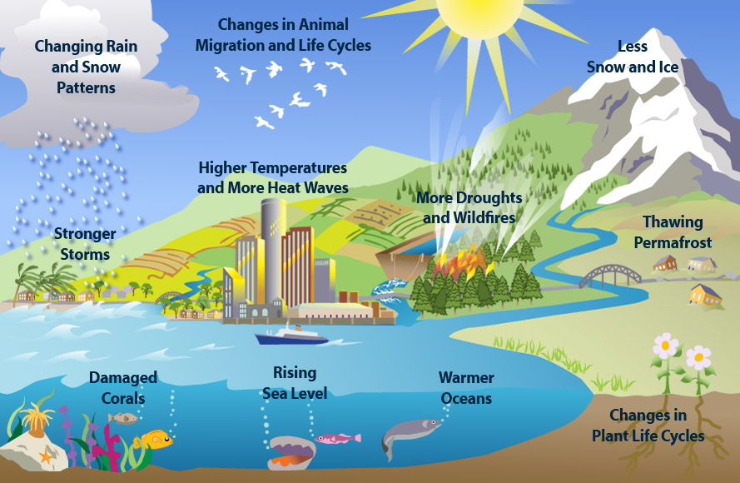
Environmental Protection Agency
Notes:
Here are some other reasons climate change would be very bad.

Slide 6
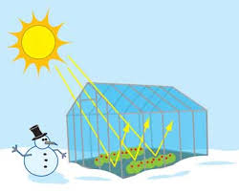
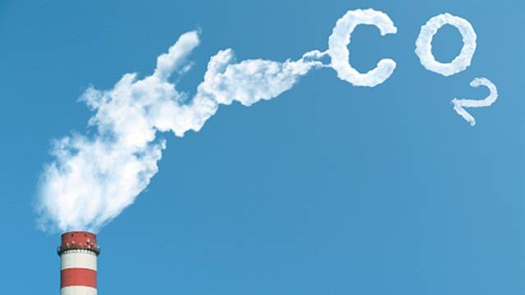
What causes climate change?
Greenhouse Effect
Carbon Dioxide
climatekids.nasa.gov

Slide 7
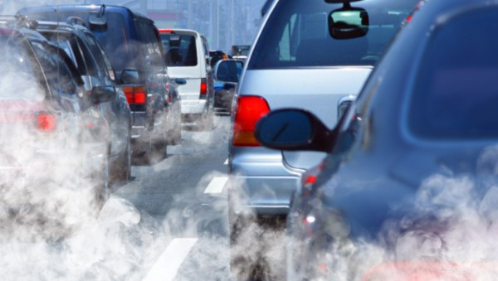
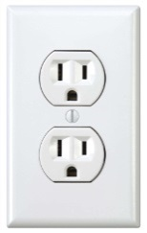

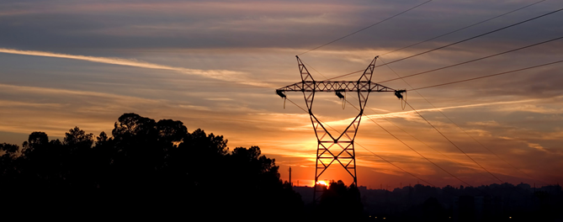
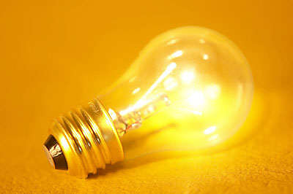
Where does carbon come from?
Cars
Making electricity

Slide 8
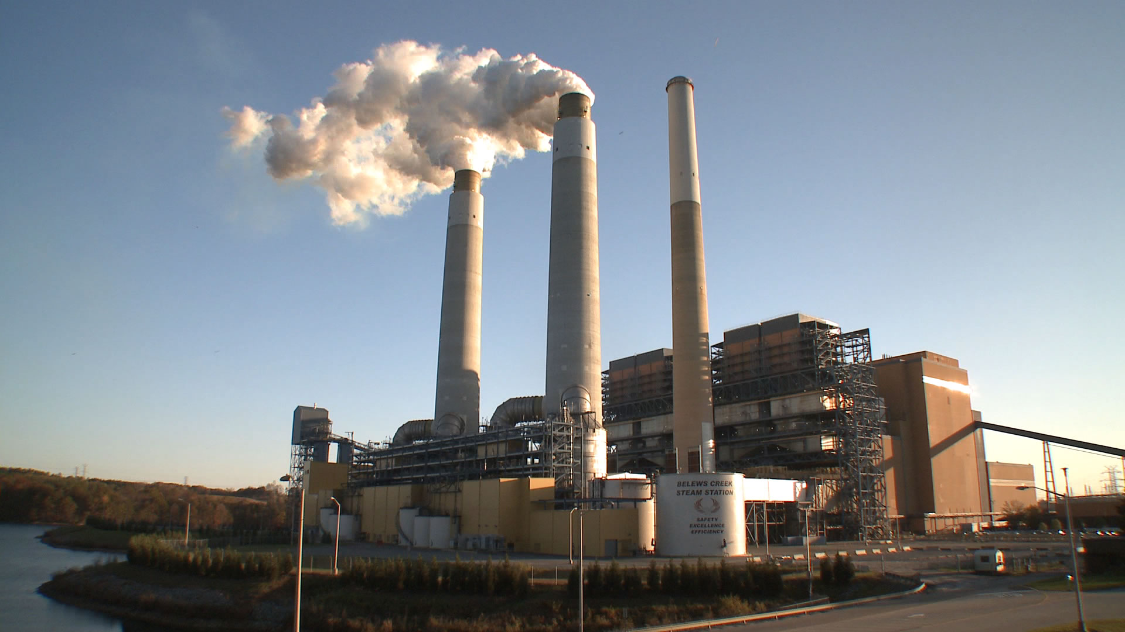
Coal Plant
Carbon dioxide

Slide 9
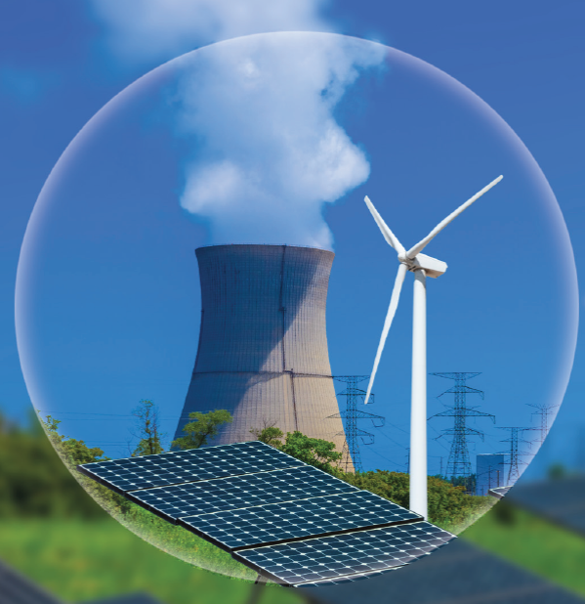
Did you know?
There are CLEAN ways to make electricity
nuclear
solar
wind
Notes:
Solar, nuclear, and wind are all carbon free ways to make electricity!

Slide 10
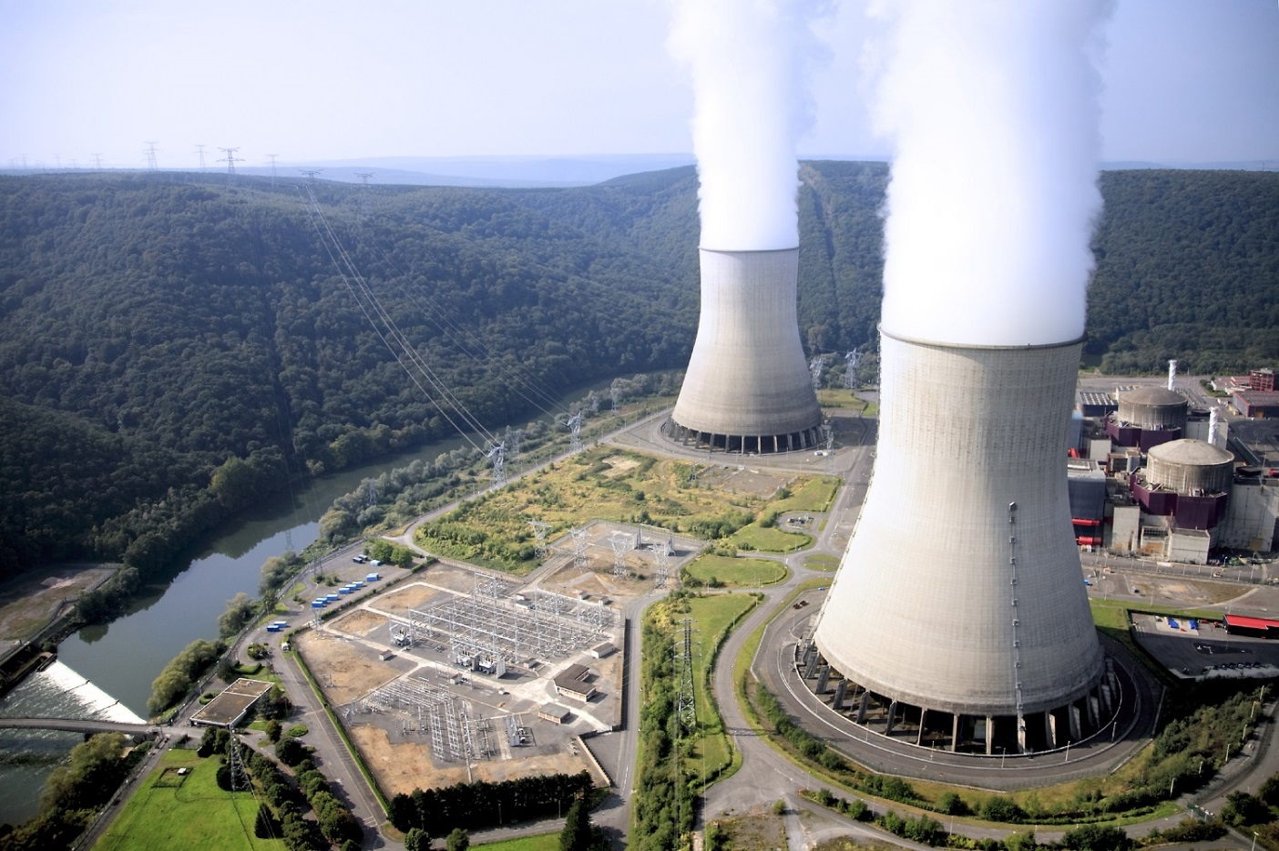
Nuclear?
YES!
carbon
STEAM
Notes:
Really? Nuclear?
Yes!
The cloud coming out of a nuclear plant is not like the cloud coming out of a coal plant.
The cloud out of a nuclear plant is just steam – it’s just water! Nuclear is a carbon free source of electricity.

Slide 11
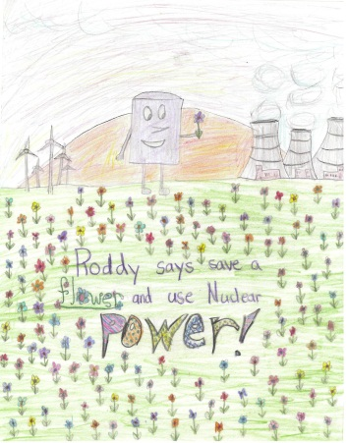
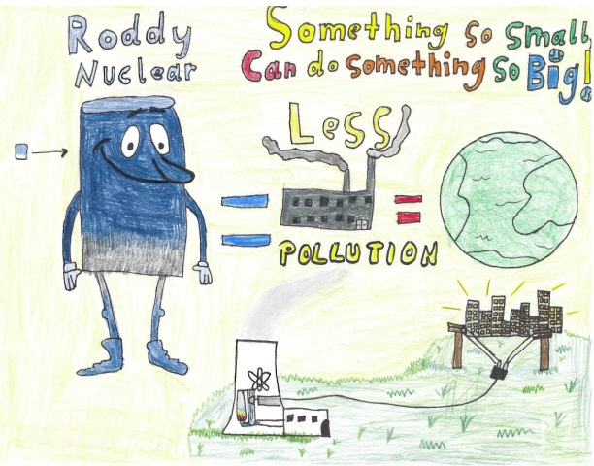
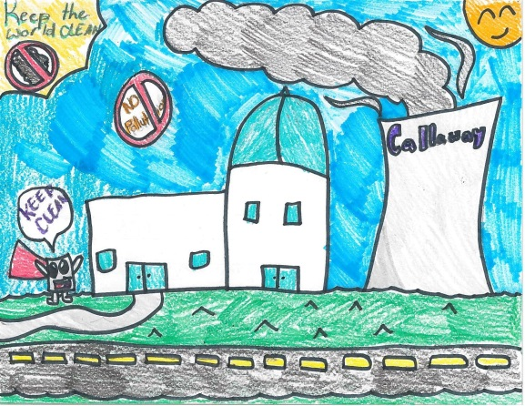
2016 Drawing Contest
Theme: NuClear: the NEW Clear Air Energy
  8 ½ x 11” sheet of paper
On the BACK of the drawing, write:
  Name
  Age and Grade
  T-shirt size
  School and Teacher’s Name
Drawings due 3/3/17

Slide 12
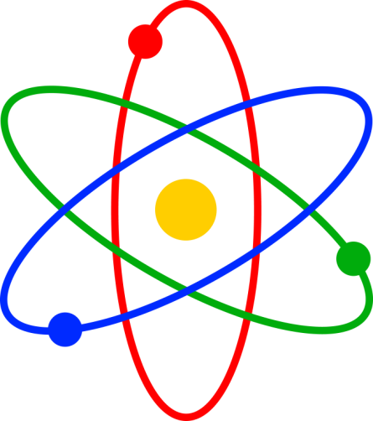
NuClear: the NEW Clear Air Energy
  On back:
  Name
  Age & Grade
  T-shirt size
  School & Teacher
nuclear
solar
wind

Slide 13
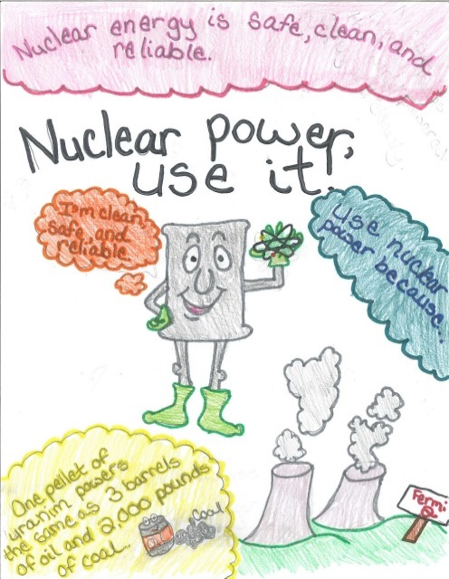
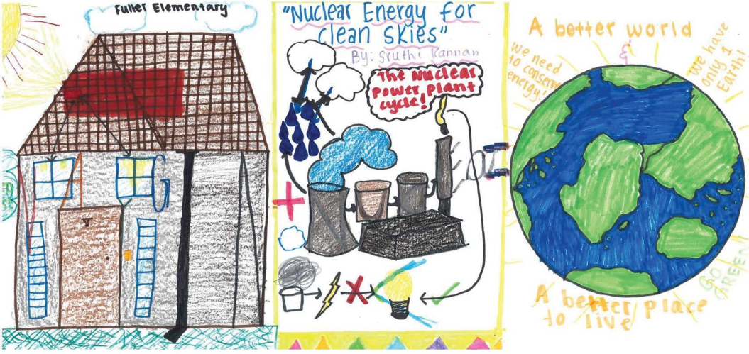
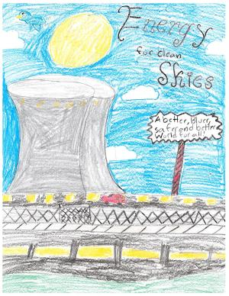
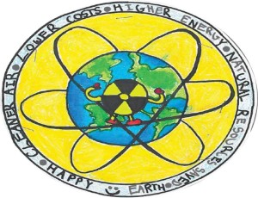
Questions?

Slide 14
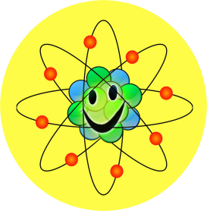
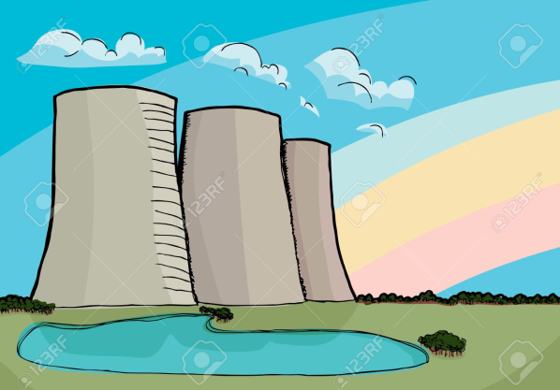
Ideas for Drawings
nuclear
Green energy for
“nu” clear skies

Slide 15
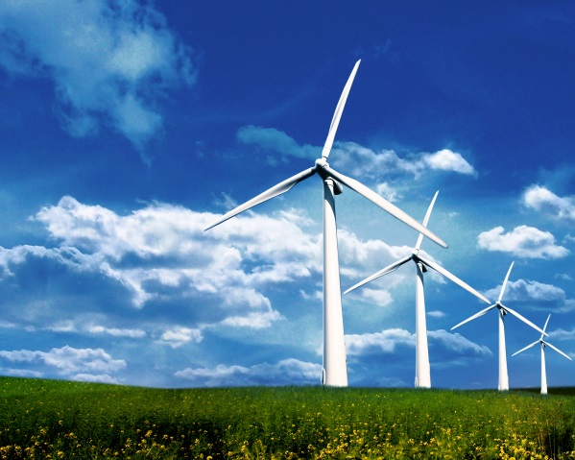

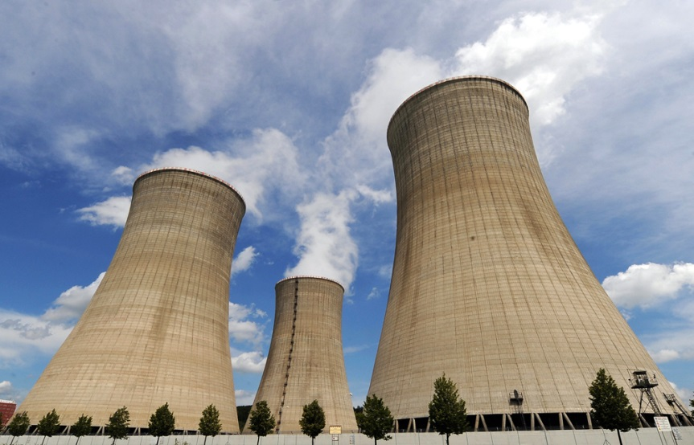
Clear skies with
“nu” CLEAR
Clean air
energy
Green
Energy
Carbon Free

Slide 16
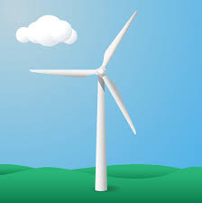
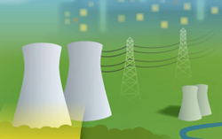

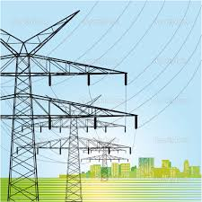
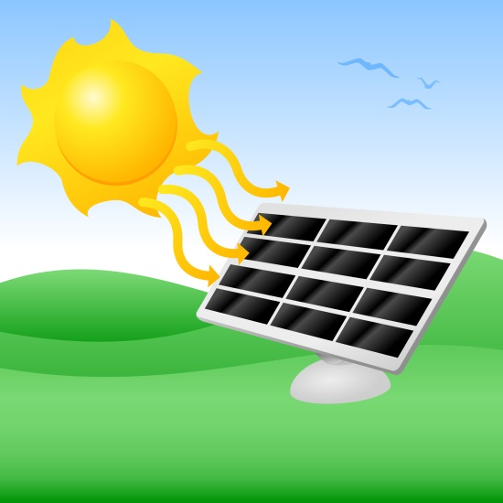
nuclear
solar
wind

Slide 17


clear
nu

Slide 18
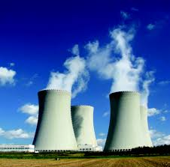
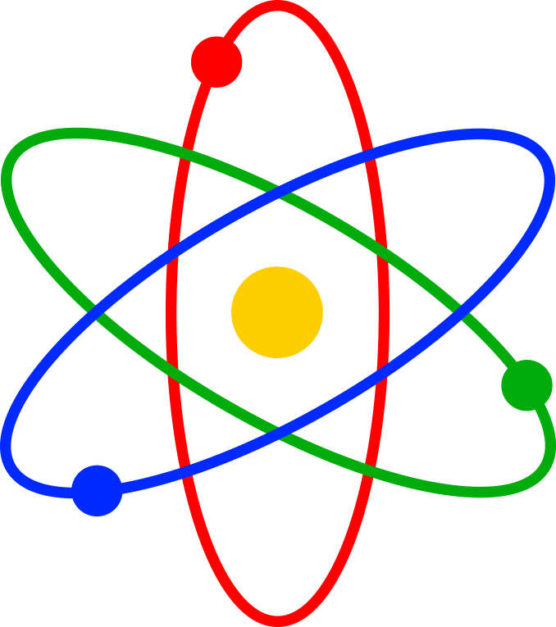
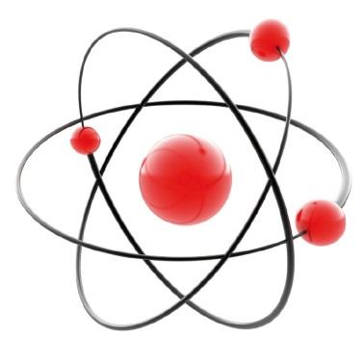
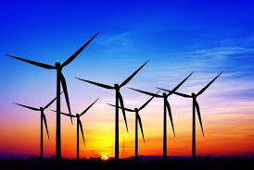
Optional Slides

Slide 19
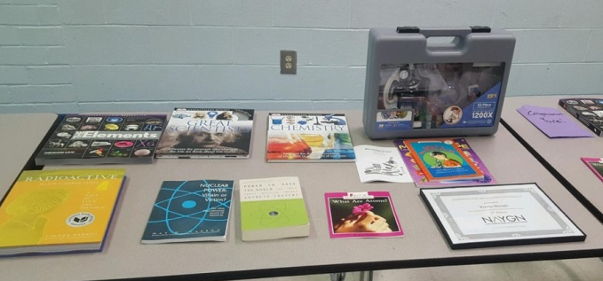
Prizes!

Slide 20
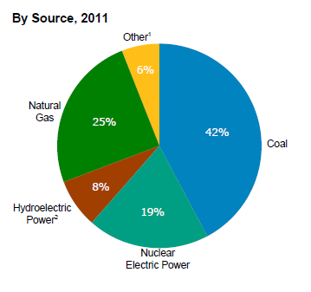
How is electricity made?
[1] Wind, petroleum, wood, geothermal, solar, etc.
[2] Conventional hydroelectric power and pumped storage
US Energy Information Administration Annual Energy Review 2011

Slide 21
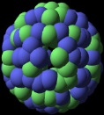


How does a nuclear power plant work?
Steam
Generator
Steam produced
Turbine
Heat
Electricity

