Slide 1
Educating America’s Future
  SIMPLIFY and DUPLICATE Your Nuclear Message

Slide 2
Mike Hayes, TVA
Program Engineer
Theresa Widger, PSEG Nuclear
Stakeholder Outreach

Slide 3
Know your audience
Notes:
To audience: Please read this. (Japanese)
Click slide: how about this one? (Greek)
Click slide: Ah Ha!! It’s easy when you put it into simple English! What language do you speak? You can’t speak “Heat Transfer” to a Fourth Grader.
Is your audience technical? Do you need to simplify or expand on a topic? Is your audience an engineering group or 9th grade general science students

Slide 4
Make it personal
Get Rid of the “Cookie Cutter Approach”
Understand your surroundings
Present information that your audience can relate to
Notes:
Get Rid of the “Cookie Cutter Approach”
Don’t use the same presentation for every public outreach or information opportunity.
Presentation should be ever evolving
Understand your surroundings
Understand that not everyone is against Nuclear power.
Present information that your audience can relate to
Not everyone wants to hear about how clean Nuclear power
Some want to know more about career opportunities.

Slide 5
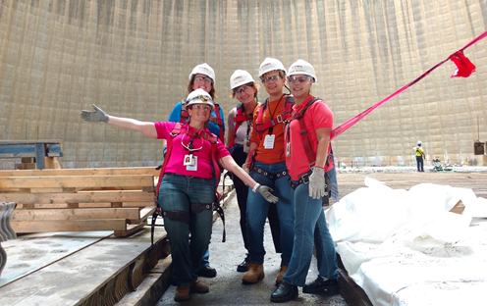
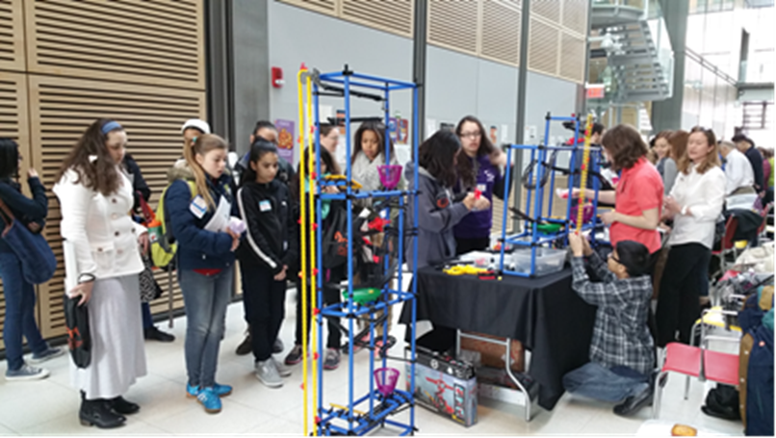
Know Your Outreach Goals
Nuclear 101
  Young/Old
  Technical/Nontechnical
Nuclear Safety
  Local residents
  Legislators
Career Opportunities/Recruiting
  STEM Promotion
  Diversity
Community Support/Building Relationships
  Charity work
  Local Events
Notes:
Are you trying to build a relationship, recruit students, promote the nuclear industry, participate in charity work?

Slide 6
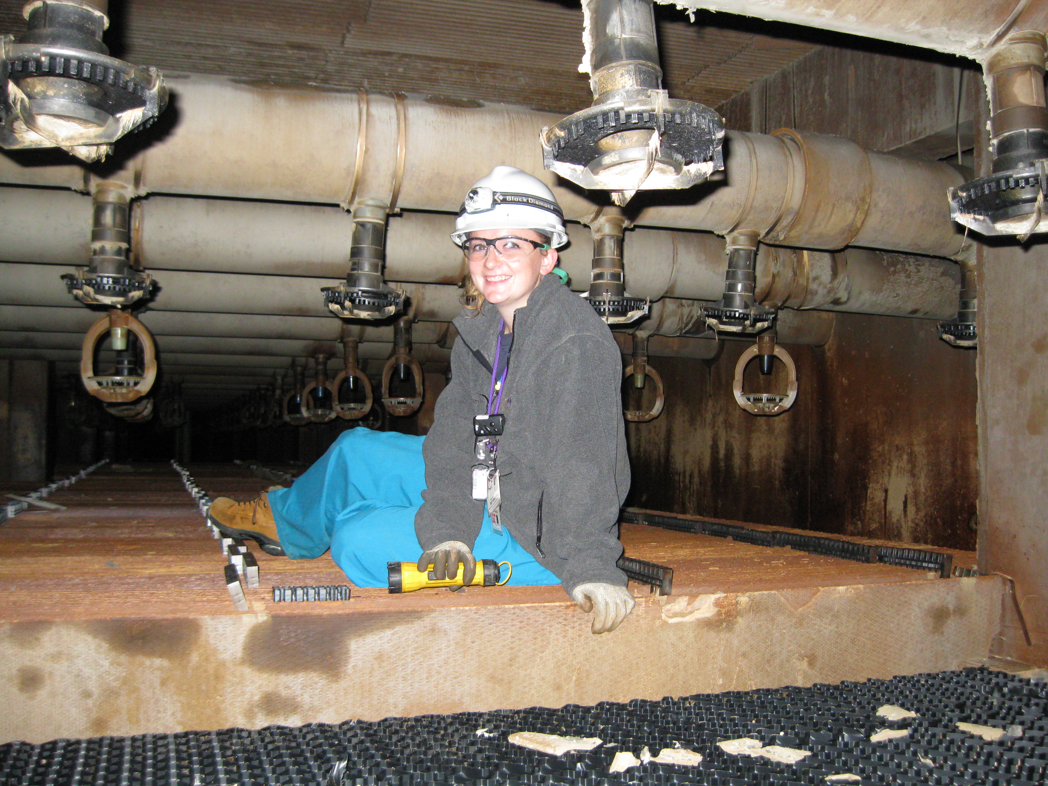
College Engineering Students
Nuclear Overview
Control Room Simulator
Career Discussion
Perimeter Driving Tour
Plant Tour
Notes:
Catering a tour to the technical group

Slide 7
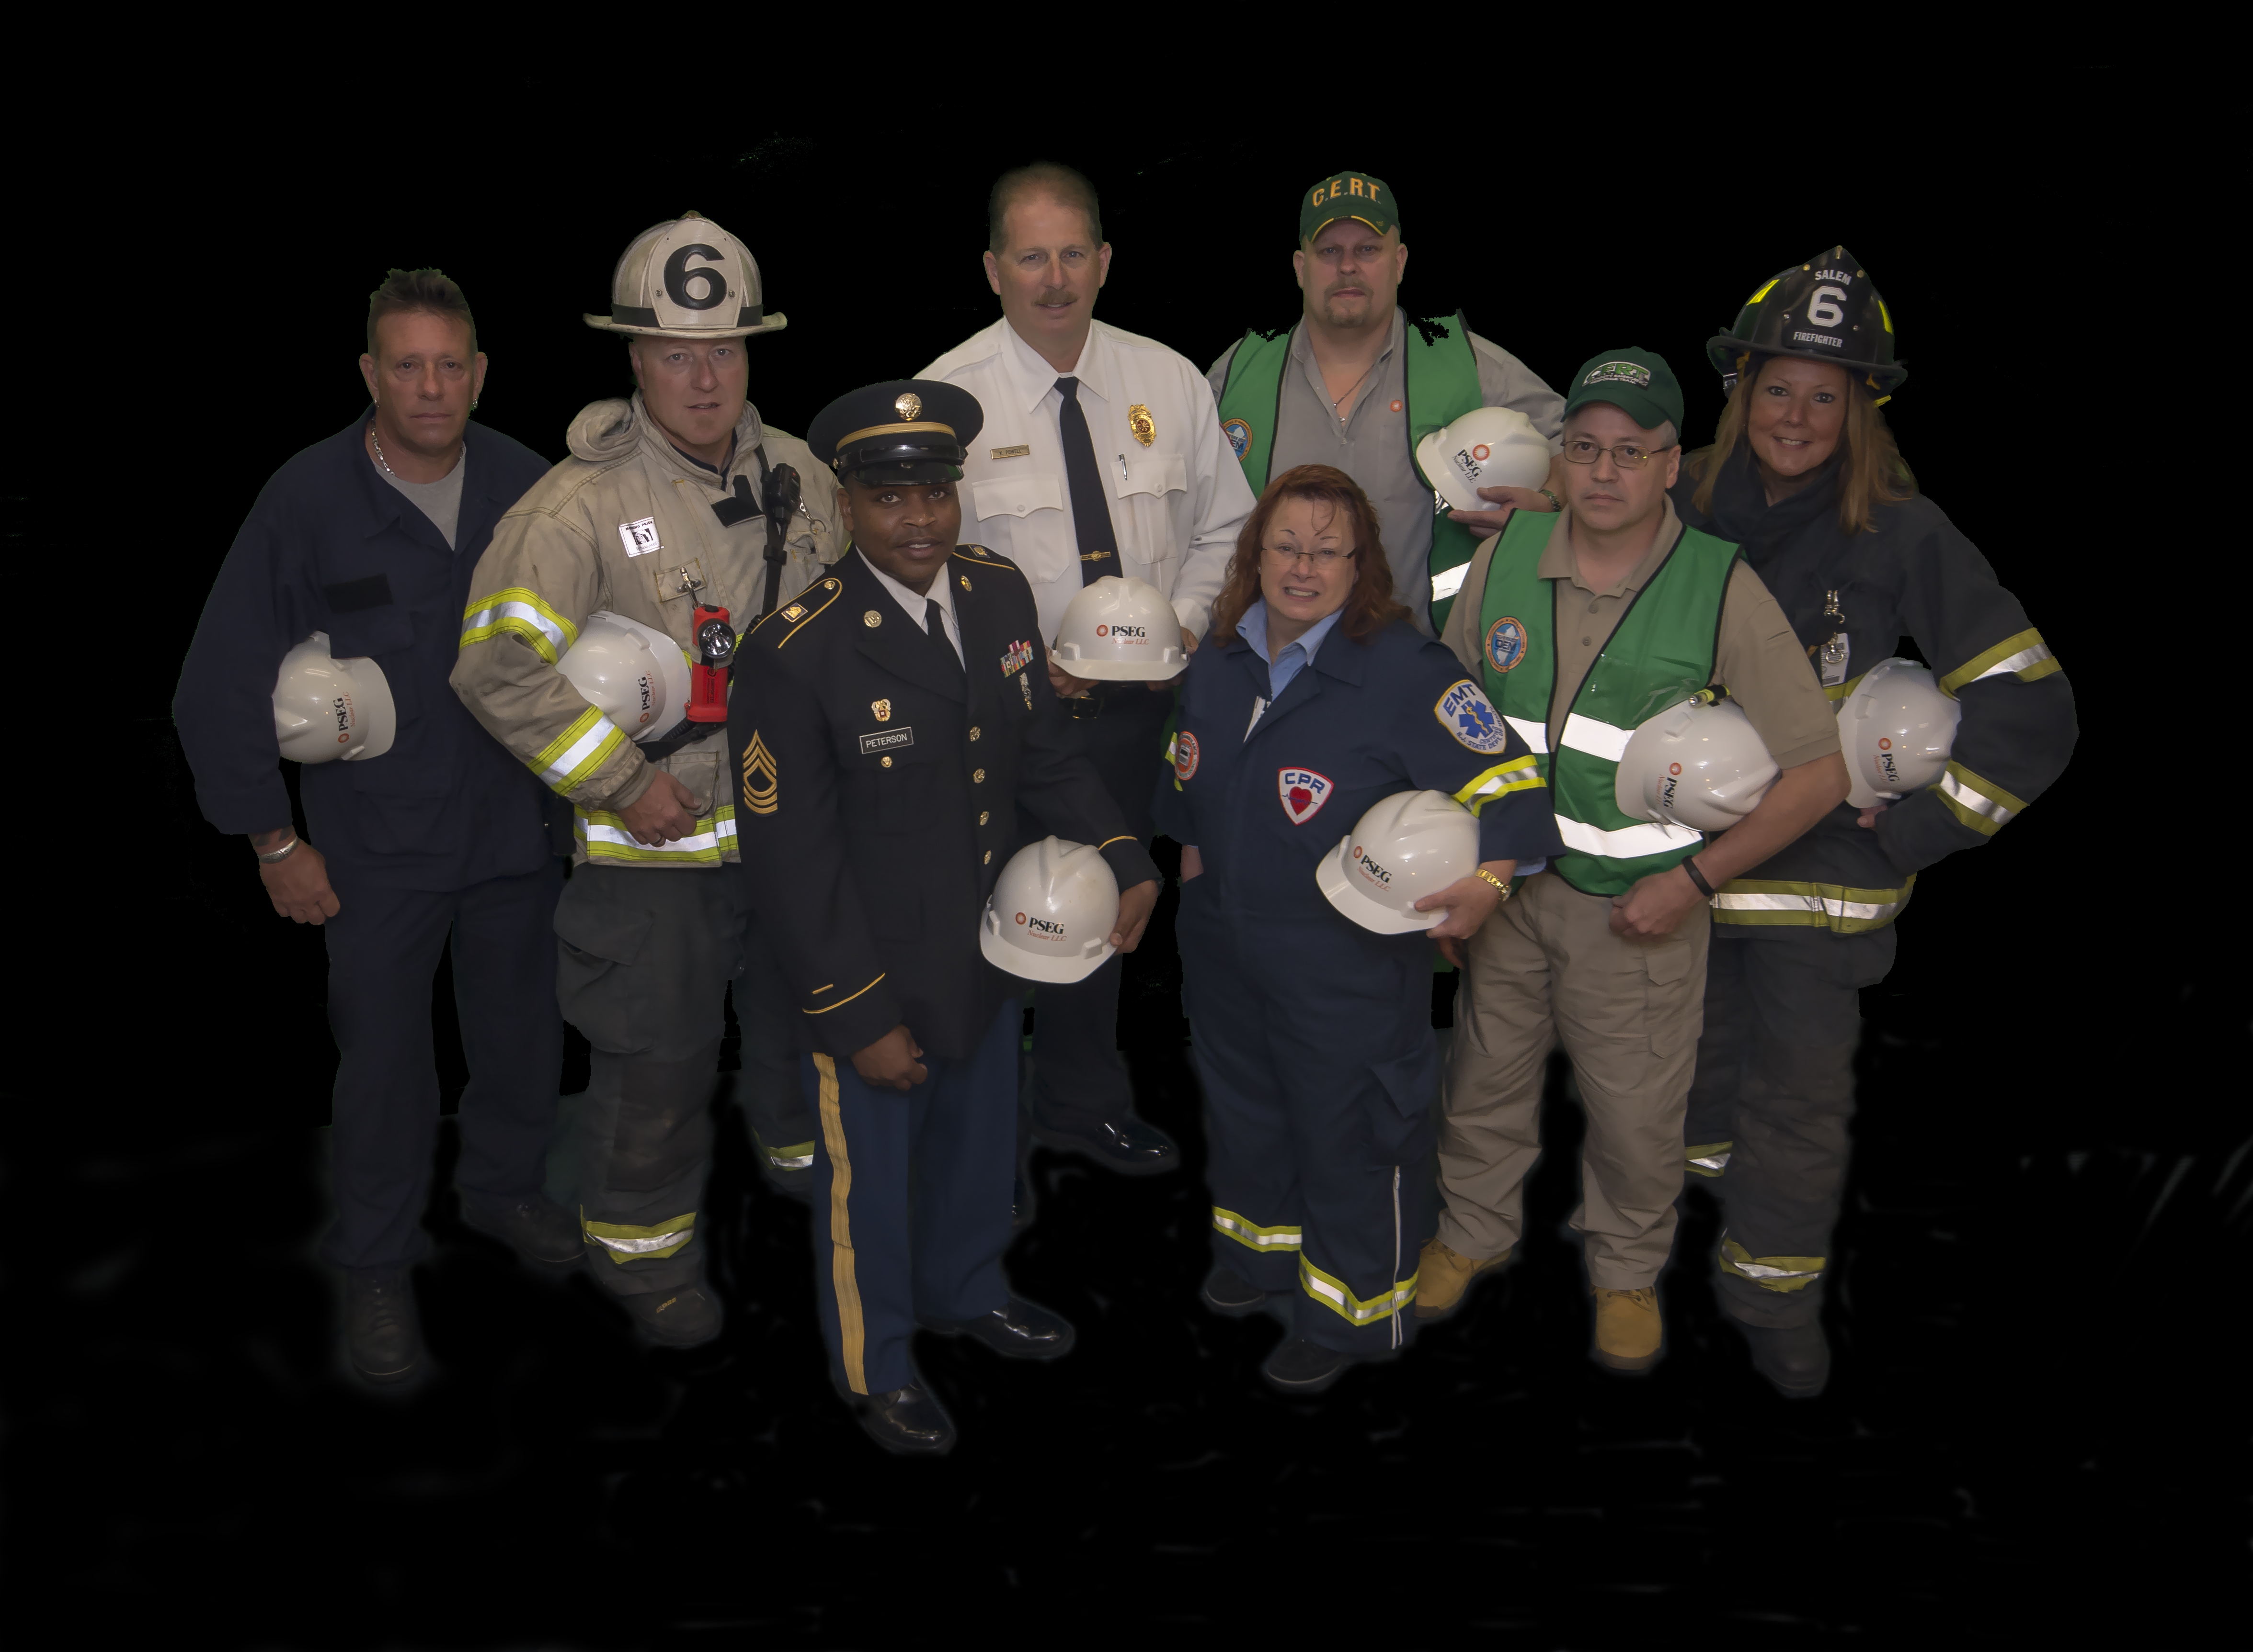
Community Events
The community needs to put a face
to the nuclear site: YOURS!
  Be friendly and honest
  Always have your one liner or slogan prepared
    Keep it simple
    Be sure to have the correct one liner/ slogan for the correct audience
    “We employ over 1,600 employees and make safe, clean and reliable electricity for almost 3 million homes….actually 97% of New Jersey’s carbon free energy!”
  What’s you slogan?
  Can you answer “What is your job?”
Distribute NEI Literature: Just the Facts, Radiation, Nuclear Energy Poster, Fuel Pellets,
Notes:
I am your neighbor, granddaughter, volunteer.
Don’t be afraid to take someone’s name and have someone contact them if they have further questions. Who is the contact for your site?
ACTIVITY 1: What’s you Slogan? What message do you want to get through to your particular audience. Appel to their interest. Work with the people at you table and develop a slogan or one liner for:
Elementary students, (tables 1 and 7)
Middle school students, (table 2 and 8)
High School Students (table 3 and 9)
College Students (table 4 and 10)
Young Professionals (table 5)
Your Community (table 6)
See how they differ? Your Slogan should have a core or foundation that you can build on to depending on you audience.
Activity 2: What is your job? Let’s break this down so you have an answer non-technical people can understand.

Slide 8


Scout Groups
Boy Scout “Nuclear Science Merit Badge”
Girl Scout “Getting To Know Nuclear Patch”
https://www.meritbadge.org/wiki/index.php/Nuclear_Science
http://www.nuclearconnect.org/know-nuclear/talking-nuclear/girl-scouts-get-to-know-nuclear-patch
Notes:
Hosting scouts is a great way to promote STEM, the nuclear industry and make relationships with active community leaders.

Slide 9
Resources
NEI
  ANS – American Nuclear Society
    http://www.ans.org/
  National Nuclear Science Week
    http://www.nuclearscienceweek.org/wp-content/uploads/2015/09/The_Fission_Game.pdf
ANS K-12 Initiative
Notes:
Click through the sites to show where you find materials. Examples will be shown later for the tables to work on.

Slide 10
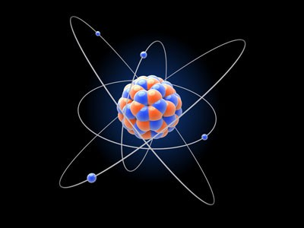
ACTIVITY TIME!!!!

Slide 11
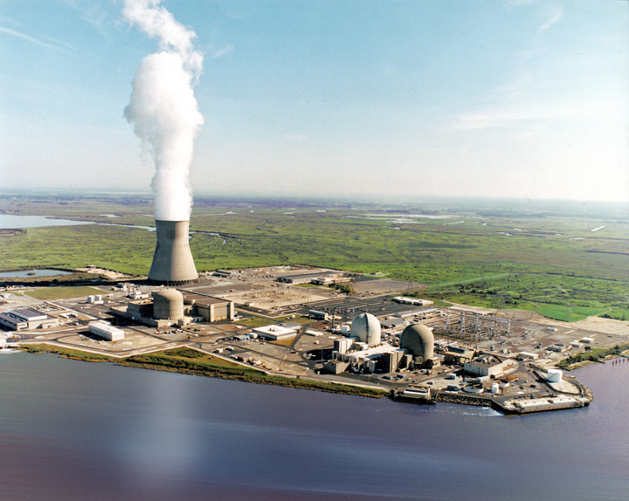
What do you make at a Nuclear Plant?
Notes:
Electricity!

Slide 12
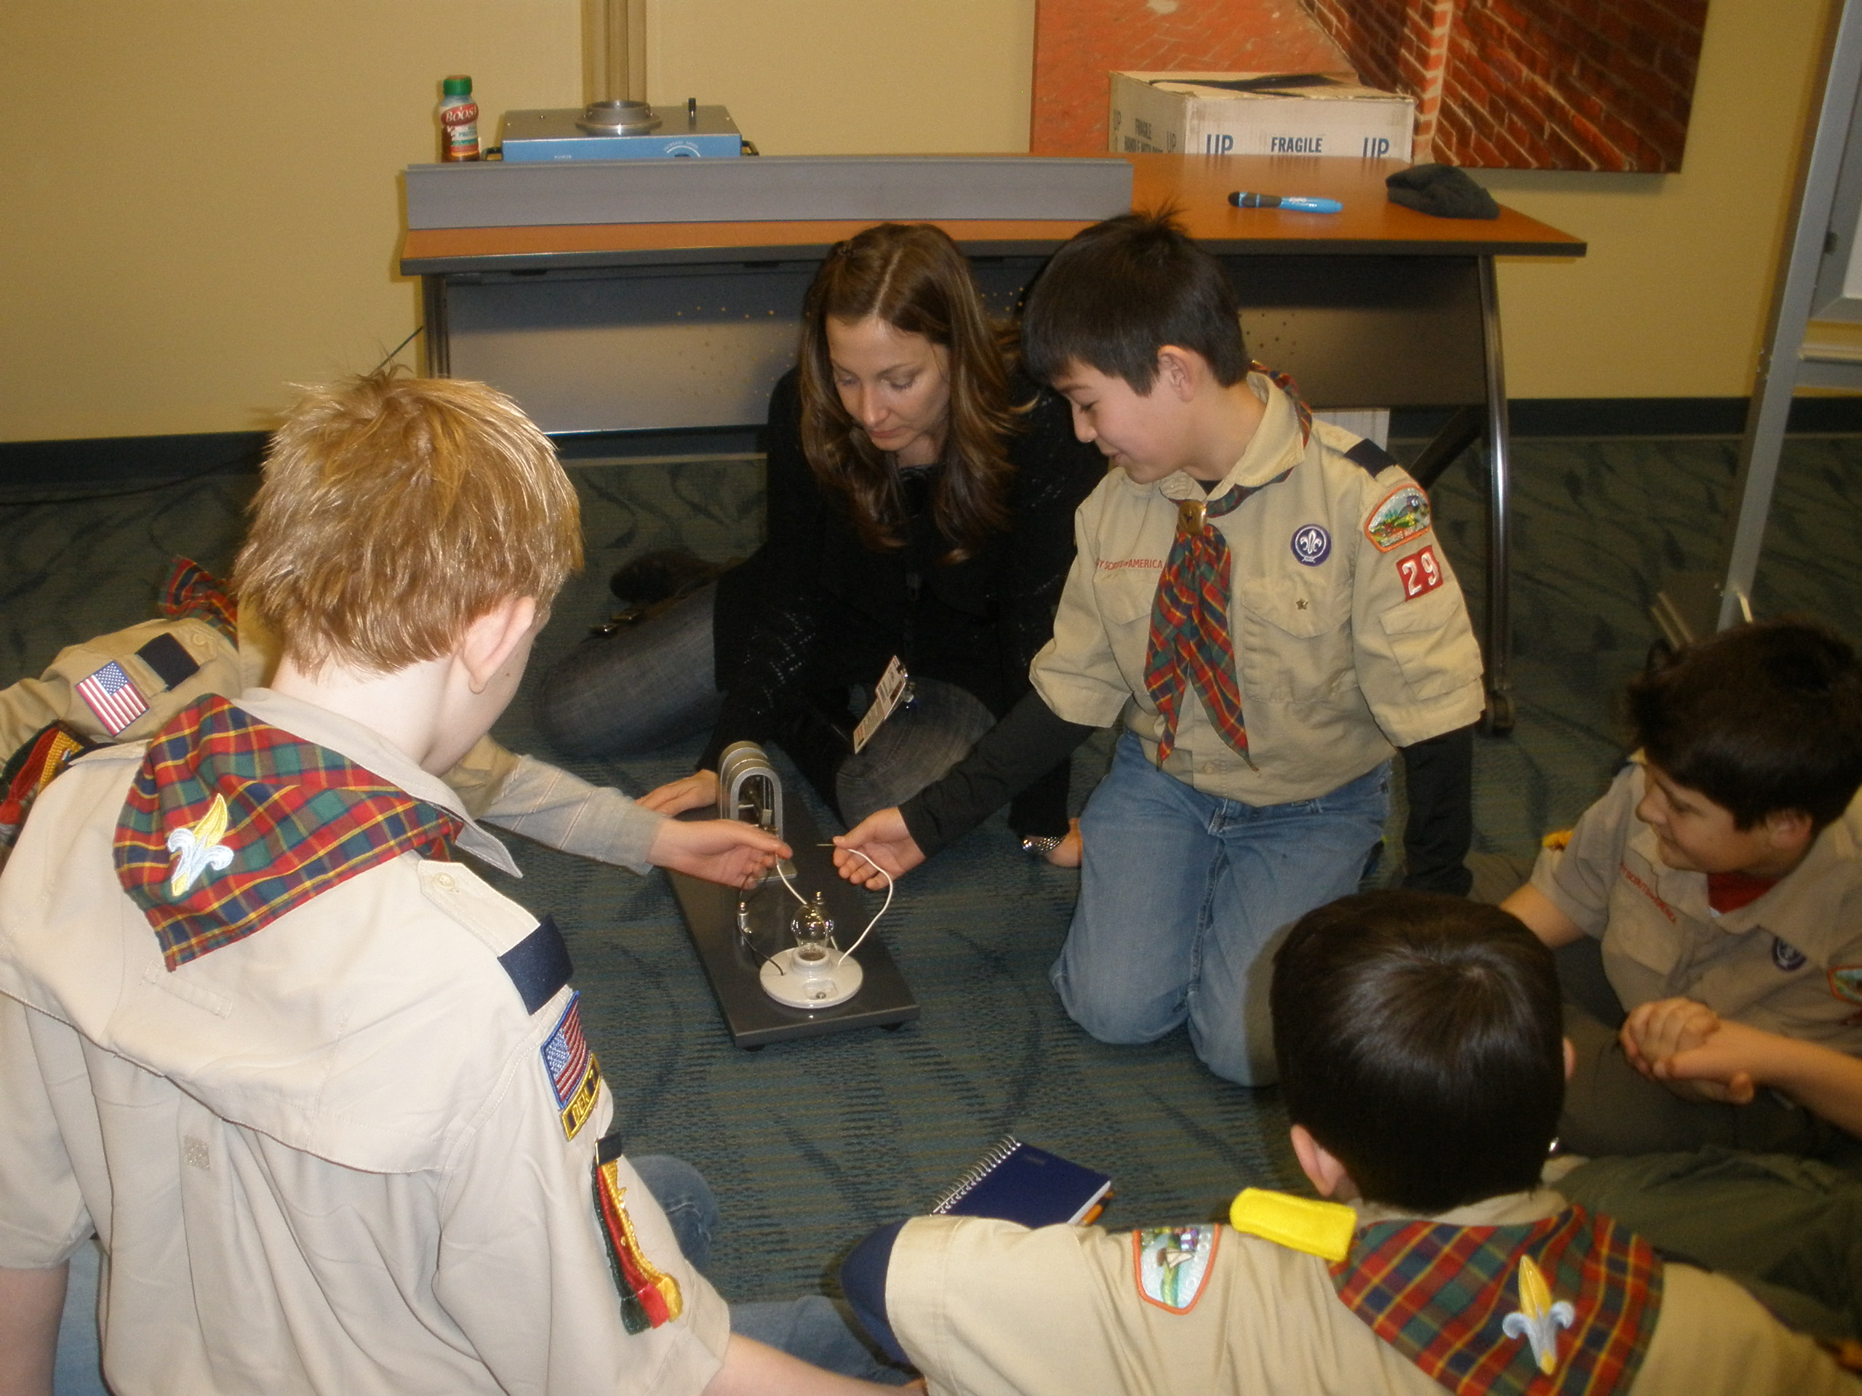
How do you make electricity?
Notes:
Demo the hand crank generator. The generator at a nuclear power plant is the size of a school bus. How do you turn a generator that size?
Demo the pinwheel – “turbine”, the container of “water” and discuss ways to make steam.

Slide 13
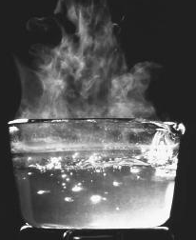
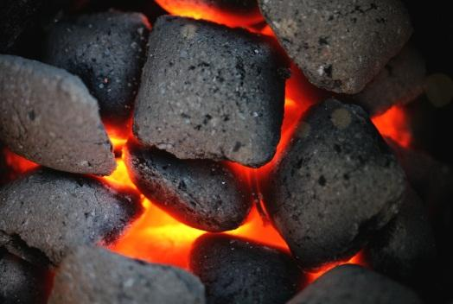
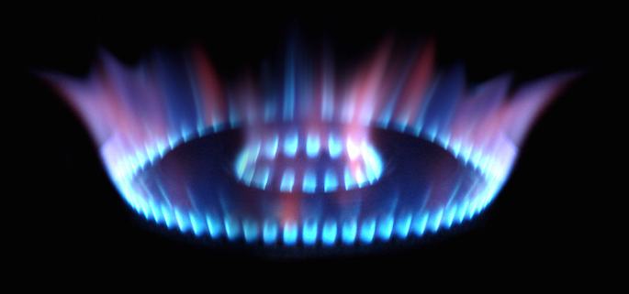

Burn Fuels for…. STEAM
Notes:
Lots of ways to make steam. Discuss how you can make steam if you put a pot of water on a campfire, then relate to coal and natural gas. What is the downside of burning fossil fuels?

Slide 14
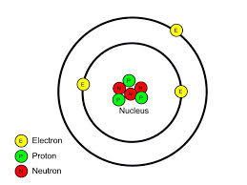
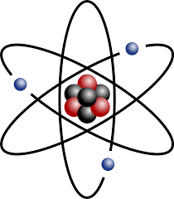
How does a Nuclear Plant make steam?
Split Atoms
Notes:
We split atoms! The entire world is made up of atoms. They are so tiny you can’t see them (30 trillion fit on the tip of a pin!). Discuss the parts of the atom: nucleus, protons, neutrons, electrons..

Slide 15
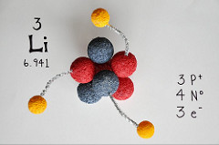
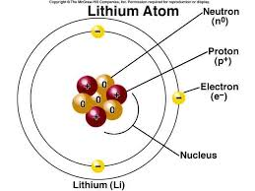
Lithium – 3 protons, 4 neutrons, 3 electrons
Notes:
This is a model of a Lithium atom. Discuss # of parts.

Slide 16
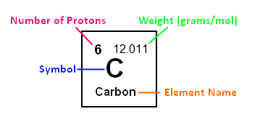
Let’s Build a Carbon Atom
6 protons - Positive Charge +
6 neutrons – Neutral Charge
6 electrons – Negative Charge -
Notes:
Every table has large & small marshmallows, toothpicks and wipes. Discuss #’s and how to build an atom from marshmallows: Mark protons (large marshmallows) with +, Electrons (small marshmallows) with a -

Slide 17
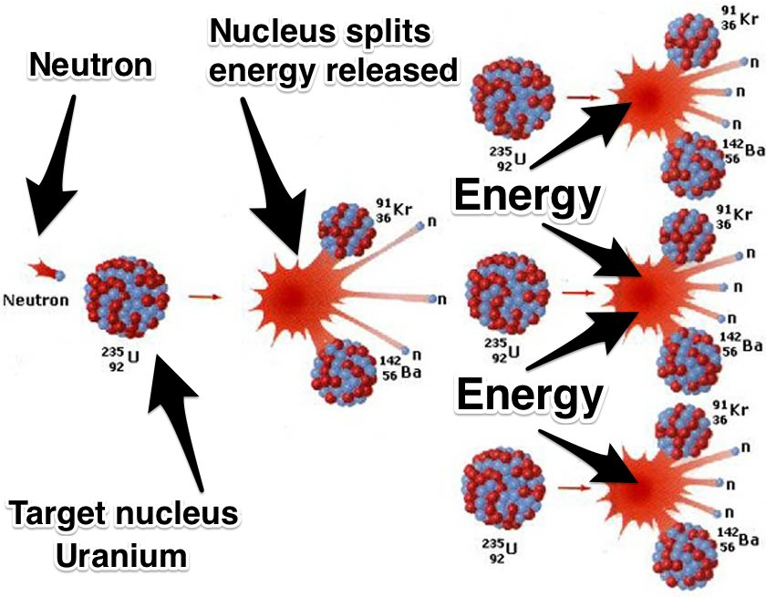
Spitting Atoms – Chain Reaction
Notes:
Explain the chain reaction then demo the “sticky note” fission exercise
Review the process of splitting atoms, making heat, making steam, turning turbine, making electricity.

Slide 18
Modeling Atoms
http://nuclearconnect.org/in-the-classroom/for-teachers/modeling-radioactive-stable-atoms
Notes:
Activity to demo atoms

Slide 19
Fission Activity
http://nuclearconnect.org/in-the-classroom/for-teachers/what-is-fission
Notes:
Activity to demo Fission

Slide 20
Chain Reaction
http://nuclearconnect.org/in-the-classroom/for-teachers/mouse-trap-reactor
http://nuclearconnect.org/in-the-classroom/for-teachers/chain-reaction-the-basic-of-nuclear-energy
http://nuclearconnect.org/in-the-classroom/for-teachers/nuclear-chain-reaction-using-dominoes
Notes:
Activities to demo Chain Reactions

Slide 21
Build Your Kit
Atom – styrofoam balls, clay, marshmallows, etc.
Sticky Notes
Pinwheel
Handcrank Generator
Container
Nuclear Energy Poster (NEI)
Fuel Pellet

Slide 22
Questions?

