Slide 1
Using Data for Effective Storytelling

Slide 2
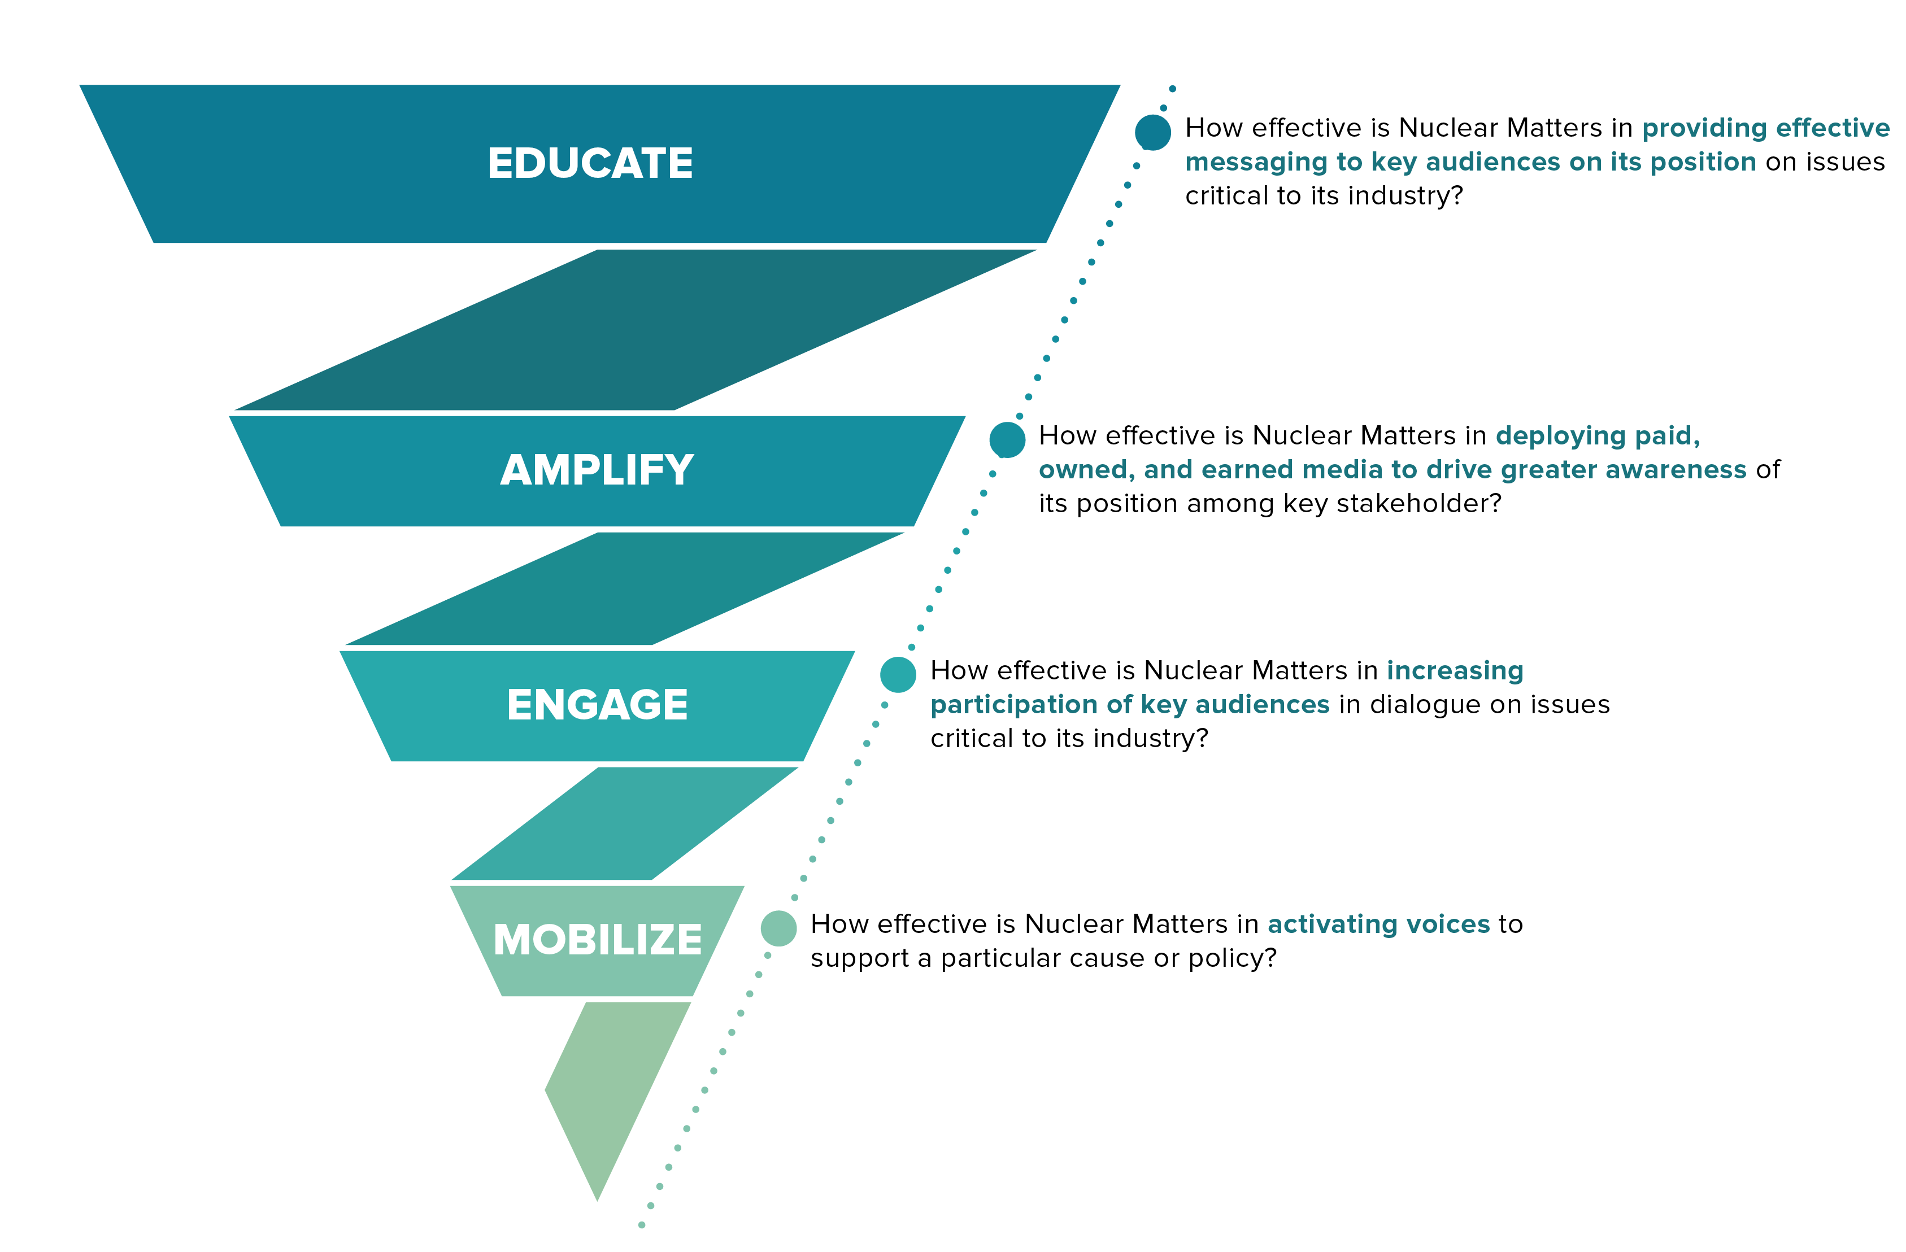
Why Effective Storytelling Matters to Industry
Data-driven communication decisions

Slide 3
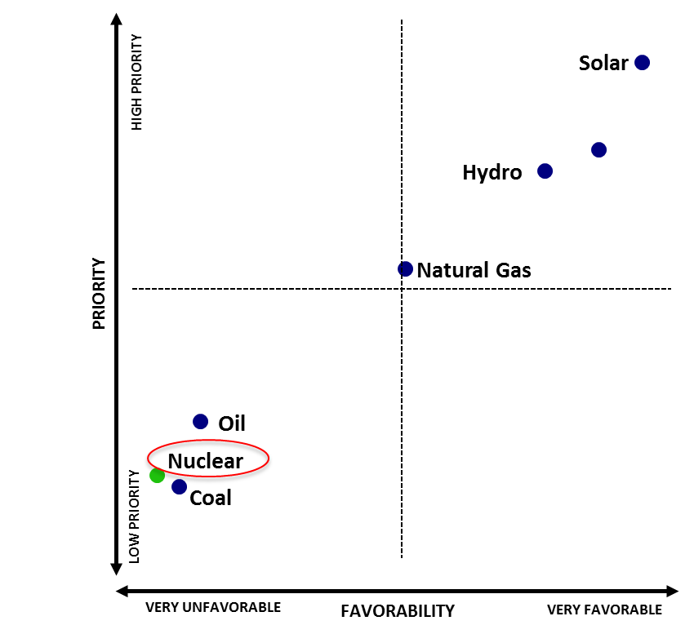
The Industry’s Quandary: A Broken Story
How many storylines?
Reading the “numbers only” can lead to conflicting conclusions
What this means for the nuclear power industry
Favorable: 58%
Priority: 52%
Notes:
What can data/analytics tell us about people and their opinions on nuclear?

Slide 4
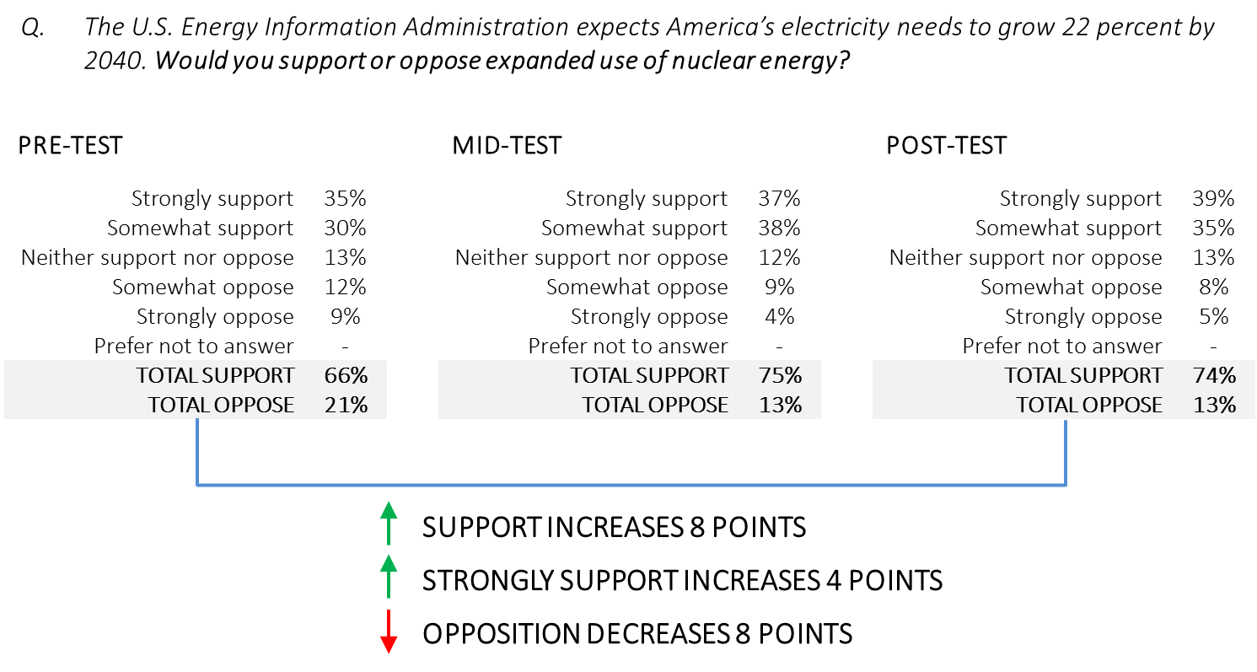
What We Want to Influence: Policy Support
Notes:
What can data/analytics tell us about people and their opinions on nuclear?

Slide 5
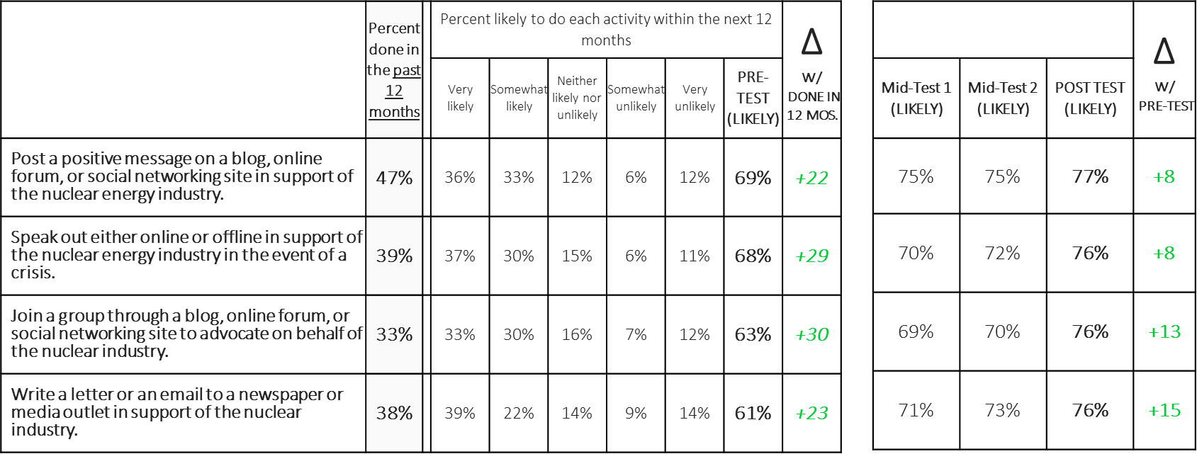
What We Want to Influence: Engagement
Notes:
What can data/analytics tell us about people and their opinions on nuclear?

Slide 6
The Popular Approach
Land siting procedures for all facilities are subject to approval by the NRC through a process of public consent, geological surveys, and environmental impact studies. | 86%
Regulators are guaranteed access to inspect plants at any time, without notice, and all inspection records are public record. | 86%
New technology, inherently safer reactor design, new regulatory organizations, training, and massive containment structures provide layer upon layer of safety. | 86%
U.S. reactor operators are licensed by the NRC and must requalify for their license every two years. | 86%
Nuclear facilities are designed with multiple backup safety systems that can automatically shut down the reactor. | 85%
Unlike other energy sources, nuclear energy is generated 24 hours a day, 7 days a week, which provides constant, reliable energy. | 83%
Resident inspectors for the NRC spend one week out of every six in training, which is more continuous training than pilots and doctors. | 83%
One nuclear power plant generates more energy than all the solar power generated in the country combined. | 82%
Ninety-nine nuclear power plants produce 20% of the country's overall energy. In comparison, 1,740 natural gas plants generate 30% of the country's energy. | 81%
The U.S. is losing global influence to countries like China and Russia that are investing heavily in next-generation nuclear technology and strengthening ties with countries looking to build advanced nuclear facilities in the coming years. | 80%
Compared to fossil fuels that release byproducts into the air, the nuclear industry is required by law to take responsibility for its waste. | 77%
Nuclear power is generated when a tightly-controlled scientific reaction boils water into steam and powers turbines to generate electricity. | 74%
Nuclear power plants use state-of-the-art technology to control the scientific reaction that generates nuclear power. | 72%
Unlike plants that burn coal, oil, and natural gas to boil water, nuclear plants do not burn anything. | 72%
The amount of nuclear waste produced by one consumer throughout their entire lifetime is the size of a soda can. | 72%
Nuclear power is produced through a simple transfer of energy that boils water. | 70%
If stacked end to end - the nuclear waste produced by the industry over the last 50 years is the size of a football field. | 65%
Notes:
How can we use that information to our benefit?

Slide 7

The Science of Storytelling
POST-TEST
Correlation: Isolating message impact
Testing related to:
Initial attitudes
Policy Support
Engagement
OPINION
MOVEMENT
^{Testing related to:}
Informed attitudes
Messages and facts associated with change
Most moveable audiences
PRE-TEST
OPINIONS
PRE-MESSAGING
MESSAGING
Reactions to messages
Notes:
How can we use that information to our benefit?

Slide 8
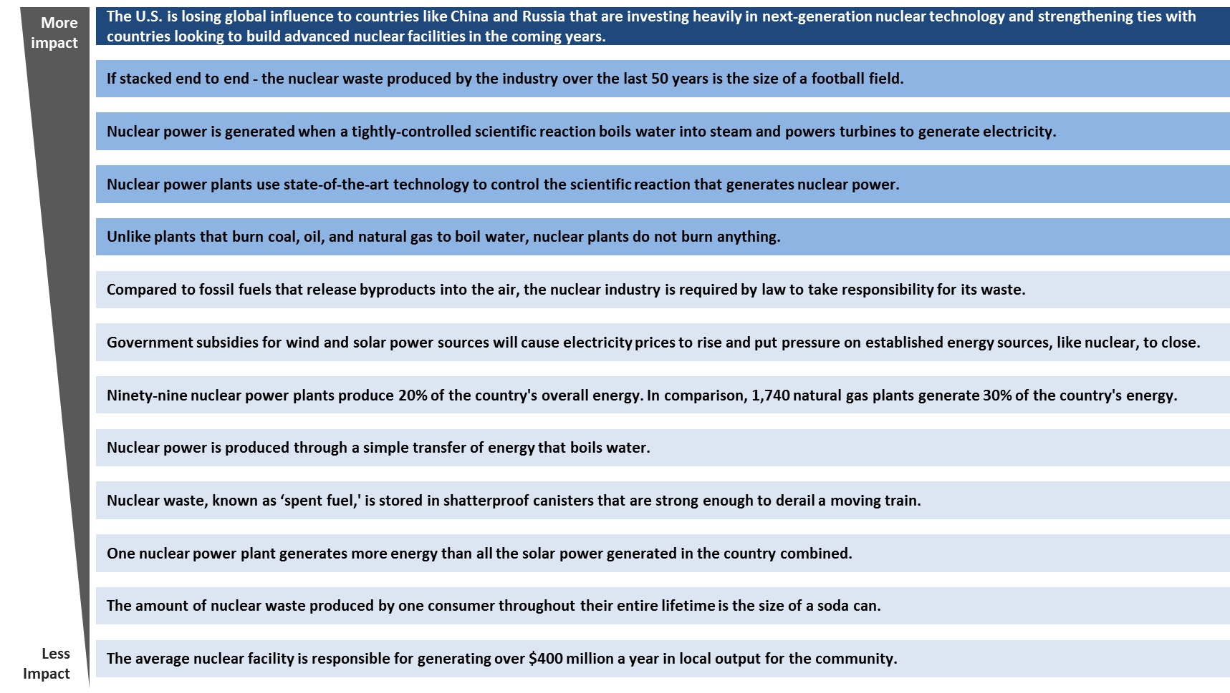
Uncovering the Effective Message Themes

Slide 9
Crafting a Story

Slide 10
Why Me? Why You?
You’re Good Enough
You’re Smart Enough
People Like You

Slide 11

Let’s Talk About The Need for Nuclear Power By Not Talking About Nuclear Power
Talk about things people
care about:
  human health
  nature
  future

Slide 12
What Works Best
Trial & error - not afraid to fail
Start by neutralizing - establish common ground “What do you think of when you hear ‘Nuclear’? Yeah, me too.”
Listen
Take the higher ground – no pig wrestling
Understand your audience / platform

Slide 13

What’s Working?
Be interesting
Pictures of people
Video
Personal stories
Express vulnerability
Controversy
Explore different frames

Slide 14
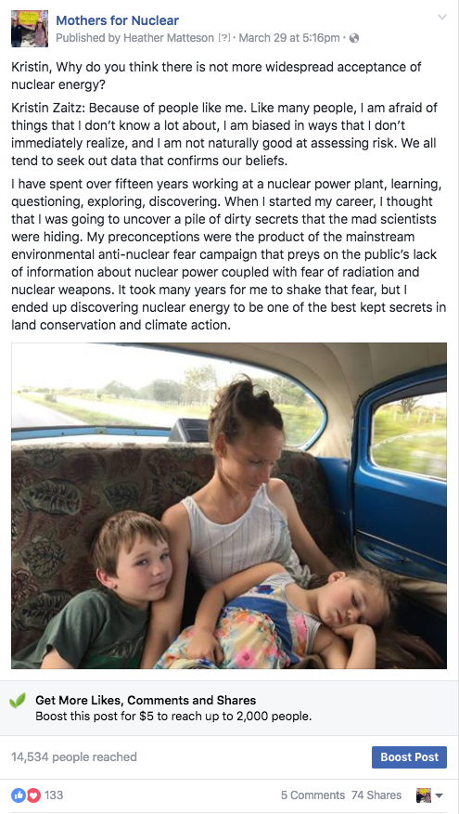
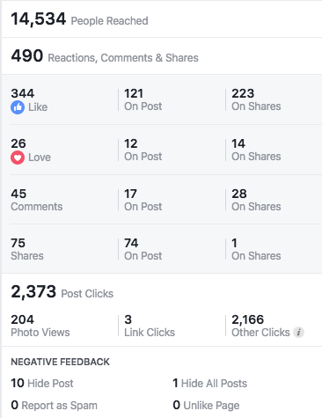
Personal stories & vulnerability
Q: Why do you think there is not more widespread acceptance of nuclear energy?
A: Because of people like me. Like many people, I am afraid of things that I don’t know a lot about, I am biased in ways that I don’t immediately realize, and I am not naturally good at assessing risk. We all tend to seek out data that confirms our beliefs…
Notes:
Discuss the picture – it was taken in Cuba, there were no seatbelts. Risk

Slide 15
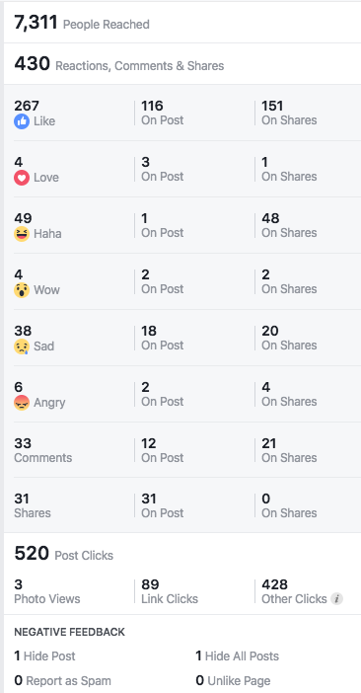
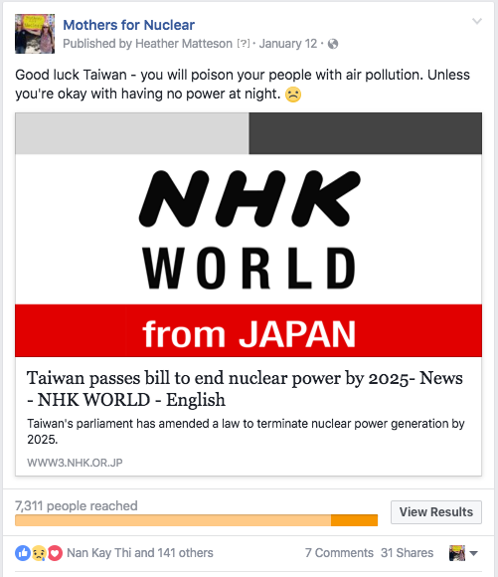
What Does Your Audience Care About? Talk About That.
Boosted to
residents of Taiwan

Slide 16
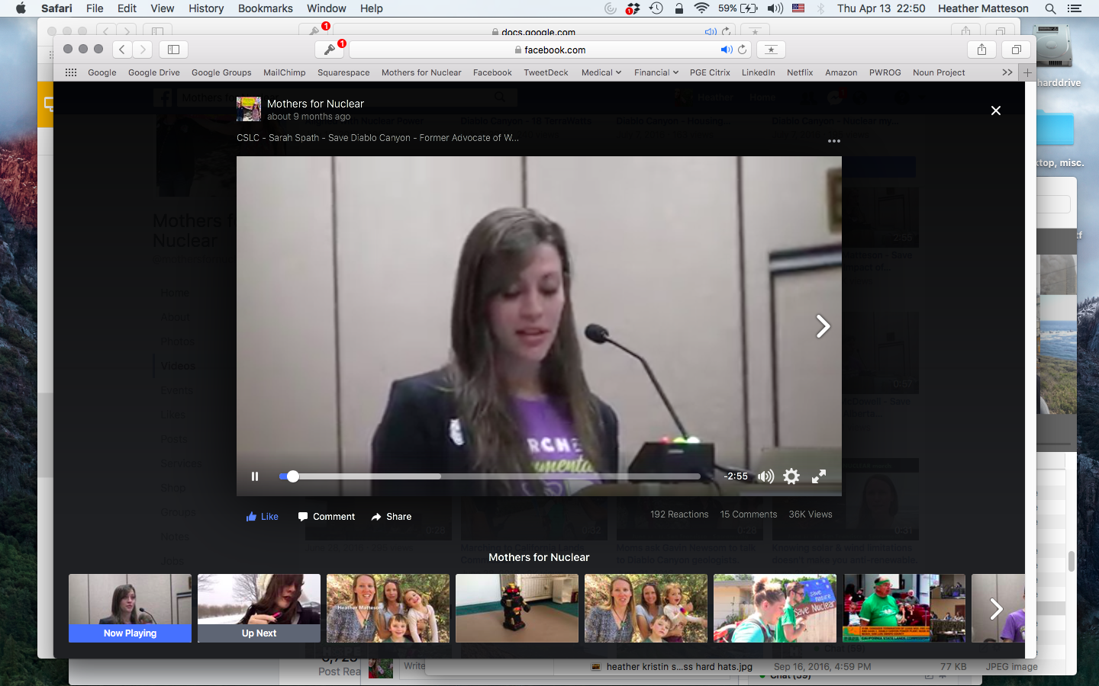
Video!

Slide 17
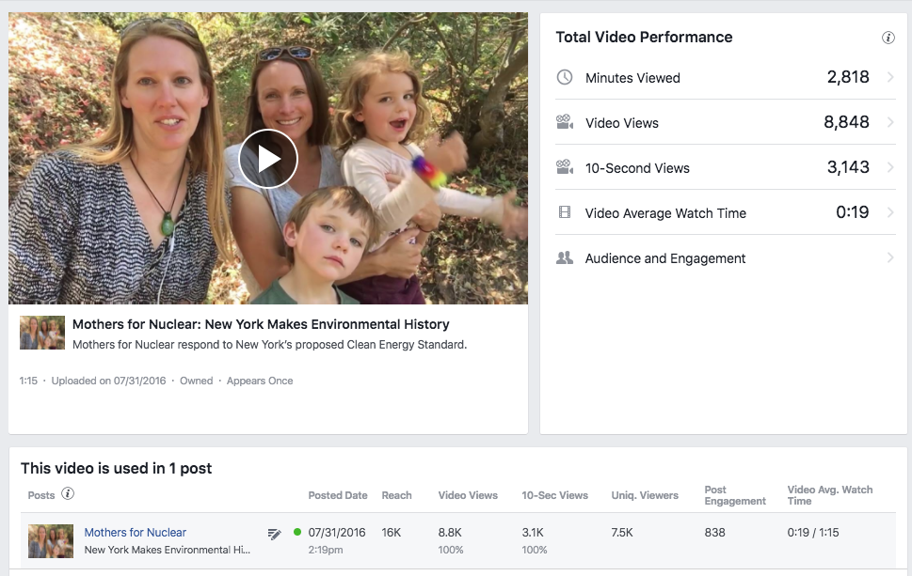
Video – Moms, Kids, Nature

Slide 18
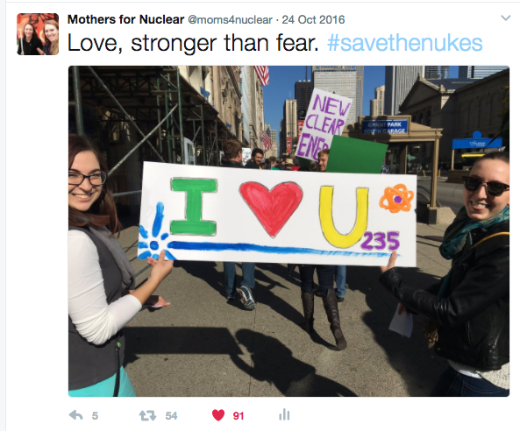
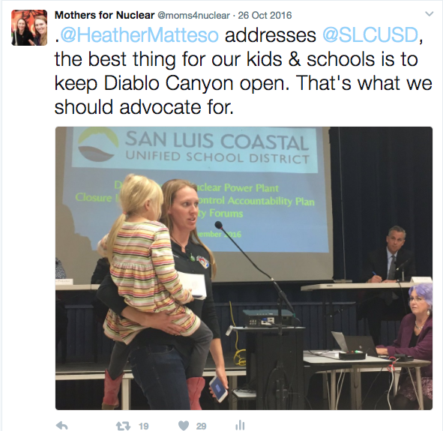
Do people in nuclear have feelings?
Yes, they do…

Slide 19
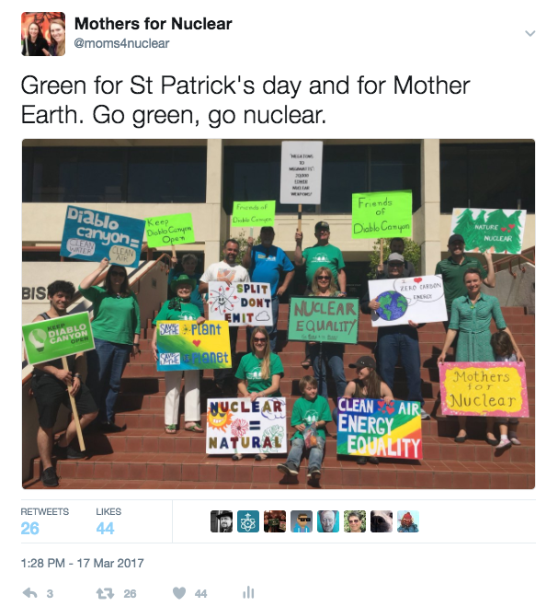
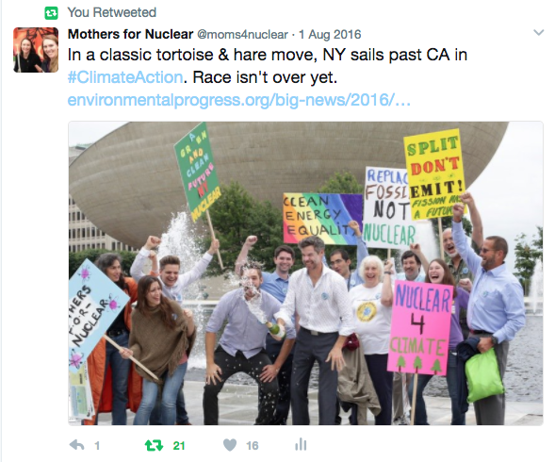
Absent: corporate branding

Slide 20
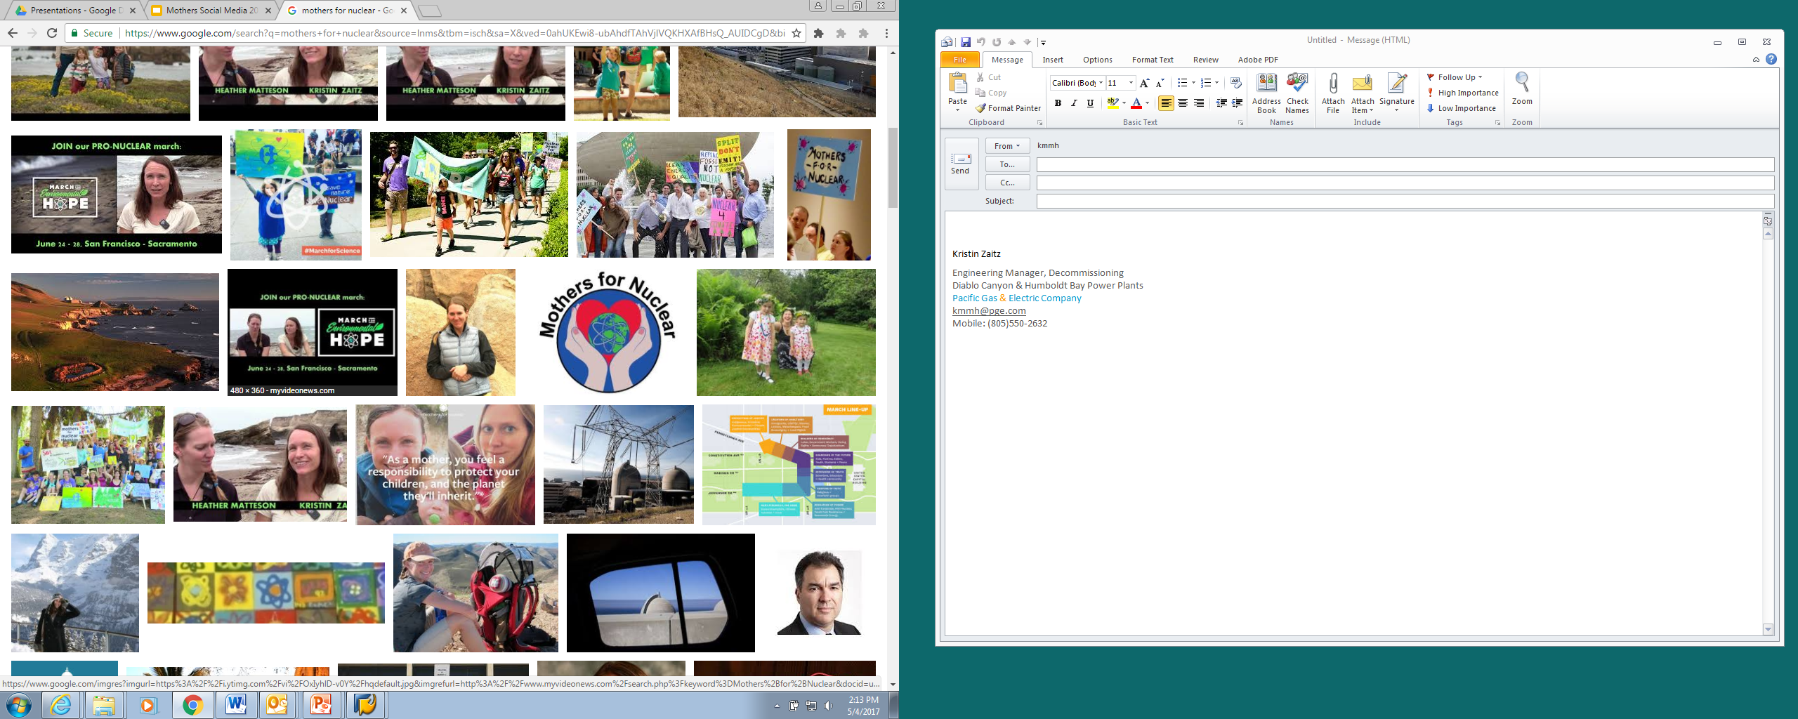
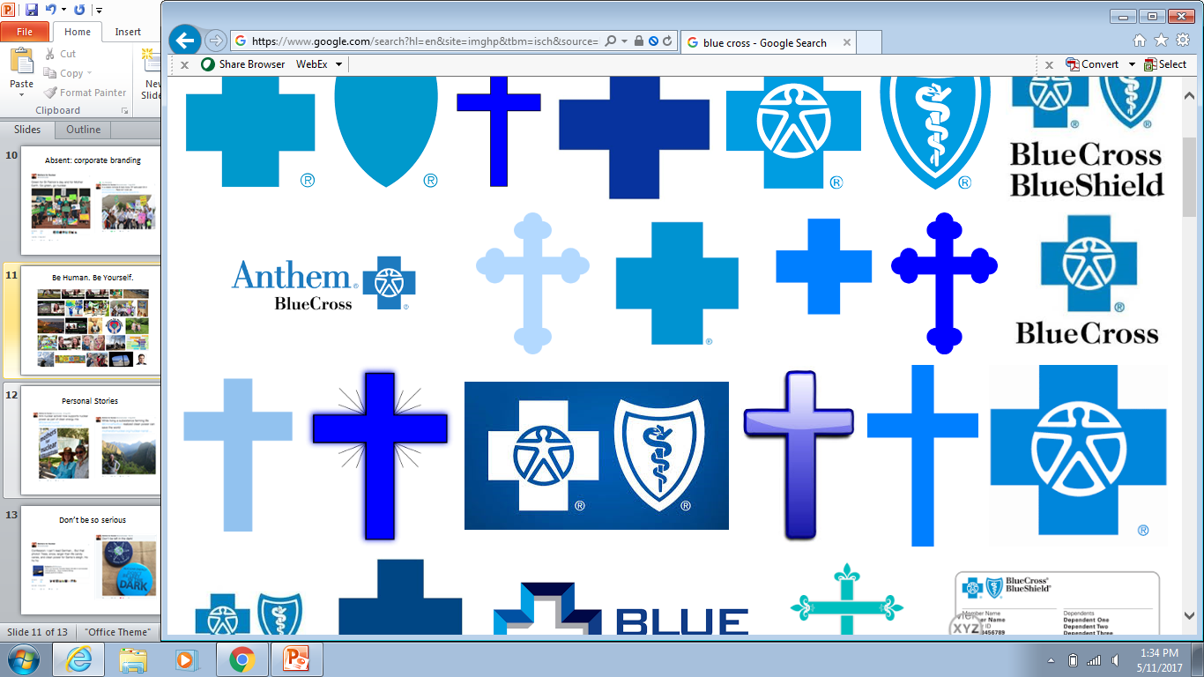
Be Human. Be Yourself.

Slide 21
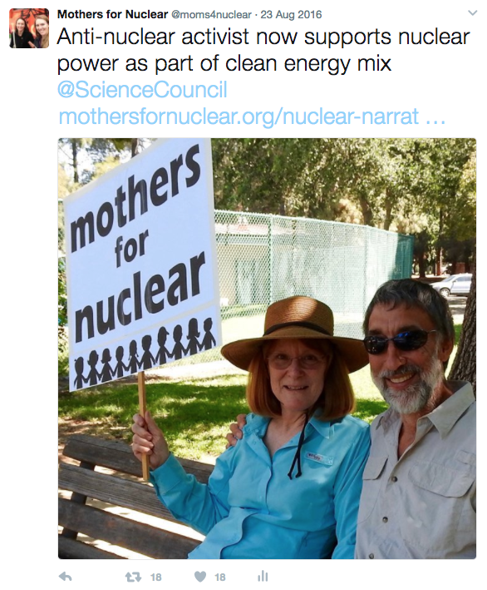
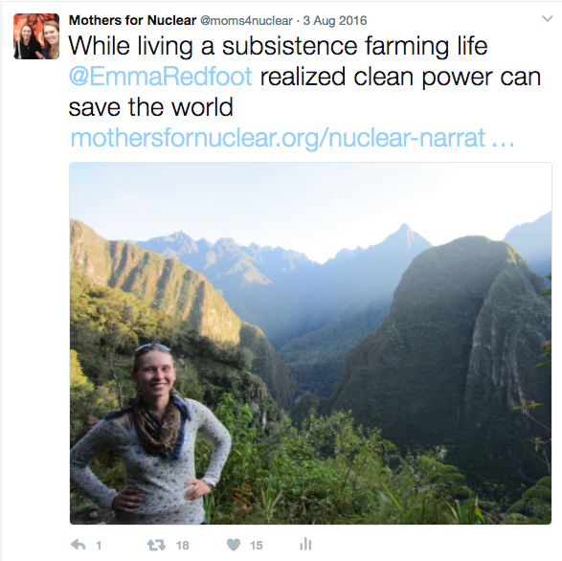
Personal Stories

Slide 22
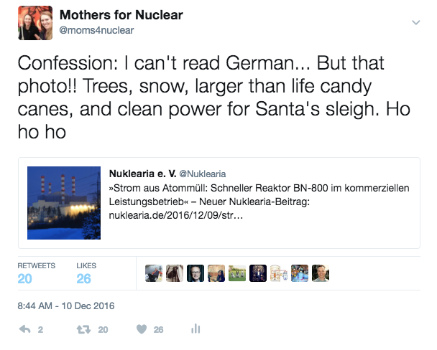
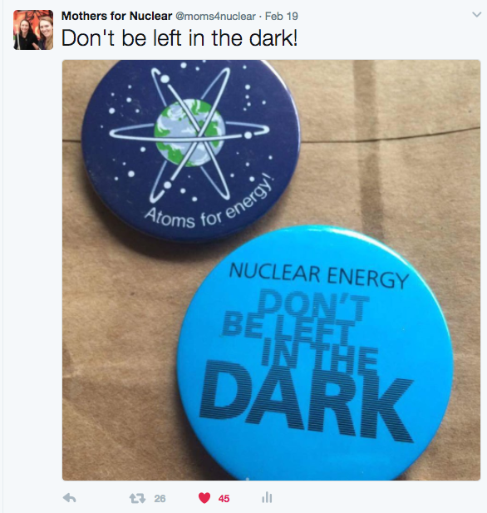
Don’t be so serious

Slide 23
Effective Marketing:
Getting the Story Out

Slide 24







Introduction
Leader, CMO, shareholder value growth
Professional Summary:
  MBA, Wake Forest University
  Deep marketing and sales experiences
  Innovative, Entrepreneurial; seven years of VC and startup reality
  Trusted advisor: CEO’s, BoD, VC
  Board Member, Lecturer, Adjunct professor

Slide 25
Situational Assessment
“It is not the essential nature of a technology that matters but its capacity to fit into the social, political and economic conditions of the day. If a technology fits into the human world in a way that gives it ever more scope for growth it can succeed beyond the dreams of its pioneers” Oliver Morton, Economist

Slide 26





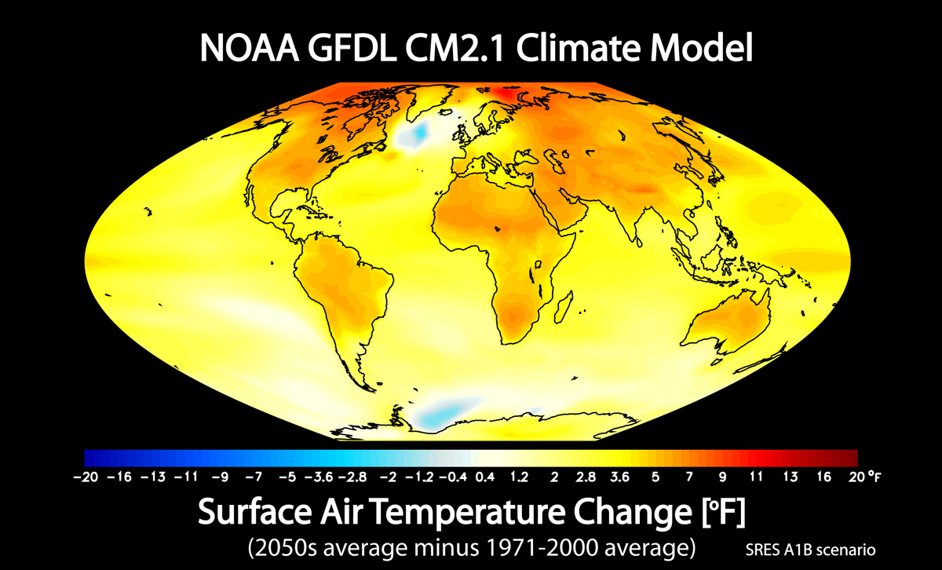
Elements to consider
Demographics
Cultural
Economics
Technology
Political
World

Slide 27
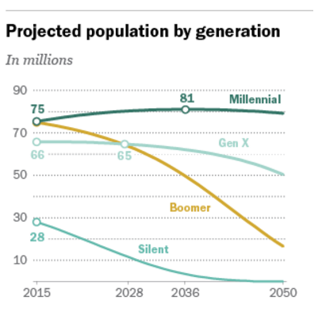
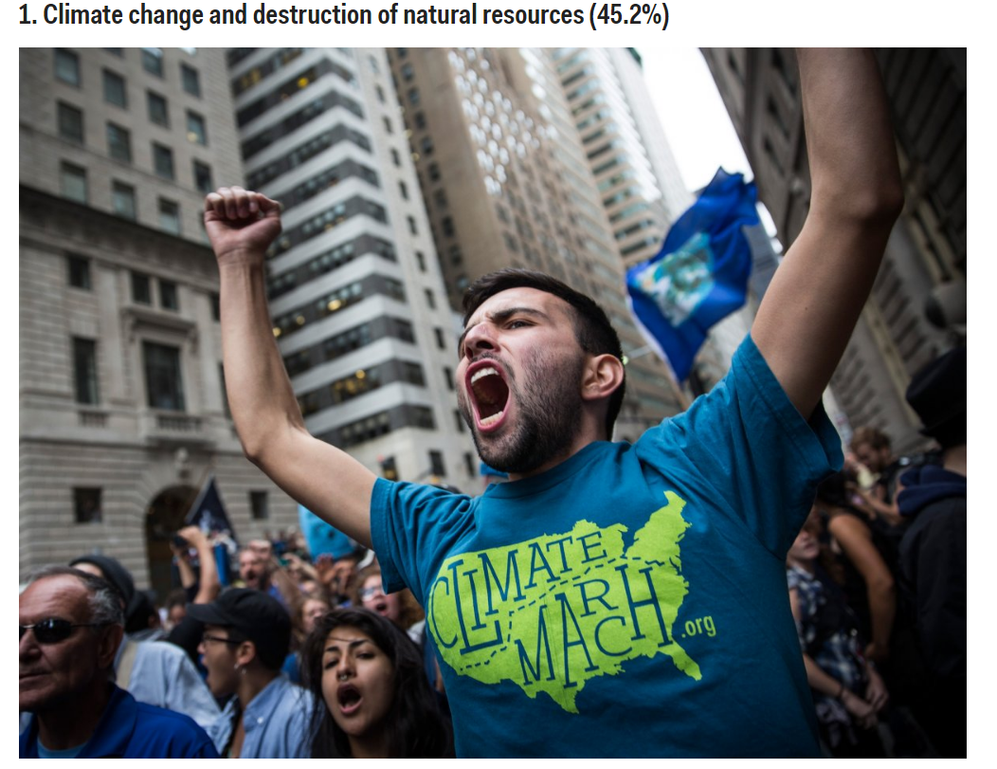
Element Status
Demographics/Cultural/Technology

Slide 28
Element Status
Economics/World
World Nuclear Association March 2017 | Nuclear Electricity Generation 2015 | Reactors Under Construction March 2017
China, Japan, South Korea | 13% | 47%
US | 33% | 8%
World | 2,441 billion kWh | 63,420 MWe Gross

Slide 29
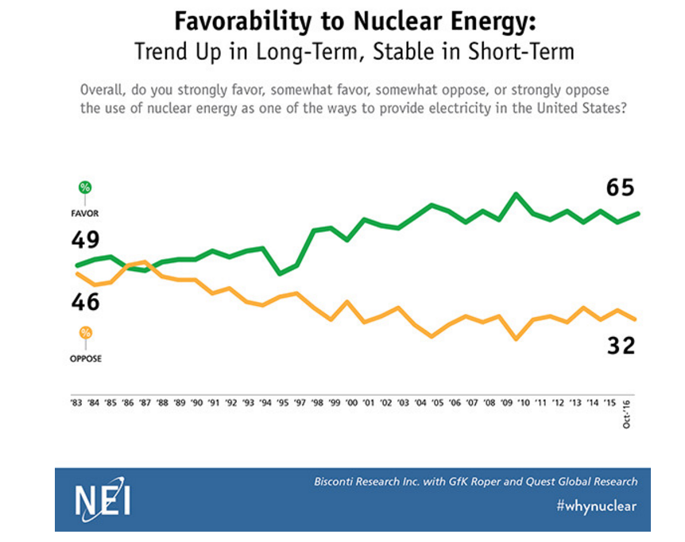
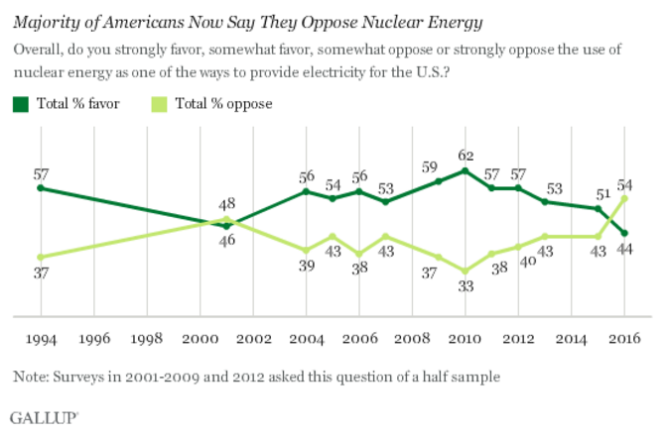
Element Status
Cultural/Economic

Slide 30

Strategies for marketing nuclear
Messaging:
    Increased proactive messaging
Target:Millennials/Politicians
    Mobile/Social platforms
Positioning:
    Answer to Climate Change
Promotion: Increased education of and partnering with the media

Slide 31
Deploying the
Nuclear Story

Slide 32
Deploying the Nuclear Story
Repeat key value messages in all communications channels
  Clean air
  Reliable energy
  Economic benefits
Use multiple communications channels focused on targeted audiences
  Employees
  Public
  Traditional media
  Social media

Slide 33
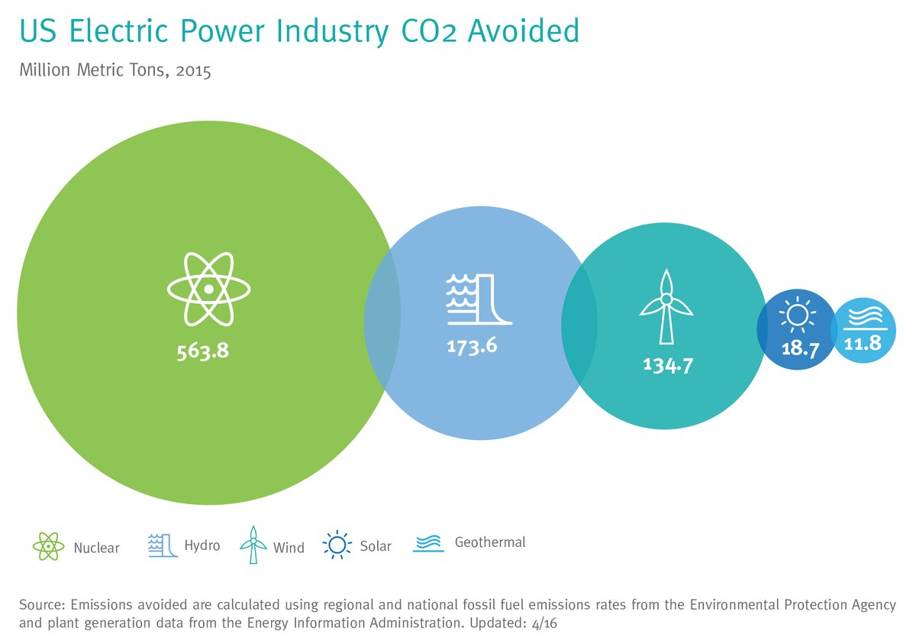
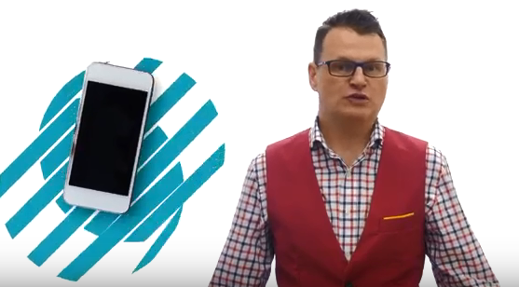
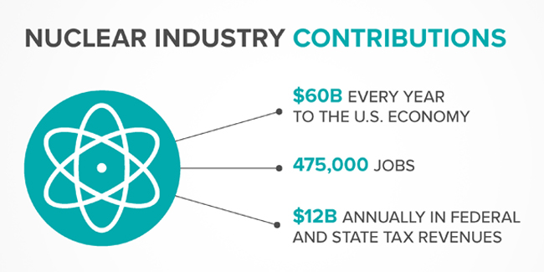
Consistent Messaging
NEI to Wall Street: Nuclear Energy Is a Cornerstone of American Infrastructure Feb. 9, 2017 WASHINGTON, D.C.—America’s nuclear reactors provide an irreplaceable suite of benefits to consumers, the economy, and the environment; states are increasingly recognizing the advantages, the head of the Nuclear Energy Institute told Wall Street analysts this morning. New technologies in the design and licensing phase will include a range of modern reactors, varied in size, design and mission, which will help America provide the technology that meets the world’s needs for electricity, water, fuels, and chemicals, cleanly and economically, said Maria G. Korsnick, NEI’s president and chief executive. Nuclear power will remain a core component of America’s electricity infrastructure, she said. But the electric markets still generally fail to pay plant owners for all the services their reactors provide, part of the reason for some announcements of premature plant closures in recent months. Yet New York, Illinois and Wisconsin have all taken pronuclear steps in the last few months. “Our operating nuclear plants are the backbone of the U.S. electric system, and a critical part of our national electric infrastructure,” Korsnick said. “We see states, regions and the federal government taking actions to preserve our nuclear power plants. They recognize that these plants constitute critical infrastructure that is too valuable to lose,” Korsnick told approximately 150 Wall Street analysts. While a handful of nuclear plants have closed prematurely in recent years, the U.S. industry worked with stakeholders in two states in 2016, Illinois and New York, to preserve five nuclear plants that would otherwise have shut down. At last year’s Wall Street briefing NEI introduced analysts to the industry’s “Delivering the Nuclear Promise” initiative, designed to bring vital efficiencies, additional safety and operational savings to every plant. Thursday morning, Korsnick highlighted the initiative’s accomplishments in just one year: More than 1,000 staff across the industry identified $650 million in potential savings for the operating fleet. Our aspirational goal is $3 billion. To date, more than 90 percent of identified measures are being implemented at plant sites. “And we are just getting started,” Korsnick said.
Clean air
Economically beneficial
Reliable energy

Slide 34
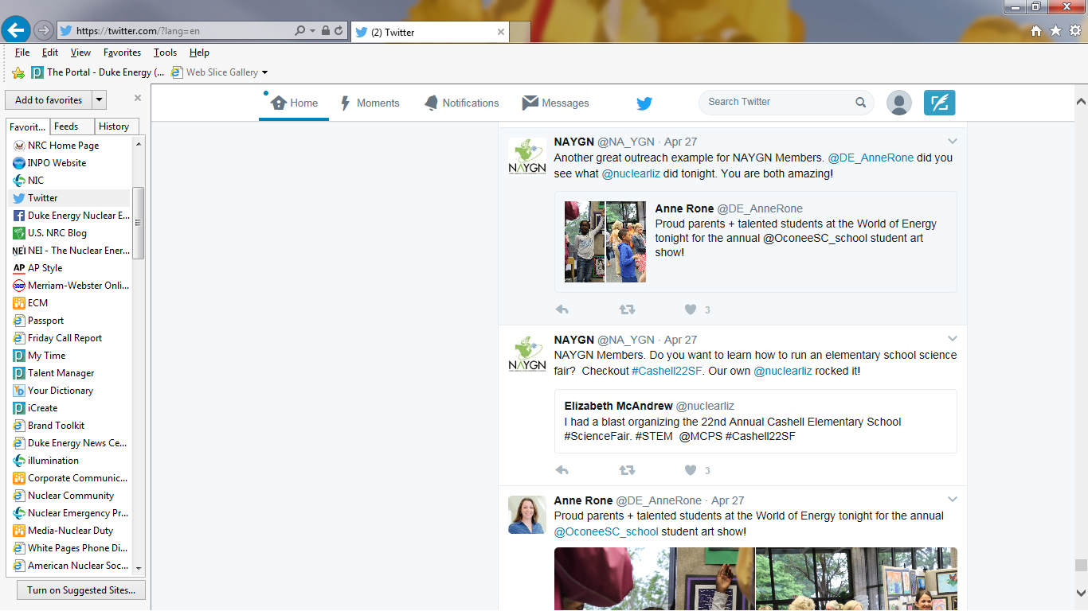
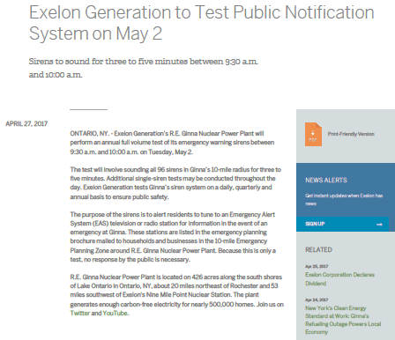
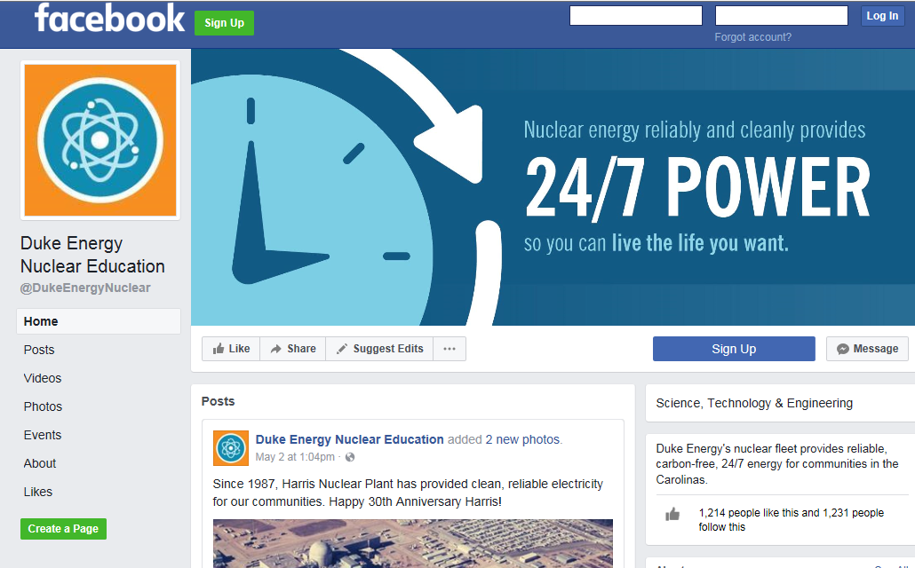
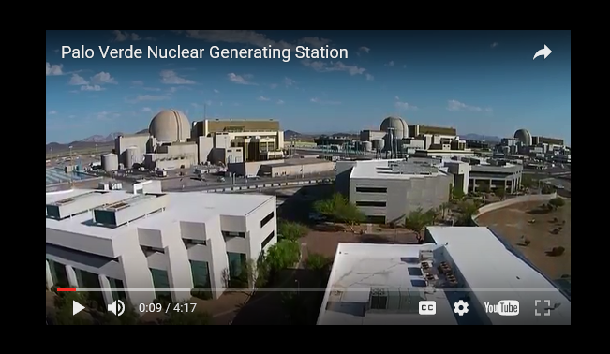
Diverse Media
Hashtags:
#whynuclear
#NAYGN
#STEM

Slide 35
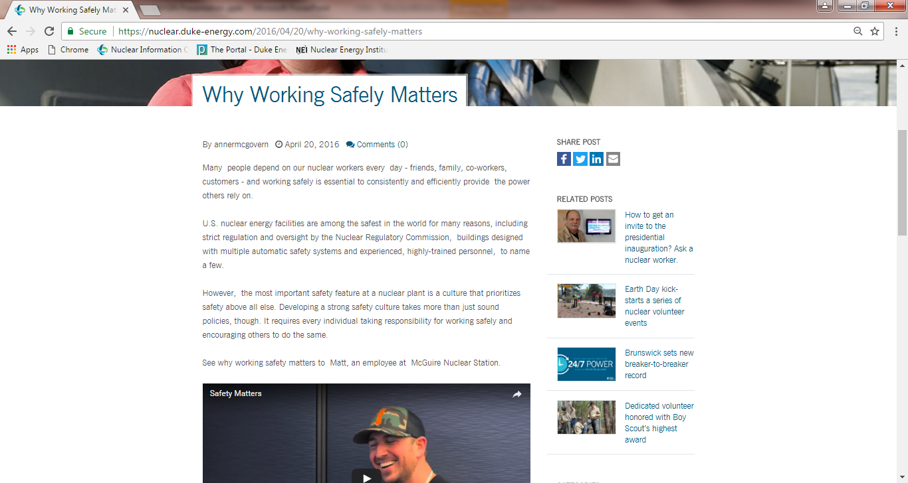

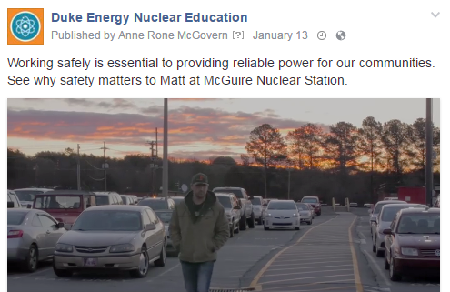
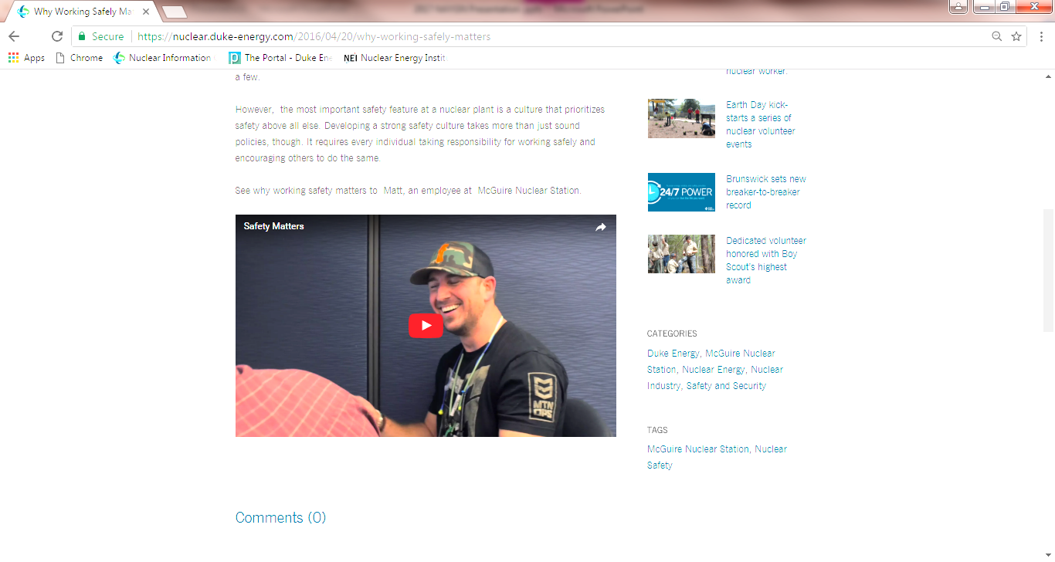
Strong Alignment
Safety Matters

