Slide 1
Nuclear Science Teacher Workshop
Energy & the Environment
Energy is directly linked to a country’s economy and its population’s standard of living. The primary difference between first and third world countries is the amount of energy the countries produce and consume. Many countries like India, China, and Brazil are rapidly developing resulting in a rapid increase in energy consumption.
However, each energy source has an impact on the environment. In this session, we will discuss how these different energy sources affect the environment on a local and global level and conduct activities to reinforce those concepts.
May 19, 2018 Atlanta, Georgia

Slide 2
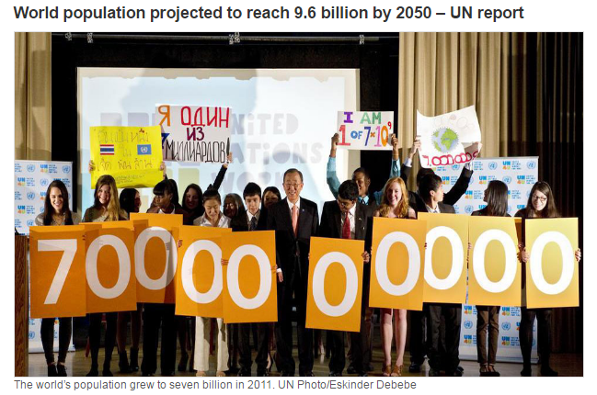
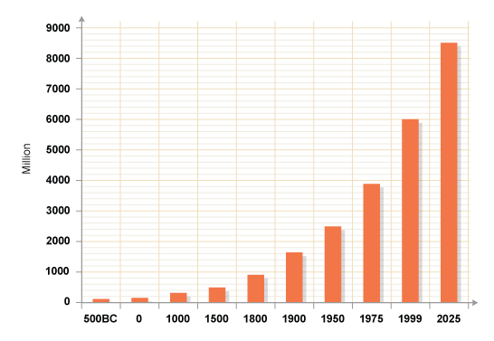

Energy as a Vital Asset
BBC
1.2 billion people don’t have access to electricity
17% of the global population lacks access to electricity
Energy access is about providing modern energy services to everyone around the world. These services are defined as household access to electricity and clean cooking facilities (e.g. fuels and stoves that do not cause air pollution in houses). - International Energy Agency
Notes:
Question to consider: what would life be like without electricity? Electricity is the key to a modern, connected life.
It frees up time by eliminating manual, time-consuming tasks (from cleaning clothes to chopping wood) to make time for education and advancement.
In addition, it allows connection to the world through the Internet.
We here in the US love our electricity. Around the globe, the human population is growing exponentially with it, the need for electricity will grow as well.

Slide 3
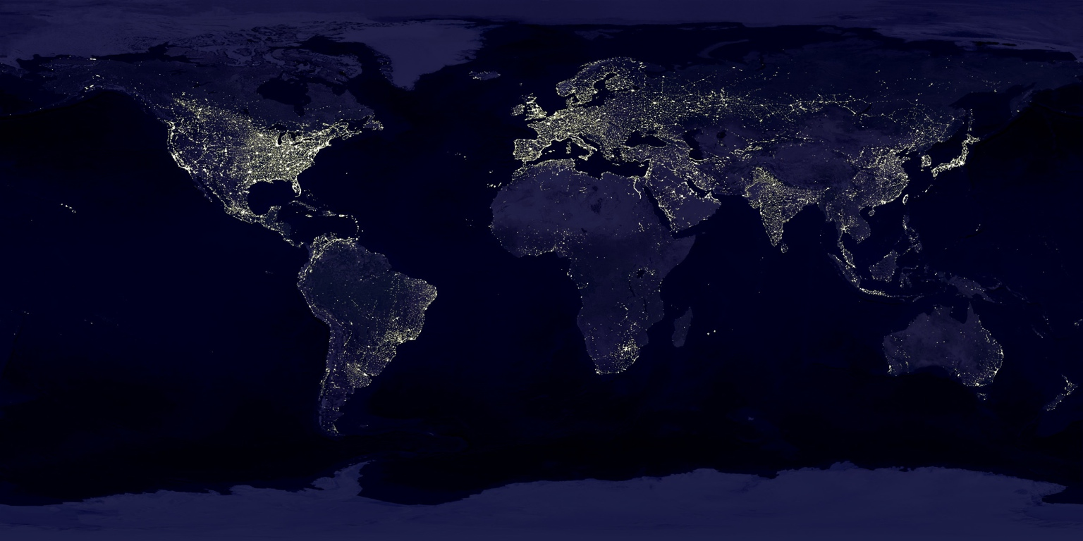
Equal Opportunity for All
Notes:
In many ways, energy access is “the great equalizer”. Shouldn’t everyone have access to energy?
The US uses 300 million BTU per person per year. Congo uses 1.87 million BTU per person. Peru uses 34 million BTU per person ⇒ see equivalences below
More details: https://www.eia.gov/beta/international/data/browser/#/?pa=000000000000000000000000000000000000000000000000000000002&c=ruvvvvvfvtvnvv1urvvvvfvvvvvvfvvvou20evvvvvvvvvnvvuvs&ct=0&tl_id=47-A&vs=INTL.47-33-AFG-MBTUPP.A&cy=2015&vo=0&v=H&end=2015
US = 316 Giga-joules = 2600 gallons of gas
Congo = 2 giga-joules = 16.4 gallons of gas
Peru = 36 gigajoule = 315 gallons of gas

Slide 4
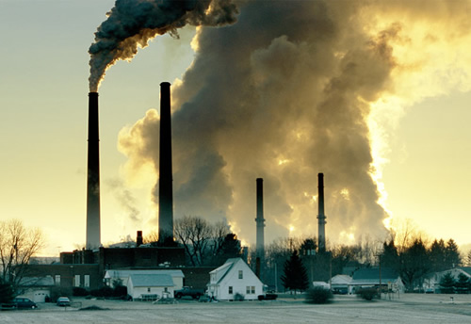
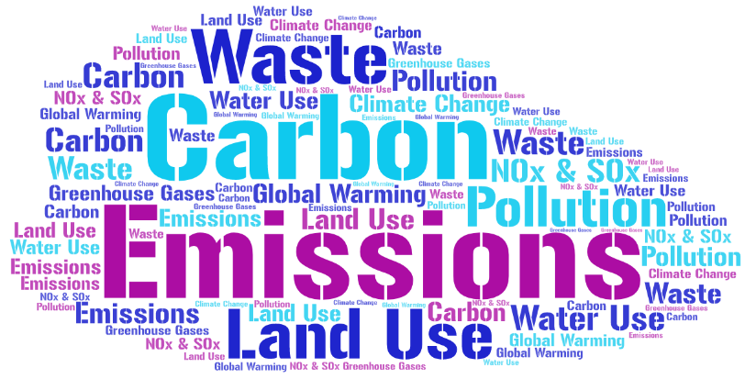
The Downsides of Energy Dependence
Notes:
Energy comes at a cost: both dollars (expense to user) and environmental impact.
Waste: chemicals from solar panel production, coal ash, emissions, nuclear waste
Carbon: carbon (and other greenhouse gases) are released into the atmosphere. These gases trap heat near the Earth resulting in global warming. The effect is like being inside a greenhouse - sunlight comes in and the temperature rises within the greenhouse.
Pollution: releasing various materials (often particulate matter) into the environment.
NOx and SOx: indirect greenhouse gases
Land, Water, and Natural Resource Use: these are limited quantities that need to be preserved

Slide 5
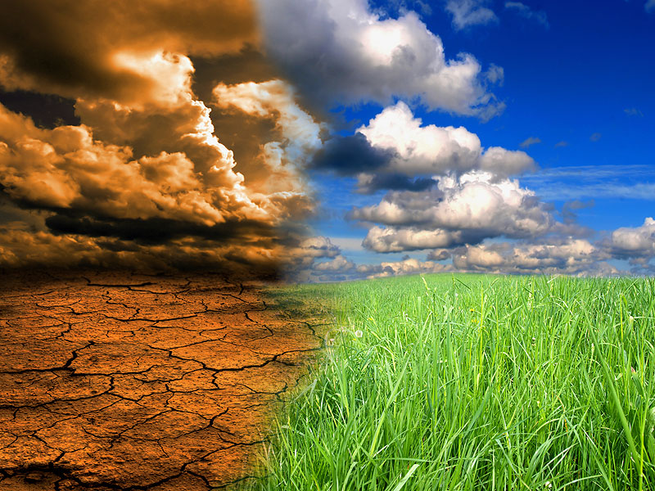
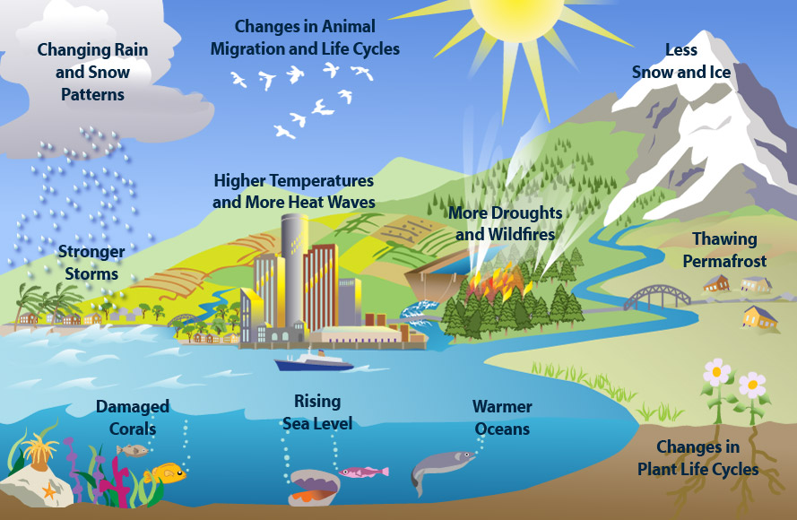
The Climate Puzzle
Climate Change
Explained by
Bill Nye
Notes:
Climate change is a difficult problem to solve because we rely so much on energy. Developed countries were able to reach their current standard of living by burning coal (since the industrial revolution in the 1800’s). Recently (since ~1970’s), developed countries have started moving toward other energy generation types because of environmental reasons. However, many countries are just now starting to rely on energy to achieve a higher standard of living. These countries are going through the initial stages of developing a modern society and (just like the US through the late 1800’s) are relying heavily on coal, petroleum, and natural gas. Would it be fair to say they can’t use these dirty generation types when the US benefited from them previously?
Also, clean generation isn’t perfect. Natural gas releases half the carbon of coal (but still releases carbon). Solar and wind are great (especially if electricity grid infrastructure is unavailable) but are intermittent and also have waste associated with them. Hydroelectric is great but disturbs ecosystems and there is a finite number of eligible rivers to build dams on.
Clearly: this isn’t an easy problem to solve!
Helpful video: https://www.youtube.com/watch?v=EtW2rrLHs08
Handout: using nuclear to solve the climate puzzle (if available from World Nuclear Association)
Now, we will weigh the pros and cons of various energy generation types based on their environmental impacts

Slide 6
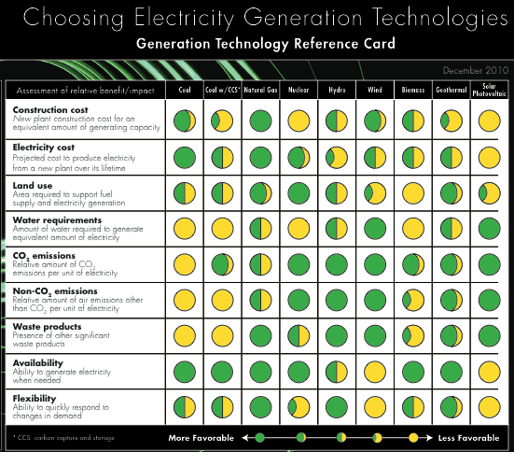
Notes:
Everything has advantages and disadvantages. Let’s look specifically at environmental impacts: carbon emissions, land use, water use, emissions, and waste.
This lines up various electricity generation sources: Coal, coal w/ carbon capture & sequestration, natural gas, nuclear, hydro, wind, biomass, geothermal, and photovoltaic solar
Green is more favorable to the environment. Yellow is less favorable to the environment.
Carbon emissions - which sources are favorable?
Land use - which source is most favorable? nuclear. are you surprised?
Water use - it’s tough to run a power plant without using water as a medium to transfer heat!
emissions - how does this compare with carbon emissions? coal and biomass are less favorable. clean air is important (dirty air causes asthma, lung issues, illness, etc)
waste - as expected coal and biomass (ash) are less favorable. Natural gas is considered more favorable (the byproducts of burning natural gas are carbon dioxide and water). Nuclear is half and half...hmmmmm we’ll get back to that later.

Slide 7
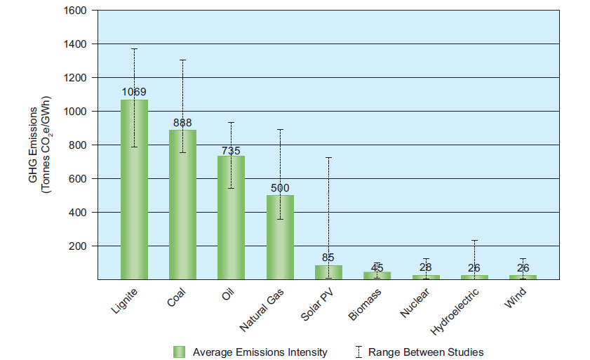
Carbon Dioxide Emissions Per Amount of Energy Generated
Notes:
This is the carbon emissions per unit of energy generated by various generation types.
GHG =greenhouse gases
Source: http://www.world-nuclear.org/nuclear-basics/greenhouse-gas-emissions-avoided.aspx
This is a compilation of various studies (note - uncertainty bars - many studies differ on the true carbon emission per energy, over 20 studies were reviewed for this graphic)
Lower = better for the environment
Let’s talk units: Tonnes CO2 - weight of carbon dioxide gas emitted into the environment
GWhr - gigawatt hour. A gigawatt is 1,000,000,000 watts. A watt is a joule (energy) per second. Energy per second is power (watt is a unit of power). Thus, a GWhr is actually a unit of energy.
1 GWhr = 3,400,000,000 BTU (British Thermal Units - another unit for energy)
Conclusion:
natural gas is ~half of the carbon emissions as coal
“renewables” (wind, solar, biomass, hydro) and nuclear are essentially equal when it comes to carbon emissions
replacing nuclear with fossil fuels (most often, it is suggested that nuclear should be replaced with natural gas) would lead to a large increase in carbon emissions
Wait a second, I thought renewables (and nuclear) were carbon free? Renewables and nuclear are carbon free during operation. However, lifecycle emissions (what is shown in this graph) include the energy it takes to construct these generation types (build the solar panels and wind turbines, build the nuclear plant and mine for Uranium) and thus there is some carbon footprint. Life cycle emissions are a great way to look holistically at an electricity generation type.

Slide 8
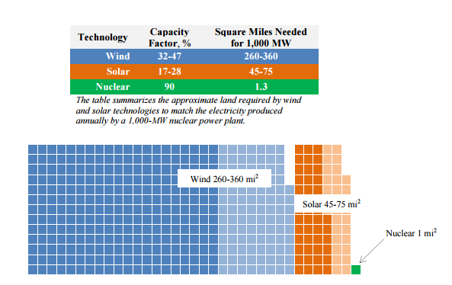
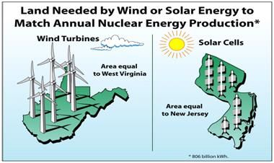
Land Use
Notes:
1 nuclear plant is typically 1000 MW electric and sits on 1 square mile of land.
Solar or wind facilities would require much greater land use for a comparable amount of energy.
This is a perk of the huge ENERGY DENSITY of nuclear. 1 nuclear fuel pellet (the size of a pencil eraser has the same amount of energy as 17,000 cubic feet of natural gas, 1780 pounds of coal or 149 gallons of oil)
For reference, Rhode Island is 1,212 square miles
Infographic: Nuclear Energy Institute: https://www.nei.org/news/2015/land-needs-for-wind-solar-dwarf-nuclear-plants
In the US, annual nuclear energy could be matched by wind turbines covering the state of West Virginia or solar panels covering the state of New Jersey
https://nuclear.duke-energy.com/2012/01/31/setting-the-record-straight

Slide 9
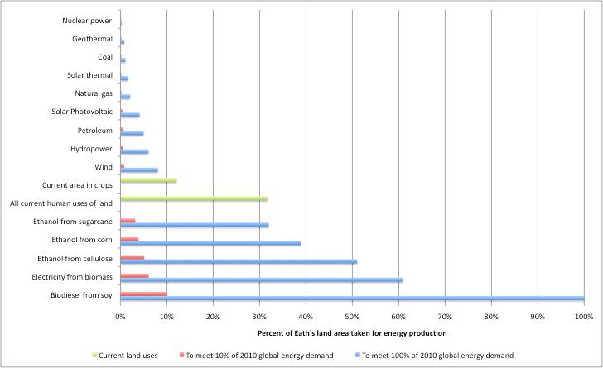
Notes:
This graph answers the question: what if 100% of the global energy demand was met by a specific source? How much land would it take?
This is extreme as it is unlikely that all energy would ever be produced using a sole generation type!
Note: to meet the global demand of energy with wind would require approximately the same current land area used for crops.
Percent of Earth's land area taken for energy production for different energy sources. Taken from: Alternative Energy and Land Use paper from Clinton Andrews et al. Land intensiveness data from McDonald et al (2009), land area data from Melillo et al (2009), global energy demand data from EIA
http://www.twtnp.com/2012/03/using-too-much-land-to-produce-energy.html
Conclusion: nuclear has a very small land footprint

Slide 10
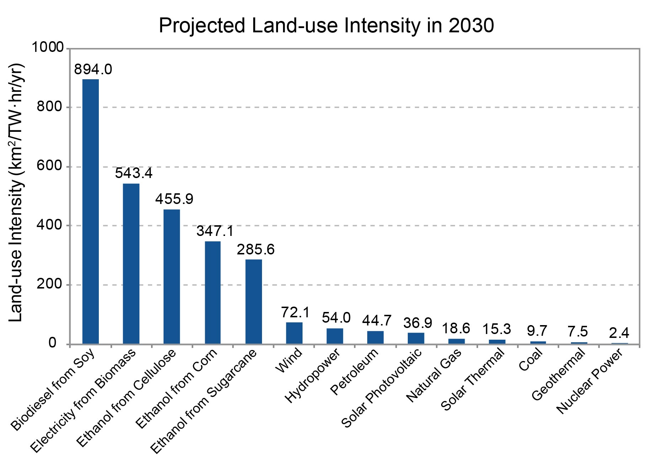
Land Use
Notes:
Source: https://data.globalchange.gov/report/nca3/chapter/water-energy-land-use/figure/projected-landuse-intensity-in-2030
The figure uses projections from the Energy Information Administration Reference scenario for the year 2030, based on energy consumption by fuel type and power plant “capacity factors” (the ratio of total power generation to maximum possible power generation).

Slide 11
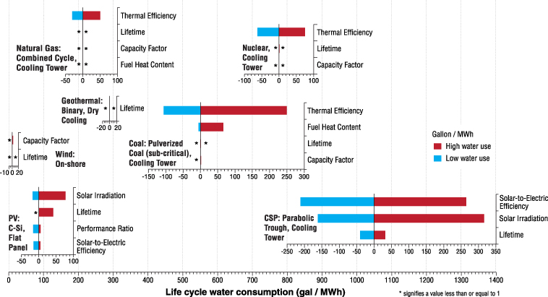
Water Use
Notes:
Nuclear energy does require a lot of water for cooling purposes. The water circulated near the fuel is never released to the environment.
However, secondary (or sometimes even tertiary) cooling loops are recycled back to the environment.
Water circulation needs can cause issues during times of draught.
Nuclear power plants require residual heat removal (via circulating cool water) even in the days and weeks after a plant has shutdown (ie the plant is in a planned refueling outage)
Source: http://iopscience.iop.org/article/10.1088/1748-9326/8/1/015031
Something to keep in mind: hydroelectric is great in a lot of ways but eligible rivers are limited (in fact, nonexistent in the United States). In addition, dams can cause huge stresses on the local ecosystem.

Slide 12
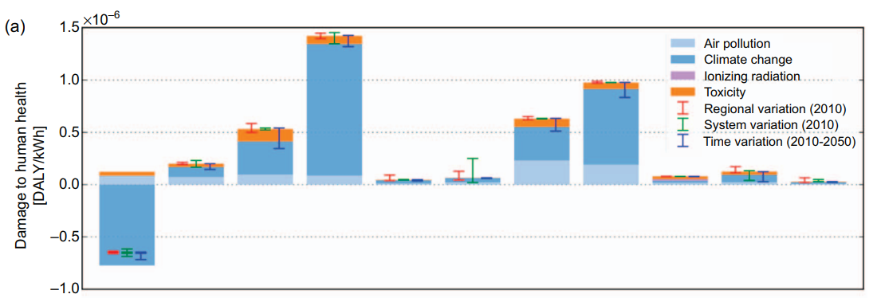
Particulate Matter (non-Carbon emissions)
Notes:
NG=natural gas, CSP = concentrated solar power (use mirrors to thermally heat water)
Source: http://iopscience.iop.org/article/10.1088/1748-9326/aa6047/meta
Air pollution (and particulate matter) are important to take into consideration as well. Air quality is vital for human health.
⇒ Wind, nuclear, concentrated solar power and hydro are the best!

Slide 13
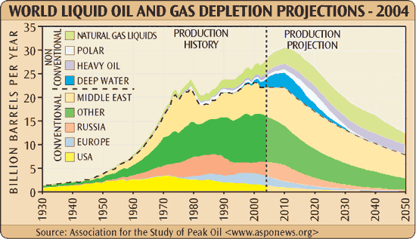
Use of Natural Resources
Notes:
Eventually, natural resources will be depleted.
Fossil fuels (coal, oil, natural gas) are made over hundreds of thousands of years.
Uranium, although plentiful, could become expensive if there was more demand for it. Uranium could theoretically “run out” but there are methods (breeding reactors, recycling, reprocessing) to extend supplies for nuclear energy much longer.
Key concept: natural resources are finite.

Slide 14
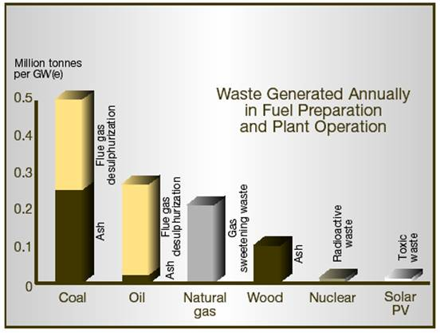
Waste
Notes:
Source: https://www.aph.gov.au/Parliamentary_Business/Committees/House_of_Representatives_Committees?url=isr/uranium/report/chapter5.html
Main takeaway: pretty much everything has a byproduct.
It is important to weigh all options and in reality, there is no one perfect solution.
Note: wind has quite a bit of volume of waste (from all the turbines) but it isn’t toxic - so it isn’t on this graph.

Slide 15
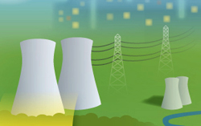

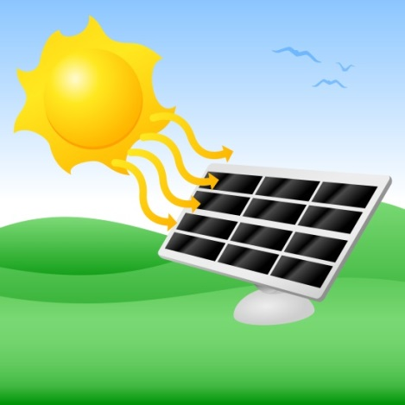
In the US: Energy Realities
https://www.thirdway.org/e-binder/we-need-a-mix
Notes:
Hopefully you don’t have graph overload...we’ll take a brief movie break to let you guys reset.

Slide 16
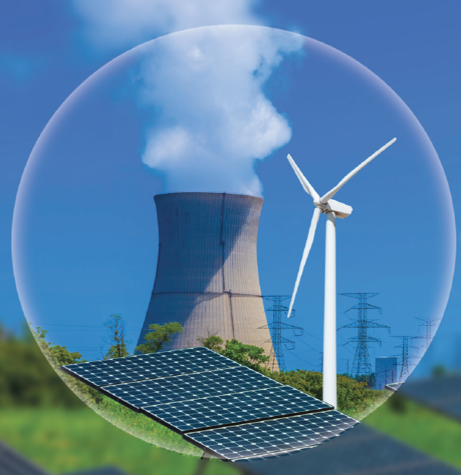
In Class Activity: The Energy Challenge
http://energychallenge.duke-energy.com/
Premise: Meet energy demand and CO2-reduction goals
How:
Build new power plants
Upgrade or retrofit current power plants
Close current power plants
Implement energy efficiency
High Score?
(Lowest cost)
Notes:
Premise: you need to meet energy demand while also meeting climate change goals
Play out the scenario - there are lots of options to try!
Who was able to achieve the two goals? Winner determined by lowest cost (yet still achieving goals)
⇒ Record winning score (overall lowest cost for the day will get a PRIZE)

Slide 17
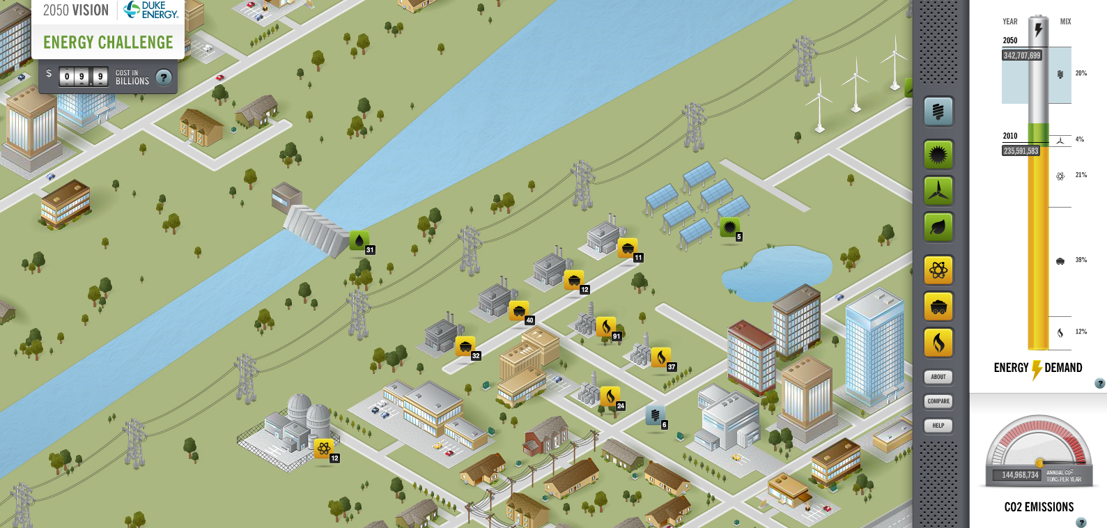
The Energy Challenge
Lessons Learned:
Need energy efficiency (but only so much you can do: 21%)
Need to retire most fossil fuel plants
What other realities did you face?
Notes:
Likely, the scenario is impossible to meet without nuclear being a pretty big part of the mix.
Who had the highest percentage of wind? What was it? How does that compare to the current generation we get from wind (about 5%)?
Why can’t you build hydro? We would have to make a dam and flood people’s homes! Not an option here.

Slide 18
Education Standards
Environmental Science
Georgia State Standards
SEV3. Obtain, evaluate, and communicate information to evaluate types, availability, allocation, and sustainability of energy resources.
Activity: This lesson plan! Students can use information found on the Energy Information Administration website to compare & contrast energy resources. Then students make a video/poster/presentation and teach the rest of their classmates what they learned.
Host an “energy debate” between different groups of students to develop energy policies and plans for allocation of natural resources.

Slide 19
Education Standards
Environmental Science
Georgia State Standards
SEV5. Obtain, evaluate, and communicate information about the effects of human population growth on global ecosystems.
Activity: This lesson plan! Focus on the beginning of the presentation and global population growth. Play The Energy Challenge game to get students thinking about what growth looks like and what the consequences are.
Tie to ethics: The United States benefited greatly from using fossil fuels. Some camps think that we need an immediate global shift away from fossil fuels. This might leave some people without electricity for longer. Is this the right thing to do for the environment? Is it the right thing to do from a humanitarian viewpoint?

Slide 20
Education Standards
Earth Science
Georgia State Standards
SES5.f Construct an argument relating changes in global climate to variation to Earth/sun relationships and atmospheric composition.
Activity: This lesson plan! Focus on climate change.

Slide 21
Education Standards
Earth Science
Georgia State Standards
SES6.d Analyze and interpret data that relates changes in global climate to natural and anthropogenic modification of Earth’s atmosphere and oceans.
Activity: Using this lesson plan as a base, students can research reliable sources for data on changes to global climate. Analyze the studies for variable isolation, adherence to the scientific method, and the conclusions drawn from the data.

Slide 22
Education Standards
Sixth Grade
Georgia State Standards
S6E6 Obtain, evaluate, and communicate information about the uses and conservation of various natural resources and how they impact the Earth.
a. Ask questions to determine the differences between renewable/sustainable energy resources (examples: hydro, solar, wind, geothermal, tidal, biomass) and nonrenewable energy resources (examples: nuclear: uranium, fossil fuels: oil, coal, and natural gas), and how they are used in our everyday lives.
Activity: Using this lesson plan as a base, students can play The Energy Challenge and discuss the pros and cons of various strategies used to win the game. Also try the board game Power Grid which involves strategies for how best to use natural resources.

Slide 23
Education Standards
Physical Science
Next Generation Science Standards
Influence of Science, Engineering and Technology on Society and the Natural World. Modern civilization depends on major technological systems. Engineers continuously modify these technological systems by applying scientific knowledge and engineering design practices to increase benefits while decreasing costs and risks. (HS-PS3-3)
Activity: This lesson plan! Play The Energy Challenge game to get students thinking about the “largest machine in the world” (the power grid).

Slide 24
Education Standards
Earth and Space Sciences
Next Generation Science Standards
Earth Systems: Changes in the atmosphere due to human activity have increased carbon dioxide concentrations and thus affect climate. (HS-ESS2-6)
Weather and Climate: Though the magnitudes of human impacts are greater than they have ever been, so too are human abilities to model, predict, and manage current and future impacts. (HS-ESS3-5)
Activity: Using this lesson plan as a base, students can research reliable sources for data on changes to global climate. Analyze the studies for variable isolation, adherence to the scientific method, and the conclusions drawn from the data.

Slide 25
Education Standards
Earth and Space Sciences
Next Generation Science Standards
Human Sustainability:
ESS2.D: Weather and Climate
Current models predict that, although future regional climate changes will be complex and varied, average global temperatures will continue to rise. The outcomes predicted by global climate models strongly depend on the amounts of human-generated greenhouse gases added to the atmosphere each year and by the ways in which these gases are absorbed by the ocean and biosphere. (secondary to HS-ESS3-6)
Activity: The Energy Challenge

Slide 26
Education Standards
Earth and Space Sciences
Next Generation Science Standards
ESS3.A: Natural Resources
Resource availability has guided the development of human society. (HS-ESS3-1)
All forms of energy production and other resource extraction have associated economic, social, environmental, and geopolitical costs and risks as well as benefits. New technologies and social regulations can change the balance of these factors. (HS-ESS3-2)
Activity: The Energy Challenge and Power Grid

Slide 27
Education Standards
Middle School
Next Generation Science Standards
Earth and Space Sciences – Human Impacts
ESS3.C: Human Impacts on Earth Systems
Human activities have significantly altered the biosphere, sometimes damaging or destroying natural habitats and causing the extinction of other species. But changes to Earth’s environments can have different impacts (negative and positive) for different living things. (MS-ESS3-3)
Typically as human populations and per-capita consumption of natural resources increase, so do the negative impacts on Earth unless the activities and technologies involved are engineered otherwise. (MS-ESS3-3),(MS-ESS3-4)
Activity: The Energy Challenge

Slide 28
Education Standards
Middle School
Next Generation Science Standards
Earth and space Sciences – Weather and Climate
ESS3.D: Global Climate Change
Human activities, such as the release of greenhouse gases from burning fossil fuels, are major factors in the current rise in Earth’s mean surface temperature (global warming). Reducing the level of climate change and reducing human vulnerability to whatever climate changes do occur depend on the understanding of climate science, engineering capabilities, and other kinds of knowledge, such as understanding of human behavior and on applying that knowledge wisely in decisions and activities. (MS-ESS3-5)
Activity: The Energy Challenge

Slide 29
Education Standards
Middle School
Next Generation Science Standards
Earth and space Sciences – Weather and Climate
ESS3.A: Natural Resources
Humans depend on Earth’s land, ocean, atmosphere, and biosphere for many different resources. Minerals, fresh water, and biosphere resources are limited, and many are not renewable or replaceable over human lifetimes. These resources are distributed unevenly around the planet as a result of past geologic processes. (MS-ESS3-1)
Activity: The Energy Challenge and Power Grid

Slide 30
Education Standards
Elementary School
Next Generation Science Standards
ESS3.A: Natural Resources
Energy and fuels that humans use are derived from natural sources, and their use affects the environment in multiple ways. Some resources are renewable over time, and others are not. (4-ESS3-1)
Activity: Visit a greenhouse to experience the temperature difference.

Slide 31
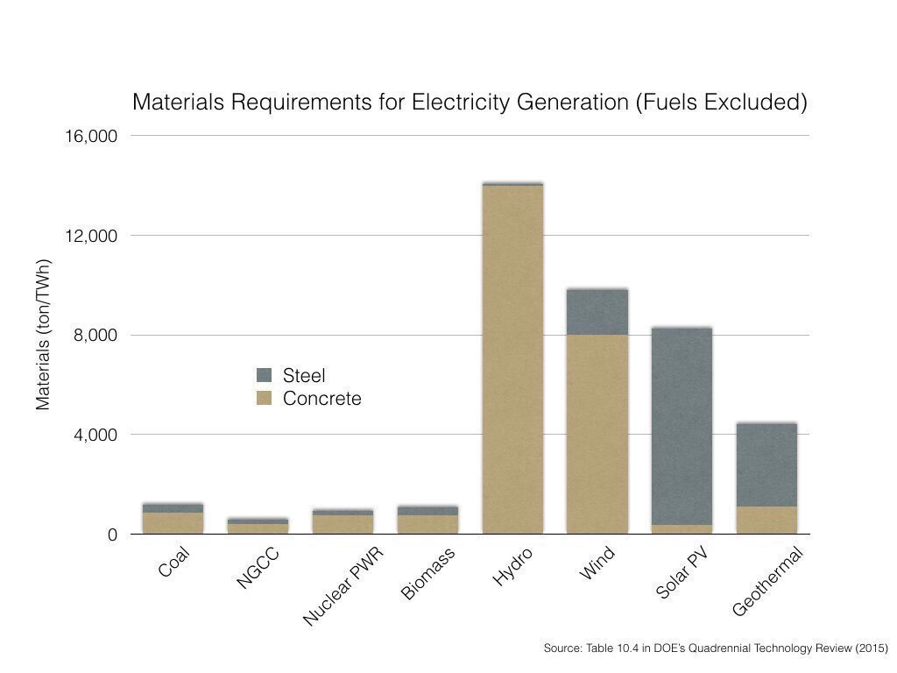

Slide 32
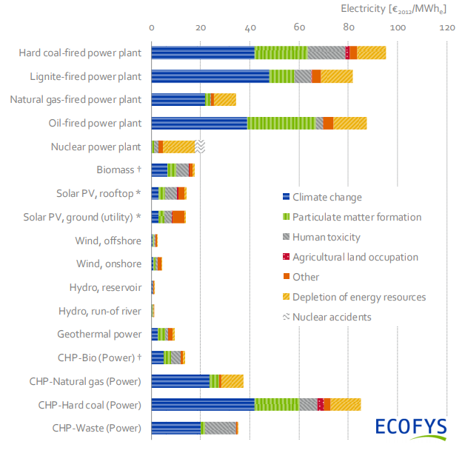
Notes:
Interesting graphic on how European Union charges generation types
https://www.ecofys.com/en/news/first-full-dataset-on-energy-costs-and-subsidies-for-eu28-across-all-techno/

