Slide 1
Introduce Yourself Here
Name, Company

Slide 2
electricity

Slide 3
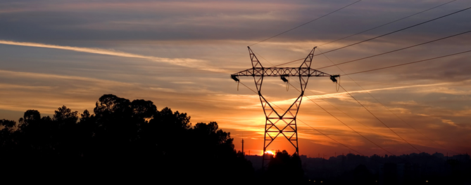
Where does electricity come from?

Slide 4
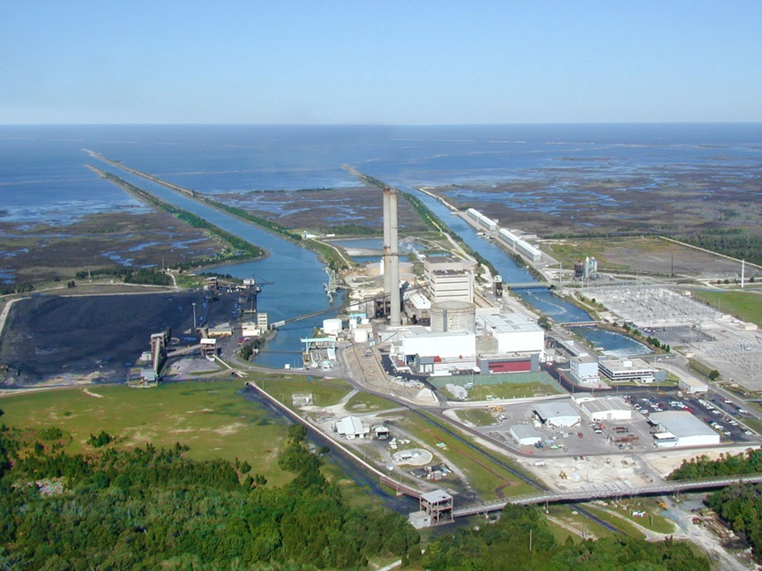
Power Plants!
Crystal River Units 1, 2 (Fossil) and Unit 3 (Nuclear)
Notes:
What is the power plant closest to where you live?

Slide 5
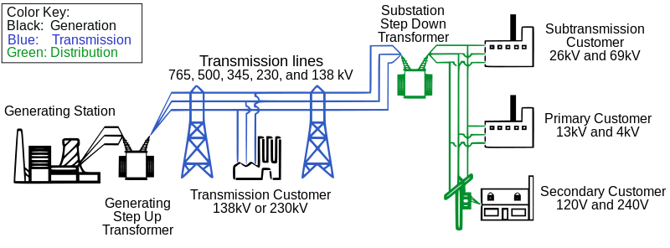
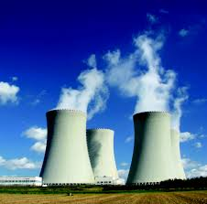
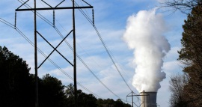

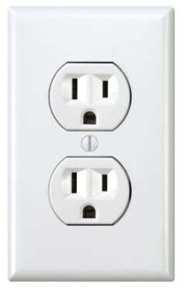
Electricity Generation
1. Power Plant
2. Transmission Lines
3. Houses!

Slide 6
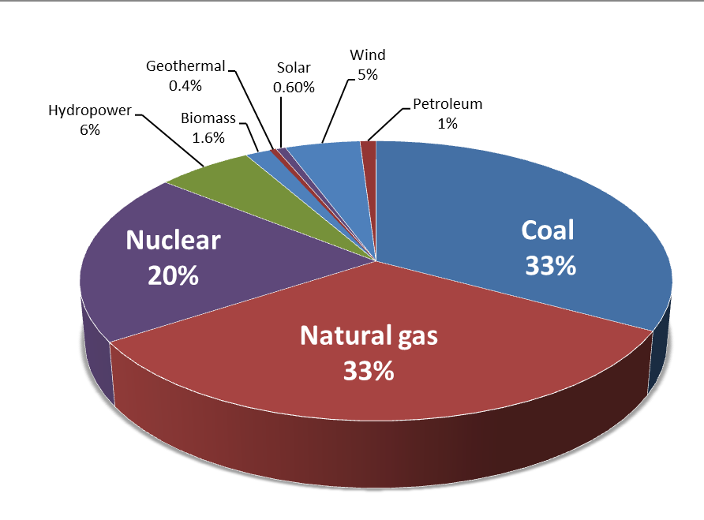
Can you name types of electricity generation?
Coal
Natural Gas
Petroleum
Nuclear
Solar
Wind
Geothermal
Hydroelectric
U.S. Electricity Generation by Source 2015, EIA

Slide 7
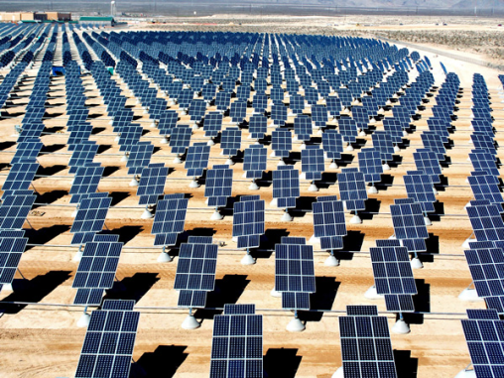
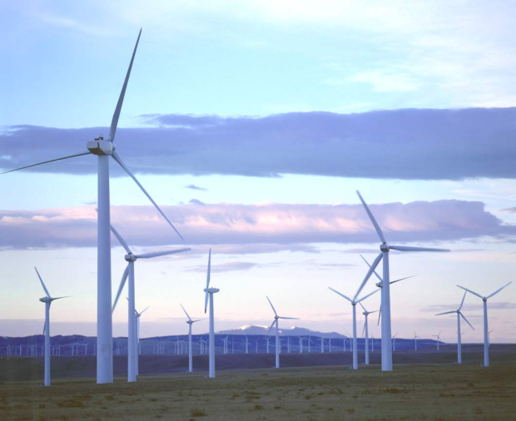
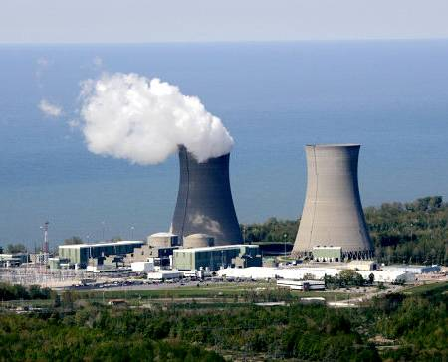
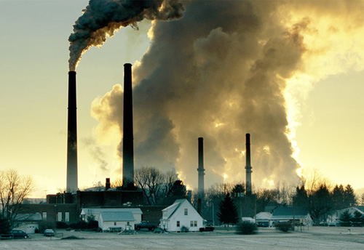
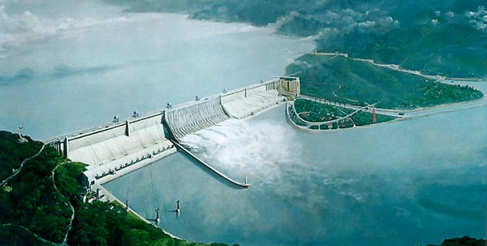
Types of Electricity Generation

Slide 8
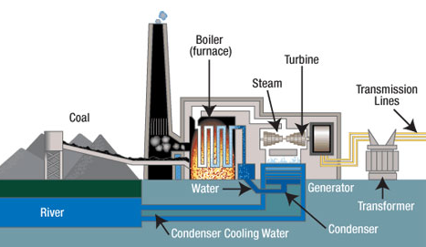
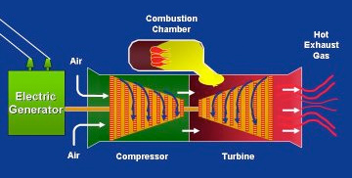
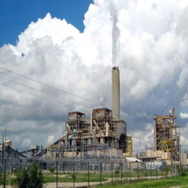
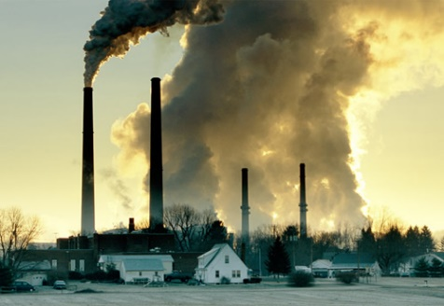
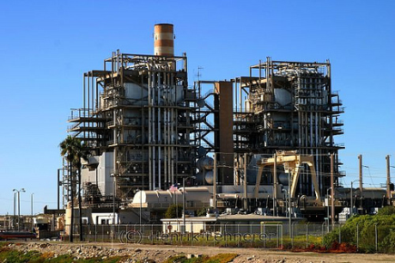
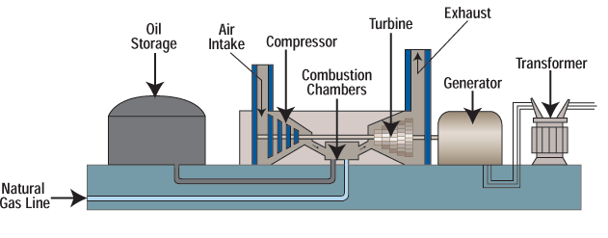
Fossil Fuels
Coal
Natural Gas
Petroleum

Slide 9
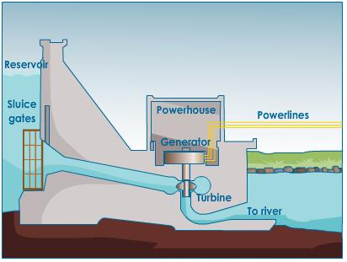
Hydroelectric

Slide 10

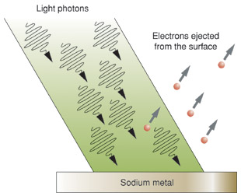
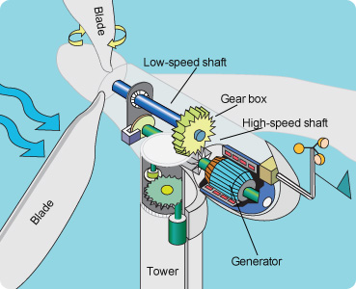
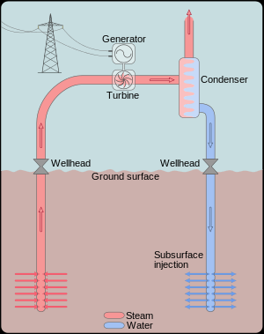
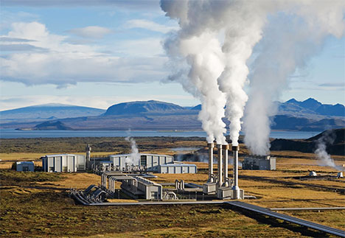
Other Renewables
Photoelectric Effect
Solar
Wind
Use geothermal steam to turn a turbine
Geothermal

Slide 11
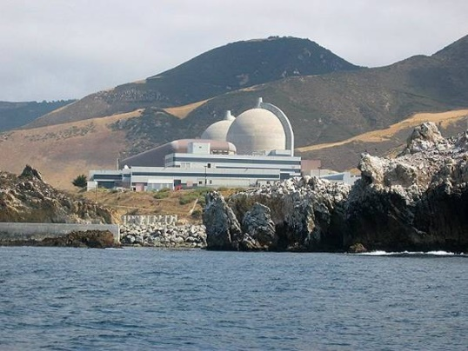

Nuclear
Use nuclear energy as a heat source
Use heat source to boil water
Boiling water turns a turbine
Turbine turns a generator
Generator spins wires through a magnetic field which results in moving electrons
(or electricity!)

Slide 12
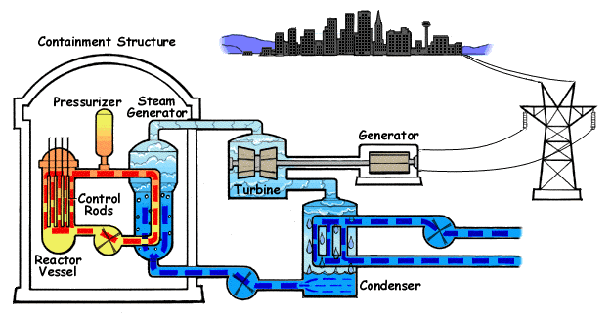
Nuclear Power Plant
FISSION=splitting atoms

Slide 13

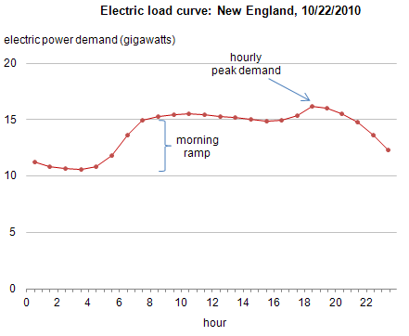
What are some challenges to electricity generation?
Electricity cannot be stored efficiently
Demand is not consistent
View it live!
https://www.eia.gov/beta/realtime_grid/

Slide 14
Climate change

Slide 15
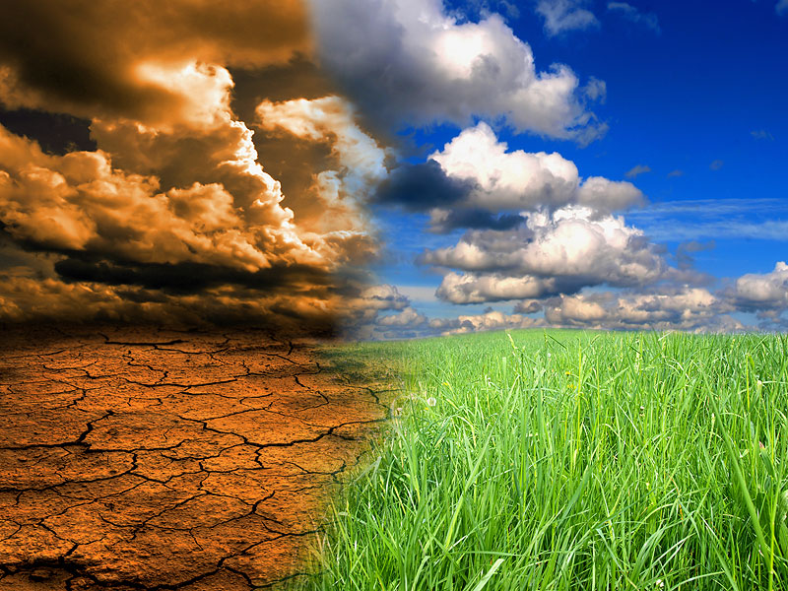
What is climate change?
Notes:
Weather = day to day
Climate = long term

Slide 16
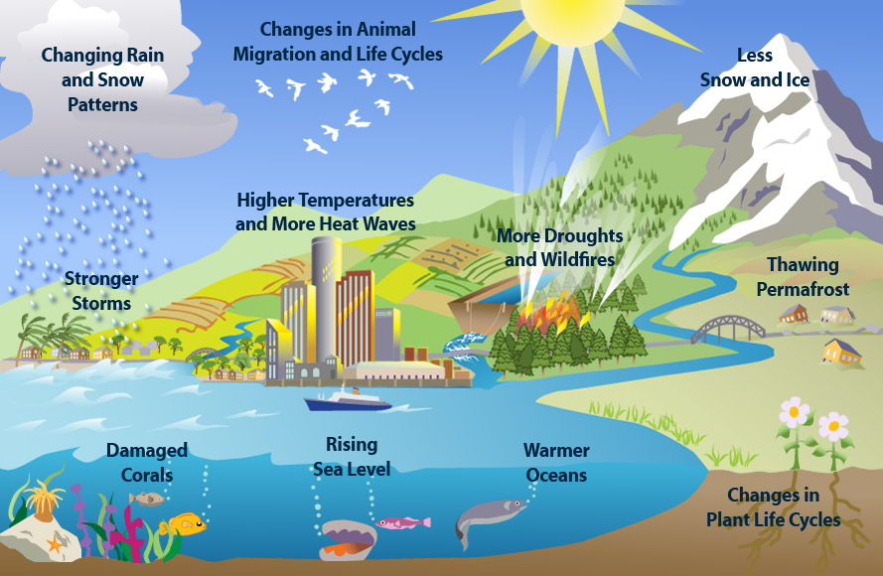
Environmental Protection Agency
Notes:
Here are some other reasons climate change would be very bad.

Slide 17


What causes climate change?
Greenhouse
Effect

Slide 18
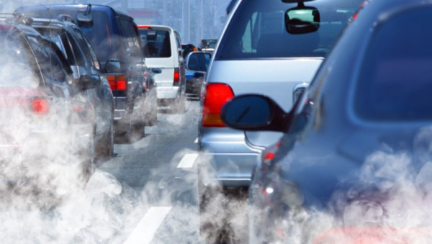

Where does carbon come from?
Cars
Electricity Generation

Slide 19
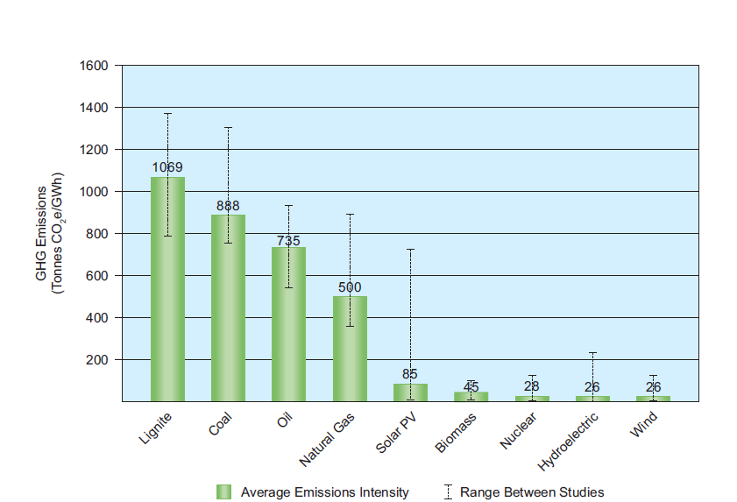
Which types of electricity generation produce carbon?
Life Cycle
Emissions
World Nuclear Association: Compilation of Energy Studies

Slide 20
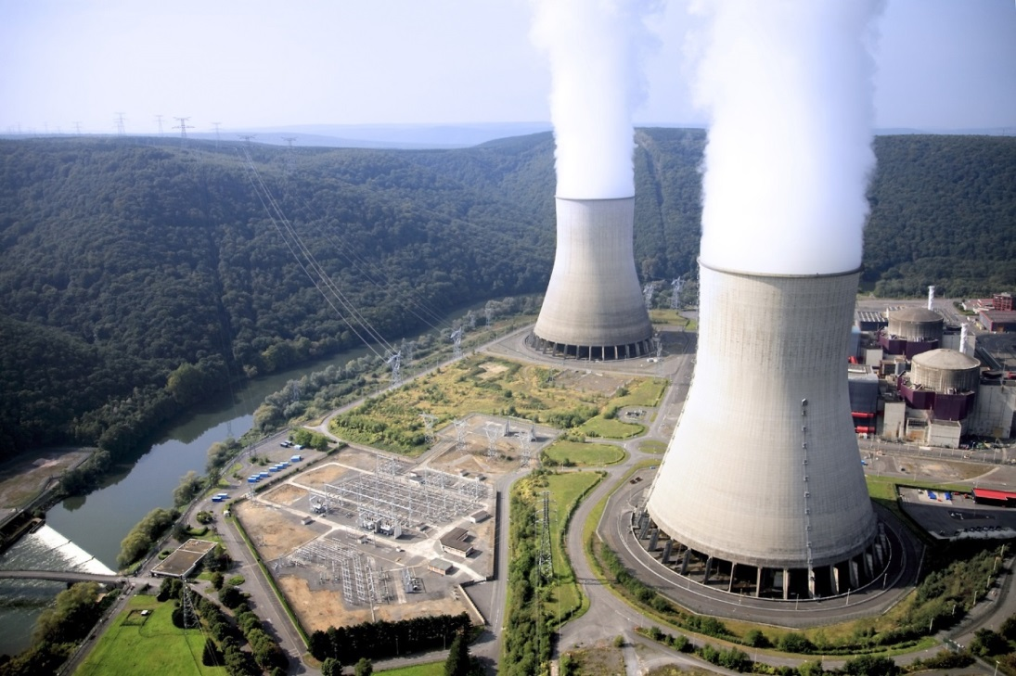
Why is nuclear cool?
Baseload electricity generation
Not weather dependent
No carbon emissions during operation
Not location-dependent
carbon
STEAM

Slide 21
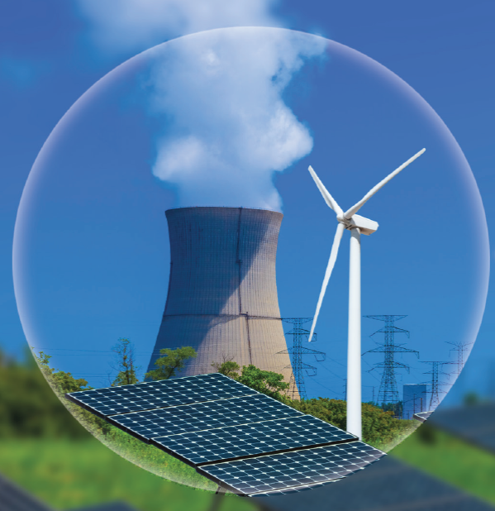
There are CLEAN ways to make electricity
nuclear
solar
wind
Notes:
Solar, nuclear, and wind are all carbon free ways to make electricity!

Slide 22

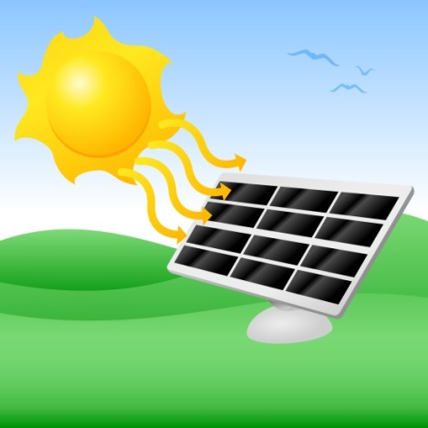
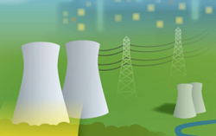
http://www.thirdway.org/e-binder/we-need-a-mix

Slide 23
The importance of electricity

Slide 24
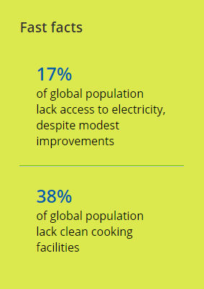
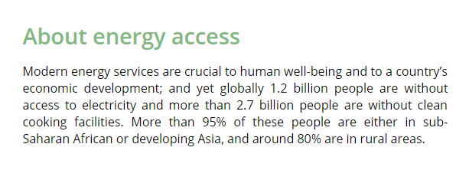
Energy Poverty
Energy access is about providing modern energy services to everyone around the world. These services are defined as household access to electricity and clean cooking facilities (e.g. fuels and stoves that do not cause air pollution in houses). - International Energy Agency
International Energy Agency

Slide 25

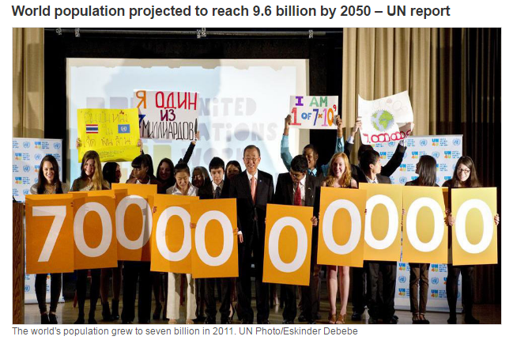
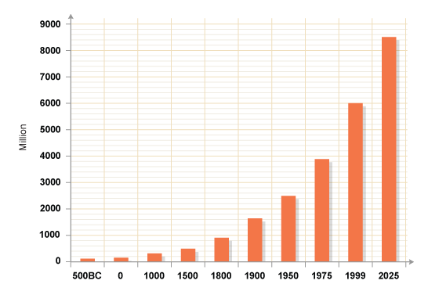
BBC

Slide 26
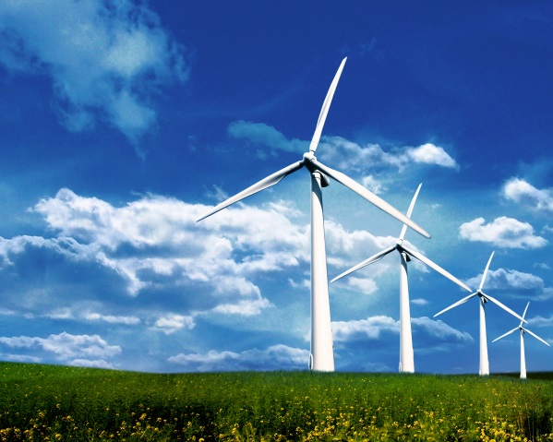

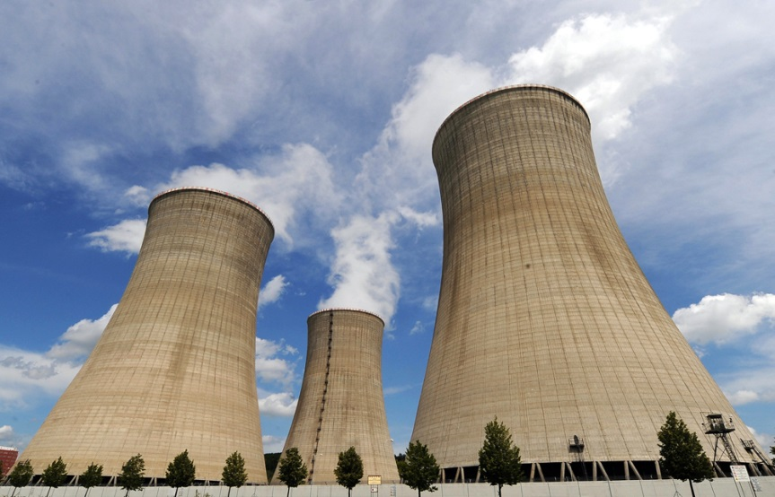
Your turn!
Clean air
energy
Green
Energy
Carbon Free

Slide 27
2022 Essay Contest
Eligibility: High School Students (Grades 9-12)
Essays due 12/16/2022
Essay Prompt: Research energy sources and climate change. Propose an informed energy solution that limits climate change, allows developed countries to maintain their standard of living, and can provide reliable electricity to the 1.2 billion people currently without access to power. Proposed energy solution should consider the environmental and practical benefits and consequences of baseload (e.g. nuclear, fossil, hydro) versus intermittent (e.g. wind or solar) sources.
Requirements:
In this essay, define baseload and intermittent electricity sources.
Use at least 3 different reliable sources for your research and cite these sources.
Essay must be between 1000 and 1500 words.
First place – Laptop
Second place – Chromebook
Top 3 Finalists – Science Kits

Slide 28
QUIZ

Slide 29
What is the path of electricity generation?
Power Plant
Transmission Lines
Houses!

Slide 30
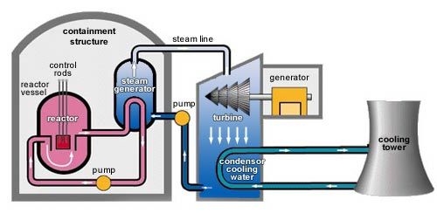
What component in a power plant spins wires through a magnetic field?
Generator

Slide 31
Name a type of electricity generation
Coal
Natural Gas
Petroleum
Nuclear
Solar
Wind
Geothermal
Hydroelectric

Slide 32
What process is used to generate heat in a nuclear power plant?
Fission!

Slide 33
Nuclear power plants produce zero carbon emissions during operation: True/False
True!

Slide 34
What percent of the global population lives without electricity?
17%

Slide 35


QUESTIONS?
clear
nu

Slide 36
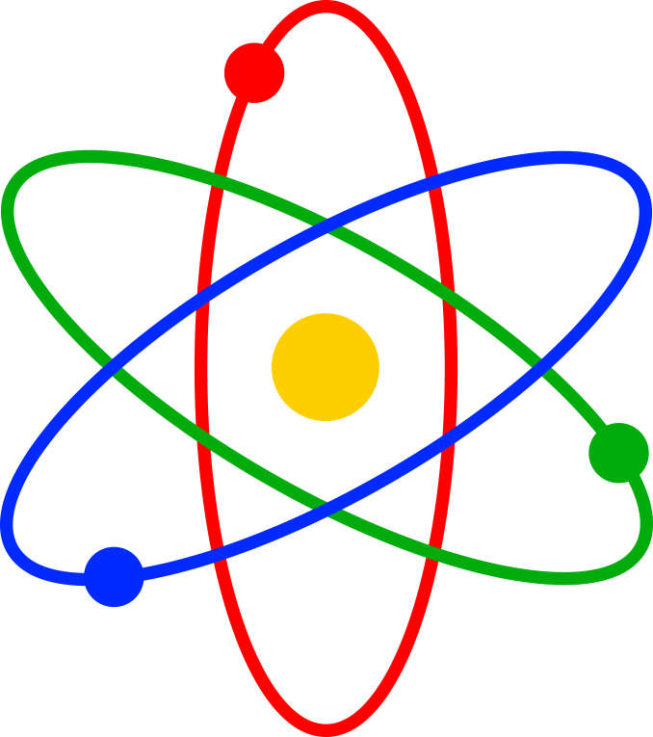
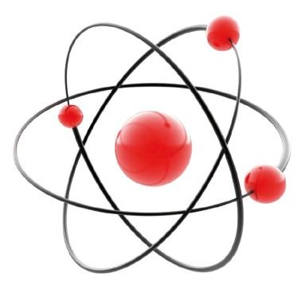
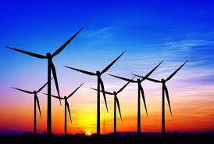
Optional Slides

Slide 37
Is Global Warming Real?
YES!
Earth Temperature Timeline
http://xkcd.com/1732/
http://www.skepticalscience.com/

Slide 38
Where does our energy come from and what is it used for?
http://energyliteracy.com/

