Slide 1
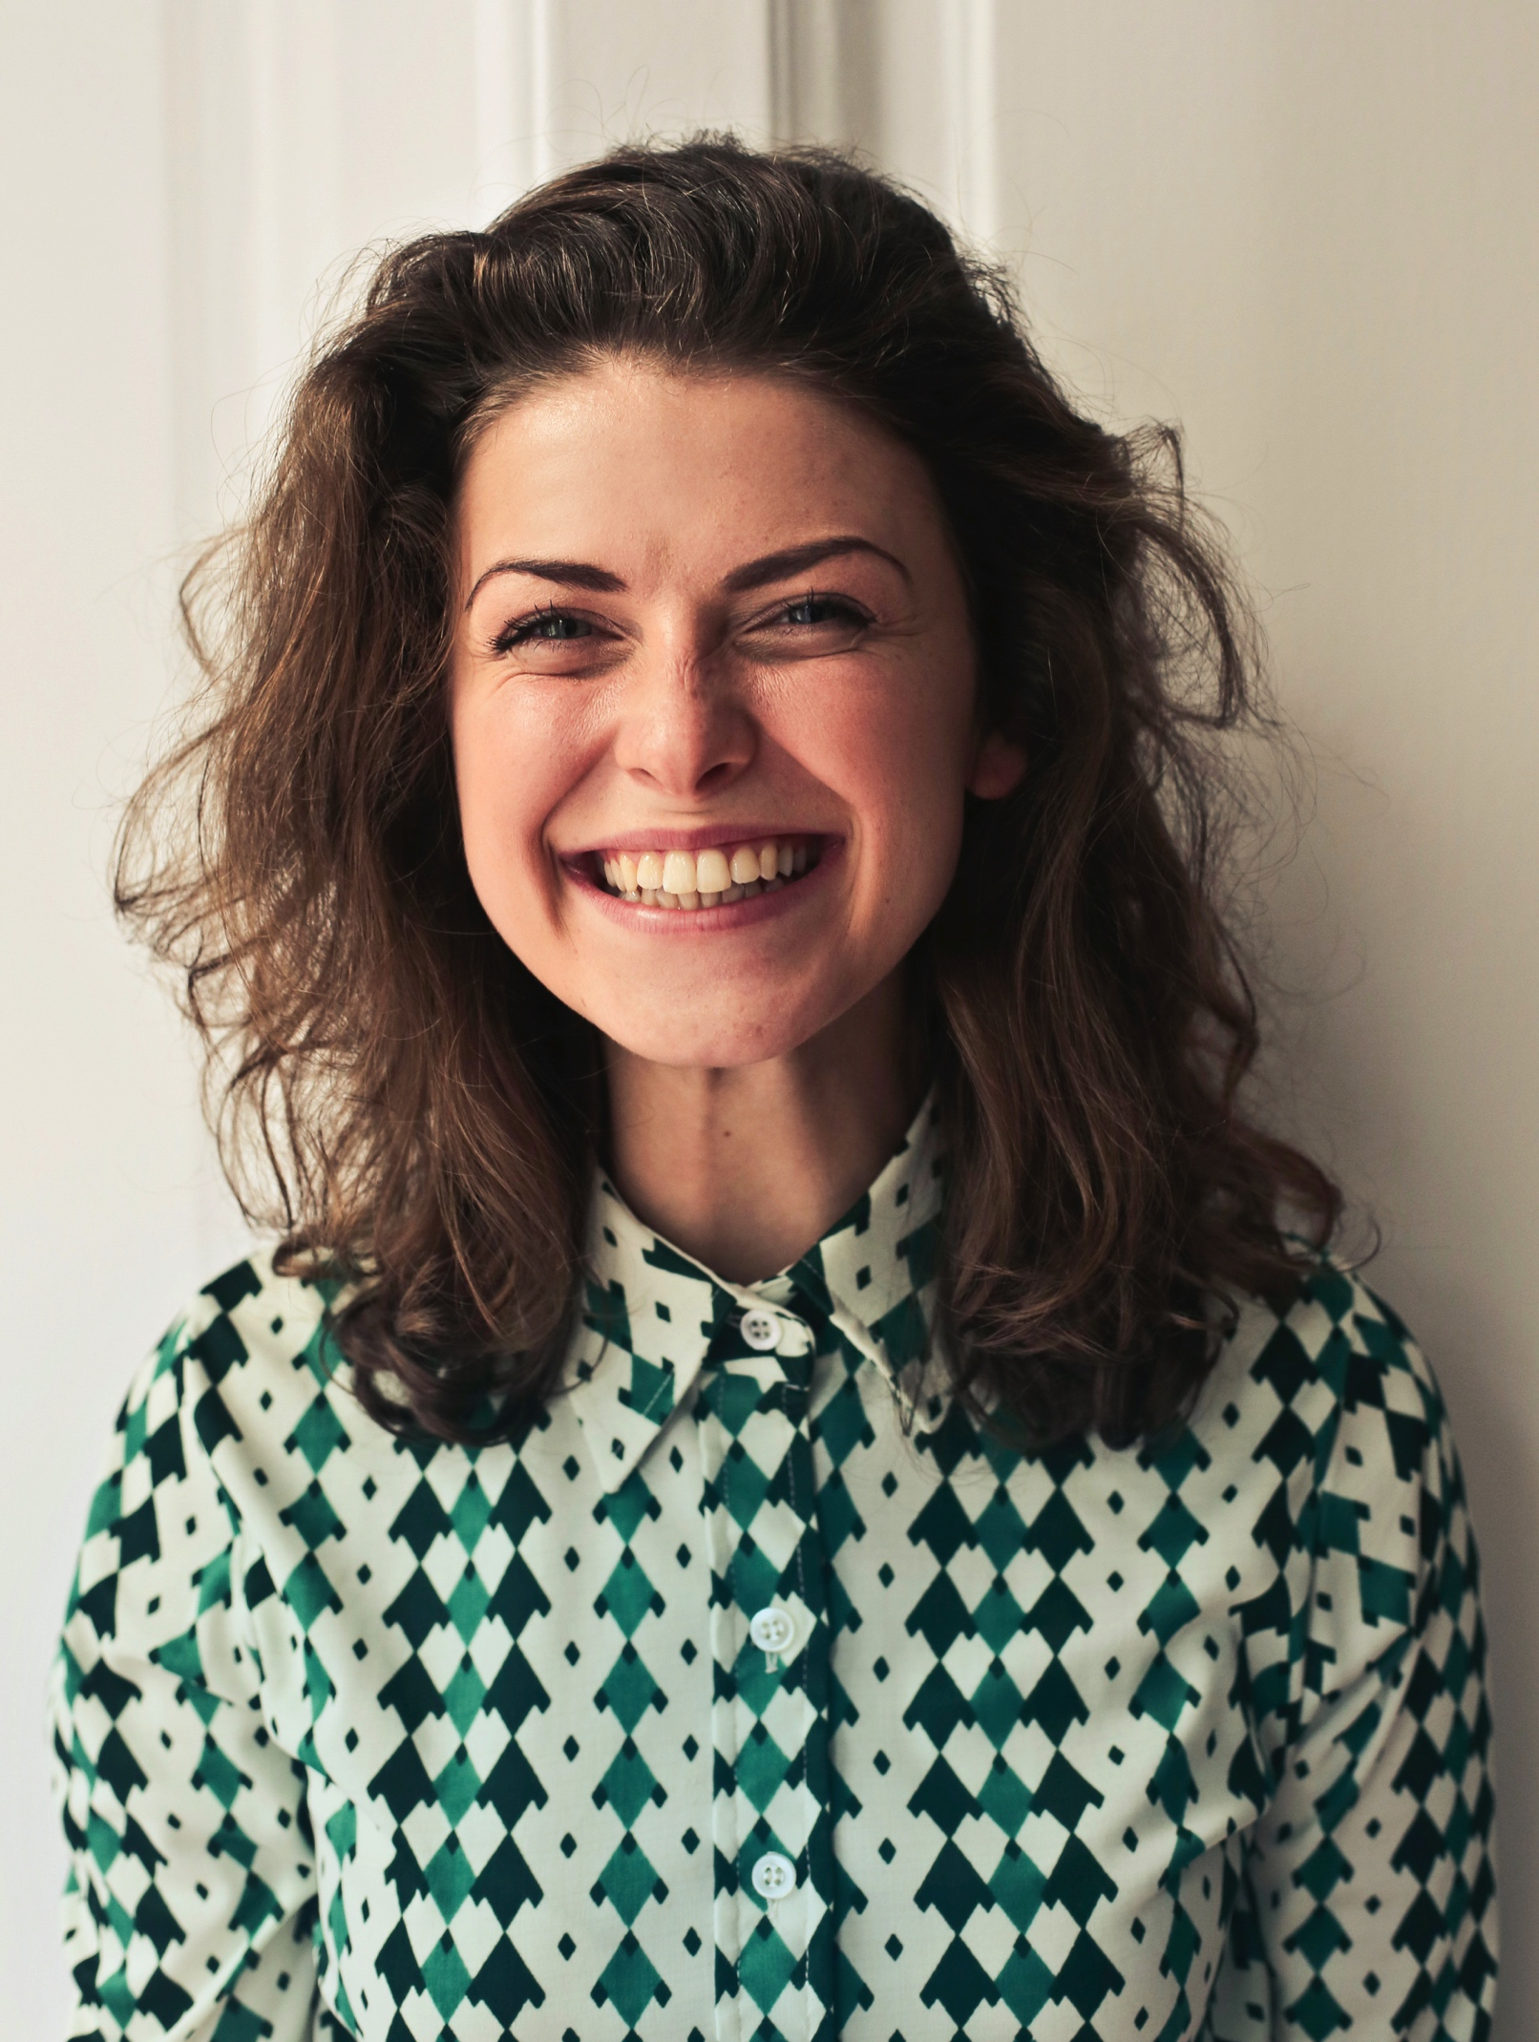
SALLY SUE
Colorado, NAYGN Member
SAMPLE
Right click → “Change Picture”
I believe in nuclear power because…insert your personal story about how you joined the nuclear industry and/or why you believe in it.

