Slide 1
Nuclear Science Teacher Workshop
To Infinity
& Beyond:
Nuclear
Applications
Nuclear technology is all around you- from soda cans and makeup to MRIs and bridges. Nuclear technology has also enabled extraordinary engineering feats such as powering the Mars Rover, deep space satellites or a pacemaker in your chest. Come discuss some of the lesser known, and less conventional applications of the atom and learn how to conduct activities to reinforce these concepts.
May 19, 2018 Atlanta, Georgia
Notes:
Much of this lesson is from: https://www.nrc.gov/about-nrc/radiation/around-us/uses-radiation.html

Slide 2
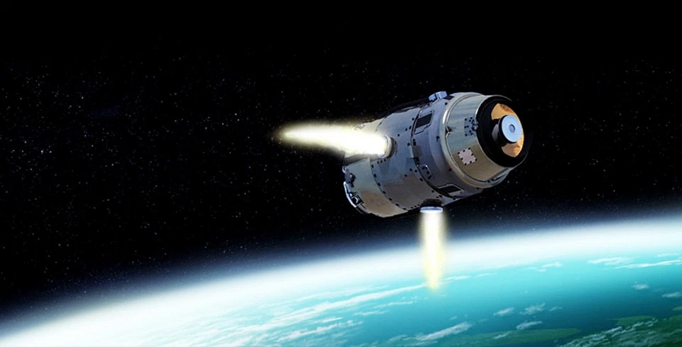
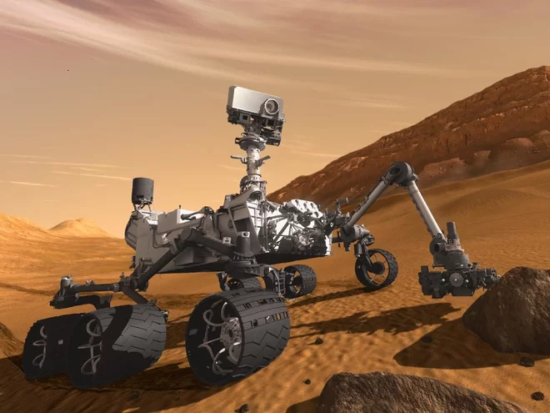
Nuclear in Space
Notes:
Radioactive materials fuel spacecraft.
Nuclear propulsion and nuclear thermal rockets are two methods of fueling space missions.
A nuclear generator powers the Mars rover
Apollo missions, the Cassini spacecraft, and Voyager 1&2 utilize nuclear power systems: https://en.wikipedia.org/wiki/Radioisotope_thermoelectric_generator

Slide 3
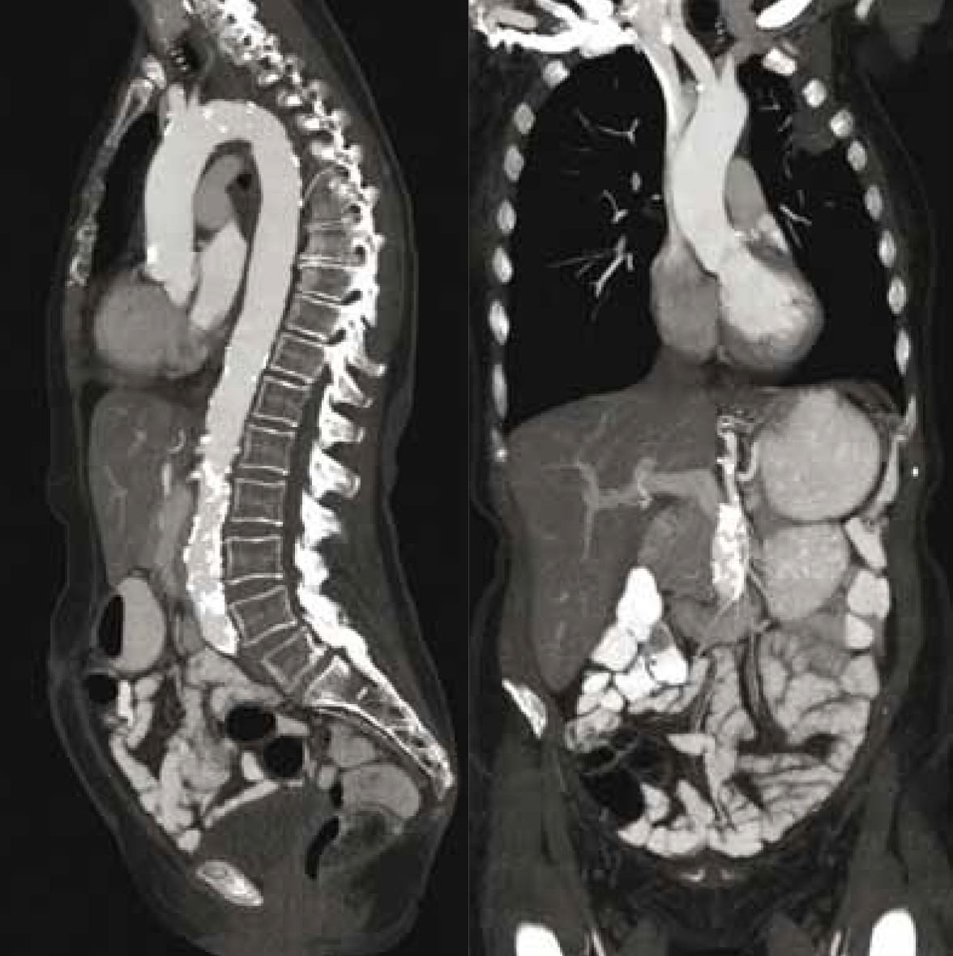
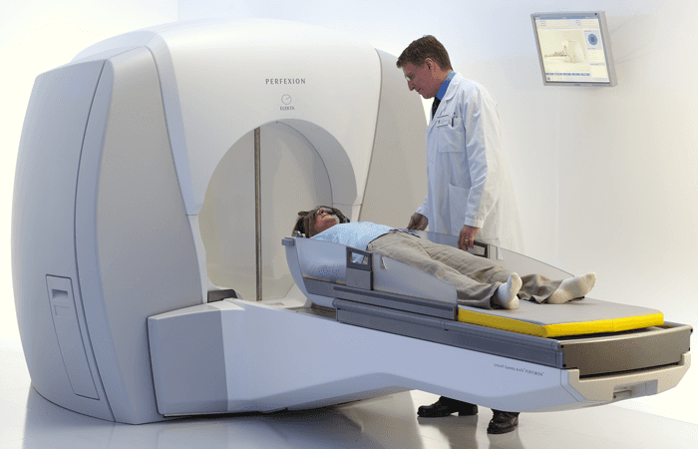
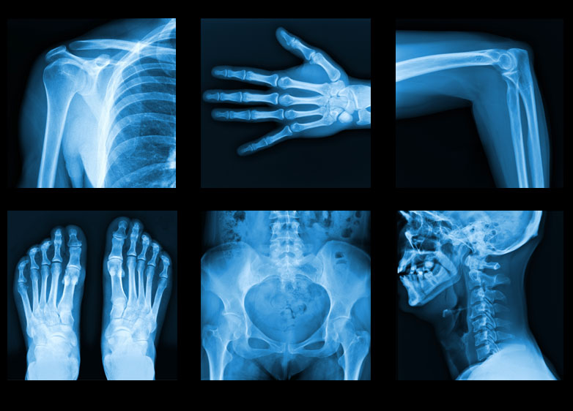
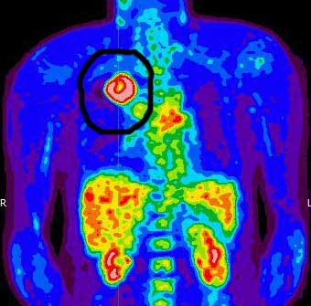
Nuclear Medicine
Notes:
Used by hospitals, doctors, and dentists, nuclear medicine is a vital tool in modern medicine.
X-rays are used to diagnose everything from broken bones to cavities.
Radiation can also be used as a therapy: kill sick tissue, reduce the size of a tumor, or reduce pain (gamma knife)
CAT scans (computerized axial tomography, top left & right) use x-rays to make color images of internal organs
Radionuclides can also be injected into patients and act as tracers. (PET scan - positron emission tomography, bottom left) This is used to diagnose problems with internal organs.

Slide 4
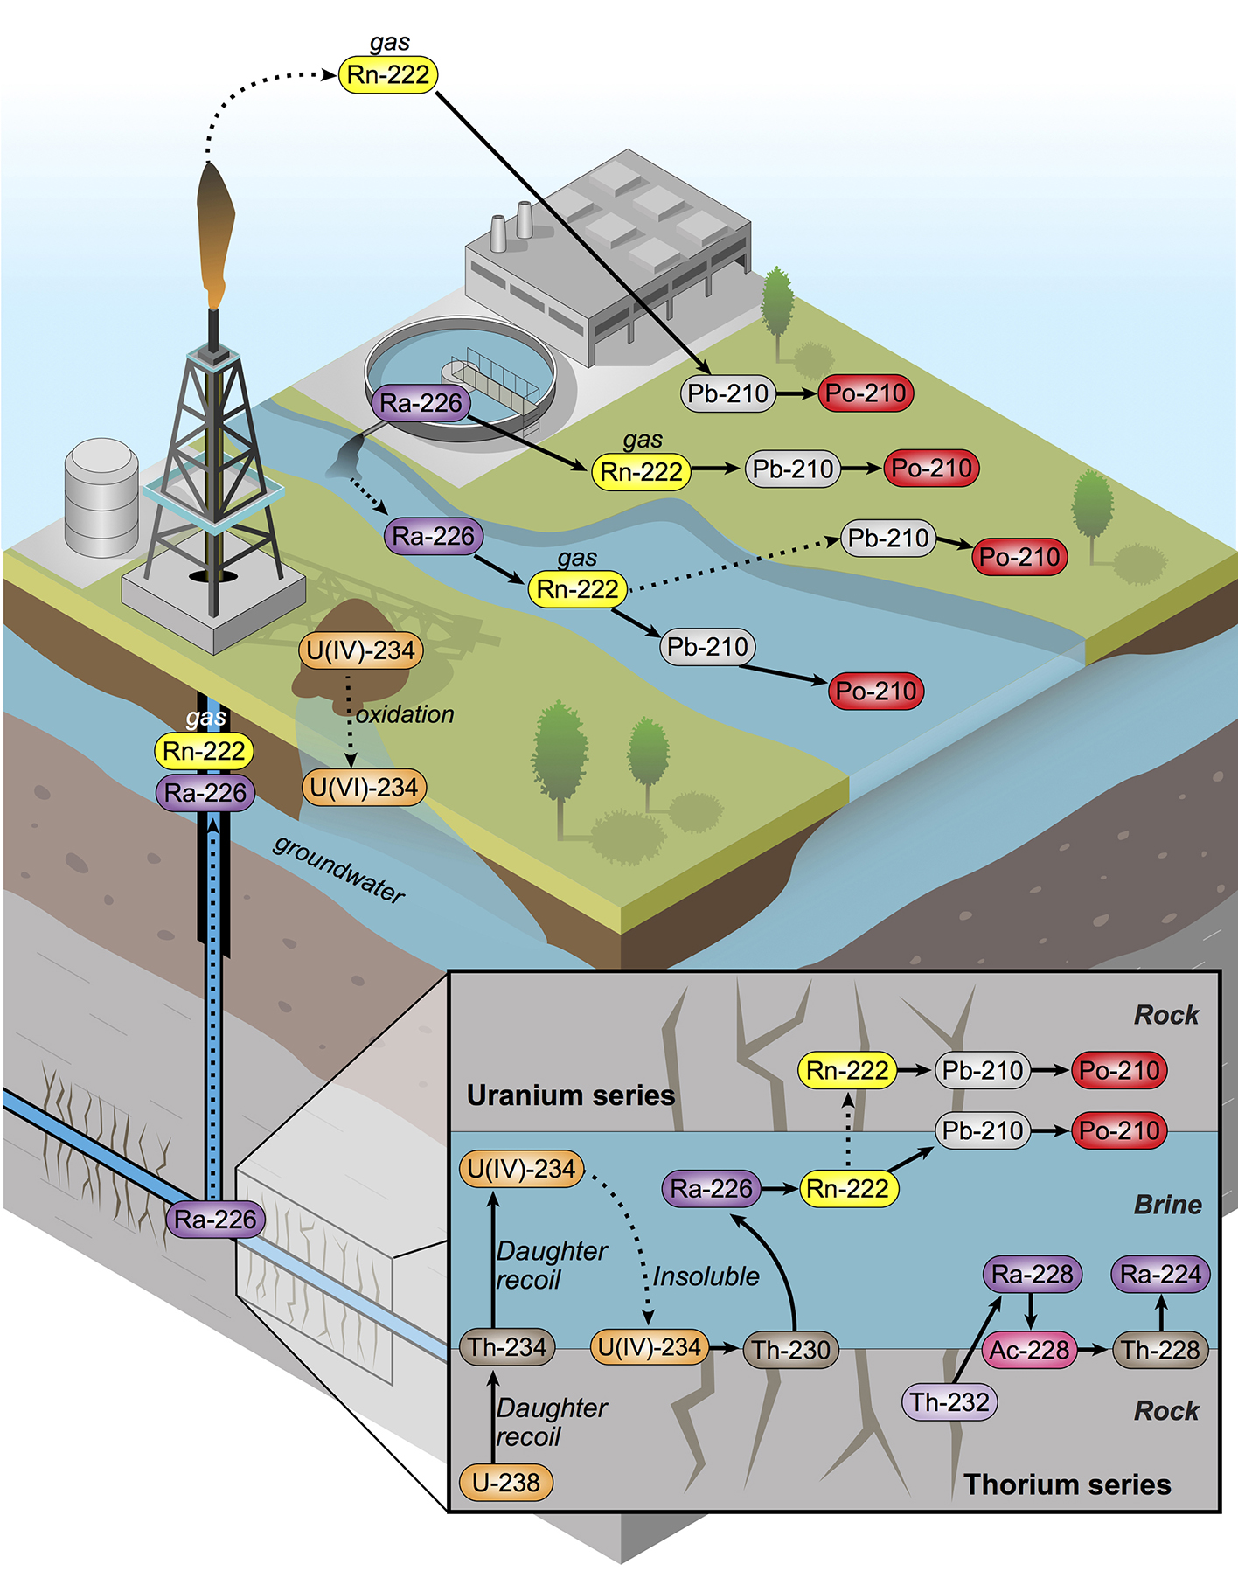
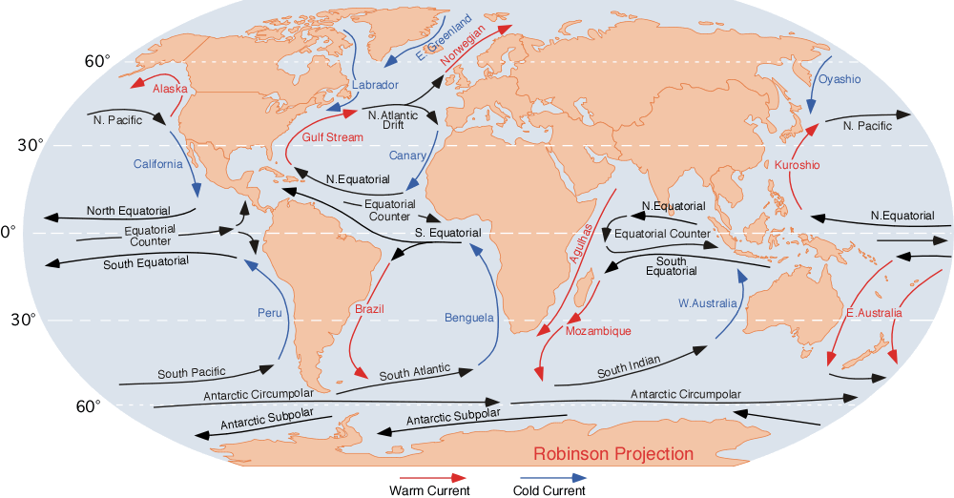
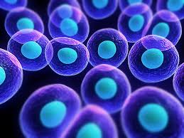
Environmental Tracers
Notes:
Just as doctors can label substances inside people's bodies, scientists can label substances that pass through plants, animals, or our world. This allows researchers to study such things as the paths that different types of air and water pollution take through the environment. Similarly, radiation has helped us learn more about the types of soil that different plants need to grow, the sizes of newly discovered oil fields, and the tracks of ocean currents. In addition, researchers use low-energy radioactive sources in gas chromatography to identify the components of petroleum products, smog and cigarette smoke, and even complex proteins and enzymes used in medical research.
Image: https://ehp.niehs.nih.gov/1408855/

Slide 5
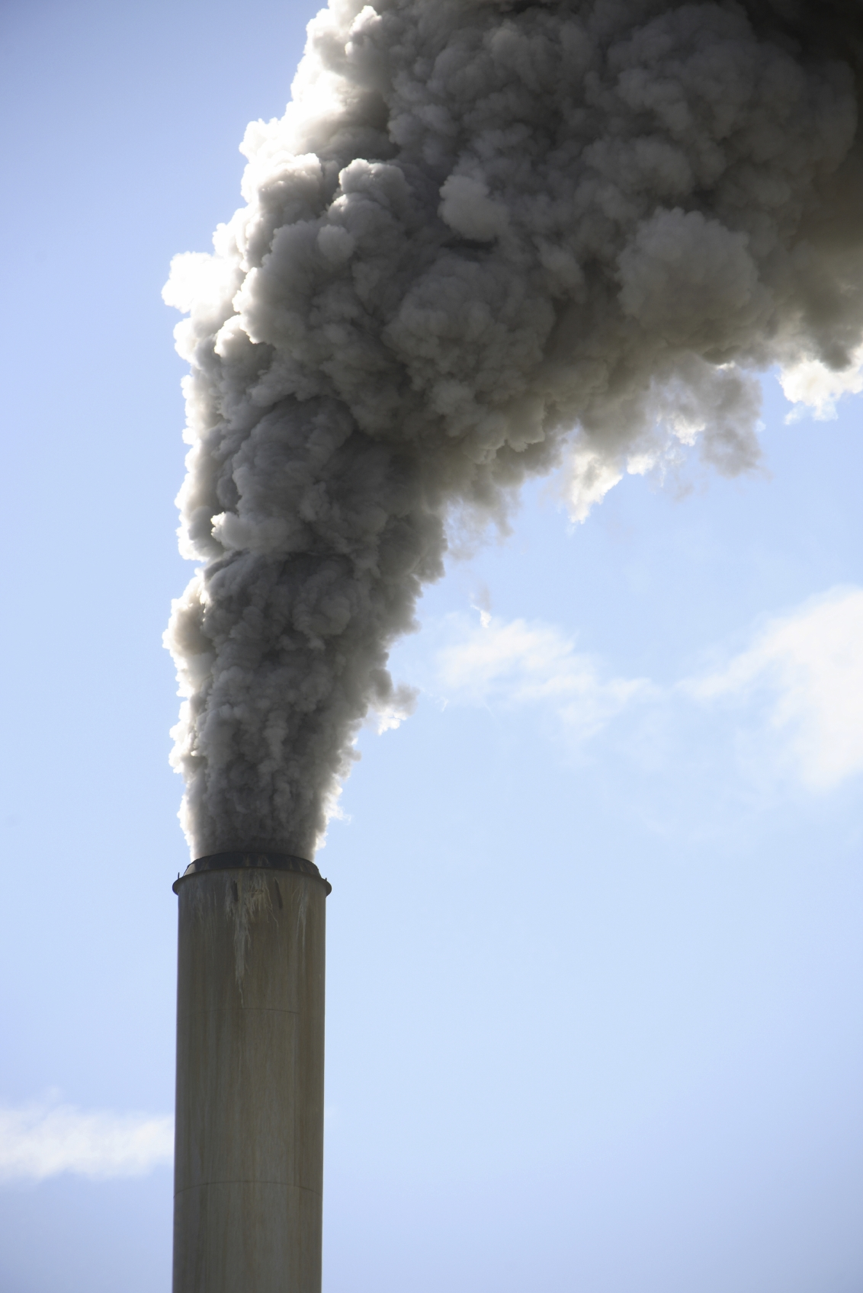
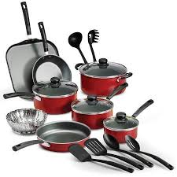
Pollution and Chemical Control
Notes:
Similarly, radiation is used to help remove toxic pollutants, such as exhaust gases from coal-fired power stations and industry. For example, electron beam radiation can remove dangerous sulphur dioxides and nitrogen oxides from our environment. Closer to home, many of the fabrics used to make our clothing have been irradiated (treated with radiation) before being exposed to a soil-releasing or wrinkle-resistant chemical. This treatment makes the chemicals bind to the fabric, to keep our clothing fresh and wrinkle-free all day, yet our clothing does not become radioactive. Similarly, nonstick cookware is treated with gamma rays to keep food from sticking to the metal surface.

Slide 6
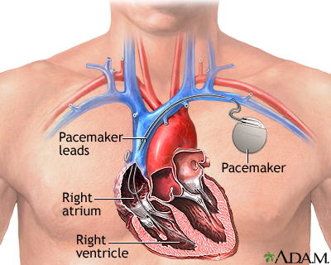
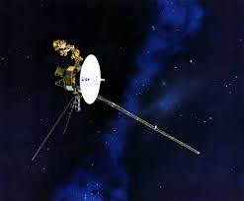
Nuclear Batteries
Notes:
Nuclear batteries can be used in pacemakers and last for decades (although most pacemakers now use lithium batteries).
Atomic batteries (or radioisotope thermoelectric generator) use long living isotopes to generate power reliably for thousands of years which is a great option for deep space missions.

Slide 7
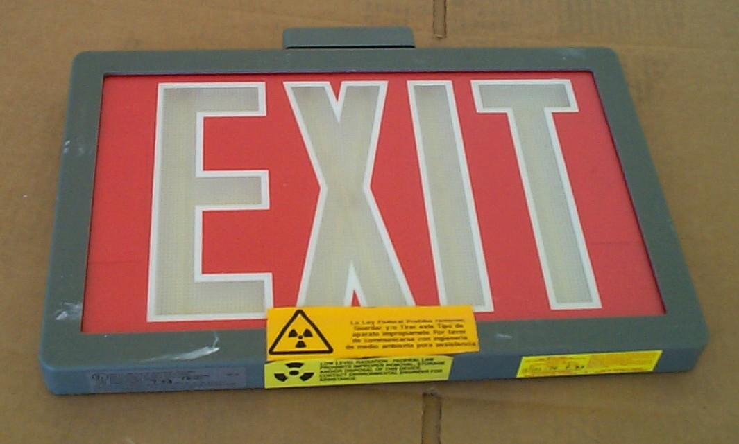
In Everyday Life
Notes:
All around us, we see reflective signs that have been treated with radioactive tritium and phosphorescent paint. Gauges containing radioisotopes measure the amount of air whipped into our ice cream, while others prevent spillover as our soda bottles are carefully filled at the factory.

Slide 8
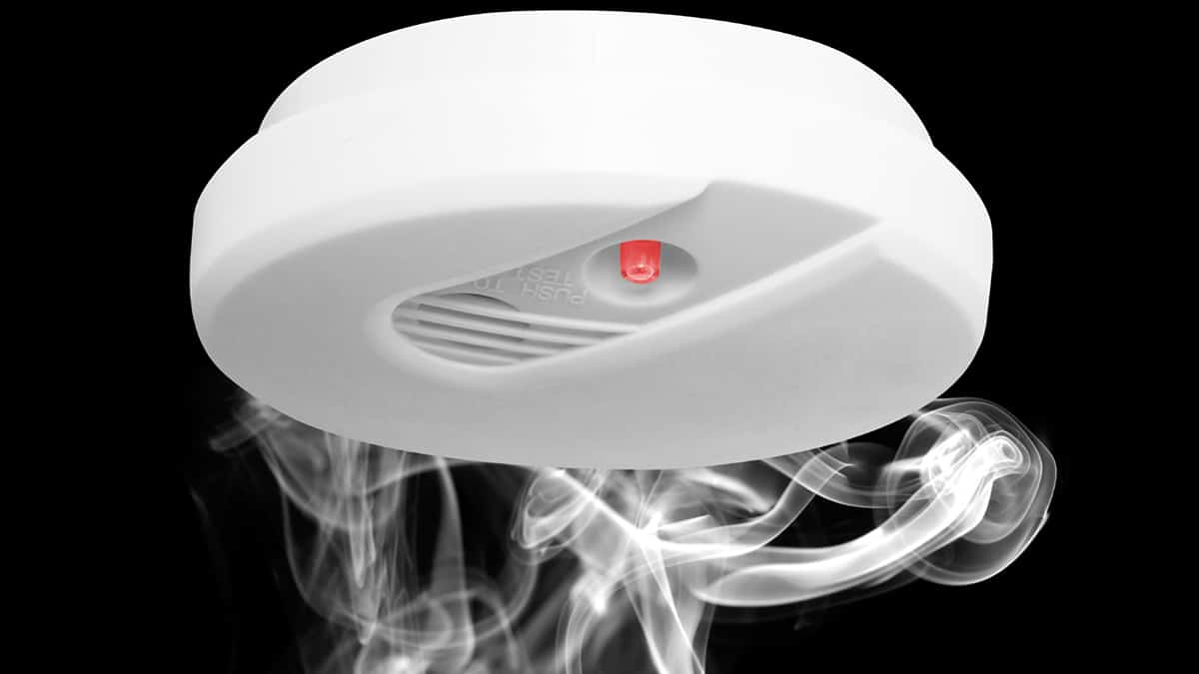
To Keep Us Safe
Notes:
Americium 241 is a radioactive isotope that emits an alpha particle during radioactive decay.
Alpha particles are large and get stopped by almost anything - in fact, they only travel about 4 inches in air before the air molecules stop them.
The alpha particles are emitted at a steady pace and detected in the smoke detector.
If there was a fire, the smoke would prevent the alpha particles from reaching the detector and sound the alarm.

Slide 9
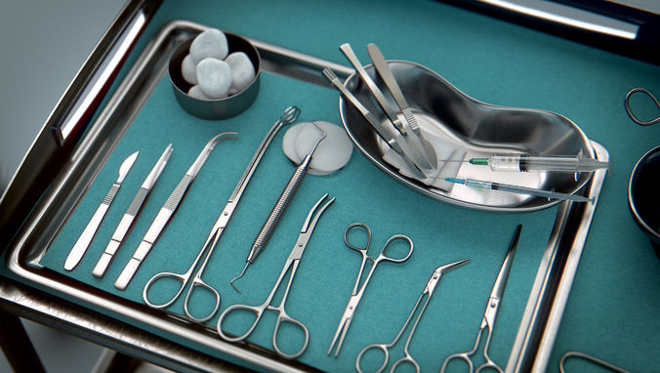
To Keep Us Healthy
Notes:
In irradiation, for instance, foods, medical equipment, and other substances are exposed to certain types of radiation (such as x-rays) to kill germs without harming the substance that is being disinfected — and without making it radioactive. When treated in this manner, foods take much longer to spoil, and medical equipment (such as bandages, hypodermic syringes, and surgical instruments) are sterilized without being exposed to toxic chemicals or extreme heat. As a result, where we now use chlorine — a chemical that is toxic and difficult-to-handle — we may someday use radiation to disinfect our drinking water and kill the germs in our sewage. In fact, ultraviolet light (a form of radiation) is already used to disinfect drinking water in some homes.

Slide 10
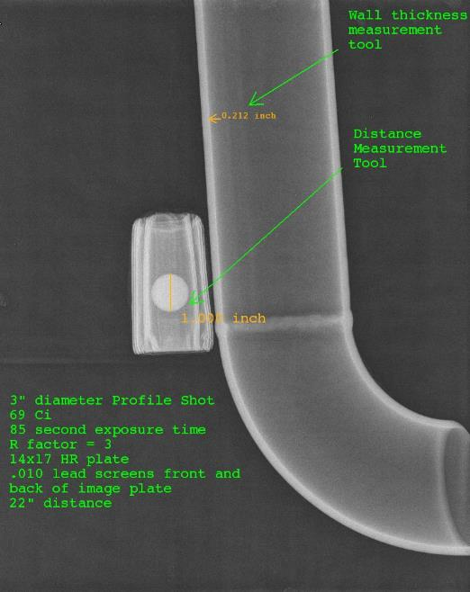
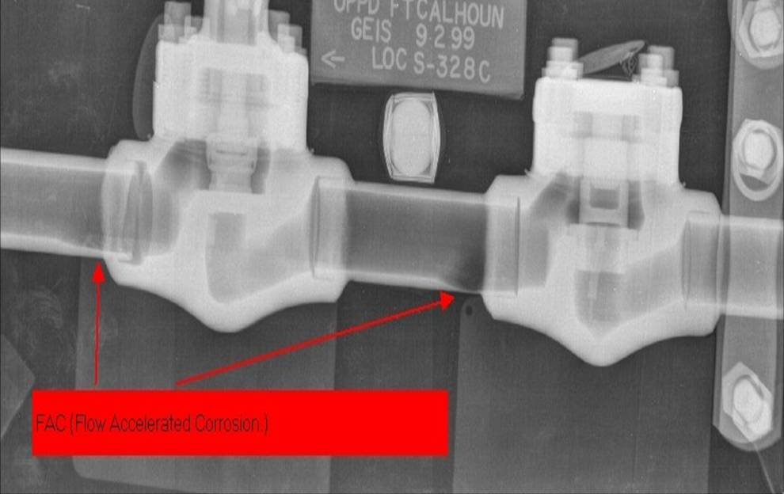
See Through Walls: Radiography
Notes:
Radiography (or high energy x-rays) can be used to examine structures (welds, pipes, etc) without destroying the structure.
It can be used to examine bridge integrity.

Slide 11
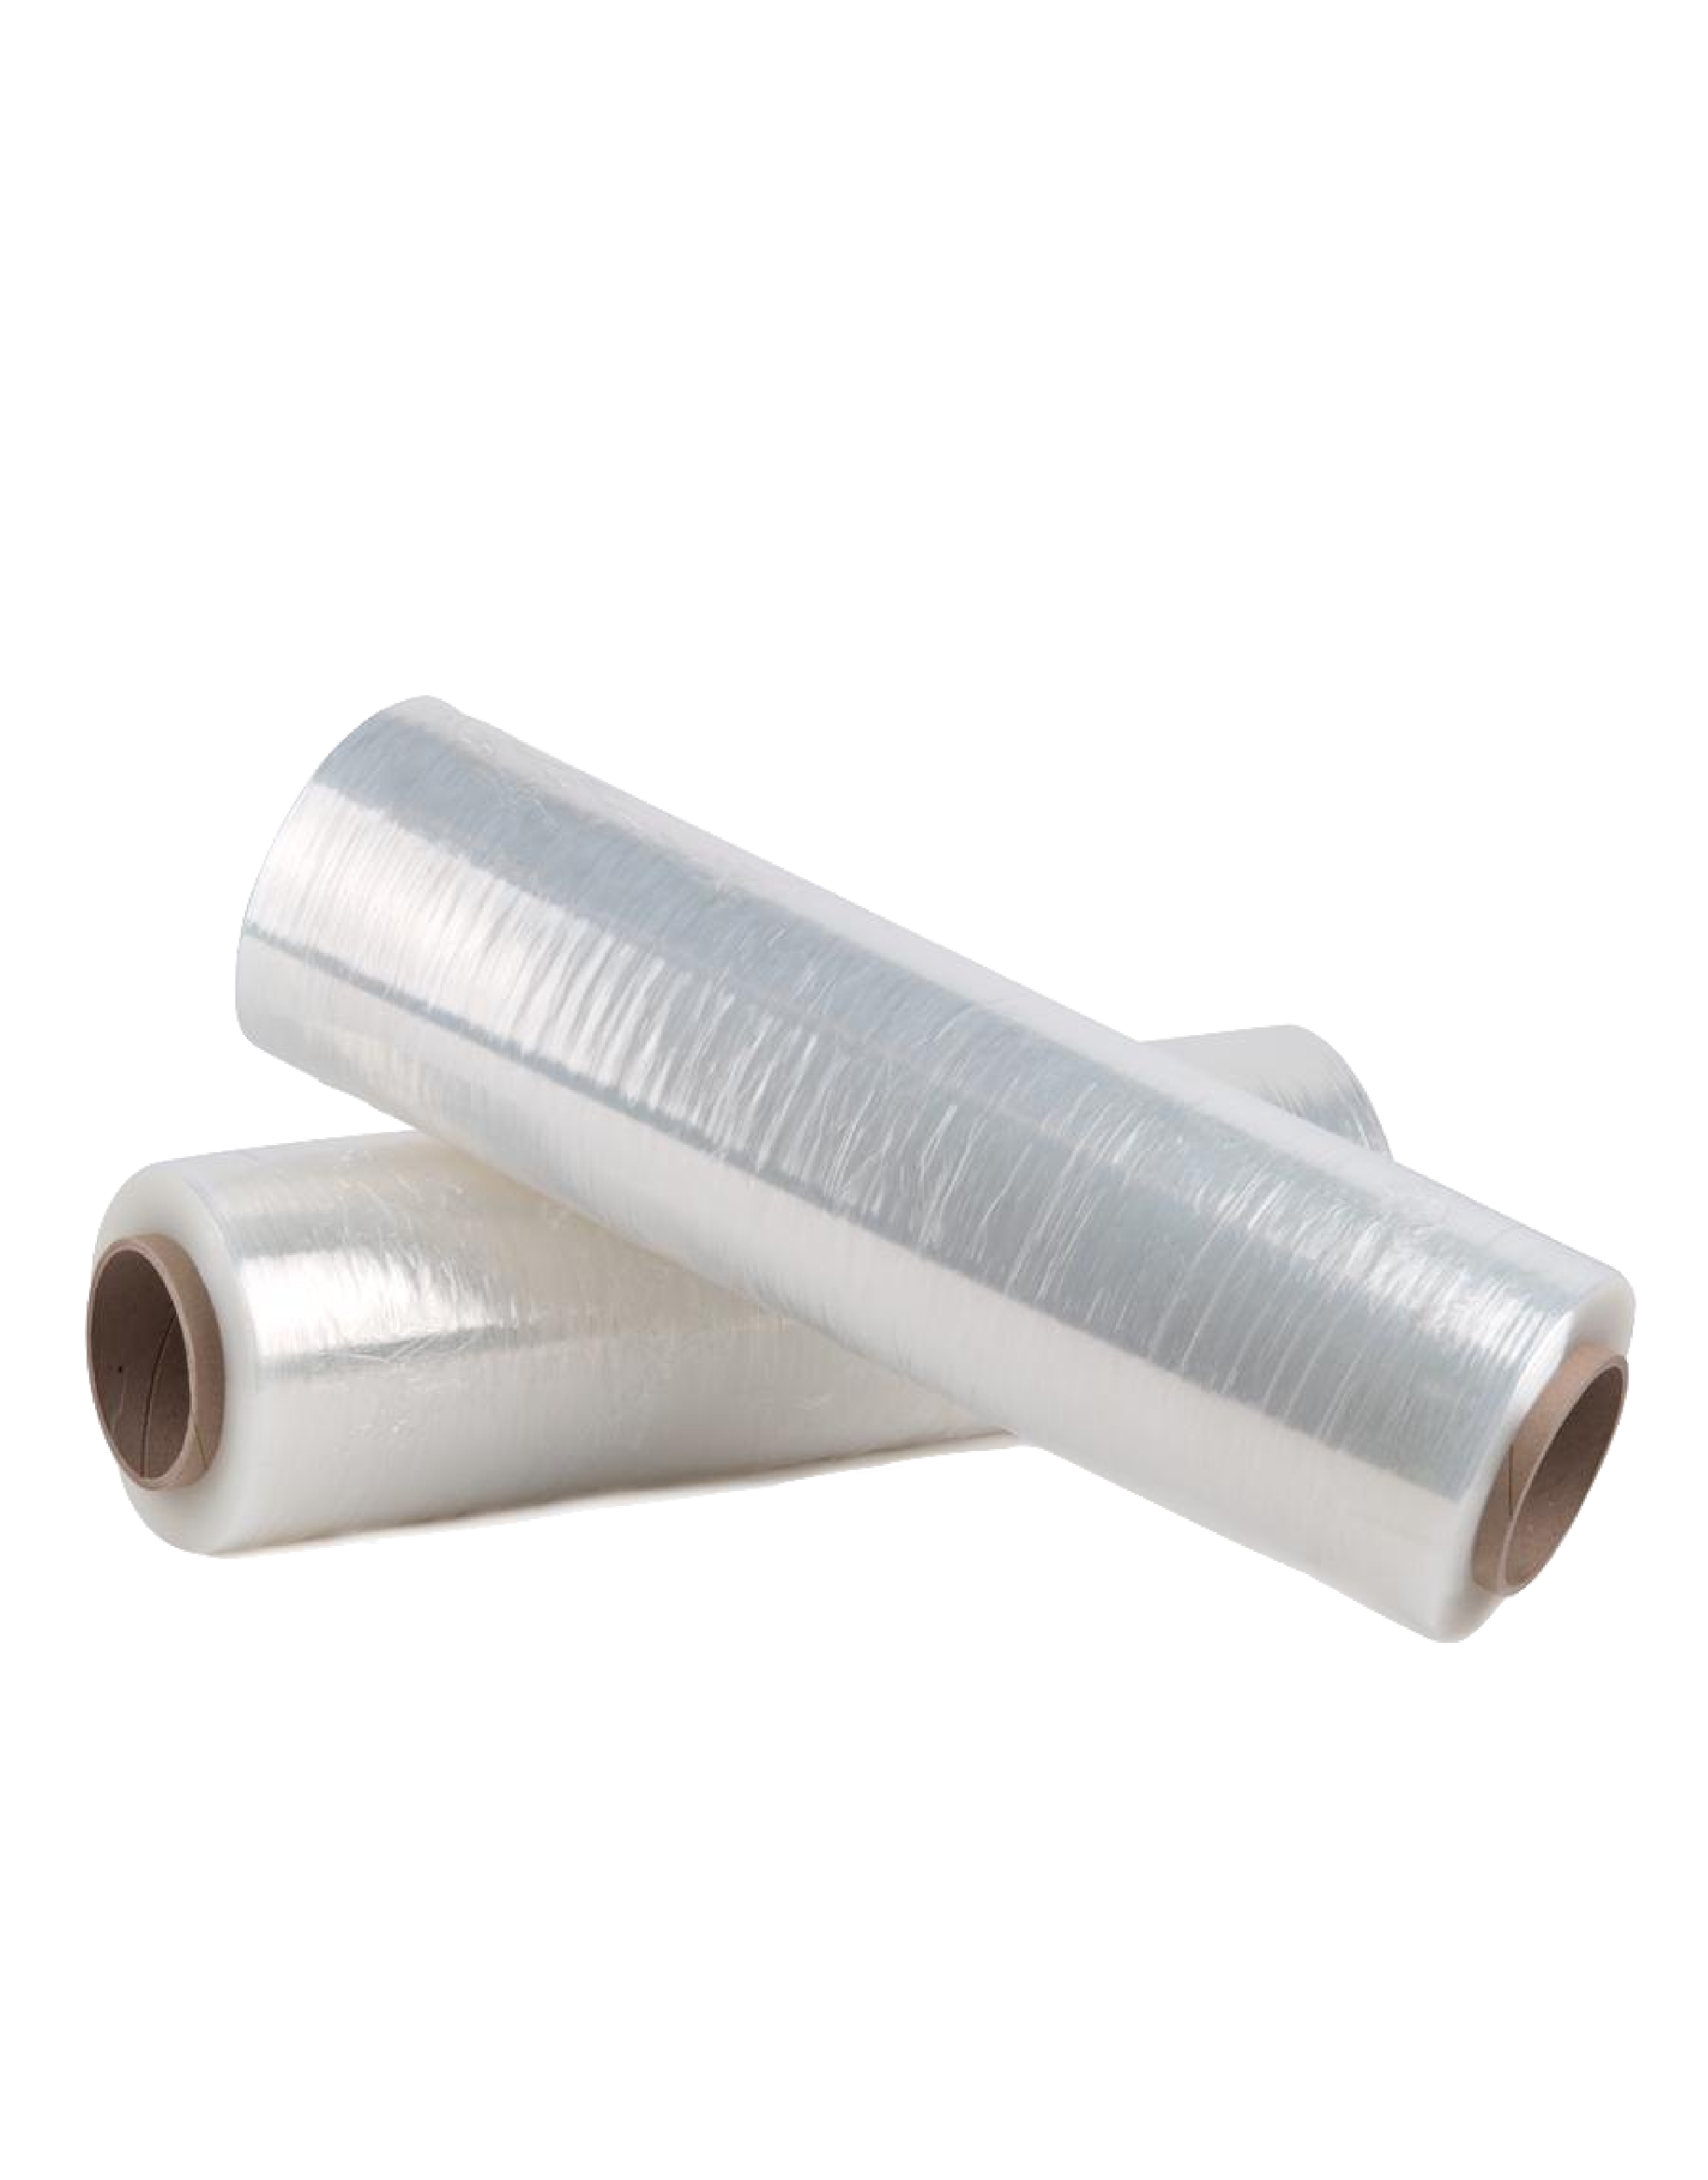
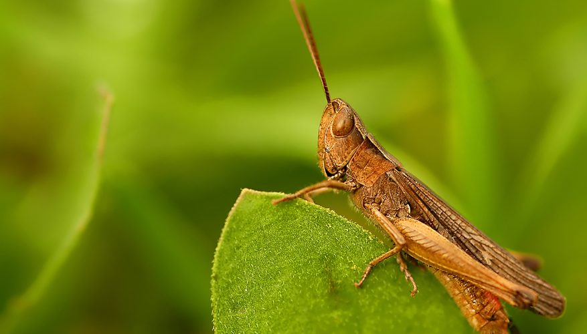
Agriculture
Notes:
The agricultural industry makes use of radiation to improve food production and packaging. Plant seeds, for example, have been exposed to radiation to bring about new and better types of plants. Besides making plants stronger, radiation can be used to control insect populations, thereby decreasing the use of dangerous pesticides. Radioactive material is also used in gauges that measure the thickness of eggshells to screen out thin, breakable eggs before they are packaged in egg cartons. In addition, many of our foods are packaged in polyethylene shrinkwrap that has been irradiated so that it can be heated above its usual melting point and wrapped around the foods to provide an airtight protective covering.

Slide 12
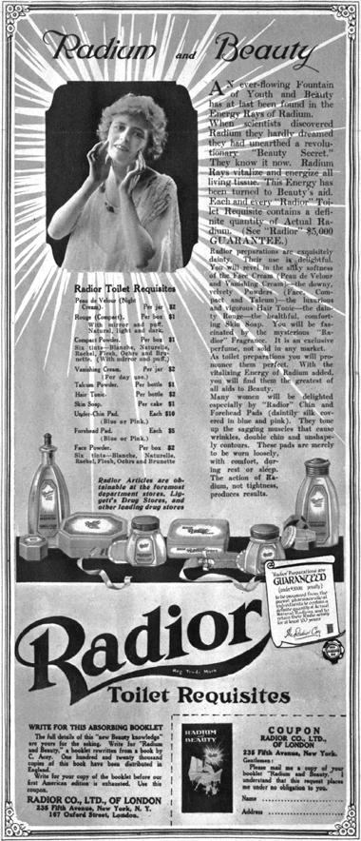
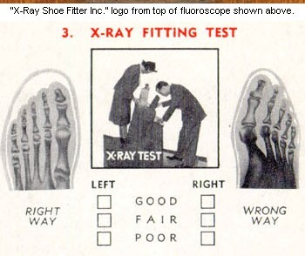
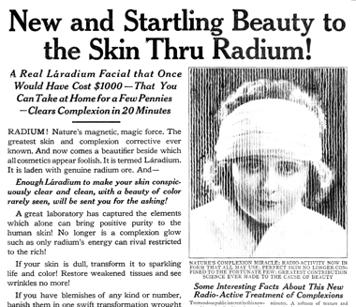
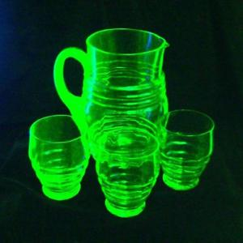
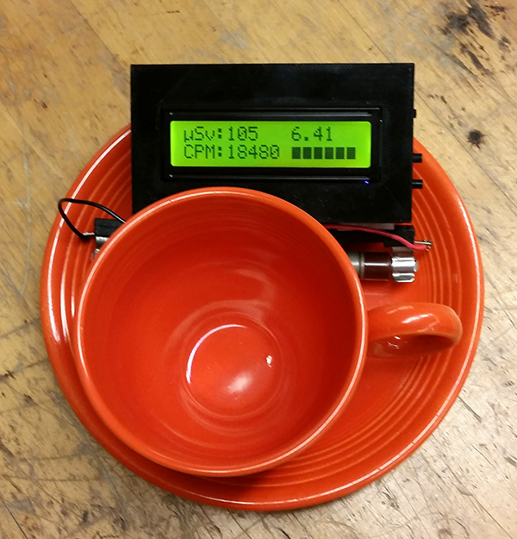
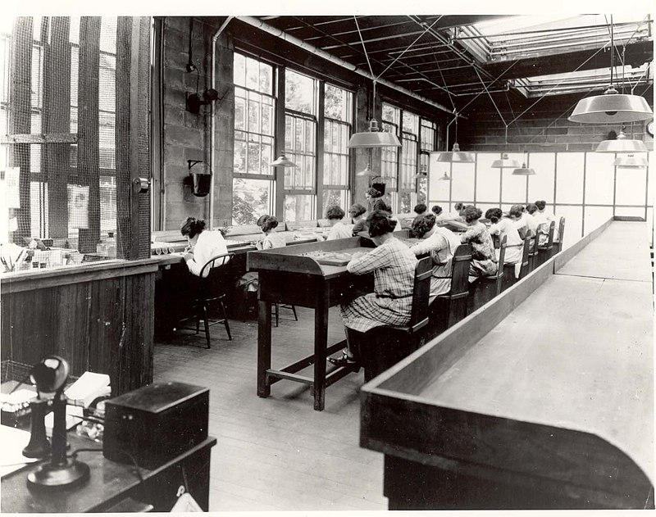
In the past...
Notes:
When radioactivity was first discovered, it was used for a lot of applications (some superfluous and some downright unsafe):
makeup - this had no scientific backing but was in vogue for awhile
glow in the dark watches (and learned that licking radium was a very very bad idea)
glow in the dark glass, bright orange paint (Fiestaware) - fine to eat off of but unhealthy if it chips and the paint is accidentally swallowed
shoe sizing - not that bad for your health (your extremities aren’t very sensitive to radiation) but pretty expensive when you could just feel your toes through the shoes

Slide 13
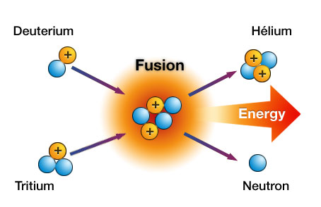
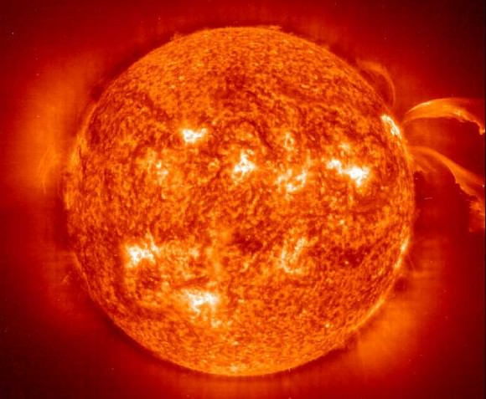
Nuclear Fusion Powers the Sun
Combination of Light Nuclei Hard to get on Earth – we’re working on it!
Example: H-3 + H-2 ⇒ n + He-4 Tritium + Deuterium ⇒ neutron + Helium
Notes:
Fusion is what powers stars. Scientists are trying to reproduce these reactions on earth for electricity generation but it is very difficult.
Fusion combines lighter elements to make heavier elements (up to iron). Supernova generate heavier elements that then decay (or fission) to lighter elements (as light as iron).
In some regards, nuclear energy is the basis for all other energy! Nuclear fusion is the heat from the sun which warms the surface of the earth (solar!) which generates wind patterns (wind!). It allows plants and animals to grow (fossil fuels). Obviously nuclear fission is nuclear energy. Hydroelectric is a little harder argument (gravitational force results in potential energy) but the water cycle is reliant on the sun! Also, oxygen was formed via fusion of atoms!
Test question - use E=mc² to calculate the energy produced in a fusion reaction.

Slide 14
Dinosaurs?!
Notes:
Archaeologists also use radioactive substances to determine the ages of fossils and other objects through a process called carbon dating. For example, in the upper levels of our atmosphere, cosmic rays strike nitrogen atoms and form a naturally radioactive isotope called carbon-14. Carbon is found in all living things, and a small percentage of this is carbon-14. When a plant or animal dies, it no longer takes in new carbon and the carbon-14 that it accumulated throughout its life begins the process of radioactive decay. As a result, after a few years, an old object has a lower percent of radioactivity than a newer object. By measuring this difference, archaeologists are able to determine the object's approximate age.

Slide 15
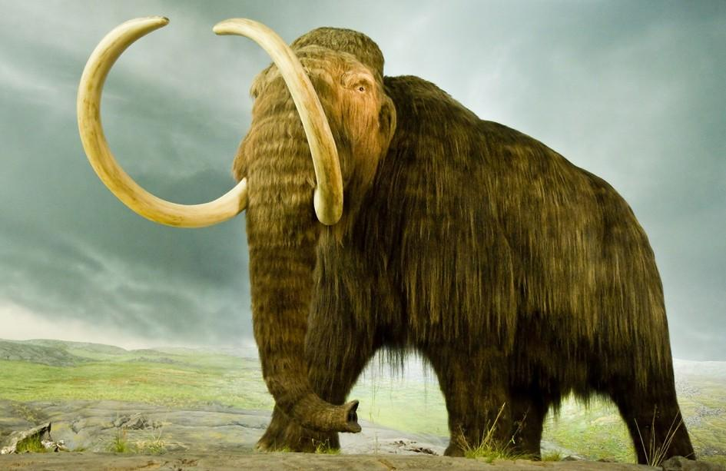
Classroom Activity
Carbon 14 Dating
All living things contain carbon (Carbon 12 and Carbon 14).
Upon death, the Carbon 12 content remains the same but
the Carbon 14 content will decrease over time because it
is radioactive.
Step 1: Use Skittles to model radioactive decay (start with 100)
While doing experiment, play video
Step 2: Assume the ratio of Carbon 12 atoms to Carbon 14 atoms is 10¹² to 1
You find a woolly mammoth fossil!! A sample of it has 10¹⁵ Carbon 12 atoms.
How many Carbon 14 atoms were in the sample when the woolly mammoth stopped breathing?
Notes:
Use Skittles’s to model radioactive decay and graph it: http://www.nuclearconnect.org/in-the-classroom/for-teachers/half-life-of-paper-mms-pennies-or-puzzle-pieces
Radiocarbon dating is used for dating once-living matter less than 40,000 to 60,000 years old, like fossilized bones and teeth. Radiometric dating is used for dating objects millions and even billions of years old. Both techniques rely on the properties of radioactive isotopes, which are unstable elements that decay into stable ones over time.
Particles radioactively decay over time. A half life is the time it takes for half of the material to decay.
Living plants exchange their carbon with the carbon in the air. The air contains mostly carbon-12, the most common carbon isotope, but it also contains a small amount of carbon-14, a radioactive isotope produced in the atmosphere when cosmic rays bombard nitrogen atoms. All living plants -- and all living things that depend on plants -- contain these two isotopes in the same ratio as the air does. When a plant or other living thing dies, it stops taking in fresh carbon from the air. While its carbon-12 content remains constant, its carbon-14 content decreases because carbon-14 is radioactive and slowly decays into nitrogen. Hence, the ratio of the two isotopes changes over time.
The half-life of carbon-14 is 5,730 years, which means that in 5,730 years, half the carbon-14 atoms will have changed to nitrogen. Assuming carbon-14 has always been present in the atmosphere and in all living things in the same concentration, the ratio of carbon-14 to carbon-12 in a sample of a dead plant and the ratio in living plants can be measured and then compared to help determine when the plant died.
Good worksheet: https://www.crsd.org/cms/lib/PA01000188/Centricity/Domain/2828/Carbon%20Dating%20Activity%20.pdf
Answer: 1000 Carbon 14 atoms

Slide 16
Classroom Activity
Carbon 14 Dating
We know there were 1000 Carbon 14 atoms when the poor
woolly mammoth died.
We measure that there are only 125 Carbon 14 atoms now.
Step 3: Given that Carbon 14’s half life is 5,730 years, how
old is the woolly mammoth fossil?
Notes:
After 1 half life, there would be 500 carbon 14 atoms.
After 2 half lives there would be 250 carbon 14 atoms.
After 3 half lives, there would be 125 carbon 14 atoms.
Therefore, we know three half lives have passed.
This means the fossil is 3*5730 years old (or 17,190 years old).

Slide 17
Education Standards
Physical Science
Georgia Science Standards
SPS4.C: Construct arguments based on evidence about the applications, benefits, and problems of nuclear energy as an alternative energy source.
Activity: Learn about other applications of nuclear.
Did you know scientists tried to design a nuclear powered airplane and nuclear powered car?

Slide 18
Education Standards
Physical Science
Georgia Science Standards
SPS7.A: Construct explanations for energy transformations within a system. (Clarification statement: Types of energy to be addressed include chemical, mechanical, electromagnetic, light, sound, thermal, electrical, and nuclear.)
Activity: Research how nuclear batteries work. Why are nuclear batteries a good candidate for powering long term space missions?

Slide 19
Education Standards
Physical Science
Georgia Science Standards
S3E2. Obtain, evaluate, and communicate information on how fossils provide evidence of past organisms. a. Construct an argument from observations of fossils (authentic or reproductions) to communicate how they serve as evidence of past organisms and the environments in which they lived. b. Develop a model to describe the sequence and conditions required for an organism to become fossilized. (Clarification statement: Types of fossils (cast, mold, trace, and true) are not addressed in this standard.)
Activity: Discuss Carbon-14 Dating.

Slide 20
Education Standards
Earth & Space Sciences
Next Generation Science Standards
Nuclear Fusion processes in the center of the sun release the energy that ultimately reaches Earth as radiation. (secondary to HS-ESS1-1)
Other than the hydrogen and helium formed at the time of the Big Bang, nuclear fusion within stars produces all atomic nuclei lighter than and including iron, and the process releases electromagnetic energy. Heavier elements are produced when certain massive stars achieve a supernova stage and explode. (HS-ESS1-2),(HS-ESS1-3)
Activity: This lesson and Critical Path

Slide 21
Education Standards
Earth and Space Sciences
Next Generation Science Standards
HS-ESS1-1. Develop a model based on evidence to illustrate the life span of the sun and the role of nuclear fusion in the sun’s core to release energy that eventually reaches Earth in the form of radiation
Activity: This lesson. Then calculate the energy produced during fusion with the equation E=mc²
https://solarsystem.nasa.gov/solar-system/sun/overview/
https://spaceplace.nasa.gov/menu/sun/

