Slide 1
Global Nuclear Fuel Economy
  Working For America

Slide 2
Global Nuclear Fuel Economy
URENCO Perspective

Slide 3
Agenda
What is driving the nuclear fuel market?
How is URENCO positioning itself in response?
Where is the growth in nuclear?
What is URENCO’s long term outlook?

Slide 4
What is driving the nuclear fuel market?
Demand < Supply
Demand
On March 11, 2011, the earthquake that hit off the coast of Japan resulted in a tsunami that fundamentally changed the future of the nuclear industry.
  The following immediate impacts were due to Fukushima
    ~12% of global nuclear generating capacity went offline almost immediately when Japan shut down its nuclear fleet.
    At the completion of Germany’s nuclear phase out, another ~3% will go offline.
    New build programs in China and South Korea were significantly delayed.
Cheap natural gas and wind subsidies have forced nuclear reactors to close in the U.S. and Sweden.

Slide 5
What is driving the nuclear fuel market?
Demand < Supply
Supply
Utilities alone are holding a four-year inventory of uranium.
Governments and producers are holding additional inventories.

Slide 6
How is URENCO positioning itself in response?
URENCO has completed a comprehensive review of its business and market in response to these challenges.
Our goal is remain a secure, long-term supplier to the industry and sustain a successful future.

Slide 7
How is URENCO positioning itself in response?
URENCO is strategically realigning the company, taking advantage of our market strength and global position to ensure that we remain a sustainable business moving forward.
  To accomplish this, we are taking a 3-pronged approach:
    Optimizing the way we do business
    Exploring growth opportunities to maximize our future sales
    Expanding our technological capabilities to more broadly serve the nuclear industry

Slide 8
How is URENCO positioning itself in response?
URENCO continues to believe that the world will need nuclear to meet the increasing demands for sustainable energy production and that we will be well positioned to be a significant part of this solution.

Slide 9
How is URENCO positioning itself in response?

Slide 10
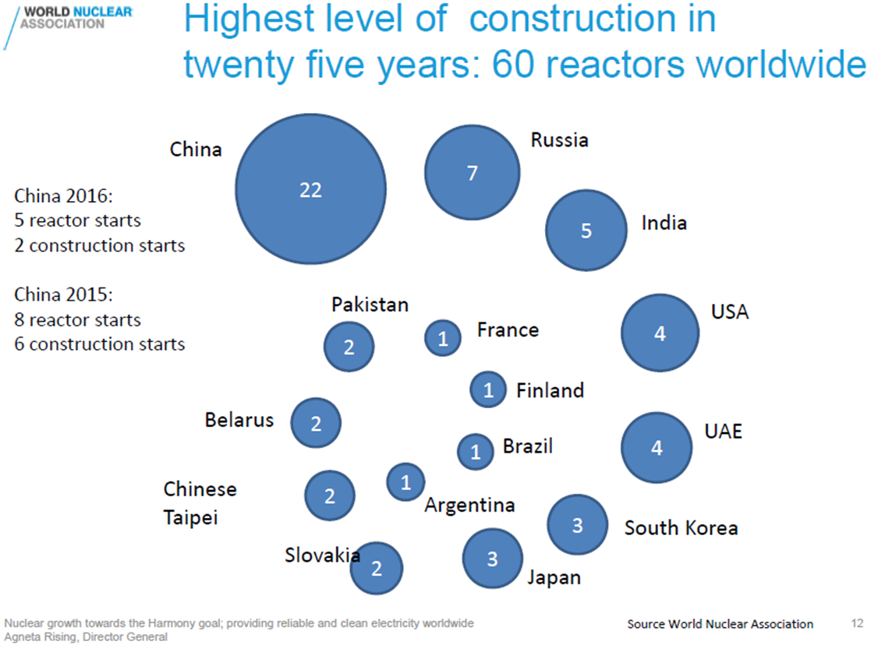
Where is the growth in nuclear?

Slide 11
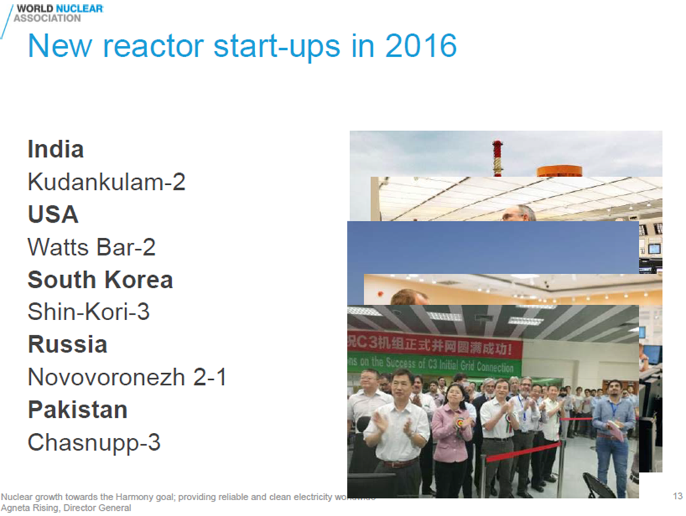
Where is the growth in nuclear?

Slide 12
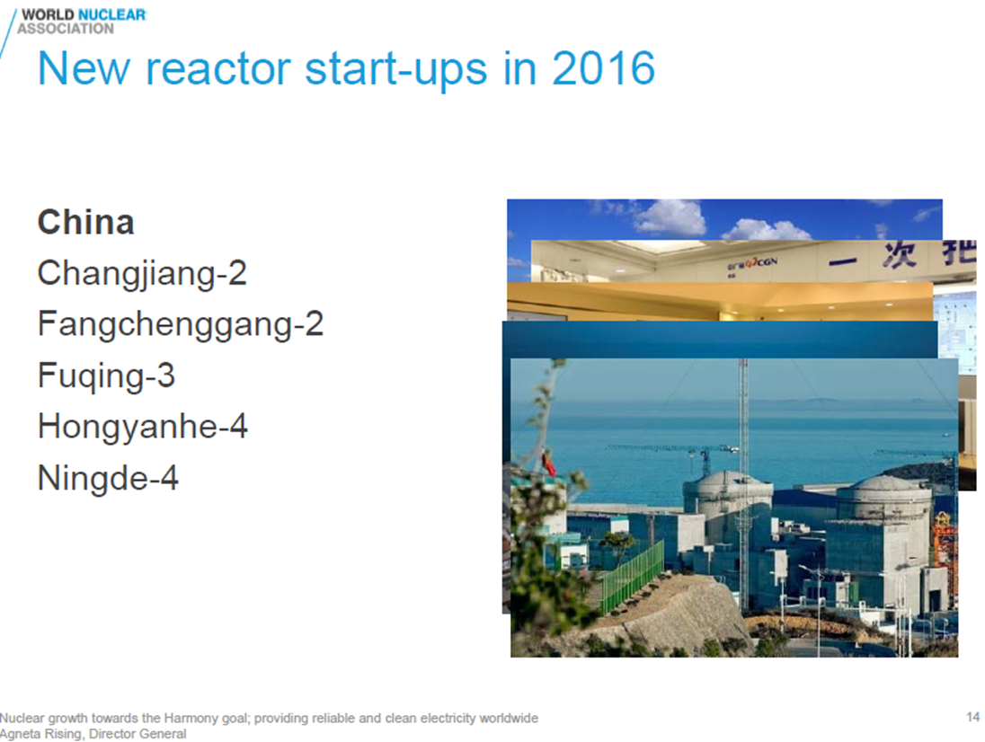
Where is the growth in nuclear?

Slide 13
What is URENCO’s long term outlook?
Nuclear remains the best choice for safe, large-scale, baseload power generation.
URENCO USA has requested and been approved for expansion from our current capacity of 4.7 mSWU to 10 mSWU when the market demand returns.
We have extended our NRC License to 2040.
We are well positioned near a supportive community with land to expand.
We wouldn’t be doing any of this if we didn’t believe that nuclear has a bright and sustainable future.

Slide 14
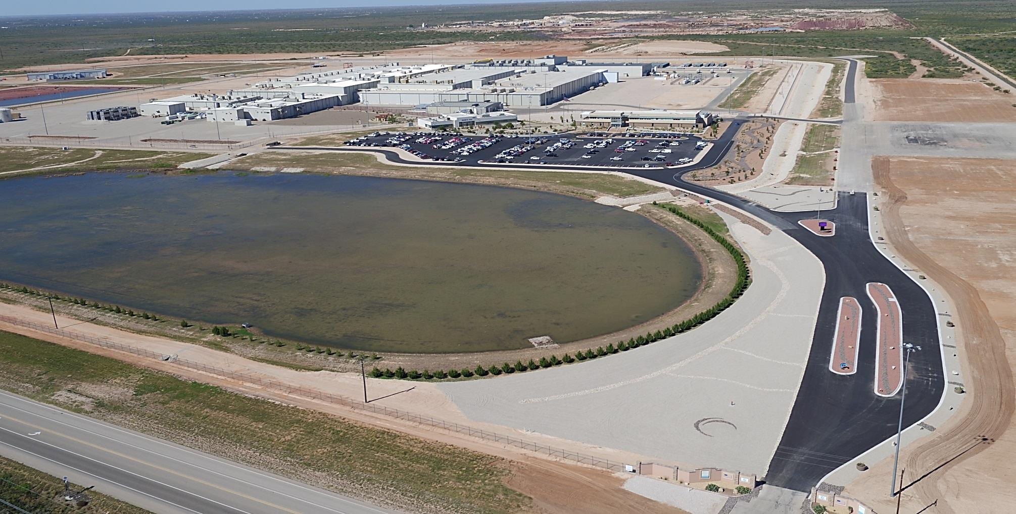
Questions?
Thank you for your time!

Slide 15
Global Nuclear Fuel Economy
A Fabrication Perspective
Patty McCumbee
Global Nuclear Fuel
Product Leader

Slide 16

Global Factors:
Regulatory
Clean energy
Economics
Nuclear expertise
Multi-generational workforce
Multi-cultural workforce
Government politics

Slide 17

Collaboration is key……
We are BETTER, STONGER, FASTER together!

Slide 18

By providing a Utility with a cohesive and complete Solution, we create conditions that are healthy for the market at large – enabling Utilities to continue operating safe, reliable, and profitable nuclear power plants

Slide 19

Balance the Equation
Safety
Quality
Regulations
~ Risk, Margin, Benefits, Cost ~

Slide 20

Way more than just a “fabricator”….
Deliver Fuel & Solve Problems
Deliver EUP in the most economic and efficient way possible
Provide fuel with flawless performance and reliability
Monitor fuel and provide expertise during operations
Provide guidance on how to maximize reactor efficiency overall
Help utility solve constraints or emergent issues
Solve industry issues with excellence in engineering
World class licensing support & analysis

Slide 21


Think Differently –
Out-of-the Box is “so last year”;
Expand the Box & Think like a Freak!

Slide 22


Slide 23
Nuclear Impact on Dry Storage Industry
  Christopher Miller
  VP, Sales & Marketing
  TN Americas

Slide 24
Areas Discussed
Global Growth of Nuclear
International SNF Policy
Global Dry Storage Market
US Reactor Fleet
US Dry Storage Market Drivers

Slide 25
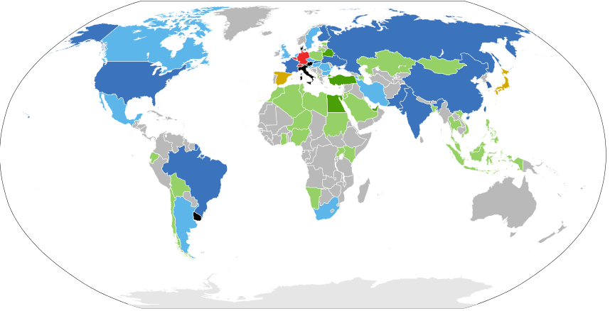
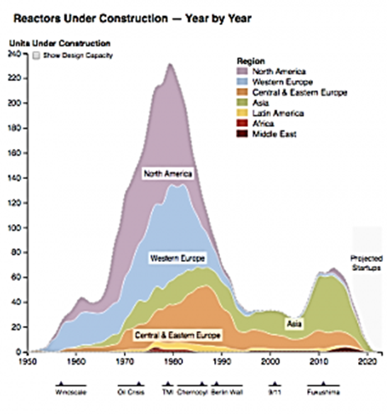
Global Growth of Nuclear
As of April 2017, 30 countries worldwide are operating 449 nuclear reactors for electricity generation and 60 new nuclear plants are under construction in 15 countries. Nuclear power plants provided 11 percent of the world's electricity production in 2014.
Source : NEI

Slide 26
International SNF Policy
Country | Policy |  | Country | Policy
Belgium | Reprocessing but moving to direct disposal |  | Russia | Reprocessing
Canada | Direct disposal** |  | South Korea | Direct disposal, wants to change
China | Reprocessing/Direct disposal** |  | Spain | Direct disposal**
Finland | Direct disposal** |  | Sweden | Direct disposal**
France | Reprocessing |  | Switzerland | Reprocessing
Germany | Reprocessing but moving to direct disposal |  | United Kingdom | Reprocessing
India | Reprocessing |  | USA | Direct disposal**
Japan | Reprocessing
Geological repositories are not fully operational which leads to interim storage

Slide 27
Global Dry Storage Market
Global spent nuclear fuel (SNF) dry storage cask market to reach $1.9bn by 2020
  Compared to $1.05bn during 2010-2015
  America largest market , led by the US
By 2020 (80% increase)
  US - $1bn
  Europe - $800M
Historical and projected amounts of spent fuel discharged, reprocessed and stored.
Asia-Pacific region (Japan, S. Korea, China) largest area of growth beyond 2020

Slide 28

U.S. Reactor Fleet to 2035
An estimated 5 to 10 plants are at risk of early closure due to adverse economic conditions over the next 10 years
Total of 31 units reaching 60 years by 2035
Kewaunee
CR3
SONGS2&3
Diablo Canyon
Fort Calhoun
Oyster Creek
Vermont Yankee
Palisades
Pilgrim

Slide 29
US Dry Storage Market Drivers
Increased use of high capacity systems
  32 – 37: decrease of 15% for PWR
  68 – 89: decrease of 30% for BWR
Market demands for lower priced systems
  Innovations
  Improved fabrication techniques
Increase in early plant closings
  Short-term spikes in market demand are created
  Reduces the long-term market value

Slide 30
The Future
Globally the industry is growing rapidly
  Market growth is heavily driven by the Asia-Pacific region
US is shrinking due to early plant closures
  Economic drivers
US economics drive lower cost and greater performance
  US innovations lead to global shifts

Slide 31

Questions?

Slide 32

Nuclear Transportation
EDLOW INTERNATIONAL COMAPNY
NAYGN Professional Development Session
May 22, 2017
Jack Edlow, President

Slide 33
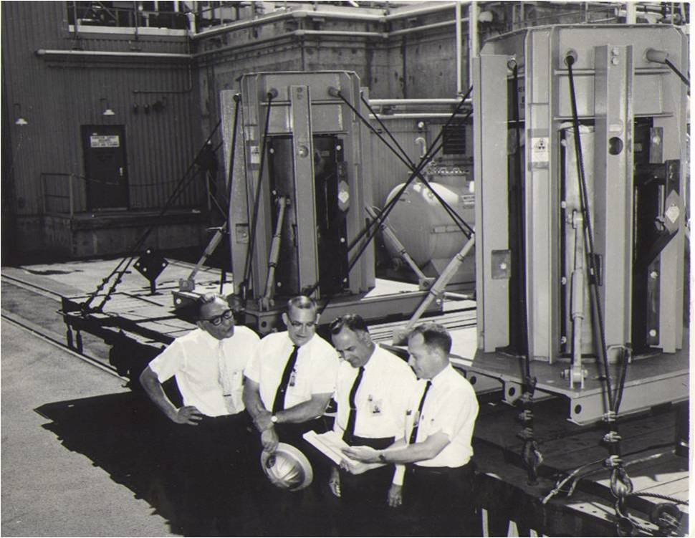
Since 1957…
Photo: Samuel Edlow (far left) and USAEC officials receive a shipment

Slide 34
Transportation Management
Everything YOU NEED TO KNOW ABOUT
Radioactive cargo transport

Slide 35

Everything You Need to Know About Radioactive Transport

Slide 36

Everything You Need to Know About Radioactive Transport

Slide 37

Everything You Need to Know About Radioactive Transport

Slide 38

Everything You Need to Know About Radioactive Transport

Slide 39
Transportation Management
What do we ship?

Slide 40
Nuclear Transportation Background
    Roughly 20 million shipments of radioactive material occur around the world each year, by road, rail, air, and ocean
    Only 5% of these shipments are nuclear fuel cycle related; the rest are for medicine, agriculture, research, manufacturing, and exploration for minerals
    There have been accidents over the years, but never one in which a container with highly radioactive materials has been breached, or has leaked

Slide 41
What Do We Ship?
EIC is capable of shipping all forms of radioactive cargo:
    Nuclear Fuel Cycle Materials
    Industrial Isotopes
    Medical Isotopes
    Research Reactor Materials

Slide 42
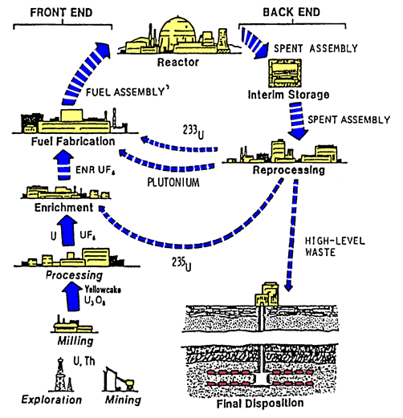
Nuclear Fuel Cycle

Slide 43
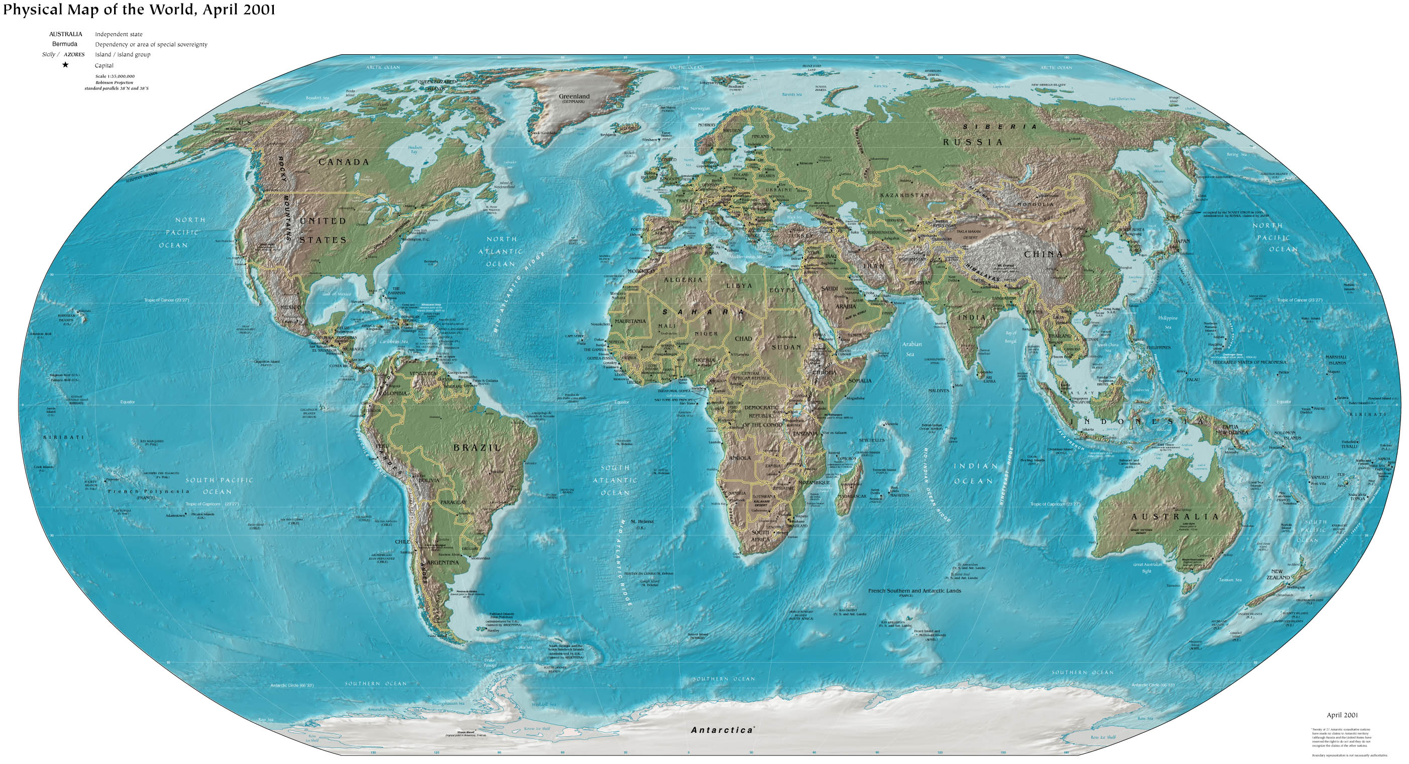
U3O8 Shipments
Australia
Kazakhstan
Namibia
Canada
Brazil
Niger

Slide 44
UF6
United States
Canada

Slide 45
Enriched UF6 and UO2
United States
United Kingdom
France
Sweden
Netherlands
Russia

Slide 46
Fresh Fuel
United States
Canada
Sweden
France

Slide 47
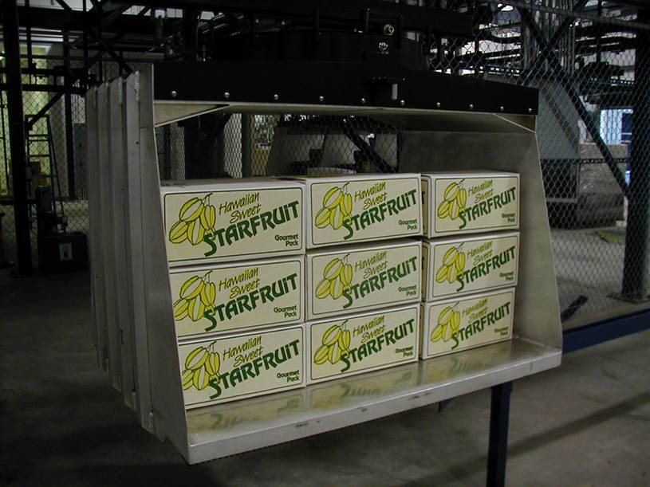
Food Irradiation

Slide 48
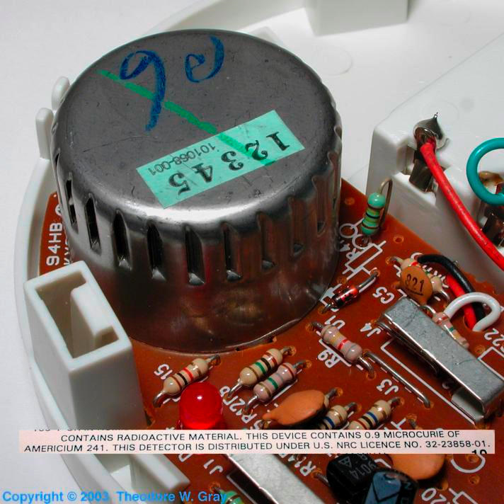
Home Use Smoke Detector

Slide 49
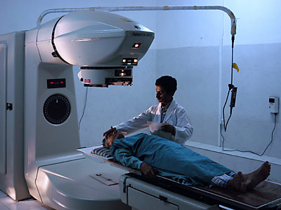
Cobalt 60

Slide 50
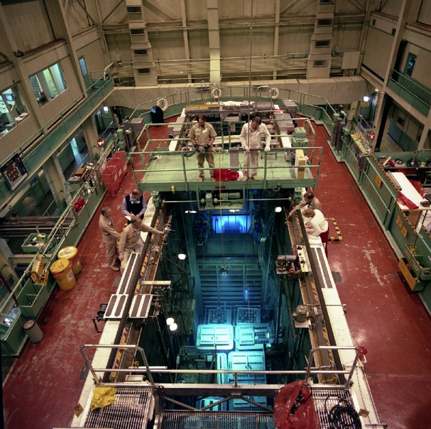
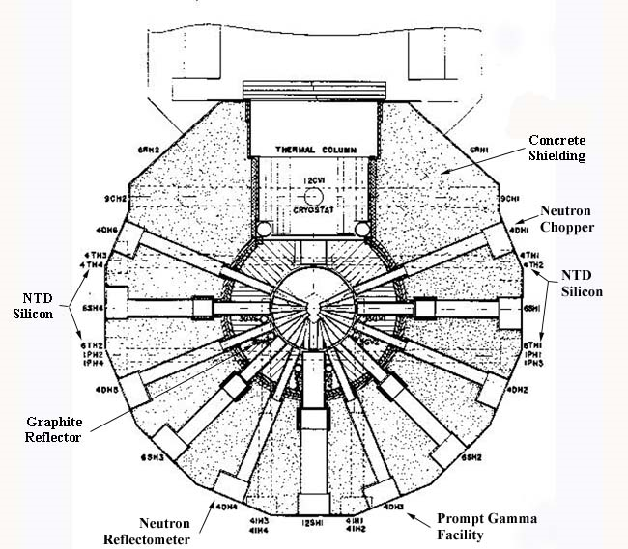
Research Reactor

Slide 51
Transportation Management
How do we ship?

Slide 52
How Do We Ship?
EIC has the capability to utilize all forms of transportation:
    Road
    Rail
    Ocean
    Air

Slide 53
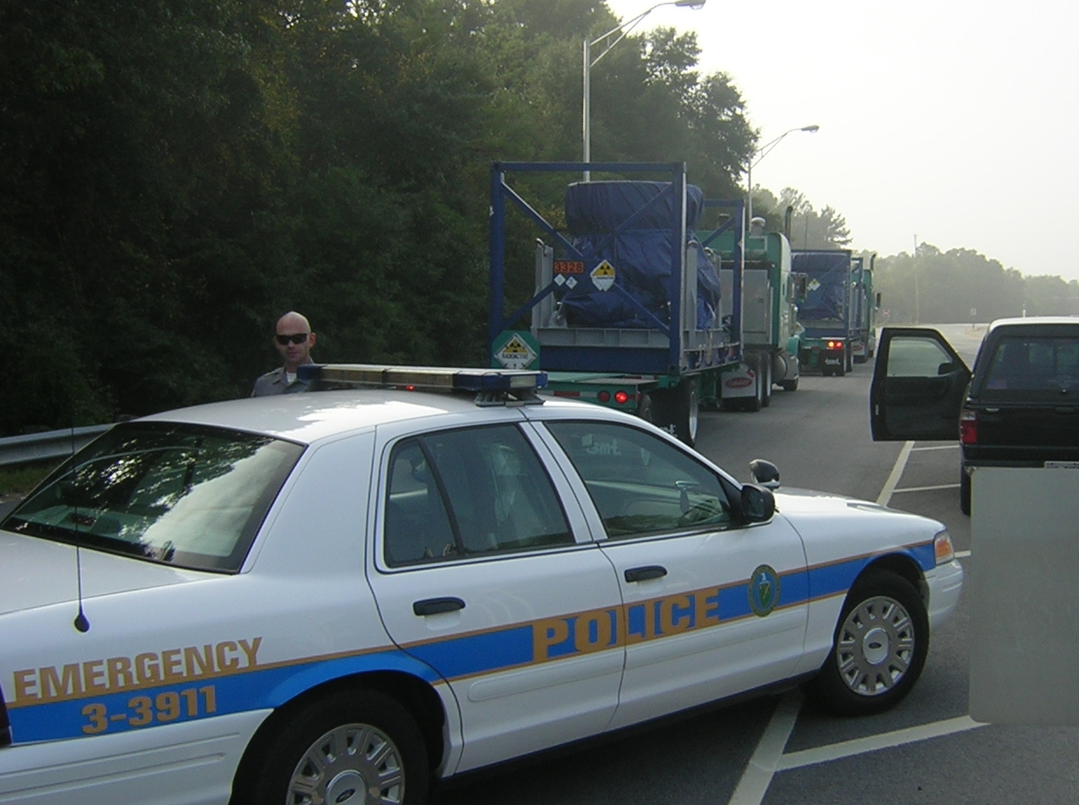
Road Transport

Slide 54
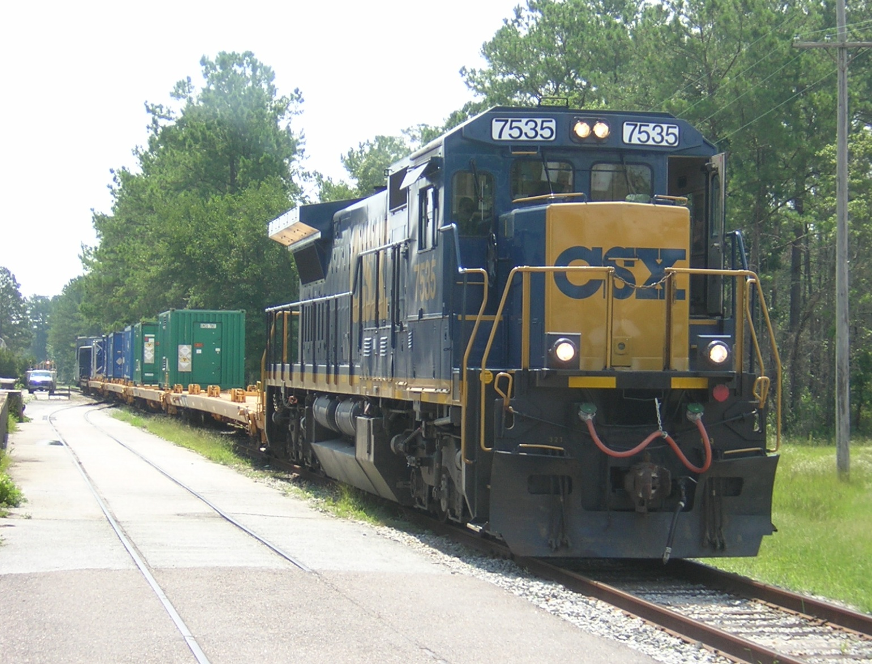
Rail Transport

Slide 55
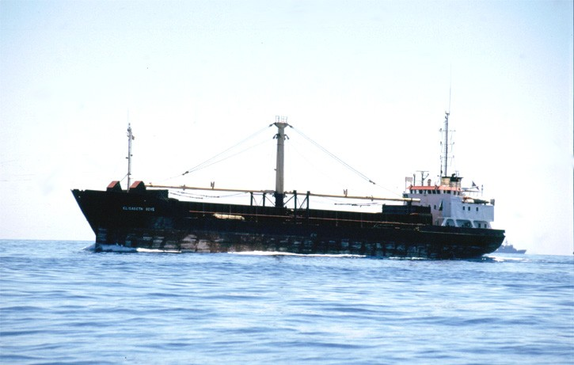
Ocean Transport

Slide 56
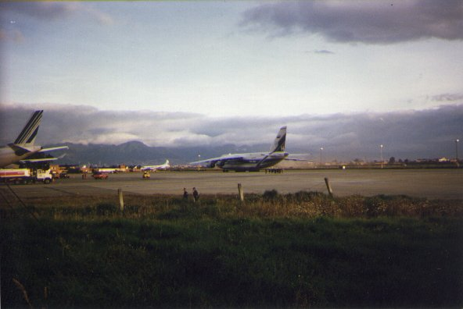
Air Transport

Slide 57
Packaging
    Transport of nuclear materials has been carried out safely and routinely for over five decades, and during this period there has never been a transport incident in which a package with highly radioactive materials has been breached or has leaked.
    The principal assurance of safety in the transport of nuclear materials is the design of the packaging. Many different packaging standards have been developed according to the potential hazard posed by the materials being transported.
    For example, ordinary industrial packages (IP) are used for low-activity materials such as yellowcake. These are usually metal boxes or metal drums. They are designed to withstand normal conditions of transport.

Slide 58
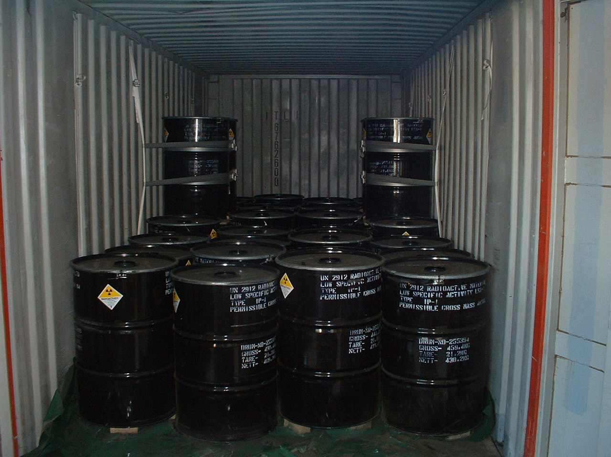
IP Packaging

Slide 59
Type A and Type B Packages
    Type A packages are designed to withstand normal conditions of transport and minor accidents and are used for medium-activity materials such as medical or industrial radioisotopes -- materials that would not result in significant health effects if they were released.
    Type B packages are designed for high activity materials (spent fuel) and must be able to survive severe transport accidents. These are very robust and secure packages and they maintain shielding from gamma and neutron radiation even under extreme conditions. Type B packages must have a Certificate of Compliance from the US Nuclear Regulatory Commission or a Certificate of Competent Authority from the US Department of Transportation.

Slide 60
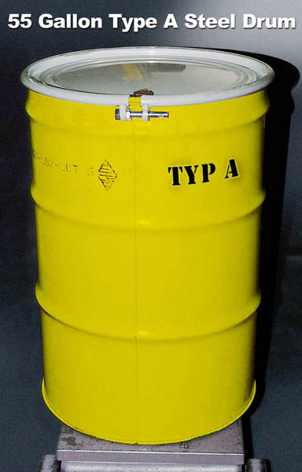
Type A Package

Slide 61
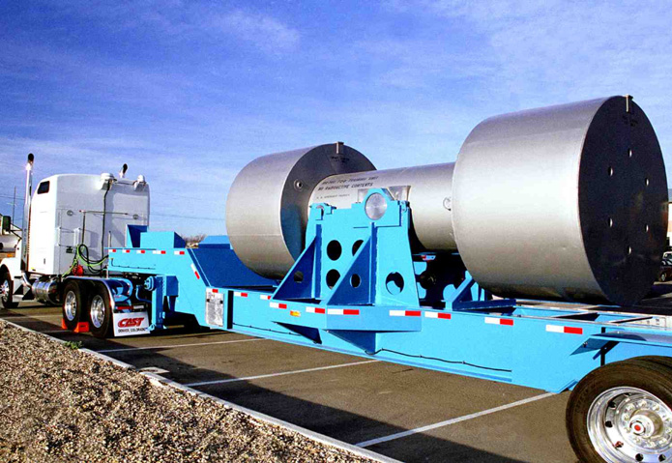
Type B Package

Slide 62
Regulation of Nuclear Transports
    Regulating the safety of radioactive material shipments in the U.S. is the joint responsibility of the U.S. Nuclear Regulatory Commission (NRC) and U.S. Department of Transportation (DOT)
    The NRC generally establishes requirements for the design and manufacture of packages for radioactive materials under Chapter I of Title 10, Energy, of the U.S. Code of Federal Regulations
    The DOT generally regulates the shipments while they are in transit and sets standards for labeling (Title 49, Transportation, of the U.S. Code of Federal Regulations)
    NRC and DOT regulations are based on international regulations issued by the International Atomic Energy Agency (IAEA)

Slide 63
Security of Nuclear Transports
    LSA (low specific activity) material (yellowcake) must follow the same highway and tunnel procedures in the U.S. as other hazardous material. There is no requirement for a special route and there is no requirement to report shipments to the NRC or to state authorities. There is also no escort requirement.
    High Specific Material (spent fuel) shipments via road and rail must follow a NRC pre-approved route. This pre-approval includes information about state and local police agencies, radiological response contacts, safe havens, and security protocols.
    High Specific Material shipments are escorted entirely by armed guards, normally provided by state agencies. The numbers and methods of armed escorts is Safeguards information, but minimums are dictated in NRC regulations and guidelines. The use of armed escorts is a federal requirement, not a state requirement, although states provide most of the services.

Slide 64

1666 Connecticut Avenue, NW
Suite 201
Washington, DC 20009
USA
Tel: (202) 483-4959 Fax: (202) 483-4840
www.edlow.com

