Slide 1
Nuclear Science Teacher Workshop
Welcome
May 19, 2018 Atlanta, Georgia

Slide 2
Safety & Schedule
Take a Minute:
Who to call
Where to go
9-9:25 | Welcome (Media Center)
9:30-10:25 | Breakout 1
10:30-11:25 | Breakout 2
11:25-12:30 | Lunch & Academic Fair (Cafeteria)
12:30-1:25 | Breakout 3
1:30-2:25 | Breakout 4
2:30-3pm | Concluding Remarks (Media Center)

Slide 3
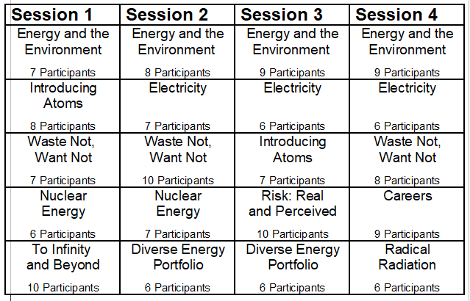
Breakout Sessions

Slide 4
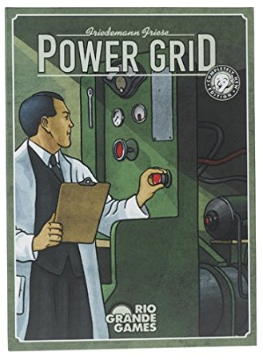
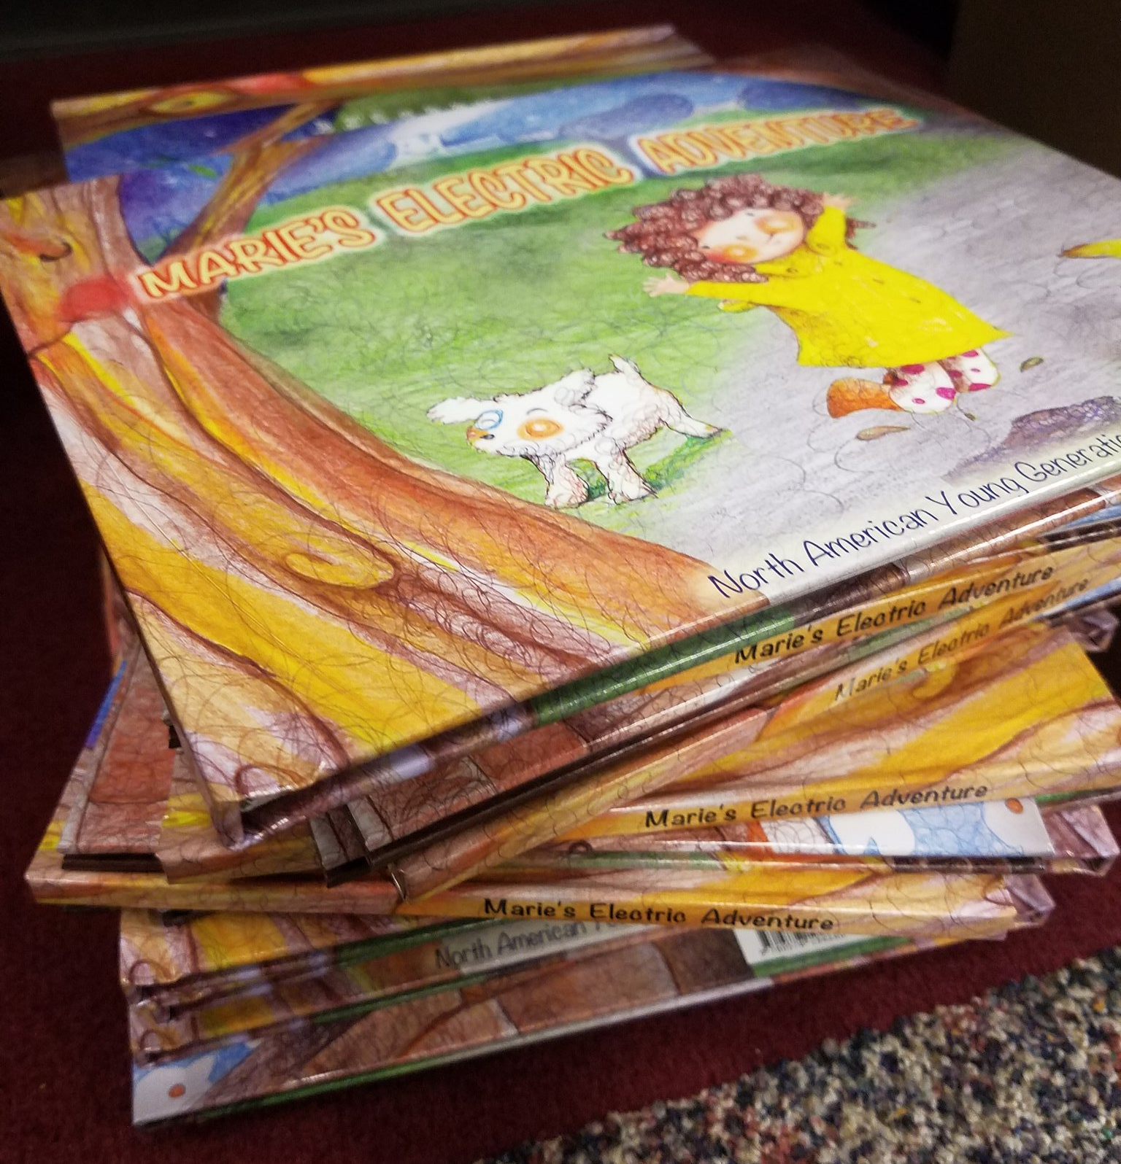
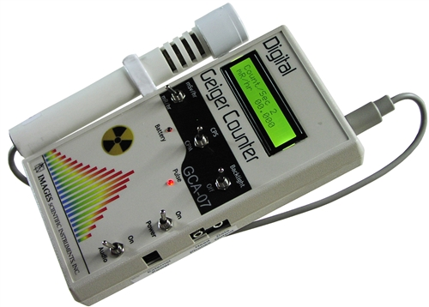
Prizes!
Write your cell phone number on the raffle tickets
Throughout the day, use the tickets for a chance to win various “Grand Prizes”

Slide 5
North American Young Generation in Nuclear
NAYGN provides opportunities for a young generation of nuclear enthusiasts to develop leadership and professional skills, create life-long connections, engage and inform the public, and inspire today’s nuclear technology professionals to meet the challenges of the 21st century.
Notes:
Who are we, why are we here
Thank the volunteers
From a variety of backgrounds
In town for the conference
Travelled from all over: Arizona to Carolinas and even from the UAE
All passionate about the nuclear industry. Ask them about their background and why they got into the nuclear industry.

Slide 6
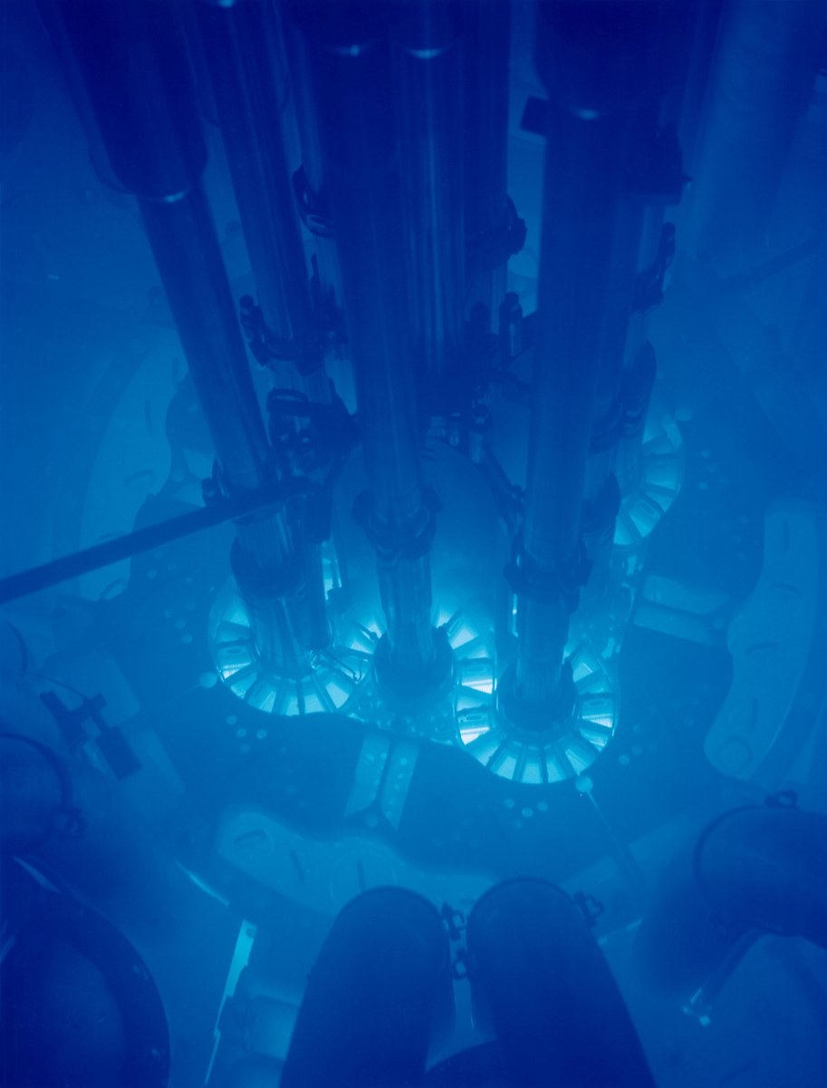
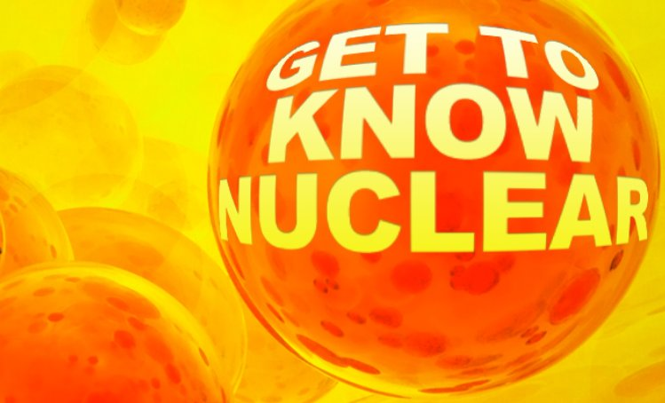
Notes:
We’re here today to learn more about nuclear science. A lot of the lessons focus on nuclear energy.
You’ll learn about nuclear reactors which harness the power of the atom to generate heat (much like conventional forms of energy such as coal)
to make steam which turns a turbine, which cranks a generator (just like your handcrank generators) which makes electricity
I got into nuclear science mostly after learning about Lise Meitner (my personal hero)

Slide 7
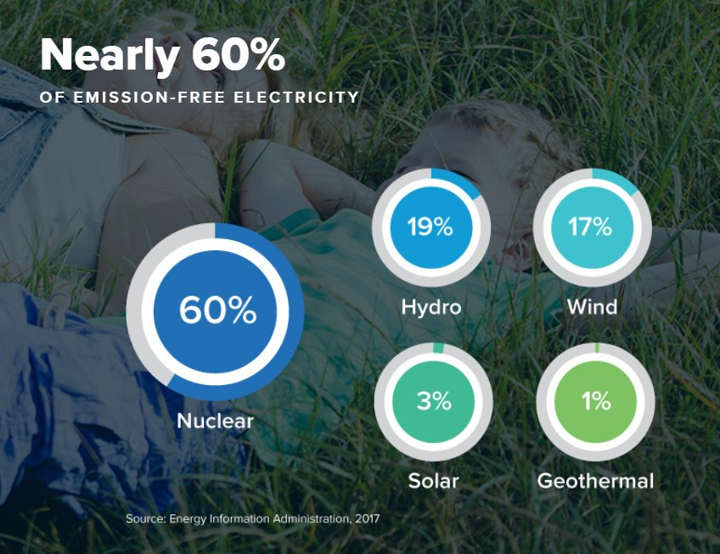
Notes:
I learned more about the need for electricity - it makes our lives pretty great! And what our options were for making electricity.
How do these options affect the environment?
All options have their pros and cons but nuclear fuel has a ton of energy AND is carbon free.

Slide 8
Notes:
Nuclear is also reliable which you’ll learn is very important.
As someone who works for an electric utility, I’ve learned that the average person doesn’t really think much about how they turn their lights on. They just want them on.
It amazes me how many people think electricity is in solar panels or in the wires in their house! It’s not! It needs to be made and immediately used.
If not, it needs to be stored and then you lose quite a bit of it through conversion.
Which reminds me that our instructors all have a similar mindset and language.

Slide 9
Lost in Translation
Outage - planned plant shutdown to refuel the reactor (“busy season”)
NRC - Nuclear Regulatory Commission (government agency that oversees nuclear power plants)
Critical Path - Tasks standing in the way to starting up the reactor
Cycle - a fuel cycle, typically 1-2 years
RP - Radiation Protection (department that plans work to achieve low dose/radiation exposure)
Ops - operations department, manipulate equipment in the plant
Plant=Station (power plant), Unit=Reactor (nuclear reactor core)

Slide 10
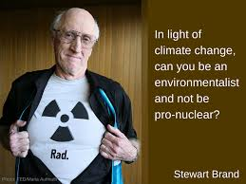
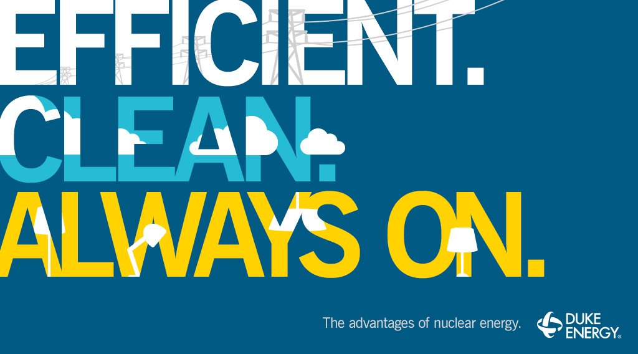
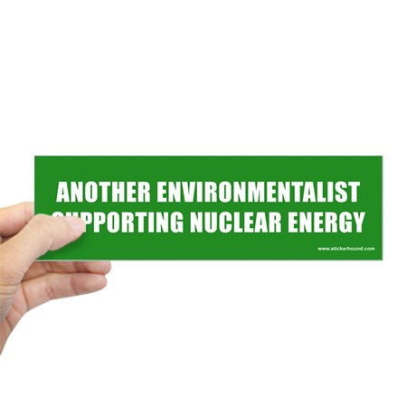
Notes:
As someone who cares about the environment, I wanted to bring life-essential energy to people without greenhouse gases and I think the best way to do that is through nuclear energy.
Now obviously there are multiple ways to solve this problem and it’s important to learn about them all!
I hope you’ll find the topics today as interesting as I do. There are a lot of sessions on energy, electricity, generation types, and the environment.
But, you’ll also learn about other cool applications of nuclear technology.
Ask questions, be curious, and have fun! There are a lot of activities to try out.

Slide 11
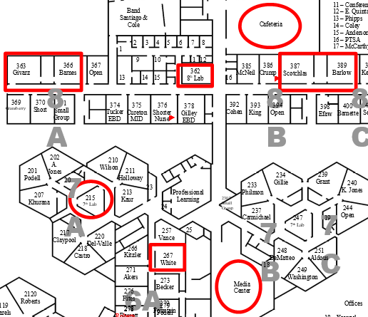
Breakout Session 1
267 Introducing Atoms & Nuclear Reactions
362 Energy and the Environment
389 Nuclear Energy
366 To Infinity & Beyond
363 Waste Not, Want Not
Academic Fair: 11:25 am
in the Cafeteria
Concluding Remarks: 2:30 pm
Media Center

Slide 13
Nuclear Science Teacher Workshop
Closing Remarks
May 19, 2018 Atlanta, Georgia
Notes:
Let’s Review!

Slide 14
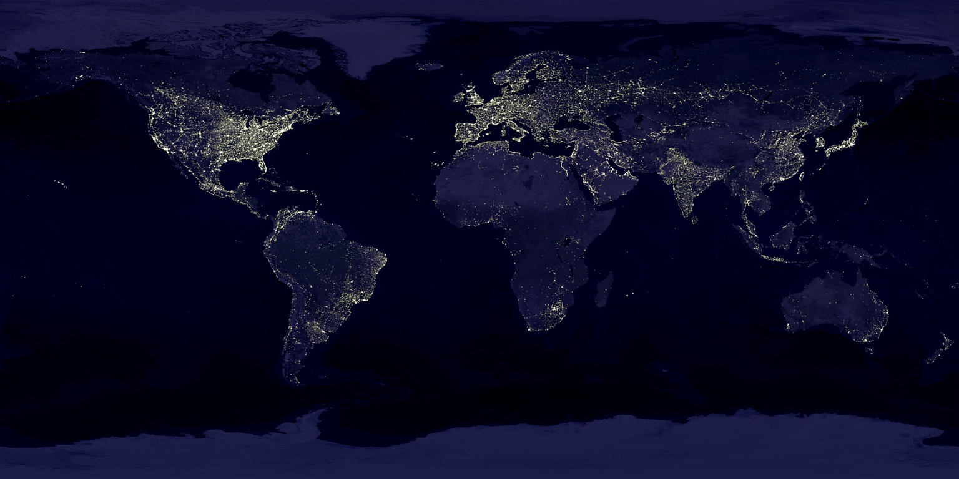
Let’s Review
Notes:
We spent a lot of the day focused on electricity - how important is it? what would life be like without it?
How is your life different because you live in one of the lit places on the map?

Slide 15
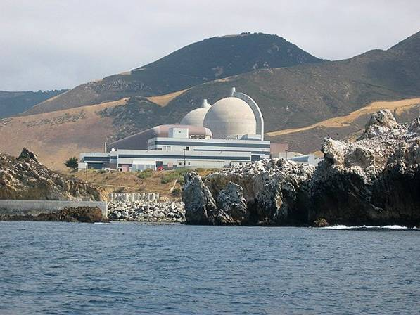
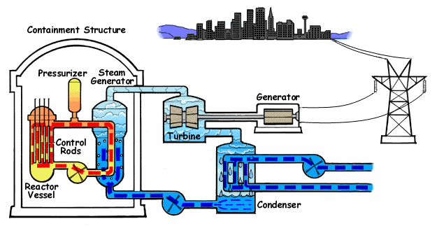
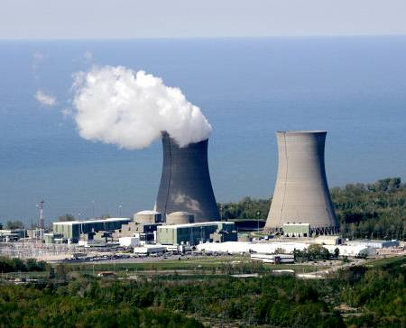
Nuclear Power Plant
Notes:
In nuclear energy, you learned that nuclear plants are similar to other types of power plants - the heat source is just different!
Also, you learned that the ’smoke’ is JUST STEAM. Nuclear plants are clean - they don’t release carbon or emissions into the atmosphere

Slide 16
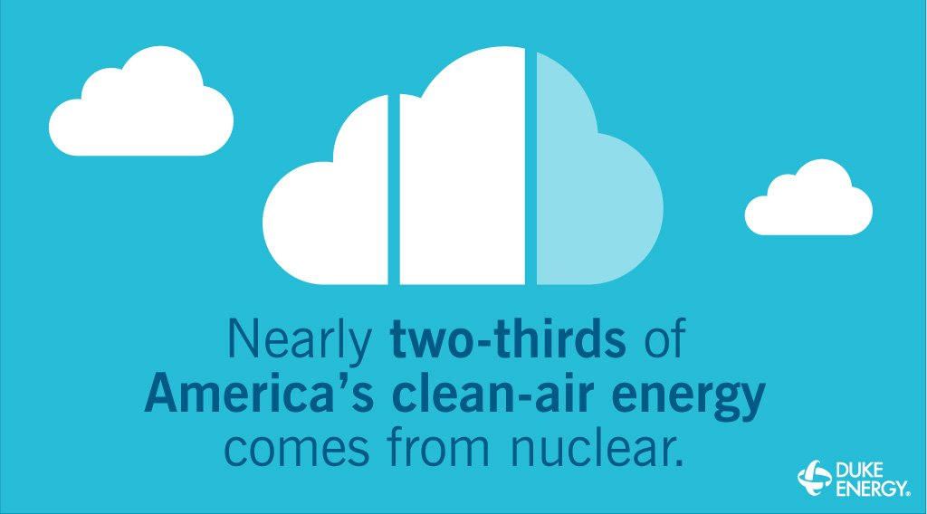
Energy and the Environment
Notes:
In energy and the environment, you learned about the realities of climate change and the importance of using clean energy.
Electricity generation is a huge contributor of greenhouse gases. With the anticipated shift from gasoline to electric vehicles, the type of technology used to make electricity will become very very important.

Slide 17
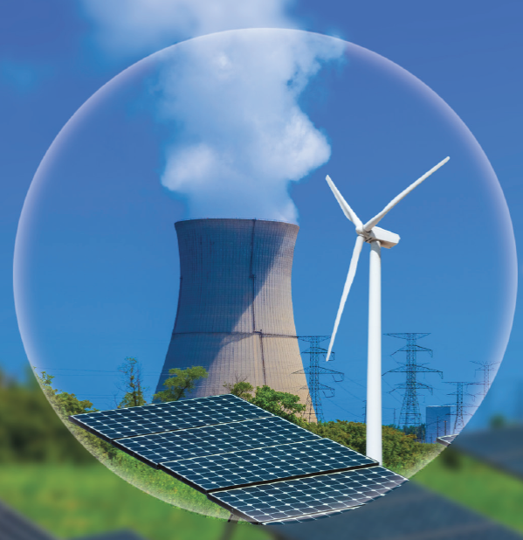
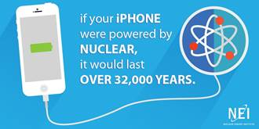
A Diverse Energy Portfolio
Notes:
All energy types have advantages and disadvantages but the need for clean sources of energy is vital: wind, solar, and nuclear are all clean, green, carbon-free energy sources.
Nuclear is unique because it is always on AND it has a huge energy density! One nuclear fuel pellet the size of a tootsie roll has the same amount of energy as 150 gallons of oil.

Slide 18
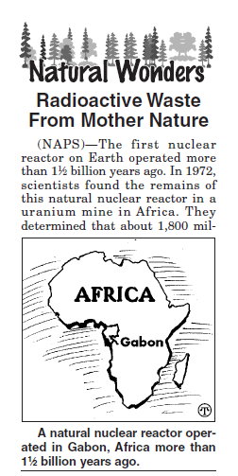
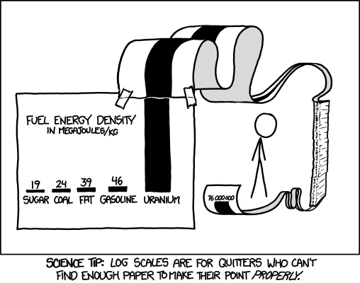
Notes:
In nuclear waste (or spent nuclear fuel as we in the industry like to say), you learned that because uranium has such a high energy density there actually isn’t very much volume associated with the waste.
We also talked about how nuclear waste is a solid (not a glowing green goo)
One fun fact I like to share is that mother nature has actually been “storing” nuclear waste for 1.8 billion years!
What?! In Africa, there was a “natural reactor” - the right mix of Uranium and water to create a fission chain reaction. The reactor would periodically go critical when conditions were exactly right.
The “fuel” for this reactor remained where it was, deep underground for over a billion years!

Slide 19
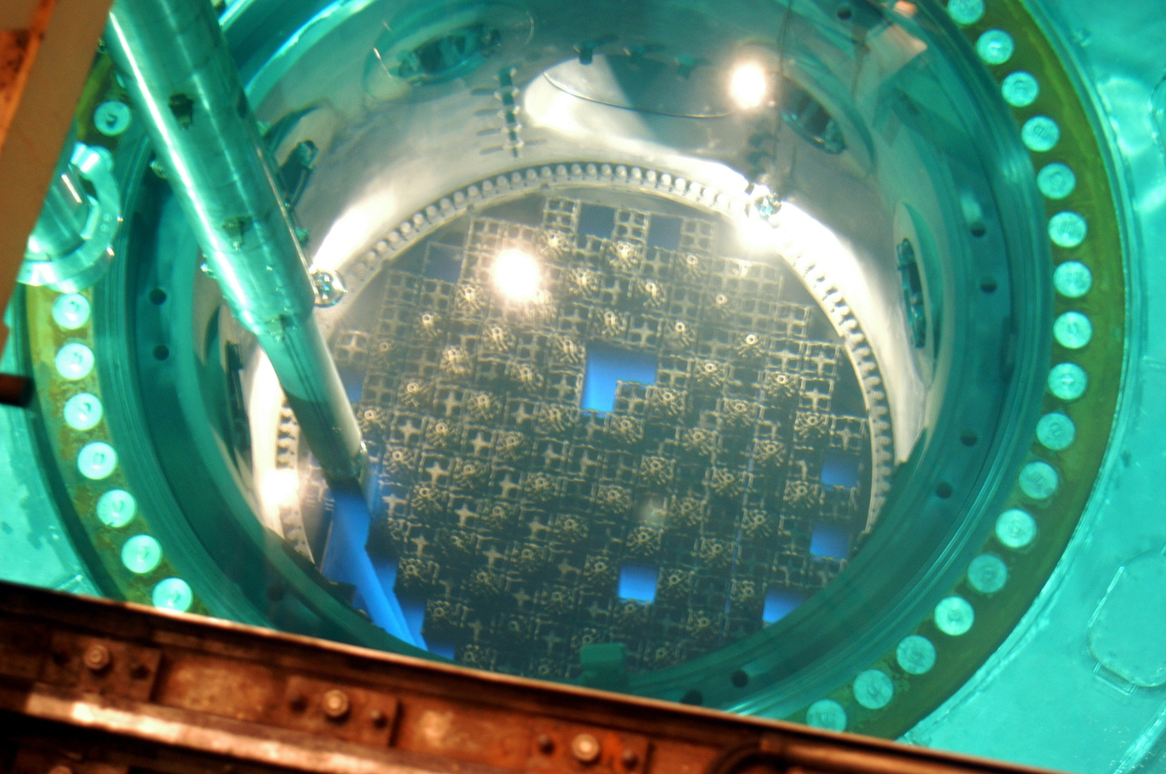
Careers in Nuclear
Notes:
Nuclear technology professionals come from a variety of backgrounds from technicians, trade and craft workers, to every type of engineer or researcher.

Slide 20
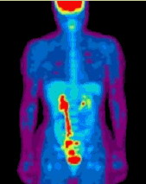
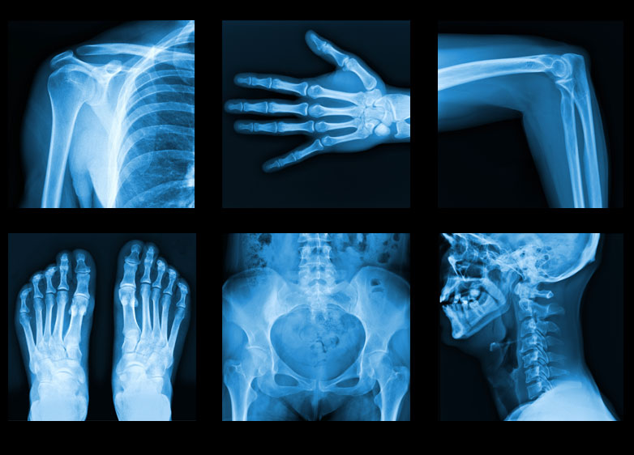
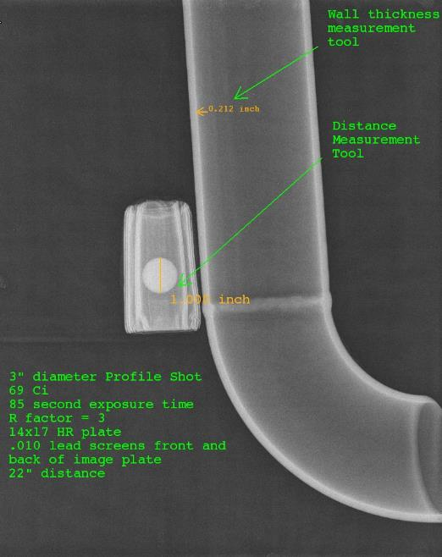
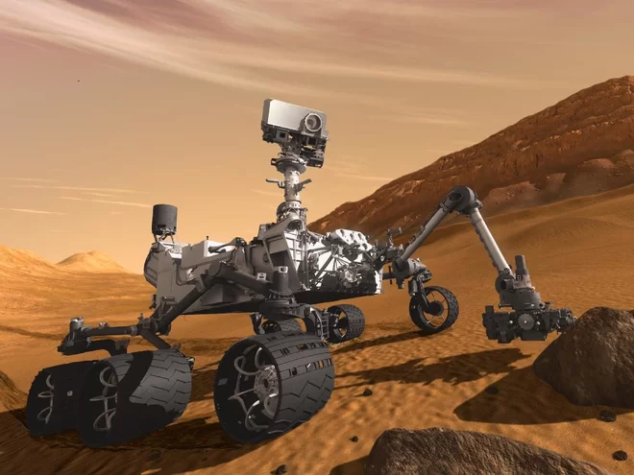
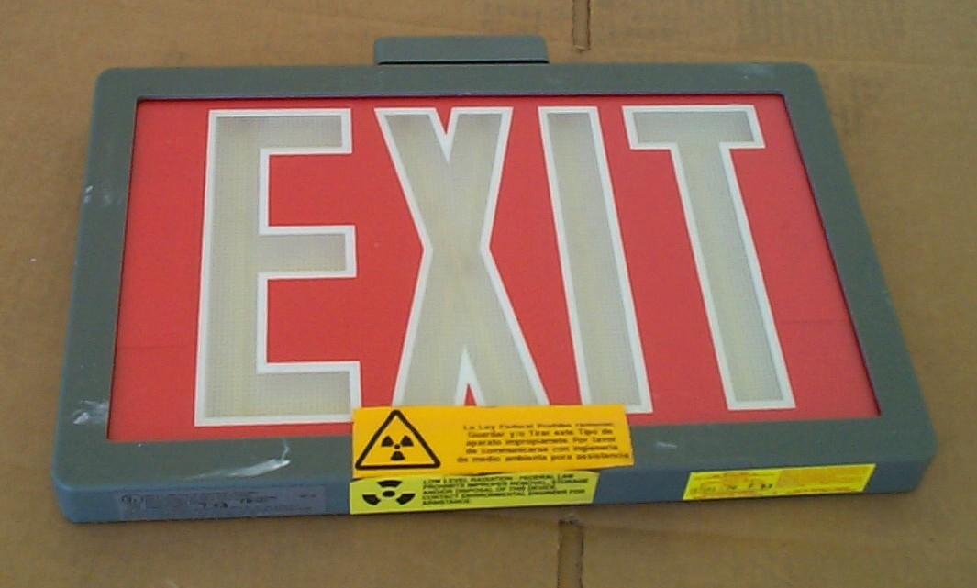
Notes:
You can even be interested in medicine - some nuclear engineers go on to become doctors or radiological technicians diagnosing diseases using nuclear science.
Nuclear technology has many applications from everyday objects like exit signs and smoke detectors, to the Mars rover or even identifying the age of a fossil through carbon dating.

Slide 21
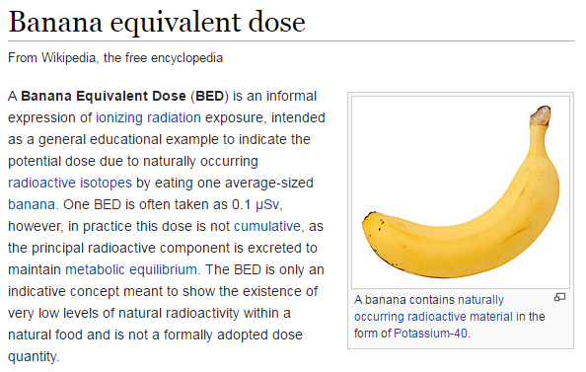
Radical Radiation
Notes:
In radical radiation, you learned that we live in a radioactive world. Radiation is all around us! It’s bananas!
(which are a radioactive food). If you’re really nerdy, you can put all radiation in terms of how many bananas you eat.

Slide 22
Introducing Atoms
Notes:
In addition to reviewing the components of an atom: electrons, protons, neutrons, we learned about three types of nuclear reactions: alpha, beta, and gamma emission (or radioactive decay) and how to solve for unknown products or reactants in a nuclear reaction.

Slide 23
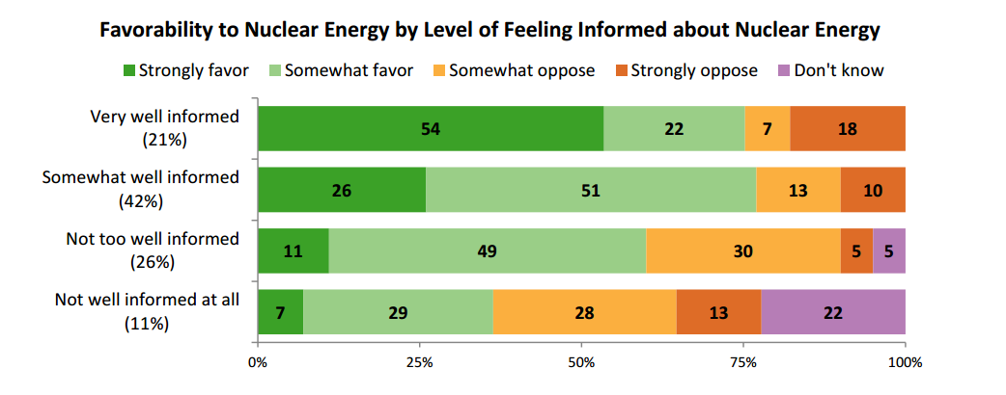
Risk: Real and Perceived
Notes:
The more you know about a topic, the more accurately you can assess the true risk of that activity or technology.
The more people become familiar and comfortable with nuclear technology, the more view it favorably and see it as a solution

Slide 24
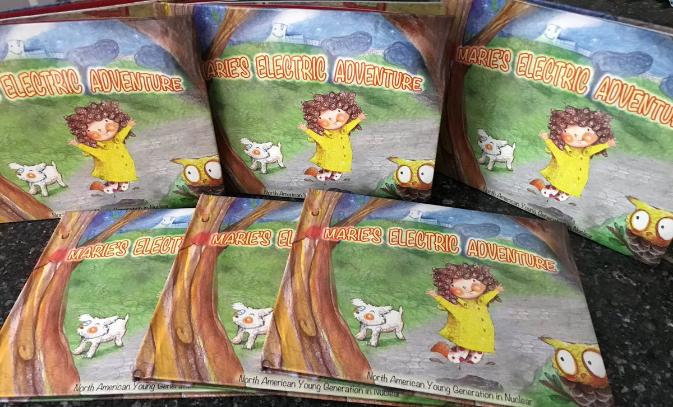
Resources:
naygn.org
Prizes
Attendance
certificate
Meet to discuss
plant tour

Slide 26
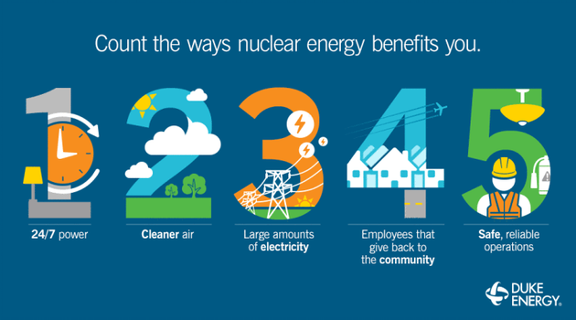
Notes:
Nuclear energy has some key benefits:
Electricity is hard to store and we use it all the time so it’s good that nuclear power plants have a capacity factor over 90% (the highest of any energy source)
Nuclear power plants do not give off emissions such as particulate matter or greenhouse gases. The ‘smoke’ you see coming out of a nuclear cooling tower is actually just normal, clean water.
Nuclear power has a very high energy density.
Nuclear energy is a bit unique because these power plants are often in rural areas and provide very high paying jobs. The fuel cost is low. Most of the expense of a nuclear plant is the nuclear workers (operations and maintenance) which means the money stays in the local community (more so than other fuel types especially natural gas).
Nuclear power is very safe. It is the safest form of electricity generation.

Slide 27
