Slide 1
Nuclear Science Teacher Workshop
Introducing Atoms and Nuclear Reactions
Learn about atomic structure and nuclear reactions including fission, fusion, and radioactive decay. Atoms are the building blocks of matter and consist of neutrons, protons, and electrons. Learn about isotopes and why some isotopes are not stable. Instruction will be provided for activities that allow students to explore these concepts.
May 19, 2018 Atlanta, Georgia

Slide 2
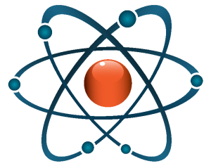
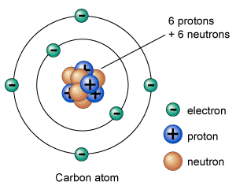
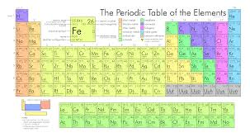
Never trust an atom: they make up everything
Notes:
Atoms are the building blocks of matter. They make up everything around us.
Atoms are EXTREMELY TINY. How many atoms can fit on the head of a pin? 5 million million!!! (depending on the size of the atom) This is the number of grains of sand that would fit in a refrigerator.
There are about 100 different types of atoms (118 to be exact) and these are listed in the Periodic Table.
Atoms have different properties. Can you name an element (or type of atom)?

Slide 3
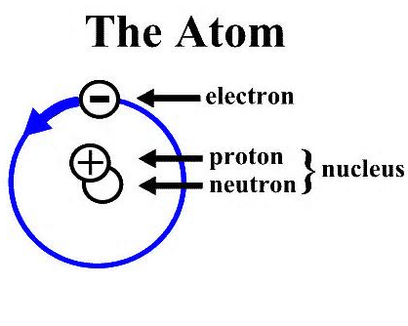
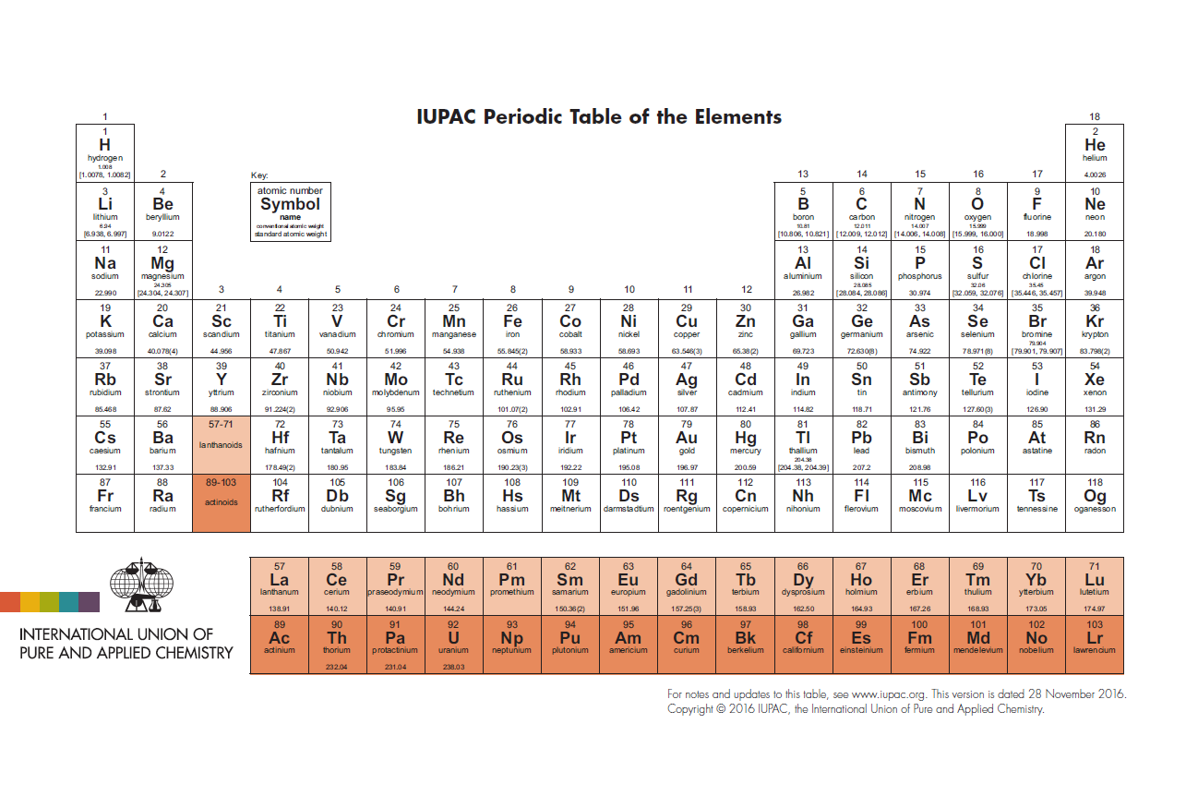
Protons, neutrons, and electrons
Mass of Subatomic Particles
Proton: 1 amu
Neutron: 1 amu
Electron: .000549 amu
What is an AMU??? 3.67 *10-27 pounds
(that’s 0.00000000000000000000000000367 pounds)
Notes:
The number of protons in an atom determines what element the atom is.
The nucleus is made up protons and neutrons. The electrons orbit the nucleus.
Electrons are much smaller. Atoms are mostly empty space!
Protons = positive charge. Electrons = negative charge.

Slide 4
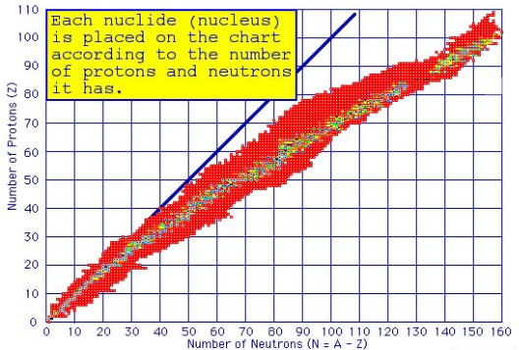
Isotopes
Explore the chart of the nuclides
Notes:
Isotopes are similar elements with different numbers of neutrons
Isotopes can be stable or unstable (or radioactive) isotopes
Brookhaven National Lab has an interactive chart of nuclides.
Enter the atomic symbol, dash, atomic mass (ex// U-235) to learn information about decay modes and half lives.

Slide 5
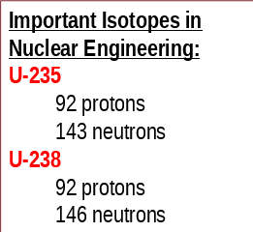
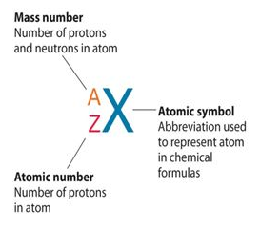
Isotopes
Sodium – 23
11 protons, 12 neutrons
Very plentiful, in salt that you eat (NaCl)
Sodium – 24
11 protons, 13 neutrons
Not natural
Highly radioactive, beta decay
Used to find leaks in industrial pipes
Notes:
Isotopes can have very different characteristics from each other.
Sodium (chemical symbol Na) has 11 protons. It can have either 12 or 13 neutrons. The two different isotopes have very different properties.
Fun fact: salt substitute is made of potassium chloride. The potassium makes salt substitute radioactive (in the same way a banana is radioactive) and this can be seen by using a Geiger counter.
The ratio of Uranium 235 (fissile) to all isotopes of Uranium (mostly U-238 which is fissionable) is the enrichment of the nuclear fuel.
Uranium is naturally 0.7% U-235. Nuclear fuel is 3-5% U-235. It is very very difficult to enrich Uranium highly enough (>95%) to make a nuclear weapon.

Slide 6
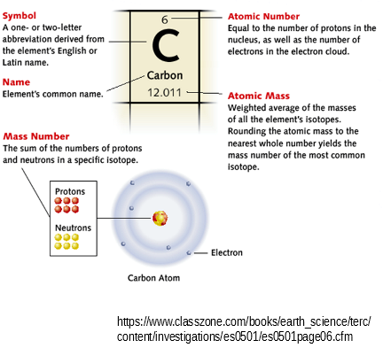
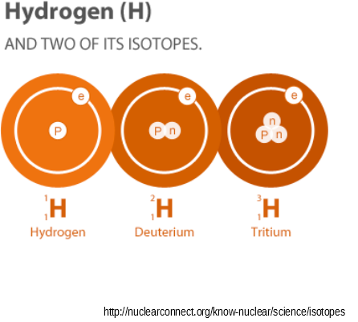
Notes:
The atomic number (or number of protons) defines the element
Elements have various isotopes which differ in their number of neutrons
Nuclide is another term used to define isotopes when speaking specifically about the nucleus
Radioactive isotopes have an unstable nucleus and decay until stability is reached
Need more? https://www.youtube.com/watch?v=lUhJL7o6_cA

Slide 7
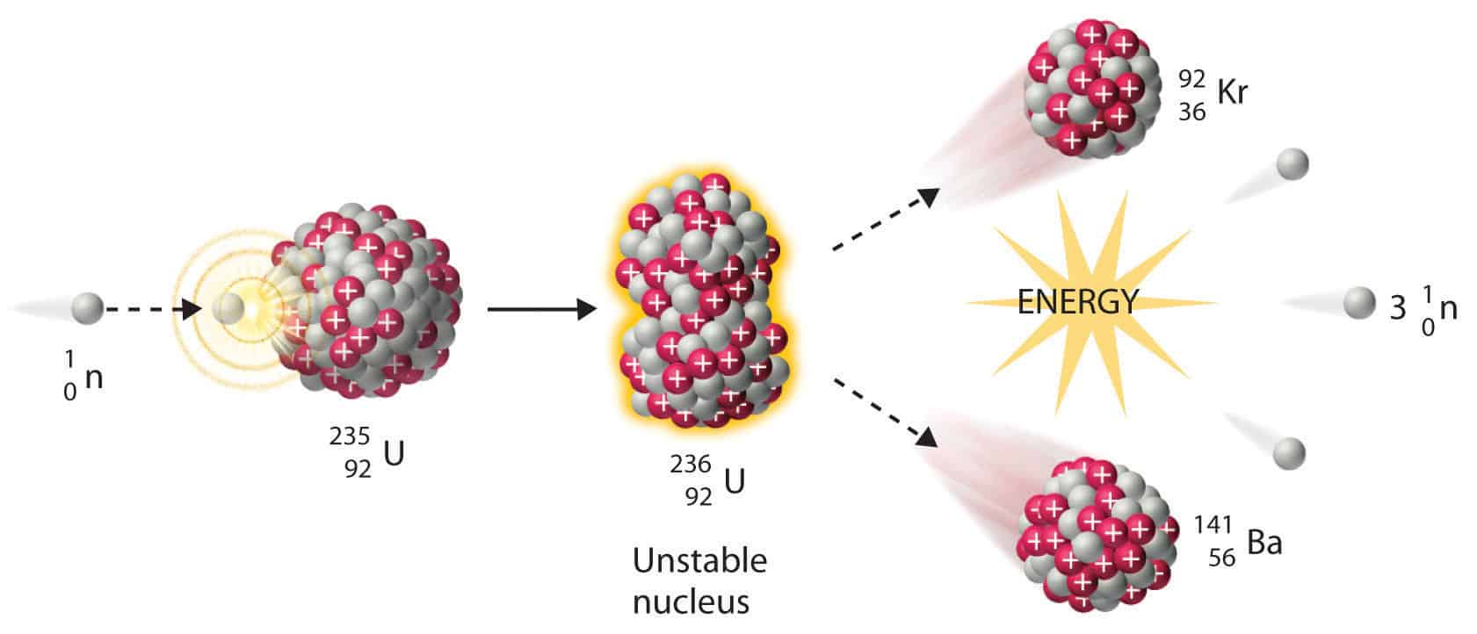
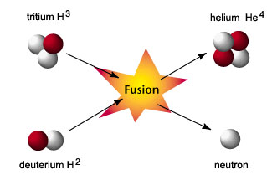
Isotopes, Reactions, and Nuclear Energy
Fission
Breaking apart of Heavy Nuclei
Example:
n + U-235 ⇒ Ba-139 + Kr-94 + 3n
Fusion
Combination of Light Nuclei
Example:
H-3 + H-2⇒ n + He-4
Tritium + Deuterium ⇒ neutron + Helium
Notes:
Fission: Makes 20% of our electricity in the U.S.
Nuclear Power plants use fission to generate heat
Fusion: Powers the Sun
Hard to get on Earth – we’re working on it!

Slide 8





Nuclear Reactions
1
?
2
?
3
?
4
-1
?
5
?
Notes:
1 - neutron absorption: Note how the mass number changes but the atomic number remains the same
2 - alpha emission: Uranium discharges an alpha particle weighing 4 amu. The alpha particle has 2 protons.
3 - beta decay: a beta particle is an electron (essentially zero amu weight and a charge of -1)
4 - positron emission: a positron is an “antiparticle” (antimatter). It is essentially weightless (like an electron) but has a positive charge
5 - gamma decay: a photon is weightless and chargeless but has energy

Slide 9
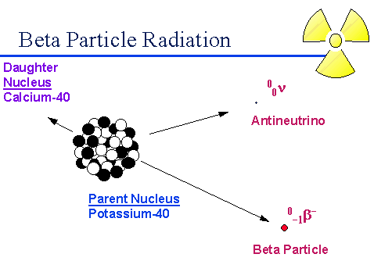
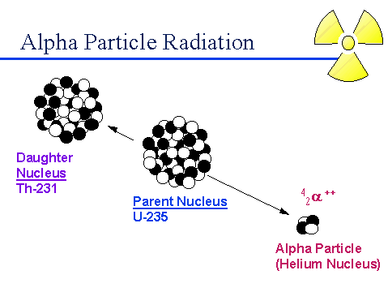
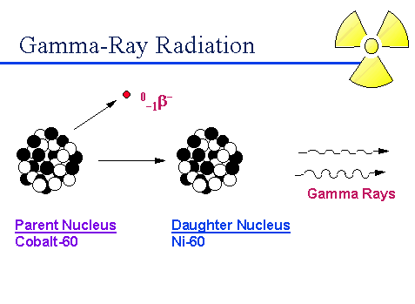
Notes:
illustrations for what we just talked about (for your reference)

Slide 10
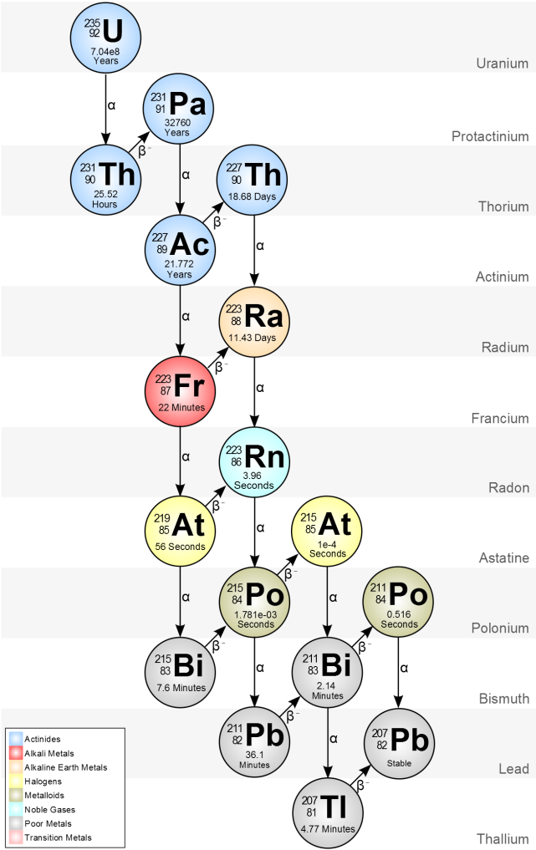
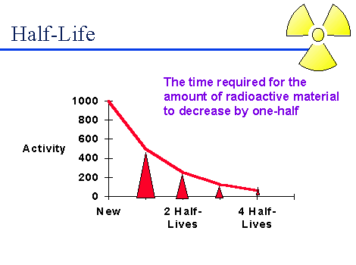
Radioactivity
Notes:
All nuclides have a particular half life ranging from very long to very short.
Whether a radioactive isotope decays is a statistical process.

Slide 11

In Class Activity: Build Model Atoms
For K-5 grade:
Hydrogen: ¹H
1 Proton, 1 electron
Deuterium : ²H
1 Proton, 1 neutron, 1 electron
Tritium: ³H
1 Proton, 2 neutrons, 1 electron
Helium: ⁴He
2 Protons, 2 neutrons, 2 electron
What are the atomic and mass numbers of each isotope?
What are the net charges?
Middle & High School:
Board game Critical Path

Slide 12
Education Standards
Second Grade
Georgia State Standards
S2P1 Obtain, evaluate, and communicate information about the properties of matter and changes that occur in objects.
b. Construct an explanation for how structures made from small pieces (linking cubes, building blocks) can be disassembled and then rearranged to make new and different structures.
Activity: assemble basic atoms with Styrofoam balls and toothpicks
alternate: pompoms of different sizes and a pipe cleaner to represent the boundary of the nucleus

Slide 13
Education Standards
Third Grade
Georgia State Standards
S3P1 Obtain, evaluate, and communicate information about the ways heat energy is transferred and measured.
a. Ask questions to identify sources of heat energy. (Clarification statement: Examples could include sunlight, friction, and burning.)
b. Plan and carry out an investigation to gather data using thermometers to produce tables and charts that illustrate the effect of sunlight on various objects. (Clarification statement: The use of both Fahrenheit and Celsius temperature scales is expected.)
c. Use tools and every day materials to design and construct a device/structure that will increase/decrease the warming effects of sunlight on various materials. (Clarification statement: Conduction, convection, and radiation are taught in upper grades.)
Activity: Assemble basic atoms. Temperature is a measure of how fast atoms are moving.

Slide 14
Education Standards
Eighth Grade
Georgia State Standards
S8P1 Obtain, evaluate, and communicate information about the structure and properties of matter.
e. Develop models (e.g., atomic-level models, including drawings, and computer representations) by analyzing patterns within the periodic table that illustrate the structure, composition, and characteristics of atoms (protons, neutrons, and electrons) and simple molecules
Activity: Use the game Critical Path to explore the chart of the nuclides to learn about isotopes.

Slide 15
Education Standards
Physical Science
Georgia State Standards
SPS4 Obtain, evaluate, and communicate information to explain the changes in nuclear structure as a result of fission, fusion, and radioactive decay.
a. Develop a model that illustrates how the nucleus changes as a result of fission and fusion.
b. Use mathematics and computational thinking to explain the process of half-life as it relates to radioactive decay. (Clarification statement: Limited to calculations that include whole half-lives.)
c. Construct arguments based on evidence about the applications, benefits, and problems of nuclear energy as an alternative energy source.
Activity: Use the game Critical Path to understand isotopes have unique characteristic half-lives. Radioactive decay is a statistical process.

Slide 16
Education Standards
Chemistry
Georgia State Standards
SSC1 Obtain, evaluate, and communicate information about the use of the modern atomic theory and periodic law to explain the characteristics of atoms and elements.
d. Construct an explanation that relates the relative abundance of isotopes of a particular element to the atomic mass of the element.
Activity: Use the game Critical Path to understand isotopes and their properties.

Slide 17
Education Standards
Chemistry
Georgia State Standards
SP6 Obtain, evaluate, and communicate information about nuclear changes of matter and related technological applications.
a. Develop and use models to explain, compare, and contrast nuclear processes including radioactive decay, fission, and fusion.
b. Construct an argument to compare and contrast mechanisms and characteristics of radioactive decay.
Activity: Fission can be modeled using a mouse trap chain reaction.
The probabilistic nature of radioactive decay can be modeled with M&M half life

Slide 18
Education Standards
Second Grade
Next Generation Science Standards
2-PS1-3 Make observations to construct an evidence-based account of how an object made of a small set of pieces can be disassembled and made into a new object.
Middle School
Next Generation Science Standards
MS-PS1-5 Develop and use a model to describe how the total number of atoms does not change in a chemical reaction and thus mass is conserved.
Activity: assemble basic atoms with Styrofoam balls and toothpicks

Slide 19
Education Standards
Physical Science
Next Generation Science Standards
HS-PS1-C Develop models to illustrate the changes in the composition of the nucleus of the atom and the energy released during the processes of fission, fusion, and radioactive decay.
Activity: Fission can be modeled using Styrofoam balls.
Calculate the energy released during fission/fusion with E=mc²

Slide 20
Education Standards
Earth and Space Sciences
Next Generation Science Standards
(HS-ESS1-2),(HS-ESS1-3) Other than the hydrogen and helium formed at the time of the Big Bang, nuclear fusion within stars produces all atomic nuclei lighter than and including iron, and the process releases electromagnetic energy. Heavier elements are produced when certain massive stars achieve a
supernova stage and explode.
HS-ESS1-2 Construct an explanation of the Big Bang theory based on astronomical evidence of light spectra, motion of distant galaxies, and composition of matter in the universe.
Activity: Use the game Critical Path to explore the chart of nuclides. Learn that the heaviest stable isotope is Pb-208.

Slide 21
Education Standards
Earth and Space Sciences
Next Generation Science Standards
(HS-ESS1-3) In nuclear processes, atoms are not conserved, but the total number of protons plus neutrons is conserved.
HS-ESS1-3 Communicate scientific ideas about the way stars, over their life cycle, produce elements
Activity: Use the game Critical Path to explore the chart of nuclides. Learn that the heaviest stable isotope is Pb-208. Learn what makes isotopes stable.

