Slide 1

2020 July Local Chapter Lead Meeting
Matthew Mairinger, Canadian Operating Officer (Canada@naygn.org) July 16, 2020
Notes:
We’ll start off with Safety.
Please stop and look around your areas for any potential hazards that would affect you leaving your area safely in case of an emergency. If there are any hazards, please take a moment to eliminate them.
If you have to get off the call, I’ll be glad to catch you up at a later time.

Slide 2
Agenda
Metrics
Diversity & Inclusion
Public Information Opportunities
Professional Development Book Club
Staying Active during COVID-19
Open discussion

Slide 3
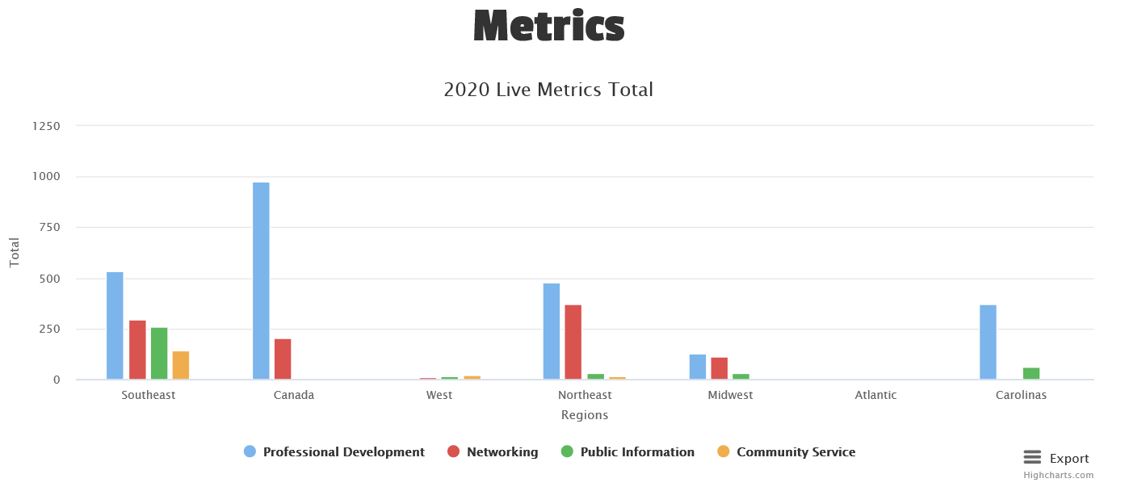
2020 Metrics
https://naygn.org/local-chapters/metrics/
Please submit 2020 metrics as they happen
Any questions/concerns (i.e. if you need to edit a submission, if your chapter doesn’t appear, etc.) email Canada@naygn.org or USA@naygn.org and we will fix it!
Notes:
Here are the current metrics for this year.
Please continue to add your metrics as you complete events throughout the year.
Any questions/concerns, please reach out!

Slide 4
Diversity & Inclusion
Over the past 30 days as an organization we have reflected and begun to take action on how we can do better. We first started by establishing the Diversity and Inclusion Committee. This committee was chartered to review the current state of diversity and inclusion in the NAYGN organization and form actions and initiatives to make NAYGN a more diverse and inclusive environment. Additionally, these initiatives should ultimately help NAYGN to be better in addressing systemic racism in our organization, in the nuclear industry, and in the communities we live.
The committee is currently charting six directions for actions:
Member content to better understand unconscious bias.
Developing/Expanding our partnerships with Women In Nuclear and the National Society of Black Engineers.
Developing strategy and guidance for chapter discussions on social issues.
Understanding the value of diversity in companies/teams.
Strategically using NAYGN’s voice within the industry to advocate for and stress the need of a diverse and inclusive environment.
Developing an outreach program targeting underrepresented groups, educating them about clean nuclear energy and careers.
As we continue to shape actions into NAYGN’s Strategic Plan, we welcome additional members to engage with this committee and help be the example of how we can institute change. We also encourage you to engage in discussions with your chapter and determine how it can become more diverse and inclusive.
Please contact diversity@naygn.org to engage with the D&I Council – we’d be happy to work with you.

Slide 5

PI Webinar
Webinar highlights K-12 outreach
Tuesday, July 21 | 10:00 - 11:30 am EDT
"Inform and Inspire the Next Generation—Part I" spotlights successful K-12 nuclear science initiatives targeting students in the U. S. The first in a series, the webinar explores the development of ANS’s Navigating Nuclear: Energizing Our World™ project.
The webinar is free and open to all. Register now.
The webinar is sponsored by ANS, the Clean Energy Ministerial (CEM) Nuclear Innovation: Clean Energy Future (NICE Future) initiative, the CEM Clean Energy Education and Empowerment (C3E) initiative, and the International Youth Nuclear Congress (IYNC). Learn more.

Slide 6
PI - Virtual STEM Summer Camp
https://nuclear.duke-energy.com/2020/07/10/virtual-stem-summer-camp
There are 5 sessions; 1 each day of the week at 10 am. Sessions last for 45 minutes and include an experiment/activity.
Topics are: nuclear science, environmental science, engineering, electricity, and ice cream (lol)
First webinar is in the next slide

Slide 7
PI - Virtual STEM Summer Camp – first webinar
Celebrate Diversity Within Nuclear!
Event address for attendees: https://naygn.webex.com/naygn/onstage/g.php?MTID=e3315b321252afd13e9beef251cb46c5b
Date and time: Tuesday, August 11, 2020 1:30 pm EST
Duration: 1 hour
Description: Have you ever wondered what it’s like to be a nuclear operator? What about being a transgender nuclear operator?
Join us for a candid discussion with Adrian Chavez about his transition journey while in the nuclear industry workplace.
The first step toward diversity and inclusion is learning about perspectives and experiences different from your own. Learn how you can be more inclusive and a better ally to your coworkers!
Adrian served in the US Navy aboard the USS Theodore Roosevelt as a Nuclear Machinist Mate. In December 2008, he was hired as a Radiation Protection contractor at McGuire Nuclear Station in Charlotte, NC. Adrian was hired as a Duke Energy employee in 2011, and began working in the Operations department at McGuire. Adrian helped to develop Duke Energy's corporate gender transition policy, and was the first person to use it in January of 2014. He and his wife, Silvia, enjoy traveling and spending time with their four-legged baby, a black labmix named Hunter.

Slide 8
Postcard Push Event
Postcard Push planning is starting this month.
This event will take place in October.
Contact governmentoutreach@naygn.org for questions, suggestions, or feedback.
Notes:
Amanda/Chris

Slide 9
Virtual PD Committee
Newest NAYGN committee with the goal of
  To share existing content, develop and/or deliver quality content virtually to our members during the time of COVID-19 where members are not able to gather together for our usual means of professional development. In addition, this committee will serve as a support structure for the committees planning regional conferences – whether in-person or virtual – ready to provide ideas, content, and other support as necessary to deliver quality opportunities for our members.
Committee lead is Joshua Bell and core sponsor is Jenny Gourley.
Email virtualpd@naygn.org

Slide 10
Virtual PD Committee
How you can help.
  Spread the word or join yourself!
  All chapters to consider what events they are conducting that could be more broadly shared for maximum participation. For example, if a chapter is putting on a virtual session - whether technical, soft skills, educational, etc. - could the chapter point of contact share the information with the Virtual PD Committee to more broadly share details (time/date/meeting link/etc.) with other chapters/members?
  If the LCLs or regional leads have ideas, to please share with the committee (virtualpd@naygn.org)

Slide 11
Regional Conference Dates
Atlantic – September/November
  Seeking input from members on survey for topics
Carolinas – October (virtual conference)
Oh, Canada (my home and native land) – Nov 27th (in person)
Midwest – TBD
Northeast – October (virtual conference)
Southeast – November/December (in person)
West – TBD (virtual)

Slide 12
Professional Development Book Club
July PD Book Club – July 21st at 11:00 EST
Book for discussion - “Mistakes Were Made (But Not by Me)”
  Chapters 1-3
Register for the event HERE
Call Information:
Notes:
Our next Professional Development book club discussion will be July 21st
The book for the discussion is “Mistakes were made (But Not By Me)” and we’ll discuss chapters 1-3 on the call.

Slide 13
Professional Development Book Club
August PD Book Club – August 18th at 11:00 EST
Book for discussion - “Mistakes Were Made (But Not by Me)”
Register for the event HERE
Call Information:
Notes:
Our next Professional Development book club discussion will be July 21st
The book for the discussion is “Mistakes were made (But Not By Me)” and we’ll discuss chapters 1-3 on the call.

Slide 14
Keeping your chapters active during COVID-19
Browse the new Advocacy Starter Kit
Share existing Resources: Take a second to share some of the below:
  Public information library: includes teacher workshop presentations ready for teachers to incorporate into their lesson plans.
  High school curriculum
  Middle school curriculum
  Virtual field trip of a nuclear power plant
  Virtual field trip of a national laboratory
Marie’s Electric Adventure: activity guide with science experiments and a free e- book on itunes including audio
George’s Energy Adventure: activity guide including coloring pages, a free e-book on itunes, and hard copies available via Amazon.
Notes:
We wanted to continue to keep these links available to you all as options to keep your organizations active during these times
These public outreach resources are great for those doing virtual summer camps and summer school

Slide 15
Keeping your chapters active during COVID-19
We are soliciting ideas for 5 minute ‘nuclear talk’ videos to distribute on our social media platforms.
  If you have ideas or would be open to filming a video on a topic –nuclear, chapter or PD related email pd@naygn.org
Houseparty! – host virtual “social events” with your members.
Virtual Lunch and Learns – the majority of our members are working from home. Host a lunch and learn to learn more about the communication tools that are being used and how to effectively use them.
Host Virtual Trivia Set up a virtual trivia night using Kahoot! (a game-based learning platform).
Notes:
These are some way to stay connected with your members with virtual networking events

Slide 16
Keeping your chapters active during COVID-19
Classroom Visits: These are still possible! Connect with a teacher for a VIRTUAL classroom visit (remember – teachers are being asked to very rapidly move their curriculum to a virtual environment and I’m sure most would love a guest lecture). Some schools are using Zoom, Google Classroom, or other platforms so be prepared to be flexible and learn something new!
Host a Virtual Hackathon Present a dynamic problem during a virtual classroom visit. Encourage collaborative problem solving (“hackathon” or “design-sprint”) as the students research a solution!
Make a 2 Minute Informative Video We are looking for more digital content to post on our social media platforms. Take a simple phone video of you explaining a nuclear topic in 2 minutes or less and we will post it!
Call Your Representatives: In lieu of Hill Day, NAYGN members are encouraged to call their elected officials for a quick chat about the importance of clean, reliable nuclear energy. Especially at a time like this! Nuclear energy is bringing you 20% of all the Netflix you are watching!
Notes:
These are great ideas to utilize social media to continue to advocate for nuclear

Slide 17
Keeping your chapters active during COVID-19
Go Live! Consider Live Streaming a science experiment or reading a STEM children’s book. If you are interested in reaching a wider audience, contact communications@naygn.org for an opportunity to get set up on the NAYGN Facebook, Instagram, Twitter, or LinkedIn accounts.
Tell Your Story: Using the template, consider posting what makes you proud to work in nuclear, especially now with #Proud2BeNuclear
Take Advocacy Digital: Take a few minutes to check out ongoing initiatives with our partner organizations and see if you can help! Generation Atomic & Nuclear Matters are good places to start!
Notes:
These are great ideas to utilize social media to continue to advocate for nuclear

Slide 18
Questions?
What would you like to see discussed on future LCL calls?
Notes:
I do have one question for the group. Did you all receive NAYGN newsletter that was sent yesterday or recently? If not, please respond in the chat box let me know or our communications officer, Paul at communications@naygn.org. We want to make sure that the NAYGN information is reaching all members!
Before we turn it over to our president, Amber, I want to open it up for any questions or comments that you may have.
Ok, over to you Amber.

