Slide 1

2020 June Local Chapter Lead Meeting
Ashley Lawrence, US Operating Officer (USA@naygn.org)
June 18, 2020
Notes:
We’ll start off with Safety.
Please stop and look around your areas for any potential hazards that would affect you leaving your area safely in case of an emergency. If there are any hazards, please take a moment to eliminate them.
If you have to get off the call, I’ll be glad to catch you up at a later time.

Slide 2
Agenda
Metrics
2020 Q2 Excellence Awards
May LCL Symposium summary
NAYGN Committee Opportunities
Career Report
Public Information Opportunities
Professional Development Book Club
Staying Active during COVID-19
Open discussion

Slide 3
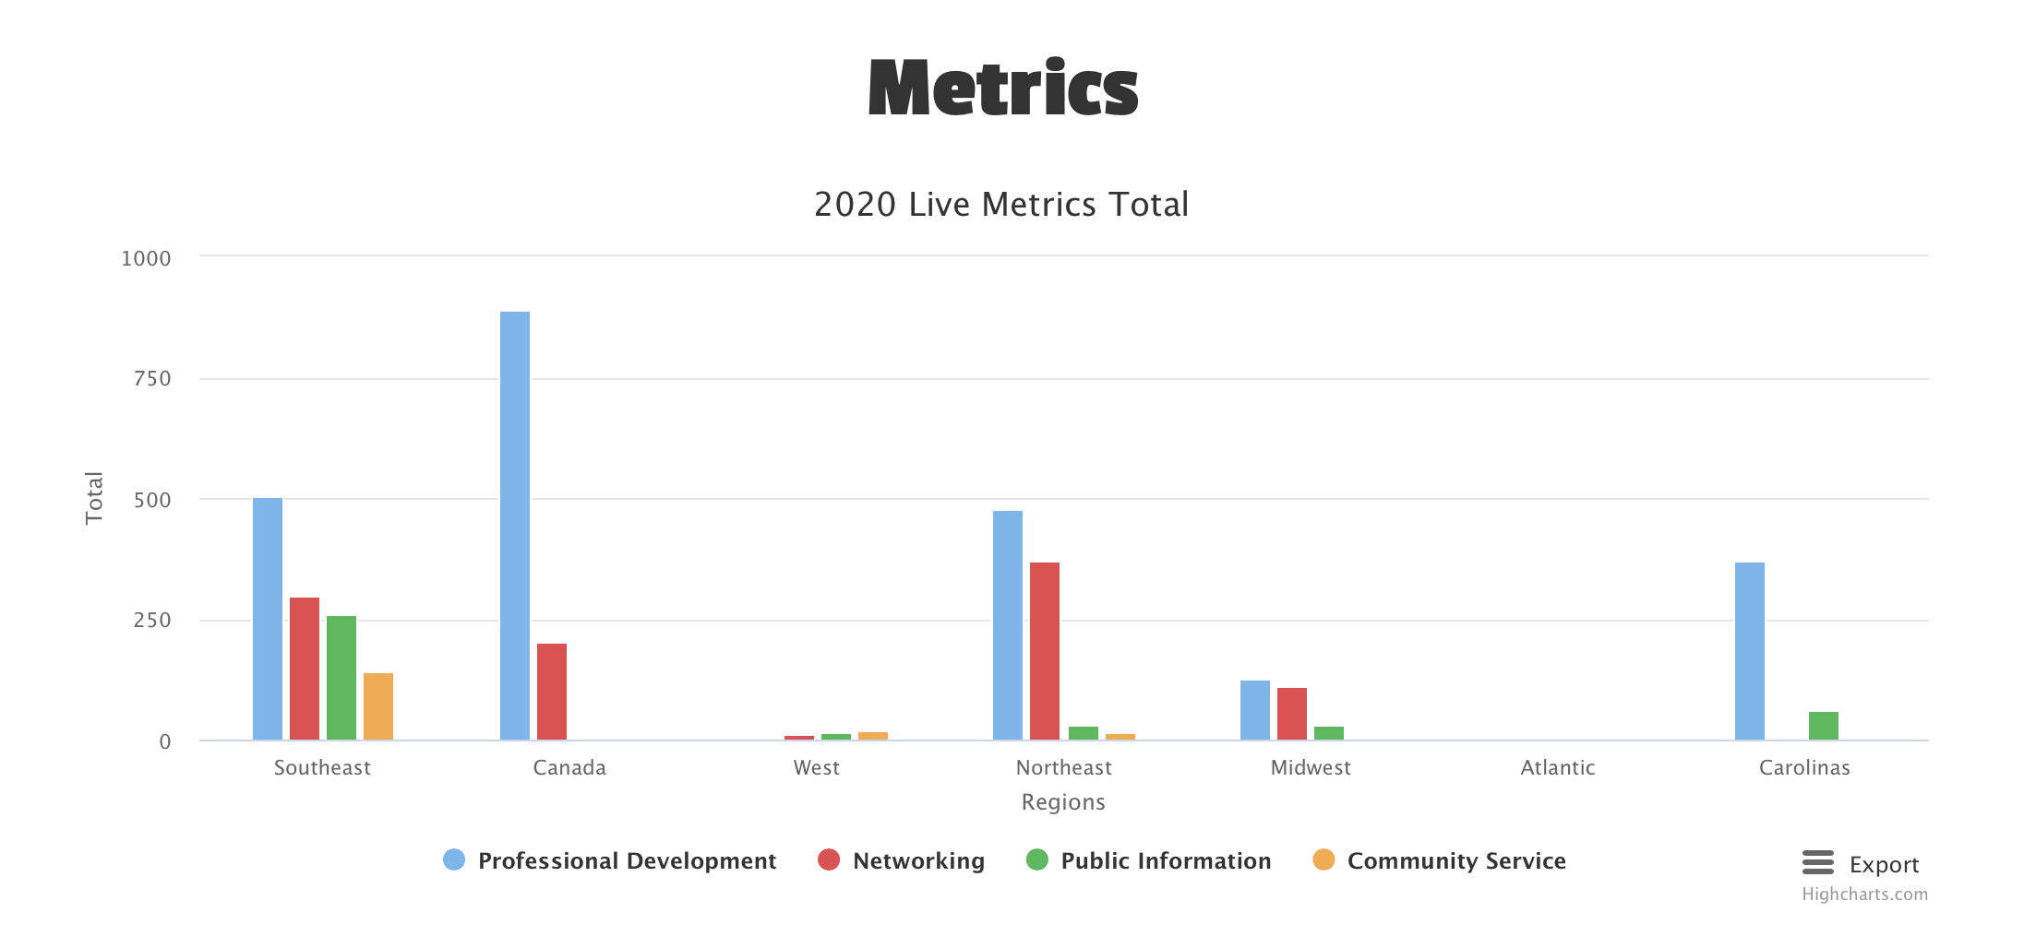
2020 Metrics
https://naygn.org/local-chapters/metrics/
Please submit 2020 metrics as they happen
Any questions/concerns (i.e. if you need to edit a submission, if your chapter doesn’t appear, etc.) email Canada@naygn.org or USA@naygn.org and we will fix it!
Notes:
Here are the current metrics for this year.
Please continue to add your metrics as you complete events throughout the year.
Any questions/concerns, please reach out!

Slide 4
2020 Q2 Excellence Awards
Nominations for the Q2 Excellence awards are now open
These nominations will be for the time period from April 1, 2020 through June 30, 2020
Deadline to submit is July 15, 2020.
Nomination link is https://www.surveymonkey.com/r/Q2ExcellenceAwards
Past award winners now appear on the website here: https://naygn.org/past-award-winners/
Recognize your fellow members for their activities supporting NAYGN!
Notes:
Nominations for Q2 excellence awards are now open.

Slide 5
LCL Symposium
LCL symposium recordings and Presentations:https://naygn.org/local-chapter-resources/
Please email Canada@naygn.org or USA@naygn.org with any questions or comments.
Notes:
We had a great virtual RL/LCL symposium last month! Thank you to all that were able to attend.
We were able to discuss past metrics as well as have regional breakout sessions to plan for 2020.
All of the presentations and recordings are now on the NAYGN website under Local Chapter resources.
Please let us know if you have any questions

Slide 6
NAYGN Committee Opportunities
Diversity and Inclusion committee
  Responsible for reviewing the current state of diversity and inclusion in the NAYGN organization and form actions and initiatives to make NAYGN a more diverse and inclusive organization with increased participation from underrepresented groups within the organization. Additionally, these initiatives should ultimately help NAYGN to be better in addressing systemic racism in our organization, in the nuclear industry, and in the communities we live.
  Email diversity@naygn.org
Special Virtual Professional Development committee
  Responsible for taking content that was developed for the 2020 NAYGN PD Conference, as well as develop new virtual content to deliver to our members.
  Email PD@naygn.org
Notes:
We are continuing our virtual committee fair and want to share the NAYGN committee opportunities that are available to you and your members.
We have two new committees that being formed. The Diversity and Inclusion committee and the Special virtual Professional Development committee
I’ll ask Lee to talk about the Diversity and Inclusion committee
The virtual professional development committee is Responsible for taking content that was developed for the 2020 NAYGN PD Conference converting to virtual content, as well as develop new virtual content to deliver to our members.
Please let Jenny, our PD chair, know by close of business tomorrow by emailing PD@naygn.org

Slide 7
NAYGN Committee Opportunities
Other committee opportunities
  Engagement Committee – engagement@naygn.org
  Sponsorship Committee – treasurer@naygn.org
  Awards Committee – awards@naygn.org
  Social Media Committee – socialmedia@naygn.org
  Publications Committee – publications@naygn.org
  Digital Committee – digital@naygn.org
  Webinar Committee – webinar@naygn.org
  Public Information Committee – pi@naygn.org
  Professional Development Committee – pd@naygn.org
Notes:
Engagement (engagement@naygn.org): Help the Board of Directors by advising and planning exciting new ways to engage our membership.
Contributor
Sponsorship (sponsorship@naygn.org): Lead or help expand our reach with new or existing sponsors so that we can continue to lead the young generation.
Committee Chair
Contributor
Awards (awards@naygn.org): Lead or help select our quarterly excellence award and annual award winners.
Contributor
Social Media (socialmedia@naygn.org): Take the lead on curating and planning content to be published to our many social media channels (Facebook, Twitter, LinkedIn, Instagram, YouTube, and now TikTok!)
Committee Chair
Contributor
Publications (publications@naygn.org): Curate and produce content for our routine newsletters and Go Nuke articles published to our website.
Committee Chair
Contributor
Digital (digital@naygn.org): Help maintain and update the NAYGN website by focusing on new technologies and designs.
Committee Chair
Contributor
Webinar(webinar@naygn.org): Lead and help plan ways to engage our membership with different digital professional development, networking, and knowledge transfer sessions.
Committee Chair
Contributor
Student Outreach(studentoutreach@naygn.org): Work with the Public Information team to plan fun events like Drawing Contest and Essay Contest and create content for classroom visits.
Contributor
Government Outreach (governmentoutreach@naygn.org): Work with Public Information team on advocacy opportunities, post card push day, and reaching to state / federal legislators.
Contributor
Professional Development – Create professional development events for the membership (such as the book club and webinar series)
Please share with your members! Any active NAYGN member can be a committee lead or committee member!

Slide 8
2020 Career Report
2020 Career Report released
  Revealed that young professionals continue to see a career in nuclear as more than a just a job.
  Job satisfaction remains high with 87% of those surveyed stating they are satisfied or very satisfied with their job.
  The most important aspects of the workplace were cited as compensation/pay, flexibility to balance life and work issues, and paid time off.
  NAYGN needs more diversity in our membership.
  The current workforce believes in subsequent license renewal as the most impactful to the future of nuclear
  The workforce is most interested in in Leadership and Management Training
  Please share with your members and sponsors!
Notes:
The Benchmarking committee worked hard to create our 2020 Career Report and it is now released!
This can be used as a benchmarking tool for your organizations so please share with your members and sponsors!

Slide 9
Drawing Contest Update
The submission period has been extended to September 20th
Winners will be announced during Nuclear Science Week
School districts across USA/Canada are handling returning to classrooms differently, so we have created an easier process to communicate the drawing contest to classrooms
  2020 contest description on our website will be revamped (within the week) to accommodate entrants visiting the site rather than NAYGN members
  A video on our YouTube teaches the material for students to be able to watch remotely (classroom visits aren’t required)
  A drafted letter is provided for LCLs to send to local schools advertising the competition and asking teachers to share the competition with their students (can be done remotely or in class)
  All entrants can submit directly to schooloutreach@naygn.org rather than being collected by local chapters
Notes:
Amanda/Chris

Slide 10
Postcard Push Event
Postcard Push planning is starting this month.
This event will take place in October.
Contact governmentoutreach@naygn.org for questions, suggestions, or feedback.
Notes:
Amanda/Chris

Slide 11
Professional Development Book Club
July PD Book Club – July 21st at 11:00 EST
Book for discussion - “Mistakes Were Made (But Not by Me)”
  Chapters 1-3
Register for the event HERE
Call Information:
Notes:
Our next Professional Development book club discussion will be July 21st
The book for the discussion is “Mistakes were made (But Not By Me)” and we’ll discuss chapters 1-3 on the call.

Slide 12
Keeping your chapters active during COVID-19
Browse the new Advocacy Starter Kit
Share existing Resources: Take a second to share some of the below:
  Public information library: includes teacher workshop presentations ready for teachers to incorporate into their lesson plans.
  High school curriculum
  Middle school curriculum
  Virtual field trip of a nuclear power plant
  Virtual field trip of a national laboratory
Marie’s Electric Adventure: activity guide with science experiments and a free e- book on itunes including audio
George’s Energy Adventure: activity guide including coloring pages, a free e-book on itunes, and hard copies available via Amazon.
Notes:
We wanted to continue to keep these links available to you all as options to keep your organizations active during these times
These public outreach resources are great for those doing virtual summer camps and summer school

Slide 13
Keeping your chapters active during COVID-19
We are soliciting ideas for 5 minute ‘nuclear talk’ videos to distribute on our social media platforms.
  If you have ideas or would be open to filming a video on a topic –nuclear, chapter or PD related email pd@naygn.org
Houseparty! – host virtual “social events” with your members.
Virtual Lunch and Learns – the majority of our members are working from home. Host a lunch and learn to learn more about the communication tools that are being used and how to effectively use them.
Host Virtual Trivia Set up a virtual trivia night using Kahoot! (a game-based learning platform).
Notes:
These are some way to stay connected with your members with virtual networking events

Slide 14
Keeping your chapters active during COVID-19
Classroom Visits: These are still possible! Connect with a teacher for a VIRTUAL classroom visit (remember – teachers are being asked to very rapidly move their curriculum to a virtual environment and I’m sure most would love a guest lecture). Some schools are using Zoom, Google Classroom, or other platforms so be prepared to be flexible and learn something new!
Host a Virtual Hackathon Present a dynamic problem during a virtual classroom visit. Encourage collaborative problem solving (“hackathon” or “design-sprint”) as the students research a solution!
Make a 2 Minute Informative Video We are looking for more digital content to post on our social media platforms. Take a simple phone video of you explaining a nuclear topic in 2 minutes or less and we will post it!
Call Your Representatives: In lieu of Hill Day, NAYGN members are encouraged to call their elected officials for a quick chat about the importance of clean, reliable nuclear energy. Especially at a time like this! Nuclear energy is bringing you 20% of all the Netflix you are watching!
Notes:
These are great ideas to utilize social media to continue to advocate for nuclear

Slide 15
Keeping your chapters active during COVID-19
Go Live! Consider Live Streaming a science experiment or reading a STEM children’s book. If you are interested in reaching a wider audience, contact communications@naygn.org for an opportunity to get set up on the NAYGN Facebook, Instagram, Twitter, or LinkedIn accounts.
Tell Your Story: Using the template, consider posting what makes you proud to work in nuclear, especially now with #Proud2BeNuclear
Take Advocacy Digital: Take a few minutes to check out ongoing initiatives with our partner organizations and see if you can help! Generation Atomic & Nuclear Matters are good places to start!
Notes:
These are great ideas to utilize social media to continue to advocate for nuclear

Slide 16
Open discussion with NAYGN President
Notes:
I do have one question for the group. Did you all receive NAYGN newsletter that was sent yesterday or recently? If not, please respond in the chat box let me know or our communications officer, Paul at communications@naygn.org. We want to make sure that the NAYGN information is reaching all members!
Before we turn it over to our president, Amber, I want to open it up for any questions or comments that you may have.
Ok, over to you Amber.

