Slide 1

March 2020 Local Chapter Lead Meeting
Matthew Mairinger, Canadian Operating Officer
Canada@naygn.org
March 17th, 2020

Slide 2
Agenda
Metrics – new year but the same process
2020 Q1 Excellence Awards
NAYGN Board of Directors – Vote!
PI Update – Drawing Contest
PD Update – NEA Conference
IYNC Conference – NAYGN is da best
Newest NAYGN Chapter - UNB
Open discussion with NAYGN President

Slide 3
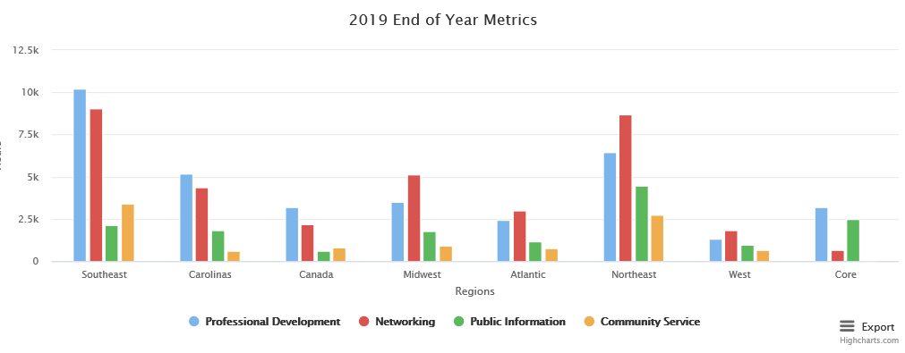
2020 Metrics
https://naygn.org/local-chapters/metrics/
Please submit 2020 metrics as they happen so we don’t always have a backlog in December/January ☺
Any questions/concerns (i.e. if you need to edit a submission, if your chapter doesn’t appear, etc.) email Canada@naygn.org or USA@naygn.org and we will fix it!
2019 totals are below, look at how beautiful it is!

Slide 4
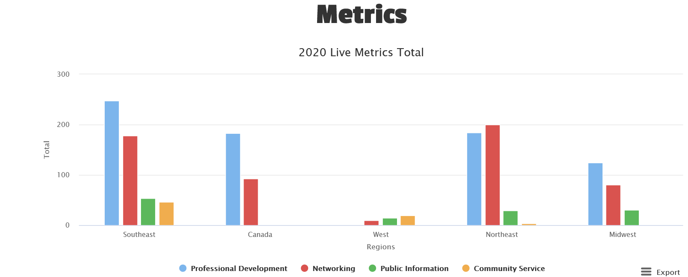
2020 Metrics
2020 metrics are now on the website. 2019 metrics have been archived.

Slide 5
Q1 Excellence Awards Open
Nominations for the Q1 Excellence awards are now open
  These nominations will be for the time period from January 1 through March 31, 2020
  Deadline to submit is April 30, 2020.
  Nomination link is https://www.surveymonkey.com/r/NAYGN_Q1_Excellence_Awards
  Past award winners now appear on the website here: https://naygn.org/past-award-winners/
  Recognize your fellow members for their activities supporting NAYGN

Slide 6
NAYGN Board of Directors
https://naygn.org/2020-elections/ voting open until March 25th
Vice President
  Paul Balik
  Monica Beistline
  Michael Hayes
Professional Development
  Umar Faraz
  Jenny Gourley
Treasurer
  Daniel Deckman
Canadian Affairs
  Matthew Mairinger
Bylaw change
  Corporation Officers (B6)- Removal of Officer

Slide 7
New NAYGN US Affairs Chair (starting May 2020)
Nick will finish his US Affairs term on May 2020. No, he was not fired he has just changed job roles at Dominion and he determined he would not be able to provide NAYGN the time and focus needed for the US Affairs role.
Ashley has been voted in by the NAYGN board to fill the remainder of the US Affairs role until the position opens in May 2021. This vote was as per the NAYGN bylaws:
  “All vacancies among the elected corporate officers shall be filled by election by the Board of Directors for the unexpired term, except that a vacancy in the office of President shall be filled by the Vice President.”

Slide 8
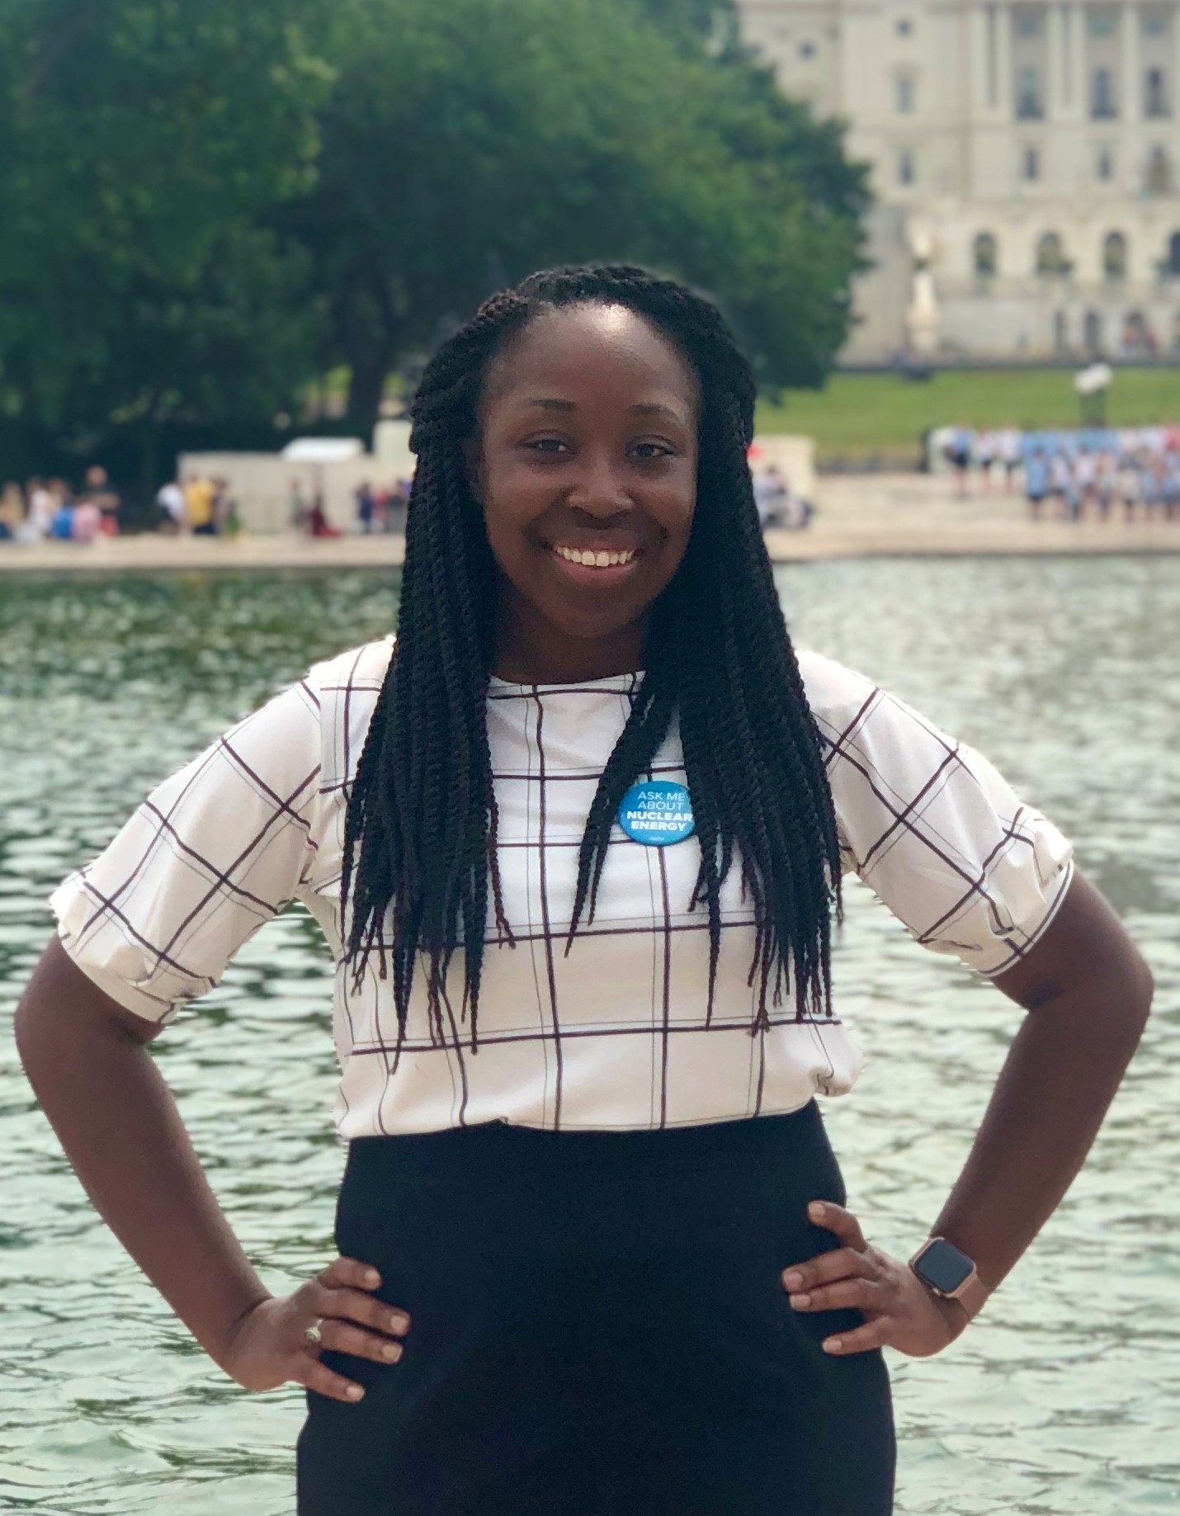
New NAYGN US Affairs Chair (starting May 2020)
Ashley Lawrence Ashley.lawrence@duke-energy.com
Senior Scientist in Health Physics at Duke Energy’s Robinson Nuclear Plant.
Been an active member of NAYGN since 2011.
Served in multiple NAYGN leadership roles at Duke Energy and currently serving the role as Duke Energy Fleet Chapter Lead.
Love the mission of NAYGN and look forward to working with the national chapter to continue to make NAYGN a great organization for young nuclear professionals!

Slide 9
PI Update – Drawing Contest
2020: Bringing Nuclear Energy Into Focus
Submissions are due by noon on April 3rd. May 8th (date may move again depending on COVID-19)
Students in 4th and 5th grade will use a 8 ½ x 11” to draw how nuclear energy will help with energy and environmental needs of the future.
When presenting the drawing contest to a classroom, use the following presentation and introduction.
For each drawing submitted, attach this form with the student’s information. Parents of the students participating in the drawing contest need to sign the linked waiver.
More information is HERE

Slide 10
NEA Conference – Corona Virus
The NEA/NAYGN Conference in May 2020 has been officially cancelled.
More details will come out shortly from NEI with more details

Slide 11
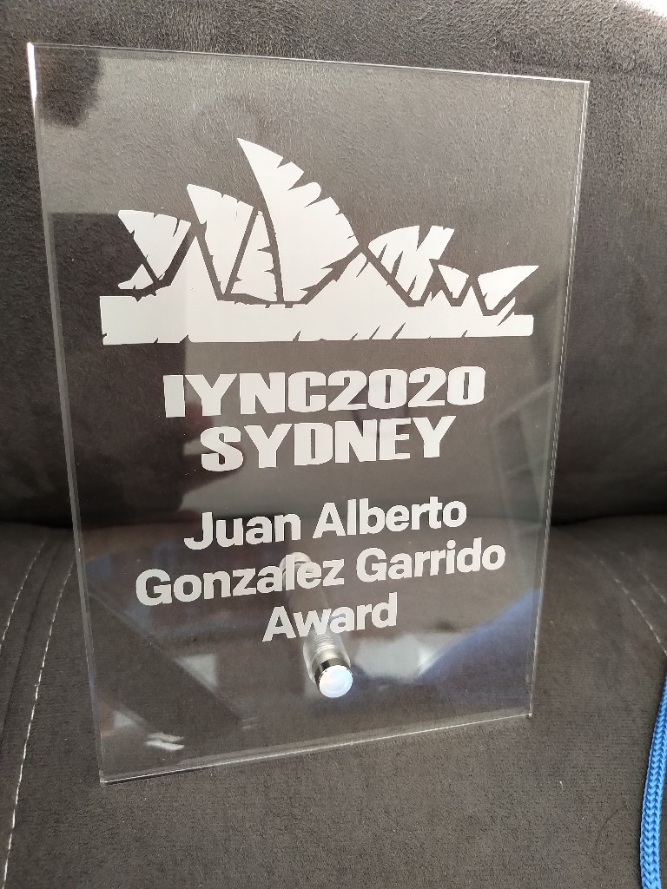
IYNC Conference
NAYGN was awarded the best YG group IN THE WORLD at the IYNC Conference in Sydney in March 2020.
More details will be out soon!

Slide 12

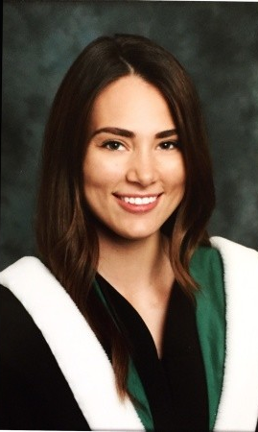
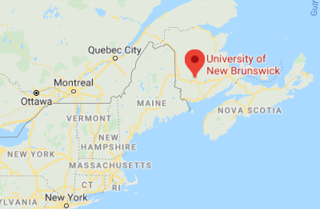
Newest NAYGN Chapter!
Welcome to the University of New Brunswick NAYGN chapter
John Flood and Jessica A. Gauthier are the LCLs

Slide 13
Communications & Best Practices
Had a great event? Is your chapter up to something cool?
Submit an event summary and pictures to communications@naygn.org to be featured in the Go Nuke article.
And/or engagement@naygn.org to have
And/or to USA@naygn.org and Canada@naygn.org to be shared on the next LCL call.

Slide 14
Open Discussion with NAYGN President

