Slide 1
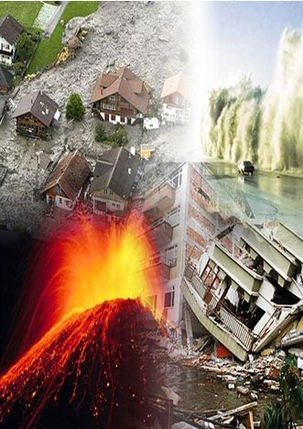
FORCES OF NATURE

Slide 2

Nuclear Accident
  One reactor is destroyed
    Banker rolls a single die to decide which unit is affected
  Every nuclear owner must pay $4 per unit to the bank to comply with new safety regulations, and new nuclear costs $4 more to build

Slide 3
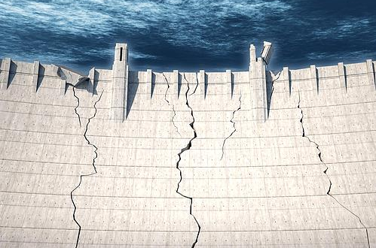
Dam Break
  One hydro plant is destroyed
    Banker rolls a single die to decide which occupied site is affected

Slide 4
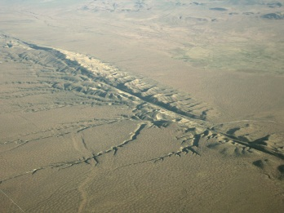
Earthquake
  Nuclear plants trip
    Do not pay nuclear next turn
  Gas pipeline breaks
    Do not pay gas next turn
    Every gas owner pays $4 per unit to the bank

Slide 5
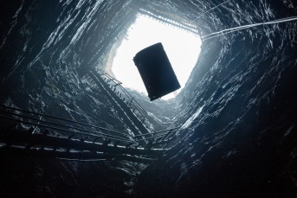
Coal Mine Collapse
  Every coal owner pays $6 per unit to the bank
  Do not pay coal next turn

Slide 6

Gas Shortage
Do not pay gas for 3 turns

Slide 7
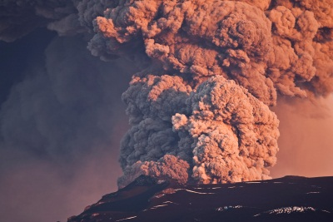
Volcanic Eruption
Do not pay solar for 3 turns

Slide 8

Drought
For the next 3 turns, or until a Rainy Day is rolled, each hydro plant earns half, and each solar installation earns double.

Slide 9
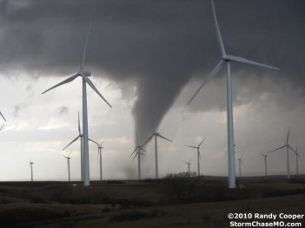
tornado
  Banker rolls a single die to decide which occupied wind farm is affected
  That wind farm earns $6 per unit, but then has all units destroyed

