Slide 1

Power Up

Slide 2

Good Networking
Can split the cost and profits of a new plant with one other ‘Good Networker’
Can buy plants from or sell plants to other ‘Good Networkers’
After Good Networking card is lost, agreements made on profit-sharing and ownership remain, but no new arrangements can be made without the Good Networking Card

Slide 3

Good Networking
Can split the cost and profits of a new plant with one other ‘Good Networker’
Can buy plants from or sell plants to other ‘Good Networkers’
After Good Networking card is lost, agreements made on profit-sharing and ownership remain, but no new arrangements can be made without the Good Networking Card

Slide 4
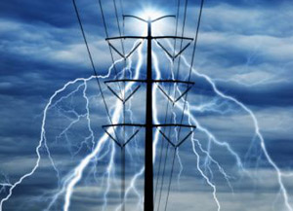
MW FEVER!
Push your plants to the limit to earn double on odd rolls, but pay the consequences by earning nothing on even rolls

Slide 5

Earn a PE License
Becoming a Professional Engineer earns you $1 extra for each plant you own, each turn

Slide 6
Industry Leader
  Carbon Tax
Coal earns $2 less and Gas earns $1 less
  Nuclear Waste Repository
Nuclear must pay $2 to the Nuclear Waste Repository Fund for each plant, each turn
  End Government Subsidies
Solar and Wind construction costs double
  Ban Fracking
Gas earns $2 less
Use your influence to bring about one of the following industry-wide changes (affects everyone). Chosen effect lasts until this card is returned to the deck.

Slide 7

You’re
Really Bright!
Congrats.

Slide 8
Keep the Lights On!
The public appreciates it.

Slide 9

Senior Reactor Operator
Becoming an SRO allows you to earn $2 more from each nuclear plant you own each turn

