Slide 1



NAYGN 2020 LCL Symposium
May 19th 12:00 PM – 2:30PM EST
Microsoft Teams Conference Call
Matthew Mairinger, Nick WILSON , and Ashley Lawrence
Notes:
matt

Slide 2
Agenda
12:00 - 12:45: LCL Meeting: general meeting
  Core/RL Introductions
  NAYGN information
  NAYGN Committees
12:45 – 13:00 Break
1300 - 1330: Region Specific Breakout
13:30 – 14:00 Region Roundtable
  Present best practices and areas for development
14:00 – 14:30 Workshop on Communicating the Value of NAYGN
Notes:
matt

Slide 3
Meet your NAYGN Region Leads!
Atlantic – Courtney Tampas
Canada – Owen Marshall-Glew
Carolinas – Glen Lawson (outgoing) Tyler Andrews (Incoming) assisted by Christopher Chance
Midwest – Vincent Roddy transitioning to Karthik Makayee
Northeast – Matthew Block assisted by Michele Marandola
Southeast – Mike Hayes
West – Sandra Stewart assisted by Hamzeh Zbib
Notes:
ashley

Slide 4
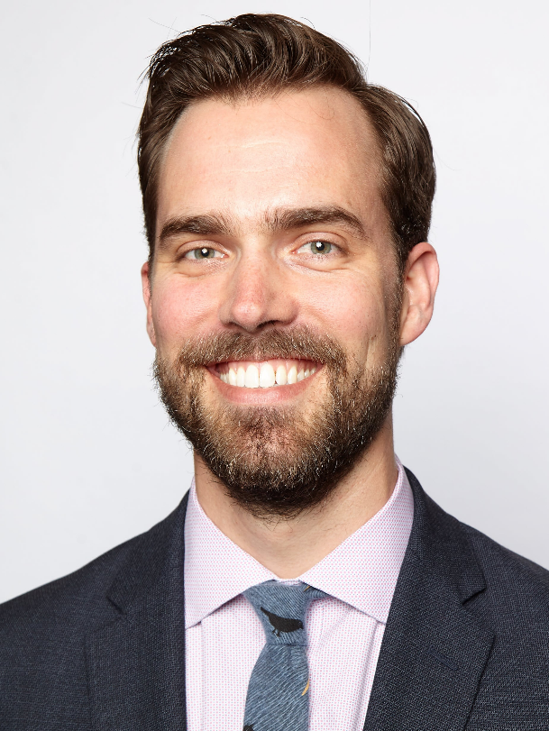
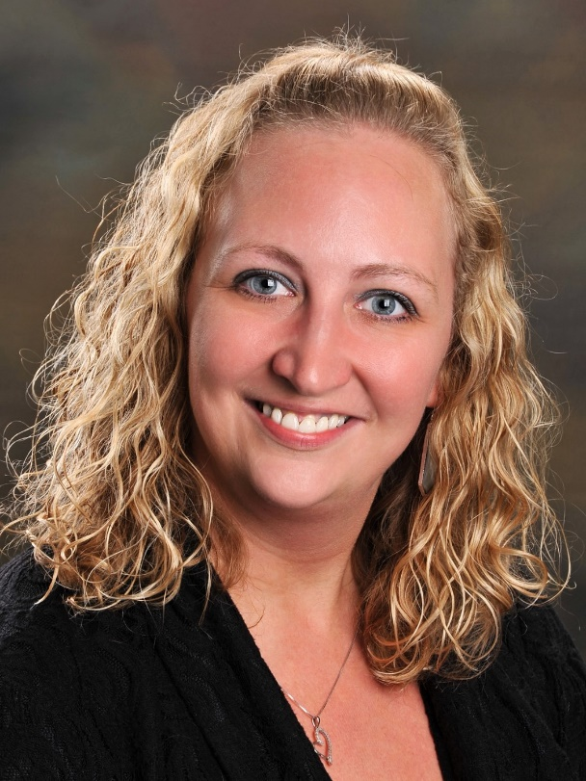
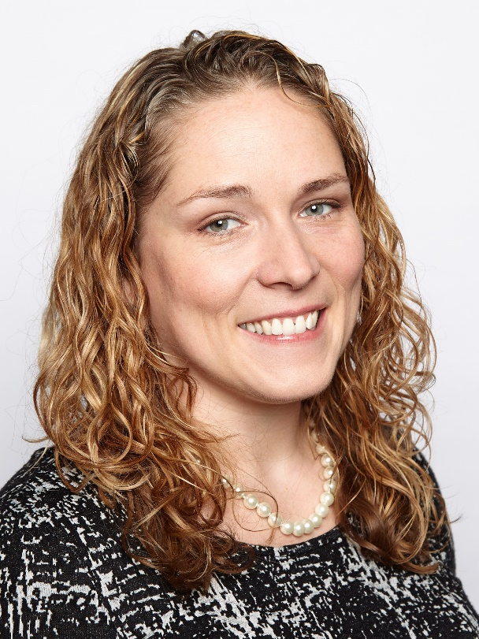
Meet your NAYGN Board of Directors!
Past President
Lee Causey
President
Amber Von Ruden
Vice President
Monica Beistline
Notes:
nick

Slide 5
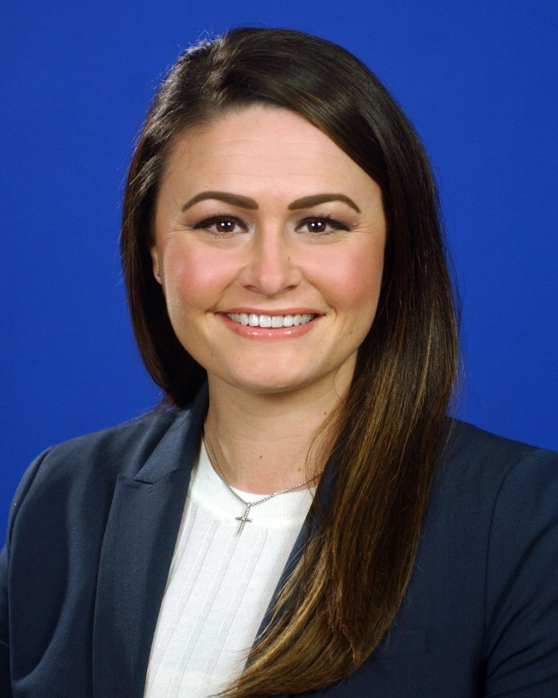
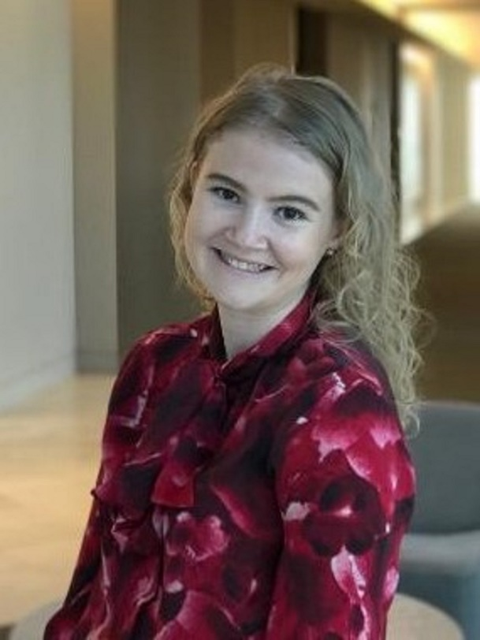
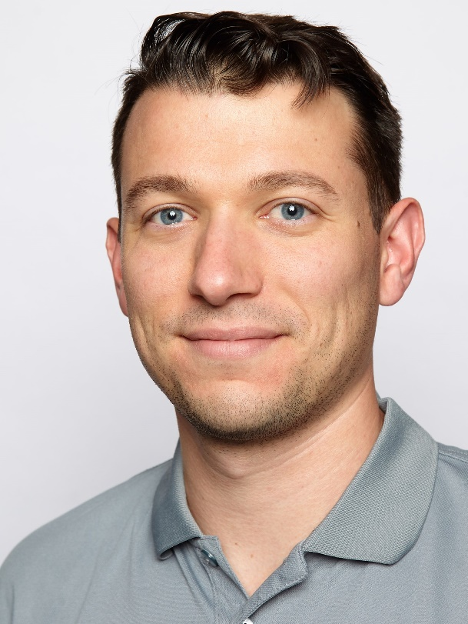
Meet your NAYGN Board of Directors!
Professional Development
Jenny Gourley
Public Information
Amanda Lang
Communications
Paul Balik
Notes:
nick

Slide 6
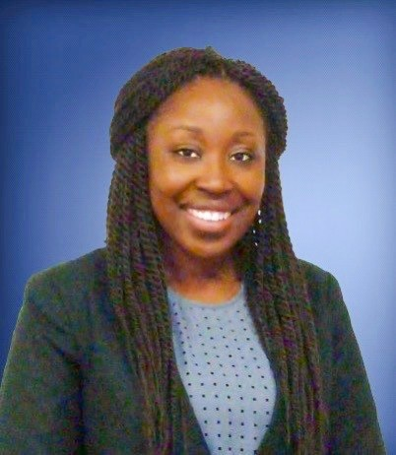
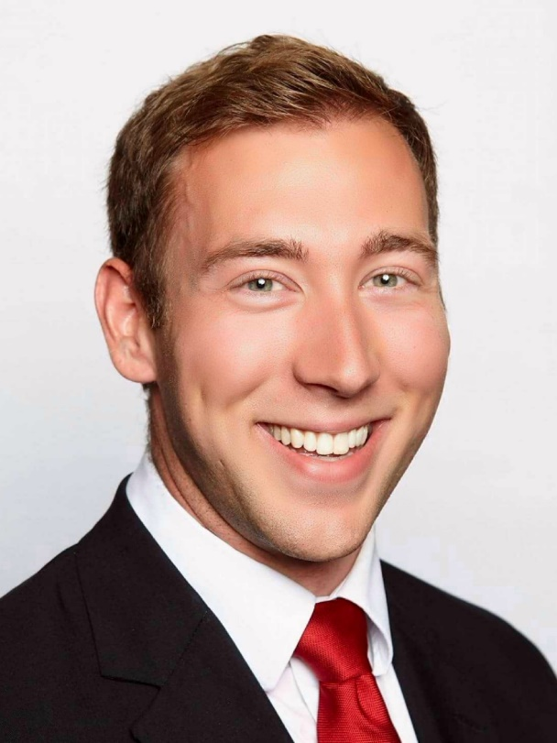
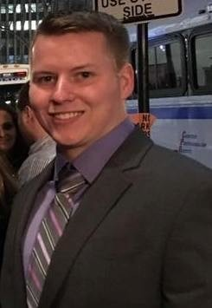
Meet your NAYGN Board of Directors!
US Operations
Ashley Lawrence
Canadian Operations
Matthew Mairinger
Treasurer
Daniel Deckman
Notes:
nick

Slide 7
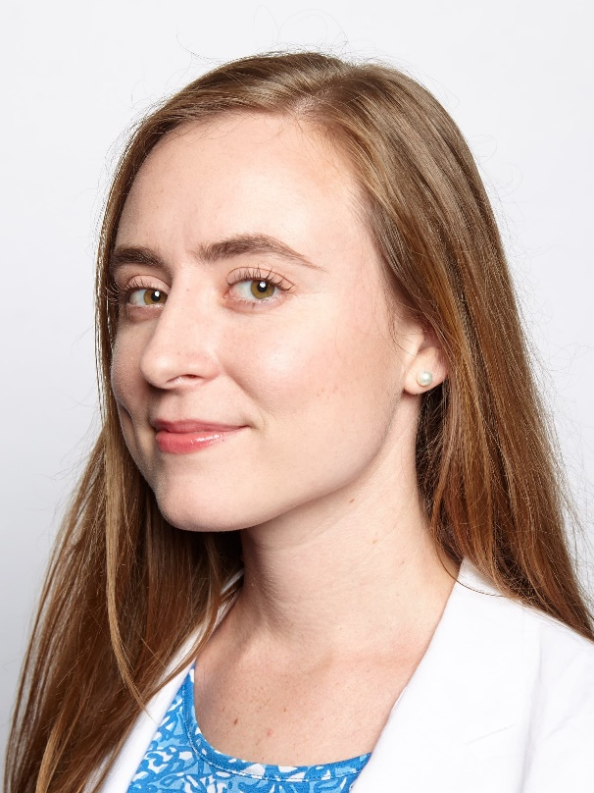
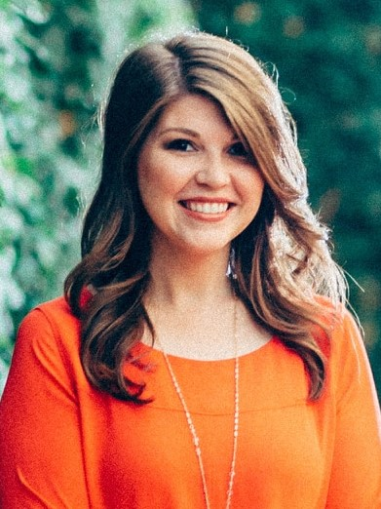
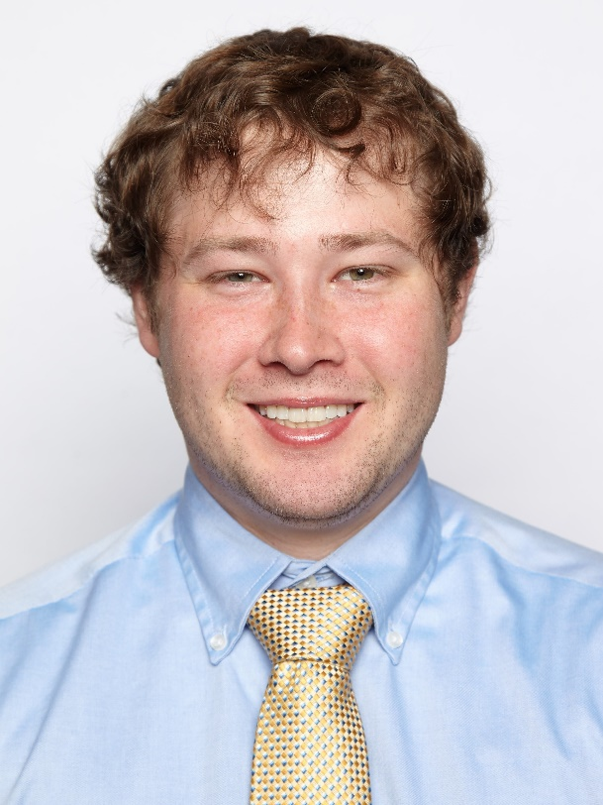
Outgoing Board of Directors,
Saying goodbye ☹
Past President
Christine Flynn
Professional Development
Cayla Thompson
US Operations
Nick Wilson
Notes:
nick

Slide 8
The naygn structure
Core
Region Lead
Committee Lead
Local Chapter Lead
Committee Member
Active Member
Notes:
ashley

Slide 9
Common questions from lcls
What is the NAYGN vision?
  Developing leaders to energize the future of nuclear
When was NAYGN started?
  1999
What is the NAYGN mission statement?
  NAYGN provides opportunities for a young generation of nuclear enthusiasts to develop leadership and professional skills, create life-long connections, engage and inform the public, and inspire today’s nuclear technology professionals to meet the challenges of the 21st century.”
Notes:
ashley

Slide 10
Common questions from lcls
What are the NAYGN pillars?
  Professional Development, Public Information, Recruitment & Retention, Knowledge Transfer
Do you have to be young to be a member
  No age restrictions for member/committee/chapter lead. Only age is <36 years of age at the time of nomination to run for the NAYGN board of directors.
Is NAYGN a non-profit? The organization or the chapter? What type of non-profit?
  The NAYGN organization (not the chapters) is a 501c(6) non-profit.
Notes:
matt

Slide 11
Common questions from LCLs
What about branding?
  NAYGN Branding Manual:
    http://naygn.org/wp-content/uploads/2015/05/NAYGN-Branding-Manual.pdf
  The branding manual includes the colors, etc. if you want to print the logo yourself
  To obtain the logo, contact your Affairs Operating Officer or communications@naygn.org
  You can also make your own chapter logo! – just check the information in the branding manual
Notes:
matt

Slide 12
Common questions from LCLs
What about speaking on behalf of NAYGN?
  If you’re asked to formally speak or comment (newspaper, speaking on a panel, etc.)…
    on behalf of your company, contact your communications department
    on behalf of NAYGN, contact NAYGN at president@naygn.org
  Day-to-day chapter activities like community events, classroom visits, sitting on local panels representing your own chapter, don’t require any special permission
Notes:
matt

Slide 13
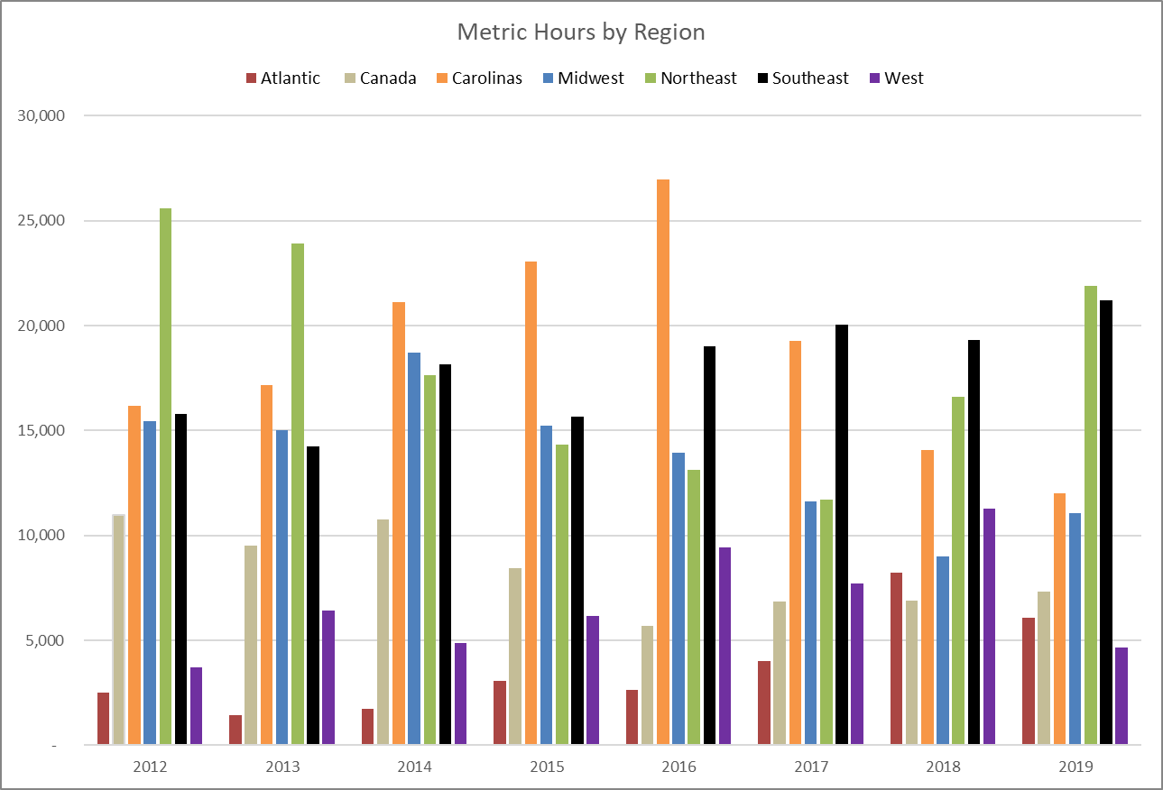
Historic Metrics by region
Notes:
nick

Slide 14
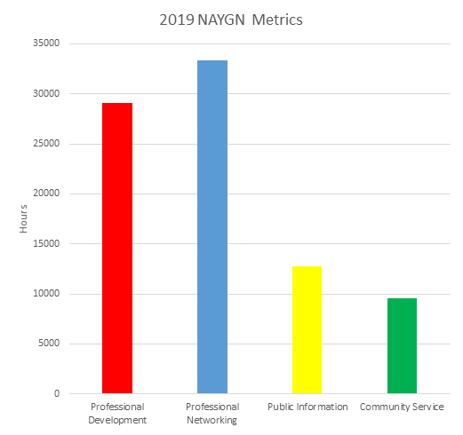
Metrics - 2019
91,121 Total Metric Hours
  77 reporting chapters
  Professional Development: 29,075 hours
  Networking: 33,364 hours
  Public Information: 12,740 hours
    PI Reach: 73,859 people NEW RECORD
  Community Service: 9,582 hours
    CS Reach: 68,818 people NEW RECORD
Notes:
nick

Slide 15
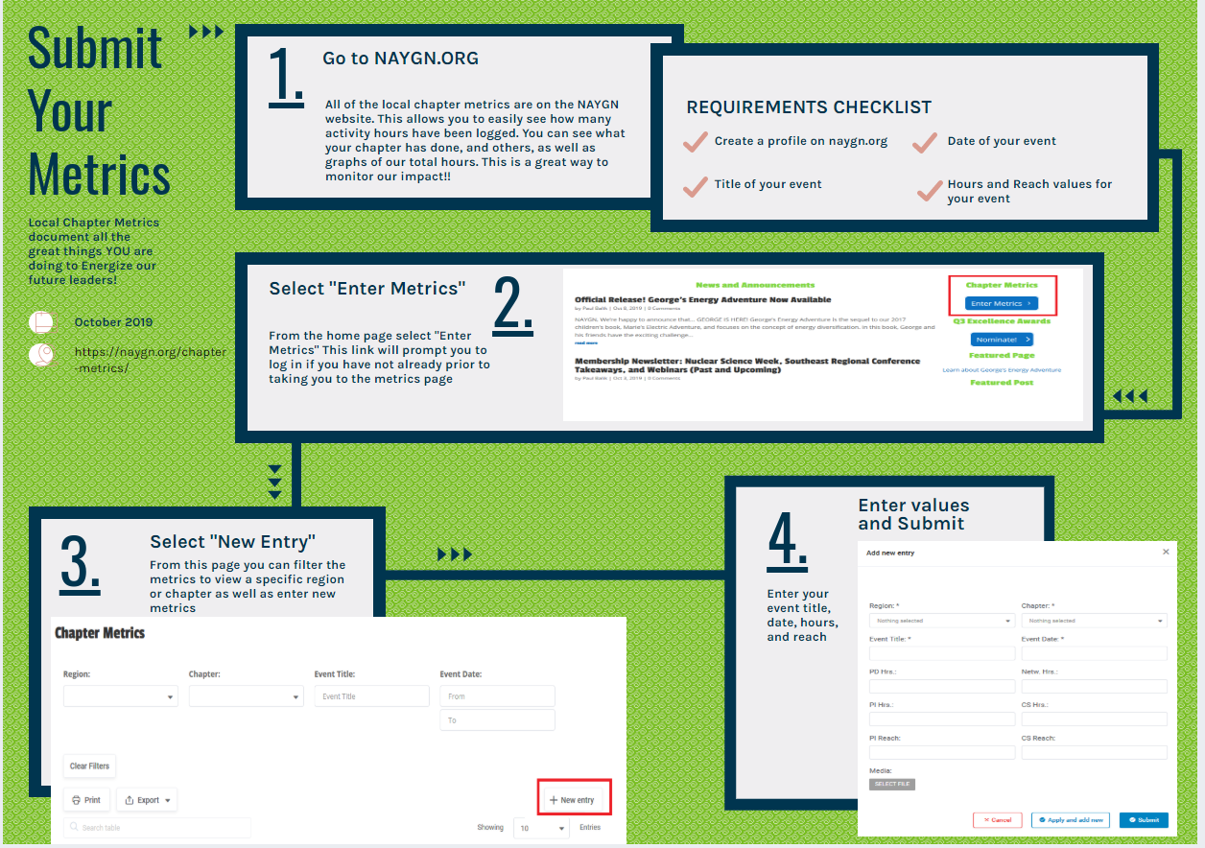
Notes:
nick

Slide 16
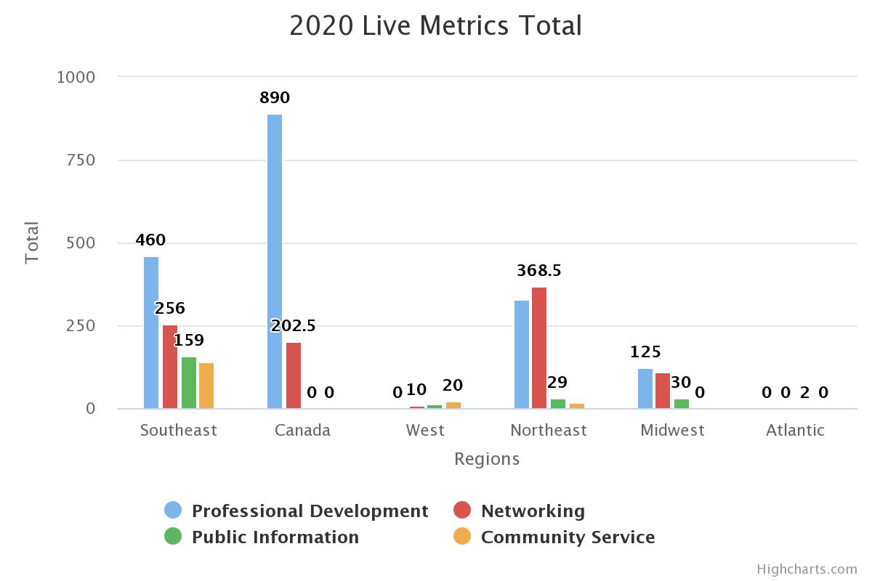
2020 Metrics
Hours: 3,165
Reach: 2,739
Notes:
nick

Slide 17
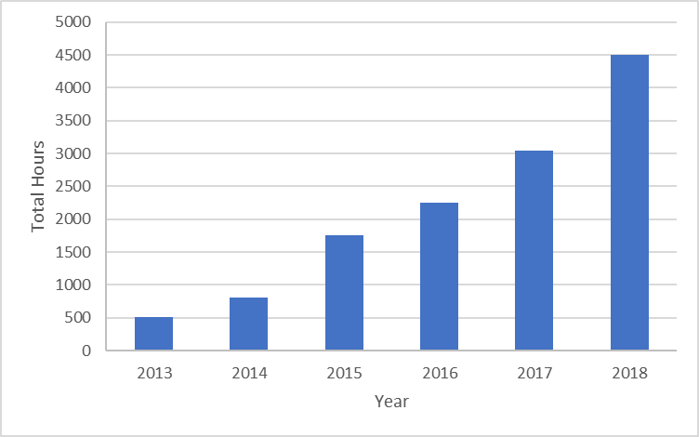
What to do with your metrics?
Look what we’ve done! Imagine what we can do next year with 20% more budget!
Share them!
Objective evidence and data to show Executive Sponsor ROI!
Bring your metrics to show your impact when meeting with Executive Sponsors!
Based on this data, you can have a 50% increase!
*Results may vary.
Notes:
ashley

Slide 18
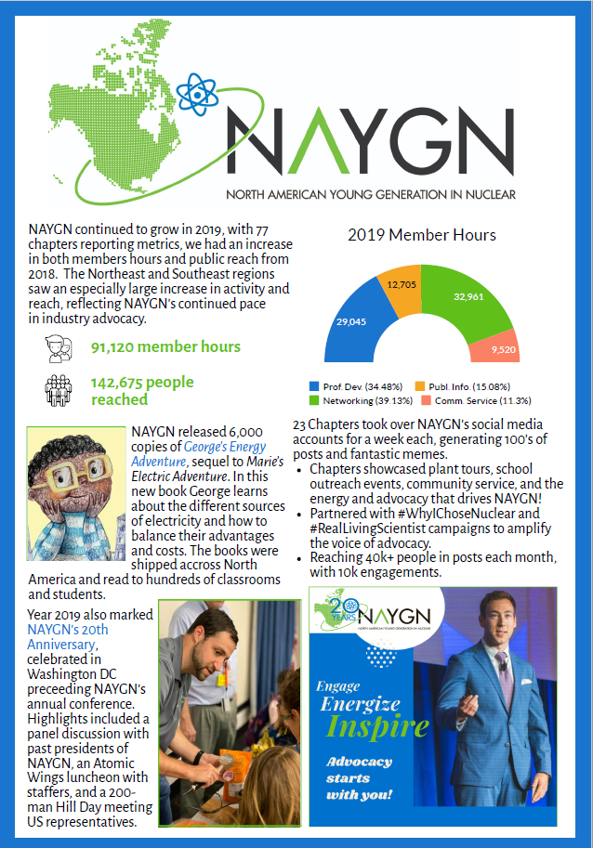
2019 End of year report
Summarizing 2019 in one page!
Show it to all your friends, your manager, your cube-neighbor, your actual neighbor!
Take this to your Executive Champion!
Reference it when requesting 2021 budget!
Notes:
ashley

Slide 19
Committee slides – Engagement
Engagement Committee
Goal: To develop, implement, and create initiatives and changes to increase membership numbers and overall member experience. Core sponsor is the Vice President (contact at vp@naygn.org or engagement@naygn.org)
2019 Accomplishments:
  Improved registration by decreasing sign up fields on NAYGN website and other changes
  Made progress in membership database cleanups through LCL list review and removal of old members
  Designed standard brochures for “Who is NAYGN,” “How to start a new local chapter,” and “Sponsorship.”
2020 Major Initiatives:
  Increase individual member leadership within chapters and international organization
  Increase information sharing between chapters
  Build a reputation for appreciation

Slide 20
Committee slides - benchmarking
Benchmarking Committee
Goal: To develop, facilitate, and analyze surveys, and report survey results. This committee is formed as needed during odd numbered years for even numbered year Career report distribution. Core sponsor is the Vice President (contact at vp@naygn.org or benchmarking@naygn.org).
2020 Career Report Findings (full report coming soon!)
  NAYGN needs more diversity in our membership
  The industry still has starting salary and job role gender disparity
  Higher salary does not necessarily equal greater job satisfaction even though it’s ranked as most important for satisfaction
  The current workforce believes in subsequent license renewal as the most impactful to the future of nuclear
  Some regional areas have changed their outlook on the future of nuclear (some more optimistic, some less)
  The workforce is most interested in in Leadership and Management Training
  Rotational programs are valuable and desired and a potential solution to some dissatisfactions with career development
  Satisfaction with NAYGN and chapter engagement remains strong!

Slide 21
Committee slides – sponsorship
Sponsorship Committee
Goal: To engage, manage, and track sponsorship commitments from NAYGN chapters. Core sponsor is the Treasurer (contact at treasurer@NAYGN.org).
2019 Accomplishments:
  Acquired 4 new sponsors, 2 of them Canadian
  Increased sponsorship commitments by 38% from 2019
2020 Major Initiatives:
  Acquire 2 additional sponsorships
  Strategize methods to incentivize sponsors without the 2020 National Conference
  Further develop materials for local chapter leads to keep executive sponsors aligned with NAYGN and promote sponsorship
Notes:
Looking for a committee chair and team members.

Slide 22
Committee slides - Awards
Awards Committee
Goal: To develop and maintain all submissions and approvals for awards and honors granted by NAYGN. Core sponsor is the Communication Officer (contact at awards@naygn.org).
2019 Accomplishments:
  Delivery of all quarterly excellence and annual awards.
  Addition of award winners on the NAYGN website (https://naygn.org/annual-awards/ and https://naygn.org/past-award-winners/).
2020 Major Initiatives:
  Continue to highlight activities performed by members and chapters.
  Announce Annual Awards on social media.
  Create new awards to continue to recognize the diversity of chapter activities.

Slide 23
Committee slides – Social Media
Social Media
Goal: To provide information to our membership and general public based on the daily initiatives of the organization. Core sponsor is the Communication Officer (contact at socialmedia@naygn.org)
Channels
  Facebook (TheNAYGN)
  Twitter (NA_YGN)
  Instagram (na_ygn)
  LinkedIn (naygn)
  YouTube (NAYGN)
2019 Accomplishments:
  20 for 20 Chapter Takeover. Each week for 20 weeks in a row we had a different chapter takeover our social media channels to share content!
  Began using HootSuite to schedule content on Twitter, Instagram, and LinkedIn.
2020 Major Initiatives:
  To continue to reach new audiences to share the mission of NAYGN.
  #U235Challenge! http://naygn.org/u235challenge
  Increase video content using online web videos tools.

Slide 24
Committee slides – Publications
Publications Committee
Goal: To develop bi-weekly membership newsletters and curate content for Go Nuke articles published to the NAYGN website. Core sponsor is the Communications Officer (contact at publications@nayng.org).
2019 Accomplishments:
  Updated the layout of our newsletters using MailChimp.
2020 Major Initiatives:
  Procure unique content to be displayed in more routine Go Nuke articles.
  Increase newsletters engagement within membership.

Slide 25
Committee slides – Digital
Digital Committee
Goal: To administer technologies used by the organization and maintain the NAYGN website. Core sponsor is the Communications Officer (contact at digital@naygn.org).
2019 Accomplishments:
  Migrated organizational platform from BlueHost to G Suite.
  Began usage of web-based task tracking tool called ClickUp.
  Stabilized NAYGN website and cleared inactive / SPAM accounts
2020 Major Initiatives:
  Redesign the NAYGN WordPress website.
  Continue to search for tools to improve efficiency of organization.

Slide 26
Public information
Do you (or your members) want to learn more about what the government & student outreach leads do?
Join us for a meet & greet! Add the calendar invite to your schedule!
governmentoutreach@naygn.org: Thurs. May 28 1-1:30pm
schooloutreach@naygn.org: Wed. June 3 3-3:30pm
We will get to know each other with an icebreaker & then brainstorm ideas for public outreach with a focus on virtual formats.

Slide 27
Public information
Informing the public is STILL POSSIBLE during the pandemic – we just need to get creative!
Check out this toolkit for details: Toolkit Here
Drawing Contest: submissions due Sept. 20, 2020
Postcard Push Day: October 14, 2020
Nuclear Science Week: October 19-23, 2020 (Big Event in Atlanta, GA this year)
Letters to newly elected legislators: November 2020
STAY
ACTIVE!

Slide 28
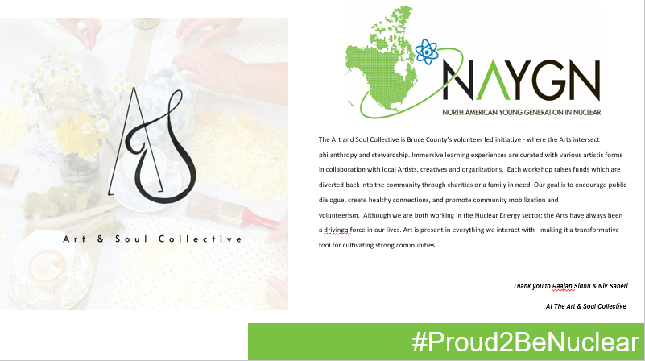
Public information
Post why you are #Proud2BeNuclear with this template

Slide 29
Committee slides – Professional Development
Professional Development Committee
  Outgoing Officer, Cayla Thompson and Incoming Officer, Jenny Gourley
  Responsibilities include managing workshops, seminars, sessions, conferences and other events – both in-person and virtually. This includes professional development, knowledge transfer, career development and more!
  Areas where you can be involved:
    Conference Planning Committee
    Book Club Committee
    Webinar Committee
  Open for ideas, discussions, and questions!

Slide 30
Committee – Bylaws & Rules
Performs an annual review of the NAYGN Bylaws and Rules, and provides recommendations to the Board of Directors.
Typically the Past President serves as Chair.

Slide 31
Committee Slides – Sustainability
Consists of all previous NAYGN Past Presidents (Christine Johnsen will be joining on May 21st).
This is chaired by Duncan Robinson, previous NAYGN President and currently a Nuclear Fuels Engineering Manager at Duke Energy.

Slide 32
Regional breakout
**CALL BACK TO THE ORIGINAL TEAMS MEETING BY 13:30 EST**
Questions for discussion:
  What is something (specific!) that your chapter excels at?
  What is one area where your chapter struggles?
________________________________________ATLANTIC REGION
Join Microsoft Teams Meeting
+1 704-659-4701 Conference ID: 126 931 957#
CANADA REGION
Join Microsoft Teams Meeting
+1 647-794-5572 Conference ID: 683 191 537#
CAROLINAS REGION
Join Microsoft Teams Meeting
+1 704-659-4701 Conference ID: 672 531 580#
MIDWEST REGION
Join Microsoft Teams Meeting
+1 704-659-4701 Conference ID: 899 289 361#
___________________________________________________
________________________________________NORTHEAST REGION
Join Microsoft Teams Meeting
+1 704-659-4701 Conference ID: 338 157 857#
SOUTHEAST REGION
Join Microsoft Teams Meeting
+1 704-659-4701 Conference ID: 872 271 494#
WEST REGION
Join Microsoft Teams Meeting
+1 704-659-4701 Conference ID: 794 324 777#
___________________________________________________

Slide 33
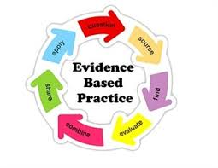
Best Practice Sharing

Slide 34
Best practices
Region | Strength | AFI
Atlantic | PD/networking (hockey games + letter writing) | Community service/PI
Canada | PD/networking | Community service/PI
Carolinas | Collaborative events (beach week, regional conference) | Recruiting, doing things “the old way”
Midwest | Community outreach, PI (nuke 101, tours, middle school events) | Lacking some engagement across site leads
Northeast | Innovative PI efforts (rallies) | NAYGN branded as largely an engineering group
Southeast | Communicating/sharing ideas (Groupme), PD, PI | Recruiting & retention/engagement

Slide 35
Communicating The Value of NAYGN
Methods for increasing leadership support for your chapter and national organization

Slide 36
Durham chapter example
Budget
  Sponsor is company Chief Nuclear Engineer
  Budget for NAYGN organization and for chapter are presented to the same sponsor but under a different budget request line item. Budget request broken down by NAYGN pillars.
  Chapter has their own bank account that they manage – cheque issued from sponsor and then deposited in account.
  NAYGN organization funding is a cheque issued directly to NAYGN Treasurer.
  Chapter charter has process for reimbursement (president/VP/treasurer – need pre-approvals and 2/3 approvals after).
  Showed value for money by presenting metrics as well as a list of all of the events/initiatives for the year

Slide 37
Durham chapter example
Professional Development
  Ran lunch and learns onsite
  Organized facility tours and leadership seminars
  Organized vendor training sessions (offered free for NAYGN members)
Public Information
  Volunteer at company Science Fair
  Volunteered and presented at Take Your Kid to Work Day
  Presentations at schools/STEM fairs/career fairs
  Would involve leadership team in community volunteer events for PR.
  Intervened at company CNSC hearings
  Participated in lobby hill days
  Supported company existing plans
    Ran food drives with existing company food donation organization
    Tied in with company charity campaign initiatives

Slide 38
Durham chapter example
Community Outreach
  Would involve leadership team in community volunteer events for PR.
  Tied in with company charity campaign initiatives
  Ran food drives with existing company food donation organization
  Tied goals to company social license aspects
  Presented at Community Advisory Council
Networking
  Ran events with vendors/suppliers/utilities
  Cross departmental/position events

Slide 39
Durham chapter example
Staying connected
  Live list of past events for the year and upcoming events
  FB/Twitter/Yammer account and chapter website
  Large distribution list for regular chapter updates
  Annual general members meeting
  Presentation to leadership teams

Slide 40
Dominion Chapter Integrating NAYGN
Found where NAYGN fit in with the larger company goals
  Nuclear Mission Key Element #3: Valued Engaged Employees
Use company language to assist events
  Put together a retiree exit presentation description included
    Dominion Knowledge Transfer and Retention Procedure
    INPO KTR documenting discussing tacit knowledge
  Social Events
    Breaking down barriers in the office between leaders and contributors
    Feeling more comfortable with each other allows better questioning attitude in the workplace

Slide 41
Dominion Chapter proving Value
Results from benchmarking survey
  Past survey (and current) show many looking for job changes. NAYGN can assist company with those items
    Professional Development opportunities
    Improving culture and communication
Yearly Summary Report Including Metrics
  Metrics are documentation of working towards organization goals
  Justification of budgets
  Goals for future years

Slide 42
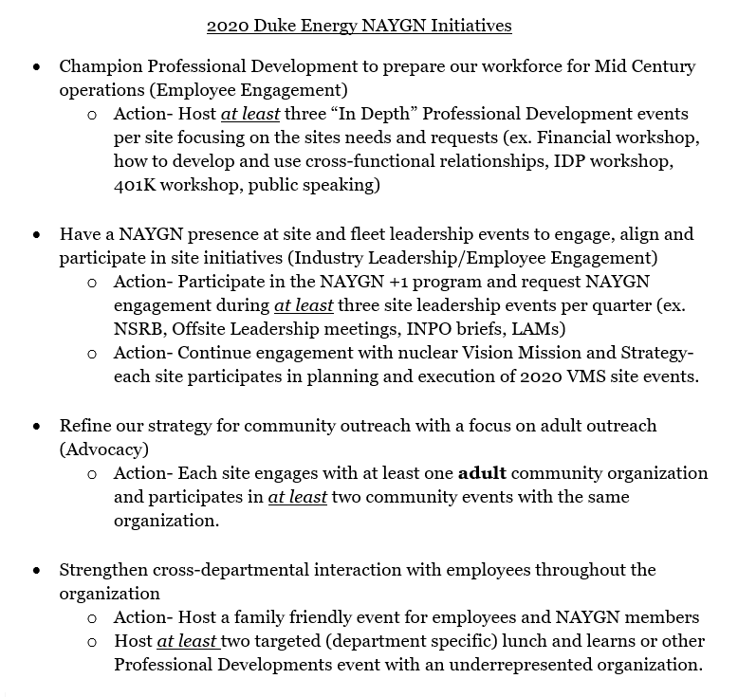
NAYGN’s role at Duke Energy
Find where NAYGN fits with your organization's goals
  Company mission statement
  Company initiatives
  Other Values
Determine how to communicate your chapters value
  Meet with company leadership/sponsor regularly
    Ask them how NAYGN can help!
  Discuss your metrics on a routine basis
  Yearly summary report
    Share your chapter successes and the National Chapter report

Slide 43
Naygn’s role AT Duke energy
Example events:
  Chernobyl Series “Ask a nuclear professional” night at a local brewery
  Carolinas Regional Conference
  Presented to the Nuclear Senior Council
  Multiple lunch and learns
  Host Individual Development Plan workshops
  Help organize site events
  Invited to participate in multiple leadership meetings/trainings
Work with other engagement councils to host bigger events

Slide 44
Open discussion

