Slide 1
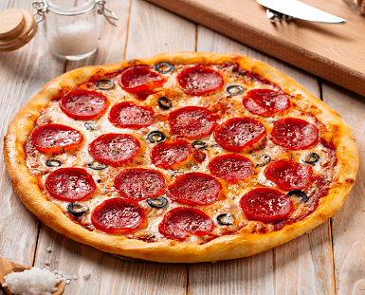
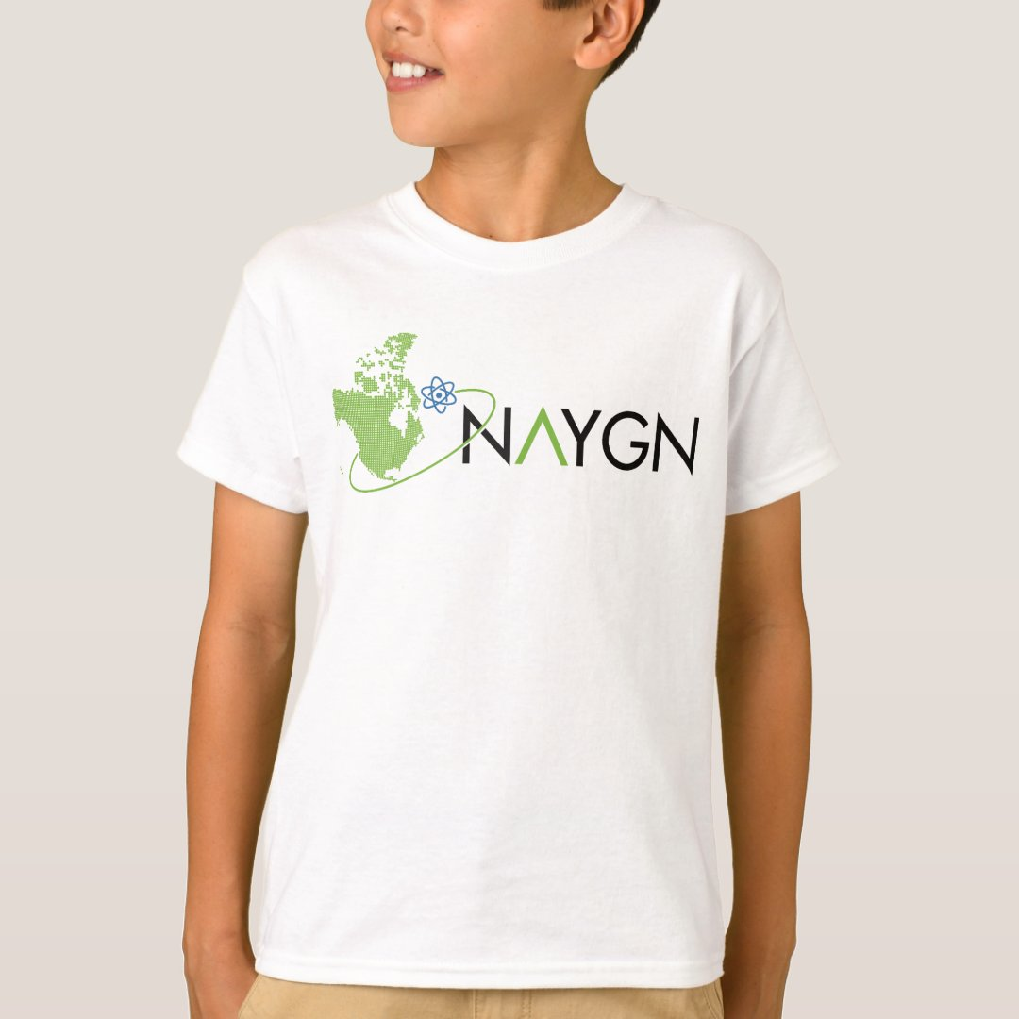
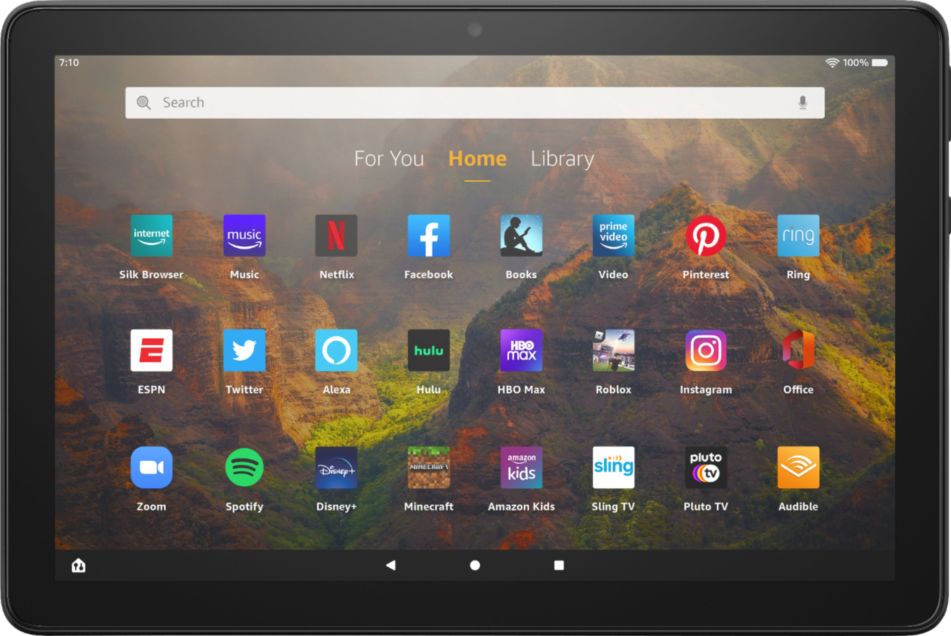
2023 Drawing Contest
Who: Students and Grades 4 to 6 are eligible to participate
Theme: “What would you [nuclear] power?” emphasizing the large amounts of clean energy a single nuclear power plant can supply.
What would you [nuclear] power?
Format: 8½” x 11” PDF or Scan in PDF format. On the back of each drawing please include:
Prizes: 1st place - Tablet, NAYGN T-Shirt, Honorary NAYGN Membership, Award Certificate, Pizza Party for the Student’s Classroom (~35 students)
2nd and 3rd place – Educational Science Kit, NAYGN T-Shirt, Honorary NAYGN Membership, Award Certificate
Each Winner’s School Library – A collection of books and materials about nuclear science and nuclear technology. The names of the winning student included on the inside cover to honor their achievement.
Name
School
City
State/Province
Grade
T-Shirt Size
Teacher’s Name
Submission Deadline: Submit to schooloutreach@naygn.org by March 31, 2023
Please contact pi@naygn.org or schooloutreach@naygn.org for more information.

