Slide 1
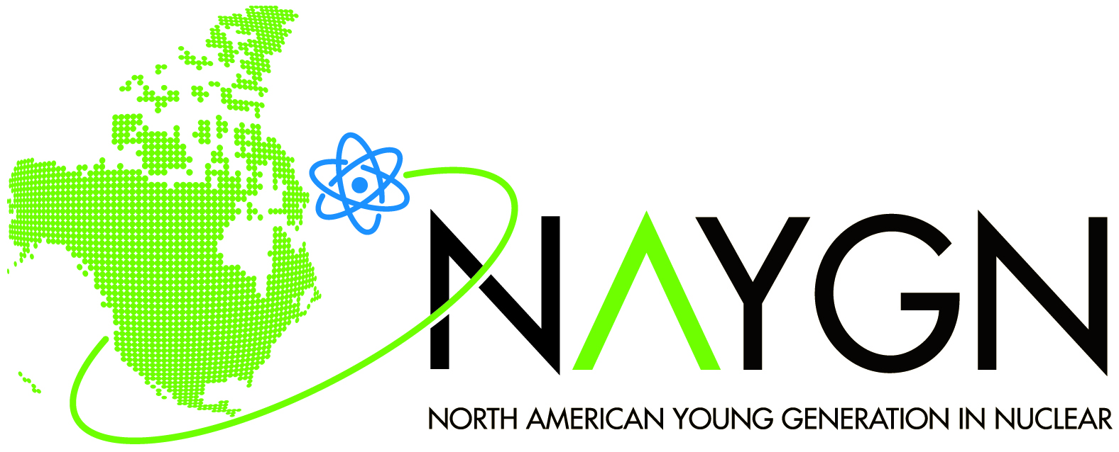
NAYGN Update
Matthew Mairinger, President
president@naygn.org
22-Sep-2023

Slide 2
NAYGN
What is the North American Young Generation in Nuclear (NAYGN) vision?
  Developing leaders to energize the future of nuclear
When was NAYGN started?
  1999
What is the NAYGN mission statement?
  NAYGN provides opportunities for a young generation of nuclear enthusiasts to develop leadership and professional skills, create life-long connections, engage and inform the public, and inspire today’s nuclear technology professionals to meet the challenges of the 21st century.”
What are the NAYGN pillars?
  Professional Development, Public Information, Recruitment & Retention, Knowledge Transfer

Slide 3
NAYGN
Do you have to be young to be a member?
  No age restrictions for member/committee/chapter lead. Only age is <36 years of age at the time of nomination to run for the NAYGN board of directors.
How do I become a member?
  Register for free at www.naygn.org/register and you will start
  to receive emails! Check your spam inbox for emails from
  ‘communications@naygn.org’
Is NAYGN a non-profit? The organization or the chapter?
  The NAYGN organization (not the chapters) is a 501c(6)
  non-profit.
Overview video here: https://youtu.be/Jga0CtSVU0Y

Slide 4
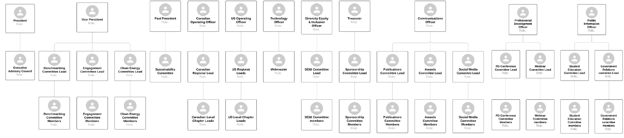
NAYGN Org Chart
11 elected board members
1 Executive Advisory Council
17 committees

Slide 5
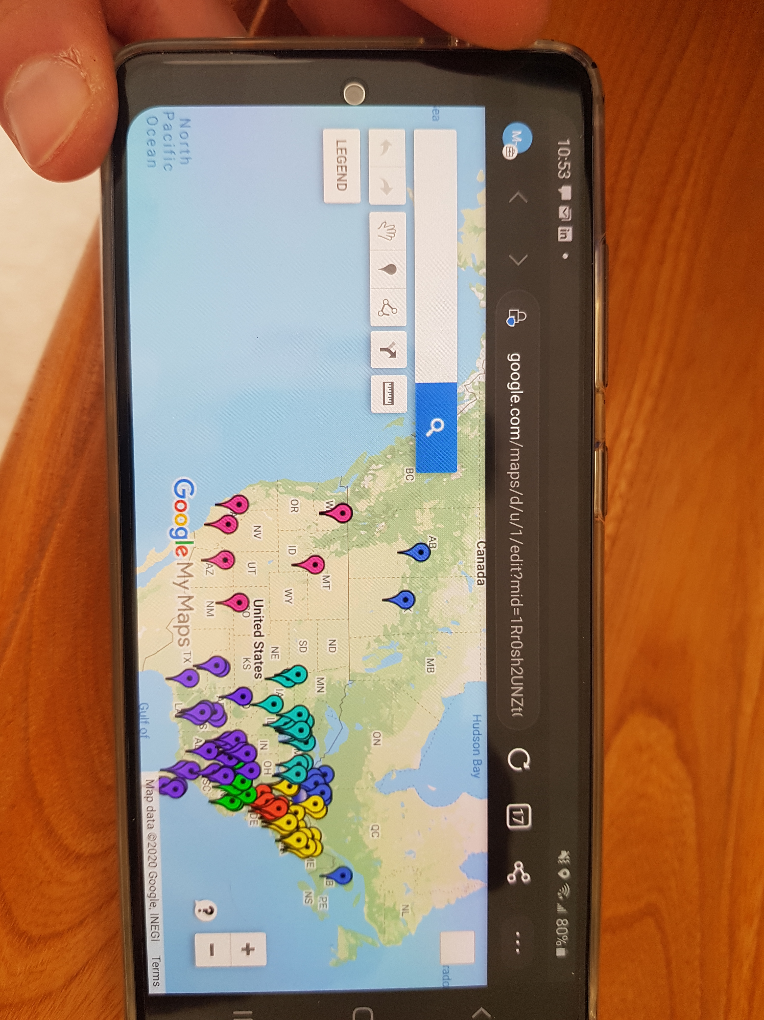
NAYGN Chapters
17 New chapters formed in 2023 :
  University of Calgary, Trent U, CANDU, Westinghouse, Calian Nuclear, NWMO, TRIUMF, York University (Canada)
  RIZZO, X-Energy (Atlantic)
  Jensen Hughest – West, Georgia Tech (Northeast)
  Thomas Thor (Midwest)
  S&ME, Longnecker & Associates (Carolinas)
  Entergy – Forth Worth (Southeast)
  Lawrence Livermore National Labs (West)

Slide 6
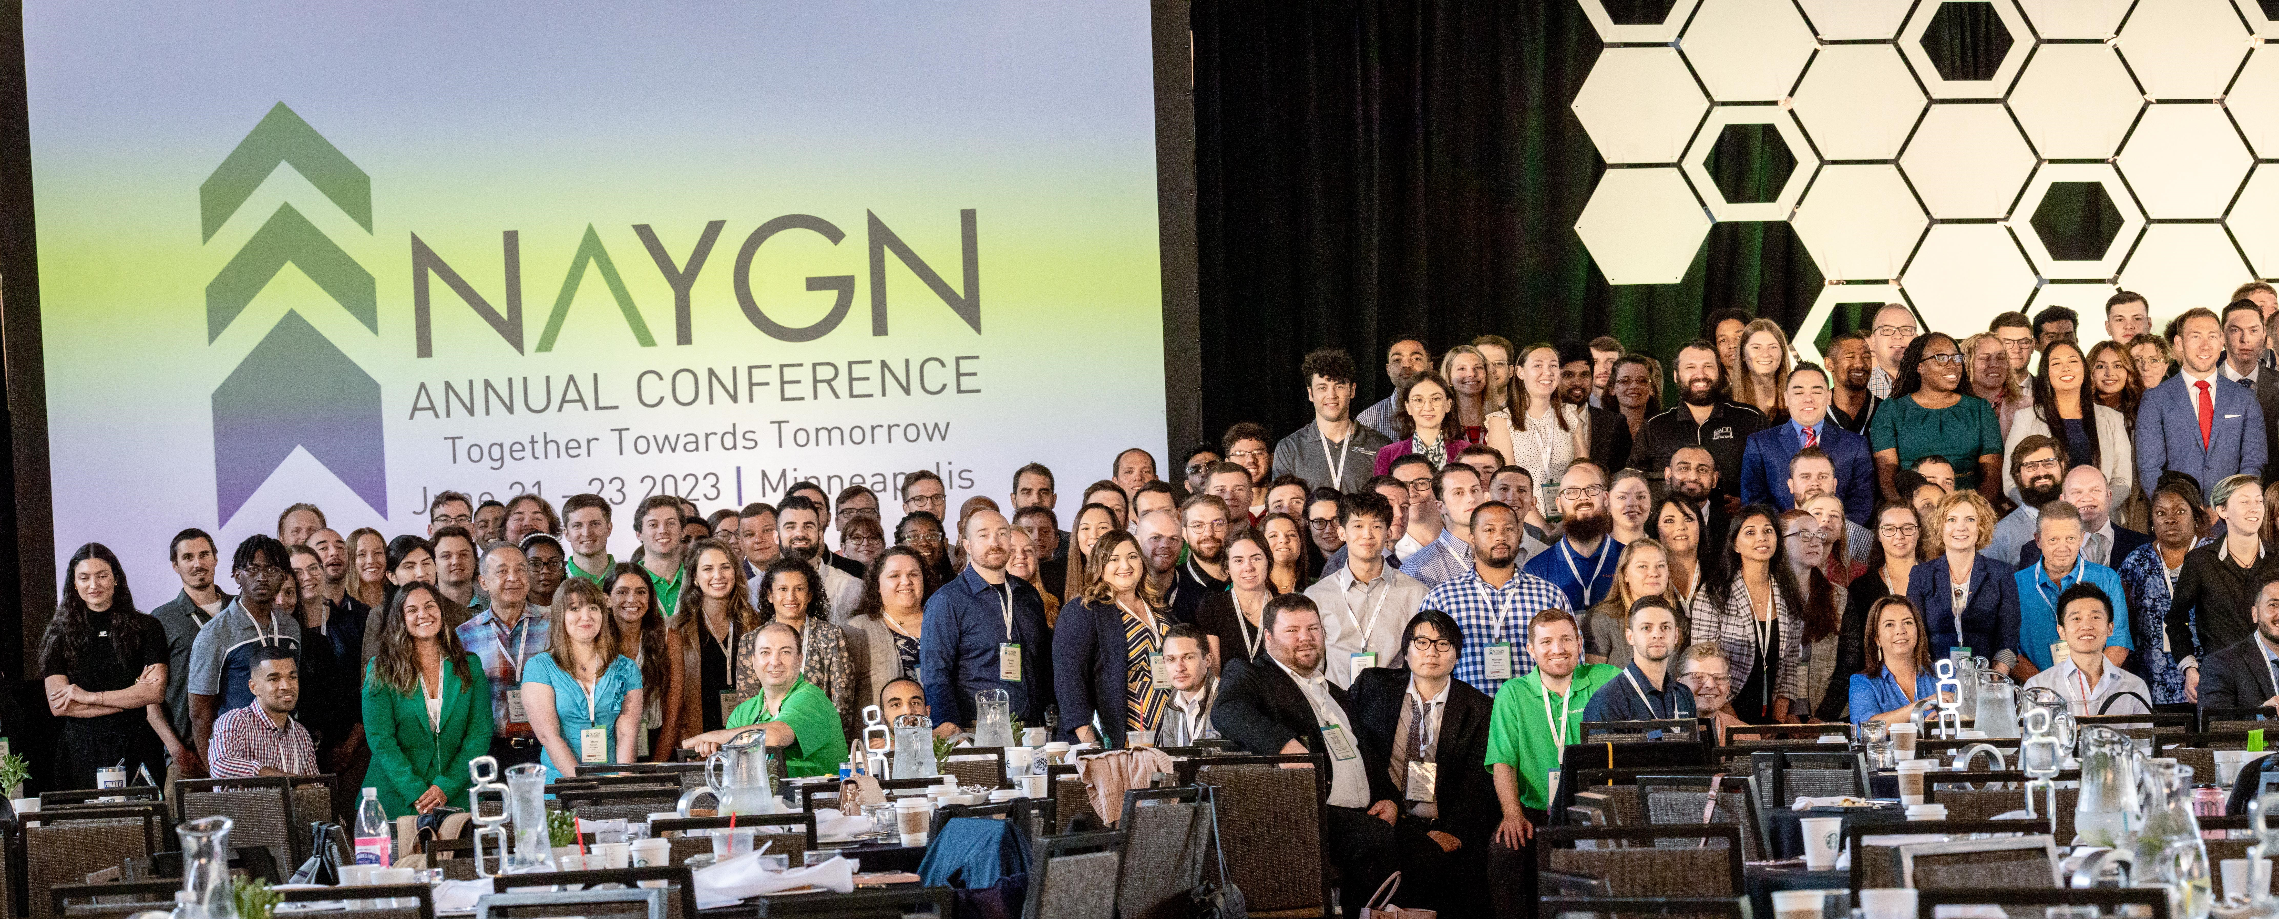
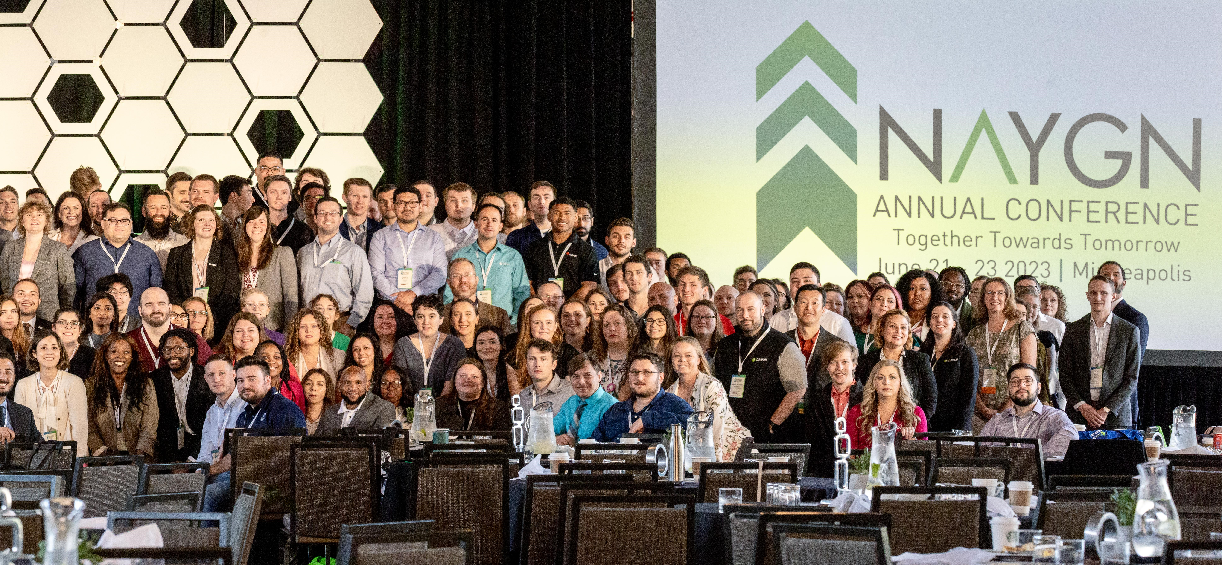
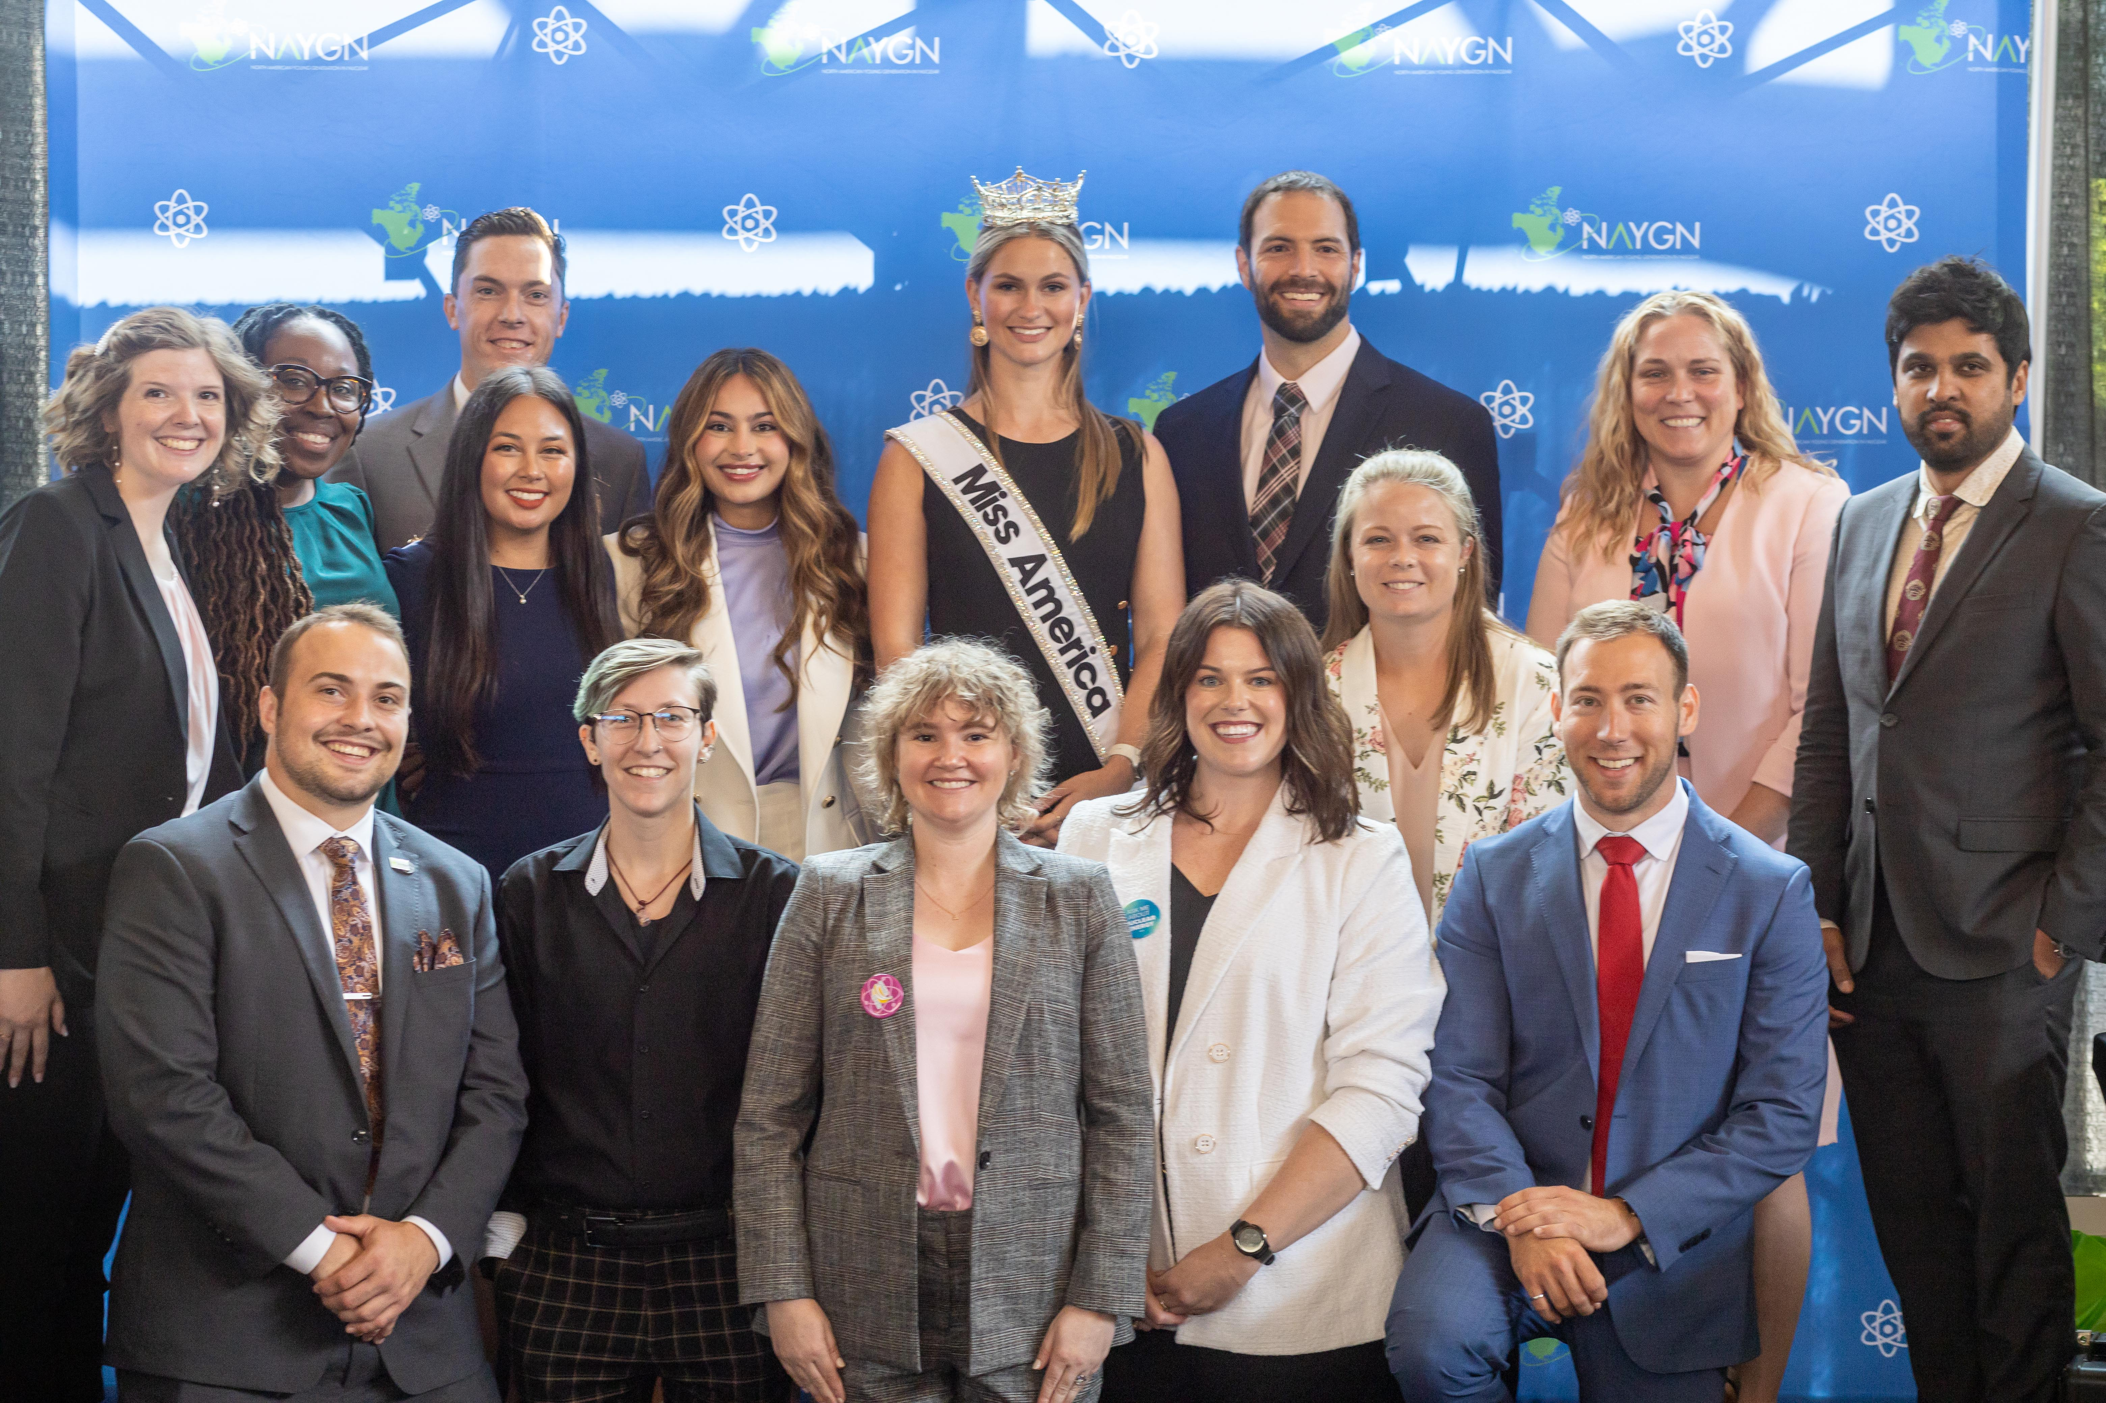
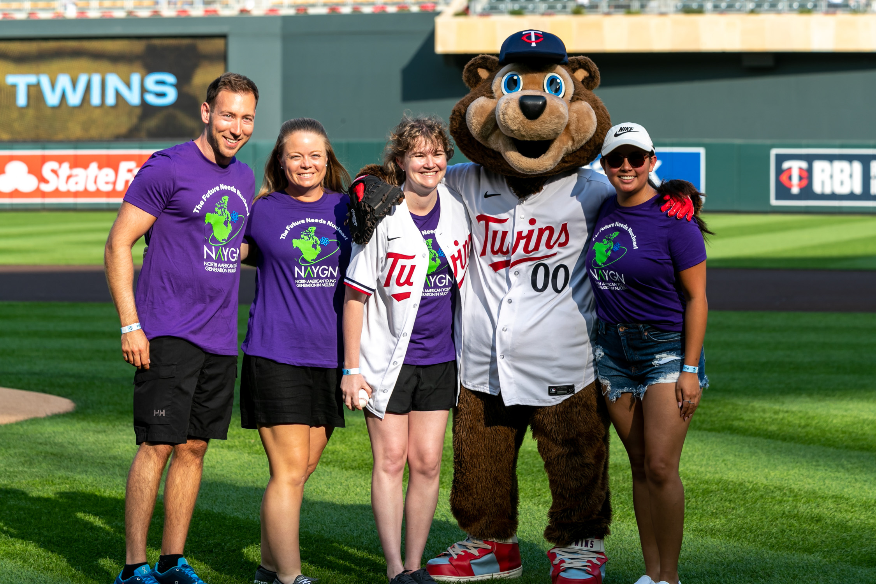
NAYGN Conference
BWR/PWR tour, Miss America, IsoDope, Twins Game, photos
DEI panel, Fusion, Nuclear Waste, workshops, much more!

Slide 7
Webinars Q1/2 2023
Innovating Nuclear Solutions for a Sustainable Future
Communication Clarity and Confidence webinar
Nuclear Fusion - Perspectives From Both Sides of the Pond
Black History Month Trivia!
Strategic Self-Awareness with Momentum Leadership Consulting
SMR Developments in North America and the UK
Professional Development Opportunity - World Nuclear University
Intro to Atomic Allies (NEI, ANS, US WiN, NAYGN)

Slide 8
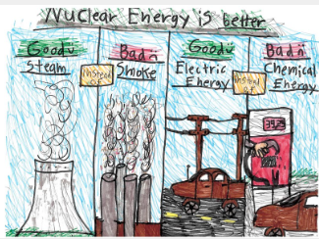
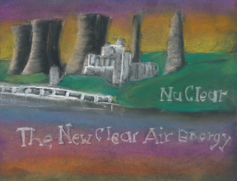
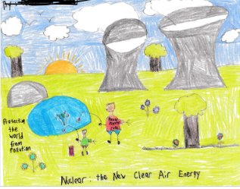
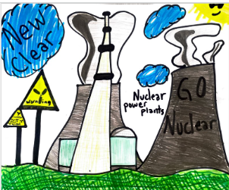
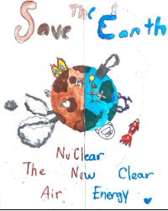
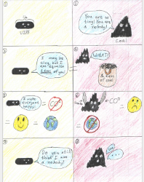
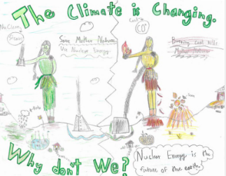
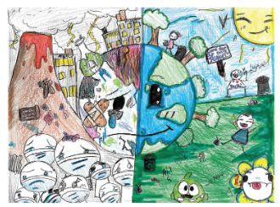
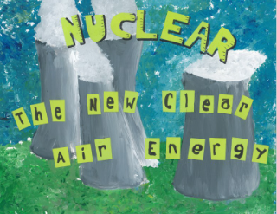
Public Information
25th annual drawing contest. NuClear: the NEW Clear Air Energy
Notes:
785 votes, tons of submissions!

Slide 9
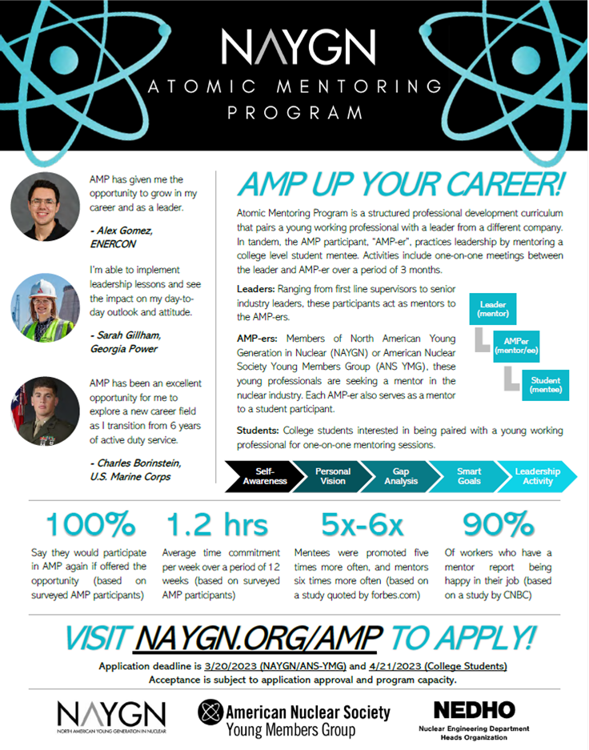
Professional Development
2nd cohort of the Atomic Mentorship Program (30 students, 30 mentees, 30 mentors). 2023 NucLEADers cohort (20 participants)

Slide 10


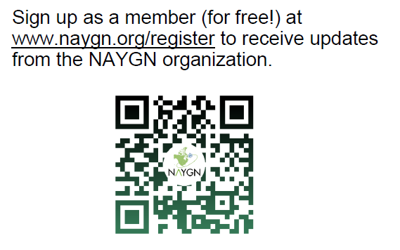




info@naygn.org
www.naygn.org
@na_ygn
@NA_YGN
North American Young Generation in Nuclear - NAYGN
@NA_YGN

