Slide 1
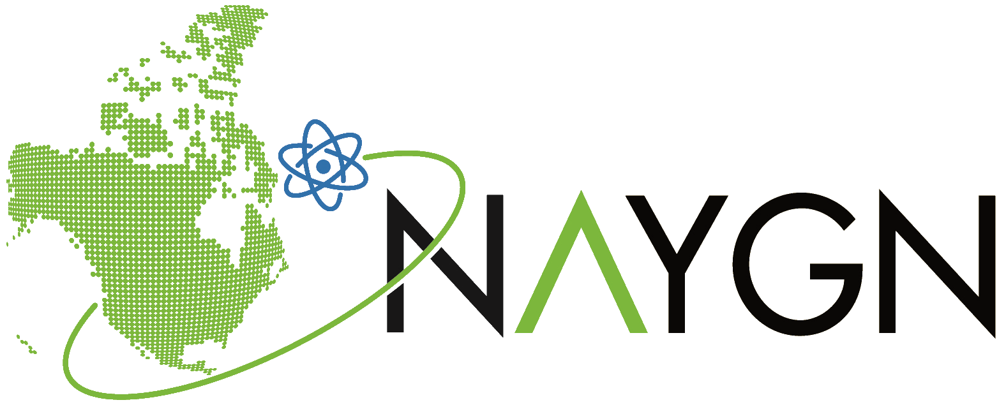
North American Young Generation in Nuclear (NAYGN)
North American Young Generation in Nuclear (NAYGN) is a 501(c)(6) non-profit organization which provides opportunities for a young generation of nuclear enthusiasts to develop strong leadership and professional skills, create lifelong connections, engage and inform the public, and inspire today’s nuclear technology professionals to meet the challenges of the 21st century.
Types of Events:
Professional Development (Resume Building, Interview Workshops, Financial Wellness, Technical Talks)
Volunteer (River Clean-ups, Helping at Festivals, Charity Golf Tournaments, Food Kitchens, Mentoring)
Public Information/Outreach (STEM Days, Plant Visits/Tours, Career Days, Supporting local schools)
Socials (Local Meetups, Trivia Nights, Boardgame Nights, Brewery Tours, Happy Hours)
Regional and National NAYGN conferences are a great spot to network with the nuclear industry
Register for free HERE, list of chapters HERE, and learn how to start a new chapter HERE
Make sure to ask your local chapter to get on their mailing list for Local/Site Events!

Slide 2
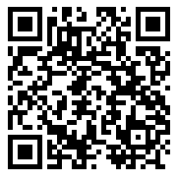
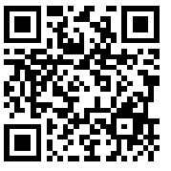
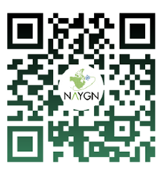
Contact or Find us on Social Media!
What is NAYGN? Video
info@naygn.org
www.naygn.org
Register to be a member (for free!)
www.naygn.org/register to receive
updates from the NAYGN organization
@na_ygn
@NA_YGN
North American Young Generation in Nuclear - NAYGN
NAYGN Link Tree
Upcoming Events/Topics
@NA_YGN

