Slide 1
INPO NAYGN Chapter

Slide 2
The mission of the NAYGN INPO Chapter is to develop nuclear professionals and building relationships among those, both new and experienced, who have an interest in the nuclear industry.

Slide 3
NAYGN INPO Chapter
Developing leaders to energize the future of nuclear
Chapter focus areas
  Knowledge Labs (Knowledge Transfer)
  Professional Development
  Public Service / School Outreach & Education
  Networking
Membership

Slide 4
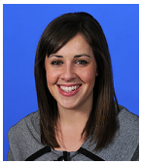
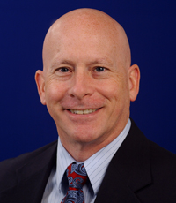
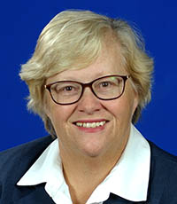
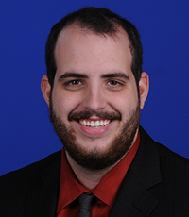
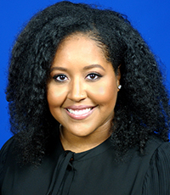
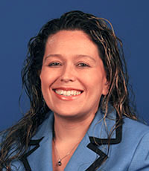
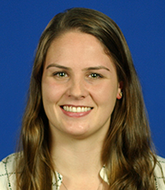
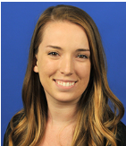
INPO Chapter
Board of Directors
Darcy Quintana
Chair
Jeff Place
Executive Sponsor
Lisa Brattin
Executive Sponsor
Patrick Dickerson
Vice Chair - KT
Gio Montanes-Durand
WANO-YG Lead
Anna Jones
Vice Chair - PR
MaryKate McNulty
Secretary
Danielle Emby
Treasurer
Special Events Dir.
Advisors

Slide 5
INPO Chapter
Board of Directors
Darcy Quintana
Chair
Jeff Place
Executive Sponsor
Lisa Brattin
Executive Sponsor
Patrick Dickerson
Vice Chair - KT
Gio Montanes-Durand
WANO-YG Lead
Anna Jones
Vice Chair - PR
MaryKate McNulty
Secretary
Danielle Emby
Treasurer
Special Events Dir.

Slide 6
2019 Accomplishments
Knowledge Transfer
Several Knowledge Labs
INPO’s Nuclear Fundamentals Course
Professional Development
EAG Luncheon, National/Regional Meetings, WANO Young Generation Exchange Assembly
Public Service
Nuclear Fundamentals (Public Education)
  Taught +50,000 students since 2010

Slide 7
2022 Focus
Continuous learning with Knowledge Labs
Collaborate with other ERGs
Reconsider NAYGN’s strategic design and goals
Influence/support the industry’s YGs
Interact/support WANO YG
Engage all INPO Employees

Slide 8
Membership
Interested in becoming a member?
  Contact quintanaed@inpo.org to join!
Visit our webpage for more information:
  http://myion/corp/ERG/NAYGN

Slide 9
Questions?

