Slide 1

2020 November Local Chapter Lead Meeting
Matthew Mairinger, Canadian Operating Officer
Canada@naygn.org
November 24, 2020
Notes:
We’ll start off with Safety.
Please stop and look around your areas for any potential hazards that would affect you leaving your area safely in case of an emergency. If there are any hazards, please take a moment to eliminate them. Make sure we are also following our COVID-19 protocols.
If you have to get off the call, I’ll be glad to catch you up at a later time.
Also, this meeting is being recorded.

Slide 2
Agenda
Metrics
Canadian nuclear news
2020 Regional Conferences
NAYGN Committee Updates
  Professional Development Opportunities
  Public Information Opportunities
  Communications Update
Open discussion
Notes:
Metrics update
Excellence Awards
Webinar
Information on our 2020 regional conferences
Committee updates
End with open discussion

Slide 3
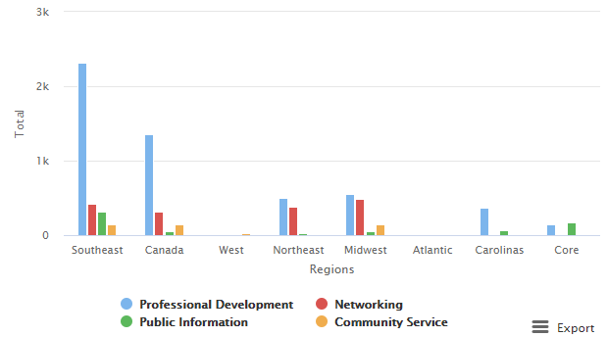
2020 Metrics
https://naygn.org/local-chapters/metrics/
Please submit 2020 metrics as they happen – submit for your chapter members attending virtual events/regional conferences!
Any questions/concerns (i.e. if you need to edit a submission, if your chapter doesn’t appear, etc.) email Canada@naygn.org or USA@naygn.org and we will fix it!
Notes:
Here are the current metrics for this year.
Please continue to add your metrics as you complete events throughout the year.
Any questions/concerns, please reach out!

Slide 4
Canadian nuclear news
Elections recently completed in Saskatchewan & New Brunswick - both premieres were re-elected.
  Important as there is an MOU between SK/ON/NB/AB for SMRs
SMR Action Plan release has been delayed a few weeks but is anticipated to be out in December 2020 (NAYGN has submitted an action plan) – more to follow.
The Centre for Canadian Nuclear Sustainability was launched
OPG resumes planning activities for Darlington New Nuclear
Canada to modernise and integrate nuclear waste management policy
  Participate in the discussion boards HERE

Slide 5
NAYGN becomes a community partner with CCNS
Wait, what is CCNS?
  Centre for Canadian Nuclear Sustainability – launched by OPG to support the clean energy lifecycle by developing sustainable solutions for the industry, environment, community and the economy. More information HERE
  Upcoming kickoff with Canadian chapter leads will be held soon.
  More to follow!

Slide 6
Regional Conference Dates
Region | Date(s)
Atlantic | DONE – please complete feedback survey: https://www.surveymonkey.com/r/2RYM5ZZ
Canada | November 27th
Midwest | December 9-10th (in conjunction with Southeast)
Northeast | DONE – please complete feedback survey: https://www.surveymonkey.com/r/2RYM5ZZ
Southeast | December 9-10th (in conjunction with Midwest)
West | DONE – please complete feedback survey: https://www.surveymonkey.com/r/2RYM5ZZ
Notes:
Regional conference season is here!
The Carolinas region started the NAYGN conference season off with a success virtual conference last week.
Here are the dates for the remaining conferences and we’ll go into details about a few upcoming ones.

Slide 7
Canada Regional Conference
Join us for the 2020 NAYGN Canada Regional Conference!
Date: November 27th
Location: Anywhere with a power outlet and WIFI!
Register HERE to attend. Visit the event website
Join other NAYGN members from across the country (and even the continent) for a digital conference on small modular reactor technology and nuclear advocacy training. The morning will feature a roundtable discussion with leaders from four different SMR companies and a presentation on new build deployment from Natural Resources Canada. The afternoon comprises a lunchtime social followed by two back-to-back seminars on nuclear advocacy run by subject matter experts from the Canadian Nuclear Association.
If you have any questions, please contact
Canada-region@naygn.org.
Notes:
Conference focusing on small modular reactor technology and nuclear advocacy.

Slide 8
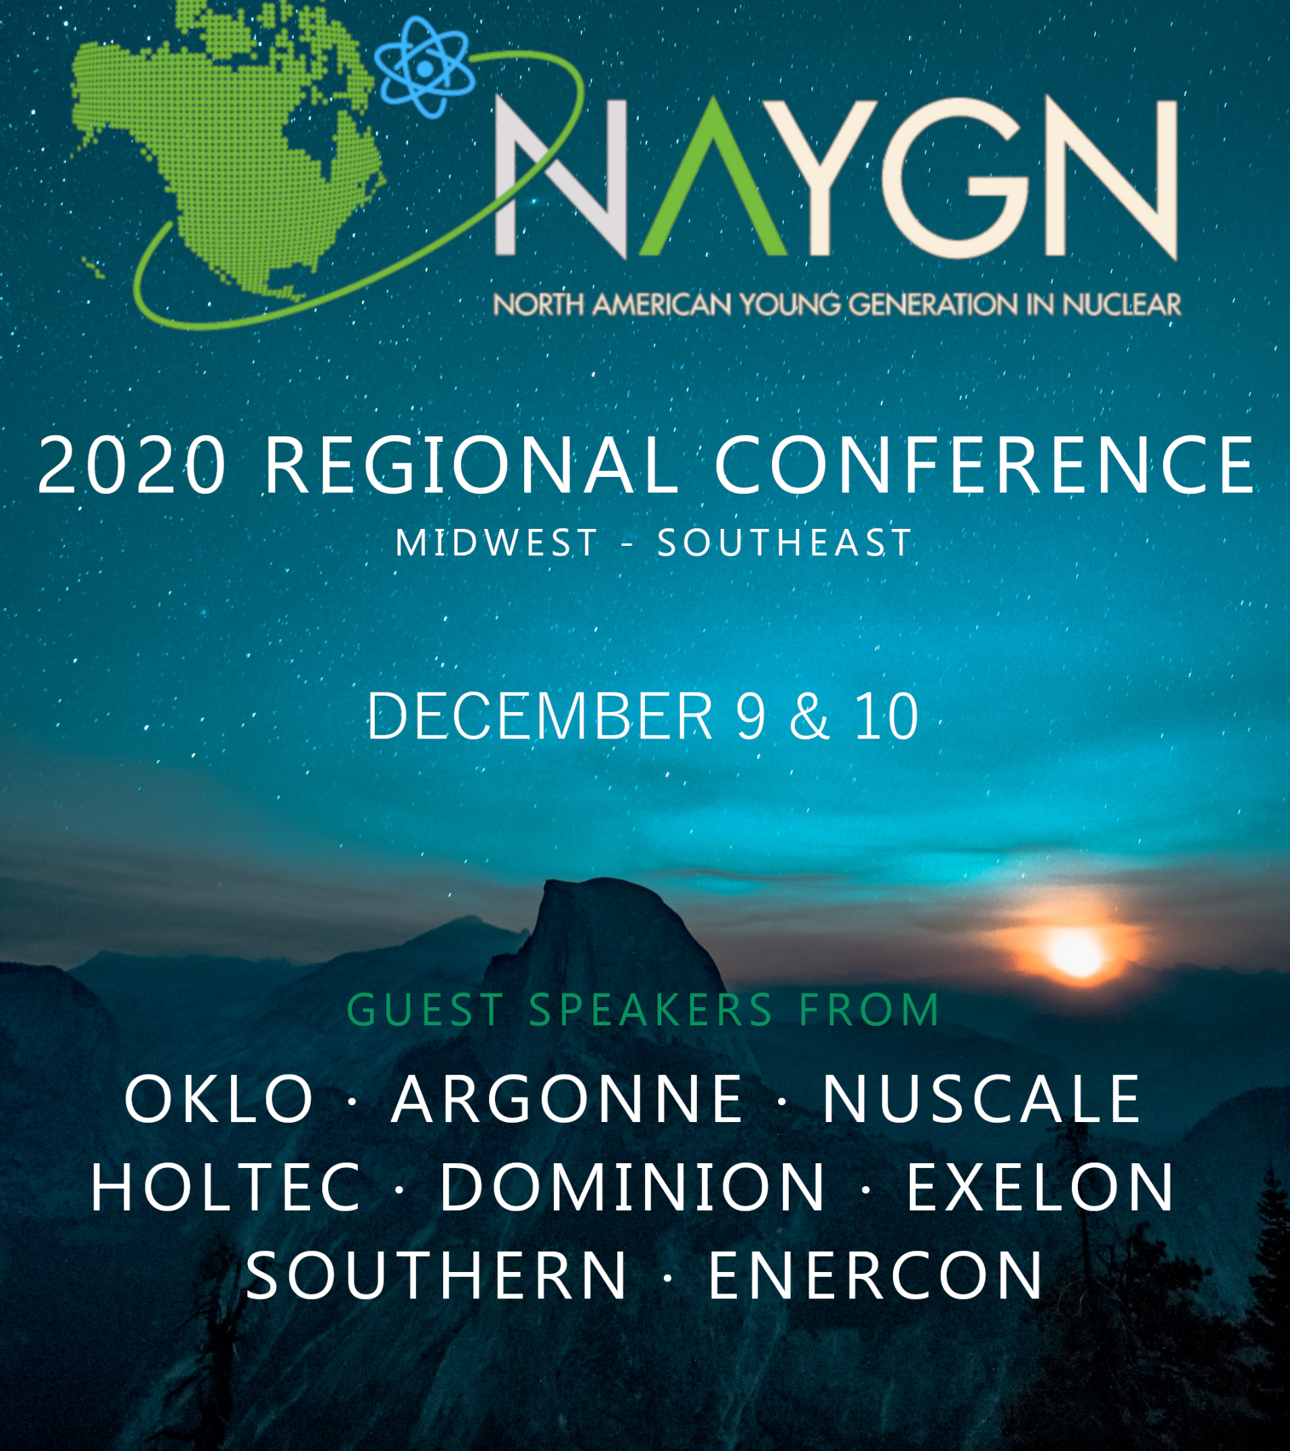
To register: https://tinyurl.com/naygn2020r
To login: https://tinyurl.com/naygn2020login
For additional details please contact MW or SE Regional leads:
Karthik.Makayee@exeloncorp.com
mahayes@tva.gov

Slide 9

Professional Development Opportunity
2021 NAYGN/NEA Conference will be virtual and likely in May 2021
More details to come
Are you interested in being on the conference planning committee?
  Email Jenny Gourley at pd@naygn.org
Notes:
The 2021 NEA conference will be virtual and we are looking for volunteers to help plan our upcoming conference.
Interested? Please contact Jenny Gourley at pd@naygn.org

Slide 10
Professional Development Book Club
When: Wednesday, December 16 at 1100 am EST
Topic: NAYGN PD Session on "How to Be an Inclusive Leader" and "Blind Spots"
Registration: https://naygn.webex.com/naygn/onstage/g.php?MTID=edb2bbdf0e6358c524912a99bac5fd944
Content: Materials will be shared with you after registration for review before the meeting.

Slide 11
Professional Development Webinar
When: Wednesday, January 27, 2021 200 pm EST
Topic: NAYGN PD Session with ScottMadden: The Effect of COVID-19 on Electricity Demand
Registration: https://naygn.webex.com/naygn/onstage/g.php?MTID=e2d4419e8b7c311e76b0cf7fac2d32e65

Slide 12
Advocacy Opportunity
Is your chapter looking for a way to stay active during Covid-19?
NAYGN recently purchased a subscription with SoftEdge and we need your help.
SoftEdge allows NAYGN to track active bills, legislator’s past votes, and social media posts so that we can take action.
NAYGN needs your help identifying items that are worth taking action.
Your chapter would be responsible for logging in to SoftEdge and identifying new hot topics that should be considered for action.
  Updates provided once a week.
  Length of volunteering is optional, but ideally 2-3 months.
Contact governmentoutreach@naygn.org

Slide 13
MegaWatt Card Game
If you are interested in an energy production themed card game, check out MegaWatt. This simple card game includes easy to follow instructions. Although mostly luck based, our fellow members at NAYGN Durham & Bruce have tested the card game and can confirm it is a great way to inform the general public on facts about energy sources! If your chapter has some end of year funding (or you need a nerdy holiday gift for someone on your list), put in your order now by visiting their website. Each deck is $27 USD and all proceeds are donated to the Eden Reforestation Projects. Bring this game to a classroom near you as an interactive activity to keep students engaged!

Slide 14

Essay Contest
Students in 9th through 12th grade are eligible to participate in this contest.
Nuclear power has numerous advantages over other forms of power generation. Write about the number one advantage you think nuclear power generation has over all other forms of electricity generation.
Reach out to schooloutreach@naygn.org for more details.
Submission deadline: Dec 31st

Slide 15
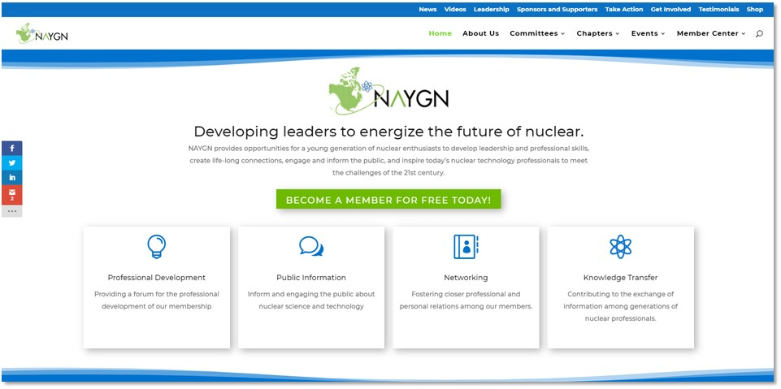
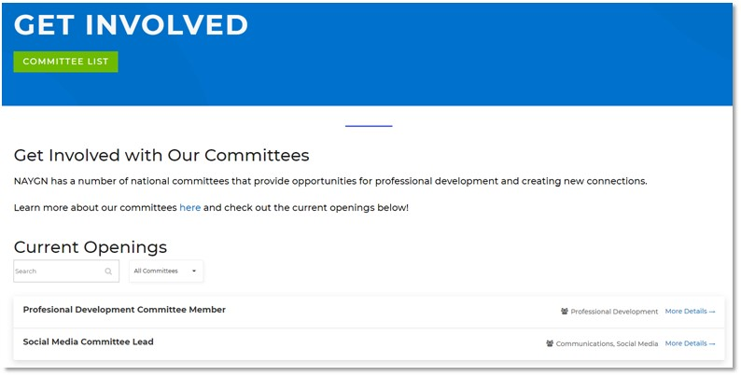
Website Update
Notes:
Contact usa@naygn.org or Canada@naygn.org with the amazing things your chapter is doing!

Slide 16
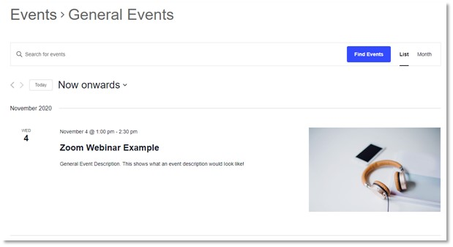
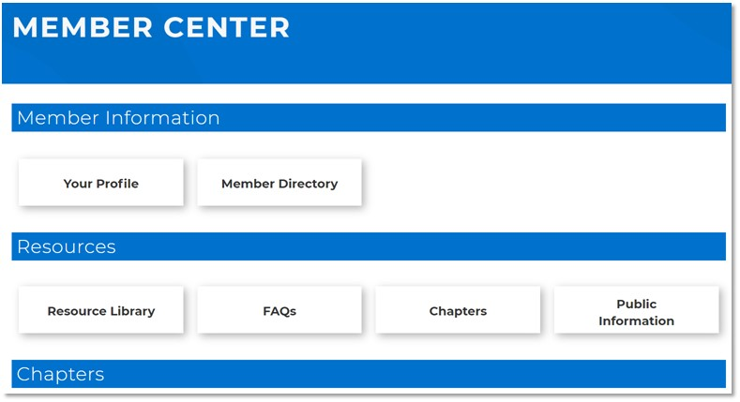
Website Update
Notes:
Contact usa@naygn.org or Canada@naygn.org with the amazing things your chapter is doing!

Slide 17
Best Practices
Share what your chapter is doing!!
Notes:
Contact usa@naygn.org or Canada@naygn.org with the amazing things your chapter is doing!
We would love to highlight all of the great work that you’re doing!

Slide 18
Questions?
What would you like to see discussed on future LCL calls?

Slide 19
Open discussion with NAYGN President
Notes:
Before we turn it over to our president, Amber, I want to open it up for any questions or comments that you may have.
Ok, over to you Amber.

