Slide 1
Perspectives on Advanced Technology
NAYGN Conference - May 22, 2017
  Presenters
  Dave Schumacher, Director of The New Fire
  Robert Daum, Electric Power Research Institute
  Jacob DeWitte, Oklo Inc.
  Jeff Harper, X-energy, LLC
  Facilitator
  Steven Buck, NAYGN / Exelon Generation

Slide 2

Perspectives on Advanced Technology
  Dave Schumacher, Director of The New Fire
newfiremovie.com

Slide 3
Perspectives on Advanced Technology
Robert S. Daum, Ph.D.
Senior Program Manager, Fuel Reliability Program
Electric Power Research Institute
North American Young Generation in Nuclear
Working for America Meeting
Scottsdale, Arizona
May 22, 2017

Slide 4
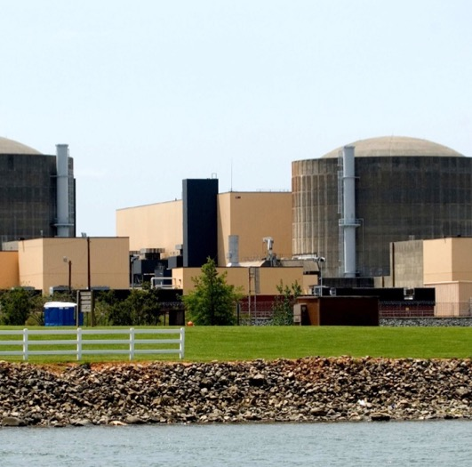
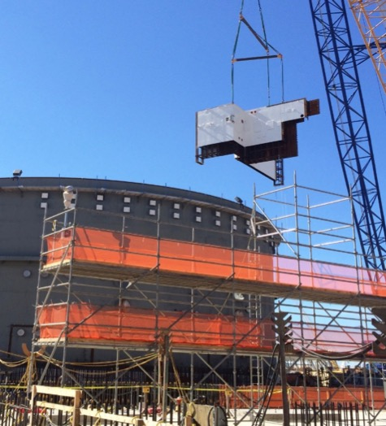
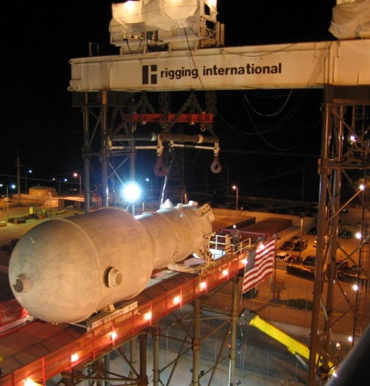
Strategic Benefits of Advanced Nuclear Technologies
Maximize
the safe utilization of existing nuclear assets
Enable
the deployment of advanced nuclear technologies
Assess
long-term sustainability of nuclear energy

Slide 5
Opportunities and Timely Benefits
Advanced technologies permit (or promise to) workflow efficiencies and simplifications, enabling reductions in cost, work scope, lead time, dose, regulation, etc.
  Directly supports the Delivering the Nuclear Promise Initiative with enhanced safety and security while doing our jobs smarter
  …here are some examples

Slide 6
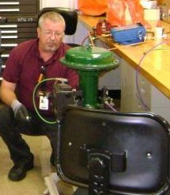
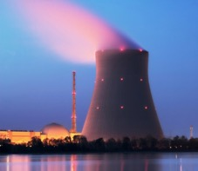


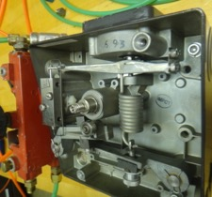
Advanced Maintenance Tools
Improving the delivery of technical information and maintenance instruction to empower the maintenance worker
Operating Experience
Subject Matter Expert
Tablet
Tablet
Maintenance Instruction
Components

Slide 7
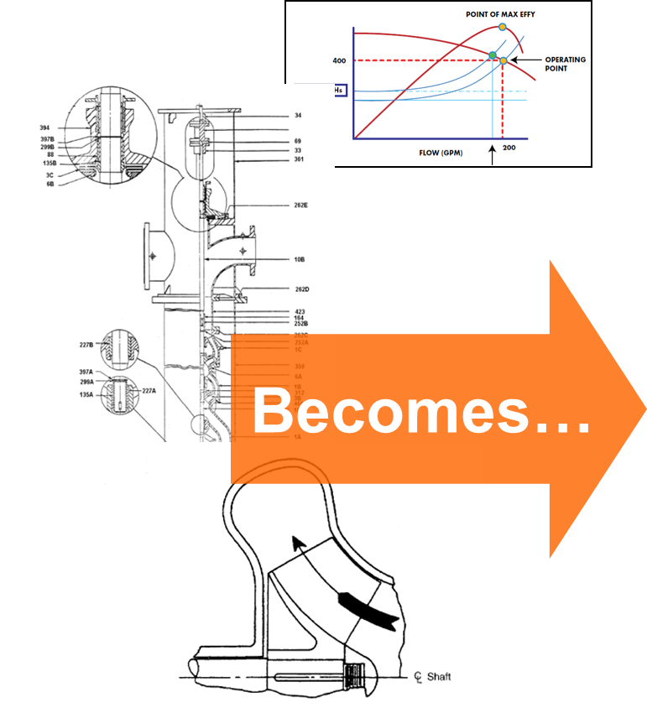
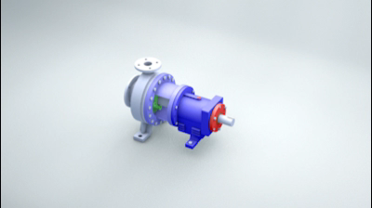
Advanced Maintenance Tools (cont’d)

Slide 8
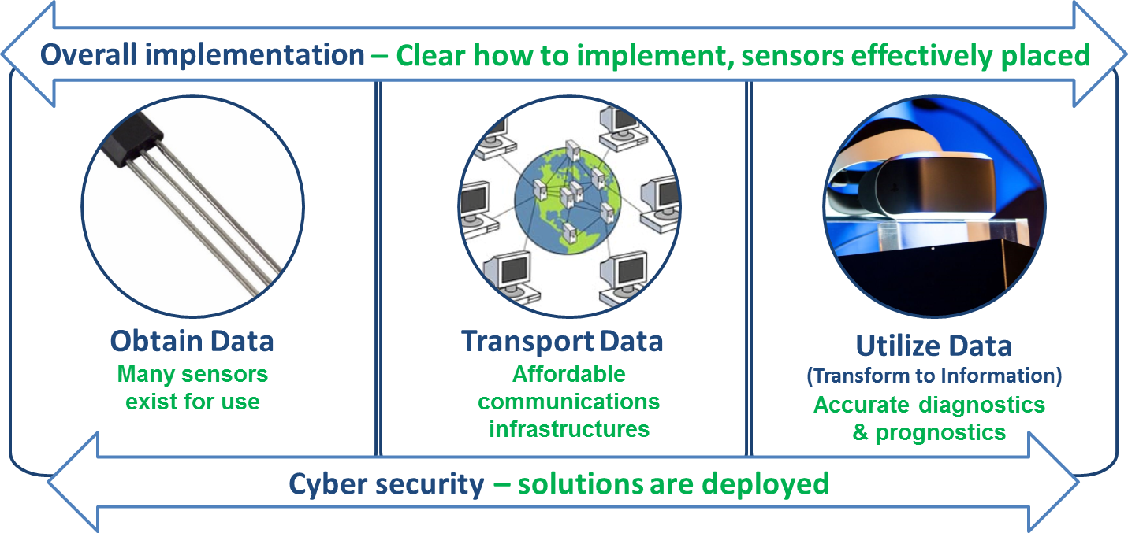
Advanced Monitoring of Plant Health

Slide 9

Advanced Technology for Training
Standardization across company, fleets, industry
Collaboration – in development and delivery
Shared resources
Increased use of on-line and distance learning
Simulated action and environments
Gamification

Slide 10

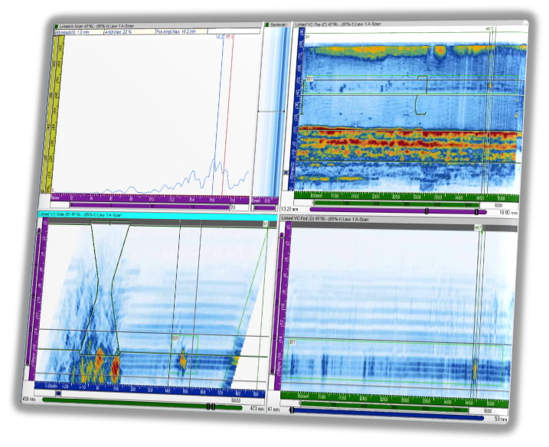
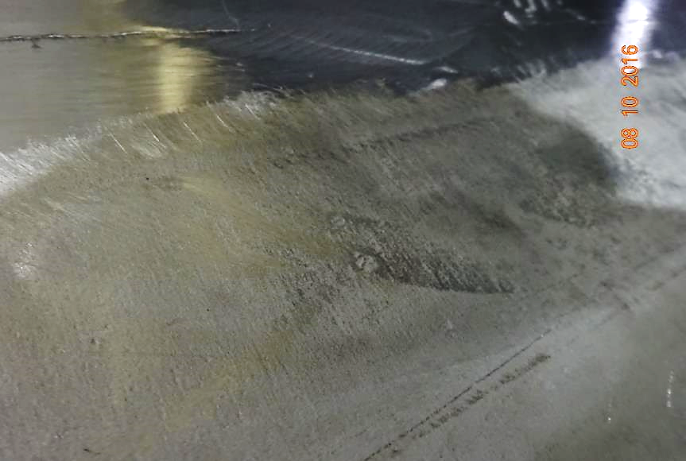
Advanced Inspection and Analytics
Case 1
Case 2
3D Visualization – Bruce Greer, Glenn Yellico
Improve defect detection
Inspect faster and more efficiently

Slide 11
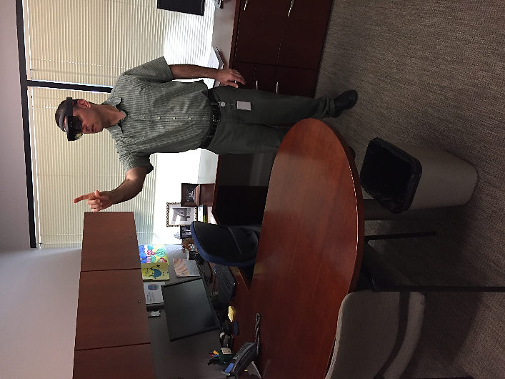
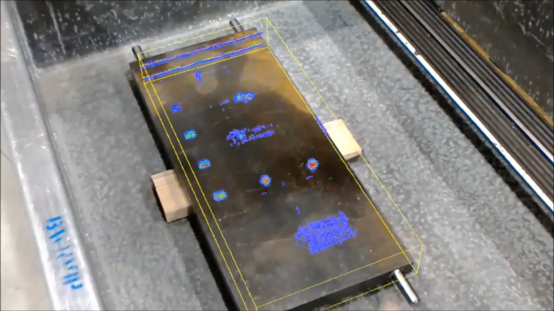
Advanced Inspection and Analytics (cont’d)
Augmented Reality provides efficiencies and/or reductions with
  Training and inspector proficiency
  Pre-job training and briefings
  Inspection consistency
  Dose and worker safety
  Inspection analyses

Slide 12
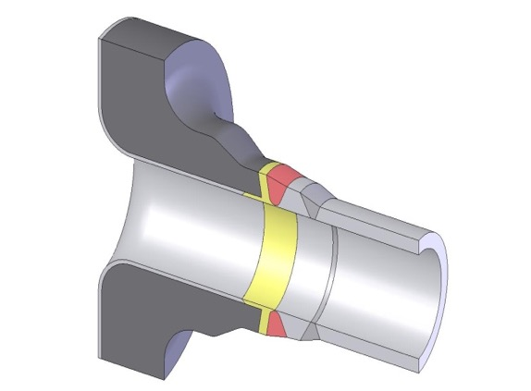
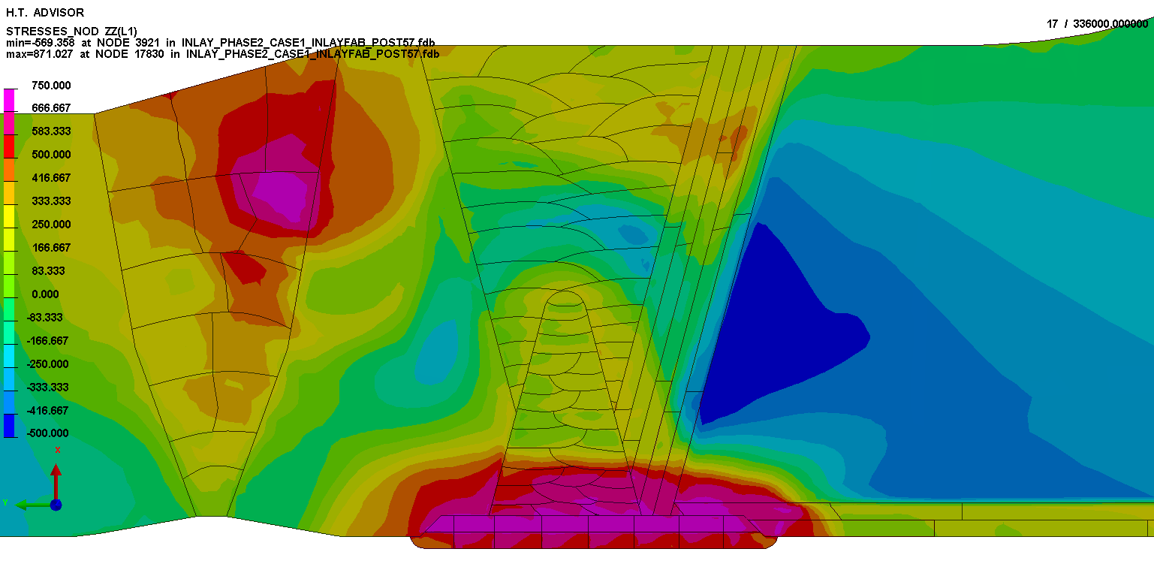
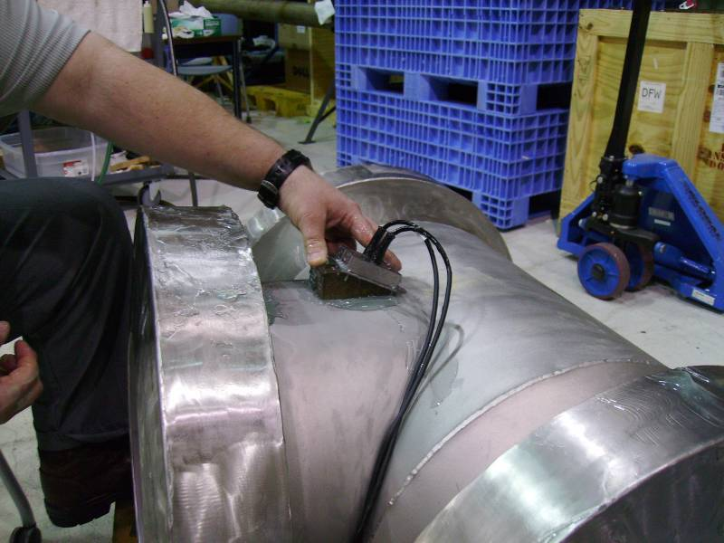
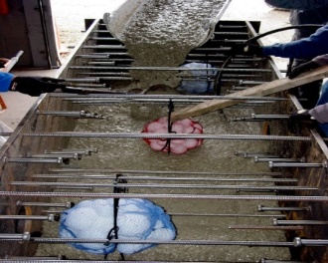
Advanced Materials and Components
Real Time Nondestructive Evaluation for Welding
Powder Metallurgy and Additive Manufacturing
Radiation-resistant Materials and Treatments
Advanced Concrete and Rebar
Enhanced Accident-tolerant Fuel

Slide 13
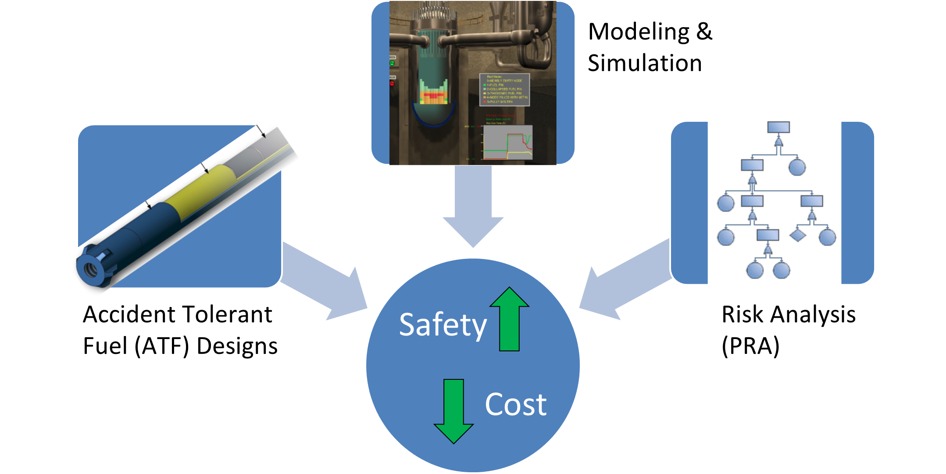
Advanced Tools for Accident Analysis and Mitigation

Slide 14
Summary
Advanced and innovative technologies are readily available and deployable in today’s nuclear industry
Successful transfer and implementation of these technologies will meet the safety, efficiency, and economic needs of the existing and future fleets
The young generation of engineers, technicians and mechanics are well suited for optimizing these technologies

Slide 16
Perspectives on Advanced Technology
  Jacob DeWitte, Oklo Inc.

Slide 17
Perspectives on Advanced Technology:
The Power of One
  Jeff Harper, X-energy, LLC

Slide 18
Global Energy Consumption
Heat and transportation represent 84% of the global energy consumption
Electricity accounts for 16%
Nuclear is limited to electricity production and is 15% of that market segment
Nuclear Energy – 15%
Source: International Energy Agency 2012

Slide 19
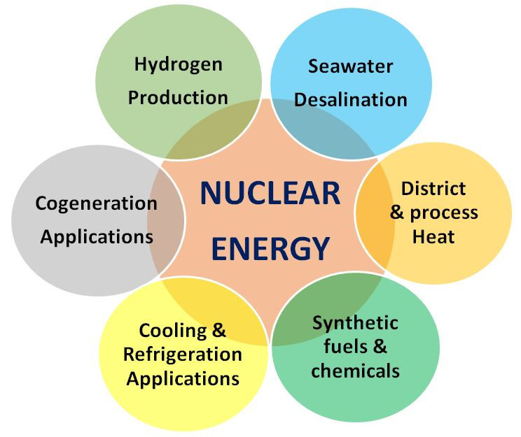
International Atomic Energy Agency
IAEA Non-Electric Applications of
Nuclear Power:
The role of the International Atomic Energy Agency (IAEA) as stated in its Statue and Medium Term Strategy is "To support and facilitate the development of new and emerging applications of nuclear technologies by co-generation and heat applications, including seawater desalination".
Source: IAEA 2016

Slide 20
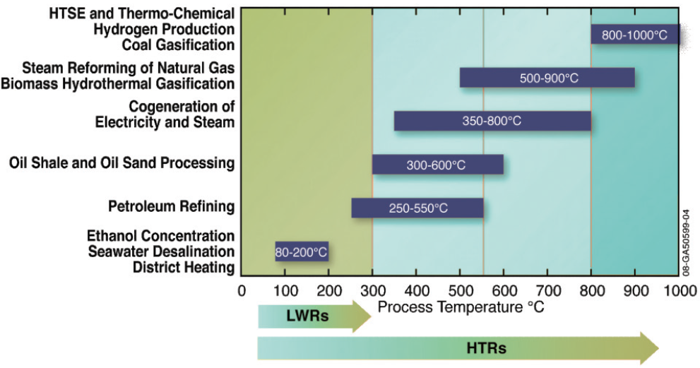
For Process Heat Usable/Required Temperatures
Source: Department of Energy

Slide 21
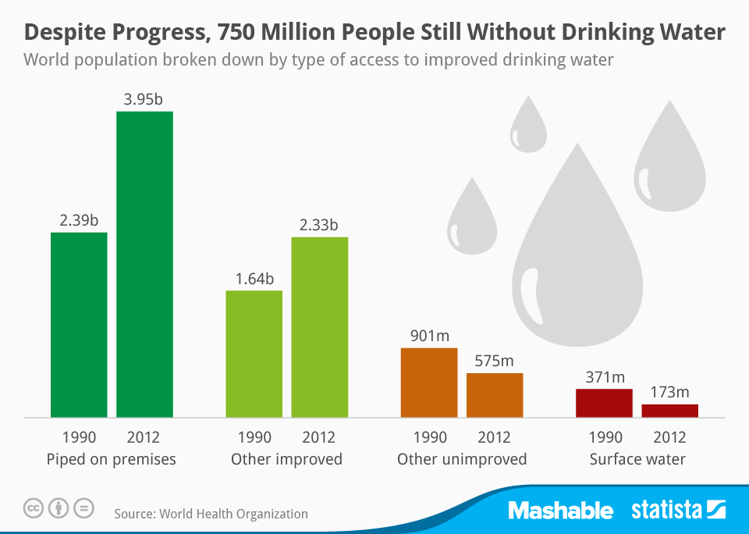
Water Crisis
The world is facing major water shortages with 750 million people lacking access to safe drinking water. The global water consumption rate doubles every twenty years, a pace that is double the rate of population growth.
If population and consumption trends persist, it is estimated that the global demand for clean water will surpass its availability by 56% and 1.8 billion people will be living in regions of water scarcity by 2025.
The World Economic Forum has stated that potential future regional water crises are a leading global risk with a far-reaching impact on society.
Source: World Health Organization 2014
Our Xe-100 reactor can be used to solve the water crisis through its application to salt water desalination plants and help provide inexpensive clean water for millions.

Slide 22
Who is X-energy?
Nuclear Design Engineering and Services Company
  Xe-100: 200MWt Pebble Bed Modular Reactor
  Nuclear Fuel: TRISO Fuel design and supply
  Services: Turn-Key nuclear projects; Engineering Support
  X-energy Strategy:
Maintain Simple Product Design
  Technically simple to design and operate
  Lowest possible plant/operational cost
Keep LCOE Competitive with Other Fuel Sources
  Natural gas combustion turbines
  Traditional nuclear
  Coal
Obtain NRC Design Certification (“Gold Standard”)
Be First to Market
  Leverage U.S. government and strategic partners to bring Xe-100 to the market by 2030
Leverage Existing Knowledge
  License existing HTGR technology where possible (subsystems, components, fuel)
  Leverage past lessons learned (South Africa, Germany)

Slide 23
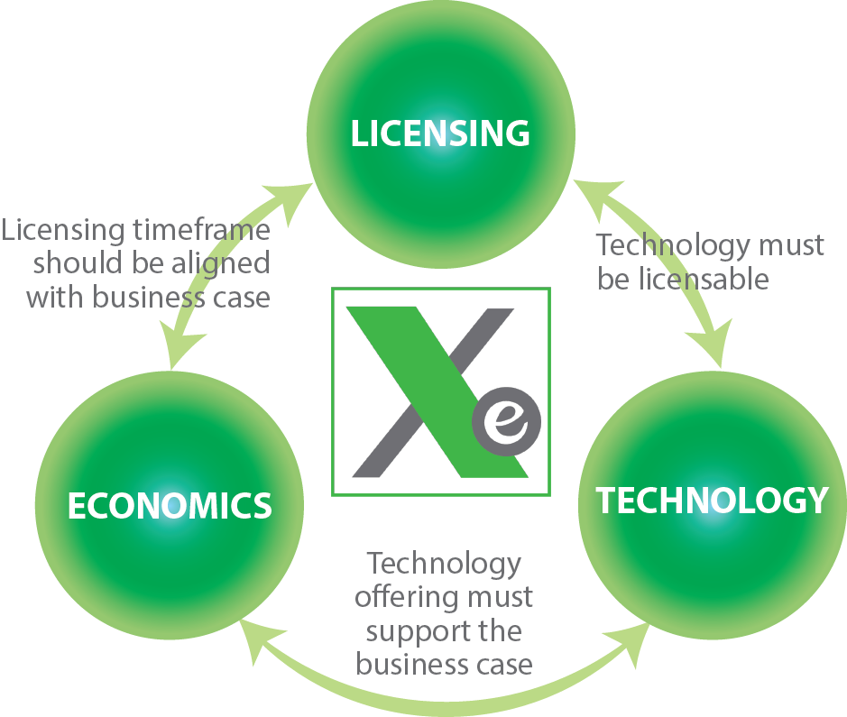
X-energy Innovation Model
  Economics:
  Markets? Customers? Competitive with other energy sources? Business Case?
  Licensing:
  Strategy? Technology? Personnel? Public Policy and Perception?
  Technology:
  Clean? Safe (meltdown proof)? Secure? Affordable? Small/Distributed? Scalable?

Slide 24
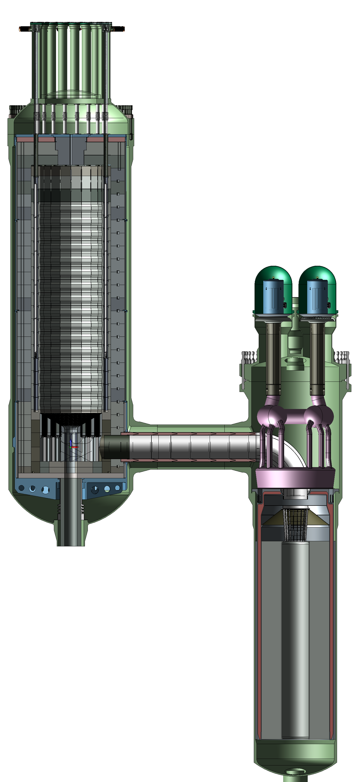
The Xe-100 Reactor
Control rods
Technology
The Xe-100 is a 200MWth/76MWe helium cooled power plant that features a 15.5% LEU fuel cycle
Small size and modular construction result in relatively low cost – single reactor plant of <$1B, expandable to 8 reactors on plant site
On-line fueling allows for continuous operations with minimal down times for maintenance and refurbishment
Benefits
The Xe-100 has the ability to perform rapid load following in real time with the power range of 100-40-100% and can replace and supplement other fuel sources (coal, wind, solar) to leverage existing transmission and distribution infrastructure
The heat source is based on pebble bed technology which has a proven meltdown proof core
The Xe-100 is a C0₂-free nuclear thermal power source that can be utilized for power generation, process heat applications, and water desalination
Graphite top
reflector
Steam Generator
Pebble bed
Graphite side
reflector
~20 Meters
Circulators
Graphite bottom
reflector
Steam collection manifold
Core barrel
Pressure vessel
Helical coil tubes (not shown)
Reactor
~4.88 Meters
Helium Flow Path
Feed water inlet
Xe-100 Reactor Specifications
Thermal Output | Steam Temperature | Steam Pressure | Electric Output
200MWth | 565ºC | 16.5MPa | ~76MWe

Slide 25
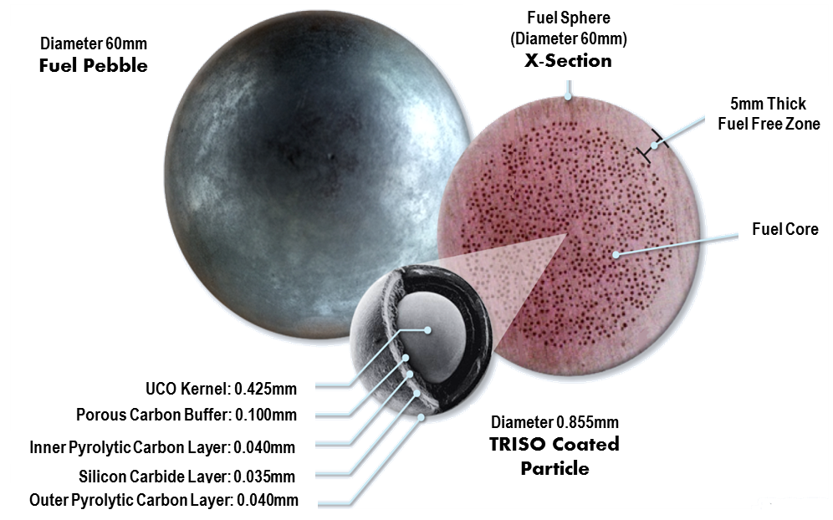
TRISO Fuel is the Key to Unsurpassed Safety
UCO TRISO coated particles act like pressure vessels to retain fission products
Leverage $400M investment by DOE thru NGNP/AGR programs
Pebble fuel development is a key thrust under our DOE Cooperative Agreement
Laboratory scale fabrication processes will lead to pilot scale production capacities
STATUS: Producing surrogate pebbles; working fab facility concept design

Slide 26
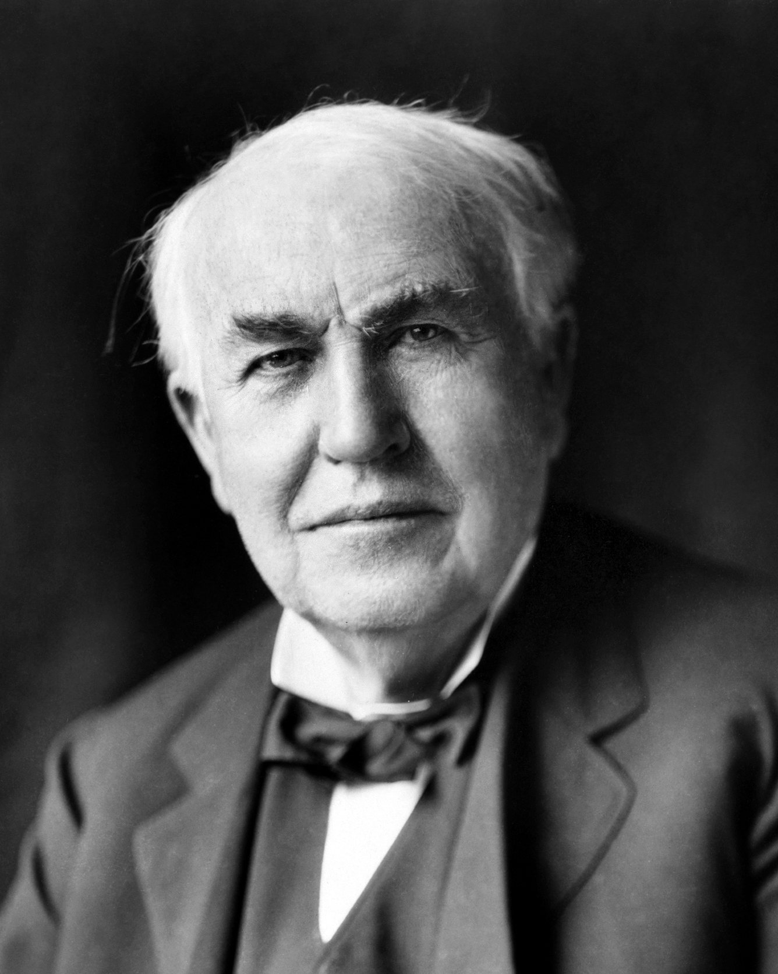
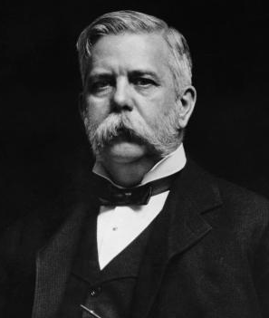
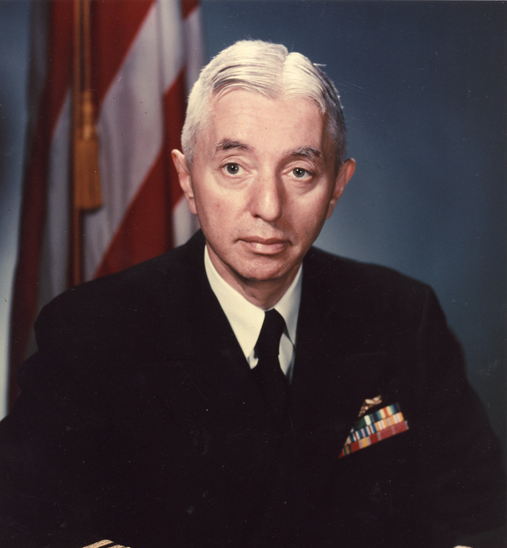
The Power of One: Game Changers
Thomas Edison
Inventor of electricity
George Westinghouse
- Created the widespread distribution system for electricity based on alternating current
Admiral Hyman Rickover
- Championed the first nuclear submarine and commercial nuclear power plant

Slide 27

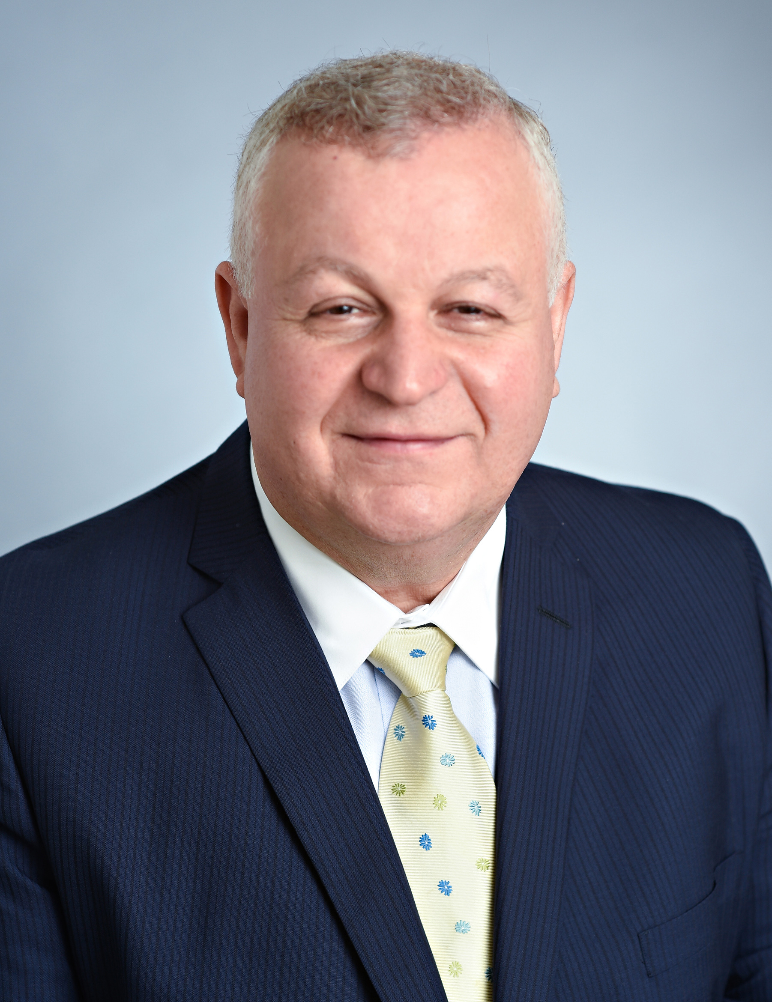
The Power of One: Potential Energy Game Changers
TerraPower
Initial champion for the information age through Microsoft.
“We need a massive amount of innovation in research and development on clean energy: next-generation nuclear plants that are even safer than today’s”
– Bill Gates, Founder & Chairman of TerraPower
X Energy, LLC
Co-founder of SGT, Inc. – 2nd largest engineering services contractor to NASA.
“I began X-energy because the world needs energy solutions that are clean, safe, secure, and affordable. With so much at stake, we cannot continue down the same path.”
- Dr. Kam Ghaffarian, Founder & CEO of X Energy, LLC

Slide 28

The Power of One: Future Energy Game Changers
What about you?
How will you fit into the transforming energy industry?

Slide 29
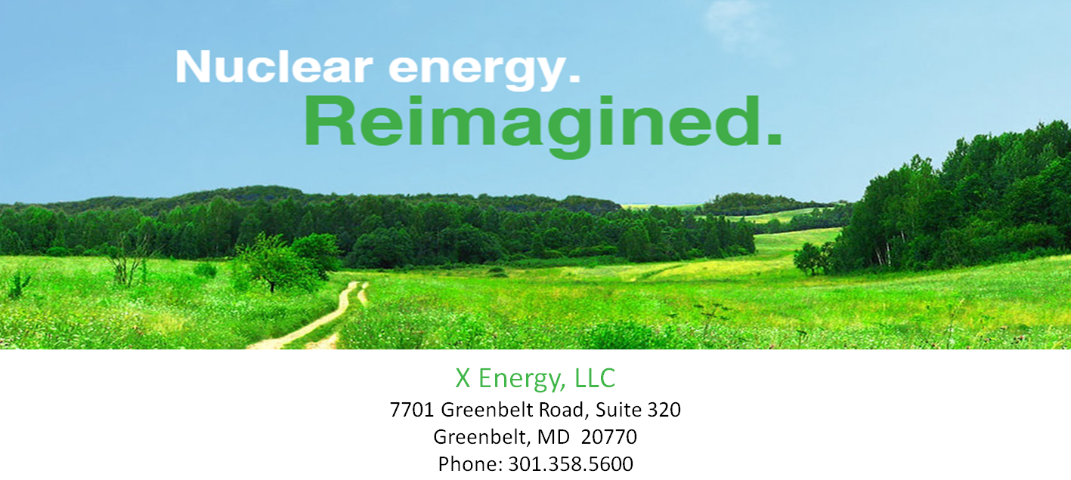
Contact Information

Slide 30
Questions
  Please use mobile app to submit questions for our presenters

Slide 31
  Thank you for attending this session.
  Please enjoy the rest of the conference.

