Slide 1
Nuclear Power Plant Operations
Nick Spitznagel
Josh Goodman
Devin Skelton
Notes:
DEVIN
- Introductions
- NAYGN
"Let's start with the basics. How much do you all know about atoms?"

Slide 2
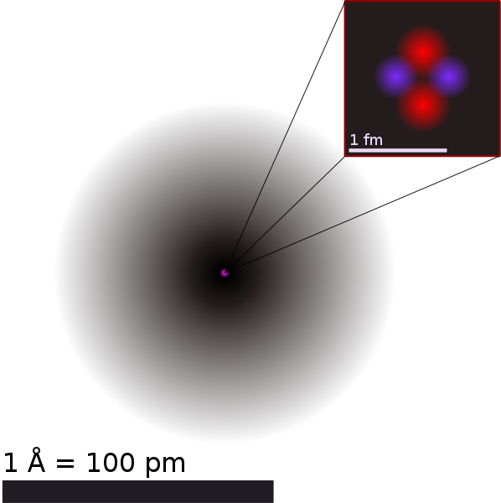
What is an Atom?
Notes:
DEVIN
- 3 Components: Protons, Neutrons, Electrons
- Protons + Neutrons = Nucleus, Nucleons
- Classic model – electrons orbit – actually more like cloud
3 components: protons, neutrons, and electrons
Protons and neutrons clump in the center, called the nucleus. Because protons and neutrons are found in the nucleus, we call them nucleons.
Electrons surround the nucleus. It's actually a bit more complicated than little spheres orbiting each other. The electrons act a little more like a cloud.

Slide 3
Elements
Notes:
- # protons = element
-Theoretically, any number of neutrons
- # neutrons = isotope
- if we expand the periodic table
The number of protons determines what element the atom is. Each element can have any number of neutrons. An element with a given number of neutrons is called an isotope. If we expand out periodic table to include all of the isotopes, we get something like this....

Slide 4
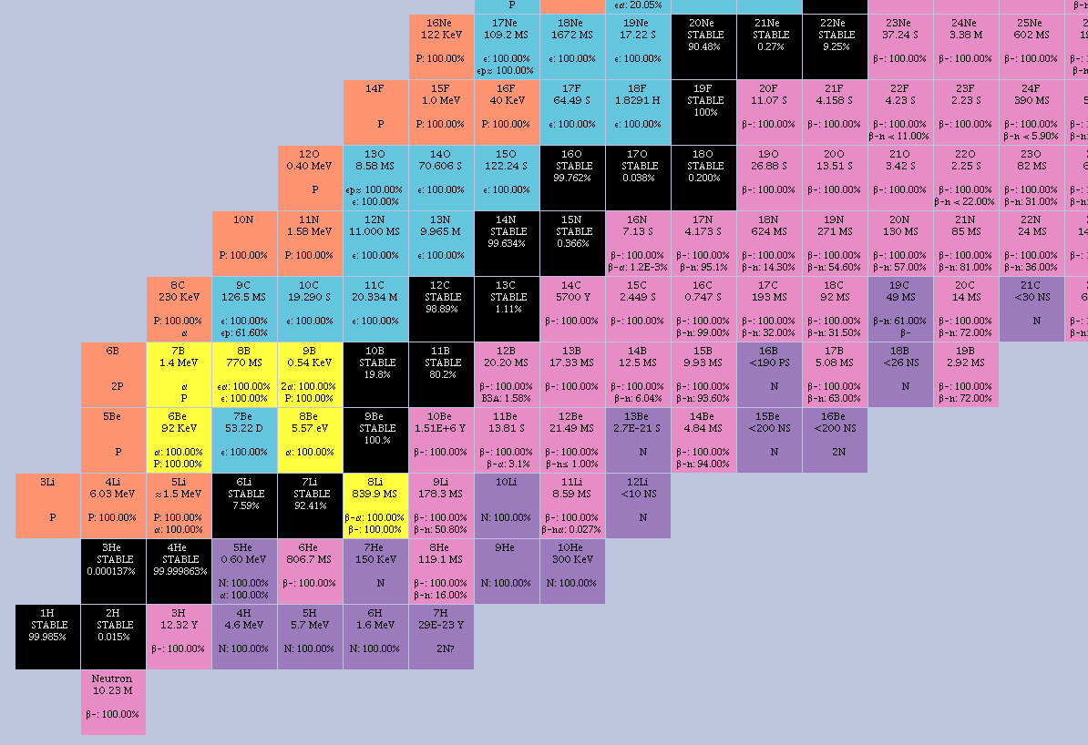
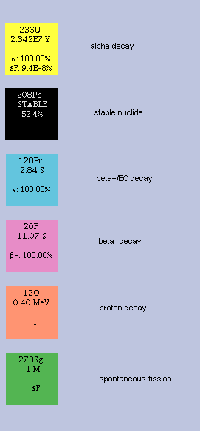
# Protons
(Element)
# Neutrons
(Isotopes)
Notes:
-Axis
-Not all Isotopes are stable
-Beryllium-9 (4 protons + 5 neutrons = 9 nucleons)
-Boron has 2 stable isotopes Boron-10 and Boron-11
-Other colors represent different unstable.
-These will decay. These decays release energy.
-We use uranium-235
We chart the elements based on the number of protons (or what element it is) on the y-axis. We chart the number of neutrons on the x-axis. However, not all isotopes are stable. Atoms like to have very roughly 1 neutron for every proton they have. The black squares represent the isotopes that are stable. So if we take a closer look *progress animation*, this is a stable isotope of Beryllium with 4 protons and 5 neutrons. We call this Beryllium-9 because it has 9 (4+5) nucleons in the nucleus. But if we look at Boron, it has two stable isotopes. Both have 5 protons, but one has 5 neutrons while the other has 6 neutrons forming Boron-10 and Boron-11 respectively. The other colors represent different forms of unstable isotopes. These unstable isotopes will perform different forms of decay until they reach a stable isotope. These decays release energy that we can make use of. In nuclear reactors, we usually use Uranium-235.

Slide 5
If this lollipop was made of Uranium-235...
=
Notes:
DEVIN
"It would meet the average American's energy needs for...
How many years?"
It contains so much energy that if this lollipop was made of Uranium-235:
It would supply the average American’s energy needs for 84 years.
The waste would be the size of this lollipop after 84 years.
It would eliminate 624 tons of greenhouse gas from equivalent coal generation.

Slide 6
What is radiation?
Notes:
-4 things that can be released or "radiated"
-Alpha, Beta, Gamma
-We can detect these with a geiger counter
-Radiation everywhere, Household products such as kitty litter and smoke detectors. Some foods such as bannannas.
-One of the jobs in a nuclear plant is radiation protection
-Lastly, we have neutrons. One of the most important in a nuclear reactor.
This energy comes from the things released from an atom during decay. The 4 things that can be released or "radiated" from the atom include Alpha particles, Beta Particles, Gamma rays, and neutrons. Alpha particles consist of 2 protons and 2 neutrons. This is the same as the nucleus of Helium-4. Because it's big, it carry's a lot of energy. But it can't fit between other atoms very well, so it is stopped by something as simple as a piece of paper. Beta particles are either an electron or a positron. Think of a positron as the positive version of an electron. They are very small, so they can slip between the atoms of low density materials, but they can be stopped reliably be denser and thicker materials. Gamma rays are high energy light. They can penetrate through most materials. They are usually only mitigated by very thick and dense materials. We can detect these three types of radiation with a geiger detector. This will beep everytime it detects one of these first three types of radiation. Radiation is everywhere. The sun and the universe bombard us with radiation all the time. Some rocks used in construction, such as granite, are slightly radioactive. Some household products are also radioactive such as kitty litter and smoke detectors. Even some food is lightly radioactive, such as bananas. *hold geiger counter over bowl of lolipos*. ...But not suckers. Anyone want to guess what's going on here? Before we knew better, uranium was sometimes used in ceramics and glass for color. In this case, the glaze of the fiestaware bowl contains uranium to give it that bright orange. One of the jobs in a nuclear plant is to determine how safe an area is based on the amount of radiation. We call this radiation protection. Lastly we have neutrons. Neutrons are one of the most important parts of a nuclear reactor.

Slide 7
How to sustain a reaction
Notes:
DEVIN
- Fission = Neutron collision + Atom split
- Neutrons MAY be released
- More collisions = Chain reaction
DEMONSTRATION
- Everyone is an atom
- Balloons are neutrons
- When YOU are hit by a balloon, you can throw YOUR balloon
"Did we get a chain reaction? Was it a good one? How can we improve it?"
- This is what a Core Designer like Nick does. How much fuel, where it goes, etc.
"But what if we want to control this reaction?"
- Catcher students = control rods.
When a neutron collides with an atom, the atom has a chance to fission. When fission occurs, the atom splits into two smaller atoms. Sometimes, more neutrons are released during fission. If those neutrons then go on to cause more fissions that create more neutrons, we can create a chain reaction. So let's try it. Everyone stand up. You all will be the atoms in our nuclear reactor and these balloons will be some of our neutrons. When you are hit by a balloon, you can throw your balloon.
Begin demonstration.
Start them far apart (perhaps at their desks). "Did we get a chain reaction? Was it a good one? How can we improve it?"
Ways to improve reaction: move everyone closer together, give everyone multiple balloons, inflate the balloons to be bigger
This is what a core designer does. We decide how much fuel is inserted in the reactor and where to put it.
"But what if we want to control this reaction?"
Assign some students to catch the balloons and drop them. These students act as control rods. Have the students throw again.

Slide 8
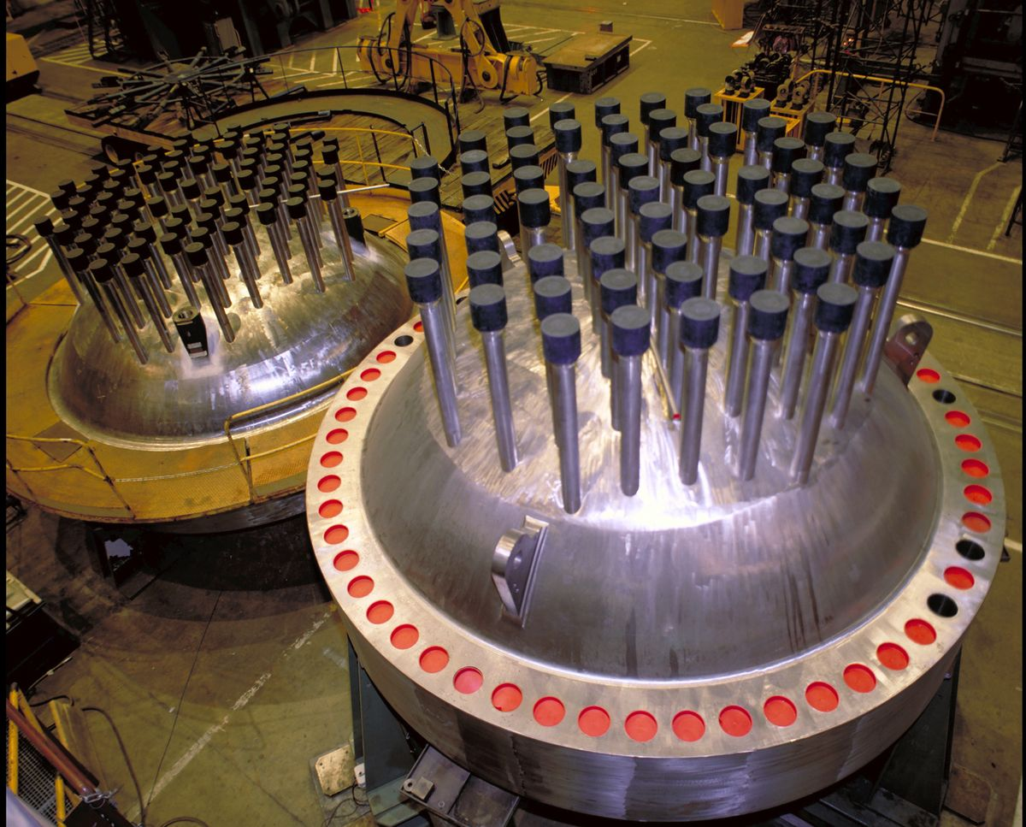
How do we control this process?
Notes:
DEVIN
- Operator controls on daily basis
- How many control rods -> Control power in reactor
- How do we convert to electricity?
- High energy particles lose some as heat
This is what a nuclear reactor operator does on a daily basis. They determine how many control rods need to be inserted in to the core. The control rods control the power in the reactor.
End of demonstration. Everyone can sit back down now.
So how do we convert this energy in the reactor into the electricity that runs in your walls? As all those particles fly around in the reactor, they impart some of their energy into their surroundings as heat.

Slide 9
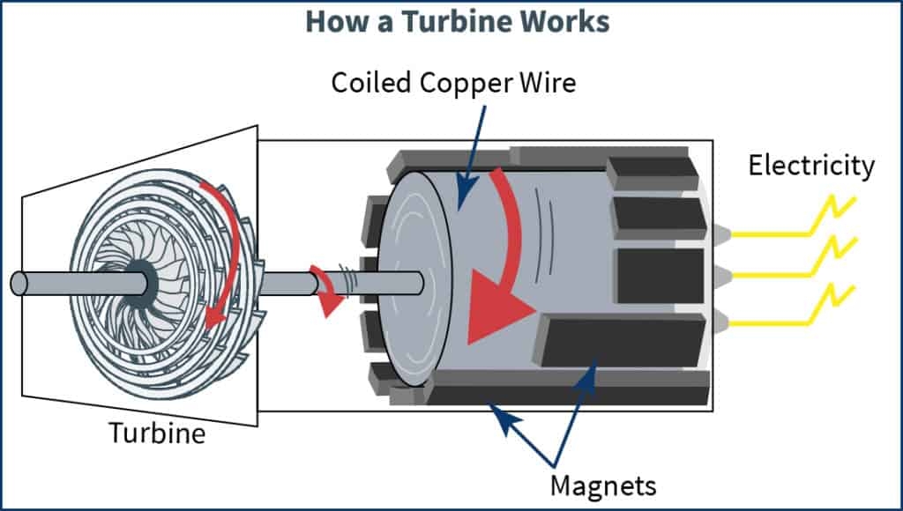
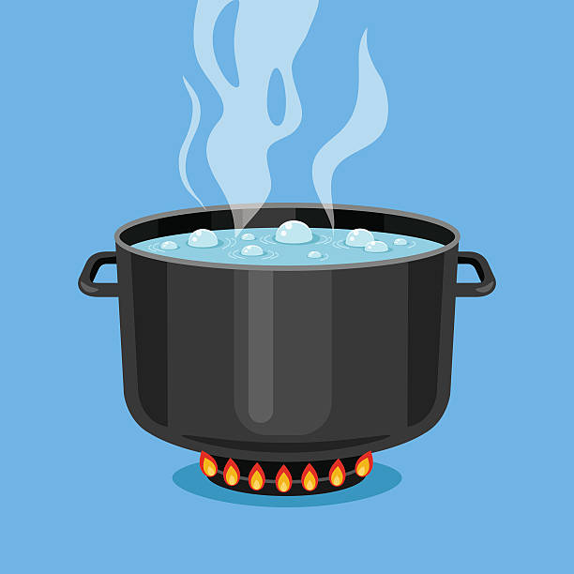
How we convert that heat energy to electrical energy
Notes:
DEVIN
- Overview of NPP
- Fission energy heats water
- Water boils to fast steam
- Steam spins turbine
- Turbine attached to electric generator
- Generator generates electricity
- Heat is energy! Sterling engine
We use that energy to heat up water. That water is eventually turned into steam. That steam is used to drive a turbine. The turbine then converts the energy into electricity. So we start with thermal energy, turn it into mechanical energy, then convert that mechanical energy into electrical energy. The take away is that heat is energy. We can demonstrate part of this with this sterling engine. It take the heat from this cup of hot water and converts it into mechanical energy by turning this fly wheel.

Slide 10
Fuel + Fission = Radiation + Heat
https://www.youtube.com/watch?v=tErnh-tv7Z0
Notes:
We have a video here summarizing all of this.

Slide 11
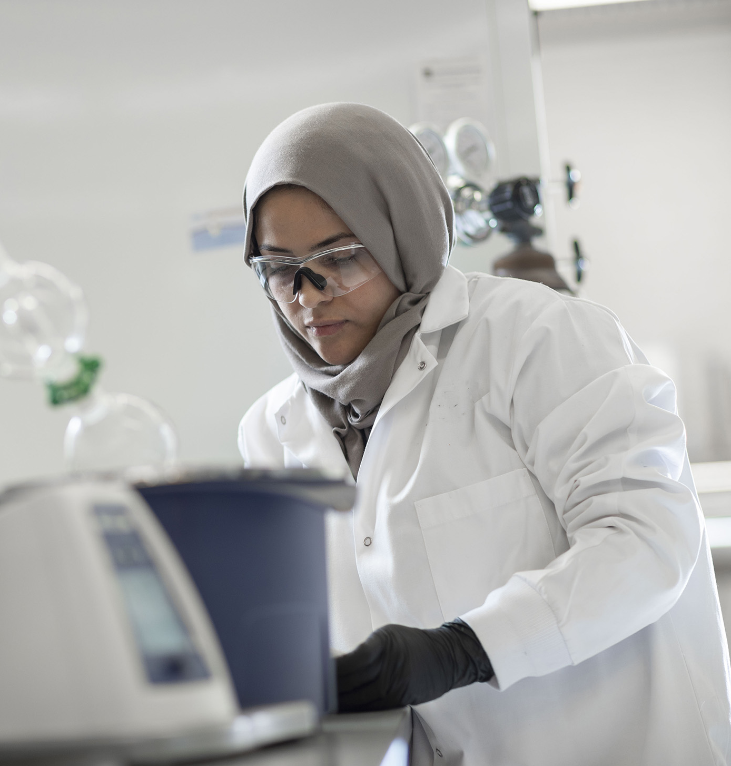
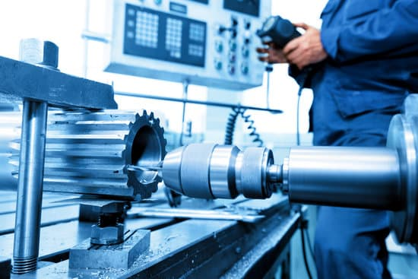
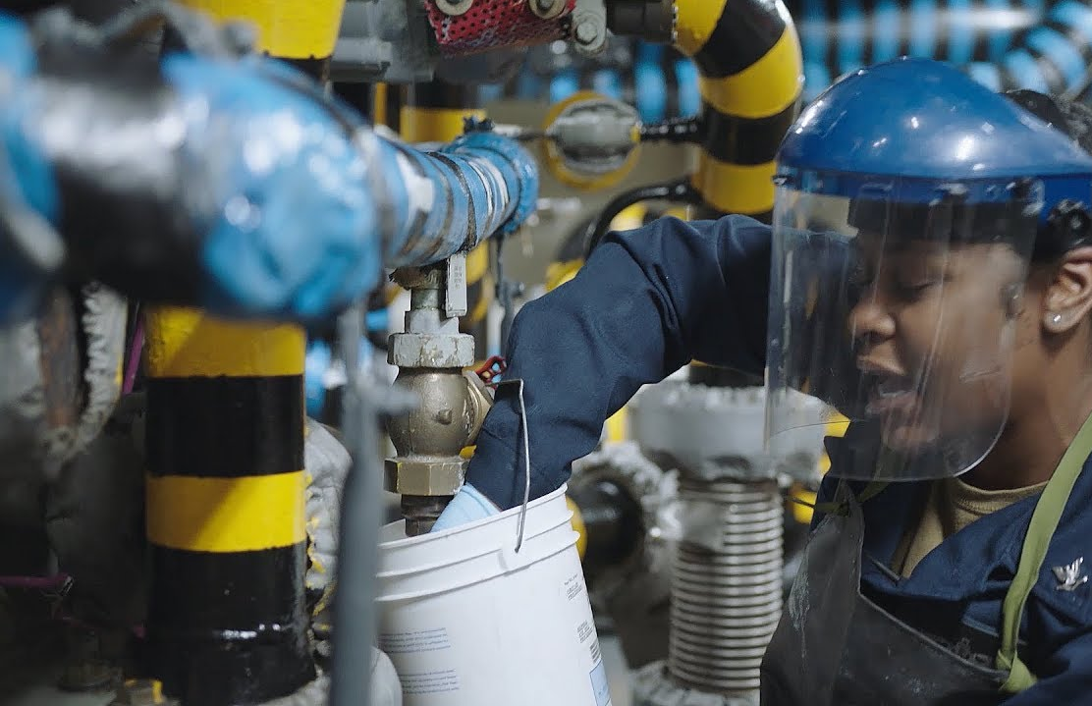
Education and Background
College
Engineering, Science, Education, Business, More!
Technical
Machining, Manufacturing, Electrical, Welding, Programming
Military
Navy Nuclear
Notes:
There are a lot of jobs that go into running a nuclear power plant. And a lot of paths to get there. We have engineers both in the office and in the field, performing calculations. We have technicians and maintenance personnel performing the day to day task required to keep everything running smoothly. We're also a business, so we have accountants, lawyers, secretaries, and custodians. Some people come in with college degrees while others come with technical qualifications. Other gain experience through Navy programs.

Slide 12
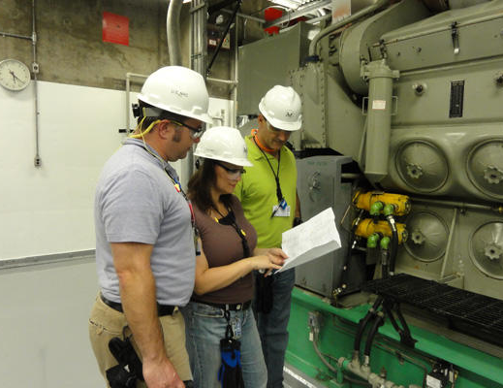
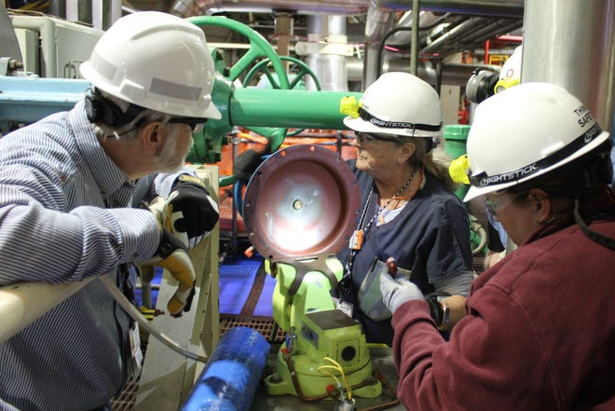
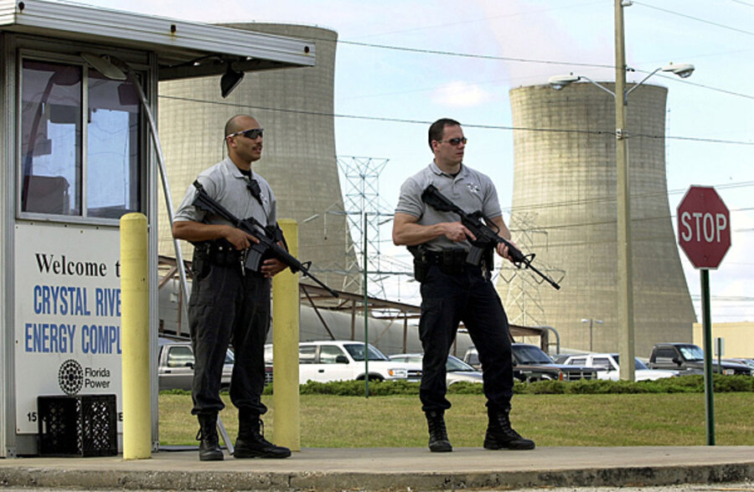
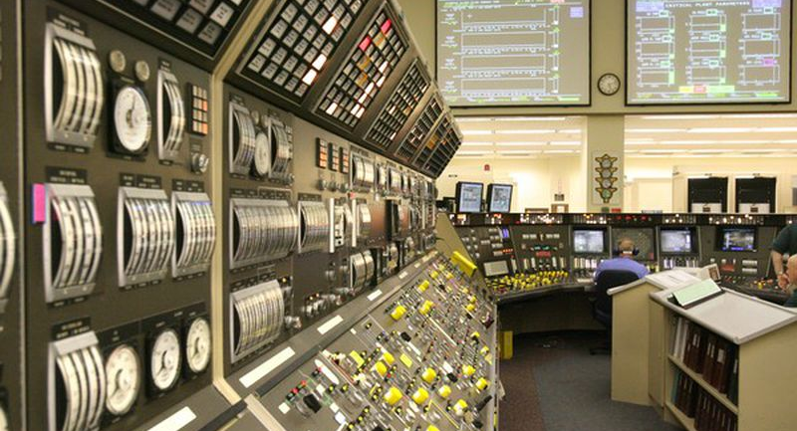
Career Opportunities
Security
Training
Maintenance
Operations
Radiation Protection
Chemical Analysis
Core Design
Engineering
Licensing
Many more!
Notes:
It ultimately takes a small village worth of people to run a nuclear plant (usually about 500). So whatever field of study interests you, you might just find yourself working at a nuclear power plant.

Slide 13
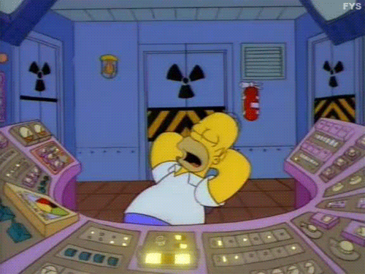
Questions?

