Slide 1

2020 September Local Chapter Lead Meeting
Matthew Mairinger, Canadian Operating Officer Canada@naygn.org
September 22, 2020
Notes:
We’ll start off with Safety.
Please stop and look around your areas for any potential hazards that would affect you leaving your area safely in case of an emergency. If there are any hazards, please take a moment to eliminate them. Make sure we are also following our COVID-19 protocols.
If you have to get off the call, I’ll be glad to catch you up at a later time.

Slide 2
Agenda
Metrics
2020 Q3 Excellence Awards
Diversity and Inclusion
Upcoming Canadian Webinars
2020 Regional Conferences
NAYGN Committee Updates
  2021 Sponsorship Drive
  Professional Development Opportunities
  Public Information Opportunities
Open discussion
Notes:
Metrics update
Update on our diversity and inclusion initiative
Information on our 2020 regional conferences
Committee updates
Professional development opportunities
Public information opportunities

Slide 3
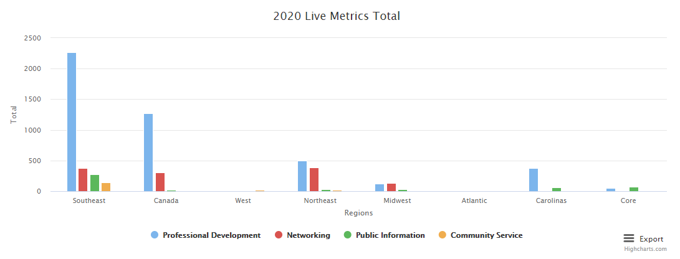
2020 Metrics
https://naygn.org/local-chapters/metrics/
Please submit 2020 metrics as they happen
Any questions/concerns (i.e. if you need to edit a submission, if your chapter doesn’t appear, etc.) email Canada@naygn.org or USA@naygn.org and we will fix it!
Notes:
Here are the current metrics for this year.
Please continue to add your metrics as you complete events throughout the year.
Any questions/concerns, please reach out!

Slide 4
2020 Q3 Excellence Awards
Nominations for the Q3 Excellence awards are now open
These nominations will be for the time period from July 1, 2020 through September 30, 2020
Deadline to submit is October 31, 2020.
Nomination link: 3Q 2020 NAYGN Excellence Awards
Past award winners now appear on the website here: https://naygn.org/past-award-winners/
Recognize your fellow members for their activities supporting NAYGN!
Notes:
Nominations for Q3 excellence awards are now open.

Slide 5
D&I Workshop
We are excited to offer an opportunity for you to attend an interactive professional development leadership workshop with our Diversity and Inclusion consultant so NAYGN can continue to foster an environment where all of our members feel welcome and attract diverse talent to our organization and the industry. Space is limited and registration is required. You will receive a calendar invite once you register. Please register at https://www.surveymonkey.com/r/JJ5K66X
Who should attend: NAYGN Leaders
What: Interactive workshop, “The Power of Being an Inclusive Leader,” with professional D&I Consultant Monica Mwanje from MMCS Limited.
When: Thursday, October 8, 1 – 3 pm EST.
Purpose: Professional leadership development being provided to aid you in being an inclusive leader in the organization and other professional leadership opportunities you pursue. We will provide you with the information and tools you need to support your chapter and NAYGN’s goals for diversity and inclusion.
Notes:
Nominations for Q3 excellence awards are now open.

Slide 6
D&I - Equal by 30
NAYGN has officially signed onto the ‘Equal by 30’ campaign!
  The Equal by 30 Campaign is part of the Clean Energy, Education and Empowerment Initiative (C3E), which works to advance the participation of women in the clean energy transition, and close the gender gap. It is a joint Clean Energy Ministerial (CEM) and International Energy Agency (IEA) initiative.

Slide 7
Upcoming Canadian Webinars
Wednesday September 23rd 12:00 – 13:00 EST- Medical Isotopes Webinar. Contact: Emma.Paul@brucepower.com
Friday September 25th 11:00 – 12:00 EST - Breaking Out of the Nuclear Bubble: Young People’s Impact on Nuclear
  Generation Atomic + NAYGN + Canadian Nuclear Association
Wednesday October 7 @ 1 pm - WiN Canada Conference
Thursday October 15th – The Brains Behind the Headlines: a technical Q&A with Global First Power’s Niel Kemp. Register here www.cnl.ca/naygn

Slide 8
Regional Conference Dates
Region | Date(s)
Atlantic | November 17-18
Carolinas | October 19-22
Canada | November 27th
Midwest | December 10th
Northeast | November 10-12
Southeast | December 10th (in conjunction with Midwest)
West | December 7-10
Notes:
Regional conference season is approaching and We’re going virtual!
Be on the lookout for more information from your regional and conference leads on session details and how to register.

Slide 9

Carolinas Regional Conference
Professional Sessions (itinerary coming soon):
NuScale Presentation with Q&A
Our Fusion Future – Expert Panel
VC Summer – Lessons Learned
Personal Finance Workshop
Inclusive Leadership: an NAYGN Perspective
Networking Sessions (itinerary coming soon):
Amazon Watch Party: Scheduled Viewing of the film “Radioactive”.
Virtual Mixology Class
Public Outreach (itinerary coming soon):
Virtual learning sessions with schools all across the Carolinas
https://naygn.org/regions/usa/carolinas/
Notes:
Regional conference season is approaching and We’re going virtual!
Be on the lookout for more information from your regional and conference leads on session details and how to register.

Slide 10
Atlantic Regional Conference
**SAVE THE DATE**
Join us for the 2020 NAYGN Atlantic Regional Conference!
This year it’s, you guessed it, All Virtual!
Dates: November 17th - 18th with a Virtual Social Event the evening of the 17th
Location: Anywhere with a power outlet and WIFI!
There will be a mix of technical presentations, panels, and social events to help keep us engaged during an unusual time for both the country and the industry. Registration information, schedule, and many more details to come shortly.
Hope to see you there! If you have any questions, please contact Atlantic@naygn.org.

Slide 11
2021 Sponsorship Drive
Sponsorship Committee looking for help – contact Treasurer@NAYGN.org to get involved!
2021 Sponsorship Brief - will be used to assist discussions for sponsorships
2021 Sponsorship strategy
  Retain current sponsors and thank them!
  Gain commitment back from previous sponsors recently lost
  Find new sponsors
    Active NAYGN chapters can help!
    Core providing one-on-one discussions and mentoring
    Utilize our extensive network and great reputation!
  Two-way approach – Core requests support from company CNOs and LCLs request support via company sponsors
  LCLs will receive information packets for their company sponsors
Benefit to NAYGN – continue to fund our amazing initiatives and events!

Slide 12
2021 Sponsorship Drive

Slide 13
Professional Development Book Club
September PD Book Club – September 29th at 11:00 EDT
Book for discussion - “Mistakes Were Made (But Not by Me)”
  Chapters 6-8
Register for the event HERE
Call Information:
  Event Number: 127 098 8817
  Event Password: ryUMYC3Wj42
Audio Conference:
  Call-in toll number (US/Canada)
    1-650-479-3208
    Access code: 127 098 8817

Slide 14
Professional Development Book Club
Call for 4Q2020 Book Club ideas!!
What topics, articles, or videos are you interested in? Email pd@naygn.org with your input!

Slide 15
Nuclear Science Week
Starts Monday October 19!
This year, the “Big Event” will be virtual so plan to join!
Add your #NuclearSciWeek event here for a bigger reach & more advertising!
Please follow #NuclearSciWeek on all social media platforms for key information.
Learn more at the Nuclear Science Week webinar on October 5 at 3pm ET. Register Now

Slide 16
NSW: Virtual Postcard Push Day
Rather than mail hard copies to our congressmen, chapters are encouraged to make Facebook posts tagging them. How it’ll work:
  NAYGN will supply the graphic and three factoids to choose from.
  Members will make the posts through their official NAYGN chapter Facebook page or personal account during Nuclear Science Week.
  Chapter members will like/share the posts, which should help them catch the eye of a political aide.
  Between the graphic, factoid, and number of likes/shares, the aide is more likely to remember that constituents support nuclear power.
  Government Outreach is still working through the details, but directions will be provided.
  Contact governmentoutreach@naygn.org to receive an email with the directions and graphic.

Slide 17

NAYGN Enercon Services, Inc.
Congressman David Scott
Please support nuclear power! Nuclear energy accounted for 55% of America’s clean energy in 2019.
Nuclear Energy
Powering Us through a Pandemic
Graphic is still in progress.

Slide 18
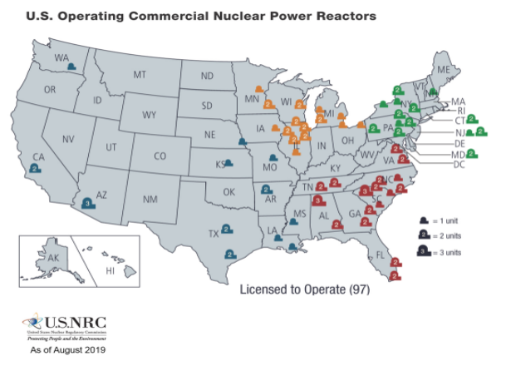
NSW: School Outreach
The high school essay contest will be launched for #NuclearSciWeek
Set up virtual classroom visits! Watch this video for some cool ideas: https://youtu.be/1_PFLcNXMqg
For younger students, try reading George’s Energy Adventure & Marie’s Electric Adventure. The e-books are free!

Slide 19

Science Communication
Have you ever struggled to explain a technical or scientific concept to your audience (be that project manager, spouse, student, or someone else)?
Join us for a 3 part series on Science Communication to hone your skills on relating, reading your audience, and getting your point across in a memorable fashion.
You are encouraged (but not required!) to read the New York Times bestselling book: If I Understood You, Would I Have This Look on My Face?

Slide 20
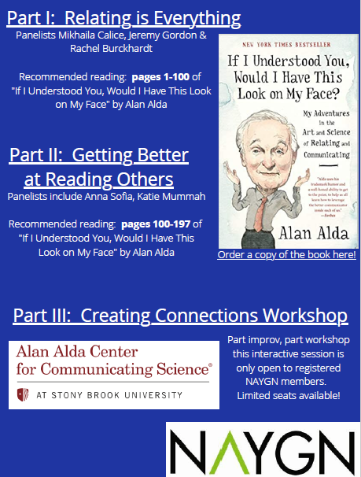
Science Communication
This series is designed to set you up for success when you participate in public outreach activities during Nuclear Science Week 2020!
Oct 1 – 11am – 12:00 ET
October 13 – 1pm – 2pm ET
October 15 – 2pm – 4pm ET

Slide 21
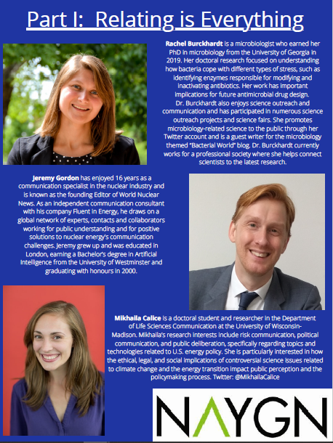

Slide 22
Advocacy Opportunity
Is your chapter looking for a way to stay active during Covid-19?
NAYGN recently purchased a subscription with SoftEdge and we need your help.
SoftEdge allows NAYGN to track active bills, legislator’s past votes, and social media posts so that we can take action.
NAYGN needs your help identifying items that are worth taking action.
Your chapter would be responsible for logging in to SoftEdge and identifying new hot topics that should be considered for action.
  Updates provided once a week.
  Length of volunteering is optional, but ideally 2-3 months.
Contact governmentoutreach@naygn.org

Slide 23
Nuclear Matters Campaign - Illinois
Exelon Generation recently announced that flawed energy policies are forcing it to prematurely shutter the Byron and Dresden nuclear power stations in 2021.
In alignment with the grassroots advocacy arm of the nuclear power industry, Nuclear Matters, has started an outreach program “Nuclear Matters for Illinois” in an effort to help save the Illinois’ nuclear plants. #NuclearMatters4IL
The ask is to send Nuclear Matters short video clips (short, 10 seconds) sharing your personal answer to “Nuclear Matters for Illinois because…” and submit the video to info@nuclearmatters.com
Submitted videos will be used on the Nuclear Matters social media channels in the fight to preserve nuclear energy in Illinois.
Notes:
Nominations for Q3 excellence awards are now open.

Slide 24
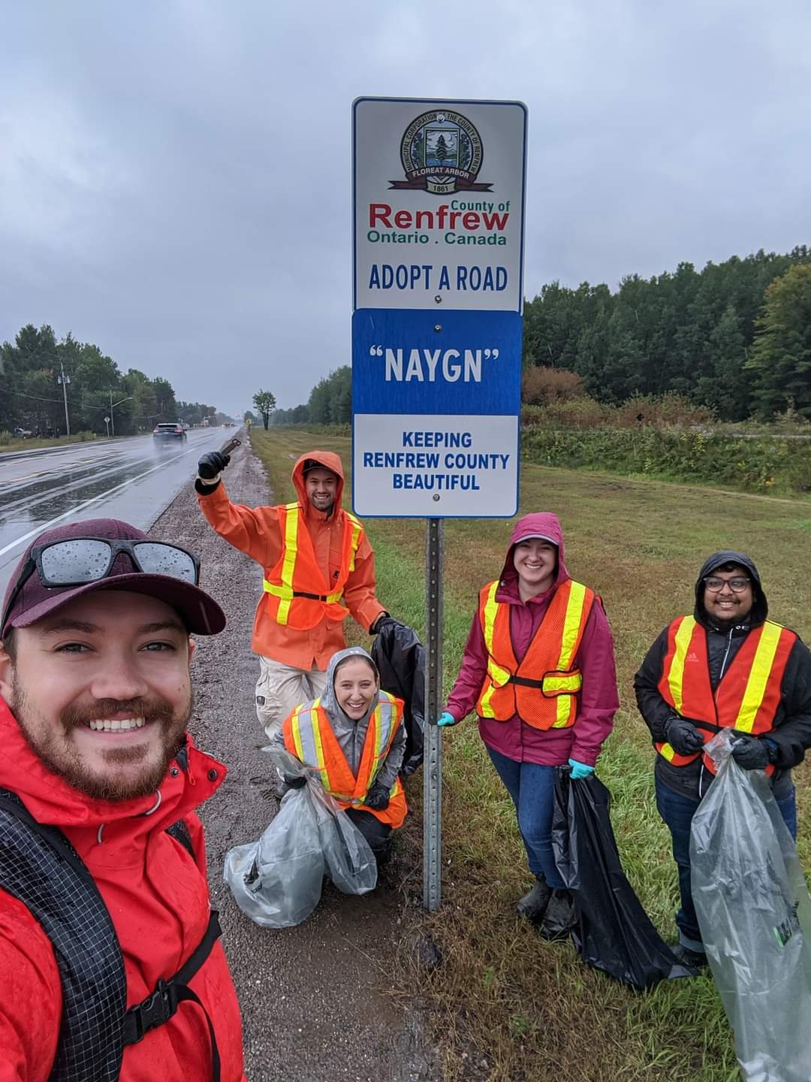
Best Practices – Chalk River
Even with COVID-19 you can still organize outdoor community events!

Slide 25
Questions?
What would you like to see discussed on future LCL calls?

Slide 26
Open discussion with NAYGN President
Notes:
Before we turn it over to our president, Amber, I want to open it up for any questions or comments that you may have.
Ok, over to you Amber.

