Slide 1
Nuclear Science Teacher Workshop
Waste Not,
Want Not
Explore the nuclear fuel cycle and learn about what happens to spent nuclear fuel.
Did you know that a soda can-size of nuclear fuel is all that you would need to power your entire lifetime of
electricity needs? Activities will be provided for students to make comparisons of the waste (and byproducts such
as carbon) from the different types of electricity generation sources.
May 19, 2018 Atlanta, Georgia

Slide 2
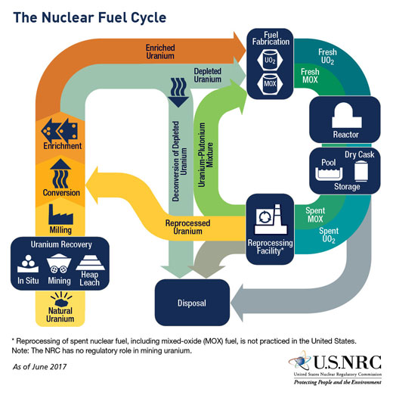
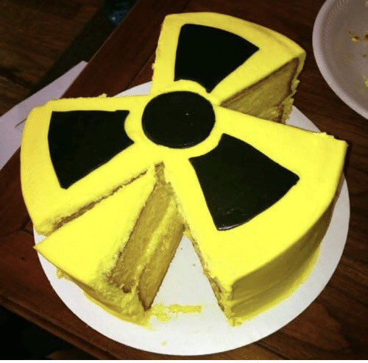
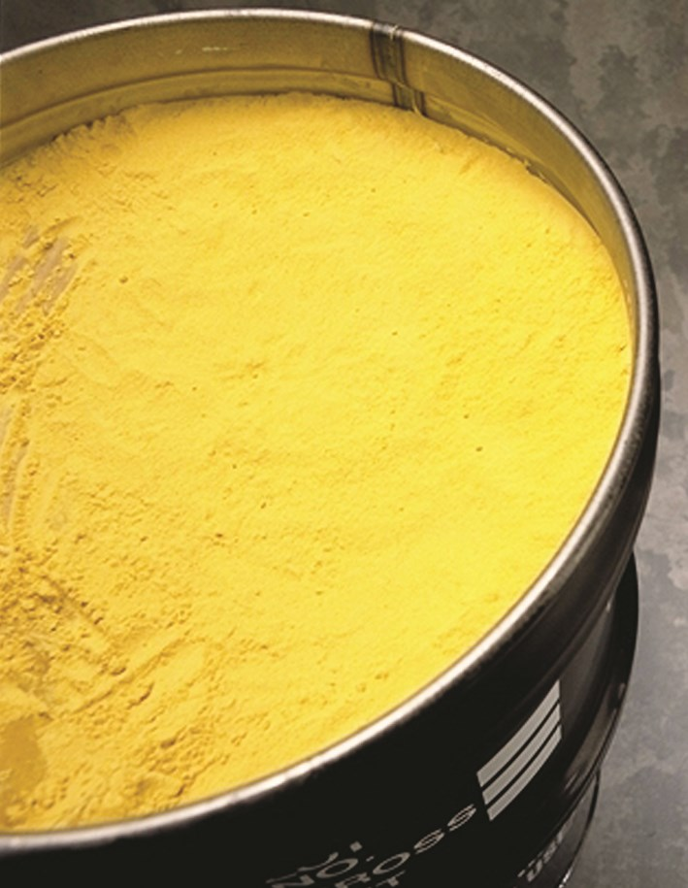
The Nuclear Fuel Cycle
Above: This is cake that is yellow. Not yellowcake.
Right: Uranium yellowcake.
Notes:
Uranium is mined from the ground. There are large amount of Uranium in Australia, Canada, and Kazakhstan. Uranium is pretty plentiful.
When the Uranium is mined it is called yellowcake (U3O8) and is a yellow sandy substance.
Uranium is then converted to uranium hexafluoride (UF6) a gas.
Then the uranium is enriched to increase the ratio of the U235 isotope (naturally 0.7%) to U238 isotope. Typically enrichment is between 3-5% Uranium235.
Fuel fabrication converts the enriched UF6 into UO2. UO2 is a ceramic pellet about the size/shape of a pencil eraser.
These fuel pellets are loaded into fuel rods. 15x15 rods make up a fuel assembly. Each assembly is ~14 feet tall.
A few hundred assemblies make up the reactor core. Fuel stays in the reactor for 3-6 years. Each fuel cycle is 1-2 years.
Fuel is stored in spent fuel pools for more than 5 years.
Then the fuel can be loaded into a dry cask (this is the interim solution for spent nuclear fuel).
Eventually, disposal of the nuclear fuel consists of geological disposal or burying the fuel deep underground.
Reprocessing is a way to loop back through the fuel cycle. We do not reprocess in the United States.

Slide 3
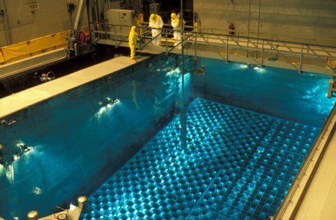
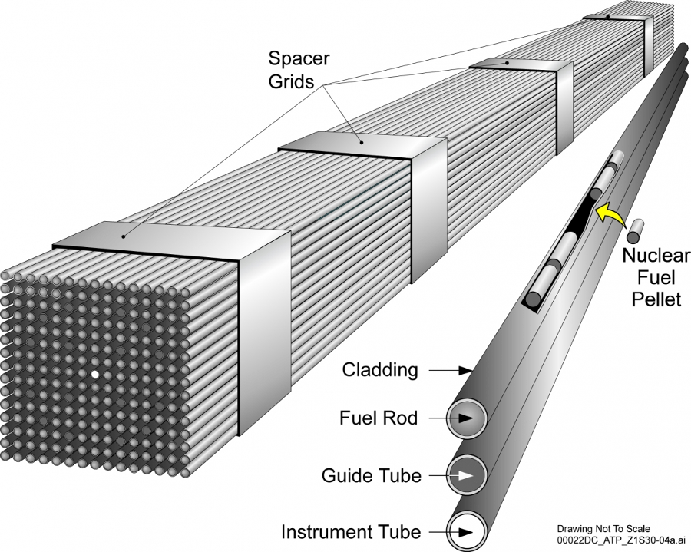
What is nuclear waste?
It’s a solid!
Notes:
Nuclear waste or spent nuclear fuel is a solid (not a glowing green goo as Hollywood would have you believe). The fuel undergoes fission in the reactor for 3-6 years and then it is transferred to the spent fuel pool.
It is covered with water because it is giving off (smaller) amounts of heat and also radiation. After five (or more) years in the spent fuel pool, the fuel can be loaded into a dry cask. This is a metal canister surrounded by concrete. These are stored on specialized concrete pads (or a giant parking lot) at the nuclear plant.
Eventually, the plan in the US was to send the dry casks to a centralized site and bury them deep underground (in Yucca Mountain, Nevada).
However, right now they are safely and securely stored on site at the nuclear power plant.
Great video: https://www.youtube.com/watch?v=mILvWNgggfU&list=PLJENL7BwJ2IwUE2Z8hwpW5flleVD1g5L-

Slide 4
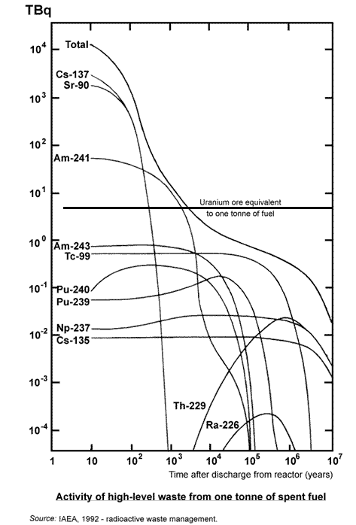
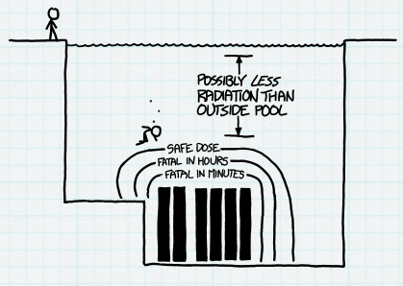
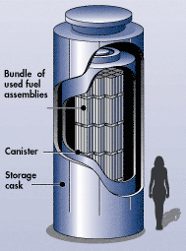
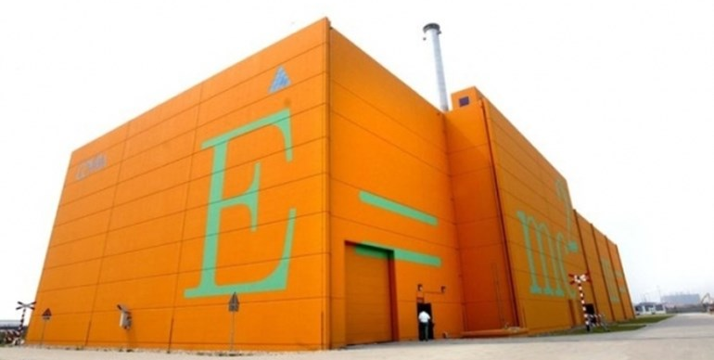
Is it safe?
XKCD
Rocket Powered Train
Airstrike
Puncture
Notes:
Yes.
In fact, you can store priceless pieces of artwork next to it. The orange building is Covra - a nuclear waste storage facility in the Netherlands. Since the building has great monitoring and temperature/moisture control, it also serves as an art storage location for pieces of art that aren’t on rotation for viewing at museums. Interestingly, you can put your hand on the fuel casks - but you can’t touch the art!
Is it still radioactive? You bet. The graph on the left shows activity (in Bq or Bequerel which is a decay per second) as a function of time. Radiated fuel will reach the same level of activity as Uranium ore in 1000-10,000 years. This is why we store it carefully.
Graph: http://www.world-nuclear.org/information-library/nuclear-fuel-cycle/introduction/physics-of-nuclear-energy.aspx
An interesting thought experiment was performed by XKCD - What If? What if you swam in a spent fuel pool? Standing next to the pool will get you essentially no radiation dose. If you were to dive into the pool, you would possibly get less radiation than standing on top! Water is a great shield and since you are constantly being irradiated by cosmic radiation, you are being shielded when you go underwater. However, if you kept swimming down to the fuel and touched it, you would likely get a fatal dose of radiation
The public is often concerned about transportation of the casks. Three videos are linked here to show the extreme testing shipping containers undergo.
The first is from the 1970’s (New Mexico - Sandia National Labs) and shows what engineers get up to when they have too much time on their hands - put rocket engines on a train and make it crash into stuff.
The next two are also examples of extreme testing.

Slide 5
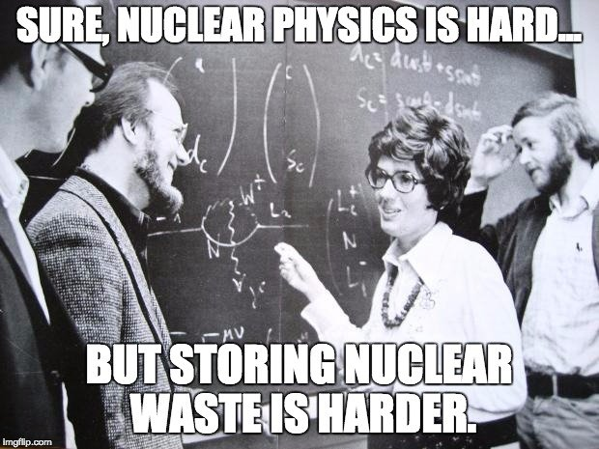
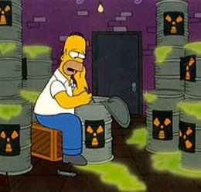
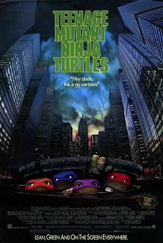
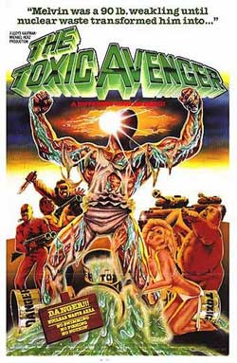
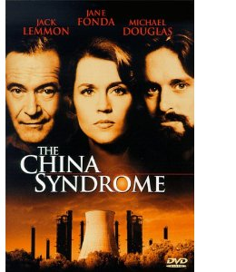
Why do people talk about nuclear waste so much?
Politics!
Notes:
Nuclear waste is a common topic in pop culture. There are a ton of movies and superheroes (or villains) that involve toxic nuclear waste.
Truth: you can’t become a mutant from radiation (from nuclear waste or other sources of radioactivity). This idea stems from the fact that radiation can damage cells but typically your body will kill and replace those dysfunctional cells - after all, humans evolved in a radioactive world so our bodies adapted to radiation long ago!
However, given the fear and reputation of nuclear waste, there is a strong sentiment of “not in my backyard”. This delves into politics and public perception.
Thus, although nuclear engineers long ago developed many solutions to nuclear waste (the one being pursued is Yucca Mountain) no one wants it in their home state.
Yucca Mountain in Nevada was chosen as the US geological repository (nuclear waste storage facility) in the 1980’s. Although the immediate area was familiar with nuclear technology (due to proximity to a weapons testing site) and amenable to nuclear facilities (and the high paying jobs that come along with nuclear facilities) the state of Nevada at large (and especially the population of Las Vegas) did not want Yucca Mountain. Therefore, it has been stopped and started repeatedly for decades. It is a highly politicized issue.
This meme is a bit tongue in cheek. Nuclear waste is well understood and there are several viable solutions. But, the nuclear industry isn’t very good at getting a political solution path. Why? My theory is engineers don’t like dealing with people (or human interaction in general).
⇒ In conclusion, nuclear waste isn’t a technical problem. It’s a political problem. Too bad nuclear physicists aren’t very good at communication. :-)

Slide 6
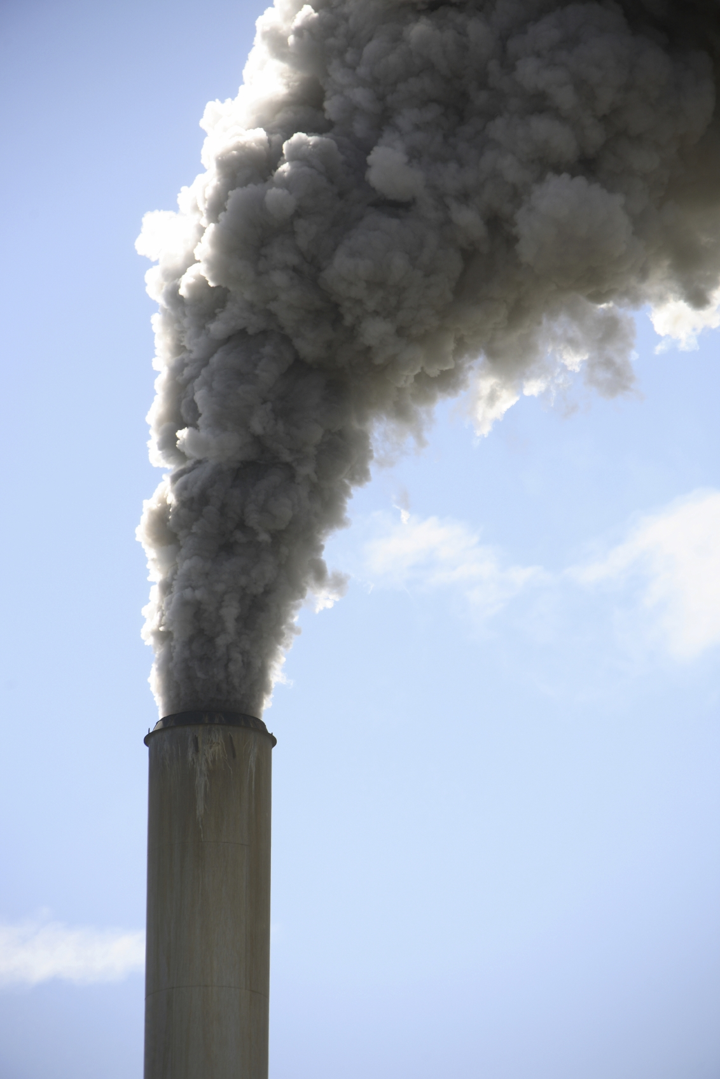
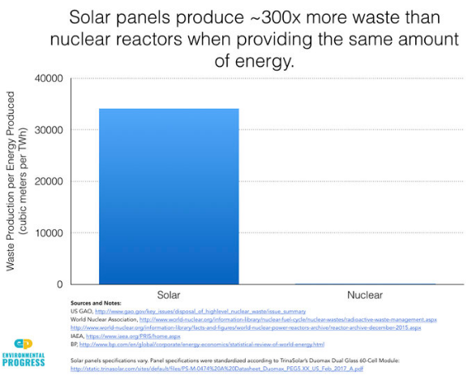
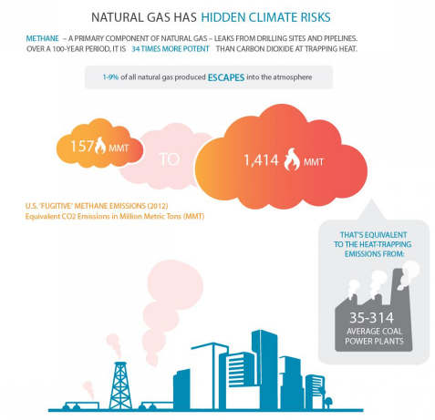
How does nuclear compare?
Notes:
All forms of energy result in some type of waste. Would you rather have solid, liquid, or gaseous waste?
What types of waste are easiest to contain?
Should all waste be contained? What determines whether we contain waste or release it to the environment?
The best answer is regulation and laws. Nuclear is very highly regulated. Other energy sources? Much less so.
Coal - particulate matter released into the atmosphere; coal ash - stored in basins
Natural gas - hydraulic fracturing chemicals (liquid), methane emissions (gaseous), NOX (ie smog)
image: https://www.ucsusa.org/clean-energy/coal-and-other-fossil-fuels/infographic-natural-gas-fugitive-methane-emissions
Solar - large volumes of harsh chemicals from making solar panels - http://environmentalprogress.org/big-news/2017/6/21/are-we-headed-for-a-solar-waste-crisis
Wind - this graphic illustrates land use but you can imagine the materials required to make all of those wind turbines (which only last 20-25 years)
https://jmkorhonen.net/2013/09/04/graphic-of-the-week-comparing-land-use-of-wind-and-nuclear-energy/

Slide 7
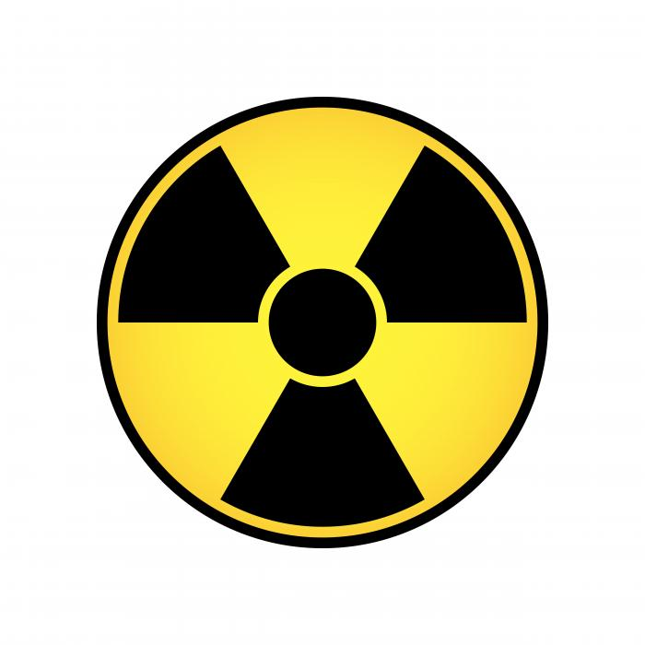
Reduce, reuse, recycle
Notes:
It is possible to recycle (or reprocess) nuclear fuel. We don’t do it commercially in the US. Why? The concern is that during certain stages of reprocessing, it might be easier for the bad guys to steal Uranium (or Plutonium). This concern is called nuclear proliferation. This is a hugely political issue that the United Nations (and the International Atomic Energy Agency aka the Nuclear ‘Watchdogs’) is very involved in. The US decided long ago to set an example and NOT reprocess, hoping other countries would follow suit. In contrast, France does reprocess their nuclear fuel.
So, why would we even both reprocessing? Well, we can get 25-30% more energy out of the fuel. We can reduce the volume of waste to 20% of non-reprocessed waste.
Also, the radioactivity of the waste is much shorter lived. Americium is an example of an isotope that can be transmuted. As such, the amount of time that nuclear waste is radioactive is hundreds of years less (if Americium is removed).
Reprocessing (and transmutation) is often tied to fast reactors or breeder reactors. Fast reactors can get energy out of both isotopes of Uranium (235 AND 238) as well as other elements (such as Plutonium and Thorium). Since we only use enriched Uranium in our reactor designs, we are only using 1% of the potential energy available in Uranium.
For the reasons discussed above (reprocessing and breeder reactors), most nuclear engineers are not overly concerned about running out of fuel or about the need for waste disposal. In some ways, permanently burying the spent nuclear fuel would be burying viable fuel for use in a different reactor (if reprocessing was allowed).

Slide 8
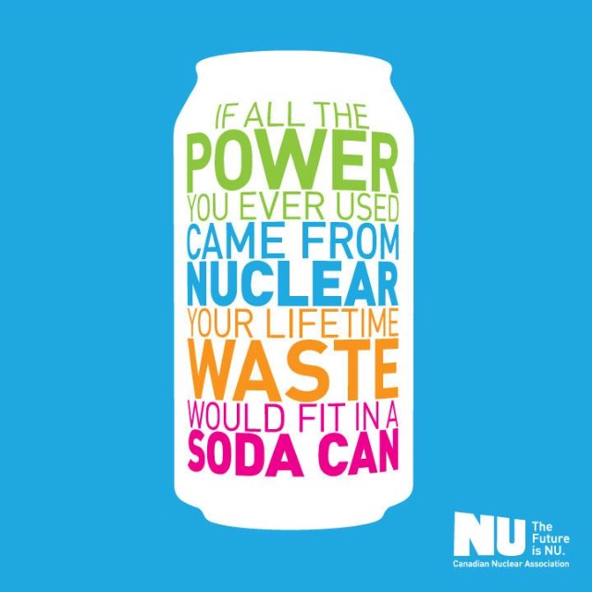
Notes:
It’s important to remember that no energy source is perfect - they all generate waste of some type..
Luckily nuclear waste is a manageable size and, in some ways, a perk of nuclear fuel is that it is radioactive - at some point, it will become non-toxic!
All of the nuclear fuel from US commercial power plant operation would fit in one football field stacked up to a height of ~50 feet. Nuclear fuel has a very high energy density so the waste is actually a very small volume.
The nuclear industry is one of the few industries that fully takes responsibility for its waste.

Slide 9
Classroom Activity
Guess Relative Lifecycle Carbon Emissions
Each cup represents a different energy source: coal, gas, hydro, nuclear, solar, wind
The black sand represents greenhouse gas emissions (waste!)
Units: grams of CO2 per kilowatt-hour
Consider lifecyle carbon emissions (direct emissions from burning and indirect emissions from construction, etc)
Place in order from high to low
Fill up each cup with the relative amount of carbon emissions (you are making a histogram graph)
Notes:
IF YOU RUN OUT OF SAND, USE WATER (with food coloring to make it visible)

Slide 10
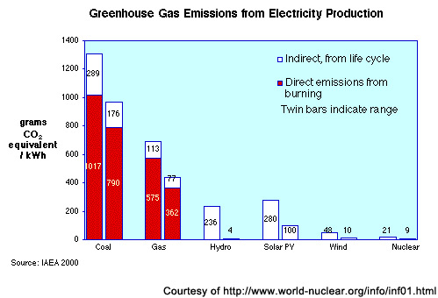
Classroom Activity - Solution
Notes:
Correct order: coal, gas, solar, hydro, wind, nuclear
Notice natural gas is about half that of coal.
Hydro, solar, wind, and nuclear are all carbon free during operation but not so when taking into account lifecycle emissions.
Teachers can keep the sand/cups/etc for use in their own classroom.

Slide 11
Education Standards
Earth and Space Sciences
Next Generation Science Standards
HS-ESS3-3. Create a computational simulation to illustrate the relationships among the management of natural resources, the sustainability of human populations, and biodiversity.
Activity: Develop a spreadsheet model with inputs such as cost of mining, cost of waste management, per-capita consumption, etc.
Example: here or read this report (pg 37)
Play The Energy Challenge

Slide 12
Education Standards
Life Sciences
Next Generation Science Standards
LS2.B: Cycles of Matter and Energy Transfer in Ecosystems Matter cycles between the air and soil and among plants, animals, and microbes as these organisms live and die. Organisms obtain gases, and water, from the environment, and release waste matter (gas, liquid, or solid) back into the environment.
Activity: Discuss different types of waste (solid, liquid, gas) from electricity generation types and whether they dissipate

Slide 13
Education Standards
Earth and Space Sciences
Next Generation Science Standards
ESS3.C: Human Impacts on Earth Systems Scientists and engineers can make major contributions by developing technologies that produce less pollution and waste and that preclude ecosystem degradation.
Activity: Discuss the climate puzzle. View films Pandora’s Promise and/or The New Fire
Learn more about fusion

