Slide 1
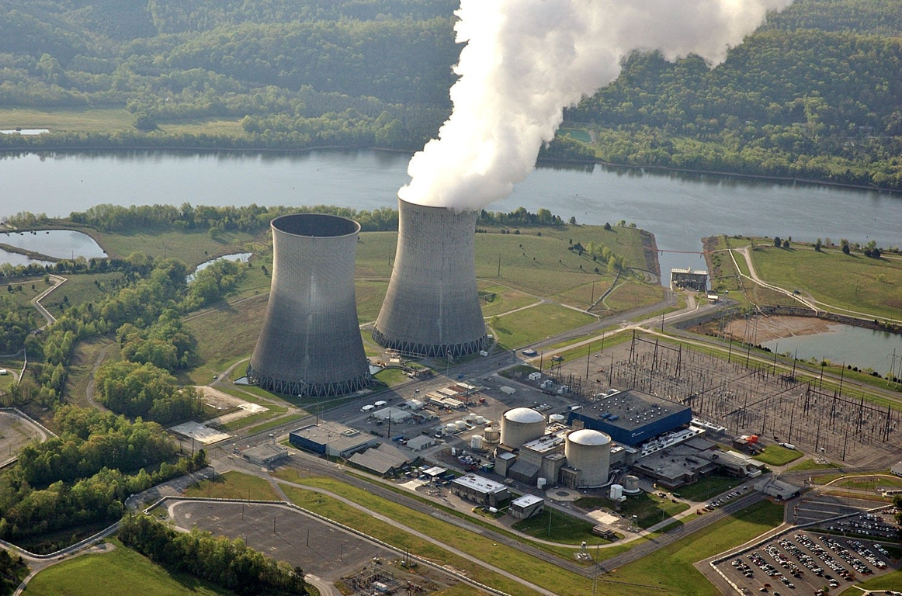
Notes:
Whats coming out the tower: (water vapor- Just like shower.. not steam, steam kills (Surry 4 dead)
You could stand in there all day- you’d just get warm and wet.
(Watts Bar)

Slide 2
Notes:
Inside Bellefonte to show fill and SIZE!

Slide 3
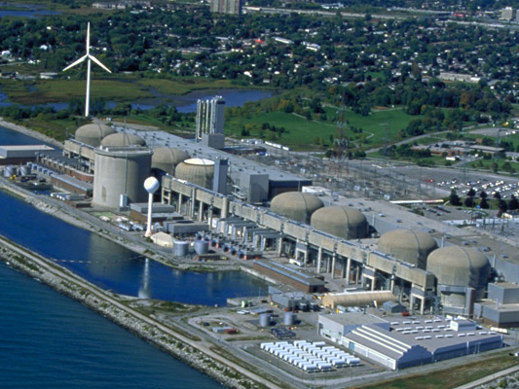
Questions ?
Notes:
Let the students drive the conversation, ask them what should we talk about?
Will Radiation kill me?
What about all that Nuclear Waste?
What about Chernobyl and Fukushima?
Why do we even need Nuclear Power (energy)?
How much can do people make at a nuclear plant?

Slide 4
Notes:
Alternate Slide to play while students fill in (portal)

