Slide 1
Reactor Safety
Notes:
Dummy Slide

Slide 2
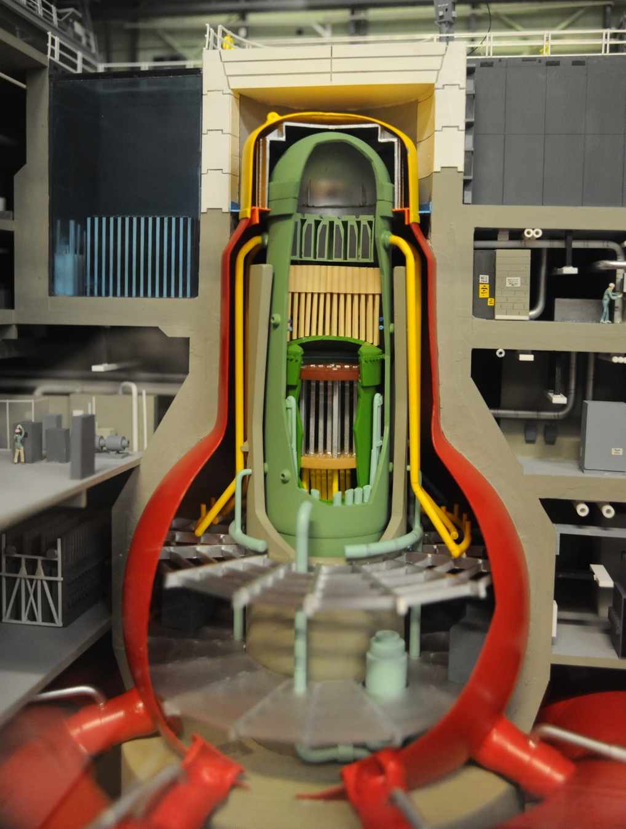
Multiple Barriers
Notes:
So there IS risk- like anything else
What do we do about it-

Slide 3
Notes:
Layers, Defense in Depth-
Want to isolate Fission Products from everyone-
Containment- defense in depth

Slide 4
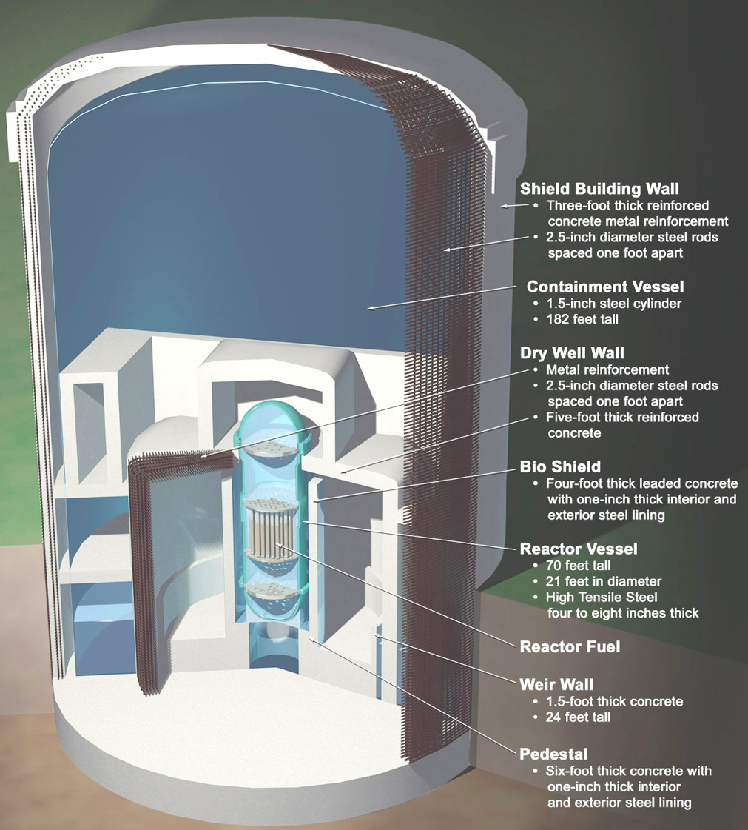
Notes:
Thickness of layers

Slide 5
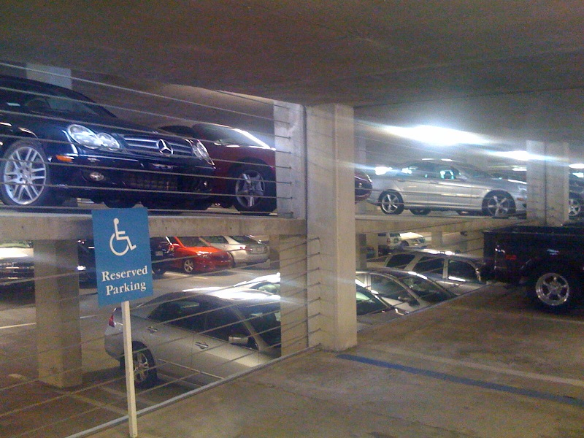
Notes:
For perspective- our parking garage
How much concrete does it take to hold a car?

Slide 6
Notes:
Containment is thick- (4’-6’)
Airplane Crashes:
Aircraft Impact assessment- Design Requirement (767)
Model Verified with F-14

Slide 7
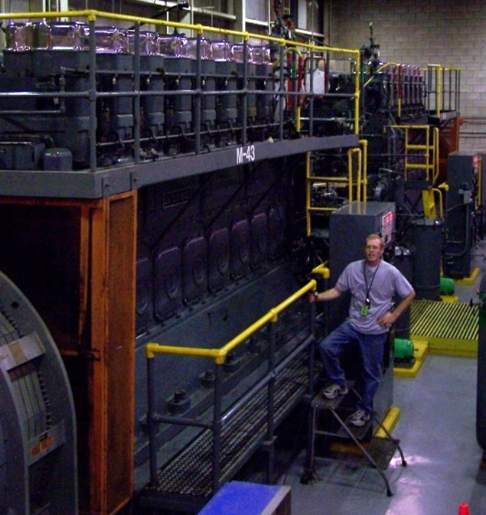
(Emergency Systems)

Slide 8
Notes:
Decay heat- As long as the core is cool- you’re safe...
General rule- High pressure and low pressure systems+ Pressure relief
ECCS- systems to cool core
(BWR example- ADS, HPCI(CS), RCIC, LPCI(CS),
Also PWR RCP flywheels SIT, nat. circ, Aux FW.

Slide 9
Notes:
Single Failure Design- Trains
-Is one emergency coolant pump enough?
How many are enough?
How many emergency brakes are in your car....?
Example EPR Emergency Systems-(EPR)
Design Specific- but good feel for robustness

Slide 10
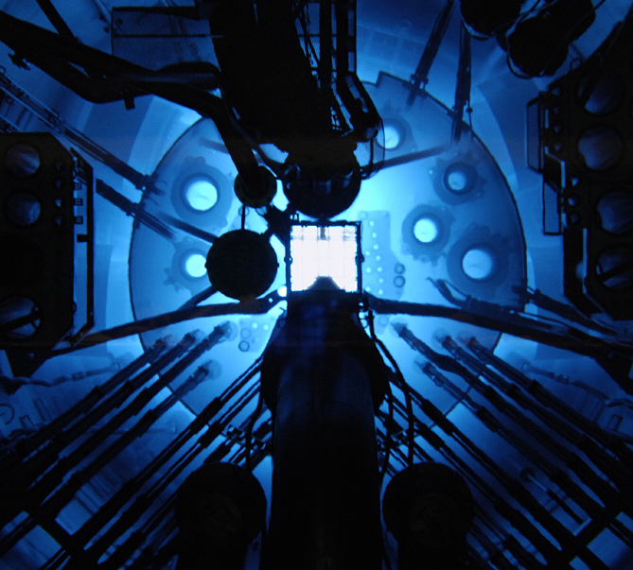
Inherent Safety
(this is reactor physics)
Notes:
A reactor cannot blow up like a bomb, for several reasons
-Containment forces too low (North Korea)
-Reactivity feedback mechanisms
-Enrichment too low
Don’t take my word for it- we’ll show you-

Slide 11
Notes:
Thermalization-
Neutron has to be SLOWED DOWN,
Or it will bounce off the uranium-235.

Slide 12
A Control Rod Is Rapidly Pulled From The Reactor-
What Will Happen?
Notes:
talk them through as follows:
1: rod pulled, chain reaction starts...
2: so what happens to water temp
3: what happens when water heats up (boils)
4: what happens to neutrons if water boils? (speed up)
5: And if neutrons go too fast what happens to reactor (shuts off)
So your telling me I can pull the control rod out
(try to make the thing blow up like a bomb)
and it will SHUT ITSELF DOWN!

Slide 13
Notes:
LETS TRY IT! (BORAX) (Long video- but can skip forward)
Did this reactor blow up? (nuclear explosion vs steam explosions)

Slide 14
Notes:
AGAIN! (SPERT)
But a twist.... what If I kept the water and steam inside a container when this happened?
(dry ice bomb)

Slide 15
Notes:
Steam explosions aren’t little things!

Slide 16
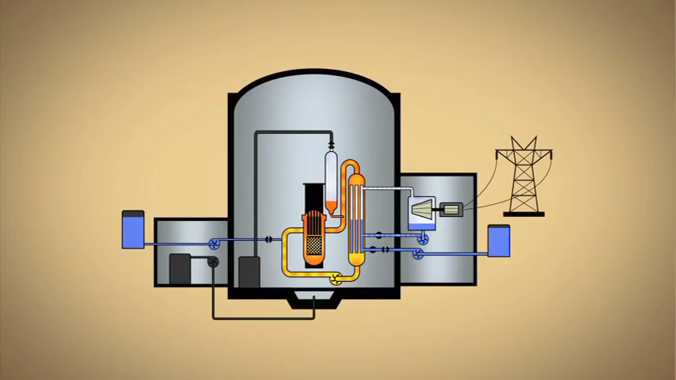
Notes:
Steam release/explosion protection is why we have Containment
LOCA- Steam pressure-Containment Integrity
~580*F coolant, what happens if you break RCS pipe-
Containment fills with steam (~50psi)
This is why containment exists
Allow us to cool and reuse the water (ECCS)
Keep the coolant from “getting out”
ALL US REACTORS ARE DESIGNED TO WITHSTAND A COMPLETE BREAK IN THE RCS.

Slide 17
Notes:
Fuel Temp coeff.- we plan ahead, this will kill the reactor even before the water boils
as uranium fuel heats up (faster than water)
the neutrons get absorbed by the U-238 and the reactor dies.
Much faster!
So reactor can’t blow up like a bomb, you can’t even boil the water
(TRIGA reactor at Penn state)

Slide 18
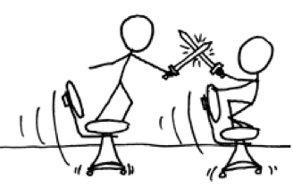
Humans
Notes:
No matter how well the systems are designed,
A person still runs them...

Slide 19
Notes:
So lets get Homer out of the way.
Notice how complicated the control panel is...

Slide 20
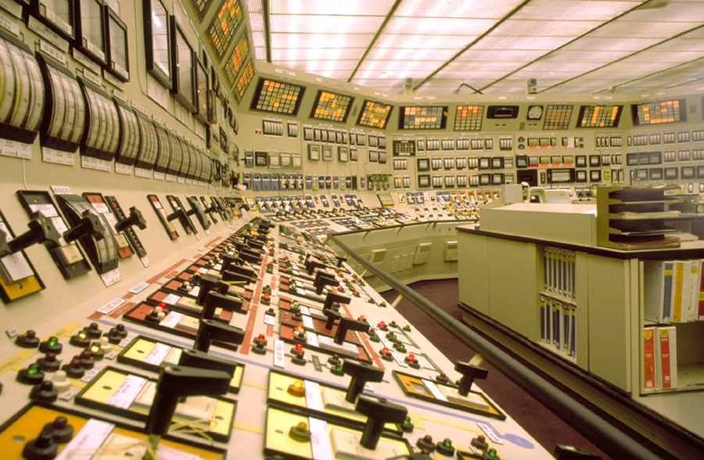
Notes:
THIS IS A REAL ONE (Oconee)
-SRO training, initial testing, Simulator refresh
Knowing the buttons only skims the surface....
Red carpet-
Need operator approval because you’d be in arms reach of buttons
Three way communication (try it with a student)
Have to get things right in nuclear...(even though it can’t blow up)

Slide 21
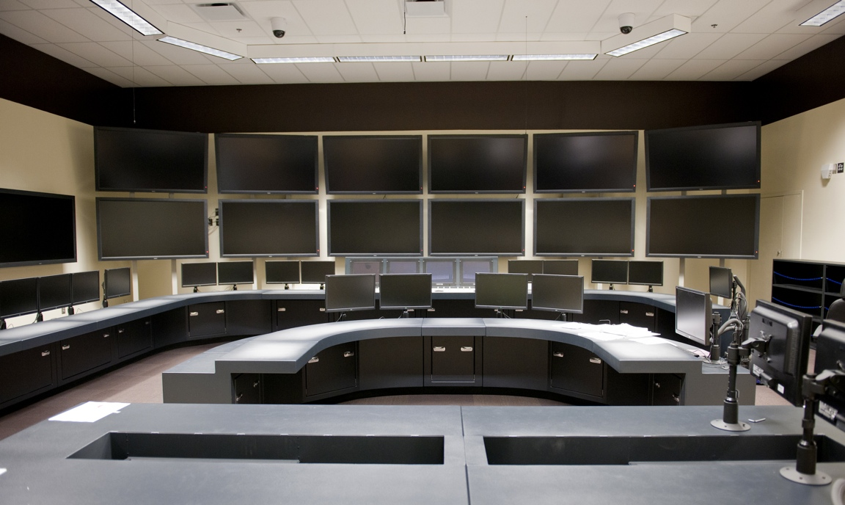
Notes:
AP1000 Simulator

Slide 22
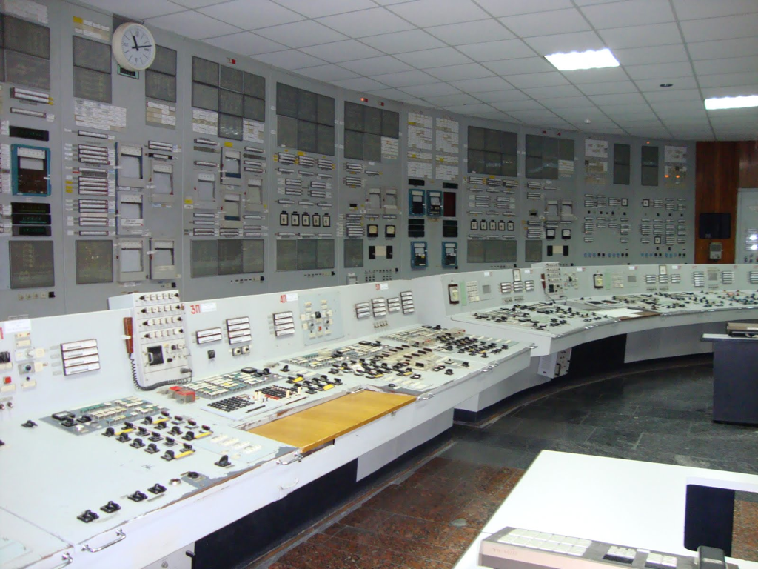
Chernobyl
Notes:
Unit 1 Control Room

Slide 23
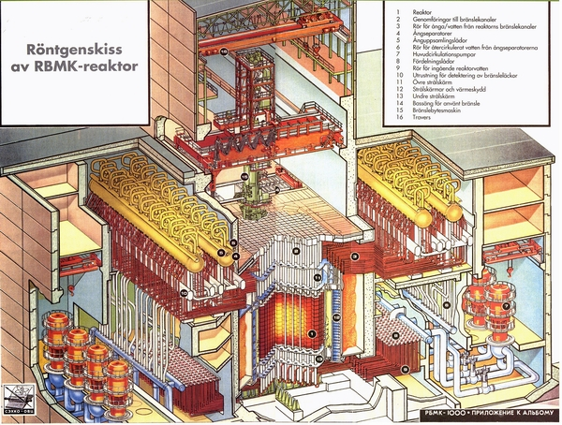
Notes:
Chernobyl-
A word- This power plant design could not be made in the US-
leningrad `75 Power Oscillations caused fuel melt
Ignalina `83 +reactivity on rod drop discovered- no fix made
Narrative-
1:Turbine trip-> Slowdown of 4 RCP’s fed by generator (other 4 offsite power)
2: + reactivity as water flow decreases (+mod Temp Coeff)
3: Less flow-> Increased RCS temps, lower subcooling, pumps cavitate, Flow drops sharply
4: + reactivity as water flow decreases (+mod Temp Coeff)
5: MANUAL SCRAM on power increase- Graphite followers=reactivity addition
6: + reactivity as water is displaced by graphite at base of core
BOOM- 2100 ton containment lid blown off reactor through ceiling.
7: graphite catches fire- core melts,
8: sand added to core by liquidators to extinguish the fire- core heats
9: Suppression pool had to be drained to prevent thermal explosion from corium
Issues:
1: Graphite Water Displacers on control rods; Water->Graphite is reactivity addition (graphite has lower absorption cross section)
2: Void Coeff could become so severely + that it could make power reactivity coeff + when sufficient rods were removed (as done @ Chernobyl)
3: OE not used- Ignalina in 1983 discovered this problem- no fixes were made.
4: Push to get the test done- Break one barrier after another.

Slide 24
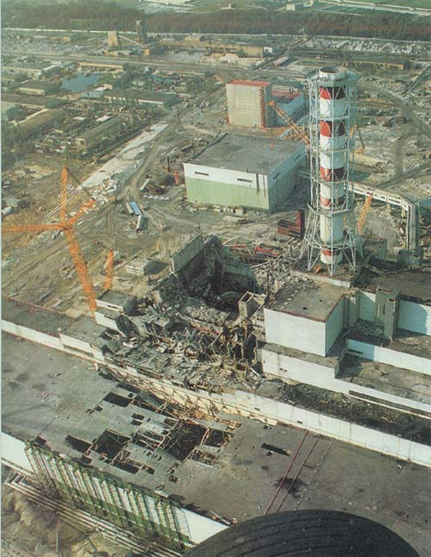
Notes:
CONTAMINATION Killed:
28 liquidator deaths within 1 month
19 more by end of 2004
UN 2005 Study Sites 56 deaths from Chernobyl
(4000 Fatal Cancers ESTIMATED from the accident. These would be added to the 100,000 cancers that would have normally occurred over 30 years without any reactor accident. pg 16 IAEA Chernobyl Report)

Slide 25
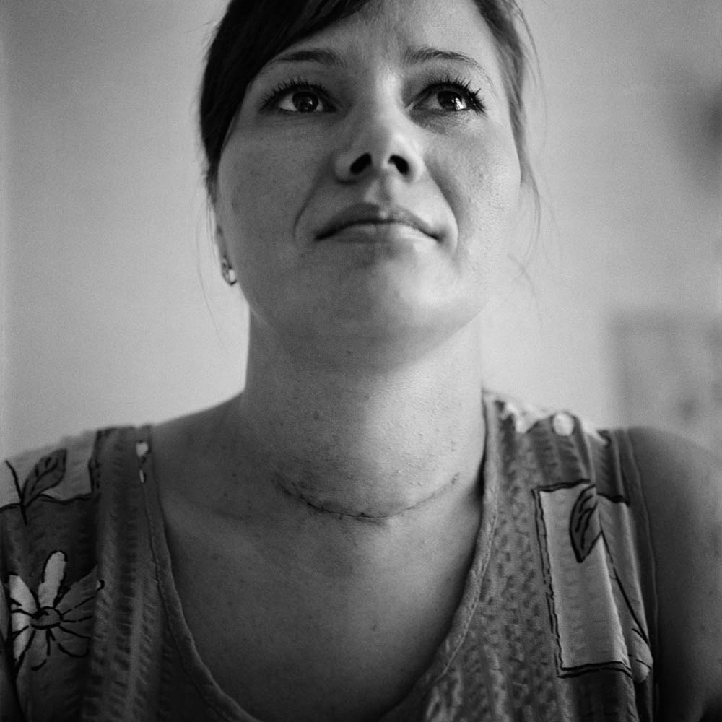
Notes:
Thyroid Cancer- I-131 uptake from the smoke that landed over the countryside.
>4000 Thyroid cancers, 15 deaths- Mostly from non-treatment. (IAEA report)

Slide 26
Notes:
Rad Levels from Pandora’s Proimise

Slide 28
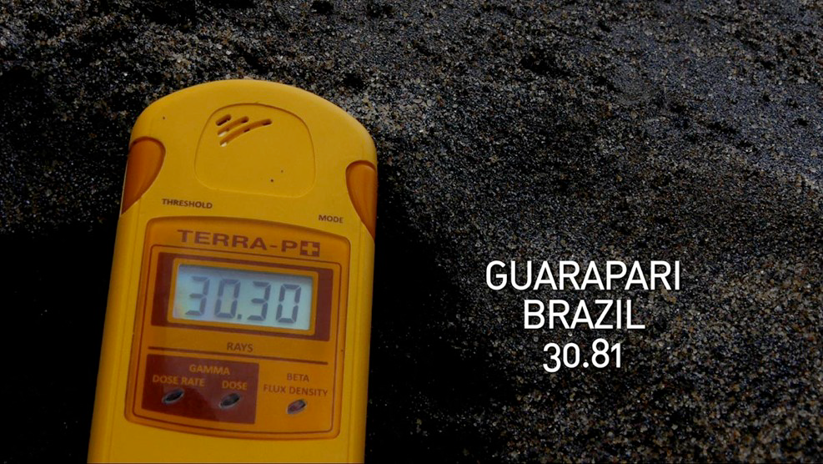

Slide 30
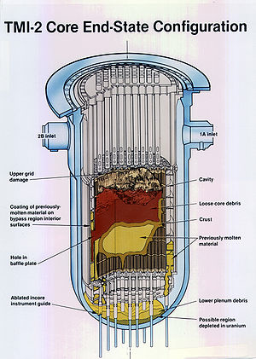
TMI
Notes:
Three Mile Island
Ed Fredrick

Slide 31
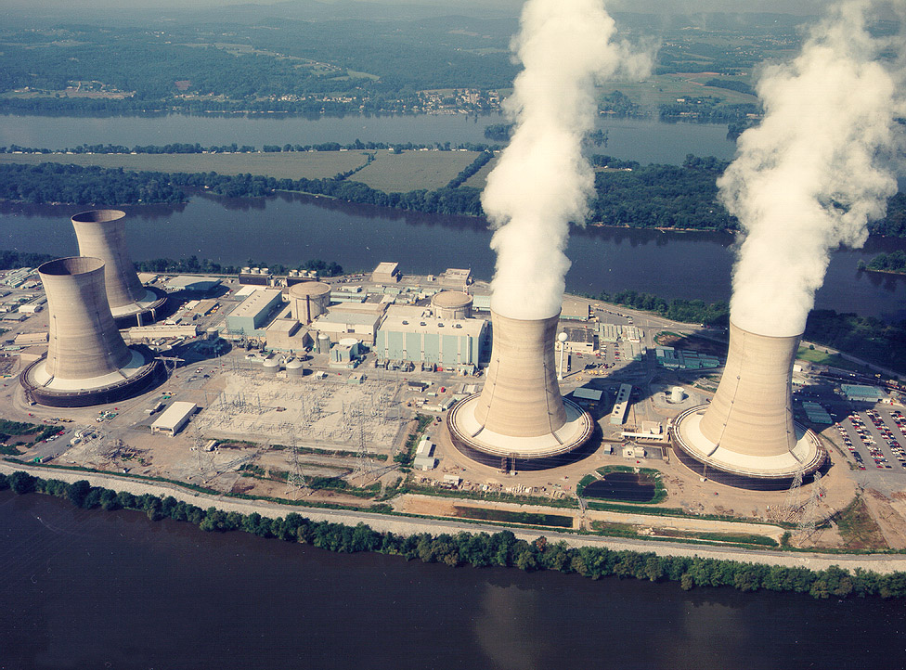
Notes:
This is what TMI looks like today..

Slide 32
Notes:
Narrative of TMI Events
Demins trip->FW
AFW (but it was left isolated by maint.)
SG boiling dry - No heat removal mechanism
RX temp & Press rise
Pressurizer level rises (due to pressure rise)
PORV lifts- discharges to tank
Valve sticks OPEN-
Pressurizer level NOT A PRESSURE INDICATOR (unknown to ops)
Steam forms in reactor (raises pzr level-
ops thinks overpressure danger because of rising pzr level
ops cuts high pressure injection
Core uncovers and melts 1/3 of the fuel
Hydrogen explosion

Slide 33
Notes:
This is what TMI looks like today (and the day after the accident)
No Deaths (NRC)
But it scared the crap out of people-
People really thought they were leaving and never coming back...
But containment worked.

Slide 34
Notes:
Fuel removed and transported to Idaho- now lives at CPP-1774 (Chemical Proccessing Plant-1774)

