Slide 1
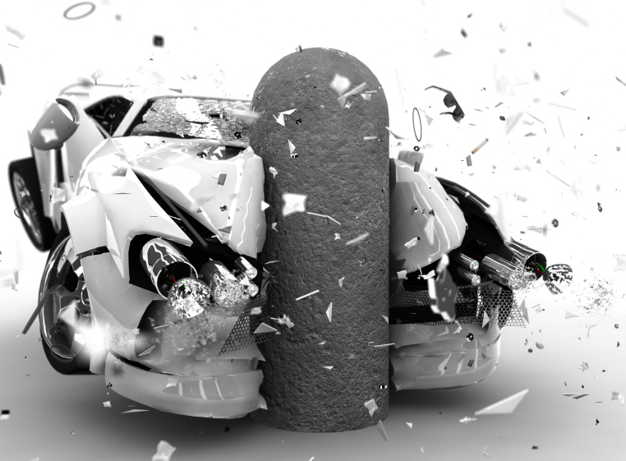
Energy Realities

Slide 2
Notes:
Where does our power actually come from? (we don;t burn gas... what do we do?)

Slide 3
Current Energy Sources
Notes:
Answer
*all numbers from 2012 Annual Energy review (data year 2011) (EIA.DOE/AER)
“Energy Independence”... whats the replacement for gasoline....?
CARS are biggest energy use-
AFTER THAT IS ELECTRICITY-

Slide 4
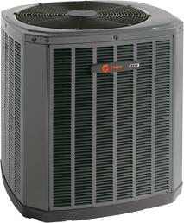
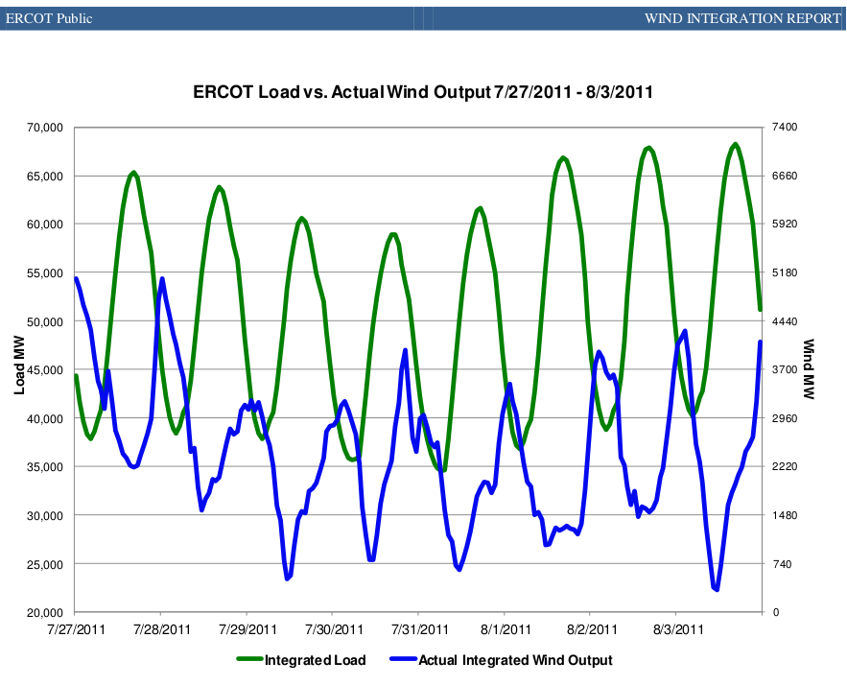
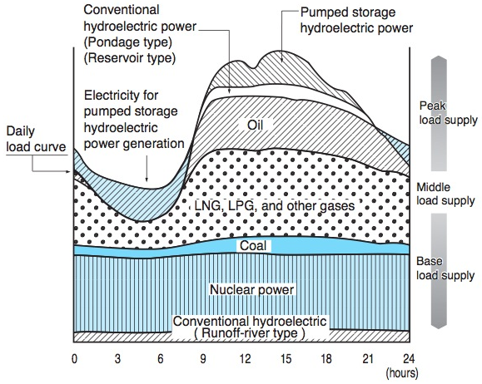
Notes:
Base Load Vs Peak Load
AC- Your AC turns on as day heats up
so does you everyone elses
So the city needs more power
And it all reverses as the temps go down

Slide 5
Notes:
On the Big Scale-
Grid Controllers balance supply and demand

Slide 6
Notes:
1 Cyclist= 100W (500W for Pro Athlete) So hair dryer is 15 people!
SURPRISE: Use isn’t constant

Slide 7
Notes:
What happens if we need more than is there?
Blackout (occurred in evening)

Slide 8
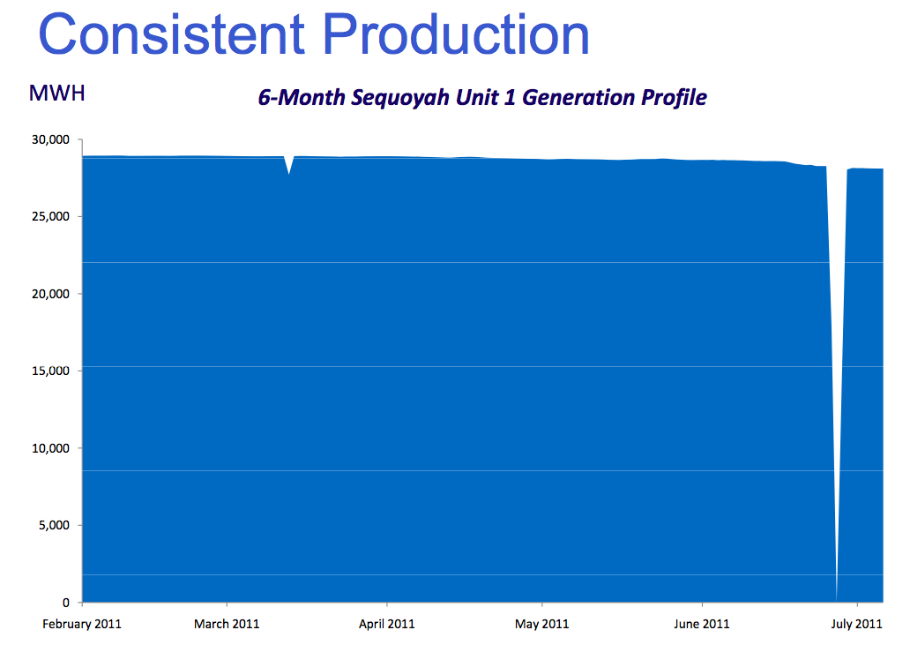
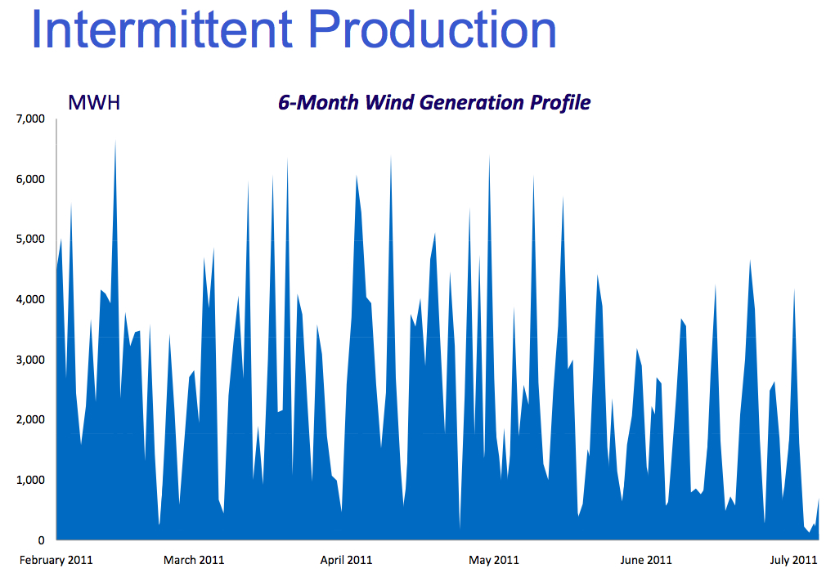
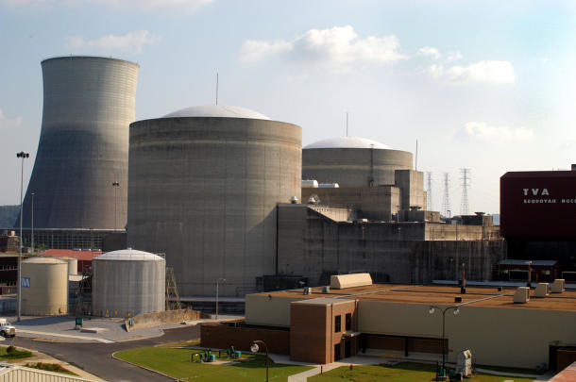
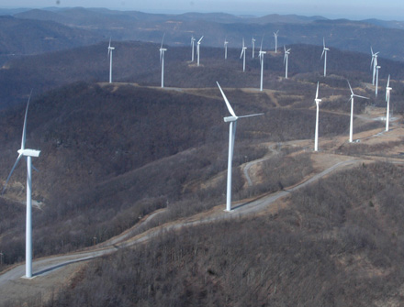
Equivalency
Notes:
TVA Load profile for wind and Sequoyah Unit 1
1 MW isn’t always a MW
Use gas/ pumped storage to supplement
*** We don;t use the same amount per day

Slide 9
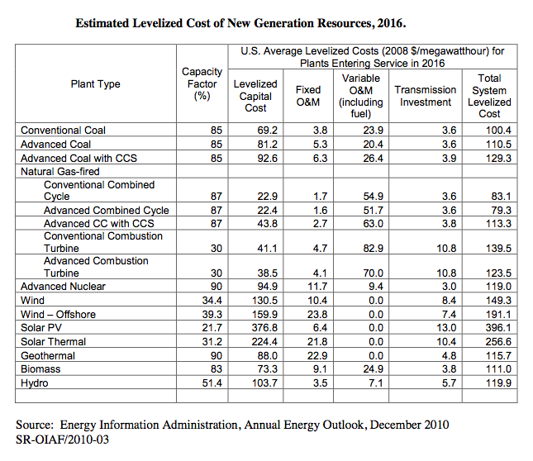
Cost of Fuel
EIA 2010 data
Notes:
Power Cost
EIA Annual energy review 2010

Slide 10
Cost of Power (including construction)
EIA 2010
Notes:
Power Cost
EIA Annual energy review 2010
(Blue is conventional design)
(source data off slide to right)

Slide 11
Notes:
There is no perfect solution- (each power supply has yellow in the chart)
each has a drawback-
(EPRI 2010)

Slide 12
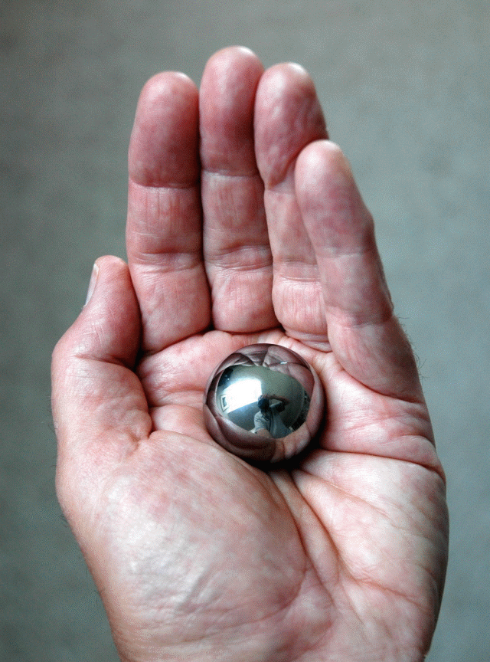
Notes:
Fuel Volumes-
This much thorium could provide all the energy you need for a lifetime....
(How much gas will your car need this week?)

Slide 13
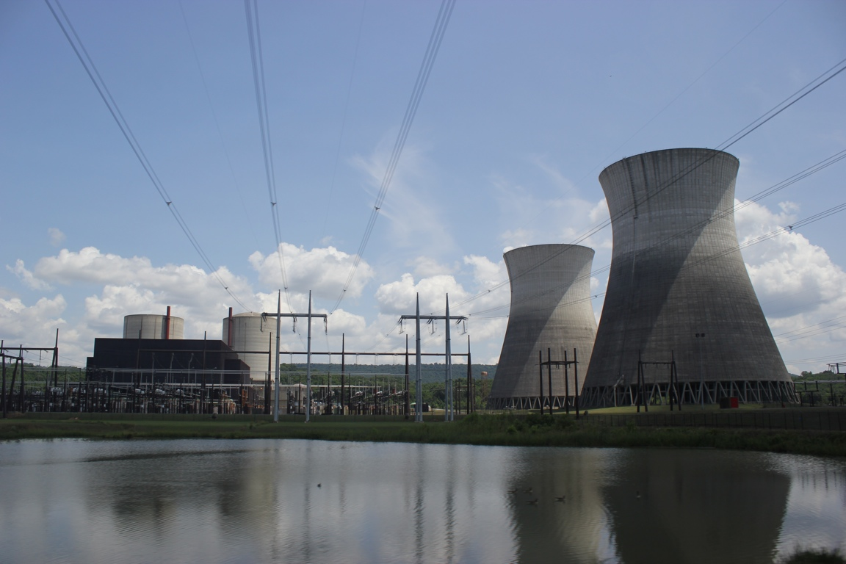
Questions
Notes:
Energy Perspectives

Slide 14
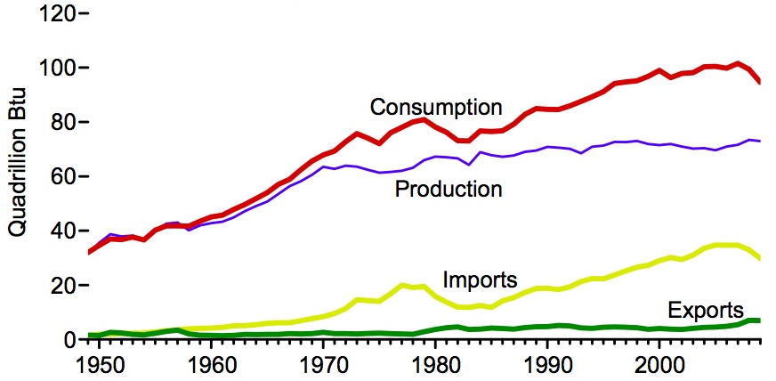
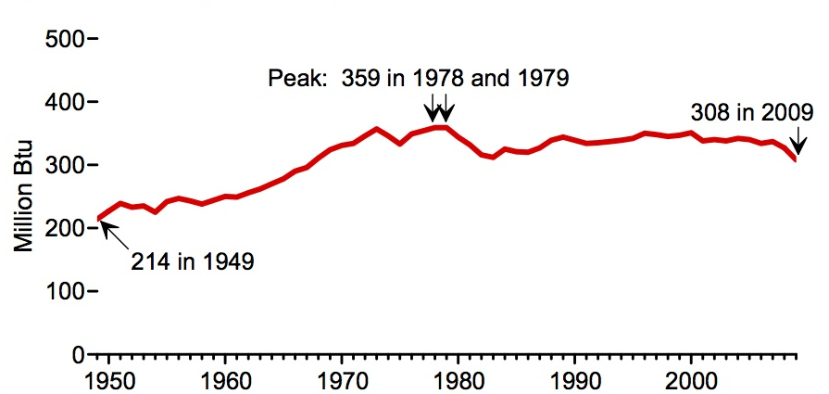
Notes:
Conservation:
Even with less power/person the country still uses more power because of population growth.
(EIA)

Slide 15
Notes:
Maybe we could cut back....all byt CLF bulbs.
So what? You can breathe easier, you aren’t responsible for most of it...
The best thing you could do is NOT DRIVE!
Most energy is for heating..
Curling iron 1200w
Water heater 3,000w
Microwave ~1,200w
10A (vacuum)=~1200w
Computers ~100w (WIDE variation up to 1,000w)
Bad bulb ~75w
Good bulb~7w
*THESE were taken from my house... Nothing special about them
*numbers from 2008 Energy review (EIA.DOE.GOV)

Slide 16
Current Energy Sources

