Slide 1
Introduce Yourself Here Name, Company “Nuclear Technology in my Community?
Notes:
My name is…
North American Young Generation in Nuclear is an organization of young professionals in the nuclear industry.
Today we are here to discuss our 2023 drawing contest theme: “What would you [nuclear] power?”

Slide 2
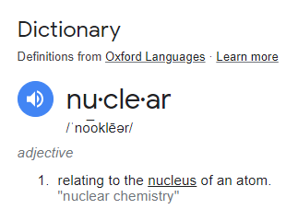
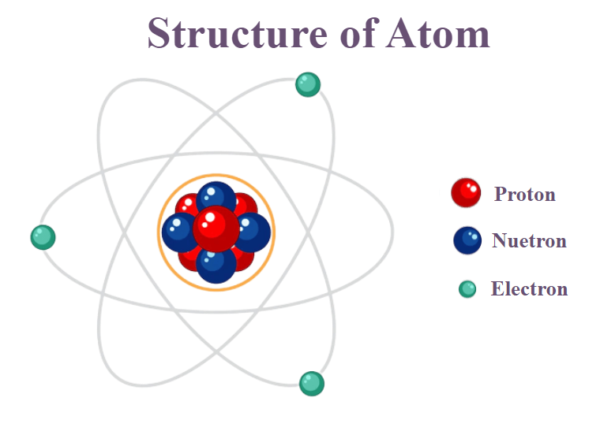
What does Nuclear Mean?
What is an Atom?
An atom is the smallest unit of matter.
Notes:
Nuclear Technology is using the energy of atoms.

Slide 3
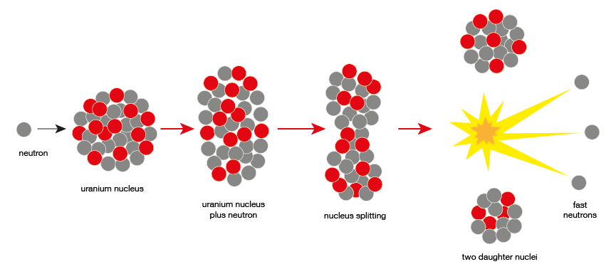
What is Nuclear Energy?
ENERGY!
When you split an atom in half (Fission), or force two atoms together (Fusion), you can release an enormous amount of energy!

Slide 4
Nuclear Technologies
How is Nuclear technology used now and how can it be used in future?
Nuclear Energy
Nuclear in Outer Space
Nuclear supporting Agriculture
Nuclear in Healthcare
Nuclear in Oceanic Transportation

Slide 5
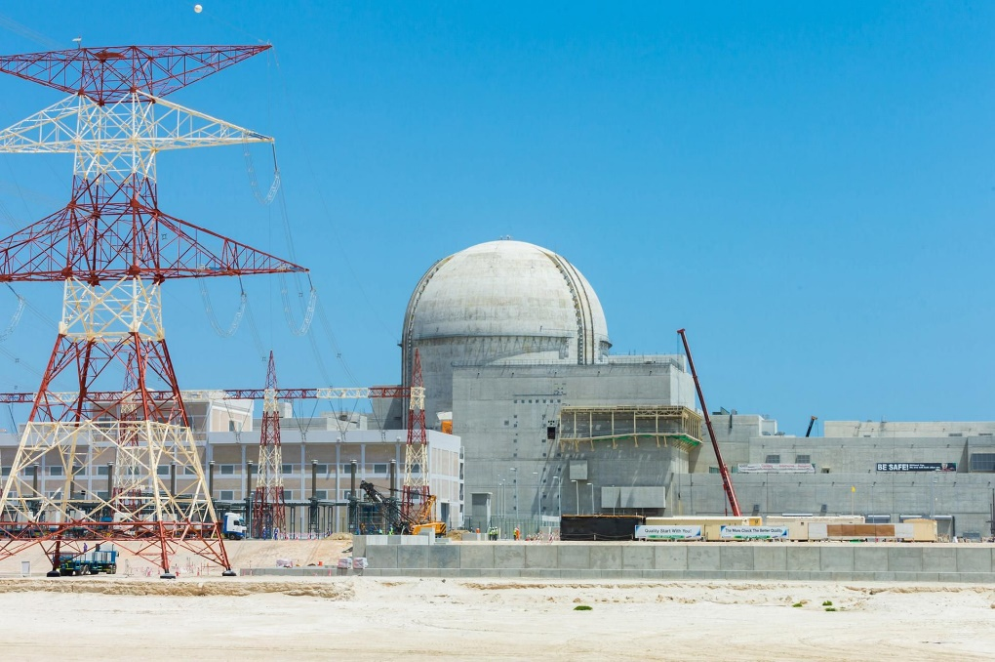
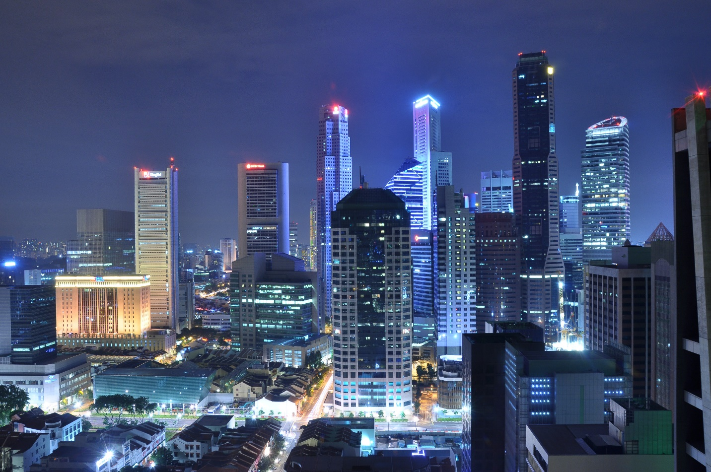
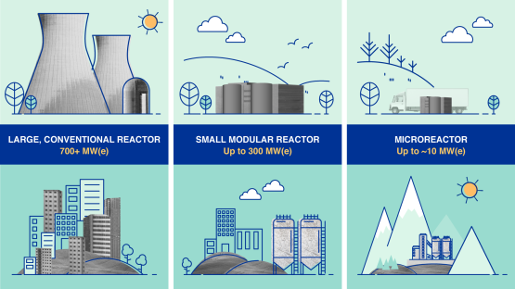
Nuclear Power
Light up a whole city!
Notes:
Provide clean, reliable energy 24/7
New Nuclear technolgoy

Slide 6
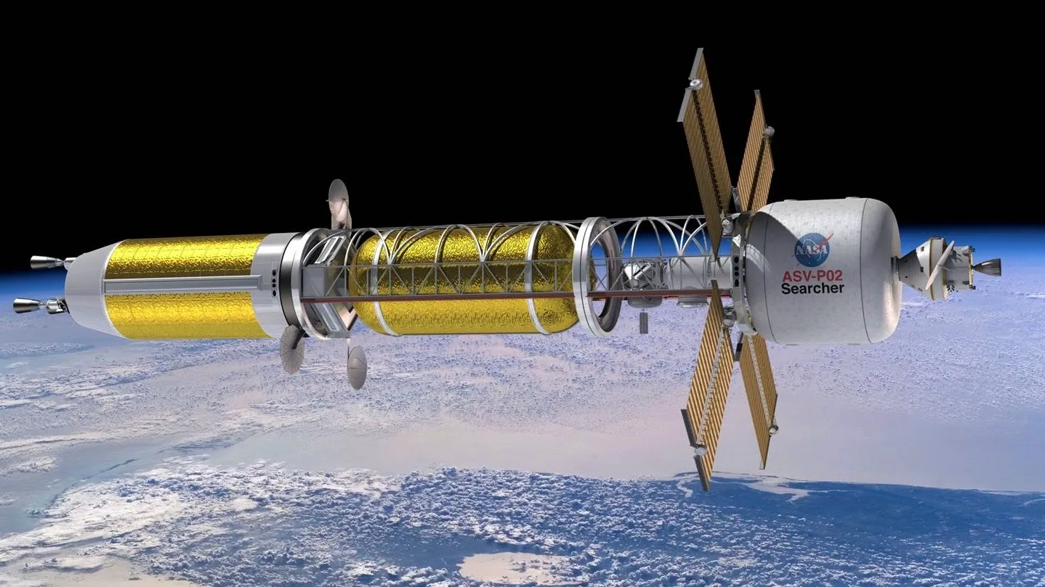
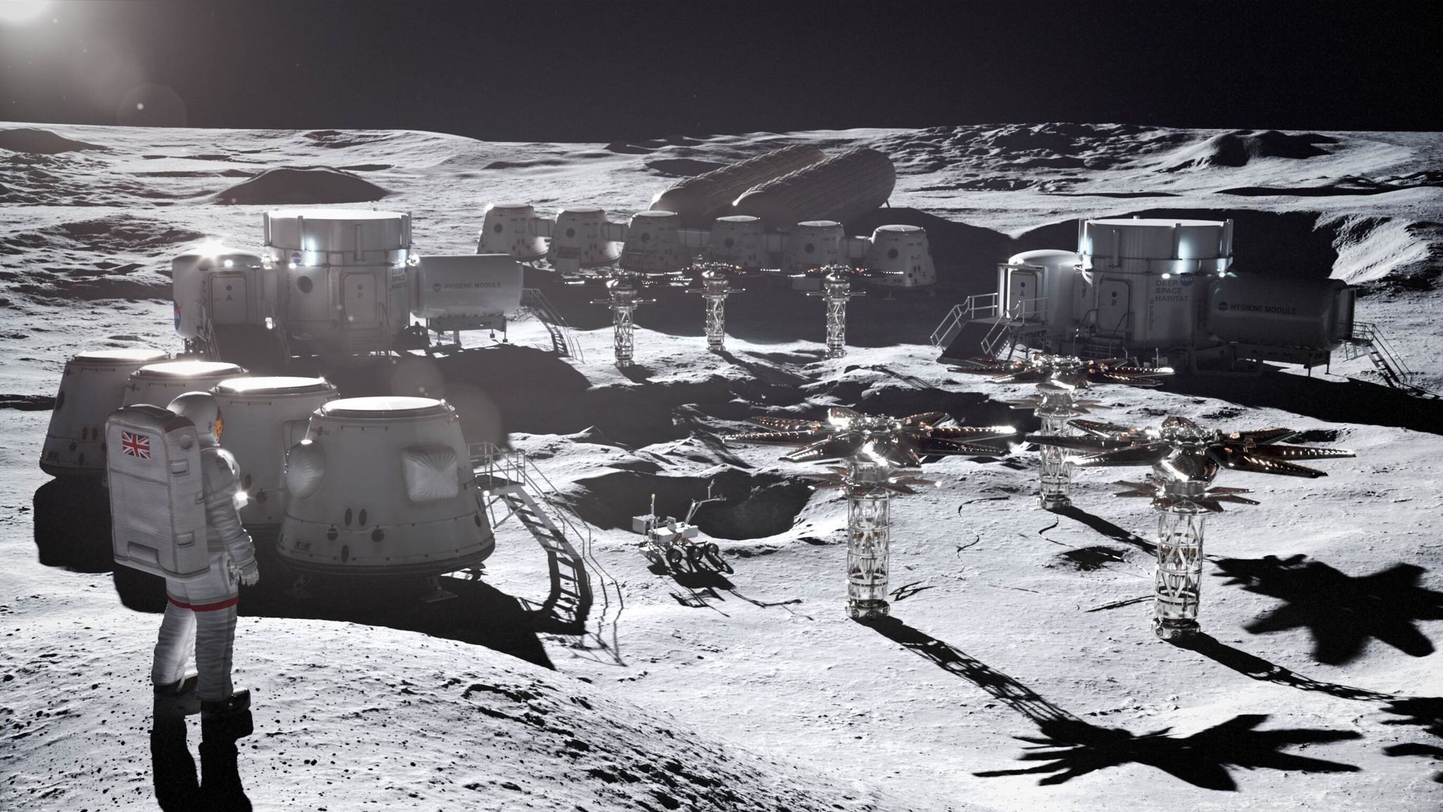
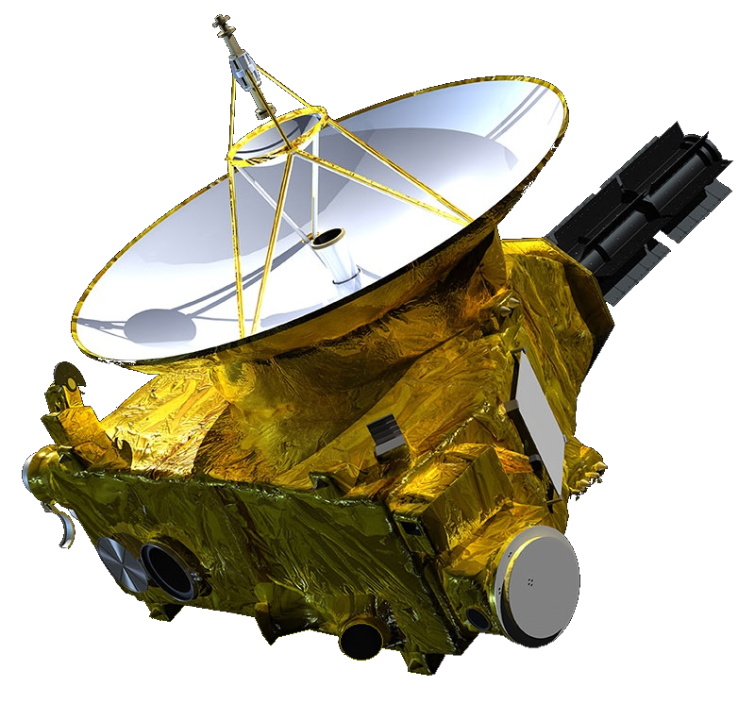
Nuclear Technology in Outer Space!
Notes:
Power spacecraft and satellites
Power community on the moon
New Horizons is an interplanetary space probe launched as a part of NASA's New Frontiers program.[5]

Slide 7
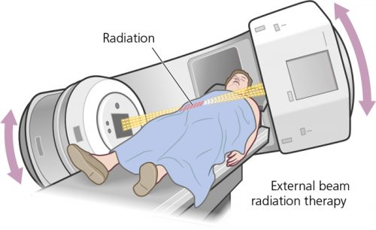
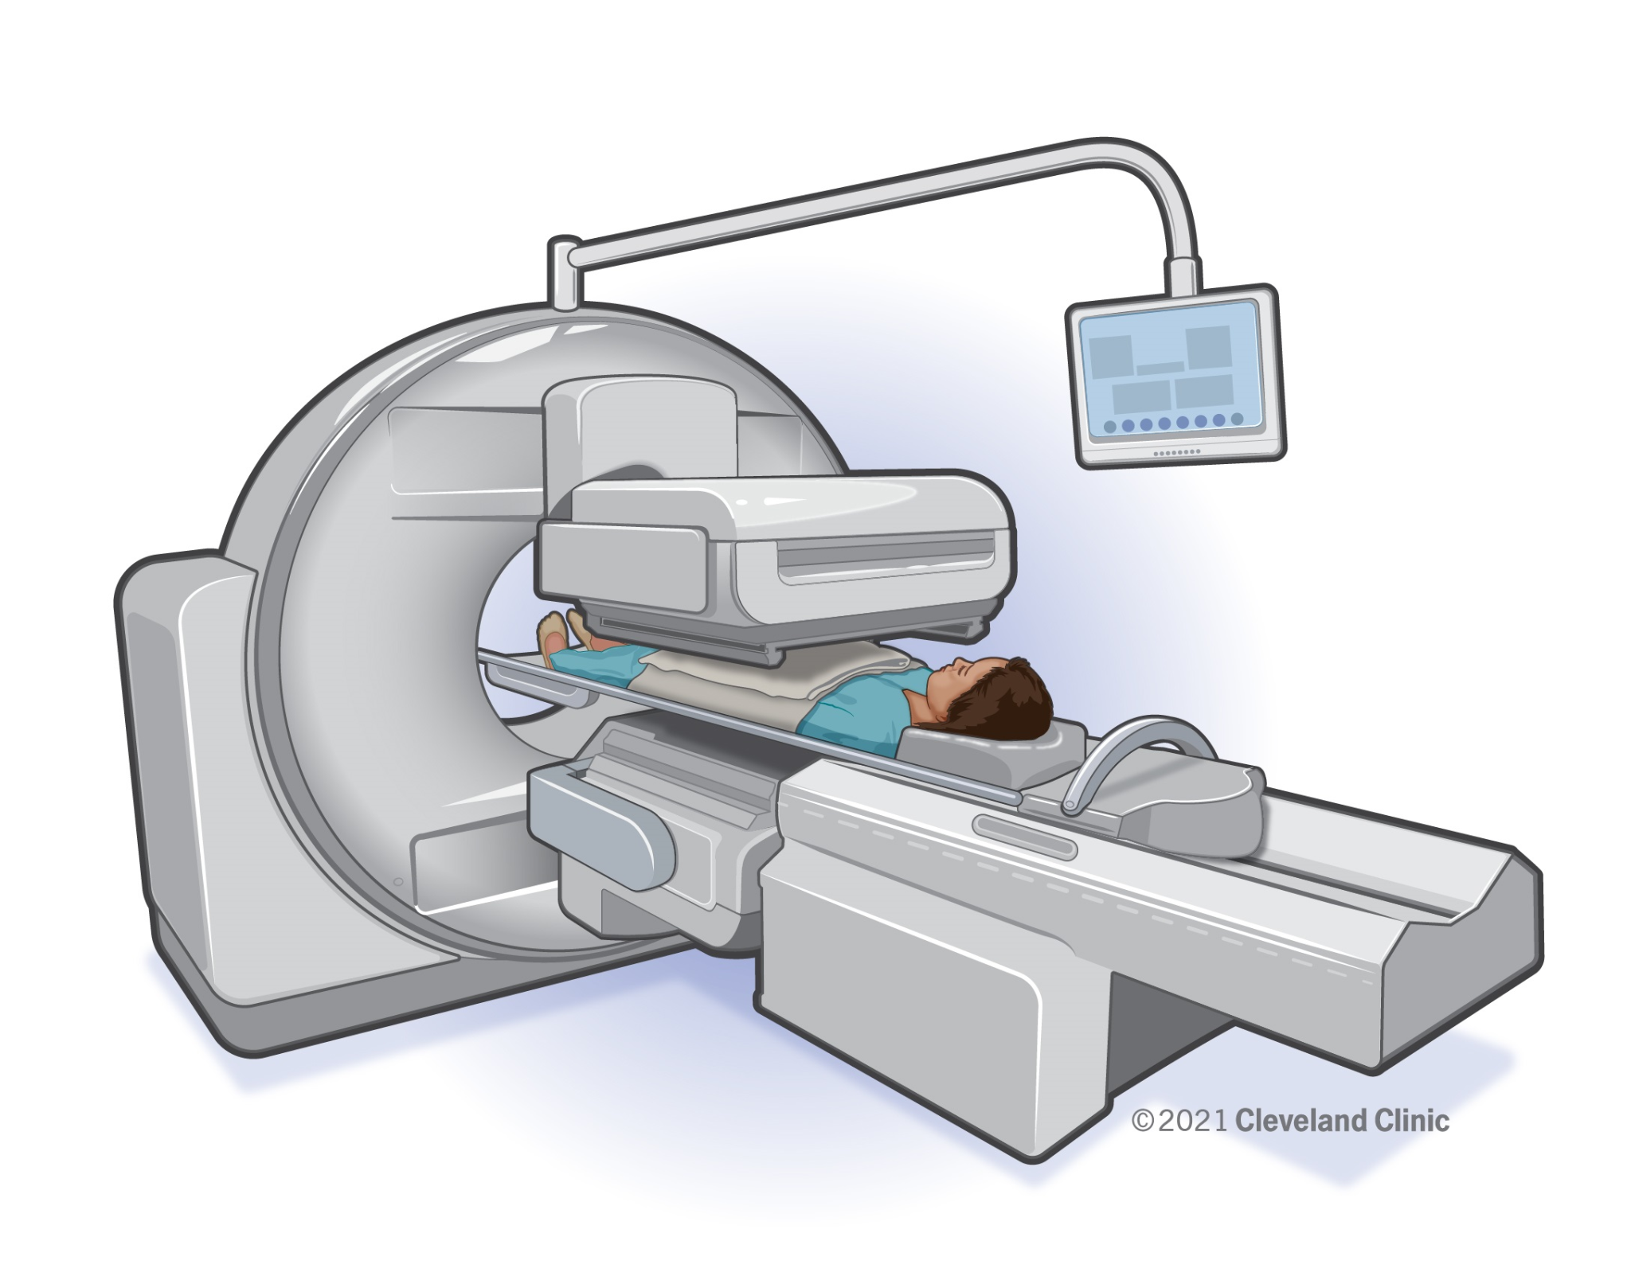
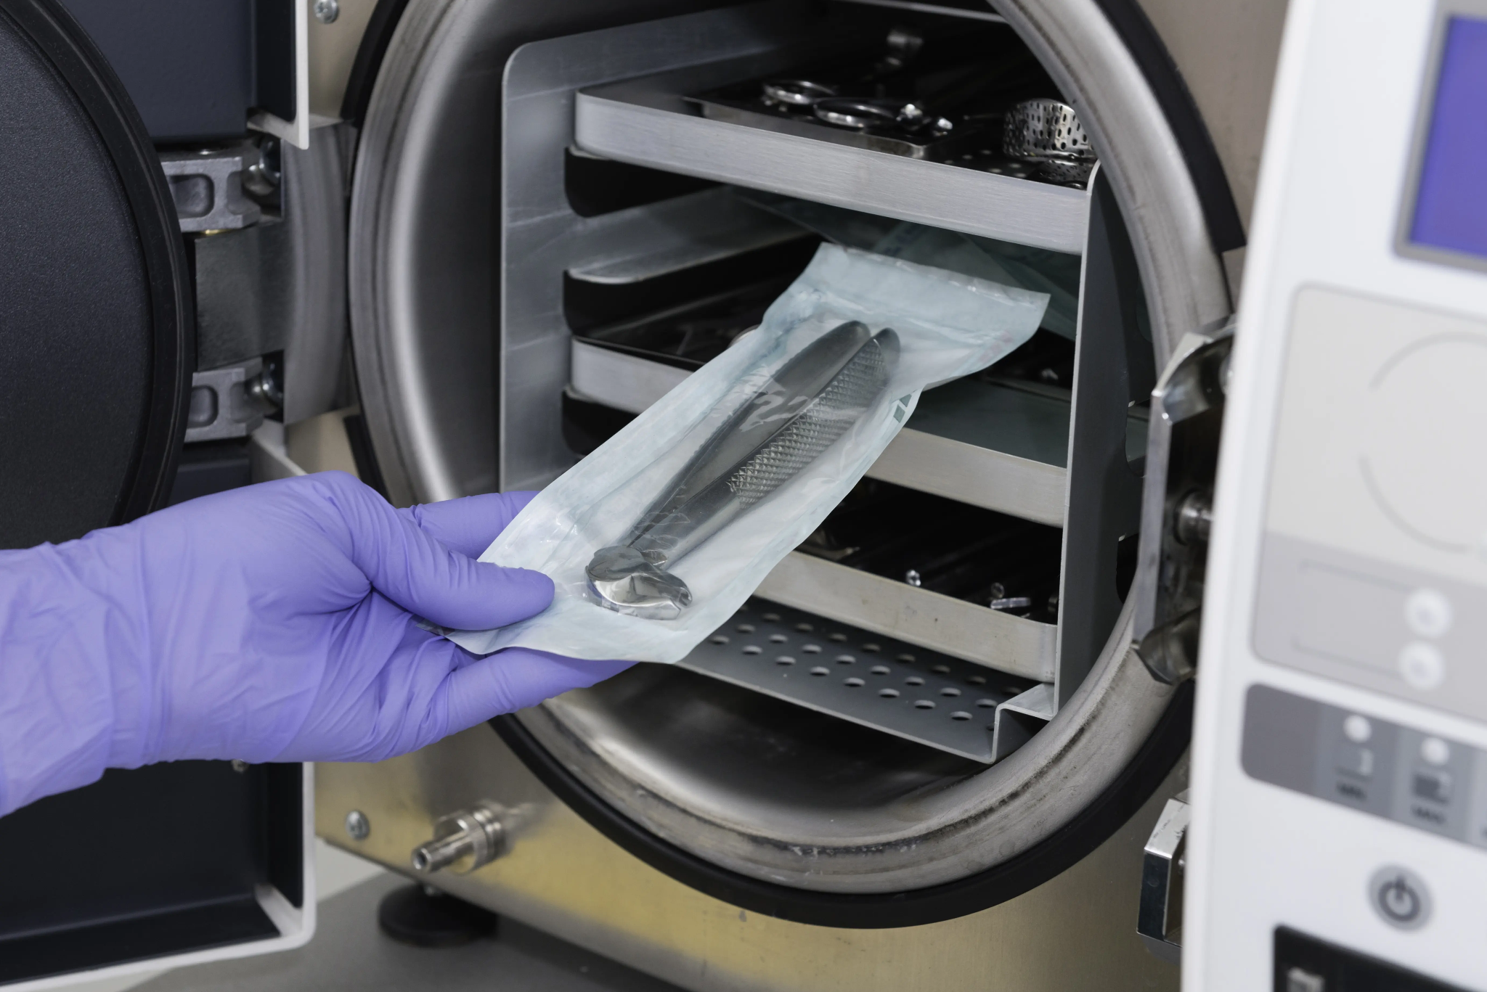
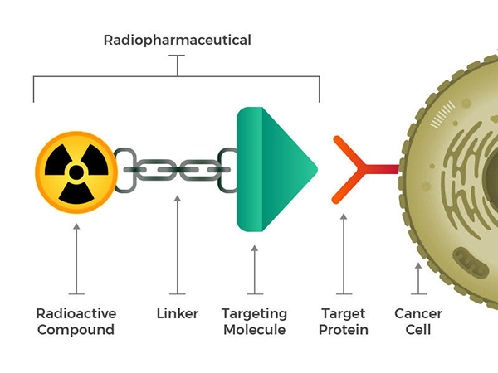
Nuclear Technology in Healthcare
Notes:
Nuclear Medicine applications.
Nuclear medicine uses very small amounts of radioactive materials to examine organ function and structure. Nuclear imaging helps physicians diagnose and treat conditions. The radioactive material, or tracer, emits radiation that is detected by a special camera.
Nuclear medicine can be used to fight Cancer cells.
External Beam Radiation Therapy
Sterilizing medical products: Radiation is a safe and cost-effective method for sterilizing single-use medical devices such as syringes and surgical gloves. One of its key advantages is that it allows already-packaged products to be sterilized. A variety of life-saving equipment is sterilized with radiation.

Slide 8
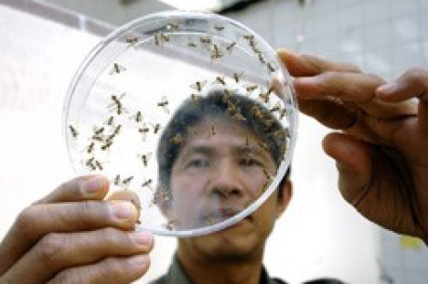
Nuclear Technology in Agriculture
Suppressing agricultural pests
Supports food safety
Notes:
Keep food clean to keep people healthy
Kill germs and reduces the amount of pesticides used.

Slide 9
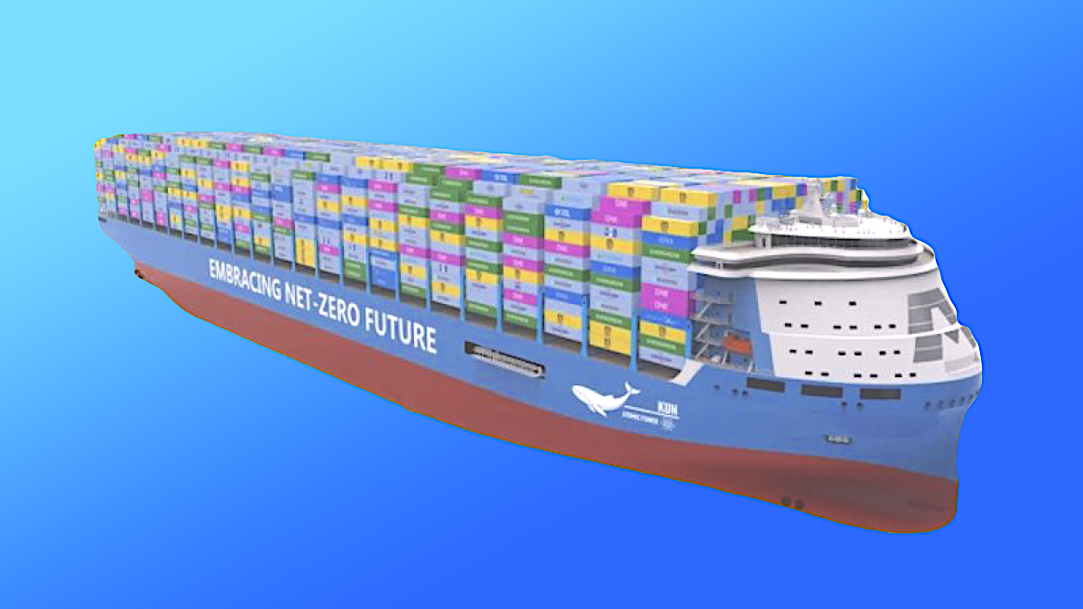
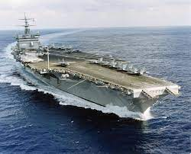
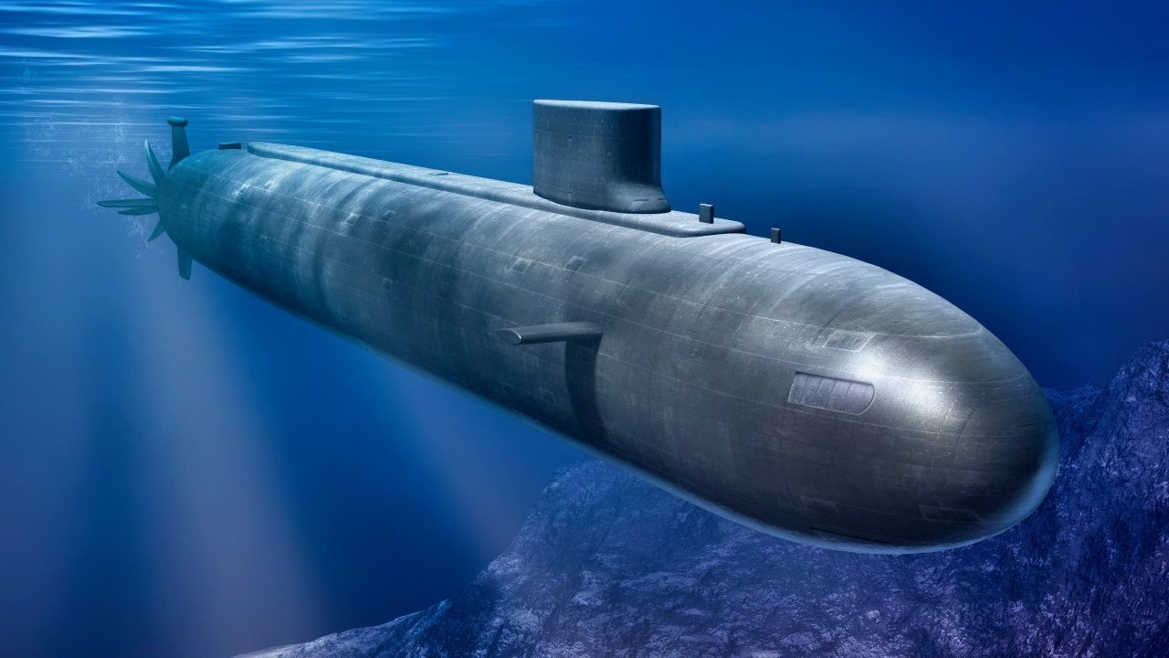
Nuclear in Oceanic Transportation
Notes:
Now
Nuclear powered submarines and naval ships
Future
Nuclear powered cruise ships and and Cargo ships

Slide 10
Chapter local example(s)
Chapters are encourage to customize this presentation to highlight specific nuclear technology in your community. I know for the majority this will be a nuclear power plant. However this could also include national labs, farms, NASA or related aerospace companies, and cancer treatment centers.
Notes:
I would like to encourage chapters to customize this presentation to highly specific nuclear technology in your community. I know for the majority this will be a nuclear power plant. However this could also include national labs, farms, NASA or related aerospace companies, and cancer treatment centers.
‘Community’ can be loosely defined to within county or state.
If you need help finding examples in your community reach out to Megan Lubbers @megan.lubbers@aps.com

Slide 11
How does your community use Nuclear technology, and what are ways it can be used in the future?
?
Draw your nuclear technology that can support your community !

Slide 12
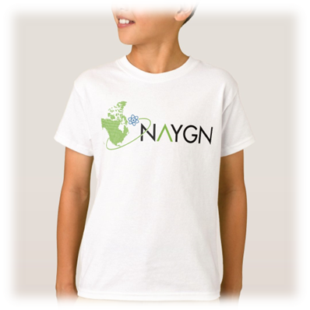
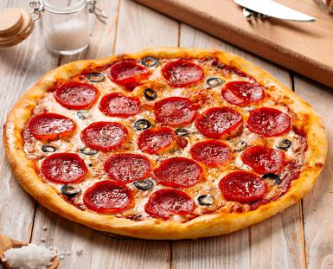
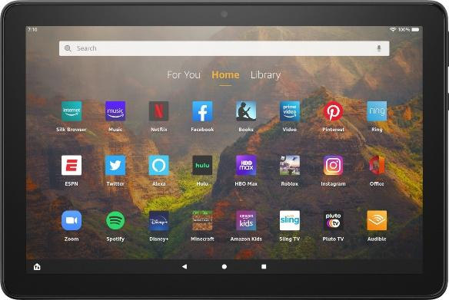
Prizes!

Slide 13
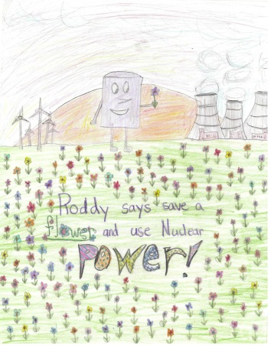
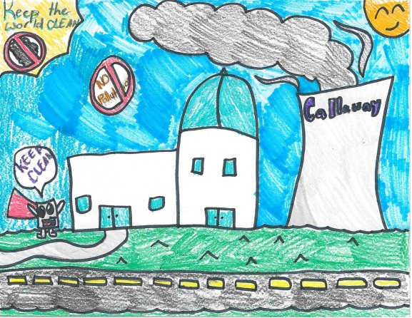
2024 Drawing Contest
Theme: “How does Nuclear Technology benefit your community?”
8 ½ x 11” sheet of paper
On the BACK of the drawing, write:
Short description of drawing
Name
Age and Grade
T-shirt size
School and Teacher’s Name
Drawings due 3/29/2024

Slide 14
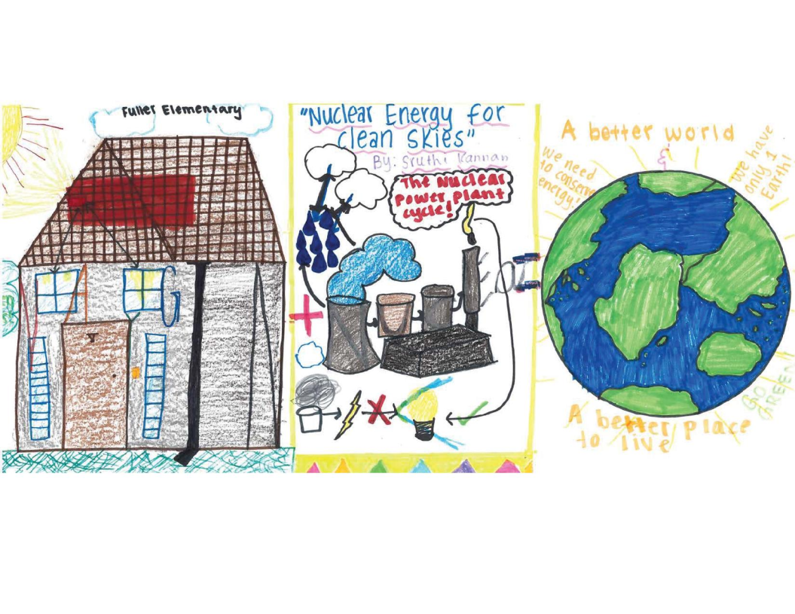
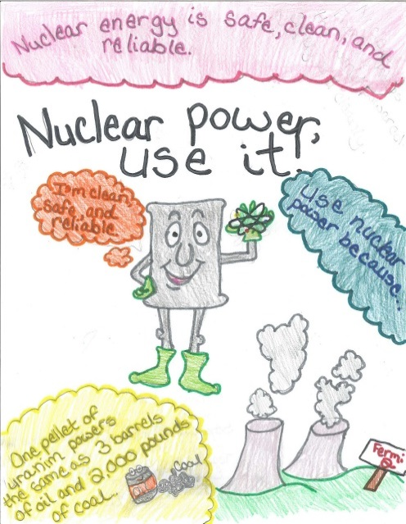
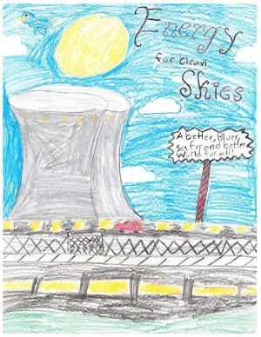
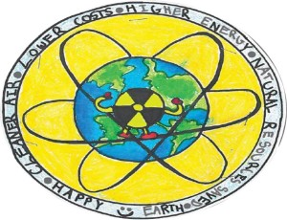
Questions?

